Slide 1
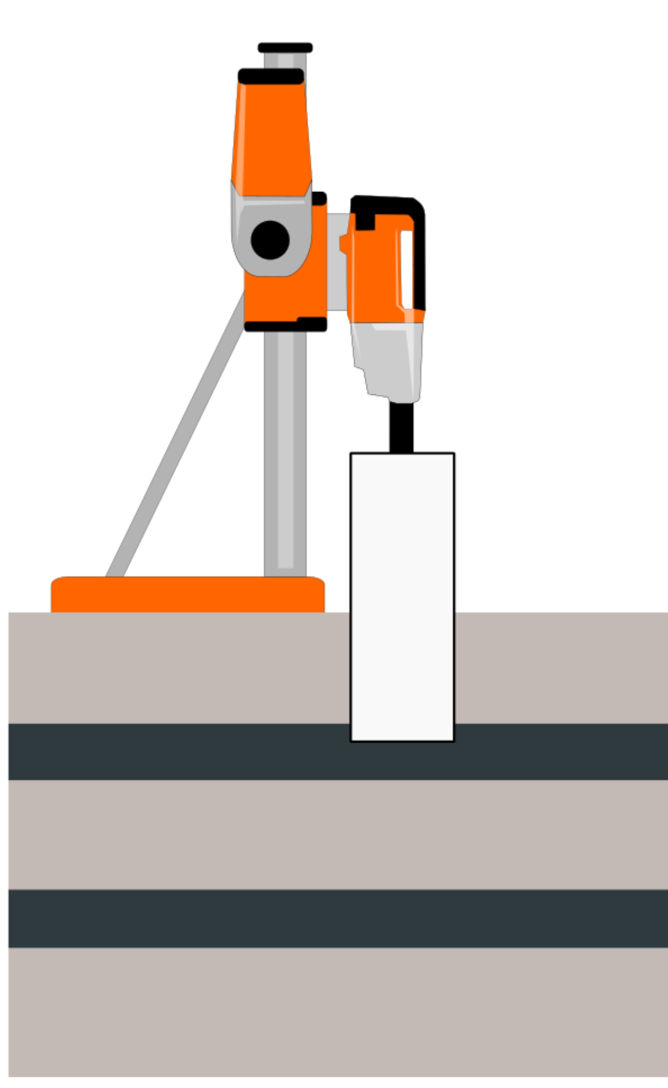
Current Technology: Automatic drilling
Concrete
Setup 1
Specialized
Controller
Material detection
(ML)
AD10
actions
Iron bars
Setup 1
Specialized
Controller
Setup 1 (Drill-1, drill bit-1)
Drilling session
Setup 2 (Drill-1, drill bit-2)
Setup 3 (Drill-2, drill bit#-6)
Notes:
A proposed plan for a presentation would be as follow;
Today we have an automatic drillcontrol, albeit a naive version, which depends on specialized controllers for each setup of the drill (Drill setup includes: drill type, drill bit, stand, angle of drilling).
This all is based on material detection and a new setup controller would be needed to drill with the current setup.
Material detection is a developed machine learning (ML) algorithm, which using data from sensors during drilling sessions and could classify the drilled material in real time.
For each material and setup specialized controllers have to be developed. Such controllers will generate the feeder (AD10) actions (pushing down more/less, stop, retract).
This development could lead to a set of specialized controllers that varies a lot across different setups and require a lot from the driller.

Slide 2
Automatic drilling effectiveness
Depth
Air
Concrete
Automatic drilling
Iron bars
Expert drilling
Time
Notes:
The Specialized controllers will never be able to reach the performance of a professional driller as there is no learning in the controller part and it is static after a release.
An improved release of the algorithm could be developed for each setup over time, but this is time-consuming and tedious.

Slide 3
Reinforced Learning (RL) - based drilling
RL-based
controller
Material detection
(ML)
AD10
actions
Drilling session
Notes:
Instead we propose developing an entire framework that builds on a material detection algorithm, but it learns the controller part generically.
This makes sure that the control can learn general enough to take care of all possible drilling setups while simultaneously improve over time.

Slide 4
RL-based drilling effectiveness
Depth
Air
Concrete
Iron bars
Expert drilling
RL-based drilling
Time
Notes:
Since this setup improves over time, it will eventually perform better than an expert driller. Initially we start of the algorithm by training on drilling sessions performed by professional drillers, this to give the RL a head start.

Slide 5
Collaborative ML controller
Material detection
(ML)
ML controller
Updated ML algorithms
On-site metadata
Cloud-based computation/storage
Drilling site #3
Drilling site #2
Drilling site #1
Notes:
Over time, the algorithm will be so good that it should not only rely on general historical drilling knowledges, but rather it can acquire knowledge of the upcoming drilling session ahead of time by communicating to nearby drills.
Site specific information, like material characteristics, can be utilized by the machine to prepare how to best drill the current hole.

Slide 6
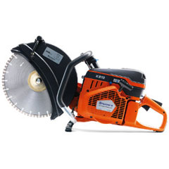
Other machines
ML controller
Material detection
(ML)
Actions
Cutting session
Notes:
Once the entire framework has been developed, the same setup could be applied to different kinds of machines, for instance cutters if they are mounted on a controllable support.

