Slide 1
Interprocess Communication
Interprocess communication
Deadlocks
Classic IPC Problems

Slide 2
Producer - Consumer Problem
Producer Process
Consumer Process
Produce
Get from buffer
Put in buffer
Consume
BUFFER
Buffer is shared (ie., it is a shared variable)

Slide 3
Progress in time…..
Producer
p1
1
p2
2
p3
3
p4
4
Buffer
3 instead of 2!
Consumer
1
c1
2
c2
t
Both processes are started at the same time and consumer uses some old value initially

Slide 4
A Race Condition
Because of the timing and which process starts first
There is a chance that different executions may end up with different results

Slide 5
Critical Sections
Critical Section
  A section of code in which the process accesses and modifies shared variables
Mutual Exclusion
  A method of preventing for ensuring that one (or a specified number) of processes are in a critical section

Slide 6
Why Processes Need to Communicate?
To synchronize their executions
To exchange data and information

Slide 7
Rules to Form
Critical Sections
1. No two processes may be simultaneously inside their CS (mutual exclusion)
2. No assumptions are made about relative process speeds or number of CPUs
3. A process outside a CS should not block other processes
4. No process should wait forever before entering its CS

Slide 8
Mutual Exclusion Problem Starvation
Definition
  Indefinitely delaying the scheduling of a process in favor of other processes
Cause
  Usually a bias in a systems scheduling policies (a bad scheduling algorithm)
Solution
  Implement some form of aging

Slide 9
Another Problem Deadlocks
  Two (or more) processes are blocked waiting for an event that will never occur
  Generally, A waits for B to do something and B is waiting for A
  Both are not doing anything so both events never occur

Slide 10
How to Implement
Mutual Exclusion
Three possibilities
  Application: programmer builds some method into the program
  Hardware: special h/w instructions provided to implement ME
  OS: provides some services that can be used by the programmer
All schemes rely on some code for
  enter_critical_section, and
  exit_critical_section

Slide 11
Application
Mutual Exclusion
Application Mutual Exclusion is
  implemented by the programmer
  hard to get correct, and very inefficient
All rely on some form of busy waiting (process tests a condition, set a flag, and loops while the condition remains the same)

Slide 12
Example
Producer
    produce
    If lock = 1 loop until lock = 0
    lock=1
    put in buffer
    lock=0
Consumer
    If lock = 1 loop until lock = 0
    lock=1
    get from buffer
    lock=0
    consume

Slide 13
Hardware ME :
Test and Set Instruction
Perform an x:=r and r:=1
x is a local variable
r is a global register set to 0 initially
repeat (test-set(x)) until x = 0;
< critical section >
r:= 0;

Slide 14
Hardware ME :
Exchange Instruction
Exchange: swap the values of x and r
x is a local variable
r is a global register set to 1 initially
x:= 0;
repeat exchange(r, x) until x = 1;
< critical section >
exchange(r, x);
Note: r:= 0 and x:= 1 when the process is in CS

Slide 15
Hardware ME Characteristics
Advantages
  can be used by a single or multiple processes (with shared memory)
  simple and therefore easy to verify
  can support multiple critical sections
Disadvantages
  busy waiting is used
  starvation is possible
  deadlock is possible (especially with priorities)

Slide 16
Another Hardware ME :
Disabling Interrupts
On a single CPU only one process is executed
Concurrency is achieved by interleaving execution (usually done using interrupts)
If you disable interrupts then you can be sure only one process will ever execute
One process can lock a system or degrade performance greatly

Slide 17
Mutual Exclusion
Through OS
Semaphores
Message passing

Slide 18
Semaphores
Major advance incorporated into many modern operating systems (Unix, OS/2)
A semaphore is
  a non-negative integer
  that has two valid operations

Slide 19
Semaphore Operations
Wait(s)
    If s > 0 then s:= s - 1
    else block this process
Signal(s)
    If there is a blocked process on this semaphore then wake it up
    else s:= s + 1

Slide 20
More on Semaphores
Two types of semaphores
  binary semaphores can only be 0 or 1
  counting semaphores can be any non-negative integer
Semaphores are an OS service implemented using one of the methods shown already
  usually by disabling interrupts for a very short time

Slide 21
Producer - Consumer Problem: Solution by Semaphores
Produce
Wait(mutex)
Put in buffer
Signal(mutex)
Wait(mutex)
Get from buffer
Signal(mutex)
Consume
CS
Initially semaphore mutex is 1

Slide 22
Another Example
Three processes all share a resource on which
  one draws an A
  one draws a B
  one draws a C
Implement a form of synchronization so that the output appears ABC
Process A
Process B
Process C
think();
draw_A();
think();
draw_B();
think();
draw_C();

Slide 23
Semaphore b = 0, c = 0;
Process A
Process B
Process C
think();
draw_A();
signal(b);
wait(b);
think();
draw_B();
signal(c);
wait(c);
think();
draw_C();

Slide 24
Bounded-Buffer Problem
We need 3 semaphores:
  we need a semaphore mutex to have mutual exclusion on buffer access.
  we need a semaphore full to synchronize producer and consumer on the number of consumable items.
  we need a semaphore empty to synchronize producer and consumer on the number of empty spaces.

Slide 25
Bounded-Buffer - Semaphores
Shared data
semaphore full, empty, mutex;
Initially:
full = 0, empty = n, mutex = 1

Slide 26
Bounded-Buffer - Producer Process
do {
…
produce an item in nextp
…
wait(empty);
wait(mutex);
…
add nextp to buffer
…
signal(mutex);
signal(full);
} while (1);

Slide 27
Bounded-Buffer - Consumer Process
  do {
  wait(full)
  wait(mutex);
  …
  remove item from buffer to nextc
  …
  signal(mutex);
  signal(empty);
  …
  consume the item in nextc
  …
  } while (1);

Slide 28
Notes on Bounded-Buffer Solution
Remarks (from consumer point of view):
  Putting signal(empty) inside the CS of the consumer (instead of outside) has no effect since the producer must always wait for both semaphores before proceeding.
  The consumer must perform wait(full) before wait(mutex), otherwise deadlock occurs if consumer enters CS while the buffer is empty.
Conclusion: using semaphores is a difficult art ... ☺

Slide 29
What is Deadlock?
Process Deadlock
  A process is deadlocked when it is waiting on an event which will never happen
System Deadlock
  A system is deadlocked when one or more processes are deadlocked

Slide 30
Necessary Conditions for a Deadlock
Mutual Exclusion
  Shared resources are used in a mutually exclusive manner
Hold & Wait
  Processes hold onto resources they already have while waiting for the allocation of other resources

Slide 31
Necessary Conditions for a Deadlock (Cont.)
No Preemption
  Resources can not be preempted until the process releases them
Circular Wait
  A circular chain of processes exists in which each process holds resources wanted by the next process in the chain

Slide 32
No Deadlock Situation
If you can prevent at least one of the necessary deadlock conditions then you won’t have a DEADLOCK

Slide 33
The Ostrich Algorithm
Pretend there is no problem
Reasonable if
  deadlocks occur very rarely
  cost of prevention is high
UNIX and Windows takes this approach
It is a trade off between
  convenience
  correctness

Slide 34
Ways of Handling Deadlock
Deadlock Prevention
Deadlock Detection
Deadlock Avoidance
Deadlock Recovery

Slide 35
Deadlock Prevention
Remove the possibility of deadlock occurring by denying one of the four necessary conditions:
  Mutual Exclusion (Can we share everything?)
  Hold & Wait
  No preemption
  Circular Wait

Slide 36
Denying the
“Hold & Wait”
Implementation
  A process is given its resources on a "ALL or NONE" basis
  Either a process gets ALL its required resources and proceeds or it gets NONE of them and waits until it can

Slide 37
Denying the
“Hold & Wait”
Advantages
  It works
  Reasonably easy to code
Problems
  Resource wastage
  Possibility of starvation

Slide 38
Denying “No preemption”
Implementation
  When a process is refused a resource request, it MUST release all other resources it holds
  Resources can be removed from a process before it is finished with them

Slide 39
Denying “No preemption”
Advantages
  It works
  Possibly better resource utilization
Problems
  The cost of removing a process's resources
  The process is likely to lose work it has done. (How often does this occur?)
  Possibility of starvation

Slide 40
Denying “Circular Wait”
Implementation
  Resources are uniquely numbered
  Processes can only request resources in linear ascending order
  Thus preventing the circular wait from occurring

Slide 41
Denying “Circular Wait”
Advantages
  It works
Problems
  Resources must be requested in ascending order of resource number rather than as needed
  Resource numbering must be maintained by someone and must reflect every addition to the OS
  Difficult to sit down and just write code

Slide 42
Deadlock Avoidance
Allow the chance of deadlock occur
But avoid it happening..
Check whether the next state (change in system) may end up in a deadlock situation

Slide 43
Banker's Algorithm
Definitions
  Each process has a LOAN, CLAIM, MAXIMUM NEED
    LOAN: current number of resources held
    MAXIMUM NEED: total number resources needed to complete
    CLAIM: = (MAXIMUM - LOAN)

Slide 44
Banker’s Problem
Customer
c1
c2
Max. Need
800
600
Present Loan
410
210
Claim
390
390
Suppose total bank capital is $1000
Current cash: 1000-(410+210)=380

Slide 45
Assumptions
Establish a LOAN ceiling (MAXIMUM NEED) for each process
  MAXIMUM NEED < total number of resources available (ie., capital)
Total loans for a process must be less than or equal to MAXIMUM NEED
Loaned resources must be returned back in finite time

Slide 46
Algorithm
1. Search for a process with a claim that can be satisfied using the current number of remaining resources (ie., tentatively grant the claim)
2. If such a process is found then assume that it will return the loaned resources.
3. Update the number of remaining resources
4. Repeat steps 1-3 for all processes and mark them

Slide 47
Algorithm
DO NOT GRANT THE CLAIM if at least one process can not be marked.
Implementation
  A resource request is only allowed if it results in a SAFE state
  The system is always maintained in a SAFE state so eventually all requests will be filled

Slide 48
Algorithm
Advantages
  Allows jobs to proceed when a prevention algorithm wouldn't
Problems
  Requires there to be a fixed number of resources
  What happens if a resource goes down?
  Does not allow the process to change its Maximum need while processing

Slide 49
Classical IPC Problems
Readers and writers problem
  Models access to a database (both read and write)
Dining philosophers problem
  Models processes competing for exclusive access to a limited number of resources such as I/O devices
Sleeping barber problem
  Models queuing situations such as a multi-person helpdesk with a computerized call waiting system for holding a limited number of incoming calls

Slide 50
Readers-Writers Problem
Any number of reader activities and writer activities are running.
At any time, a reader activity may wish to read data.
At any time, a writer activity may want to modify the data.
Any number of readers may access the data simultaneously.
During the time a writer is writing, no other reader or writer may access the shared data.

Slide 51
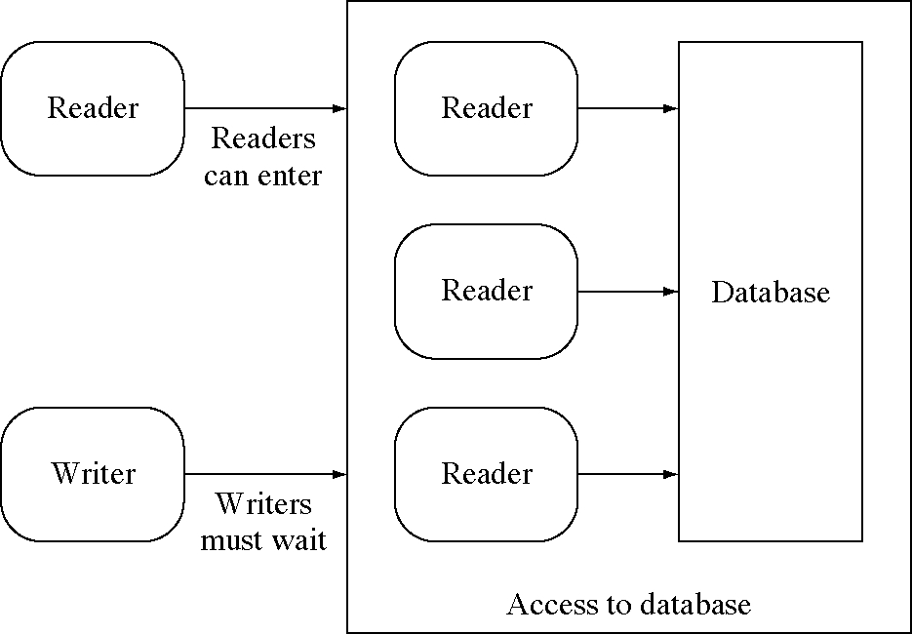
Readers-Writers with active readers

Slide 52
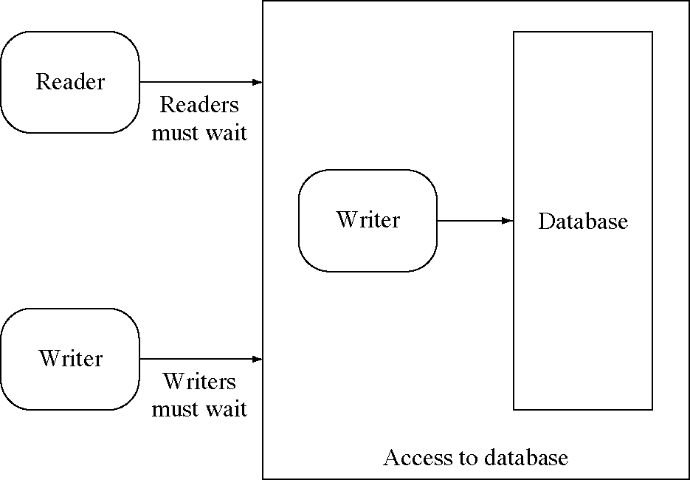
Readers-Writers with an active writer

Slide 53
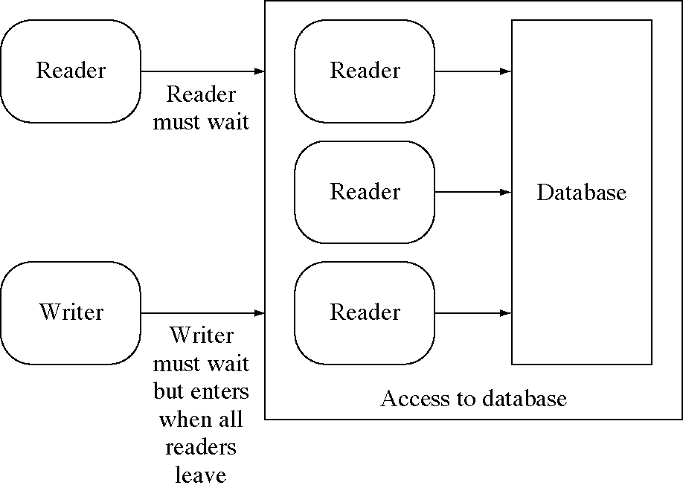
Should readers wait for waiting writer?

Slide 54
Readers-Writers problem
The first readers-writers problem, requires that no reader will be kept waiting unless a writer has obtained access to the shared data.
The second readers-writers problem, requires that once a writer is ready, no new readers may start reading.
In a solution to the first case writers may starve; In a solution to the second case readers may starve.

Slide 55
First Readers-Writers Solution
readcount counter keeps track of how many processes are currently reading.
mutex semaphore provides mutual exclusion for updating readcount.
wrt semaphore provides mutual exclusion for the writers; it is also used by the first or last reader that enters or exits the CS.

Slide 56
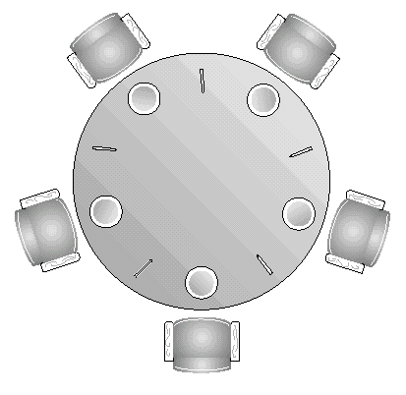
Dining Philosophers Problem
Five philosophers are seated around a circular table.
In front of each one is a bowl of rice.
Between each pair of people there is a chopstick (fork), so there are five chopsticks.
It takes two chopsticks (forks?) to eat rice, so while n is eating neither n+1 nor n-1 can be eating.

Slide 57
Dining Philosophers Problem
Each one thinks for a while, gets the chopsticks needed, eats, and puts the chopsticks down again, in an endless cycle.
Illustrates the difficulty of allocating resources among process without deadlock and starvation.

Slide 58
Dining Philosophers Problem
The challenge is to grant requests for chopsticks while avoiding deadlock and starvation.
Deadlock can occur if everyone tries to get their chopsticks at once. Each gets a left chopstick, and is stuck, because each right chopstick is someone else’s left chopstick.

Slide 59
Dining Philosophers Solution
Each philosopher is a process.
One semaphore per fork:
  fork: array[0..4] of semaphores
  Initialization: fork[i].count := 1 for i := 0..4
Process Pi:
repeat
think;
wait(fork[i]);
wait(fork[i+1 mod 5]);
eat;
signal(fork[i+1 mod 5]);
signal(fork[i]);
forever
First attempt: deadlock if each philosopher starts by picking up his left fork (chopstick)!

Slide 60

Dining Philosophers Solution
Possible solutions to avoid deadlock:
Allow at most four philosophers to be sitting at the table at same time.
Odd numbered philosopher picks up left fork first, even one picks up right fork.

Slide 61
Weakness of the Semaphore
  The user is expected to write wait and signal in the right order.
  The user must remember to execute signal for each exit
  Calls may be spread throughout the program
  The logic may demand that a process must check and signal his peers.
    Review the logic for the Dining Philosophers solution.
There have been a wide number of alternatives proposed.
Monitors are one common approach

Slide 62
Monitors
A new language construct that includes synchronization
Implemented in Java via synchronized keyword
Only one process can enter a Monitor (use the entry points) at a time.
For example, compiler might generate a call to a common semaphore on entry: signal on exit.
If process P makes a monitor call, and process Q is in the monitor, P will block until Q exits

Slide 63
Java Example
class Account {
  private double balance;
  public Account(double deposit) { }
  balance = deposit;
  public synchronized double getBalance() {
    return balance;
  }
  public synchronized void deposit(double amount) {
    balance += amount;
  }
  public synchronized void withdraw(double amount) {
    balance -= amount;
  }
}

Slide 64
Equivalence
Monitors and semaphores have equivalent power
Anything you can do with Monitors, you can do with semaphores.
  Proof: we can implement a monitor with a semaphore
Anything that you can do with Semaphores, you can do with Monitors
  Proof: we can implement a semaphore with a monitor

Slide 65
Summary
We have seen two problems
  Critical Sections - cannot both be modifying variable
  Synchronization - must define ordering
Often, our problems are a combination of the two
  Readers/writers share storage, and readers should wait if there are writers waiting
It is difficult to use semaphores correctly.
While there has been language support for Monitors for some time, standard UNIX still only supports semaphore (man sem_open)

