Slide 1
Classification of Similar Users on Twitter
By
Rishab Doshi-12IT59
Rohit John Joseph-12IT61
Shravan Kartik-12IT77
Siddharth P Ramakrishnan-12IT79

Slide 2
Project Overview
Over the course of this project we plan to build a system which when given a user’s twitter handle is able to classify the user , i.e, say he is a sports enthusiast, is into art and politics etc.
This can be used by various marketing firms seeking a specific target audience.

Slide 3
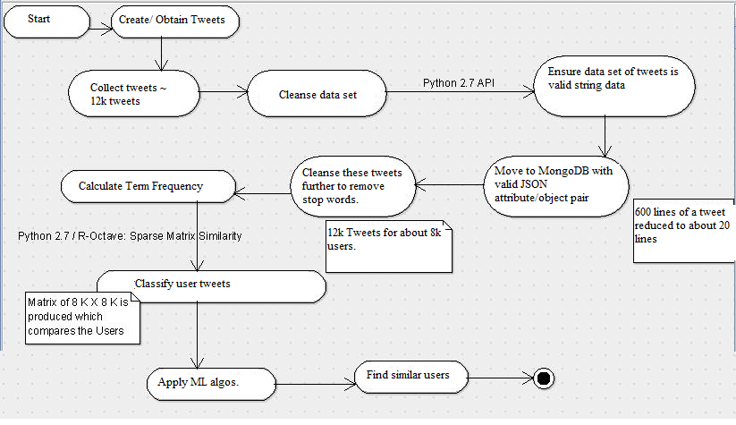
Flow diagram

Slide 4
Obtaining The Dataset
A dataset had been provided by a firm that collects tweets during campaigns for independent social analysis.
This dataset was however skewed in favour of politics and so to test our model we manually used the Twitter API to obtain user tweets
This API object can be used to retrieve twitter status objects, and these status objects can be filtered based on
Hashtags
Events
Keywords
Geographical Location

Slide 5
Structuring the Obtained Data
The dataset obtained from the firm has all the twitter status objects as JSON strings. All these JSONs are dumped on one line and curly braces are used to separate given two twitter JSON objects.
This line is read and all the twitter status objects are separated from the given line.
This status has a structure as shown in the file
These are pushed to MongoDB

Slide 6
Cleaning the JSON file further
The obtained JSON is cleaned to consider only the relevant features like
Screen_Name
Text
URL’s
and this is then pushed to MongoDB
The user information is also pushed to MongoDB
User Attributes:
Screen_Name,Description,Location,Friends and followers count

Slide 7
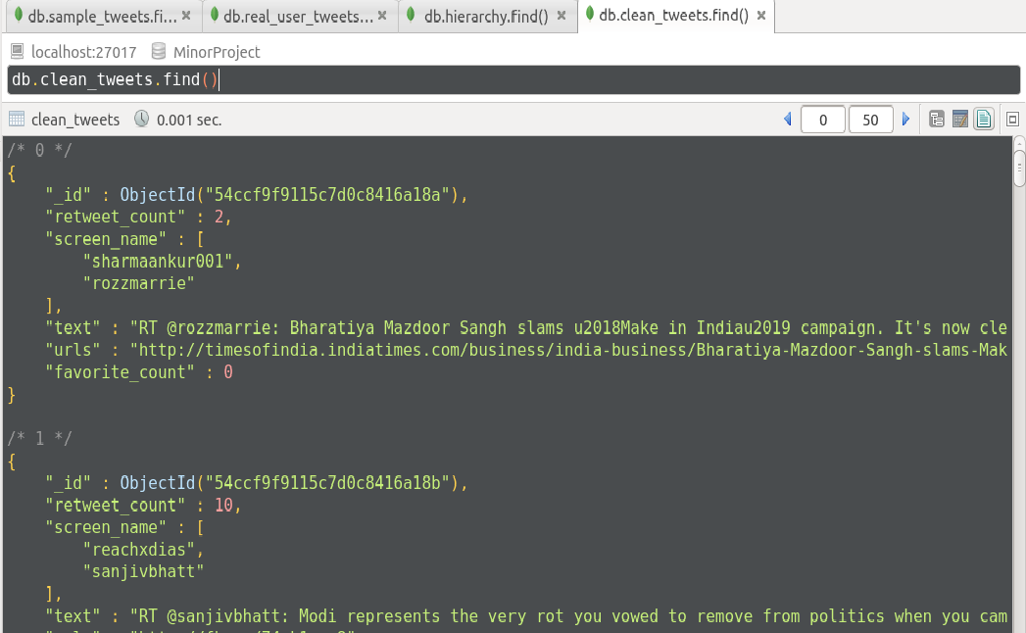
Cleaned Entry

Slide 8
Obtain Unique Tweets
All the tweets are considered and grouped based on the user.
Only unique set of tweets are taken for every user.
This is done by using the information in the User Collection and the Clean Tweets collection

Slide 9
Merge User Features
All the set of tweets grouped by user are then analysed to remove the stop words.
These words are taken as features for every user.
So analogy is
User -> Document
Words in Tweet -> User Features or Document Features

Slide 10
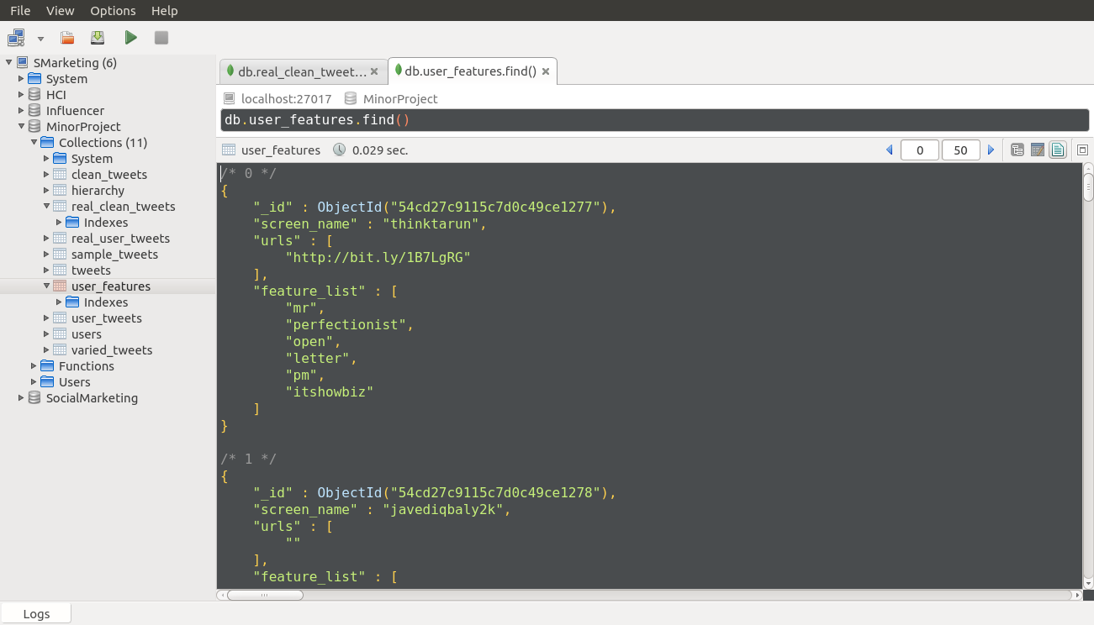

Slide 11
TFIDF
TFIDF – Term Frequency Inverse Document Frequency
This weight is a statistical measure used to evaluate how important a word is to a document in a collection or corpus.
TF(t) = (Number of times term t appears in a document) / (Total number of terms in the document).
IDF(t) = log_e(Total number of documents / Number of documents with term t in it).

Slide 12
Our Implementation
Build a dictionary of all unique words from all tweets.
Build a corpus which is a collection of words for each user.
Compute TFIDF for every word
Compute similarity for each user with respect to every other user.
Scores lie between 0 to 1 with a higher score referring to a greater similarity.

Slide 13
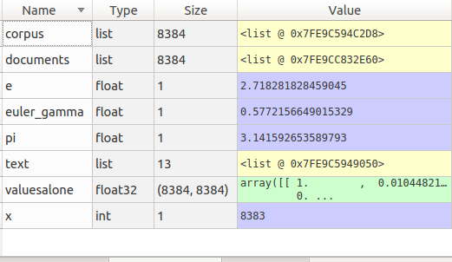

Slide 14
Similarity
Similarity of user X w.r.t user Y = Sum(TFIDF of common words to both user X and Y) / Sum(TFIDF of words for user X)

Slide 15
Issues
Issues :
Results are not very accurate.
Computationally challenging as the number of words and documents increase.
What’s Next :
Obtain similarity using semantic analysis.
Semantic Analysis + TFIDF could generate better results.
PCA to reduce dimensions.

Slide 16
Principle Component Analysis
Once the Similarity Matrix is obtained the matrix is of order N * N where N = No of users
To run Learning Algorithms efficiently the matrix dimension has to be reduced to K dimensions so now matrix dimension is N * K
Once way to do this is using PCA which reduces the dimension by projecting the vectors ( in this case similarity values) onto a subspace of reduced dimension.

Slide 17
To obtain this first a covariance matrix is computed. Formula for covariance matrix =
# Let the similarity matrix be simMat # final result cov stores the covariance Matrix for i in 1 : noRows meanRow = mean(SimMat[i]) for j in 1 : noCols cov[i][j] = SimMat[i][j] - meanRow end end cov = cov * cov' # Matrix Multiplication of cov and its transpose
Using the covariance matrix, we can obtain a set of Eigen Values and Eigen Vectors ( used standard NumPy.linalg library)

Slide 18
The Eigen Values are reverse sorted according to Eigen Values and thus k columns of the Eigen Vectors is chosen. Let this be Matrix M
Matrix M has dimension N * K.
Now this matrix can be used to train the dataset ( Learning Algorithm )
Note in Matrix M, N = no of training set

Slide 19
Semantic Model
Why Semantic Model?
TFID is not an accurate yardstick to measure the similarity of users against.
System needs to be smart and understand more intricate relationships between users.

Slide 20
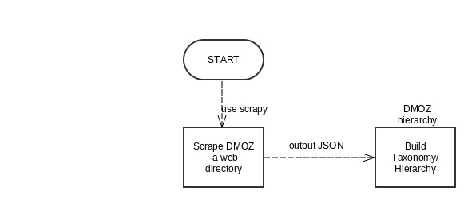
Process of Semantic Modelling

Slide 21
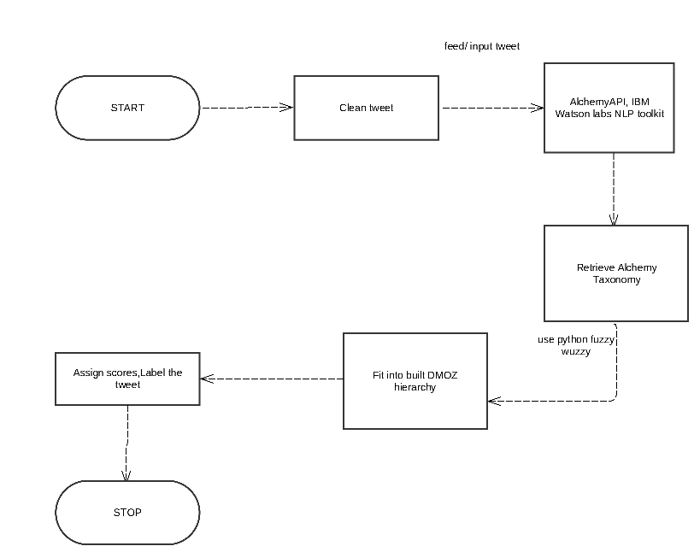

Slide 22
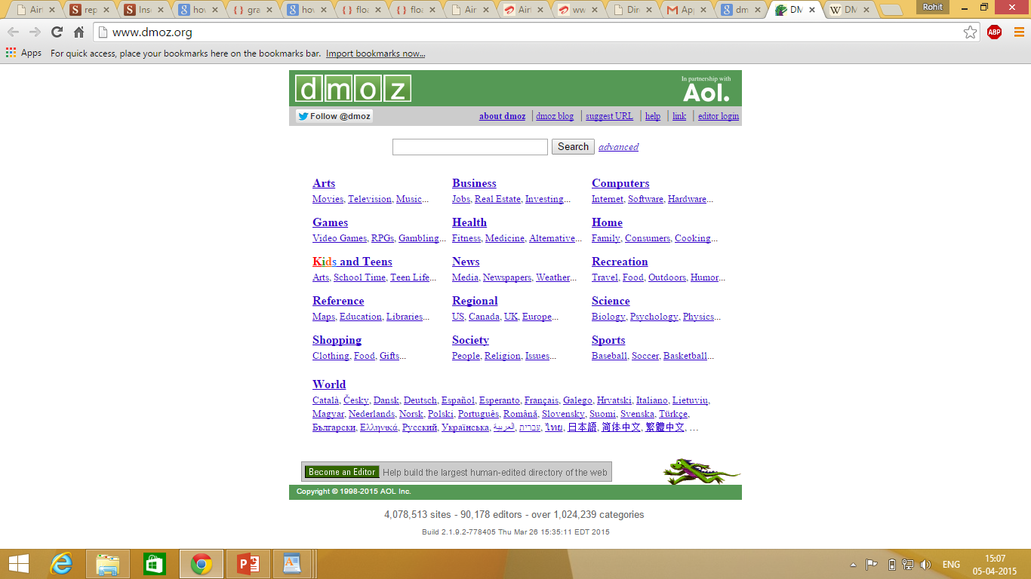
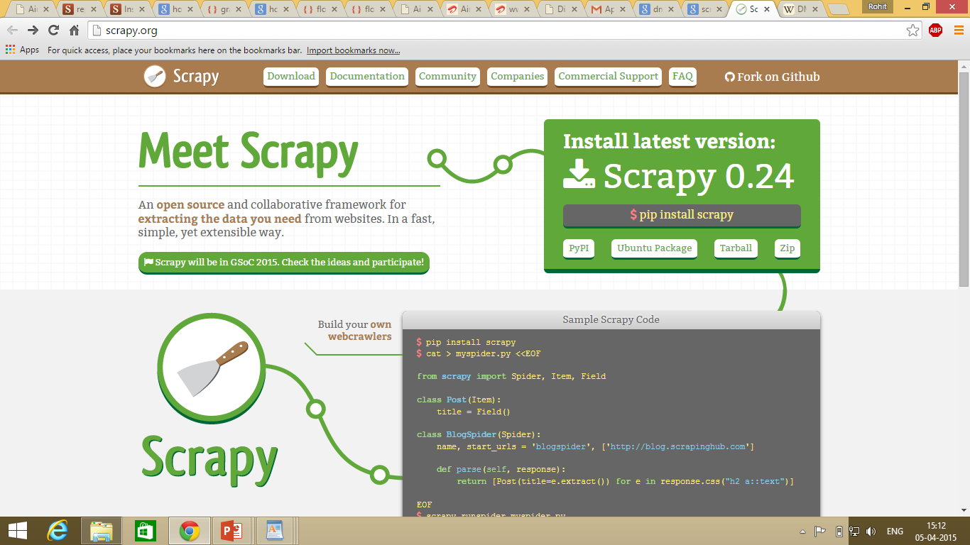

Slide 23
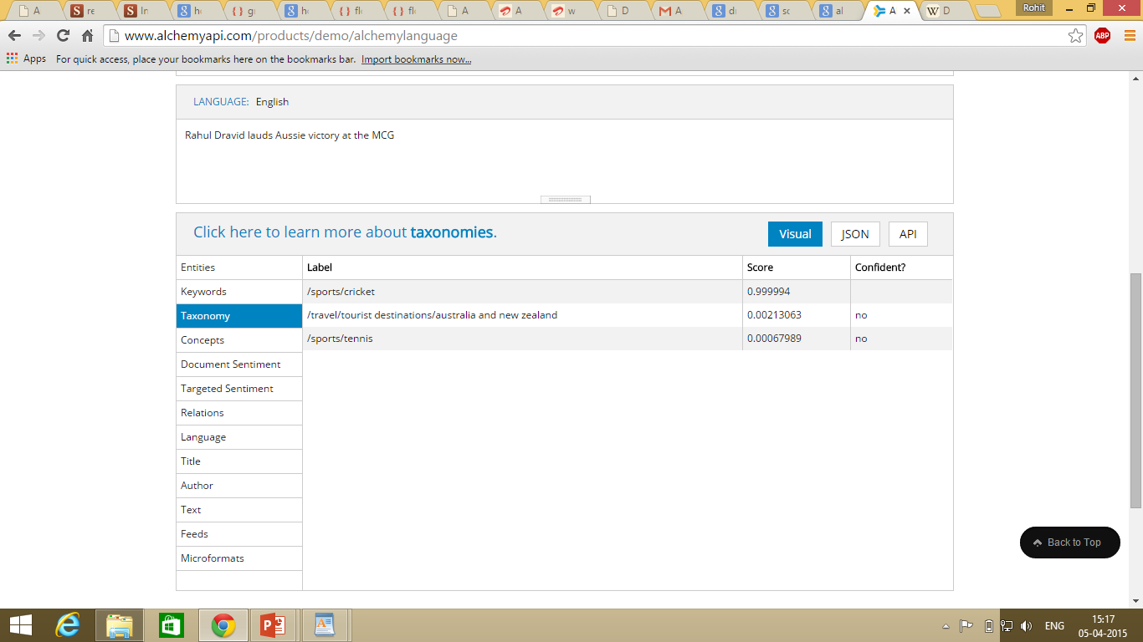

Slide 24
Work Done
Scraped through the DMOZ website.
Due to space constraints, scraped the first two levels
O/P Json files cleaned and pushed onto the DB.

Slide 25
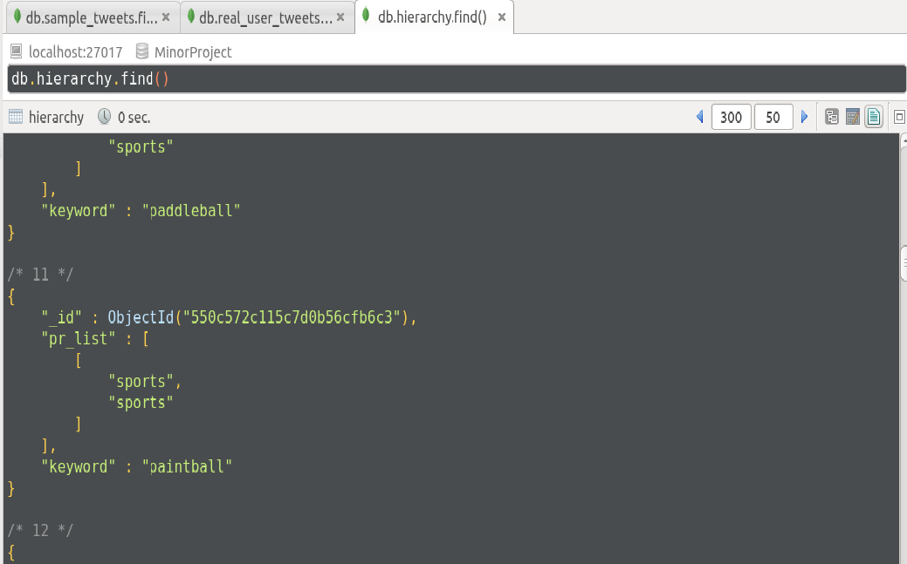
Example of the JSON hierarchy created

Slide 26
Work Done(contd.)
Tweets are now collected and queried using the Alchemy API
The results are then fitted into the DMOZ hierarchy and a similarity score is calculated for a given tweet against the categories of DMOZ.
At the end of this model, for a given tweet we get a score corresponding to its relevance to the list of categories and this is then fed into our learning algorithms.

Slide 27
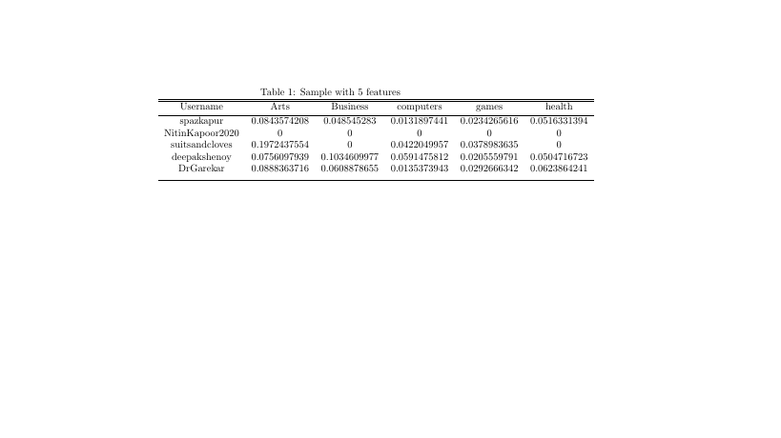

Slide 28
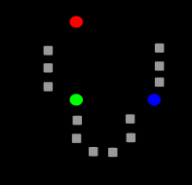
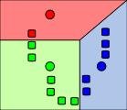
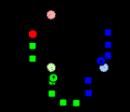
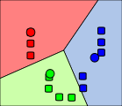
K-Means Clustering
k-means clustering aims to partition n observations into k clusters in which each observation belongs to the cluster with the nearest mean, serving as a prototype of the cluster.
a) b) c) d)
a)
a)Unclustered Data
b)Initial Clustered Data
c)Movement of centroids – Calculating mean within clusters
d)Result after convergence – No more elements can be added or removed from cluster

Slide 29
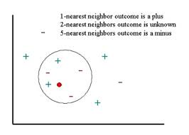
KNN
In k-NN classification, the output is a class membership. An object is classified by a majority vote of its neighbors, with the object being assigned to the class most common among its k nearest neighbors (k is a positive integer, typically small).

Slide 30
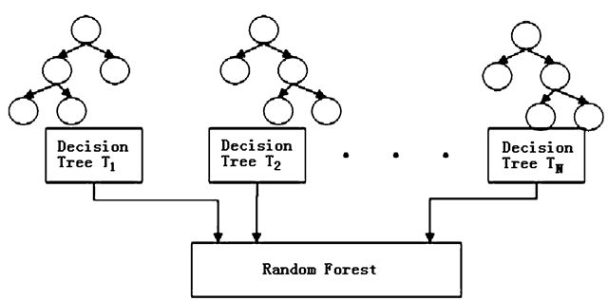
Random Forests
Random forests are an ensemble learning method for classification, regression and other tasks, that operate by constructing a multitude of decision trees at training time and outputting the class that is the mode of the classes (classification) or mean prediction (regression) of the individual trees.

Slide 31
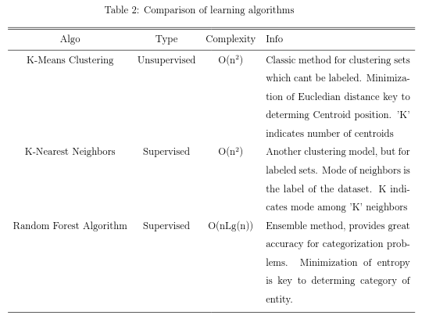
Conclusions
We were able to classify similar users using each of the above algorithms with best results obtained by Random Forests.
Comparison of the three
.

Slide 32
Future Work
Extend classification to multiple languages, i.e, be able to classify tweets in Hindi and so on.
Apply online learning to improve accuracy.

Slide 33
Thank You!

Slide 34
Questions?

