Slide 1

AnimeVerse
Anime Recommendation System
Sidhartha Reddy Potu - sp7835
Sai Chandra Kaushik Siddavarapu- ss1743

Slide 2
Problem Statement
As anime continues to grow popularity around the world, viewers face challenges in discovering content that matches their unique preferences from the vast array of available titles. There is a gap in content discovery and user satisfaction caused by the inability of traditional recommendation systems to offer dynamic, personalized suggestions.
This project aims to close the gap that exists between the wide range of anime content available and the specific viewer by making sure that every recommendation is made with a thorough understanding of personal preferences.

Slide 3
Why is it BIG DATA
The complexity of anime data, characterized by its volume, variety, and the velocity of user interactions, necessitates the use of big data concepts. Processing and analyzing this data to extract personalized recommendations requires scalable, efficient technologies capable of handling large- scale datasets and performing complex computations.

Slide 4
Data Description
Users-score-2023.csv : Data containing user ids,anime ids, anime name and scores of the animes. This data contains 24,325,191 rows or samples.
users-details-2023.csv: unique user id, user name, gender, DOB, location, Date joined, Days watched, Mean Score, Watching, Completed
Anime data: anime id, Name, English name, Score, Genres, Synopsis, Type, Episodes, Aired
Data is scraped from My Anime List site which in their words “the world's most active online anime and manga community and database”
https://www.kaggle.com/datasets/dbdmobile/myanimelist-dataset

Slide 5
Project Pipeline
Data Collection: Aggregate diverse data sources including user interactions, ratings, and anime metadata.
Data Ingestion: Ingestion of data into the system using Pyspark.
Data Preprocessing: Clean, normalize, and feature engineer the data to prepare it for analysis.
Recommendation Model Training: Train models using algorithms like ALS, TF-IDF, and ChromaDB on the data.
Recommendation Generation: Generate personalized anime recommendations using trained models.

Slide 6
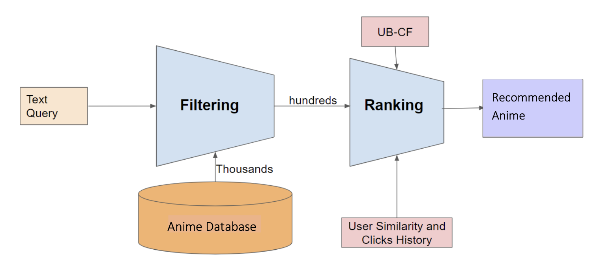
Recommendation Architecture
ALS , CB & UB-CF

Slide 7
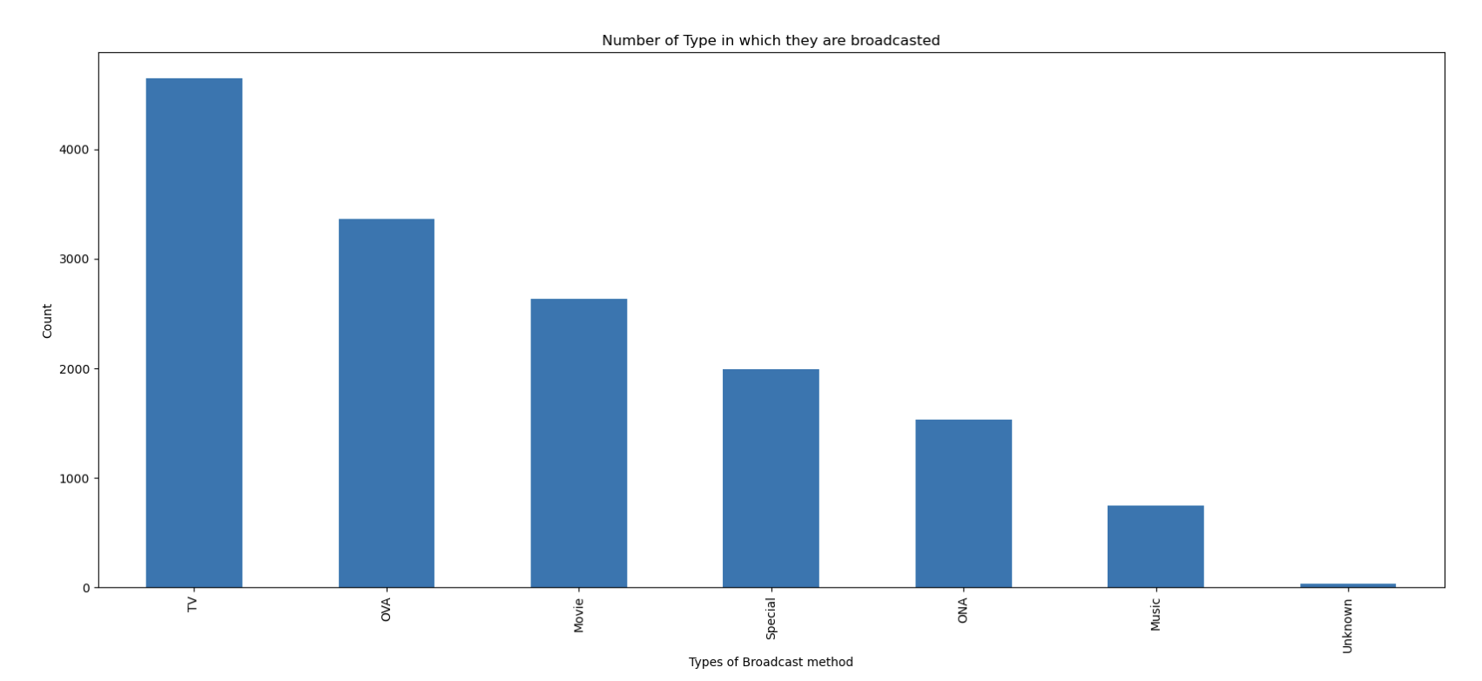
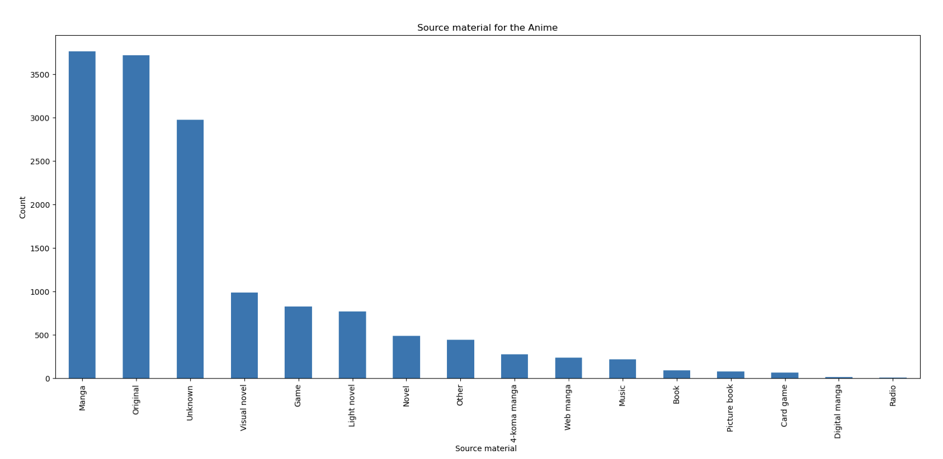
EDA
Number of Type in which they are broadcasted: The graph shows the distribution of different broadcast types (e.g., TV, OVA, movie) used for anime.
Score Material for the Anime: This graph probably displays how different materials (e.g., manga, light novel) influence the anime scores.

Slide 8
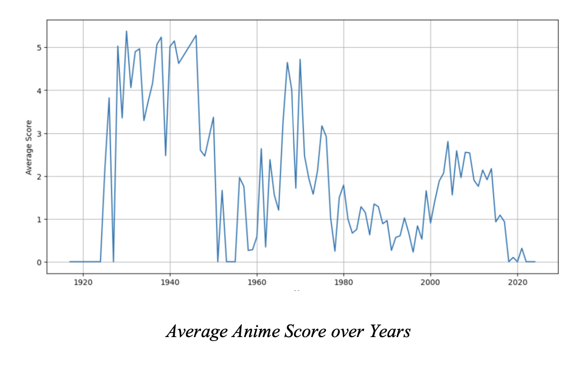
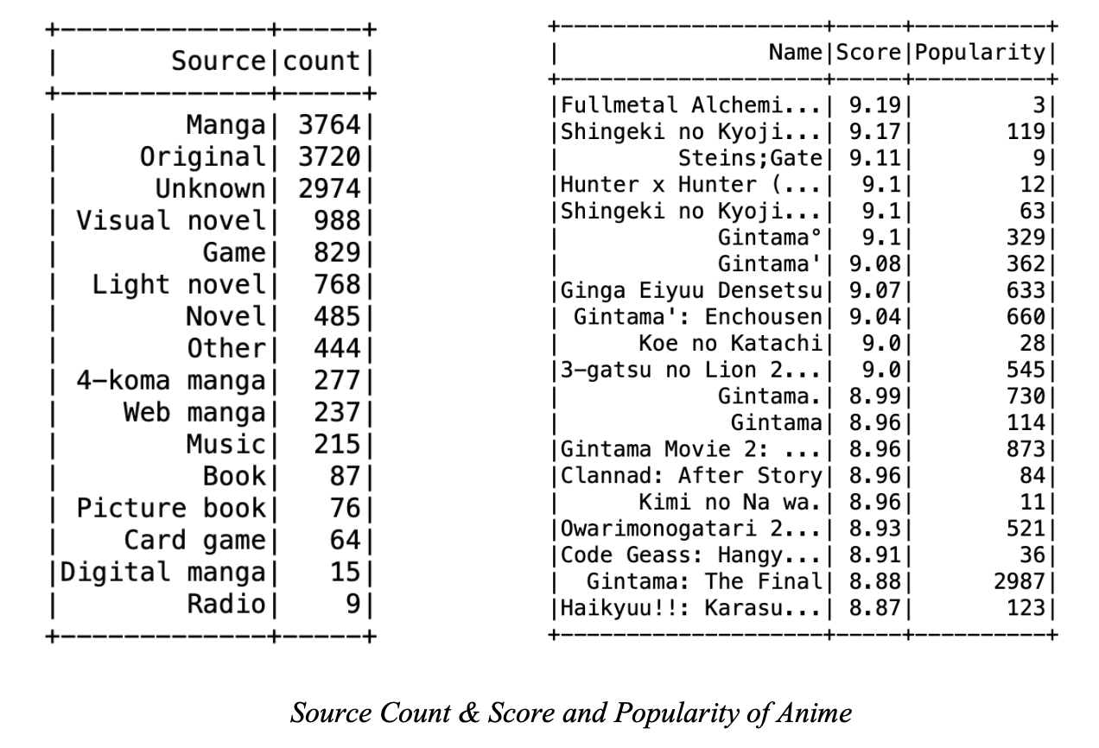
EDA
Average Anime Score over Years: Indicates trends in anime quality over the years, showing whether scores are increasing or decreasing.
Source Count & Score and Popularity of Anime: Reveals which sources (e.g., original, manga adaptations) are most popular and highly rated.

Slide 9
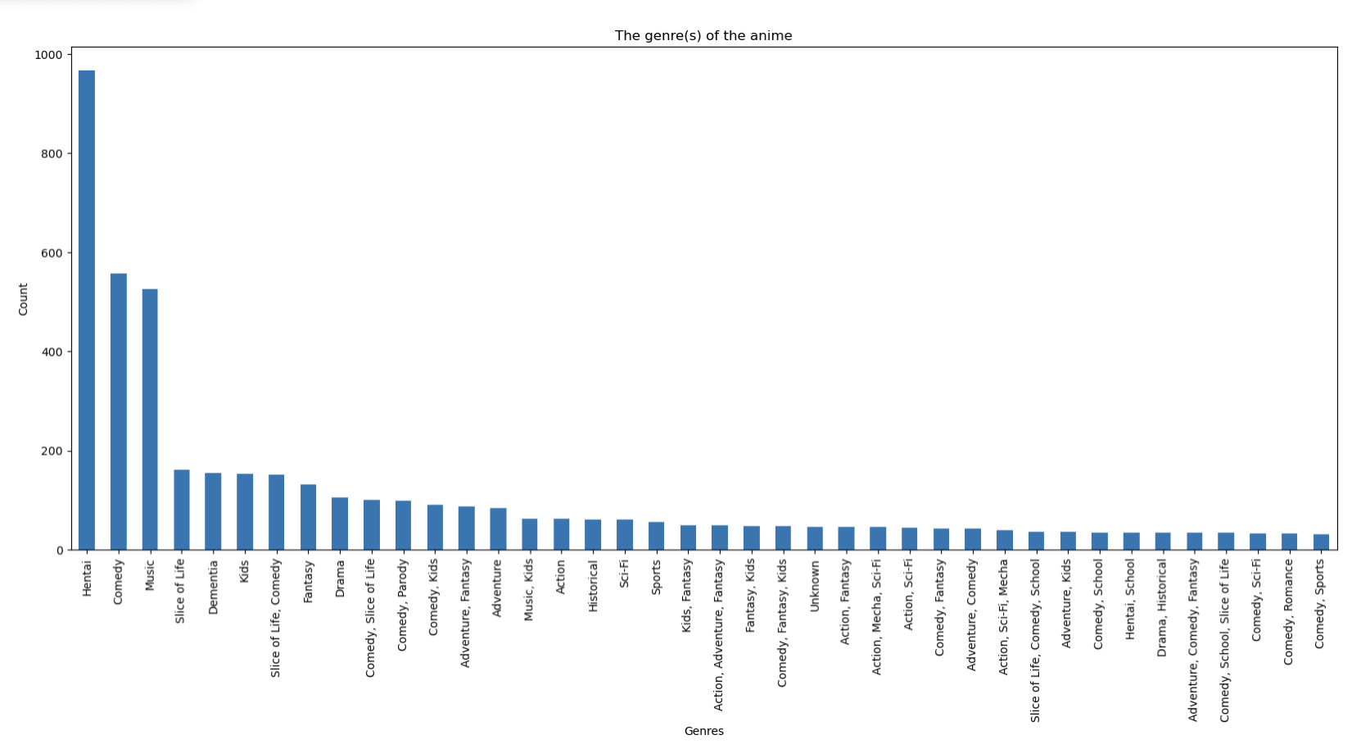
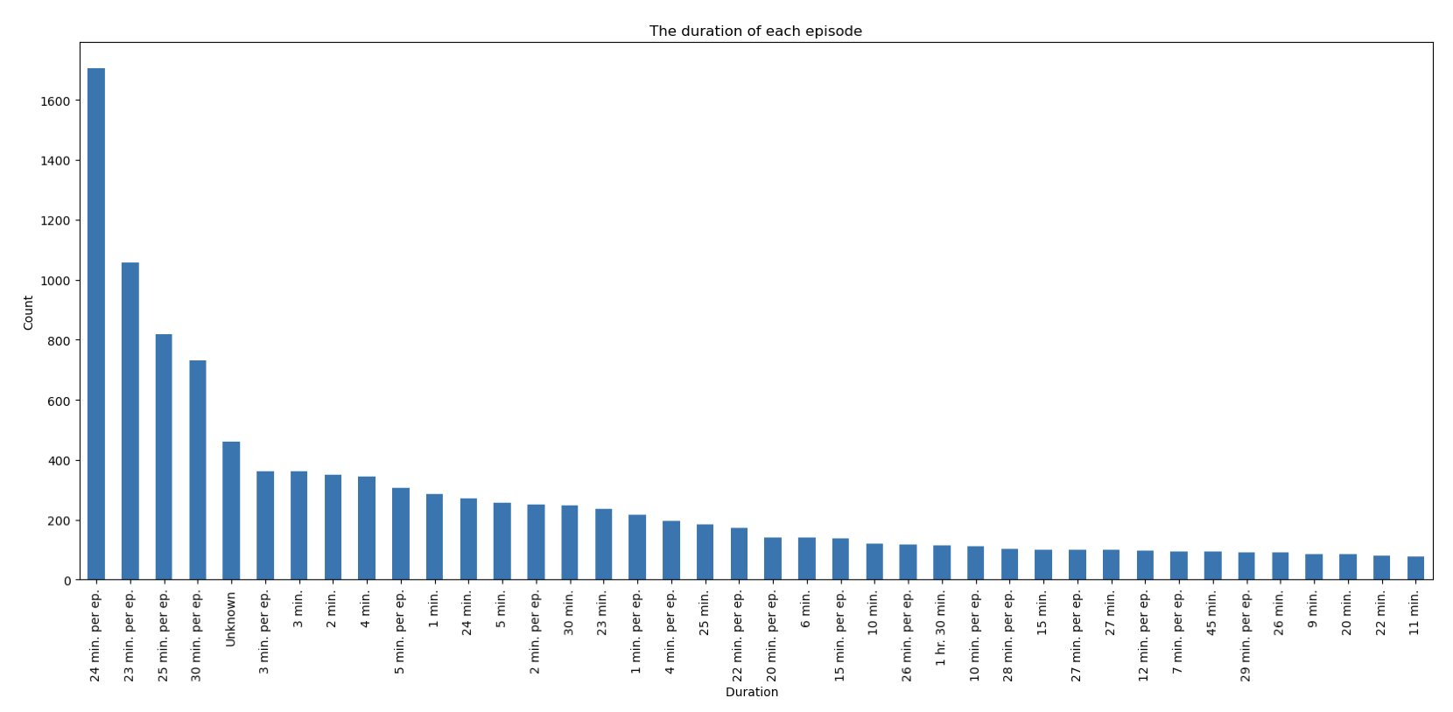
EDA
The duration of each episode: This graph likely illustrates common episode durations, identifying standard lengths for anime episodes.
The genre of anime: Shows the distribution of anime across various genres, highlighting the most prevalent ones.

Slide 10
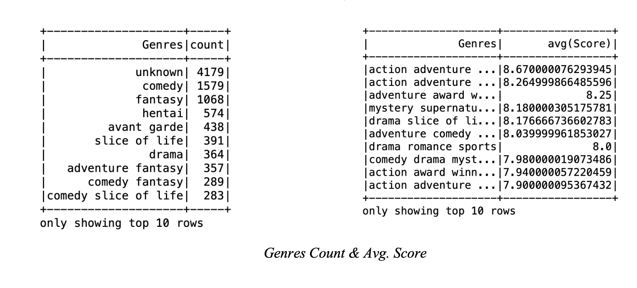
EDA
Genres Count & Avg. Score: Depicts the number of anime in each genre and their average scores, indicating genre popularity and quality.

Slide 11
Results & Discussion

Slide 12
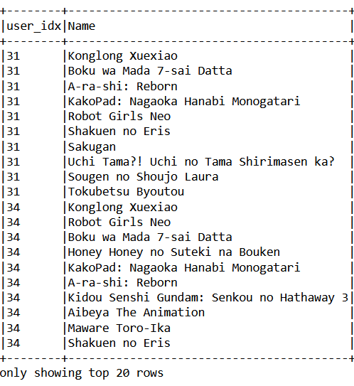
ALS - Collaborative filtering
Collaborative filtering works by taking care of user past behavior and other similar users
Root-mean-square error = 1.7267104018791564
Notes:
Underhood matrix factorization is the state-of-the-art solution for sparse data problem. Works for sparse ratings and takes care of popularity effect. User-item interaction into user item matrices
ALS minimizes two loss functions alternatively; It first holds user matrix fixed and runs gradient descent with item matrix; then it holds item matrix fixed and runs gradient descent with user matrix
Its scalability: ALS runs its gradient descent in parallel across multiple partitions of the underlying training data from a cluster of machines

Slide 13
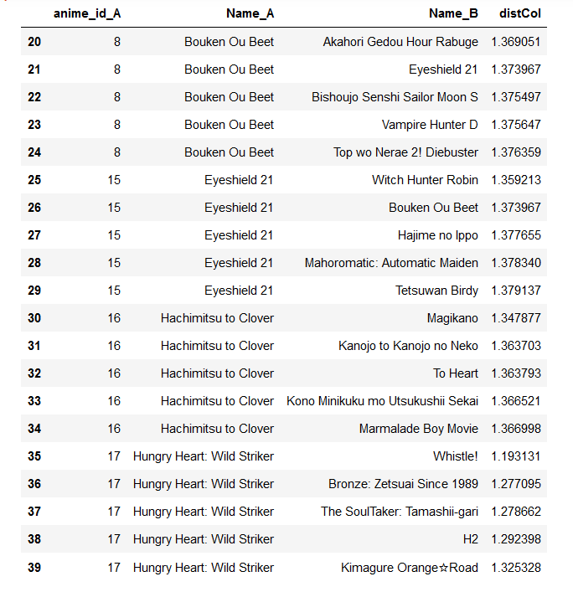
Synopsis based- TF IDF
Using TF-IDF on the anime synopsis and leveraging LSH for similarity join for approximate neighbor search
Notes:
Bucketed Random Projection LSH is an efficient method for approximating nearest neighbors. It works by hashing similar items into same buckets with high probability

Slide 14
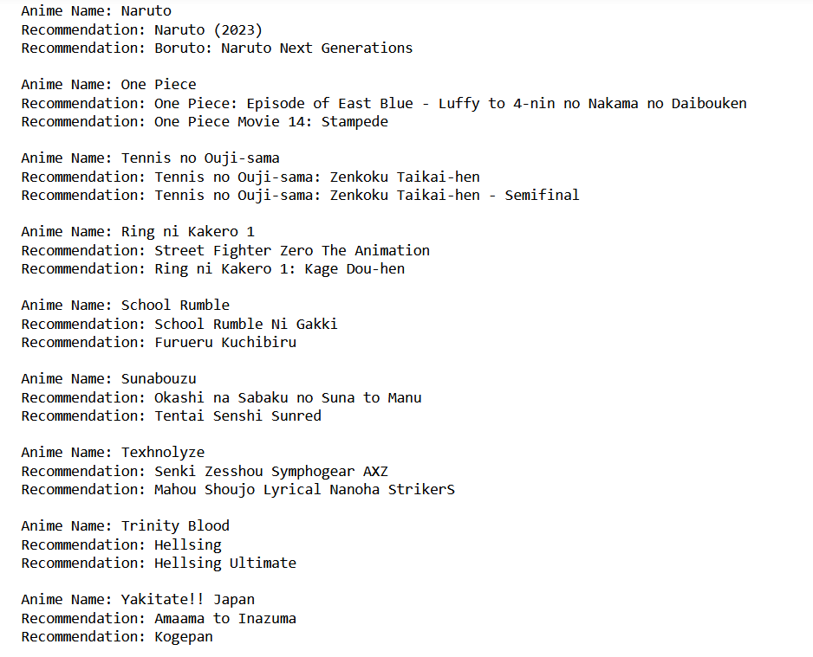
Embedding based recommendations
Used Mistral-7B-Instruct-v0.2 to generate embedding for synopsis of anime
Chroma DB performs nearest neighbor search for us using cosine similarity
Efficient than TF-IDF, able to run on whole dataset

Slide 15
Limitations and Future Scope
Data was only upto 2023
Incorporate real time data and usage patterns using kafka
Extracting user reviews and incorporating review sentiment in the recommendations
Build a full scale recommendation system with a web app

Slide 16
Conclusion
In conclusion, the Anime Recommendation System effectively leverages big data and machine learning to personalize anime recommendations, addressing the vast and growing demand within the anime industry. The system’s comprehensive pipeline ensures scalability and adaptability, enhancing user satisfaction
Technologies: Pyspark, SparkML, ChromaDB, Huggingface, matplotlib

