Slide 1
Aletheia: faster reports, zero quiet changes
HACKATHON DEMO · TRACK: 3
Online test requests, online workflow, tamper-evident reports for the CPRI Short Circuit Laboratory.
10
4
157
Document types
Import formats
Automated tests
Team CyberSiege
Siddhartha · Bhargav · Koushik · Abhijit
Notes:
[~0:10] We are CyberSiege. Aletheia takes a customer's test request from an online application to a signed, verifiable report for the CPRI Short Circuit Laboratory. The story in one line: from paper and hand-offs to one online flow, faster for the lab, clearer for the customer, and impossible to tamper with quietly.

Slide 2



Reports depend on data from many sources that people collect and retype by hand
PROBLEM UNDERSTANDING
Many sources, no flow
Manual retyping
Delay and doubt
Request forms, test logs, measurement records and laboratory databases are collected separately.
Entries are checked and copied into report templates by hand, which is slow and error-prone.
Customers wait for the report and cannot verify the finished PDF.
Today the request, logsheets and report live in separate files and hand-offs, so every value is retyped and re-checked by hand.
Notes:
[~0:15] The challenge: a lab's reports depend on data from request forms, test logs, measurement records and databases. Today people collect, validate and retype that data into templates, which is slow, error-prone and delays the customer, and the finished PDF cannot be checked. Add one real figure or quote from the lab here if you have one.

Slide 3
Aletheia answers each of the four objectives with a working feature
THE FOUR OBJECTIVES
1
2
3
4
Reduce report generation time
Minimise manual errors
Improve productivity
Enhance customer experience
Template mapping fills the report from stored data. A numbered, hashed PDF is built in seconds.
Values come straight from the logsheet with source cells. Automatic checks and independent verification catch the rest.
Upload once, no re-keying. Each person's dashboard lists the tasks waiting for them.
Apply online, follow status, raise tickets, ask the assistant, download and verify the report.
EFFICIENCY
INTEGRITY
EFFICIENCY
CUSTOMER
From paper and hand-offs to one online flow:
faster for the lab, clearer for the customer, and impossible to tamper with quietly.
Notes:
[~0:20] The organisers set four objectives and each one maps to a feature you will see: time saved by template mapping, fewer errors through source cells, checks and verification, productivity through upload-once with no re-keying, and a better customer experience. The coloured pills show which of our three pillars each one serves. The one-line story: from paper and hand-offs to one online flow, faster for the lab, clearer for the customer, and impossible to tamper with quietly.

Slide 4
The prototype covers every module and input source the problem statement asks for
EXPECTED SOLUTION
DATA COLLECTION
DATABASE MANAGEMENT
REPORT ENGINE
DASHBOARD
Customer request form, online
Every test stored with its full history
Template mapping to the lab's format
Report status and progress per job
Excel and CSV logsheets with source cells
Files kept with SHA-256 fingerprints
Numbered, hashed, downloadable PDF
Search records, export many jobs to Excel
CSV, Excel, JSON, SQLite and legacy registers
Historical records searchable
Partial report from approved tests
Tasks waiting for each person
Excel templates that mirror the paper logsheets
Testers fill in the same layout they use on paper, then upload it once: an easy move online, with every value imported beside its source cell.
EFFICIENCY
INTEGRITY
Input sources handled
Customer request forms
Laboratory log sheets
Test measurements and results
Existing databases and spreadsheets
Notes:
[~0:10] The problem statement asks for four modules: data collection, database management, a report generation engine and a dashboard. All four are in the prototype, and it handles all four input sources: request forms, log sheets, test measurements and existing databases or spreadsheets.

Slide 5
Aletheia follows the suggested six-step workflow and adds verification
SUGGESTED WORKFLOW
1
2
3
4
5
6
Capture customer request details
Import test and measurement data
Validate and store data
Populate the template automatically
Generate the final report
Review and export
Online Customer Request Form
Excel, CSV, JSON or SQLite upload, with source-cell preview
Automatic checks, then the database with full history
Template mapping to the lab's report format
Numbered, hashed PDF with a QR code
Verify, approve, sign off, then download
Added by Aletheia
Independent verification of every test
Admin approval and signed release
Customer QR verification
Tickets and assistant
Notes:
[~0:10] This is the six-step workflow from the problem statement, mapped to what Aletheia does at each step. We add four things on top: independent verification of every test, admin approval and signed release, a QR code so customers can verify the report, and tickets and an assistant for customer questions.

Slide 6
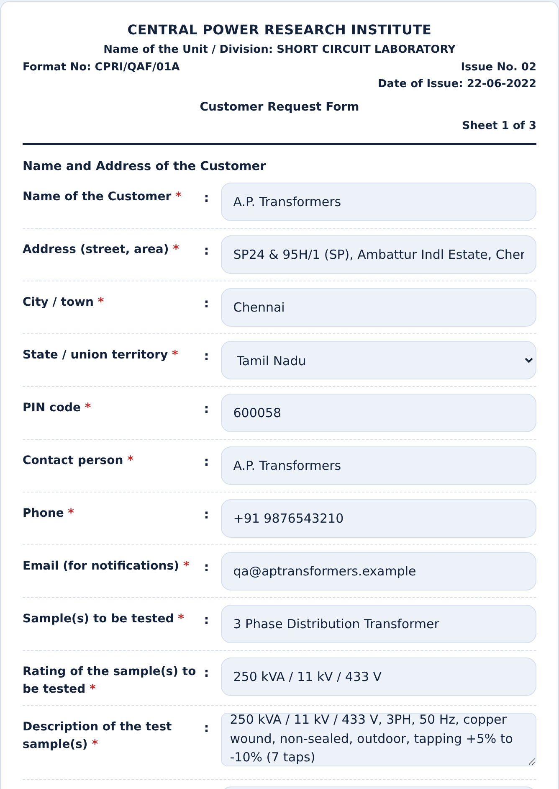
Customers apply online instead of filling a paper form
CUSTOMER EXPERIENCE
Objective 4: Customer experience
BEFORE
AFTER
Paper request form
Online request form
Customer fills in a paper form
Same fields as the lab's own form
Delivers or posts it to the lab
No retyping at the lab
Lab retypes every field
Lab receives it instantly and accepts it on screen
Delays and transcription errors
Series and sample numbers assigned automatically
Notes:
[~0:35] This is the first thing a customer touches. Before, a paper form was delivered or posted and the lab retyped it. Now the customer fills in the same Customer Request Form online, the lab receives it instantly, and series and sample numbers are assigned when the request is accepted. Show the form screenshot, or go straight to the live demo.

Slide 7
One logsheet upload feeds checks, verification and the report
IMPROVED EFFICIENCY
Objectives 1 and 3
BEFORE
AFTER
Logsheets filled by hand or in Excel
Tester uploads the logsheet once
Emailed or carried between tester, checker and report writer
Every value is captured with its source cell
Values retyped into the report
The same data flows through checks, verification and report
SAME DATA, NO RE-KEYING
Upload once
Automatic checks
Second look and verify
Report built
Notes:
[~0:35] Before, one logsheet could be touched by three people and retyped into the report. Now the tester uploads it once, every value is stored with the cell it came from, and the same stored data flows through the checks, the verification and the report. There is no point in the chain where a person re-keys a number.

Slide 8
Nine steps and three roles take a request to a released report
IMPROVED EFFICIENCY
Objective 3: Productivity
1
2
3
4
5
6
7
8
9
Request
Accept
Upload
Check
Verify
Approve
Generate report
Sign off and release
Report ready
Customer
Tester or Admin
Tester
Tester
Tester
Admin
Admin
Admin
Customer
ADMIN
TESTER
CUSTOMER
Can: Assigns tests, approves, generates, signs off, answers tickets
Can: Accepts requests, uploads, runs checks, verifies tests
Can: Raises requests and tickets, follows own jobs
Cannot: Enter, check or verify data
Cannot: Approve, generate or sign off
Cannot: See other customers' jobs or unapproved values
Notes:
[~0:10] The whole journey is nine steps owned by three roles: Customer, Tester and Admin. Testers handle intake, upload, checks and verification; the Admin approves, generates and signs off; the customer starts and ends the flow. Each role is also limited in what it cannot do, enforced by the server.

Slide 9
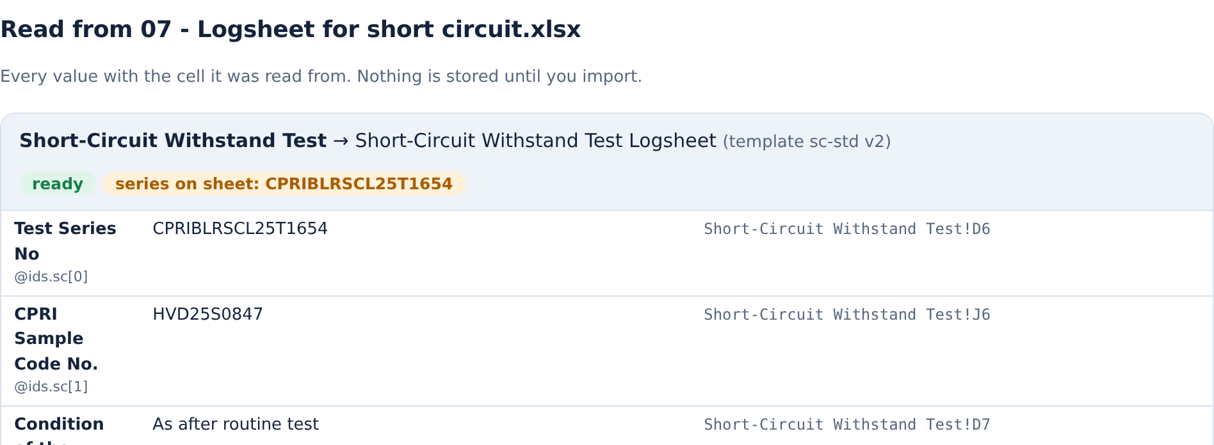



Testers upload logsheets once and see every value beside its source cell
IMPROVED EFFICIENCY
Objective 2: Fewer errors
Upload Excel or CSV once
The preview shows each value next to its source cell.
Missing cells block the upload
Required empty cells are never stored as NA. Formulas must be recalculated.
All 10 documents are covered
1 Customer Request Form
6 No-Load Loss and Current Logsheet
Checks before sign-off
2 Proforma for Transformers
7 Routine Test Logsheet
Automatic checks against standard limits flag problems.
3 Work Instruction
8 Short-Circuit Withstand Test Logsheet
4 Loss Measurement Datasheet
9 Temperature-Rise Test Logsheet
5 Winding Resistance and Loss Logsheet
10 Pressure and Oil-Leakage Test Logsheet
Notes:
[~0:15] A tester uploads an Excel or CSV logsheet and sees every value next to the cell it was read from. A required cell that is empty blocks the upload, and automatic checks against standard limits flag problems before anyone signs. All ten documents of a short-circuit job are supported.

Slide 10

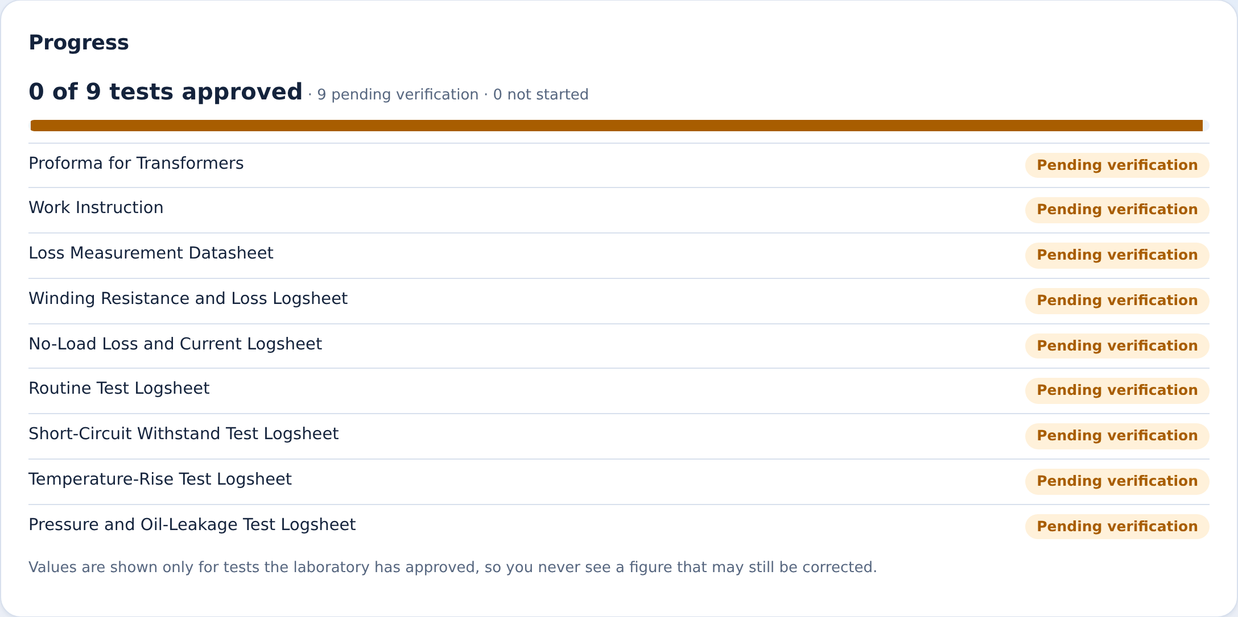
Customers follow their request as it moves forward, without phoning the lab
CUSTOMER EXPERIENCE
Objective 4: Customer experience
1
2
3
4
5
Request received
In progress
Pending verification
Approved
Report released
Status pills the customer sees
In progress
Pending verification
Approved
Being corrected
One notification at release
When the final report is released, the customer gets a link to download it.
Report released
Not started
Progress updates as soon as a stage moves forward.
Notes:
[~0:35] The customer's portal lists every request with a status pill, and the progress updates as soon as a stage moves forward, so nobody has to phone the lab. Tests show as pending verification, then approved, and the job ends as report released. At release the customer gets one notification with a link to download the report.

Slide 11


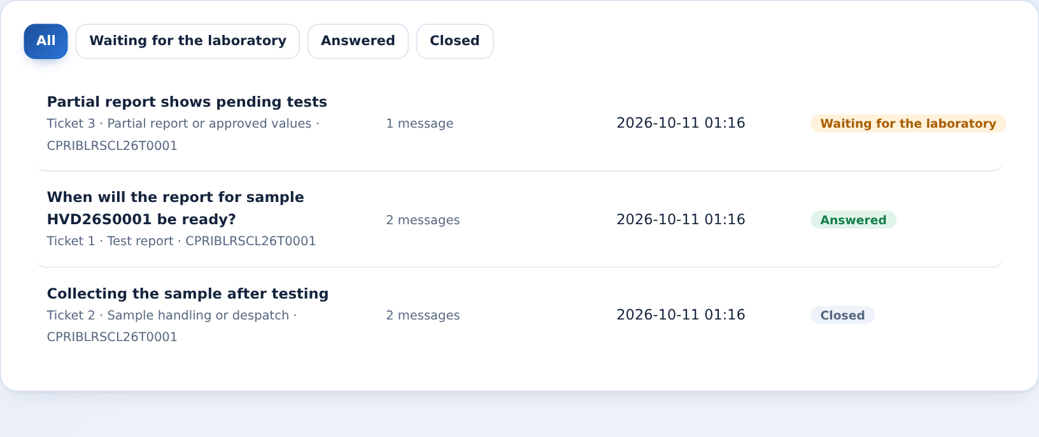
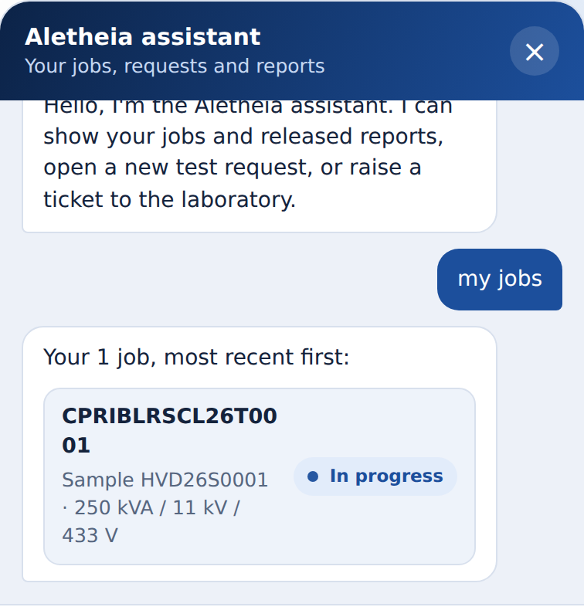
Customers get answers through tickets and a built-in assistant
CUSTOMER EXPERIENCE
Objective 4: Customer experience
Tickets to the laboratory
Built-in assistant
Raise a ticket about a request, a report, values or sample handling, and follow its status. The answer arrives in the same thread, with a notification.
A chat helper shows the customer's jobs and released reports, opens a new request or raises a ticket. It is rule-based, not an AI model.
OPEN
ANSWERED
CLOSED
My jobs
New test request
Raise a ticket
Notes:
[~0:25] Customers are never left guessing. If something is wrong or unclear they raise a ticket to the laboratory about a request, a report, values or sample handling, and see its status move from open to answered to closed. The built-in assistant is a simple rule-based chat helper: it lists the customer's jobs and released reports and opens a new request or ticket for them.

Slide 12
A numbered, hashed PDF report is built from stored data in seconds
IMPROVED EFFICIENCY
Objective 1: Less time
Stored data
Template mapping
Numbered, hashed PDF
Manual
Aletheia
Fields typed by hand
By hand
0.4
514 to 0
Every value retyped into the report
Seconds to build the PDF
Re-keyed
Notes:
[~0:05] Template mapping fills the report from stored data, so the PDF is numbered and hashed in seconds. Fill in the measured manual and Aletheia times and the count of fields typed by hand before presenting; use measured values only.

Slide 13
Testers verify, admins approve, and no report is built until every test is checked
HIGH INTEGRITY
Objective 2: Fewer errors
Tester
Upload the logsheet
A tester compares each value with the original file
Verified
Test is locked
Verify, return or mark N/A
Returned
Sent back with a reason
Not applicable
Recorded with a reason
Admin
Approve, generate, sign off
No report is generated until every test is Verified or Not applicable
Enter, check or verify data
BLOCKED
The report manifest names who uploaded and who verified each test.
Notes:
[~0:10] Duties are split: testers enter and verify data, the Admin approves, generates and signs off but can never enter, check or verify data. A tester compares each value with the original file, then verifies, returns with a reason, or marks the test not applicable. In the current build a tester may verify their own upload; the manifest records both names. No report can be generated until every test is verified or not applicable.

Slide 14
Four layers mean nothing changes quietly: edits are blocked or detected
HIGH INTEGRITY
Objective 2: Fewer errors
SHA-256 fingerprint of every file
Layer 2: the audit chain
1
Each uploaded file and its data are hashed and stored together.
Entry n-1
prev_hash + entry_hash
Hash-chained audit log
2
Edit one entry and the chain breaks after it. Check the chain proves it.
Entry n
Verified tests are locked
prev_hash + entry_hash
3
Reopening needs a reason, and every revision stays in the history.
Entry n+1
Numbered, hashed, never edited
prev_hash + entry_hash
4
Release needs the admin's password. Old versions are superseded, not changed.
Each entry stores the hash of the one before it.
Notes:
[~0:35] Four layers. One: every uploaded file is fingerprinted with SHA-256 and stored with the data. Two: the audit log is hash-chained, so editing any entry breaks the chain after it, and a Check the chain button proves nothing was altered. Three: verified tests are locked and reopening needs a reason, with every revision kept. Four: reports are numbered and hashed, release needs the admin's password, and old versions are superseded, never edited.

Slide 15
Edit one entry and the chain check turns red and names the broken entry
HIGH INTEGRITY
BEFORE: UNTOUCHED
AFTER: ONE ENTRY EDITED
Check the chain
Check the chain again
Audit chain intact (93 entries)
Audit chain broken at entry 40: entry content was changed
1
Run the chain check: green
2
Edit one audit entry directly in the database
3
Run it again: red, with the entry number
This is the part we'll show live
Notes:
[~0:35, then run the live tamper test] We try to cheat. First we run Check the chain and it is green. Then we edit one audit entry directly in the database, and run the check again: it turns red and points to the exact entry that changed. This is the part we'll show live.

Slide 16
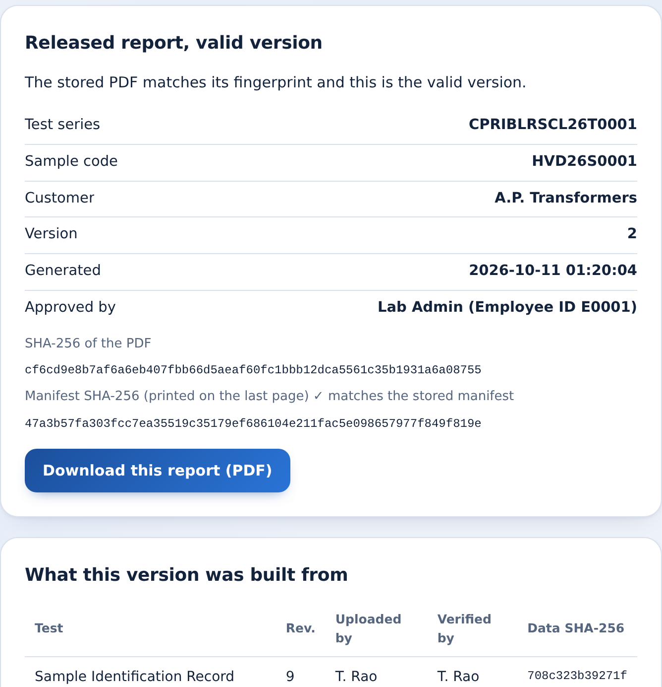
Customers verify the report themselves by scanning its QR code
CUSTOMER EXPERIENCE
Objective 4: Customer experience
1
Scan the QR code on the printed report
It opens the verification page for that exact version.
2
The PDF is checked against its manifest hash
A changed file shows as not intact.
3
It shows who tested, verified and approved it
Every test lists its source file fingerprint.
4
It flags a superseded version, and why
Old versions stay verifiable, never silently replaced.
INTACT
CURRENT
SUPERSEDED
Notes:
[~0:15] Every released report carries a QR code. Scanning it opens a verification page that confirms the PDF against its manifest hash, shows who tested, verified and approved it, and warns if the version has been superseded and why. The customer does not have to trust us, they can check.

Slide 17
Architecture: one Flask app and one SQLite database run the whole flow on one lab PC
ARCHITECTURE
USERS
GATE
INPUT
ENGINE
STORE
Browser UI
auth.py
importers.py
app.py
integrity.py
Static pages (index.html + JS)
Roles, CSRF, permission per route
CSV, Excel, JSON, SQLite, legacy registers
Flask API, job lifecycle
SQLite: sections, history, files
Customer portal
xltemplates.py
rules.py
Audit hash chain
portal.py, tickets.py
Excel logsheets with source cells
Checks against limits
Sealed on every action
workflow.py
report.py
notify.py
Customer Request Form
PDF, manifest, QR
Notices; retention.py backups
Module
Integrity layer
Python
Flask
SQLite
openpyxl
ReportLab
pypdfium2
HTML + JS
About 83% of the code
REST API
One file, no extra service
Excel logsheets
PDF reports
PDF checks
Front end
Notes:
[~0:05] Under the hood it is one Flask process and one SQLite database on an ordinary lab PC, no other services. Inputs flow through importers and logsheet templates into the store, the engine runs the checks and builds the PDF, and every action is sealed into the audit chain. Skip the details unless asked.

Slide 18
Results: ten documents, four import formats and 157 automated tests, with more to come
RESULTS
10
4
What is done, what is next
DONE
Online request form and source-cell preview
Document types
Import formats
DONE
Hash chain, chain check and QR verification page
PLANNED
Scan-to-form assist for paper logsheets (a human confirms every value)
157
0.4 s
PLANNED
Click-to-trace from a value to its source cell
PLANNED
Anchor the daily chain tip outside the server
Automated tests
Report build time, measured
PLANNED
Signed PDFs
Notes:
[~0:10] Real numbers only: ten document types, four import formats and 157 automated tests. Add the measured time and error figures once you have them. Done: the online request form with source-cell preview, the hash chain with its check button, and the QR verification page. Planned: scan-to-form assist, click-to-trace, anchoring the chain tip outside the server, and signed PDFs.

Slide 19
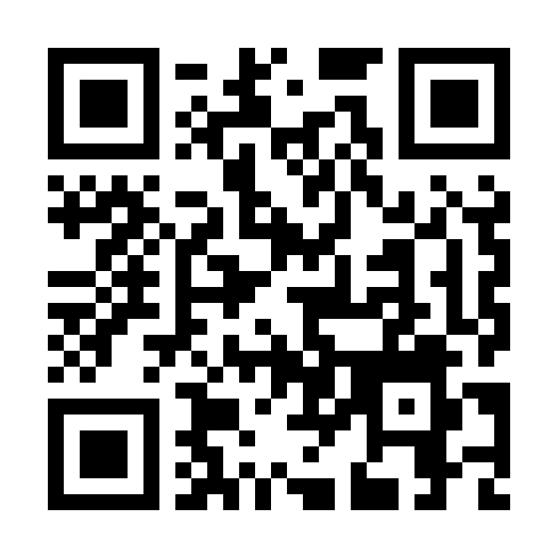
Fast to produce.
Easy for customers.
Impossible to quietly change.
THANK YOU
Team CyberSiege
Siddhartha · Bhargav · Koushik · Abhijit
Repo: github.com/sid-zyy/aletheia
Deliverables: working prototype, documented source code, architecture diagram, live demo, this presentation
Notes:
[~0:05] Fast to produce, easy for customers, impossible to quietly change. Thank you from Siddhartha, Bhargav, Koushik and Abhijit. Add the repo link and QR code before presenting, then hand over to the live demo.

