Slide 1
EDUCATION IN INDIA
SUBMITTED BY – Sahil sHarma
1711981254

Slide 2
INTRODUCTION
As According to Indian constitution free and compulsory education is provided as a fundamental right
In census 2011 literacy rate is 75%
India runs the biggest education system in the world
Education in India is provided by public schools(controlled and funded by three levels: central, state and local) and private schools

Slide 3
NEED OF PROJECT
In this project analyze education in India through every state and union territories
In this use database for further research and other purpose
In this we analyze the basic requirements are fulfil or not like
No of qualified teachers
Basic infrastruture (building, electricity connection)
Drinking water facility

Slide 4
HISTORY OF EDUCATION IN INDIA
Earlier education system is commenced under the
supervision of gurus
There is no special class rooms or laboratories are there in
older days the house of gurus are place to learn and it is
called as VEDHA NILAYAM
In older days the teachers has to choose the student, to
whom they want to teach the skills.
There is no fee or any prizes given to the gurus instead of
that a life long benefits will be provided by the student to his
Guru

Slide 5
NO OF SCHOOLS

Slide 6
NO OF TEACHERS

Slide 7
LIBRARY FACILITY

Slide 8
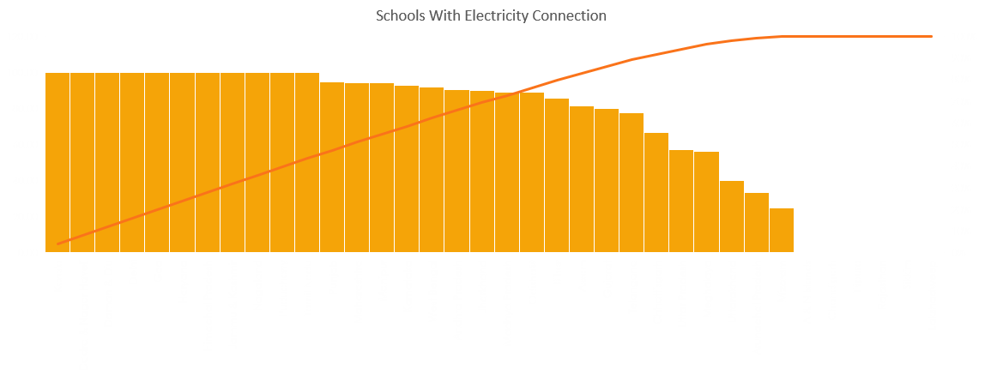
DRINKING WATER FACILITY

Slide 9
Schools With Drinking Water Faciity

Slide 10
Schools With Buildings

Slide 11
CONCLUSION
Now a days lot’s of positive changes are happening in the
education system of India.
There is a definite need of revolutionary changes in the
Indian education system.
With the effective learning system, India can successfully
utilize its vast human resources, and by that the dream of
our youngsters hero “Dr. A. P. j. Abdul Kalam” dream of India
2020 will get success

Slide 12
THANK YOU

