Slide 1
LMS Platform Decision
Build vs buy, governance, operating model, infrastructure, and next-step decision points
Decision focus
Move from a working prototype discussion to an executive path: prove, buy, or build with clear ownership.
Current process
Build option
Buy option
Governance
Prepared for leadership discussion | June 2026

Slide 2
Current Process: Email Validation and LSP Disbursement
Useful as a control layer, but not the target scalable LMS platform
1
LSP sends email / data
2
GCP script validates
3
Approval email returns
4
LSP disburses
5
PostgreSQL stores approval
Input arrives through current LSP channel.
Automated script checks submitted email data.
Approval response is sent back to the LSP.
Disbursement remains outside the platform.
Approval record is kept for reference/control.
Current facts
What works today
Key risks
Validation is a GCP script, not a managed platform.
Approvals are returned to the LSP by email.
Only approval evidence is a PostgreSQL record.
Money moves on the LSP's own channel.
Low-cost way to prove the control concept.
Quick to change while the process is still evolving.
Keeps the current LSP disbursement flow running.
Produces basic approval evidence.
Weak control over money flow — disbursement sits outside the platform.
Audit exposure: limited logging, access, and segregation of duties.
Email is not a defensible system of record.
Risk and manual effort grow with every new LSP.
Executive takeaway: keep this as prototype learning, not as the long-term scalable platform.
Bhawana Capital | LMS platform decision
02

Slide 3
Decision to Make: Build vs Buy
The executive decision is not just technology; it is ownership, control, adoption, and auditability
Option A: Build
Option B: Buy
Cost
Higher upfront build effort; no recurring licence fees.
Cost
Lower build effort; recurring licence and change fees.
Team
Needs dedicated engineering, SDLC, and support capacity.
Team
Vendor-led; less in-house build, but vendor management.
Governance
Full control of audit model, security, and data path.
Governance
Shared or limited control; relies on vendor audit/exports.
Time to Market
Slower: infrastructure, build, and hardening take months.
Time to Market
Faster: mature features sooner, after due diligence.
Decision lens: choose the path that gives LSPs a reason to move, keeps controls auditable, and has clear ownership.
Bhawana Capital | LMS platform decision
03

Slide 4
Prototype Implemented: What It Means
Informative prototype, not production platform
What exists
What does not exist
Manual interactions
A working concept for validation, approval, data capture, and basic workflow.
Useful for learning and vendor comparison.
No production deployment.
No Azure India subscription or production infrastructure.
No proven HA, DR, monitoring, support model, or security certification.
People still review exceptions, approve decisions, manage partner issues, and own follow-up.
The platform should make these steps auditable.
1
2
3
4
Prototype
MVP
Pilot
Scale
Current state sits at the first point: useful evidence, but not ready for external production use.
Bhawana Capital | LMS platform decision
04

Slide 5
Governance and Operational Model
The platform should make compliance easier, not add undocumented manual work
Area
Platform control
Owner
Manual interaction
Audit evidence
Immutable logs for approvals, status changes, downloads, and exceptions.
Platform + Ops
Ops reviews exception trail.
Security standards
Group SDLC, secure coding, dependency checks, and change approvals.
IT Security + Engineering
Security signs off gates.
Change requests
Formal intake, impact analysis, approval, test evidence, release note.
Product + Governance
Change board approves.
Access management
Entra ID, role-based access, joiner/mover/leaver process.
IAM + Platform
Access owner reviews.
Operations
Runbooks, on-call, incidents, SLAs, partner support queue.
Support + SRE
Support handles partner issues.
Ownership model
RACI across platform, support, infra, security, governance.
To finalize in Miro
People ownership remains explicit.
Principle: automate the evidence, but keep accountable people visible for approvals, exceptions, and operational ownership.
Bhawana Capital | LMS platform decision
05

Slide 6
Security and Access Model
Use group standards and bank IT Security support from the start
Identity
Audit and evidence
Group security
Entra ID for users and groups.
Role-based access by function.
Joiner/mover/leaver process.
Every approval, exception, data change, and access event should produce searchable audit evidence.
Bank / group IT Security supports standards, review gates, access model, and production readiness.
Control
Build path
Buy path
Access
Bhawana defines roles and Entra integration.
Vendor must support SSO/RBAC requirements.
Audit
Native platform logs and reporting evidence.
Vendor audit export must be tested.
Security review
Code and infra reviewed internally.
Vendor audit, penetration test, and contract review.
Bhawana Capital | LMS platform decision
06

Slide 7
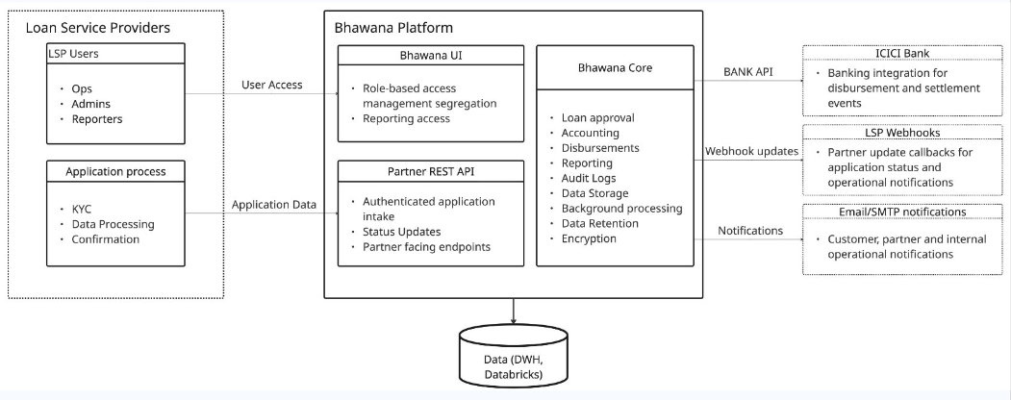
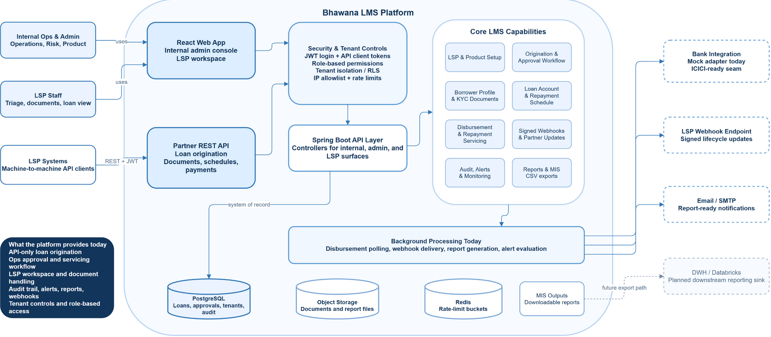
Current Platform Architecture
Current platform modules, connections, data stores, integrations, and what the platform provides today
Bhawana Capital | LMS platform decision
07

Slide 8
Infrastructure Direction and Indicative Cost
Start an Azure India subscription only after the decision path is clear
Initial cloud choice
Indicative run cost
Cost caveat
Azure India subscription for data residency and group-aligned operations.
Planning estimate: about EUR 3K per month for a controlled non-large-scale production footprint.
Actual cost depends on HA, DR, logs retention, data volume, Databricks integration, and vendor contracts.
Infra area
Likely components
Decision needed
Application
App Service / AKS, gateway, monitoring
Build vs vendor deployment model
Data
PostgreSQL, storage, backup, retention
RPO/RTO and data residency
Integration
Databricks DWH, email, LSP channels
Interface ownership and support
Bhawana Capital | LMS platform decision
08

Slide 9
Buy Option: Assessment Required
A vendor decision needs months of diligence, not a demo-only comparison
Assessment area
What to verify
Owner
Outcome
Functional fit
Origination, approval, audit, reporting, exceptions.
Product + Ops
Fit-gap matrix
Security audit
SSO, RBAC, logs, encryption, vulnerability posture.
IT Security
Security sign-off
Integration
LSP channels, email, PG/DWH/Databricks, APIs.
Engineering
Integration plan
Operations
Support model, SLAs, incident process, release process.
Support + Vendor
RACI
Commercials
License, implementation, change costs, exit rights.
Finance + Legal
TCO and contract
Data governance
Ownership, retention, exports, residency, audit access.
Governance
Control evidence
Key question: who manages what after go-live? Vendor capability does not remove Bhawana ownership of controls, approvals, data, and LSP experience.
Bhawana Capital | LMS platform decision
09

Slide 10
Buy Option: Indicative Vendor Cost
Two live proposals, shown at ~€100M annual scale, first three LSPs, before tax
Cost element | Vendor A | Vendor B (current) | Build (in-house)
One-time setup | ₹7,500,000 / €69,139 | ₹0 today | Build effort (TBD)
Fixed yearly cost | ₹1,000,000 / €9,219 (AMF) | Floor ₹400,000 / €3,636/mo | Infra ₹3,900,000 / €36,000
Usage fee - based on | 0.20% of disbursement | Tiered % of AUM | None
Usage fee at ~€100M | ₹21,700,000 / €200,000 | ₹28,400,000 / €257,727 | n/a
Year-1 known cost | ₹30,200,000 / €278,358 | ₹28,400,000 / €257,727 | ₹3,900,000 / €36,000 + team
Lock-in / exit | None stated | 36 months | Full control
Indicative, pre-tax at ~€100M scale: vendor cost scales with disbursement and AUM; Build cost is mostly infra plus an internal team.
Bhawana Capital | LMS platform decision
10

Slide 11
Build Option: Gated Roadmap
The current prototype is the starting evidence, not the production end state
Hard gate
LSP value proof
No production LSP migration until ownership, security, audit, infra, and manual exception operations are proven.
Pilot must prove the platform is easier for LSPs than email and manual follow-up.
1
2
3
4
0-1 month
1-3 months
3-5 months
5-8 months
Decision and scope
Confirm owner, target process, LSP value case.
MVP hardening
Azure, Entra ID, audit, GitHub CI/CD, SDLC.
Pilot
One or two LSPs, manual exception flow, reporting.
Scale readiness
Monitoring, DR, performance, Databricks DWH.
Bhawana Capital | LMS platform decision
11

Slide 12
Key Challenges and Executive Asks
The decision can move forward if these questions are explicitly owned
Technology
Operations
Scalability
Business
Prototype is not deployed or scale-ready. Build path needs infra, SDLC, observability, and DWH integration.
Manual interactions remain. The platform must define who approves, who supports, and who escalates.
Email-based process and ad hoc approvals will not scale across multiple LSPs without control automation.
LSP motivation depends on lower effort, faster answers, better transparency, and clean integration.
Executive ask
Decision required
Owner
Build vs buy assessment
Approve criteria, timeline, and vendor shortlist.
Leadership
Prototype path
Decide whether prototype becomes MVP or remains learning artifact.
Product + Engineering
Operating model
Confirm RACI, manual approvals, support, and security gates.
Ops + Governance
Bhawana Capital | LMS platform decision
12

