Slide 1
Bhawana LMS
CEO-ready platform overview
Architecture, deployment, operating model, security, roadmap, and future challenges
Executive decision frame
Originate
Approve
Disburse
Repay
Close
Strong product foundation. Scale readiness and money-path hardening are the gates before live volume.
Prepared from repository architecture, security, roadmap, and graphify sources. As of 2026-06-19.

Slide 2
Executive Summary
What leadership needs to know before production scale-up
01
Platform purpose
02
Current shape
03
Scale target
04
Go-live posture
Multi-tenant lending platform where LSP partners originate by API and internal teams control the loan lifecycle.
Spring Boot modular monolith, React portal, PostgreSQL, Redis, S3 storage, webhooks, and async reporting.
~100K loans/day, 1M+/month, and 10+ LSP tenants. Current high-volume readiness is about 32%.
Product flows exist, but real-bank volume needs money-path safety, observability, and performance isolation first.
CEO-level takeaway
Recommended decision
This is not a rebuild. It is a gated hardening program: protect funds movement, prove operations, then ramp partners.
Endorse P0 as the hard gate before live volume and confirm cloud/region plus recovery targets.
Bhawana LMS executive platform overview
02

Slide 3
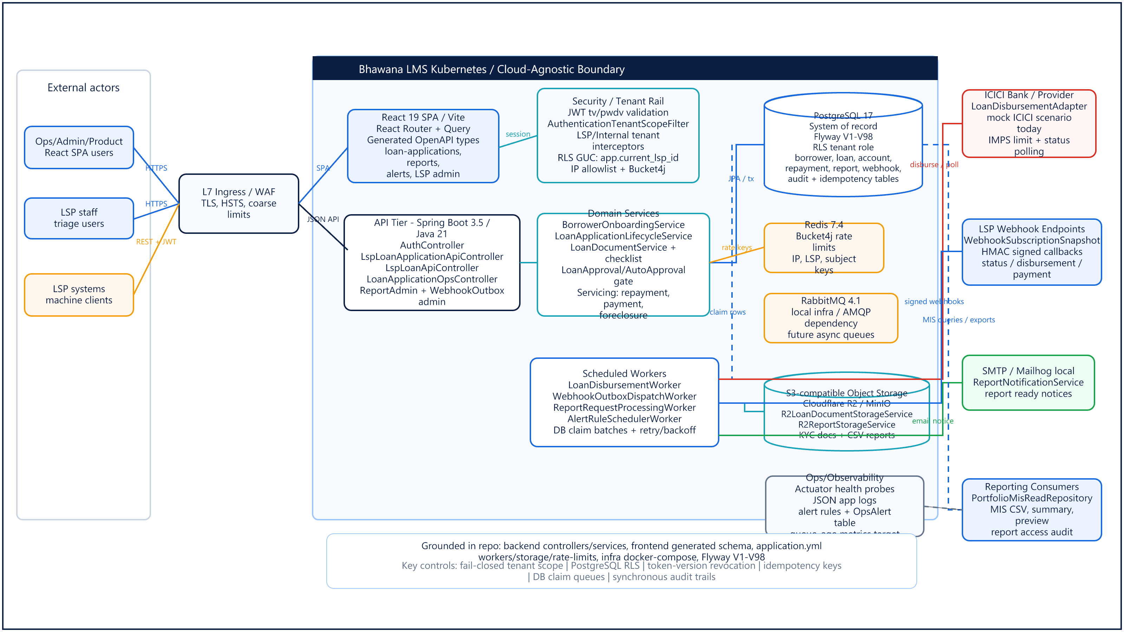

Slide 4
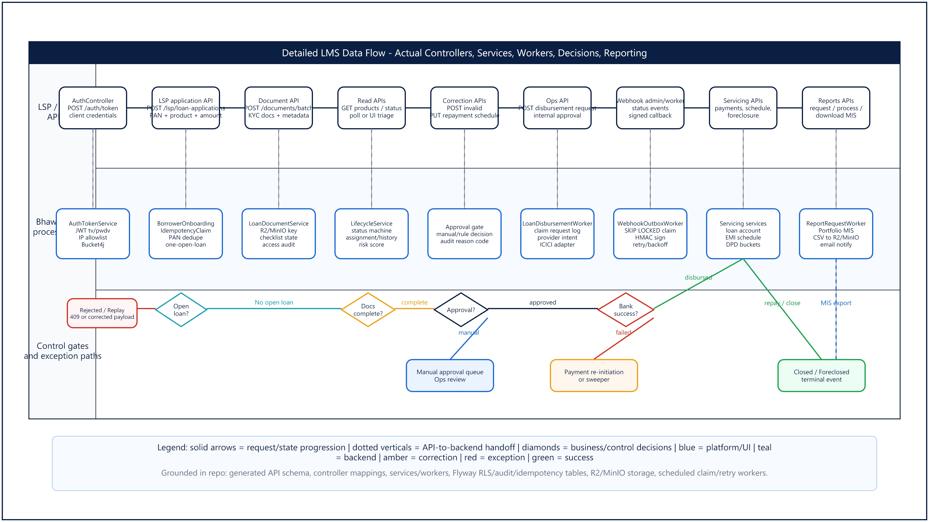

Slide 5
Technology Stack
Mainstream, hireable technologies with cloud-agnostic interfaces
Backend
Java 21, Spring Boot 3.5, Spring Security, JPA, Flyway
P0
At-scale add-on
OPS
At-scale add-on
Transaction-mode DB pooler. Mandatory because database connections bind before CPU.
Prometheus, Grafana, structured logs, and alert fan-out for production operations.
Frontend
React 19, Vite, TypeScript, Tailwind, shadcn/Radix, Recharts
Data
PostgreSQL, Row-Level Security, Redis, S3-compatible storage
DB
At-scale add-on
SEC
At-scale add-on
Integrations
REST + JWT, OpenAPI generated types, HMAC webhooks, SMTP, bank adapter
Partitioning and retention for audit, idempotency, webhook, and payment growth.
Image scanning, upload AV, and dependency/SAST checks in the pipeline.
Testing and CI
JUnit, Testcontainers, ArchUnit, Vitest, Playwright, GitHub Actions
Design principle: the app depends on portable protocols: Kubernetes, PostgreSQL, Redis, S3 API, SMTP, Prometheus, and 12-factor configuration.
Bhawana LMS executive platform overview
05

Slide 6
Deployment Procedure
Controlled promotion from local development to production ramp
1
DEV
2
TEST / UAT
3
STAGING
4
PRODUCTION
Local full stack
Fast engineer feedback
Ops and partner validation
Business acceptance
Prod-shaped topology
Load and noisy-neighbor tests
Multi-AZ, autoscaled
Controlled volume ramp
Gate 1
Gate 2
Gate 3
Gate 4
Green CI: tests, lint, typecheck, build
UAT sign-off with at least one LSP flow
Performance matrix and staging validation
P0 hardening cleared before live volume
Database migrations run as a pre-deploy Flyway job using expand -> migrate -> contract so rolling deploys remain compatible.
Bhawana LMS executive platform overview
06

Slide 7
CI/CD Pipeline and Release Controls
Every production change should be tested, traceable, reversible, and observable
1
PR
2
CI
3
Build
4
Staging
5
Approval
6
Prod
Peer review
Tests, lint, contract, scans
Container image
Deploy and validate
DevOps + risk gate
Rolling deploy or flag flip
GOV
Controls
RB
Rollback
SEC
Security checks
Architecture or API contract change -> ADR and sign-off. Behavior changes ship behind feature flags by default.
Flag flip for behavior. Previous image for bad builds. Expand/contract schema keeps prior app compatible.
Target state includes dependency scans, SAST, container scanning, signed images, and upload AV.
Bhawana LMS executive platform overview
07

Slide 8
Operating Model and Ownership
Clear accountability across build, test, support, infrastructure, governance, and security
1
Development
2
Testing
3
Support
App / Platform Engineering
Backend, frontend, domain rules, OpenAPI contracts, migrations
Engineering + Ops UAT
Unit, integration, e2e, partner validation, release acceptance
Ops / Support
Loan lifecycle tickets, LSP onboarding, alert triage, partner queries
4
Infrastructure
5
Governance
6
Security
DevOps / SRE
Kubernetes, Helm, DB pooler, backups, scaling, DR
Architecture + DevOps
ADRs, change control, release approvals, roadmap gates
Security / Compliance
Secrets, RBAC policy, audit, data residency, incident response
Access principle
Open operating item
Least privilege by default; elevated production access is time-boxed and audited.
Formal RACI and worker-tier on-call ownership need closure before ramp.
Bhawana LMS executive platform overview
08

Slide 9
Security Model: Permissions and Tenant Isolation
Fail closed, prove tenant scope, then allow access
1
Authenticated principal
JWT for users and API clients; token versions enable instant revocation
OK
Strong control
2
Role and permission check
SYSTEM_ADMIN, OPS_USER, PRODUCT_ADMIN, LSP_UI_READ/WRITE, LSP_API_CLIENT
Tenant data isolation is designed around RLS and fail-closed scoping.
3
Tenant scope
LSP users and machines see only their tenant; internal roles can see all LSPs
FIX
Open gaps
4
Database enforcement
PostgreSQL RLS, tenant DB role, and fail-closed routing
Bank PII masking, API-client lockout, CORS config, and upload AV.
5
Operational guardrails
IP allowlists, rate limits, audit events, and correlation IDs
Bhawana LMS executive platform overview
09

Slide 10
Security Model: Environments, Secrets, and Pipeline
Production is separated by network, credentials, approvals, and audit trail
1
Dev
2
Test / UAT
3
Staging
4
Production
Local data, local services, no production credentials
Synthetic or approved test data, partner validation
Prod-shaped, small scale, load tests, no live borrowers
Private networks, managed secrets, audited access only
KEY
Secrets and config
NET
Network controls
CI
Pipeline security
12-factor env injection from provider secret store. No secrets in images. Startup blocks placeholder secrets outside local/test.
TLS at the edge. Database, Redis, and storage remain private. WAF and coarse edge rate limits add defense in depth.
Target state: scan dependencies, source, containers, and partner uploads. Sign images and use private registries.
Bhawana LMS executive platform overview
10

Slide 11
Roadmap Timeline: Gated Path to Production
Relative timing is shown because source docs do not commit calendar dates
Bank go-live condition
Production ramp condition
Real ICICI starts only after P0 money-path controls and contract tests.
Ramp after staging performance passes and readiness reaches target >=85%.
1
2
3
4
5
Now
Month 0-2
Month 2-4
Month 4-6
Gate
Functionally complete
Auth, tenancy, products, lifecycle, servicing, webhooks, MIS, audit
P0 production blockers
DB pooler, money-path safety, payment correctness, worker split, observability
P1 scale readiness
Reporting stream, audit retention, partitioning, webhooks, security gaps
P2 operating maturity
Runbooks, dashboards, staging test bed, automation, cleanup
Bank + production ramp
ICICI integration, perf matrix, target readiness >=85%
Bhawana LMS executive platform overview
11

Slide 12
Key Future Challenges and Mitigations
The main risks are known, bounded, and roadmap-backed
TECH
Technology
OPS
Operations
SCALE
Scalability
BIZ
Business
Database connections bind first. Monolith maintainability and real-bank integration require disciplined boundaries.
Worker on-call, alert delivery, runbooks, DR drills, and incident response need formal ownership.
Audit, idempotency, webhook, payment, and reporting tables will grow fast at 100K loans/day.
API-only origination shifts partner errors into support. Compliance and data residency must stay ahead of growth.
Mitigation themes
Pooler + worker split | P0
Metrics + alert fan-out | P0/P1
Partitioning + retention | P1
Partner sandbox + clear contracts | P1
PII masking + audit controls | P0/P1
Bhawana LMS executive platform overview
12

Slide 13
Recommendation and Executive Ask
A small set of decisions unlocks a controlled production path
1
1. Endorse the P0 gate
2
2. Confirm production constraints
3
3. Authorize bank track
Do not onboard live volume until money-path safety, pool sizing, worker split, dashboard snapshots, and observability are complete.
Choose target cloud/region with India data residency. Confirm RPO/RTO so infrastructure and DR drills are testable.
Start real ICICI integration only behind P0 safety controls and contract/reconciliation testing.
Next 90 days
Close production blockers, stand up staging validation, define RACI/on-call, complete security quick wins, then run the performance matrix for go/no-go.
Outcome: a portable, auditable, multi-tenant lending platform ready to ramp partners with controlled risk.
Bhawana LMS executive platform overview
13

Slide 14
Appendix: Source-Backed Assumptions
Reference facts behind the executive narrative
Target volume
Reporting
~100K loans/day, ~1M+/month, 10+ LSP tenants
Portfolio MIS is async: request, queue, generate CSV, store, notify
Architecture
Readiness
Spring Boot modular monolith + React SPA; PostgreSQL with RLS; Redis; S3-compatible storage
About 32% high-volume readiness; validation target >=85% before ramp
Integrations
Security posture
Outbound HMAC webhooks, SMTP, bank adapter; ICICI is the target real-bank integration
Strong tenant-isolation foundation; open gaps include PII masking, API-client lockout, upload AV, CORS externalization
Primary sources: graphify-out/GRAPH_REPORT.md; architecture package; deployment strategy; LMS blueprint; implementation roadmap; security audit; backend/frontend build files; CI and infra configs.
Bhawana LMS executive platform overview
14

