Slide 1
Exploratory Data Analytics for Absenteeism at work
Subject : Applied data Analytics
Student name : Siddhi Kate
Student number : 2982006

Slide 2

Factors affecting
Sickness
Family
Age
Transportation
Season etc.

Slide 3
Reason for Analytics
Analytics can help to identify the major causes for absenteeism at work.
Organizations can study past patterns and predict what might be the rate of attendance in future.
This can help the organization to develop measures to minimize the value, such as identifying sickness cause that affects a large group, providing direct transfers to people living far off, reducing the work load by increasing the work force etc.

Slide 4
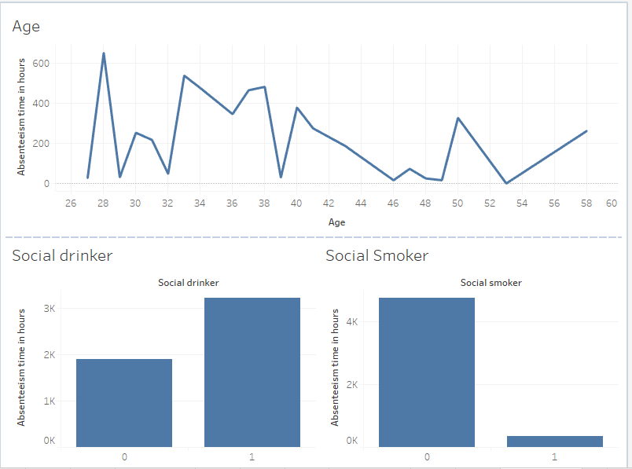
Social life/ absenteeism at work
Young people and social drinkers tend to miss work more.

Slide 5
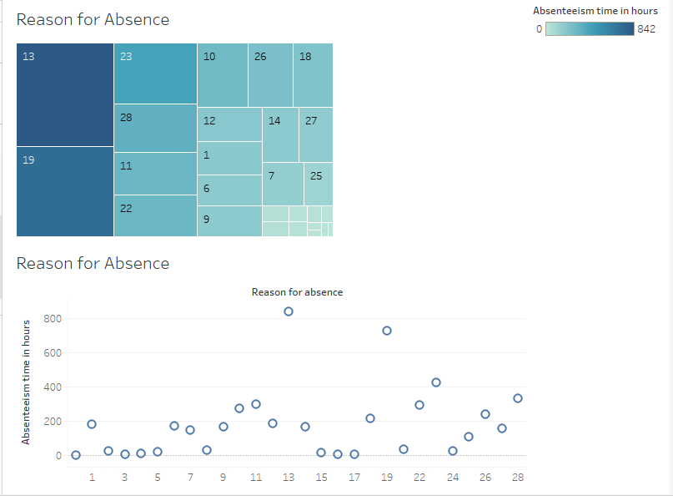
Sickness / absenteeism at work
People that are infected by communicable diseases, food poisoning miss work more.

Slide 6
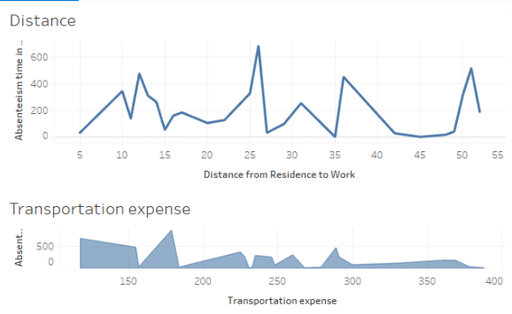
Transportation / Absenteeism at work
A similar trend in graph shows that they affect the absenteeism in a similar manner.

Slide 7
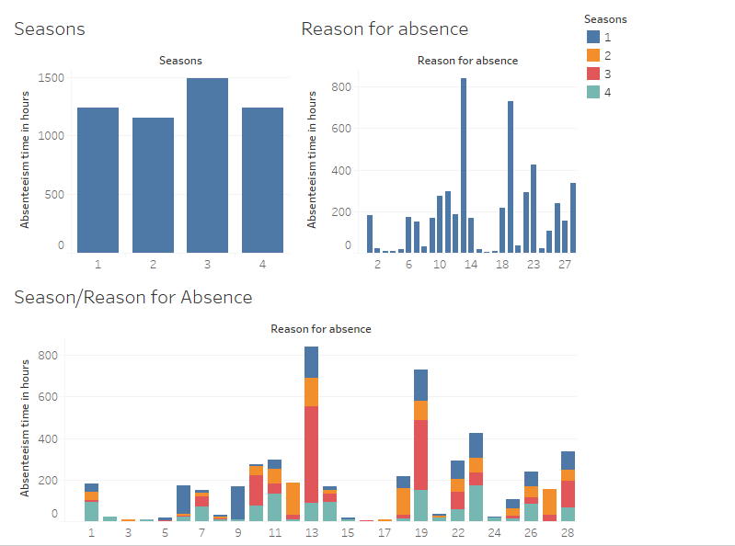
Season/ Absenteeism at work
Winter is the season where more absenteeism at work is seen.

Slide 8
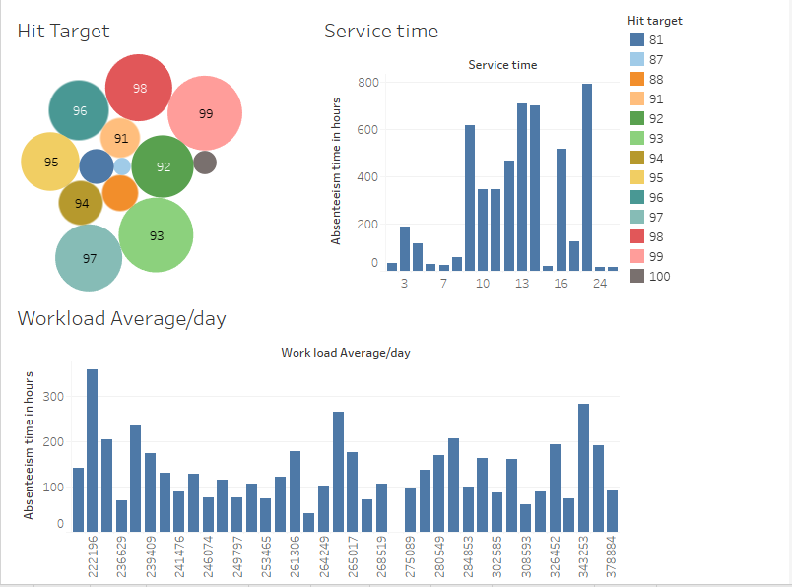
Work performance/ absenteeism at work
An unusual trend in the graph is seen . Absenteeism is highest for least work pressure .

Slide 9
Actionable intelligence
Sickness being one of the major cause, employers should pay attention to the physical fitness of the employees
If any medical condition is recurring, the root cause should be found out and it should be minimized.
Commute to work should be provided to people who live far off.
Leaves should be granted after 4-5 days of continuous work.
Reducing the work pressure by increasing work force can improve the situation and minimize absenteeism.

Slide 10
Thank you!

