Slide 1
GitHub Repository - Team 2
Submitted by:
Devanshi Trivedi (013530530)
Keerthi Akella (013858819)
Nithin Gollanapally (013820599)
Thinh Manh(012050571)
Rajesh Thummala (013829179)
Siddarth Varanasi (013854295)

Slide 2
Project Introduction
Our application is a code hosting platform for version control and collaboration
When programmer wants to add code or revert to a change he made. Commit comes in
Programmer can also follow each other and can be inspired by other’s work

Slide 3
Technologies
Database engine: MySQL
Programming Language: Java
DB access technology: JDBC 6.0
Log Files : Log4j

Slide 4
Functionalities
General User
Sign up and Login
Create and View Repository
Create and View Branches
Create and View Project Files
Select a branch
Commit
Pull Request
Follow a user
View followers and following

Slide 5
Functionalities…
2) Admin
Delete a user
Delete a repository
Rename repository
Rename branch

Slide 6
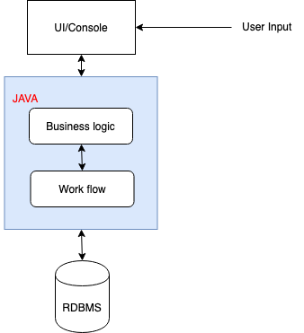
Architecture Diagram

Slide 7
Objects
Actors/ Roles
User
Admin
Users
Repositories
Project Files
Branches
Pull Request
Commits

Slide 8
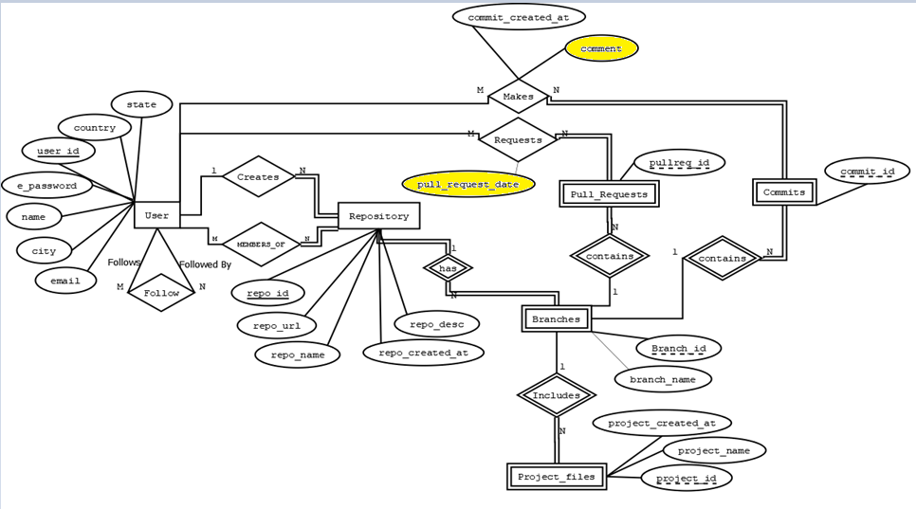
ER Diagram

Slide 9
Schema Diagram
All the tables are in 3rd normal form

Slide 10
Additional Features :
Transactions
Implemented transactions in all the functionalities which involves DML operations
Password Encryption
Encrypted user input password using MD5 Algorithm
Log File
Implemented log4j feature using Apache log which can log all the operations

Slide 11
Questions ?

Slide 12
Thank You

