Slide 1


RoadMap Based Robot Motion Planning
SURGE 2014
By,
Siddhant Manocha(12714),
Department of Computer Sci. and Eng.
Indian Institute of Technology,Kanpur.
Mentor:
Dr.Amitabha Mukerjee
Department of Computer Sci. and Eng.
Indian Institute of Technology,Kanpur.

Slide 2
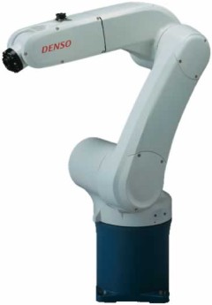
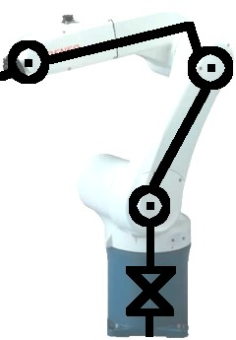
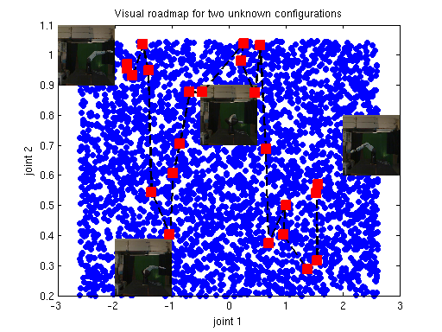
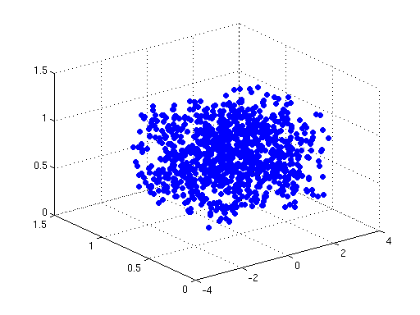

Introduction
Joint parameterisation
Image
Processing
Joint
Parameters
Learn
Mapping
Visual RoadMap
Test
image
Lower dimensional
representation
Inferred image

Slide 3
Gaussian Processes
GPs are distributions over functions – a set of random variables indexed by a continuous function f (x).
Inputs X={x₁x₂,x₃……………} with corresponding function values
f={f₁,f₂,f₃ ………….}.
Gaussian Process on functions
- Any set of function variables has joint Gaussian distribution
- Covariance matrix comes from covariance function or Kernel
-Covariance function determines the correlation between different points from the GP

Slide 4
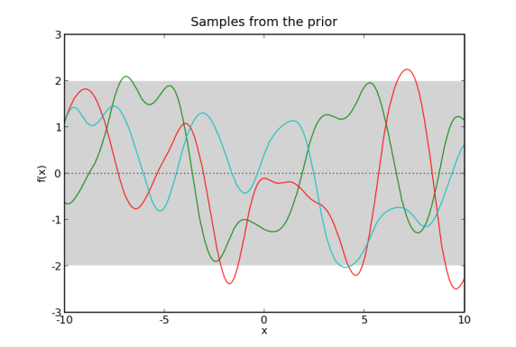
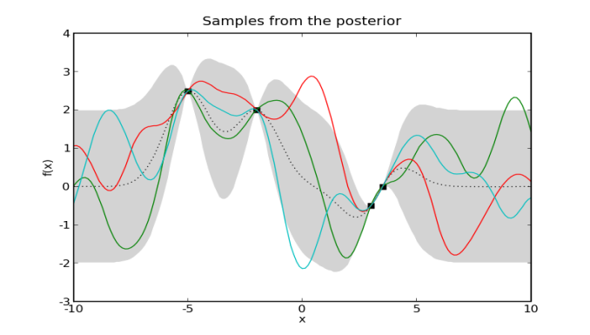
Gaussian Process Regression
Assume functional relation between observation spaces,corrupted by noise(Gaussian distributed).
Define joint distribution over the inferred observation space.For any new point x* ,corresponding y* can be obtained by maximizing the posterior distribution derived from the joint distribution.
Joint distribution
Posterior distribution
a)Prior distribution
b)Posterior distribution

Slide 5
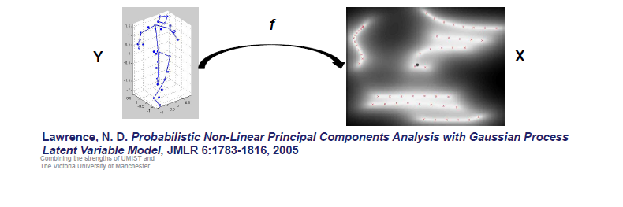
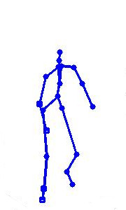
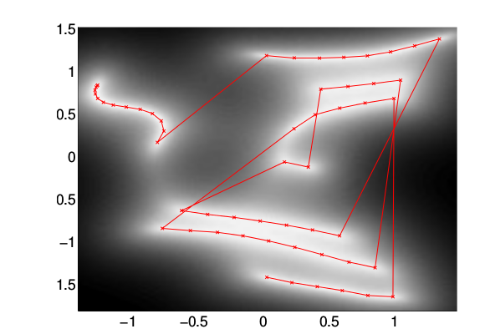
Gaussian Process Latent Variable Model
Assume the observed data Y is related to the latent data X by a mapping f corrupted by noise
A Gaussian Process prior is placed on f
Optimise likelihood w.r.t. X using Scaled Conjugate Gradient method

Slide 6
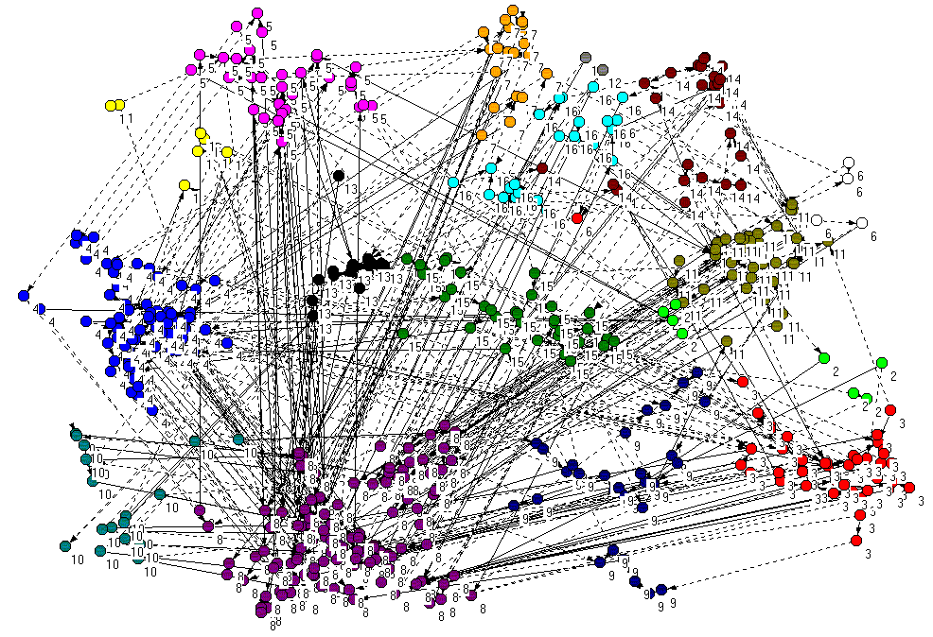
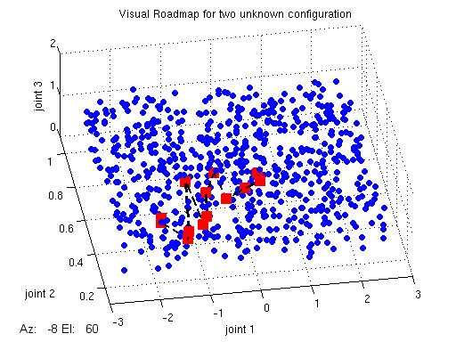
Visual RoadMap
Proximity graph is constructed assuming all possible transitions in known configuration space.
Similarity matrix for proximity graph is evaluated on basis of distance measure by using K-means clustering.
Nearest neighbor for unknown configuration is found in known configuration space.
A shortest path through known configuration space is reported by applying Dijakstra’s algorithm on proximity graph.
Proximity graph
(built using K-means clustering)
Visual Roadmap built
from proximity graph

Slide 7
Workflow
Random Projection
Helps to reduce high dimensional image to lower dimension while preserving inter point distance
GPLVM
Initialized using LLE(Locally Linear embedding)
Optimized using SCG(Scaled Conjugate Gradient)
GP Regression
Find a mapping Image space(Y )to joint angle space (Θ)
K Means
Cluster n points into K clusters so that points within same cluster are closely placed
Visual Path Planning
Generate a path between two given configurations through known configuration space via Dijakstra’s algorithm.

Slide 8
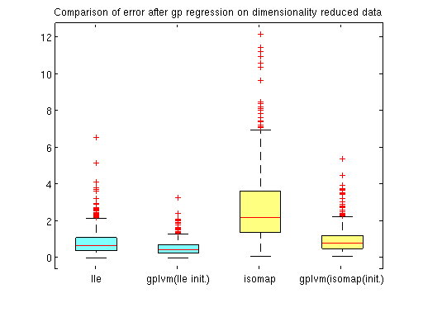
Results
Gaussian Process regression is applied on random projected data followed by dimensionality reduction using GPLVM,Isomap and LLE.
GPLVM is generative dimensionality reduction method , requires initialization of latent space using other methods(GPLVM,Isomap).
Statistical analysis of deviation from the ground truth is done for various techniques used.
Technique | Avg. error | Min error | Max error | Std. Dev.
LLE | 0.855 | 0.030 | 6.507 | 0.66
GPLVM (LLE init) | 0.558 | 0.013 | 3.247 | 0.38
Isomap | 2.713 | 0.081 | 12.10 | 1.85
GPLVM (isomap init.) | 0.968 | 0.084 | 5.378 | 0.66
Comparison of error among dimensionality reduction techniques

Slide 9
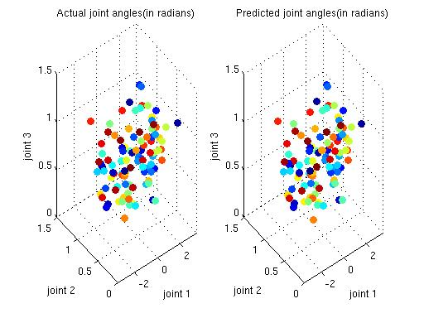
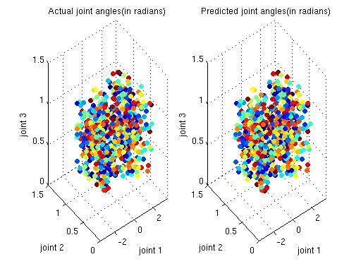
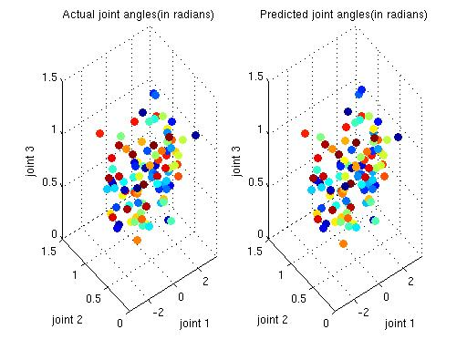
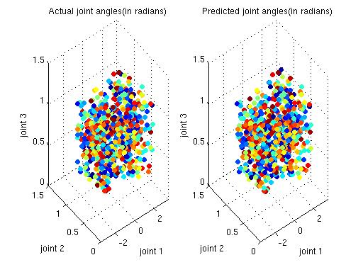
Results
a)
b)
Comparison of GPLVM results with ground truth a)100 points b)675 points
a)
b)
Comparison of LLE results with ground truth a)100 points b)675 points

Slide 10
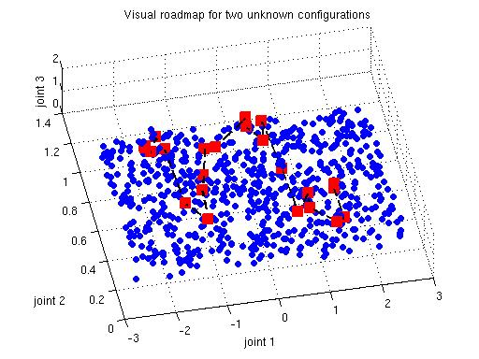
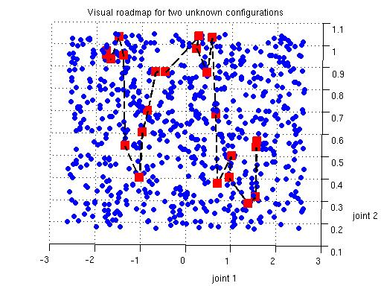
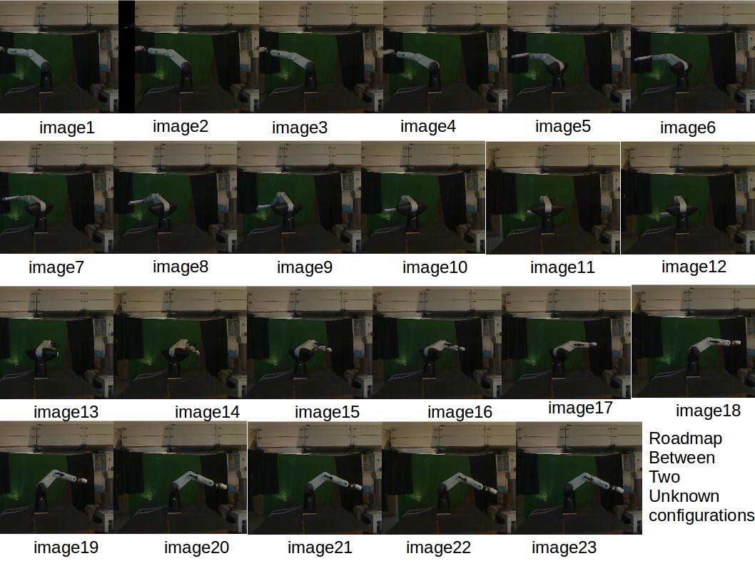
Results
a)
b)
Visual Roadmap between two unknown configurations a)3D b) 2D
Image transitions over the roadmap

Slide 11
Conclusion
Statistical analysis shows that GP Regression coupled with GPLVM (lle init.) gives superior results to other dimensionality reduction techniques which are favorably close to ground truth.
Gaussian Methods are sensitive to parameters as no. of optimization iterations , no. of nearest neighbor in lle, and hence the result must be validated.
Future Work
In future , we will like to reconstruct the manifold to extend it to generate an obstacle free path.
Implement shared manifold models for direct multivalued regression.
Dynamical shared manifold models can be used to consider usefulness of sequential data to improve manifold structure.
To use unlabelled image data along with labeled data to improve upon the manifold structure for sparse datasets.

Slide 12
Acknowledgement
I take this opportunity to express my profound gratitude and deep regards to Dr.Amitabha Mukerjee for his exemplary guidance, monitoring and constant encouragement throughout the course of this project.I will also like to thank my project colleague Satvik Gupta for his coordial support in completing the task through various stages. I am highly indebted to Neil Lawrence for his publicly available Gaussian Process Software.
References
Ek, C.H., Torr, P.H.S., Lawrence, N.D.: Gaussian process latent variable models for human pose estimation. In: MLMI'07: Proc. of the 4th International Workshop on Machine Learning for Multimodal Interaction. Volume 4892 of Lecture Notes in Computer Science. (2007)
Rasmussen, C. E. and Williams, K. I., Gaussian Processes for Machine Learning, MIT Press, 2006
Lawrence, N.D.: Probabilistic non-linear principal component analysis with Gaussianprocess latent variable models. Journal of Machine Learning Research 6 (2005)1783-1816
Ramanan Navaratnam, Andrew W. Fitzgibbon , Roberto Cipolla: The Joint Manifold Model for Semi-supervised Multi-valued Regression.ICCV 2007: 1-8

