Slide 1



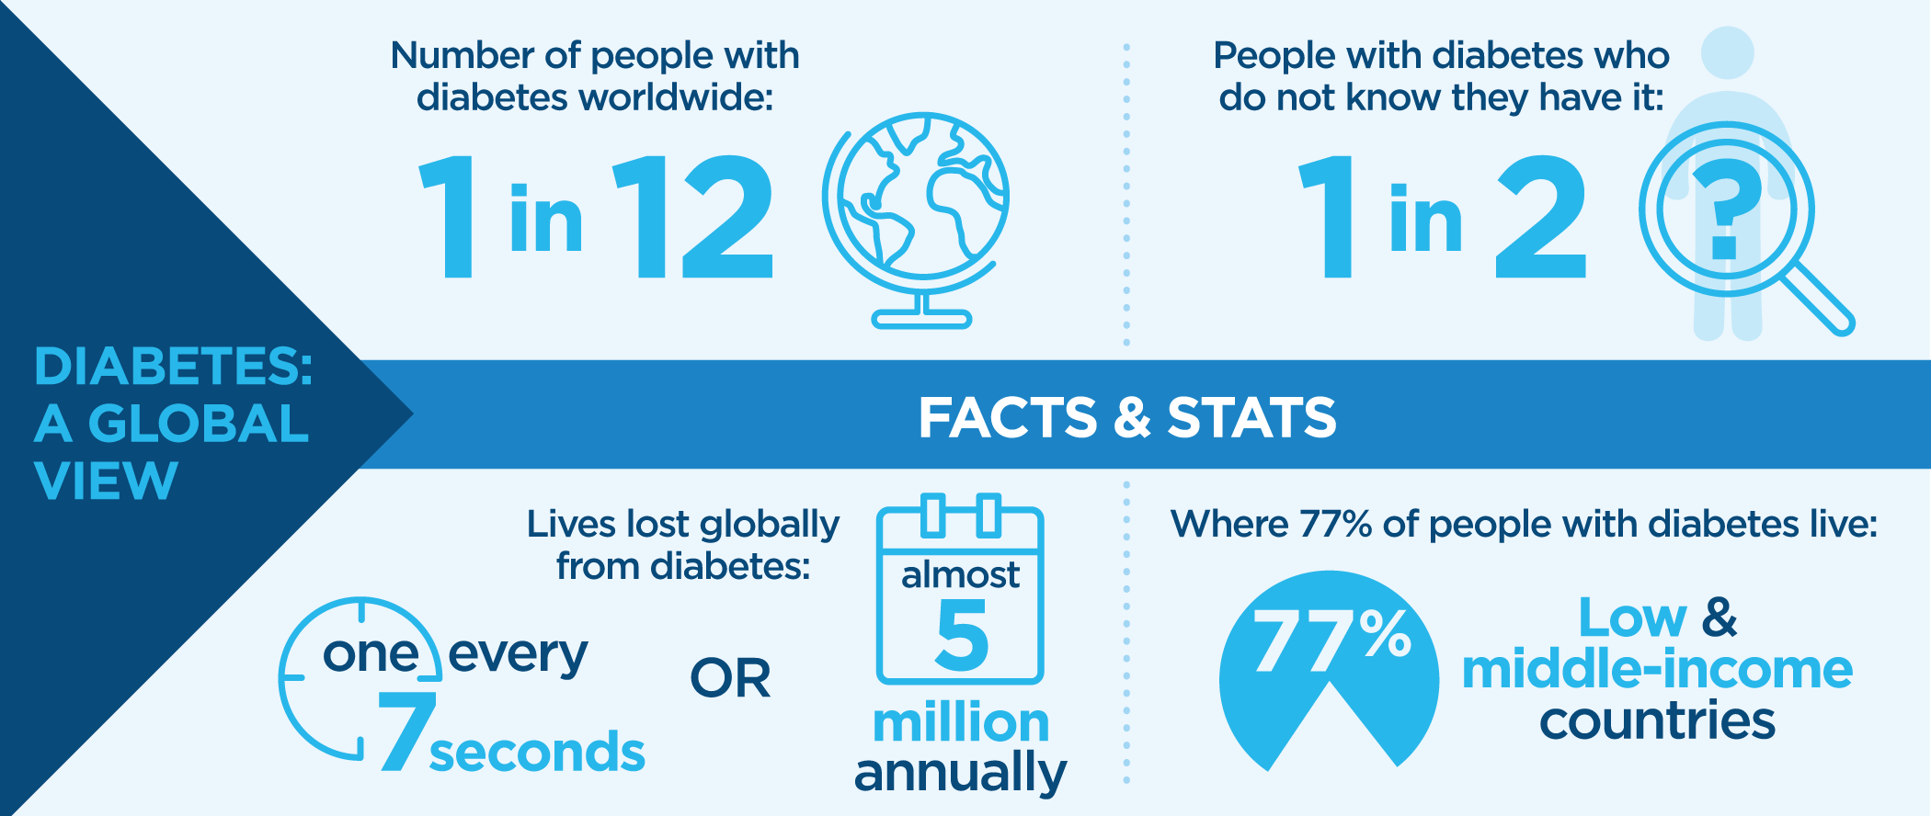
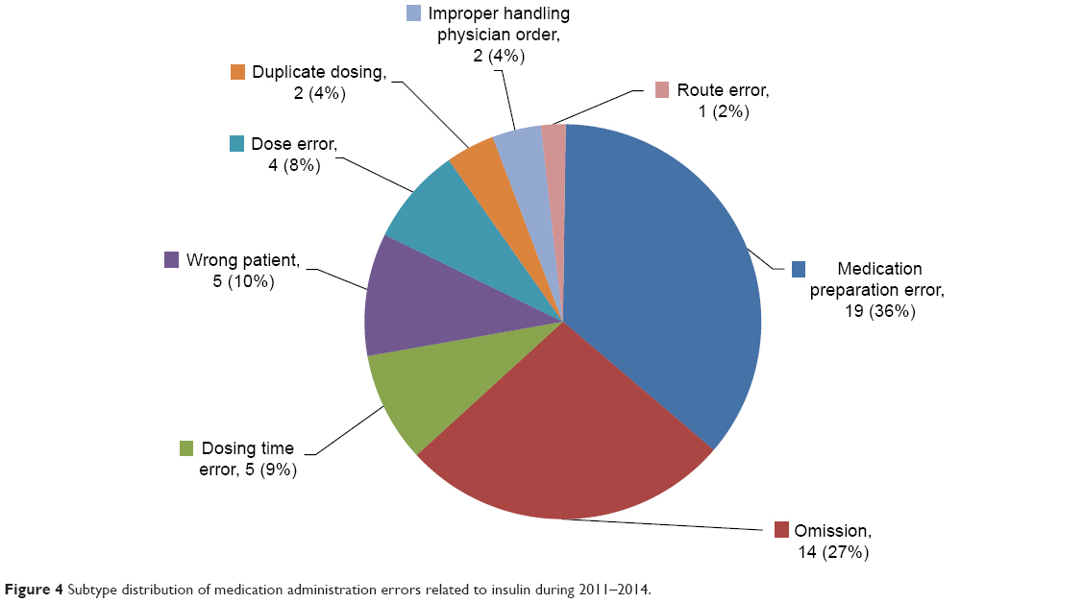
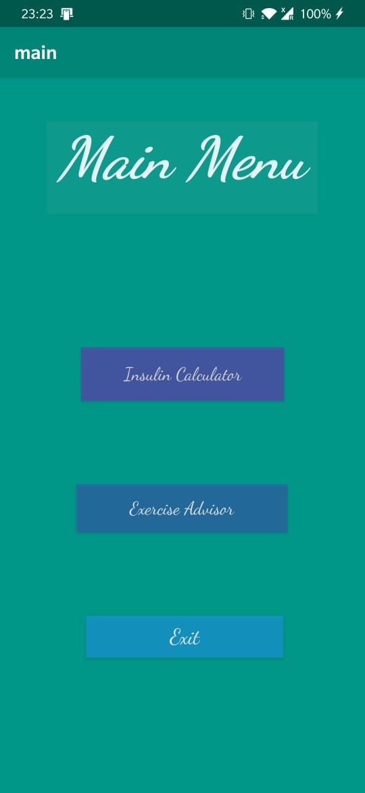
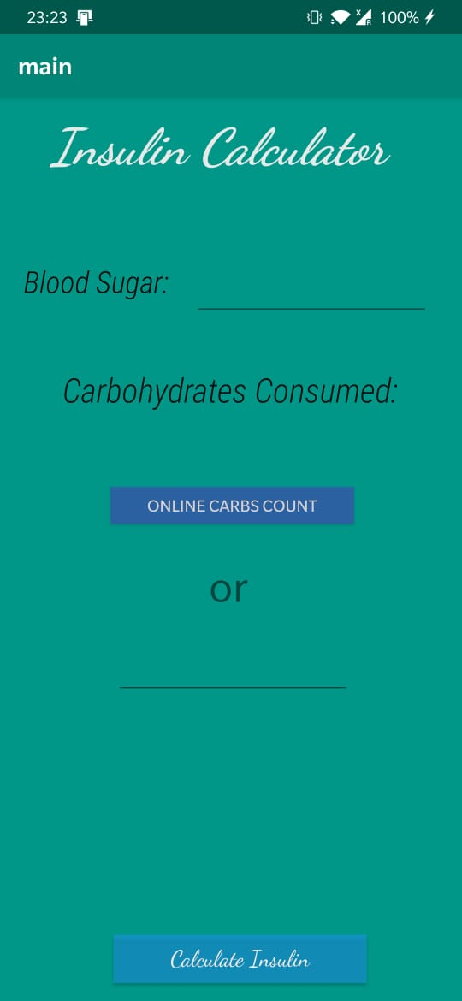
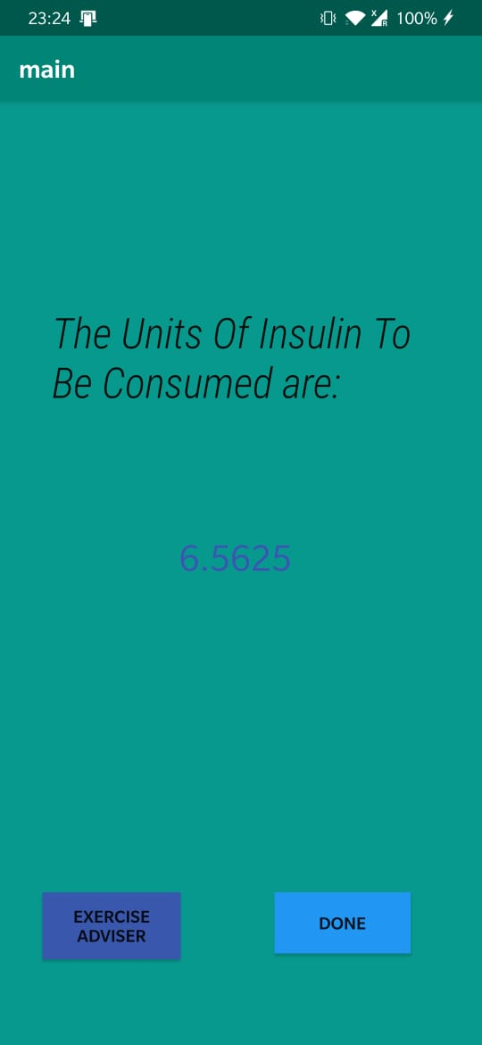
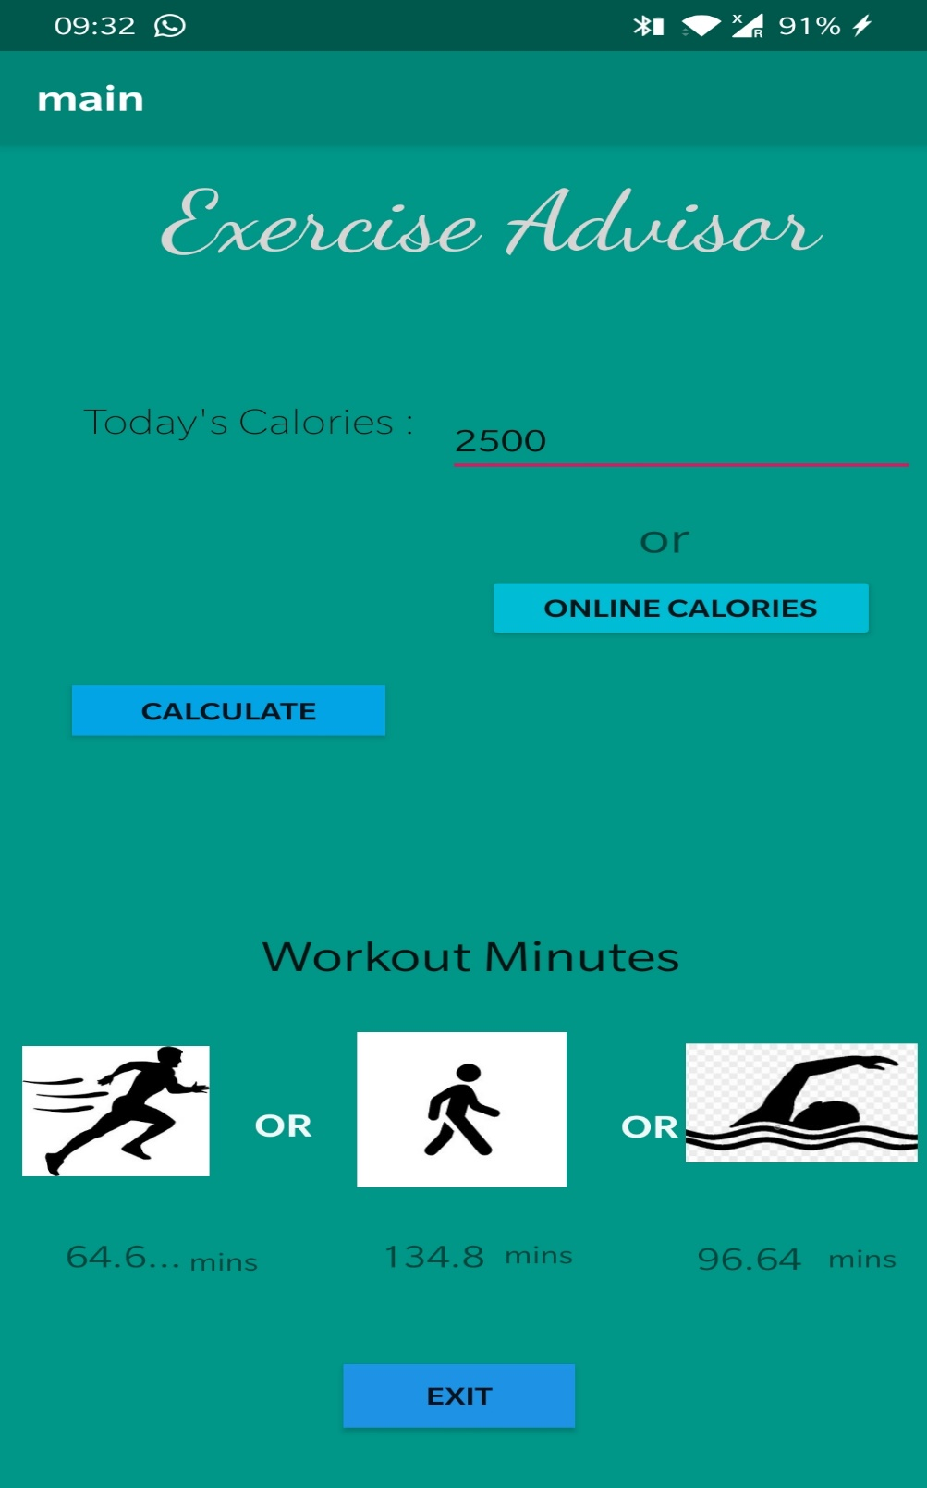
Insuage
First Year Project Poster, Fall 2019, Bennett University, Greater Noida, India
Siddharth Prabhu (E19CSE164), Muskan Garg (E19CSE185), Shaurya Pratap (E19CSE388), Nishank Babu (E19CSE345)
Dept. of Computer Science Engineering, Bennett University, India
Introduction
Techniques Utilized
Juvenile diabetes is insulin dependent and a math equation is required to calculate the insulin dosage. There are rarely any apps serving the purpose.
Problem
The seriousness of Juvenile diabetes can be seen as around 7 lakh people suffer from juvenile diabetes only in top 10 countries. Also as 77% are from developing economies , the poor education level results in generally giving a standardised insulin dosage causing more harm to the body than helping it
Android studio will help the app to be used by the common user and will give us a large user base and java will help us code in Android studio.
Future Work
The app we currently delivered requires to calculate the calories and carbohydrates consumed, also a lot of manual typing has to be done to find the above mentioned data. There is a basic UI setup, but a good deal of knowledge would be required to implement plans of using computer vision and AI to calculate carbohydrates and calories which can be implemented in the coming years, once we acquire the required knowledge and skill.
Conclusion
This app if is made as promised will make the patient’s life easier as currently many common day items don’t have the no of carbs unit written which is important to calculate the insulin usage which leads to omission of insulin intake , dose error and delayed intake of insulin leading to a combined 44% of complications caused due to insulin medication in as seen in the stats below.
Solution
The app we will be creating will just require the user to enter his blood sugar and the food items he would be consuming to find the amount of insulin he would require to consume using an equation
Formula used
Insulin required=
(Blood sugar - 125) / 24) * 0.5)+ Carbohydrates consumed * 0.05
User Interface/Demo Snapshots

