Slide 1
EXPLORATORY PROJECT
Link Prediction In Social Networks
By :
Siddhant kharwar 21075083
Shailendra kori 21075080
Under:
Dr. Bhaskar Biswas

Slide 2
Introduction
→link prediction method is used to find missing links or used to predict the likelihood of future links. →there exists a lot of link prediction techniques like similarity-based indices , probabilistic models etc.

Slide 3
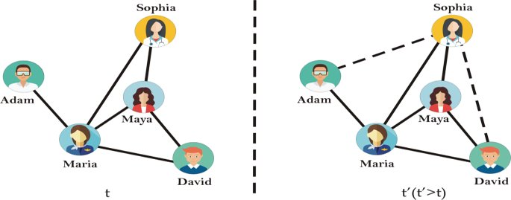
Link Prediction In Dynamic Networks
If given the current state of a network, link prediction focuses on evaluating the probability of the existence of an edge in a future state. This can be understood to represent the likelihood of a future friendship in a social network.

Slide 4
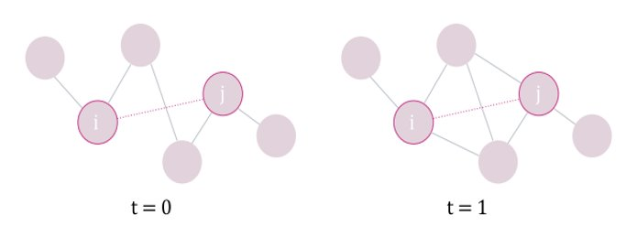
Link Prediction In Static Networks
In the given current state of network some of the links have been deleted, then link prediction is used to determine the existence of these deleted edge over the network that is finding the missing links in the network.

Slide 5
Link Prediction Techniques
Implemented In The Project
Local Similarity Indices
Quasi-local Indices
Using logistic regression

Slide 6
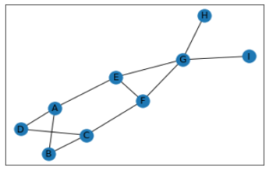
SIMILARITY METRICS
Common Neighbours
The Common Neighbor Metric Is Defined As |N(i) ∩ N(j)|. ​
Common Neighbors Reflect The Belief That A Link Is More Likely To Be Formed When The Nodes Share Links With Other Nodes, Analogous To The Friend-of-a-friend (Fof) Approach Used In Friend Recommendation Systems​

Slide 7
SIMILARITY METRICS
2) shortest path
The shortest path d(i, J) represents the distance of the shortest path from I to J, reflecting the expectation that nodes with low degrees of separation are likely to interact.​
Since the network consists of large number of nodes we cannot apply normal bfs or dfs as it will cost in time, so we need to define a boundary to which we search for minimum distance and if not found the connection till boundary we return an upper bound.​

Slide 8

SIMILARITY METRICS
3) ADAMIC/ADAR INDEX
It captures the notion that neighbors with fewer links are more influential in facilitating future interaction. In other words, the Adamic/Adar index is a variant of the common neighbor metric that gives more weight to neighbors with lower degree.​
​
The Adamic/Adar predictor is defined as follows:

Slide 9

SIMILARITY METRICS
4) JACCARD INDEX
The common neighbors metric scores potential links highly if they share many neighbors, but does not account for the proportion of links shared. ​
In this way, two nodes with many neighbors may score highly even if the relative strength of their relationship is week. ​
The Jaccard Index, otherwise known as Intersection over Union, compensates for this by presenting common linkage as a probability. It is defined as​

Slide 10
SIMILARITY METRICS
5) PREFERENTIAL ATTACHMENT
Defined simply as |N(i)| · |N(j)|​
Preferential Attachment encodes the belief that nodes with many neighbors are more likely to form more in the future, and thus gives higher scores to potential links whose nodes have high degree.​
6) RESOURCE ALLOCATION INDEX
Defined as a fraction of a resource that a node can send to another node through their common neighbours. It performs well with lower time complexity.
It is defined as:

Slide 11
SIMILARITY METRICS
7) COMMUNITY COMMON NEIGHBOURS
Number of common neighbors with bonus for neighbors in same community.
8) COMMUNITY RESOURCE ALLOCATION
Computes the resource allocation index of all node pairs using community information.
It is defined as:

Slide 12
SIMILARITY METRICS
9) SALTON INDEX (SI)
In a vector space, document similarities can be computed using the Salton Index also known as Cosine Similarity. This Similarity index between two records is measured by calculating the cosine of the angle between them.It is defined as:
|Γ (x) ∩ Γ (y)| /(√ (kx.ky) )
10) SORENSEN INDEX
It is defined as:-
2|Γ (x) ∩ Γ (y)|/ (kx + ky)

Slide 13
OTHER SIMILARITY INDICES USED
CAR- based Common Neighbor index
CAR-based Adamic/Adar Index
CAR-based Resource Allocation Index
CAR-based Preferential Attachment Index
HUB Promoted Index (HPI
HUB Depressed Index (HDI)
Local Naive Bayes-based Common Neighbors (LNBCN)
Leicht-Holme-Newman Local Index (LHNL)
Node Clustering Coefficient (CCLP)
Node and Link Clustering Coefficient (NLC)

Slide 14
QUASI LOCAL INDICES
On the basis of performance Quasi local metrics have been introduced as a trade of between local and global approaches.
These metrics are as efficient to compute as local indices and some of these indices extract the entire tropological information of the network.
Examples of such Indices :-
Local Path Index (LP)
Local Random Walk Index
Local Directed Path (LDP)

Slide 15
Logistic regression
First we calculated the several network features for each pair of nodes in a given dataset and creates a new data frame with these features and corresponding label
Calculated networks features are following:
Common Neighbors:
Jaccard Coefficient:
Resource Allocation Index
Adamic/Adar Index:

Slide 16
We define a binary value that indicates whether there is a link between the two nodes.
The resulting data frame can be used to explore the relationships between the different network features and the presence of links between nodes. For example, one could use this data frame to train a machine learning model to predict whether a link exists between two nodes based on their network features.
We used the logistic regression model on the new dataset that we have created and train the model to predict the link between nodes with the helps of level.

Slide 17
The features used for classification are all the columns except the label column then instance of the logistic regression algorithm is created using Logistic Regression(), and the model is trained on the training data using fit().
The model is evaluated on the testing data using the predict() method, and the accuracy of the model is computed using the accuracy_score() function.
The predicted probabilities are filtered using a threshold value, and only pairs with probabilities above this threshold are recommended as potential connections using new_data[predicted_labels >= threshold][['From', 'To']]. Finally, the recommended connections are printed .
Dataset:
Karate.

Slide 18
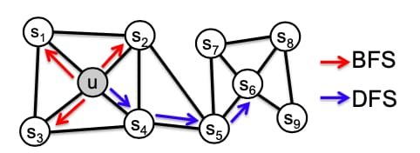
Embedding-Based Link Prediction

Slide 19
→The network embedding is considered as a dimensionality reduction technique in which higher D dimensional nodes (vertices) in the graphs are mapped to a lower d (d ≪ D) dimensional representation (embedding) space by preserving the node neighborhood structures. In other words, find the embedding of nodes to a lower d-dimensions such that similar nodes (in the original network) have similar embedding (in the representation space).

Slide 20
After applying the model localsimilarity and local probablisitic model hierarchical model and quasilocal indices we try from the our side to make aan machine learning model to predict a link between node in the int his part kori will write what he have done in the project this is the very important part of the project
Linked Prediction Using Machine Learning

Slide 21
DATASETS USED
Karate.net (A network of football players).
Karate.csv(Network of karate club members).

Slide 22
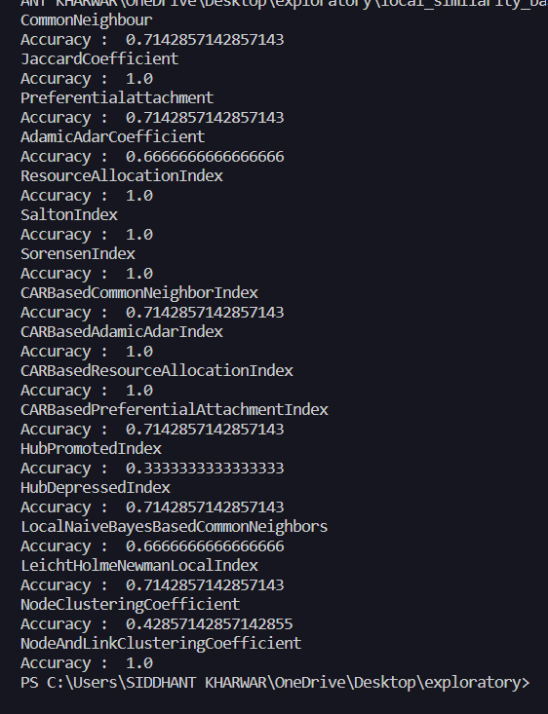
RESULTS
This is the accuracy result of the local similarity based linked prediction model .
This is perform on the karate.net given data set and we apply different model and get the accuracy each of model.
Here we get maximum accuracy 1 in many model like Jaccard coefficient , ResourceAllocationIndex and SaltonIndex etc.
There are many whose accuracy is not 1 but quite better in on the given data .

Slide 23
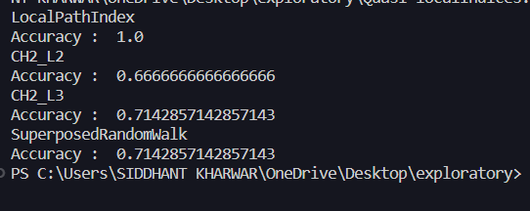
RESULTS
This is the result of the quasi-localIndex based link prediction .
Here we use three model LocalPathIndex , CH2_L2 , CH2_L3 and superposedRandomwalk.
Here we use the karate.net data set .
By calculating the accuracy of all the model we get to know the accuracy of the LocalPathIndex is 1.which is maximum in all these three.

Slide 24

Result
This is the result of the link prediction using the logistic regression on the data set karate.csv

Slide 25
THANK YOU

