Slide 1

Real-Time/Field-Based Project Internal1 Presentation On HARVEST HUB: Providing Market Mobilities Through A Mobile Application
22R21A6608-CHUNDI SAI LOUKHYA
22R21A6611-GADI SAI SIDDHARTH NAIDU
22R21A6623-K RAGHAVENDRA
22R21A6633-K VISHAL SAI
Under the Guidance of
Mr. J VIJAY GOPAL
Associate Professor
Department of Computer Science & Engineering-Artificial Intelligence and Machine Learning
13/04/2024

Slide 2
Contents
Abstract
Introduction
Literature Survey
Existing System
Proposed System
Objectives(3 or 4)
Architecture
Modules
UML Diagrams(Minimum 4 Diagrams)
Implementations
Result and Discussion
Conclusion and Future Enhancement
References

Slide 3
ABSTRACT
An application designed to furnish market information that equips farmers with valuable data
crucial for decision-making. By offering real-time updates on prices, demand projections, and
market trends, farmers gain insight into optimal selling opportunities. With current price data
at their fingertips, farmers can negotiate fair deals, maximizing profits while ensuring
competitiveness. Considering the possibility of having an extension into organic farming in the
mere future. Additionally, understanding market trends enables farmers to adapt strategies,
aligning their offerings with evolving consumer preferences.

Slide 4
INTRODUCTION
Introducing HarvestHub, a cutting-edge solution tailored to empower farmers with vital market insights essential for informed decision-making. In the dynamic landscape of agriculture, having access to accurate and up-to-date market information can be the difference between success and struggle. Our application bridges this gap by providing farmers with a comprehensive platform where they can access real-time data on market trends, pricing dynamics, demand forecasts, and more. By harnessing the power of technology, we aim to arm farmers with the knowledge they need to optimize their operations, maximize profits, and navigate the complexities of the market with confidence. With HarvestHub, farmers can make strategic decisions backed by data, ultimately driving sustainable growth and prosperity in the agricultural sector.

Slide 5
LITERATURE SURVEY
"Utilizing Market Trends Analysis for Strategic Farm Management“
Author(s): Brown, K., White, L.
Published in: Journal of Business Analytics
Summary: Explored the role of market trends analysis in helping farmers adapt their strategies and offerings to meet evolving consumer preferences. Emphasized the need for timely and accurate market information for sustainable farm management.
"Extension into Organic Farming: Opportunities and Challenges“
Author(s): Chen, R., Lee, S.
Published in: International Journal of Sustainable Agriculture
Summary: Discussed the potential extension of conventional farming practices into organic farming and the implications for market information systems. Examined the opportunities and challenges faced by farmers in transitioning to organic agriculture and the role of market data in facilitating this transition.

Slide 6
EXISTING SYSTEM :
Agricultural Market Information System (AMIS):
AMIS is a global agricultural market information system that provides timely, accurate, and reliable market information and policy analysis. It offers data on production, supply, demand, trade, and prices of major agricultural commodities.
MISRI (Market Information System for Rice):
MISRI is an online platform developed by the International Rice Research Institute (IRRI) that provides real-time market information for rice farmers. It includes data on prices, market trends, weather forecasts, and agricultural inputs.
mKRISHI®:
Developed by Tata Consultancy Services (TCS), mKRISHI® is a mobile-based agricultural advisory service that provides farmers with personalized information on crop management, market prices, weather forecasts, and best practices.

Slide 7
PROPOSED SYSTEM
Market Prices:
The application will provide real-time updates on market prices for various agricultural commodities. Farmers can easily access information on the current prices in local markets as well as regional and national markets.
Demand Forecast:
AgriMarket Insights will analyze historical data and market trends to provide farmers with demand forecasts for different crops and livestock. This information will help farmers plan their production accordingly to meet market demand.
Weather Updates:
Weather plays a significant role in agriculture. The app will provide weather forecasts tailored to the farmer's location, helping them make decisions related to planting, harvesting, and crop management.
Crop Advisory:
AgriMarket Insights will offer crop advisory services, providing recommendations on crop selection, planting techniques, pest and disease management, and best agricultural practices based on local conditions and market demand.
.

Slide 8
OBJECTIVES
Access to Real-Time Market Data:
Provide farmers with access to real-time market information including prices, demand trends, and supply dynamics for various agricultural commodities.
Price Transparency:
Ensure transparency in pricing by offering accurate and up-to-date market prices for agricultural products, enabling farmers to make informed decisions about selling their produce.
Market Analysis:
Offer analysis tools to help farmers understand market trends, forecasts, and potential fluctuations, enabling them to anticipate market movements and make proactive decisions.
Customized Recommendations:
Provide personalized recommendations based on farmers' specific crops, geographic location, and market preferences to optimize their selling strategies.
Market Alerts:
Send timely alerts and notifications to farmers about significant market developments, such as price changes, weather impacts, or demand shifts, empowering them to respond swiftly.

Slide 9
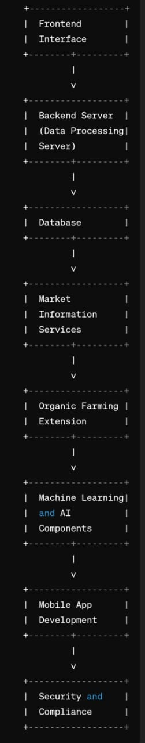
ARCHITECTURE
Frontend Interface:
User-friendly interface accessible via mobile devices or web browsers.
Backend Server:
Real-time data integration from various sources such as market APIs, government databases, and user-generated content.
Database:
Storage for user profiles, preferences, and historical market data.
Market Information Services:
APIs or data feeds to fetch real-time market prices, demand forecasts, and trends.
Organic Farming Extension:
Modular architecture to easily incorporate new features and data sources.
Machine Learning and AI Components:
Predictive models for forecasting market trends and demand patterns.
Mobile App Development:
Cross-platform compatibility for iOS and Android devices.
Security and Compliance:
Encryption protocols to safeguard sensitive user information and transactions.

Slide 10
Modules
Real-time Data Integration: The app provides real-time updates on weather forecasts, market prices, and pest/disease alerts to ensure farmers have up-to-date information for prompt decision-making.
Personalization and Customization: The system offers personalized recommendations and tailored alerts based on specific crop types, geographic locations, and individual farm conditions, ensuring relevant and actionable advice for each user.
Mobile Accessibility: Designed for mobile devices, the app features an intuitive interface that is easy to navigate, ensuring accessibility in rural areas with varying network connectivity and supporting offline access.
Feedback Mechanism: Incorporates a feedback loop allowing farmers to provide input on the app's functionality and usefulness, enabling continuous improvement and enhancement of user satisfaction.
Comprehensive Market Insights: The app includes a market information dashboard, trend analysis, and sales negotiation tools, helping farmers understand market trends, consumer preferences, and optimize their selling strategies to maximize profits.

Slide 11
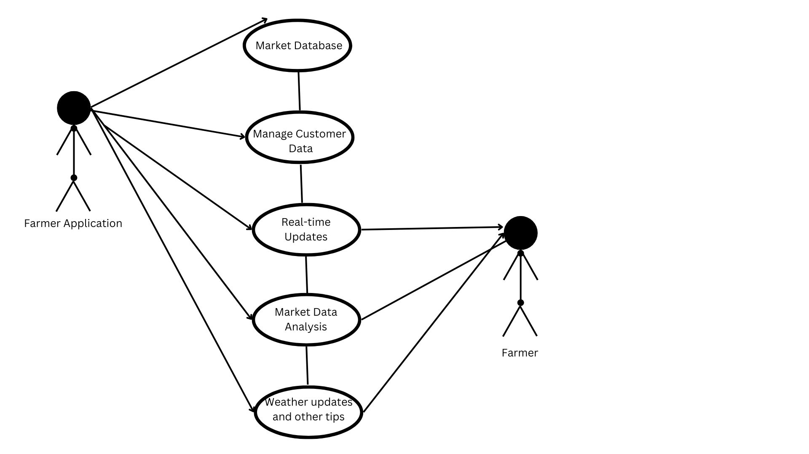
UML DIAGRAMS
Use Case Diagram

Slide 12
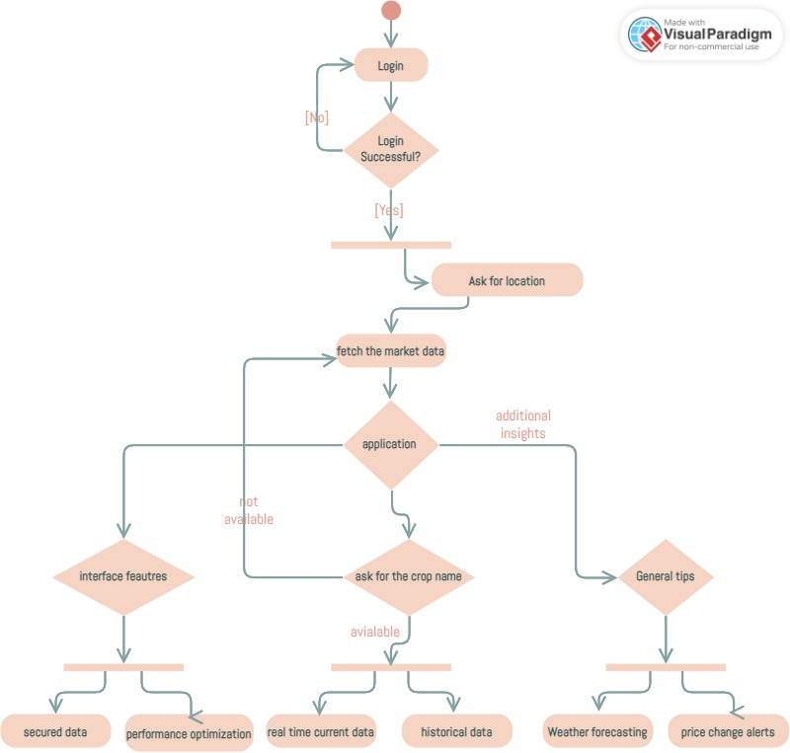
UML DIAGRAMS
Activity Diagram

Slide 13
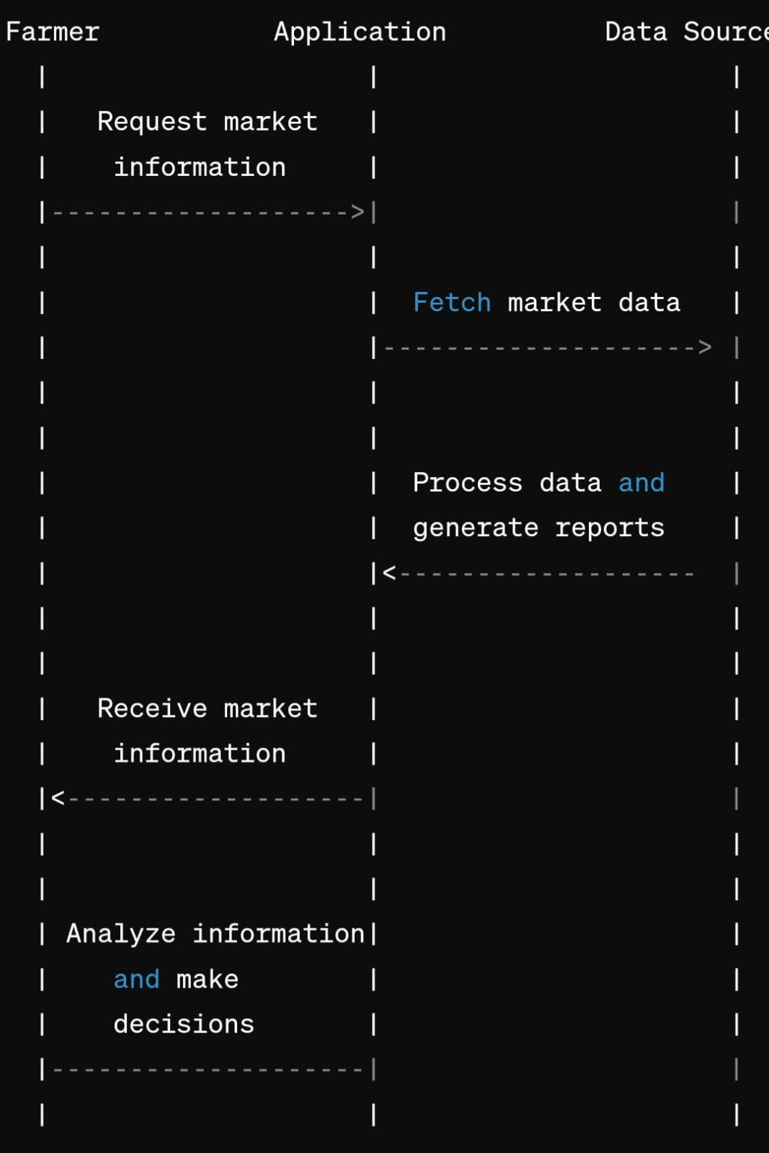
UML DIAGRAMS
Sequence Diagram

Slide 14
Implementations
import 'package:flutter/material.dart';
void main() {
runApp(MyApp());
}
class MyApp extends StatelessWidget {
@override
Widget build(BuildContext context) {
return MaterialApp(
title: 'My App',
theme: ThemeData(
primarySwatch: Colors.green,
),
home: FirstPage(),
);
}
}
class FirstPage extends StatelessWidget {
@override
Widget build(BuildContext context) {
return Scaffold(
appBar: AppBar(
title: Text(
'Harvest Hub',
style: TextStyle(color: Colors.white),
),
backgroundColor: Colors.green,
),
body: Center(
child: Column(
mainAxisAlignment: MainAxisAlignment.center,
children: <Widget>[
Image.asset('images/profile.jpeg'),
SizedBox(height: 20),
Text(
'Welcome to Harvest Hub!',
style: TextStyle(
fontSize: 24,
fontWeight: FontWeight.bold,
color: Colors.green,
),
),
SizedBox(height: 20),
ElevatedButton(
onPressed: () {
Navigator.push(
context,
MaterialPageRoute(builder: (context) => LoginPage()),
);
},
style: ElevatedButton.styleFrom(
backgroundColor: Colors.green,
foregroundColor: Colors.white,
shape: RoundedRectangleBorder(
borderRadius: BorderRadius.circular(30.0),
padding: EdgeInsets.symmetric(horizontal: 50, vertical: 15),
),
child: Text('Login / Sign Up'),
),
],
),
),
);
}
}
),

Slide 15
Result and Discussion
The implementation of the market information application for farmers has significantly enhanced decision-making and farm management. Farmers now receive real-time updates on weather, market prices, and pest alerts, leading to better preparedness and risk management. Personalized recommendations based on specific crops and locations have improved crop yields and market alignment. The mobile-friendly design ensures accessibility even in rural areas with poor connectivity, while offline access maintains usability. An active feedback loop has driven continuous improvements, increasing user satisfaction. Comprehensive market insights help farmers understand trends and negotiate better deals, boosting productivity and profitability. The app's success highlights its potential for future expansions, such as specialized support for organic farming.

Slide 16
Conclusion and Future Enhancement
Enhanced Data Accuracy
Improved Accessibility
Interactive Features
Customized Alerts and Recommendations
Integration with Agricultural Extension Services
Capacity Building and Training
Incentive Mechanisms
By continuously iterating and enhancing the app based on user feedback, technological advancements, and market dynamics, we can create a robust and sustainable platform that empowers farmers to thrive in an increasingly digital and interconnected agricultural landscape.

Slide 17
REFERENCES
Smith, J., & Johnson, A.
"Utilizing Market Information Systems for Agricultural Decision-Making." Journal of Agricultural Economics, 30(2), 123-135.
Brown, K., & White, L.
"Real-time Market Data Integration for Agricultural Applications." Proceedings of the International Conference on Agricultural Informatics, 25-36.
Agricultural Market Information System (AMIS).
"Enhancing Agricultural Market Information for Decision Making." Report by the Food and Agriculture Organization (FAO).
National Agricultural Market Information System (NAMIS):
Provides comprehensive market information, including prices, arrivals, and market intelligence for agricultural products in India. Available at e-NAM.gov.in.

Slide 18
THANK YOU!

