Slide 1
Customer Segmentation Modelling and Analytics
MINOR PROJECT 2 - G62
MEMBERS:
AAYUSHIE PRASAD - 19104008 - B11
SARANSH GUPTA - 19104015 - B11
SIDDHARTH KHANDELWAL - 19104058 - B11

Slide 2
PROBLEM STATEMENT
Domain - Hospitality Industry
Business problem statement – Customer Segmentation in Hospitality Industry
• A hotel’s ideal goal must be to provide the finest facilities and services in the market while providing a good workplace for its employees and a reasonable return for the investments by its owners.
•Customer Segmentation process in Hotel industry helps to improve the revenue of the business and allows business people to understand their customers.
Why we do Cluster Analysis:
To understand the customers expectations.
Increasing the business revenue and providing right recommendations to customers

Slide 3
State Of The Art
Why Customer Segmentation modelling?
The Hotel Industry (or any business) needs to better identify and understand client groups and supply them with more appropriate products and services to meet customers’ various needs and standards.
Segmentation is necessary so that the organisation may build profitable segments and respond to them based on their competitive advantages and cater to the tailored needs of the customers. Customer retention has become a high priority for marketing executives. However, many businesses struggle to identify the optimal consumer segments for marketing campaigns and advertising strategies. This results in ineffective loyalty programmes and promotions, as well as a waste of marketing initiatives and advertising strategies.
Why is our work better than others?
We have chosen a novel technique for customer segmentation. We have performed clustering and RFM modelling both on preprocessed data. Then we have integrated the two to give a combined result. Customers in each cluster belonging to different RFM categories.

Slide 4
Gaps in research papers
Critical analysis
Use data mining only on unstructured data.
Usually perform only text analysis from online reviews.
No research paper available which performs customer segmentation modelling/analysis on real-world Hotel/Hospitality industry data.
Available research papers use the same technique - of applying RFM modelling then clustering algorithm.

Slide 5
Work Distribution
01
Data Analysis and Visualization
AAYUSHIE PRASAD
02
Data Pre-Processing and Modelling
SARANSH GUPTA
03
Data Pre-Processing and Modelling
SIDDHARTH KHANDELWAL

Slide 6
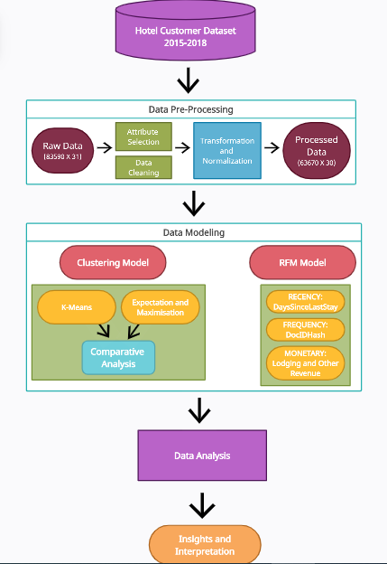

Slide 7
Proposed Design and Implementation
DATA CLEANING AND PRE PROCESSING
Null value imputation(only Age variable has 4% null variables, it’s been imputed using mode.)
Data cleaning:
In our dataset, around 19920 instances have no information on all variables. Removing those instances does not affect the model, so those instances are removed.
Feature Transformation:
Nationality:
Nationality variables are having 188 unique categories, to reduce the levels the countries are converted into 7 continents.
Amenities:
Boolean variables like SRHighFloor, SRLowFloor, SRAccessibleRoom, SRMediumFloor, SRBathtub, SRShower, SRCrib, SRKingSizeBed, SRTwinBed, SRNearElevator, SRAwayFromElevato, SRNoAlcoholInMiniBar, SRQuietRoom represents the preference of the customer, combining all columns implies whether the customer has opted for any special requests and gives much more information than the variables. The Boolean variables combined into a single variable named Amenties

Slide 8
Data Modelling
K-Means Clustering: K-Means is a standard algorithm which takes the parameters and the number of clusters as inputs and partitions the data into the defined number of clusters such that the intra-cluster similarity is high.
For each value of K, we calculated WCSS ( Within-Cluster Sum of Square ) and plotted the WCSS with the K value in order to find the optimal number of clusters (called the Elbow Method).
Optimal Number of clusters = 4
Next, dimensionality reduction applied through PCA to find a low-dimensional representation of the observation that explains a good fraction of the variance.
The optimal number of components determined =7. Thus using PCA before K-means clustering reduces dimensions and decreases computation cost.After PCA analysis , again the K-means algorithm is applied to get more accurate and defined clusters.

Slide 9
EM Clustering: The EM clustering algorithm computes probabilities of cluster memberships based on one or more probability distributions. Similar approach of applying PCA analysis and then EM clustering is proposed on the processed dataset, resulting in 4 clusters of different sizes.
Comparative Analysis of Clustering Models
All the clustering techniques were evaluated using internal indices like the Silhouette Score/Coefficient.
Silhouette Score: Performance metric used to calculate the goodness of a clustering technique. Greater the silhouette coefficient of a clustering technique, better the clustering model used for segmentation.
Silhouette Score for K-Means: 0.229
Silhouette Score for Expectation and Maximization: 0.074
Thus, K-Means algorithm is best suited for Data Modelling through clustering technique.

Slide 10
RFM Segmentation
RFM Scores allow you to create classes that will allow your team to look how often a customer visits the hotel and how valuable they are. Based on the RFM Score we have divided our customers into 11 segments: Champions, Loyal, Potential Loyalist, New Customers, Promising, Need Attention, About To Sleep, At Risk, Cannot Lose Them, Hibernating and Lost Customers.
Champion - These are our best customers and should be given special facilities that others don’t get
Loyal - Communicate with these customers personally. Our target should be to satisfy these customers even more so they preserve their current behaviour.
Potential Loyalist - These customers are not regular but they do come occasionally and by recommending them offers we can motivate them to increase their visits.
New Customers - They’ve just visited once and should be provided with discounts to see if they can become of high value in the future.
Promising - They’ve provided us with high monetary value for the first time and if encouraged in a correct manner, we can then eventually invest in this segment to turn them into regular spenders.
Need Attention - These are on the verge of using services provided by your competitors in the market. They should be communicated with time limited promotional campaigns so that they get attracted towards us

Slide 11
About To Sleep - They haven’t been active for a long time but are still approachable using correct discounts
At Risk - These are customers who have in past given monetary values at regular intervals but recently have been inactive meaning they’re going towards other competitors in the market. These customers can still be brought back using discounts targeting them in specific.
Cannot Lose Them - This is similar to the At Risk segment only these have been a bit more recent than them and are little less monetary than them.
Hibernating - These are below average customers. We can’t overspend on them. The most basic discount and nothing more than that is needed for them.
Lost - They generate the least part of the revenue and so have the minimum priority. Don’t waste resources or time on them. Just send some free items and analyse their behaviour after that.

Slide 12
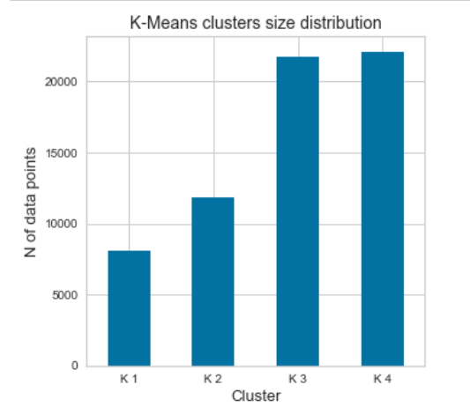
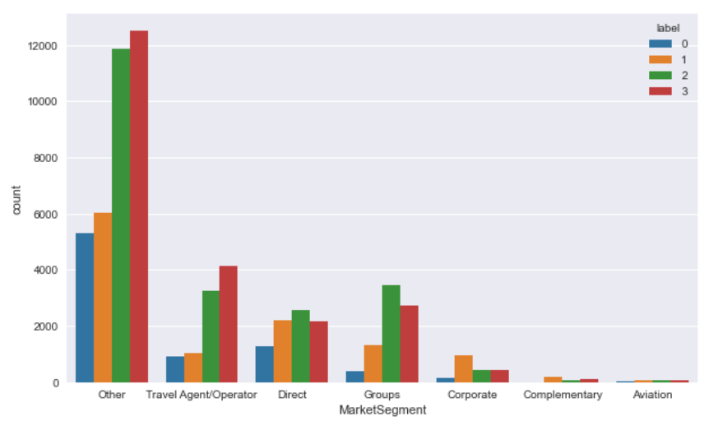
Results and Analysis
The number of customers belonging to each cluster.
The number of people belonging to each cluster with respect to the their market segment.

Slide 13
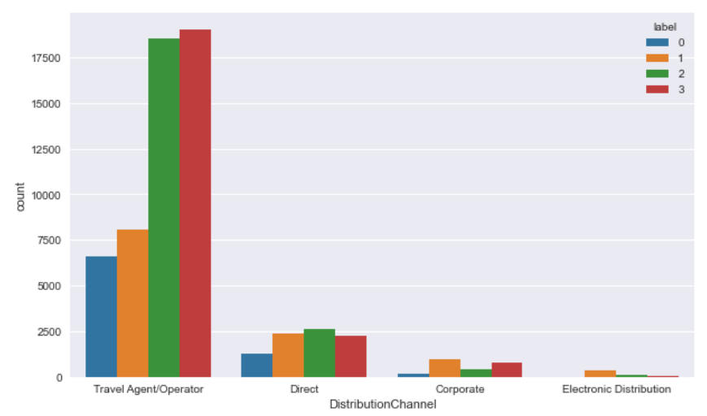
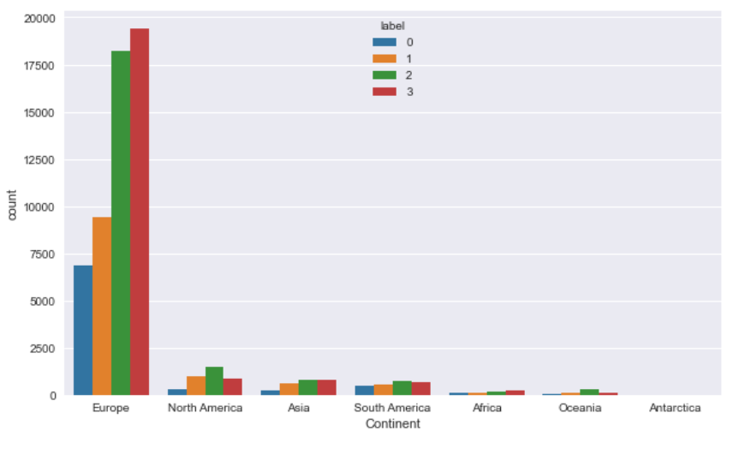
The number of people present in each cluster with respect to the distribution channel.
This graph shows the continent wise distribution of the customers of each cluster.

Slide 14
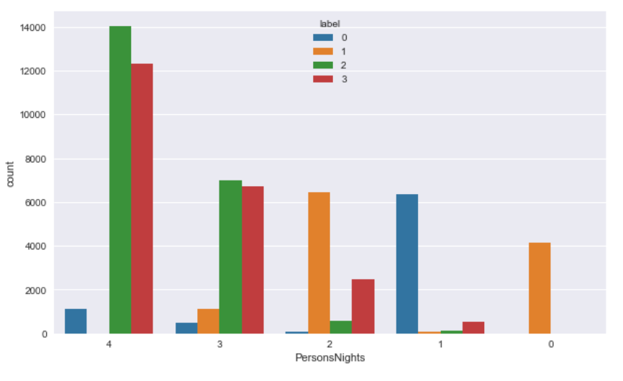
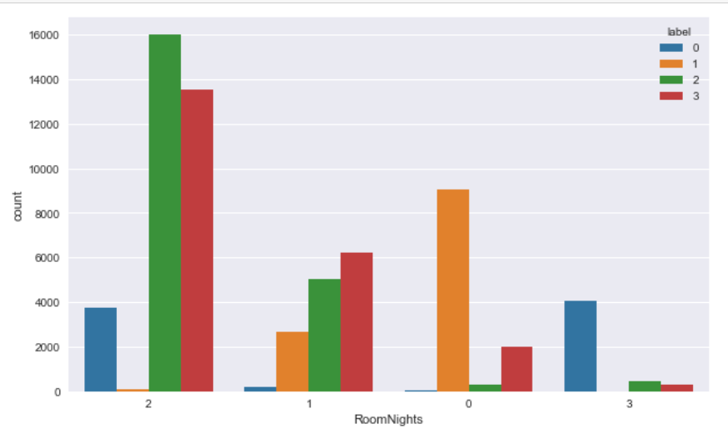
The graph depicts the distribution of the customers based on the fact that booking is done for how many people. And based on that cluster wise number of people are shown.
The graph depicts the number of people in each cluster with respect to the number of rooms that they’ve booked over a single transaction.

Slide 15
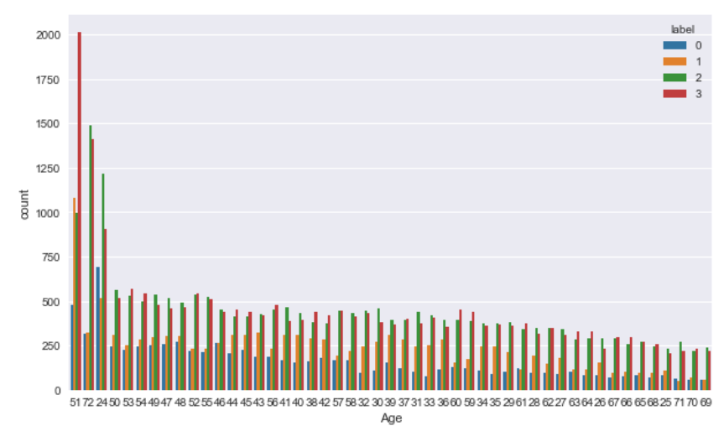
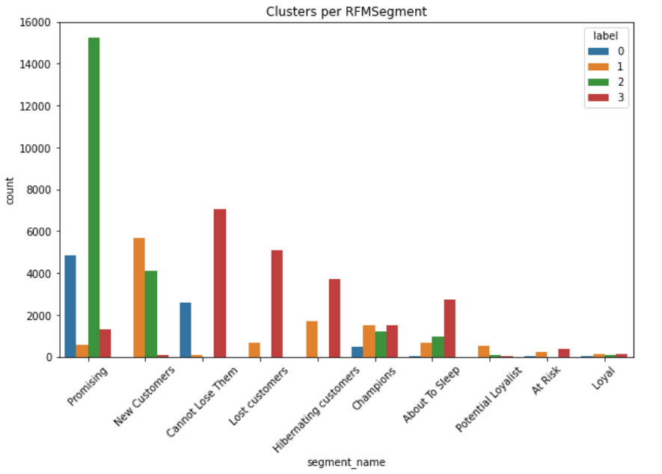
This graph is showing the number of people cluster wise of each age that has visited the hotel in these three years.
Number of customers present in each cluster belonging to different RFM categories.

Slide 16
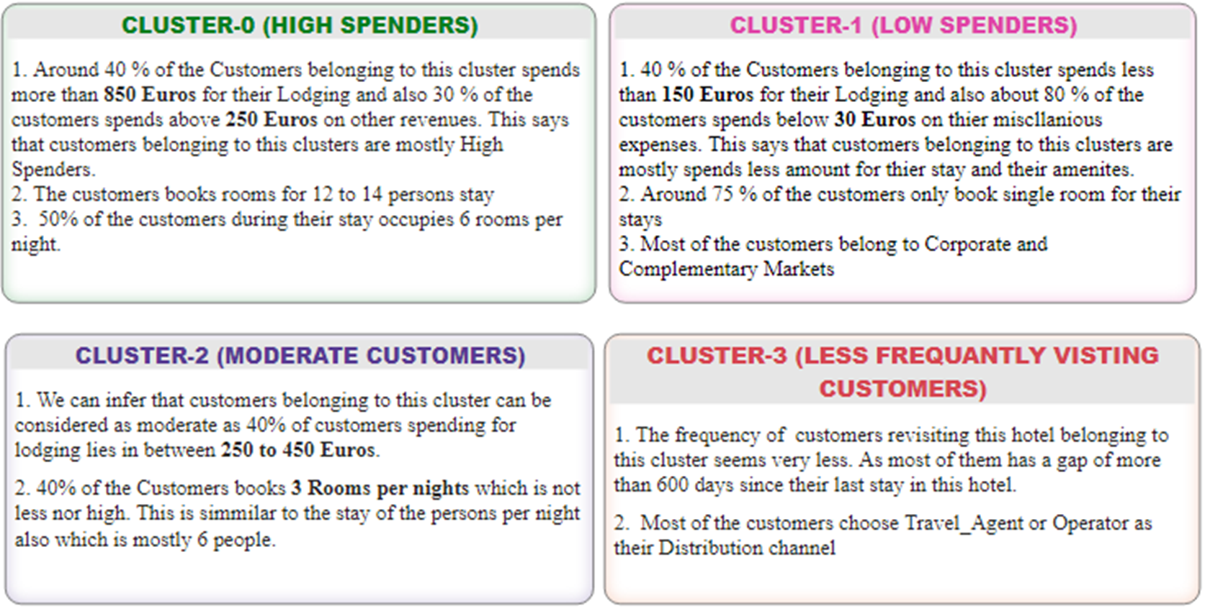
Cluster Traits

Slide 17
Conclusion
Businesses can gain complete insight into their customers using a variety of models and algorithms. This will help them quickly design relevant consumer strategies by grouping customers having similar characteristics. To demonstrate the same, a Hotel customer dataset having over three years of data was chosen. The process of dimensionality reduction using PCA was performed on the raw data and some dataset attributes were normalised. K-Means Clustering algorithm and Expectation - Maximisation (EM) Algorithm were applied to the preprocessed data. The Clustering Performance was evaluated using the Silhouette index. The best results were obtained by the K-means clustering algorithm. Four clusters were formed. Then RFM modelling was performed on the reduced dataset and customers were divided based on their RFM scores 11 categories. Then using the DocHashID of each customer, we analysed the number of customers in each cluster belonging to different RFM categories.

Slide 18
Future Scope
In future work, the process of classification and regression can be applied to the dataset due to the high number of variables enclosed. Association rule mining can also be applied because it finds interesting associations and relationships among large sets of data items (here, customers). It allows for identifying relationships between the hotel facilities that people prefer frequently. Given a set of transactions, rules can be found that can predict the choice of an amenity based on the occurrences (choices) of other hotel services in the transaction.

Slide 19
Thank You!

