Slide 1
🎓 Netflix Data Science Capstone
Final Project Presentation
Classification & Recommendation System

Slide 2
🔍 Objectives
- Predict if content is a Movie or TV Show
- Recommend titles based on genre, rating, and description
- Ensure explainability via SHAP
- Deploy using Streamlit & Docker

Slide 3
📦 Dataset Overview
- Netflix Titles from Kaggle (~8,800 entries)
- Fields: Title, Description, Genre (listed_in), Rating, Type, Year

Slide 4
📊 Exploratory Data Analysis
- Content Type: More movies than TV shows
- Ratings: Most content is TV-MA or PG
- Release Year: Spike in recent years
- Top Genres: Documentaries, Dramas, Comedies

Slide 5
🛠️ Feature Engineering
- Label encoded ratings
- Counted number of genres per title
- Used release year as numeric input

Slide 6
🤖 Model Training
- Model: Random Forest Classifier
- Features: release_year, rating_encoded, genre_count
- Tuned with GridSearchCV

Slide 7
📈 Evaluation Results
- Accuracy: ~89%
- F1 Score: ~0.88
- AUC Score: ~0.91
- Reliable type classification

Slide 8
🧠 Explainability with SHAP
- Top Features:
1. release_year
2. rating_encoded
3. genre_count
- Visual insights using SHAP summary plots

Slide 9
🚀 Deployment
- Streamlit UI: interactive user input
- Docker container: platform-independent deployment
- Optional cloud hosting (Streamlit Cloud)

Slide 10
🎯 Recommendations Engine
- Keyword-based genre mapping
- TF-IDF similarity for description
- Final score includes type match, recency, genre

Slide 11
✅ Conclusion
- Built a full ML pipeline with real Netflix data
- Delivering explainable predictions and recommendations
- Ready for real-world deployment

Slide 12
🙌 Thank You
Questions?

Slide 13
🖥️ Streamlit App Demo
Screenshots of the deployed UI and user experience

Slide 14
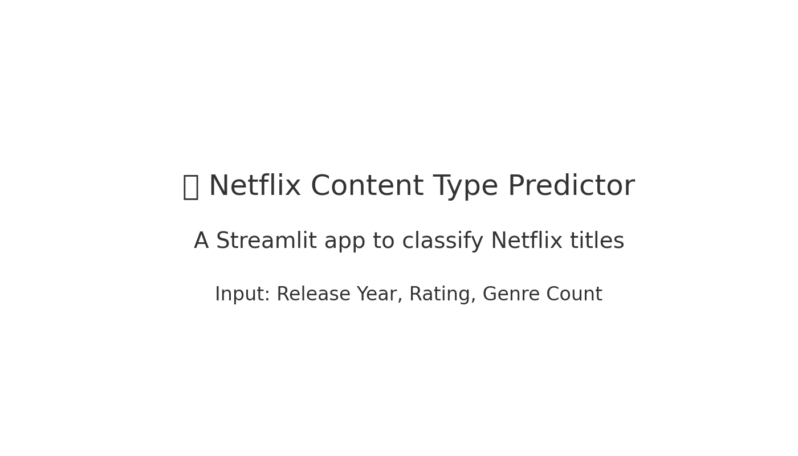
🔷 App Landing Page

Slide 15
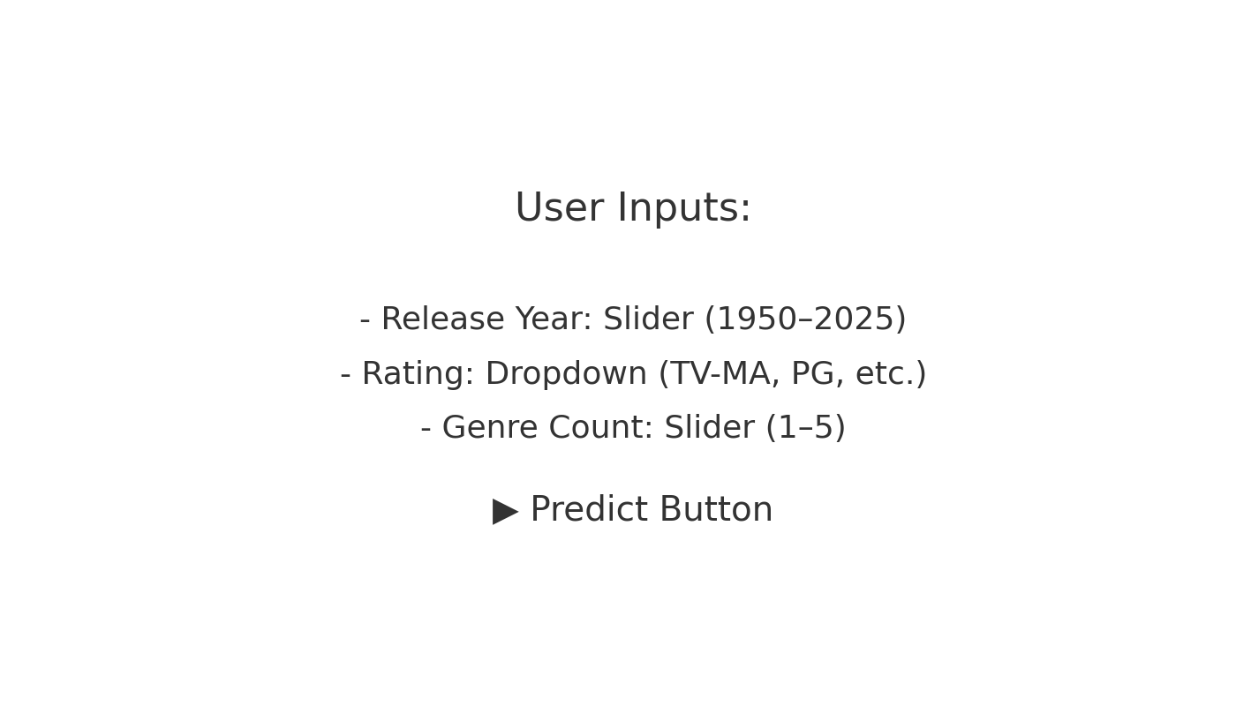
🎛️ User Inputs

Slide 16
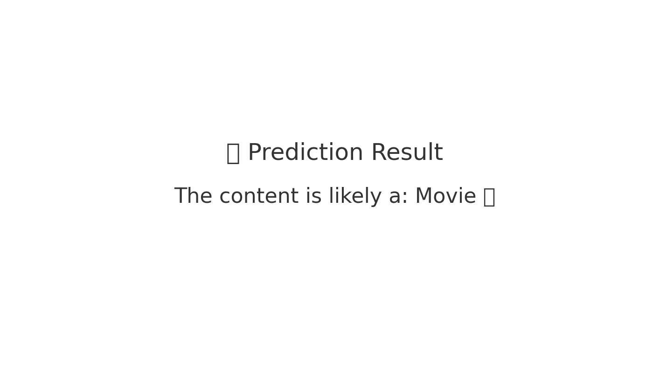
📊 Prediction Output

