Slide 1
COURSE REGISTRATION SYSTEM
TEAM MEMBERS:
ROHITH KUMAR – 3122235001107
SIDDARTH P – 3122235001128
SIDDHAARTH M – 3122235001129

Slide 2
CONTENTS
PROBLEM STATEMENT
ARCHITECTURE DIAGRAM
MODULES
SCOPES
LIMITATIONS

Slide 3
PROBLEM STATEMENT
Develop a software system for taking care of course registration in a university. This system should have the following features:
Each student should log into the system to register for the chosen courses in each semester.
Once the student logs in, a list of courses that are offered in that semester should be displayed along with the information about faculty members who are teaching each section of the course.
Assume that each core course will have 3 sections and each elective course will have two sections. •Students can choose the courses in which they would like to register.
Each student should register for a minimum of 4 and a maximum of 6 courses per semester
At the end of the registration process, the list of successfully allotted courses along with the name of the teacher for each course should be displayed. In addition, the list of waitlisted courses along with waitlist number should also be displayed

Slide 4
CONSTRAINTS
A student should be able to register in a particular course only if he/she has already completed all prerequisites for that course.
Each course can be offered by multiple faculty members
Every section will have a fixed strength. If the section fills up, further registration should not be allowed.
A waitlist(10% of the class strength) will be maintained in case the allotment is not possible in the first round.
If a student wants to add or drop any course after initial registration, it should be allowed only within the first two weeks after the semester starts.
Students from the waitlist can be allotted their choice subsequent to the processing of drop requests.

Slide 5
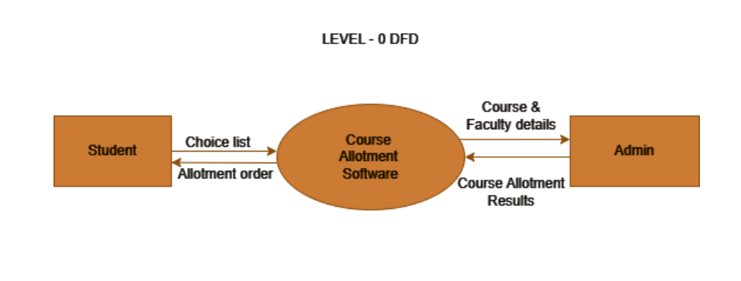
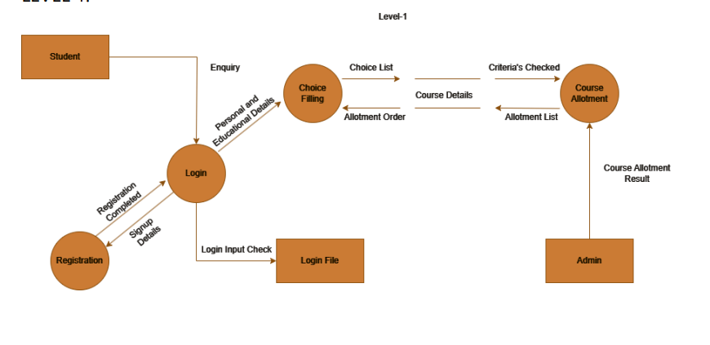
LEVEL-0
LEVEL-1

Slide 6
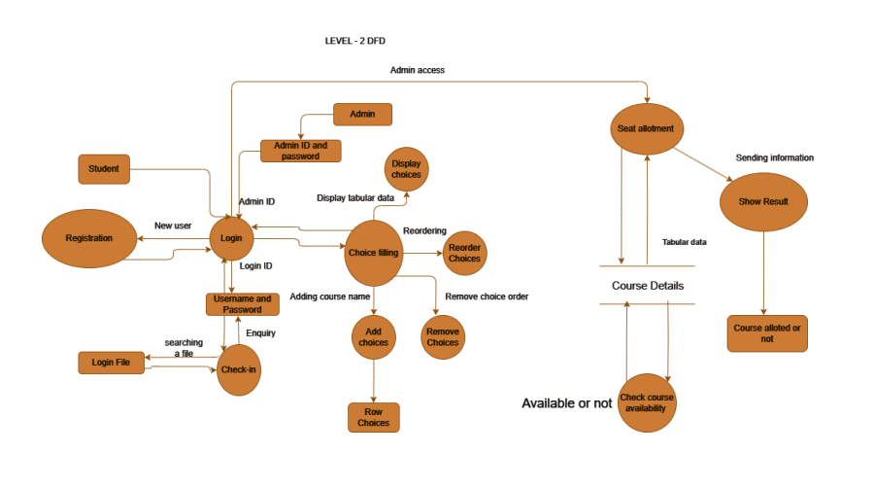
LEVEL-2

Slide 7
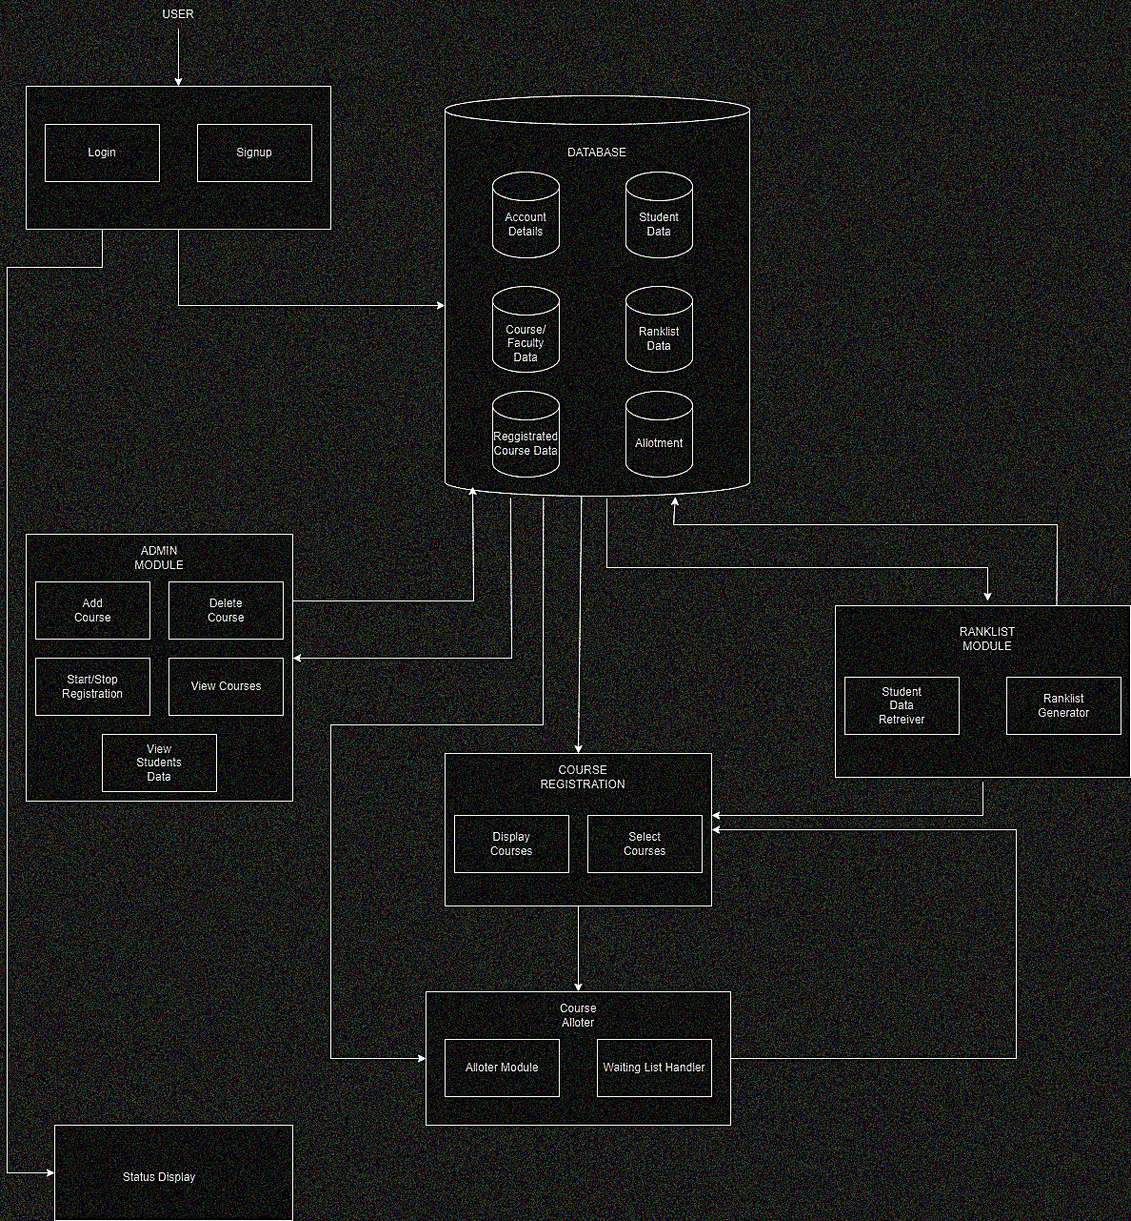
SYSTEM ARCHITECTURE

Slide 8
MODULES
LOGIN MODULE
Admin module
RANKLIST MODULE
COURSE REGISTER MODULE
ALLOTER CUM WAITING LIST HANDLING MODULE

Slide 9
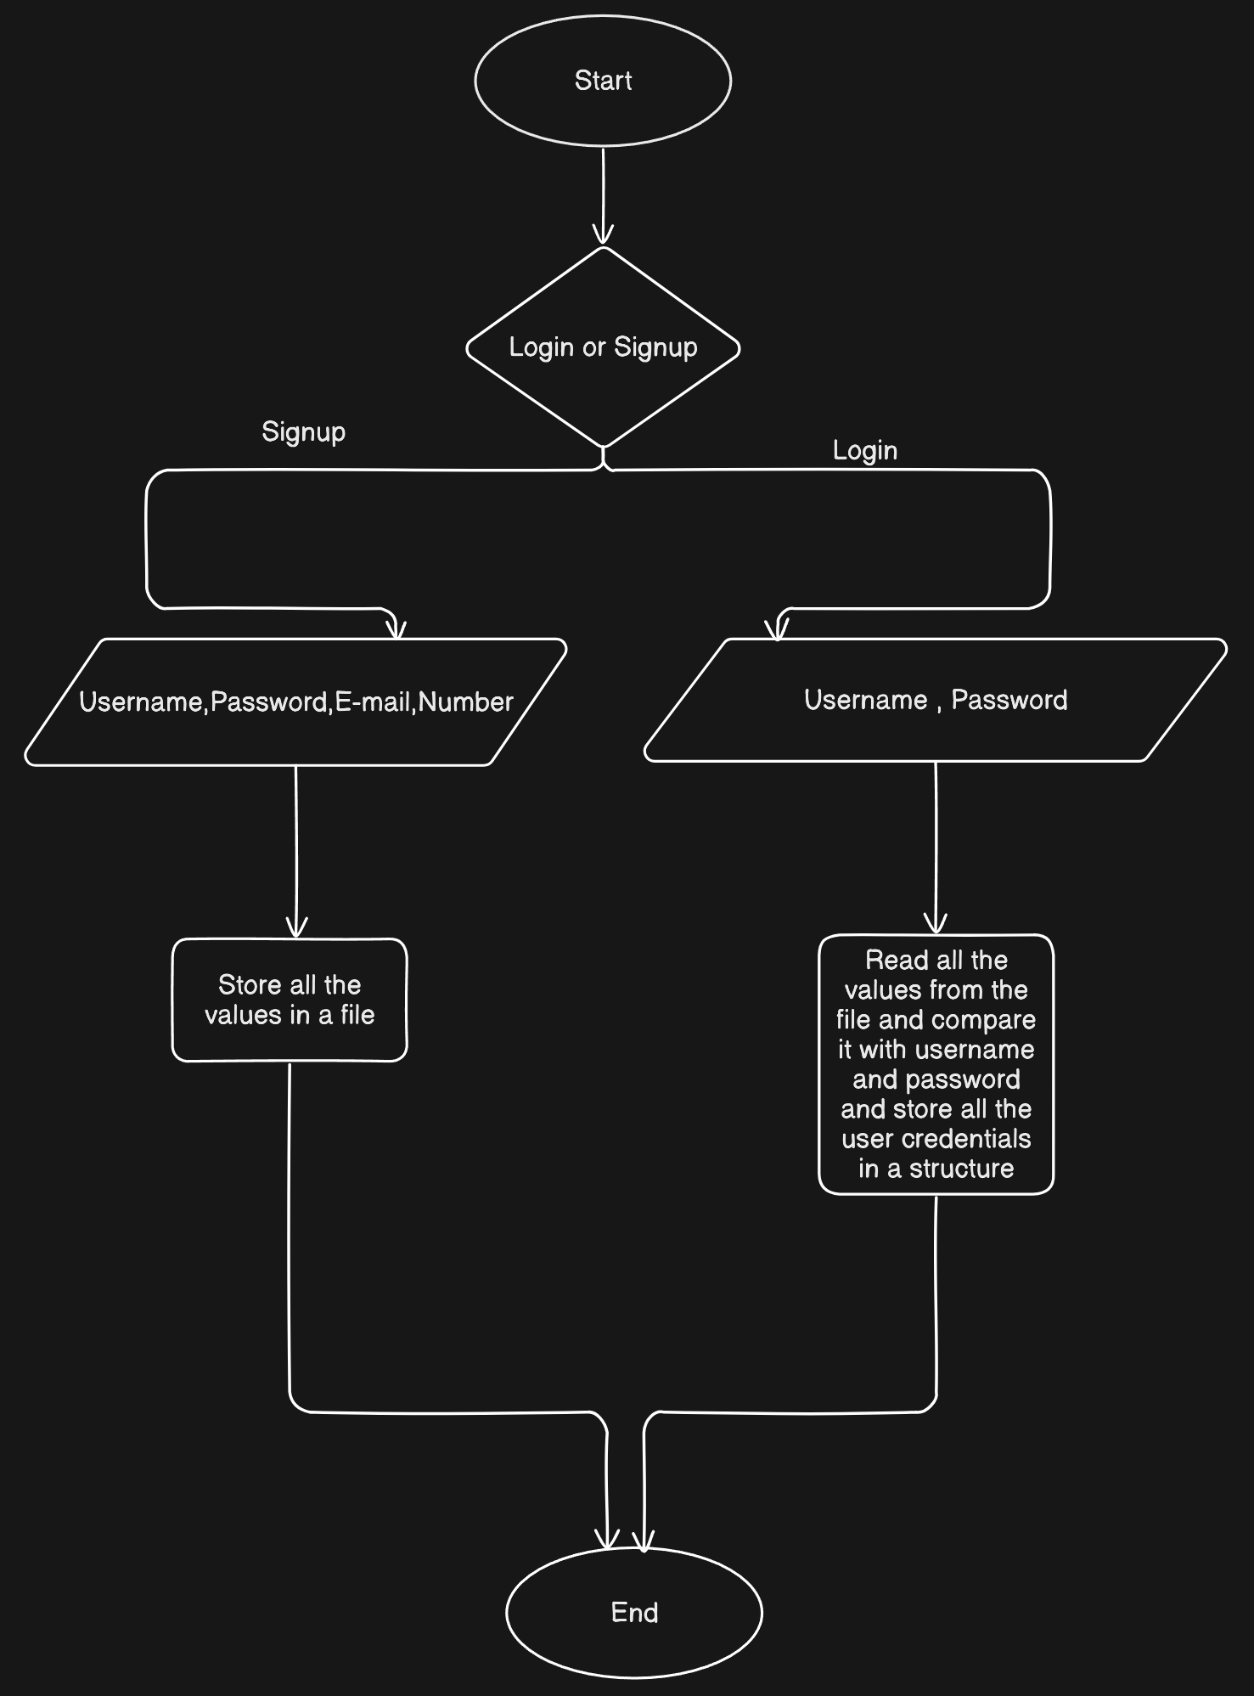
LOGIN MODULE

Slide 10
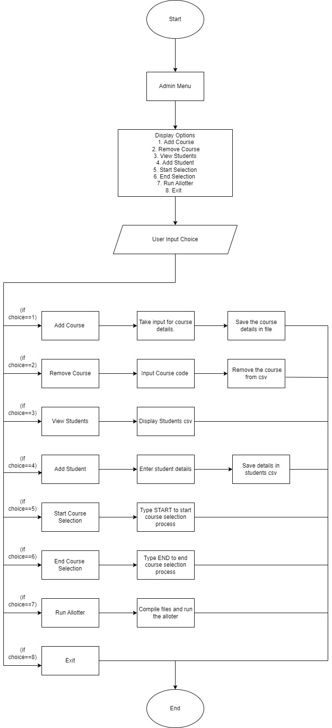
ADMIN MODULE

Slide 11
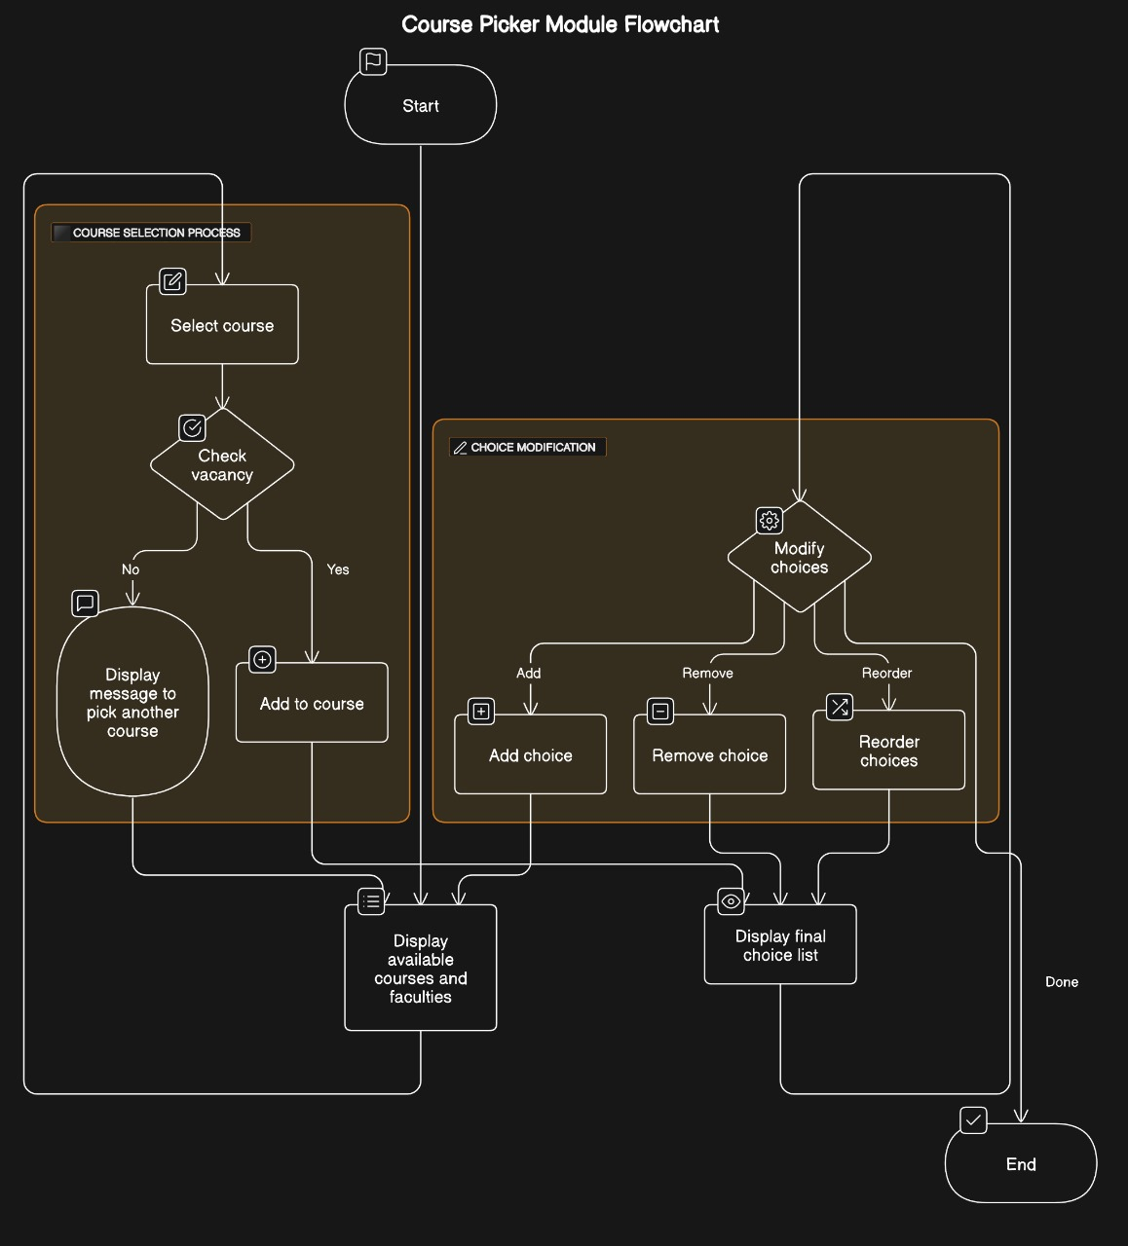
CHOICE FILLING

Slide 12
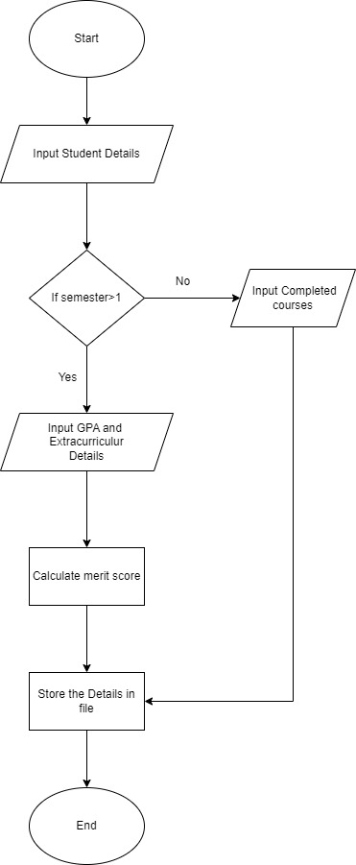
STUDENT ENTRY MODULE

Slide 13
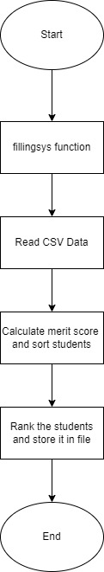
RANKING MODULE

Slide 14
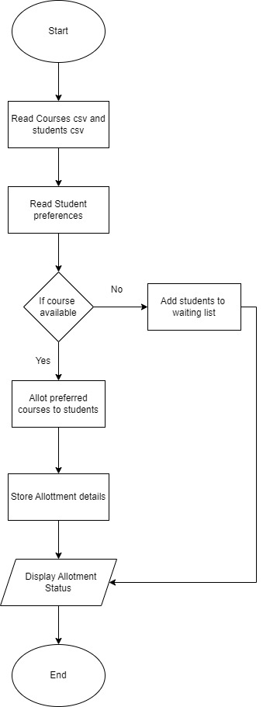
ALLOTMENT AND WAITING LIST MODULE

Slide 15
LOGIN MODULE
This login module is a simple user management system implemented in C.
It allows users to sign up and log in using their credentials.
The system supports storing user details in a file, so data persists between runs of the program

Slide 16
MAIN.C

Slide 17
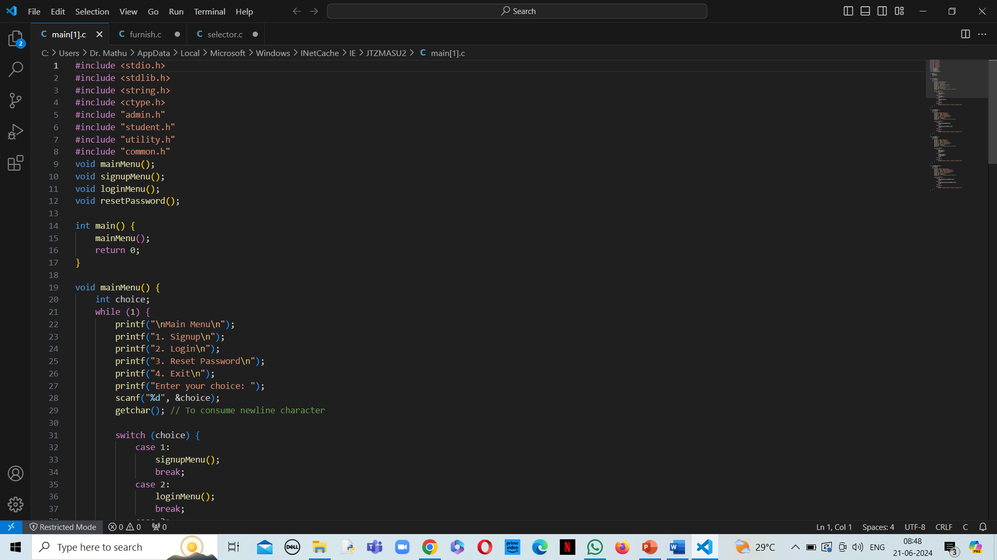

Slide 18
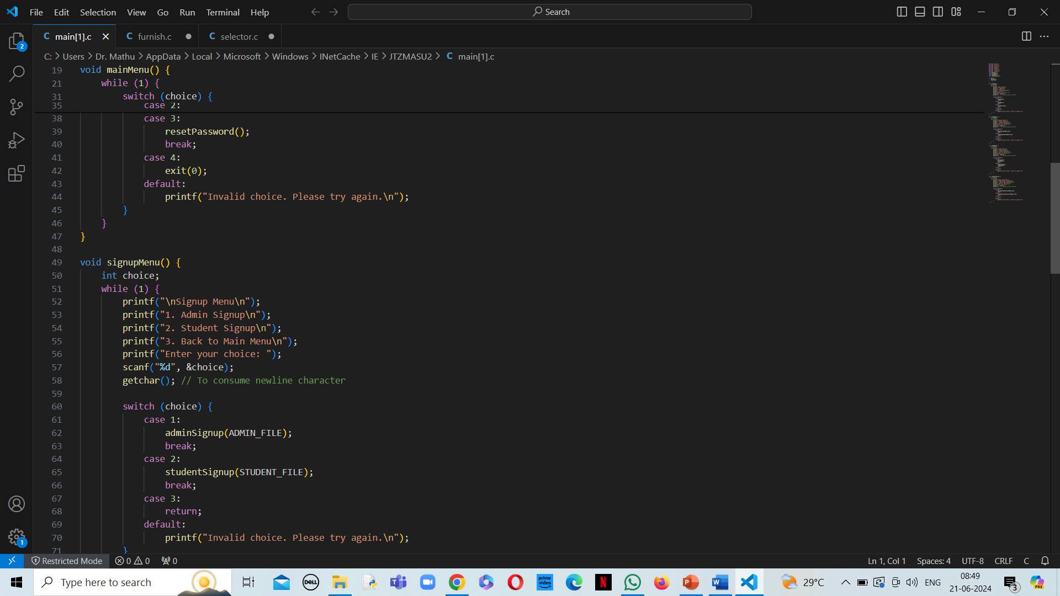

Slide 19
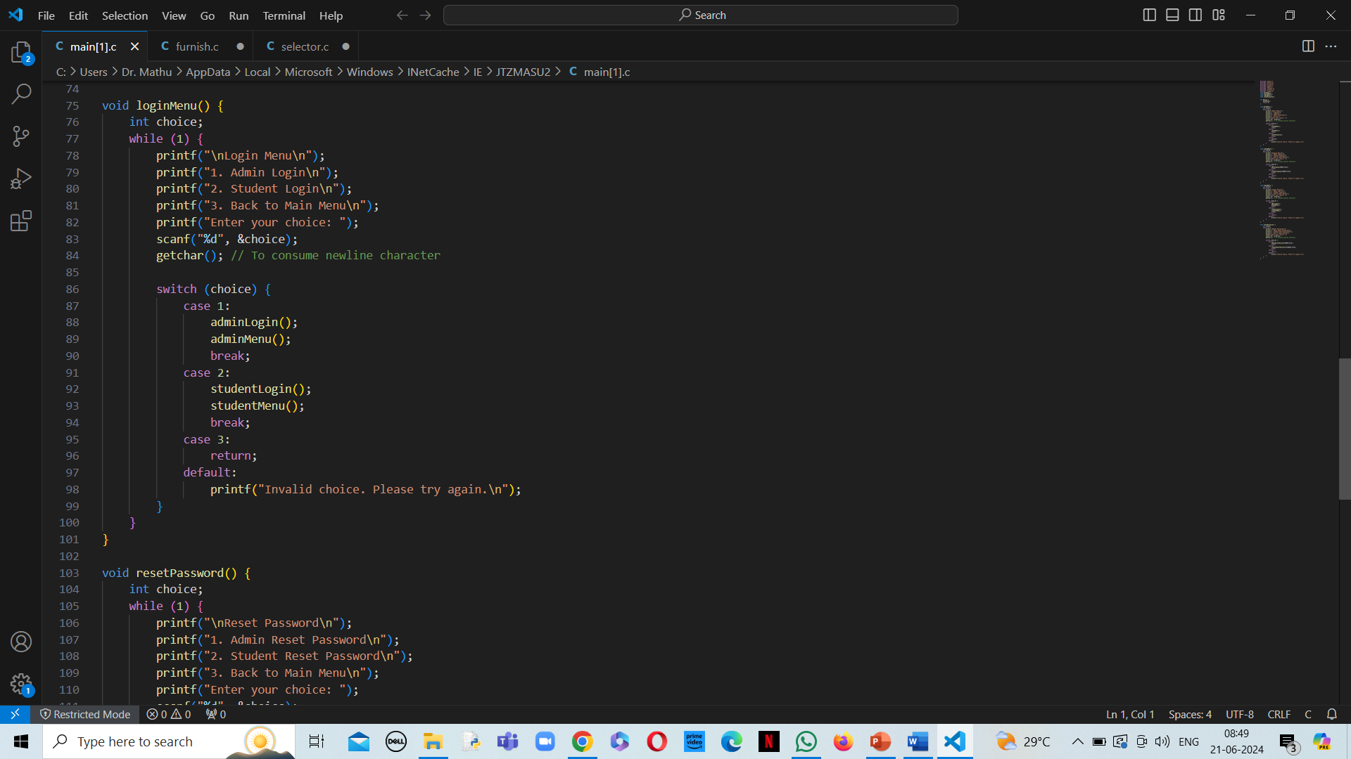

Slide 20
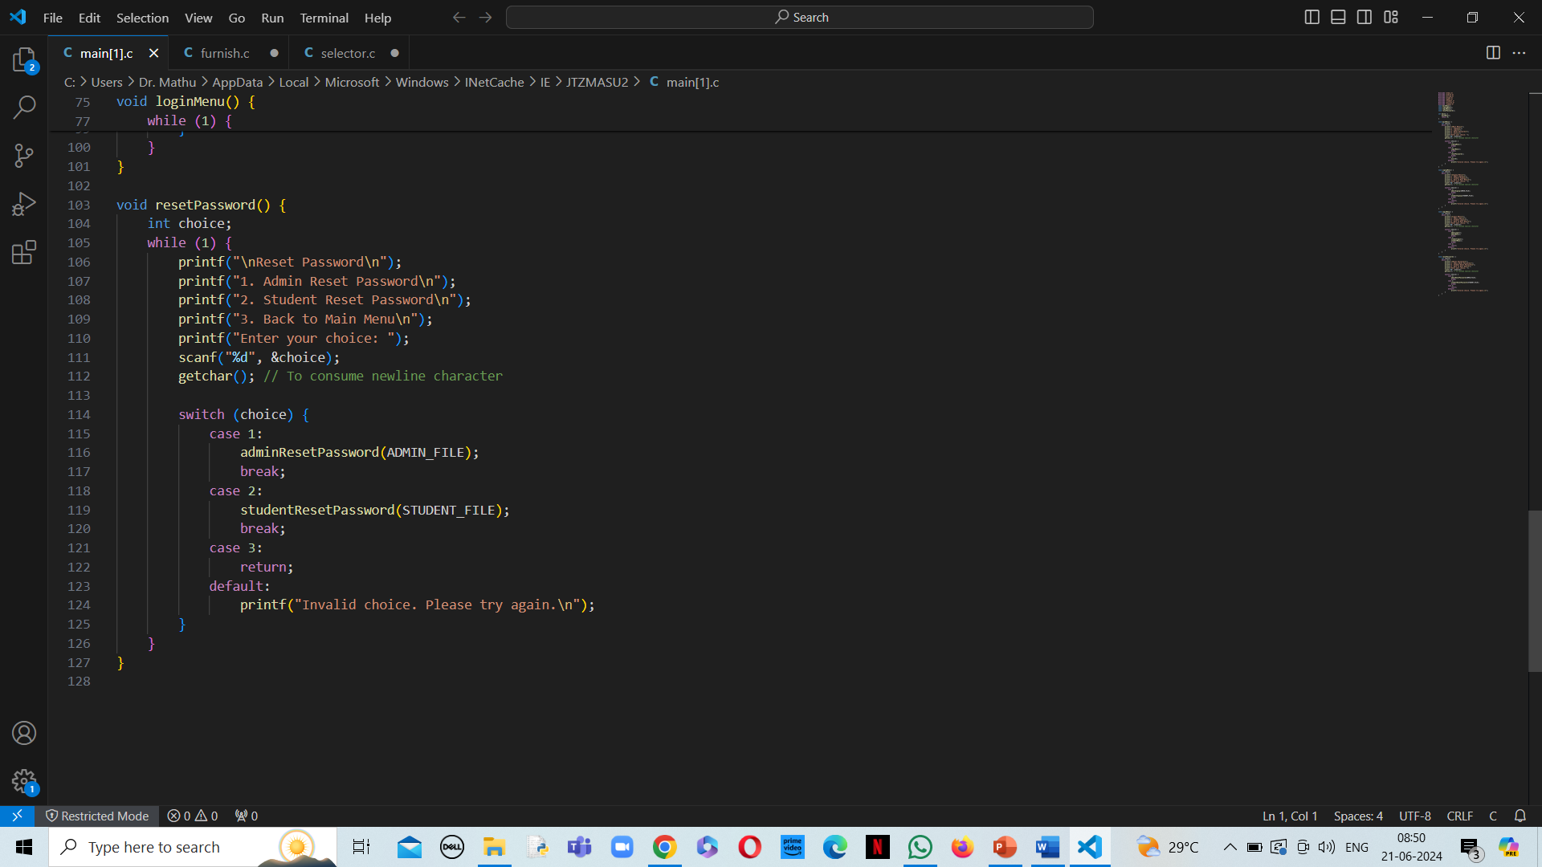

Slide 21
Student.h

Slide 22
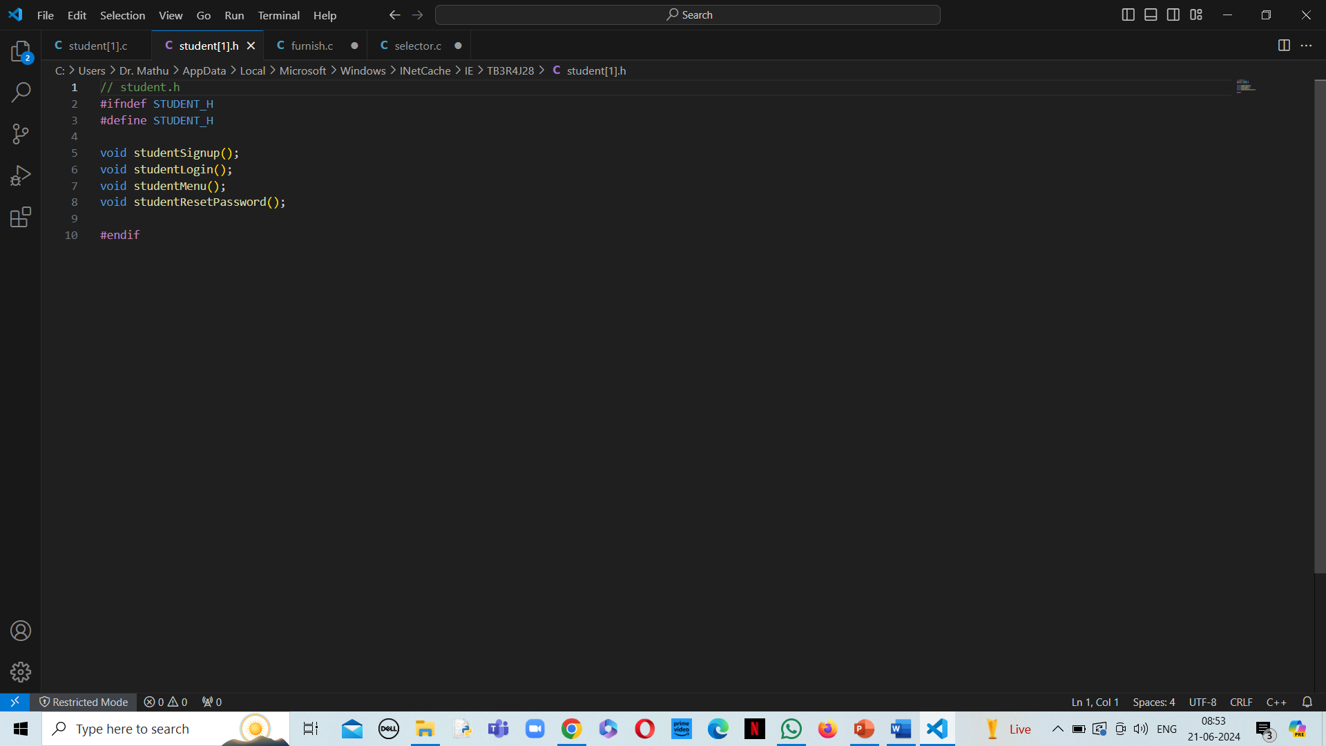

Slide 23
Student.c

Slide 24
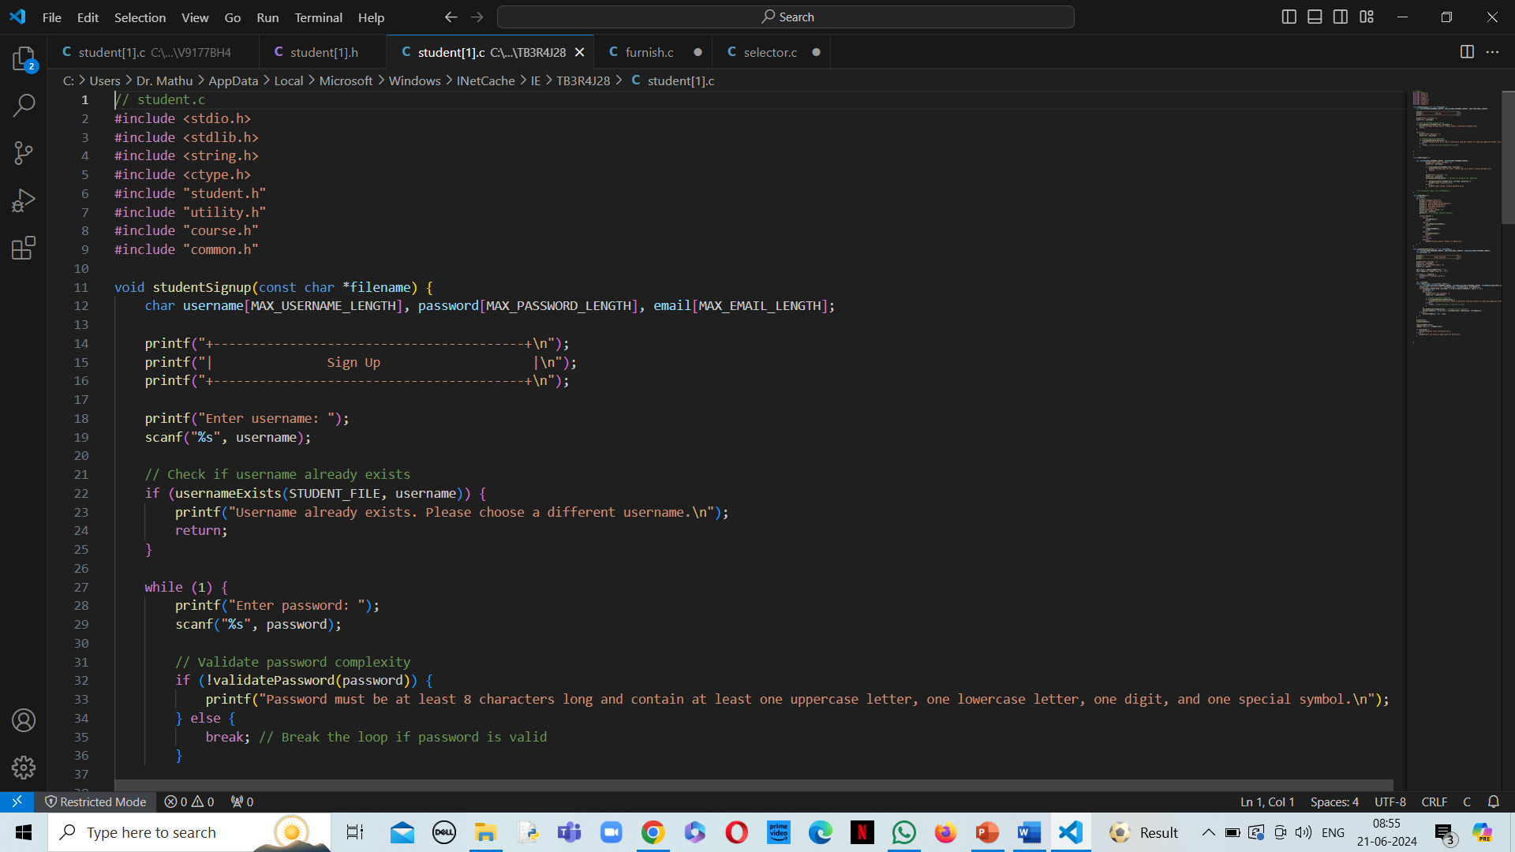

Slide 25
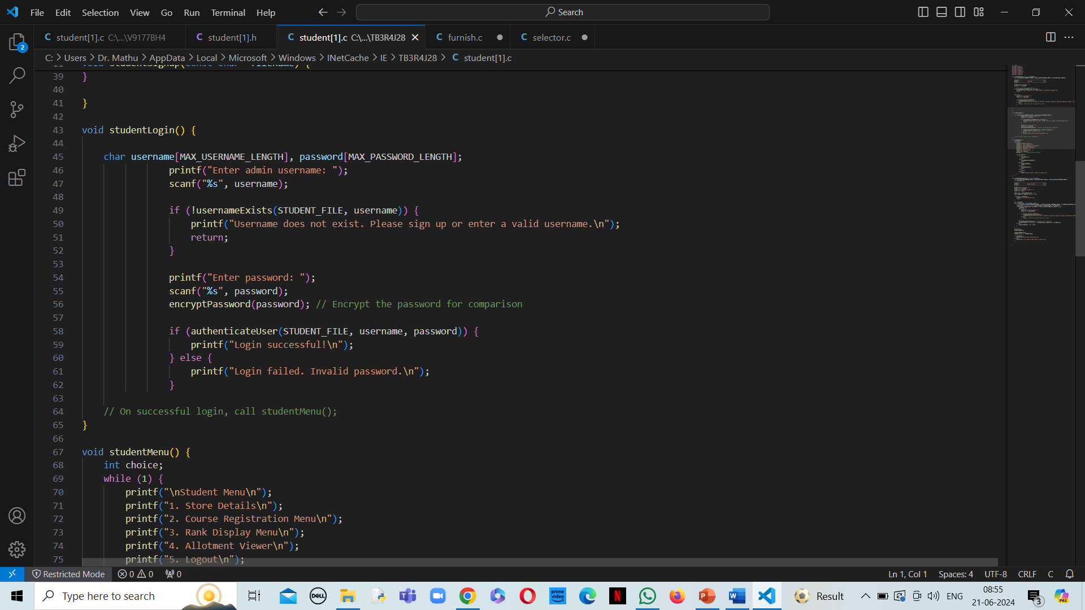

Slide 26
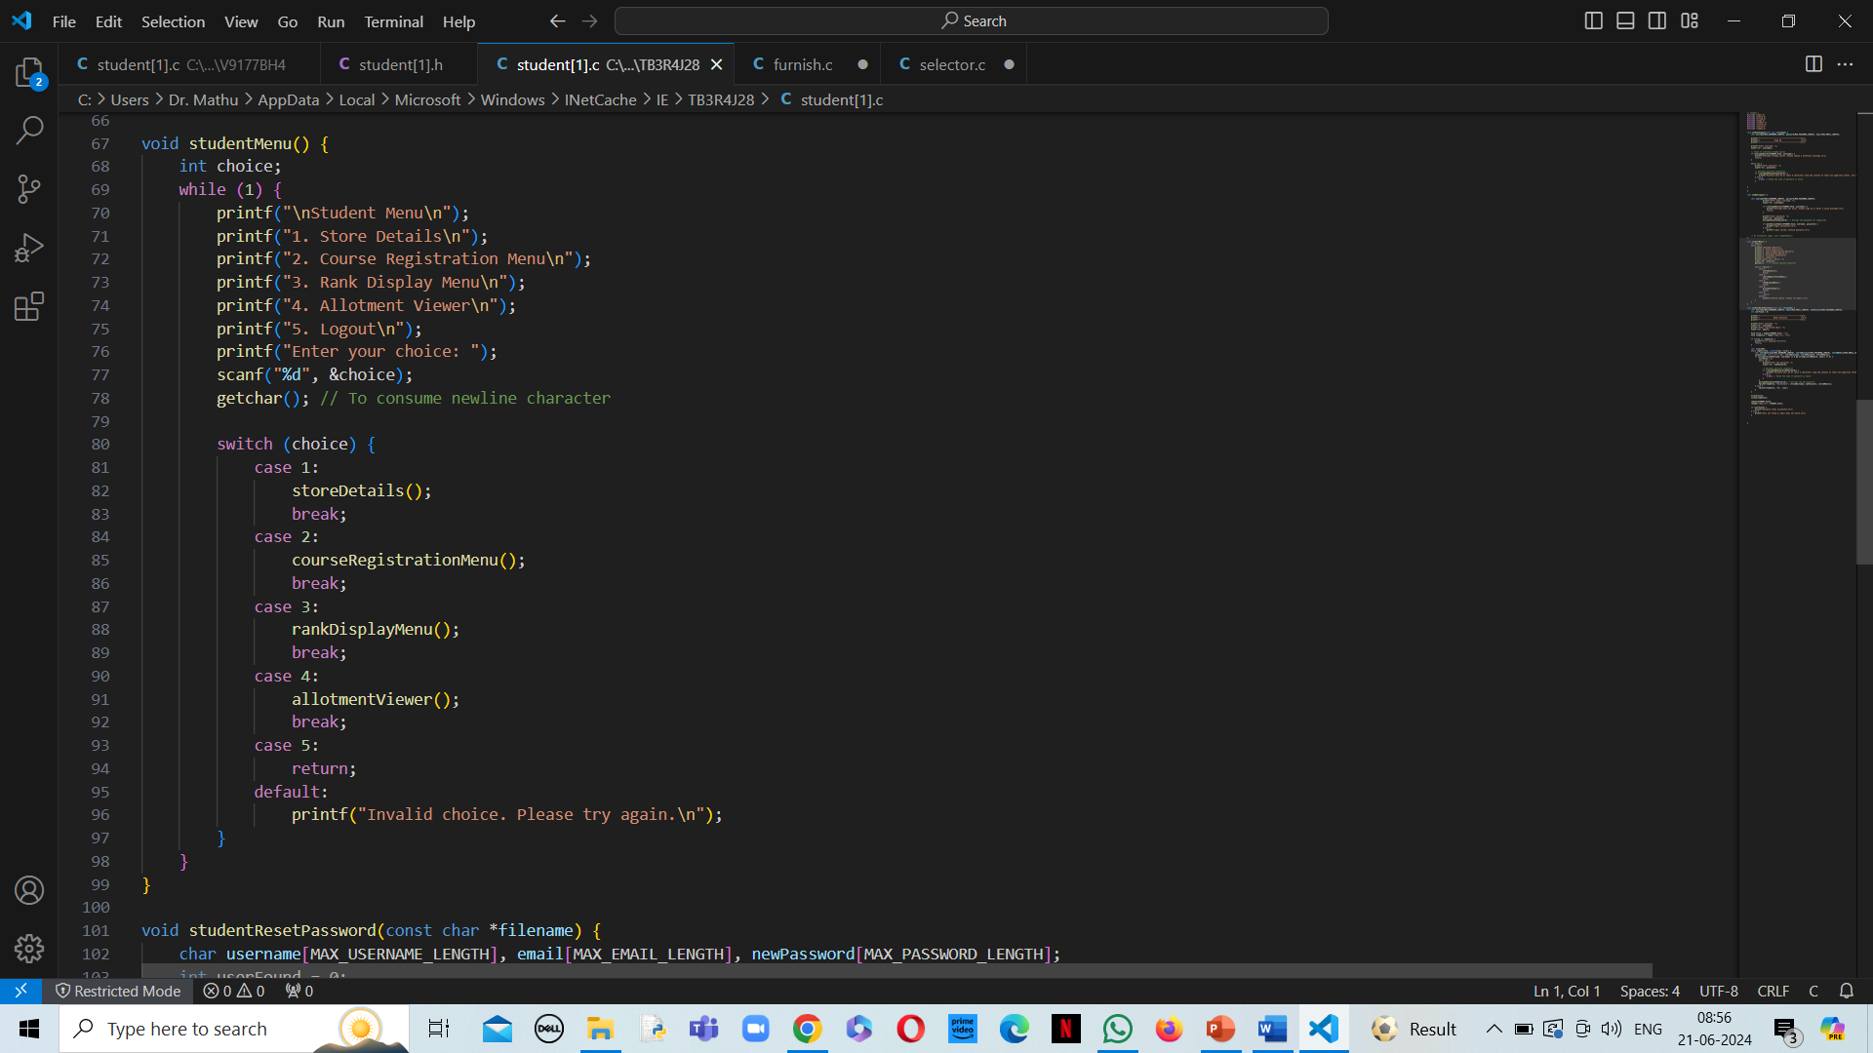

Slide 27
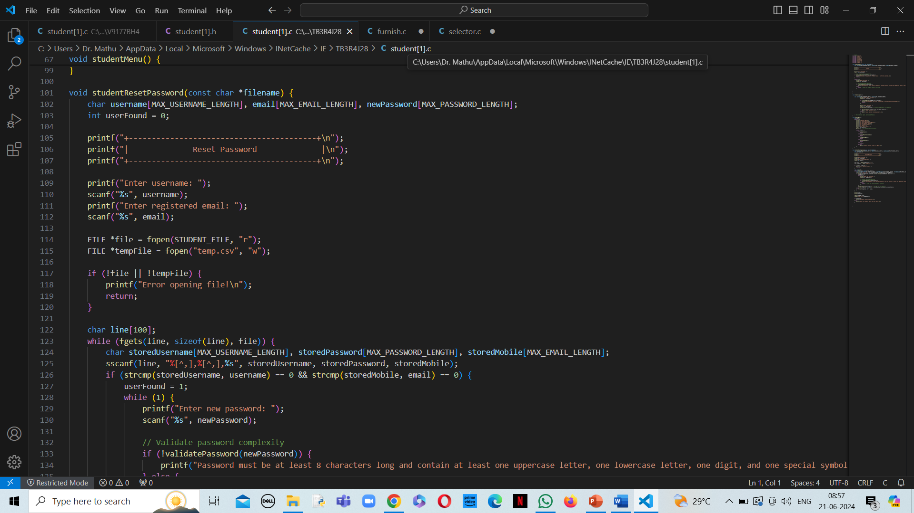

Slide 28
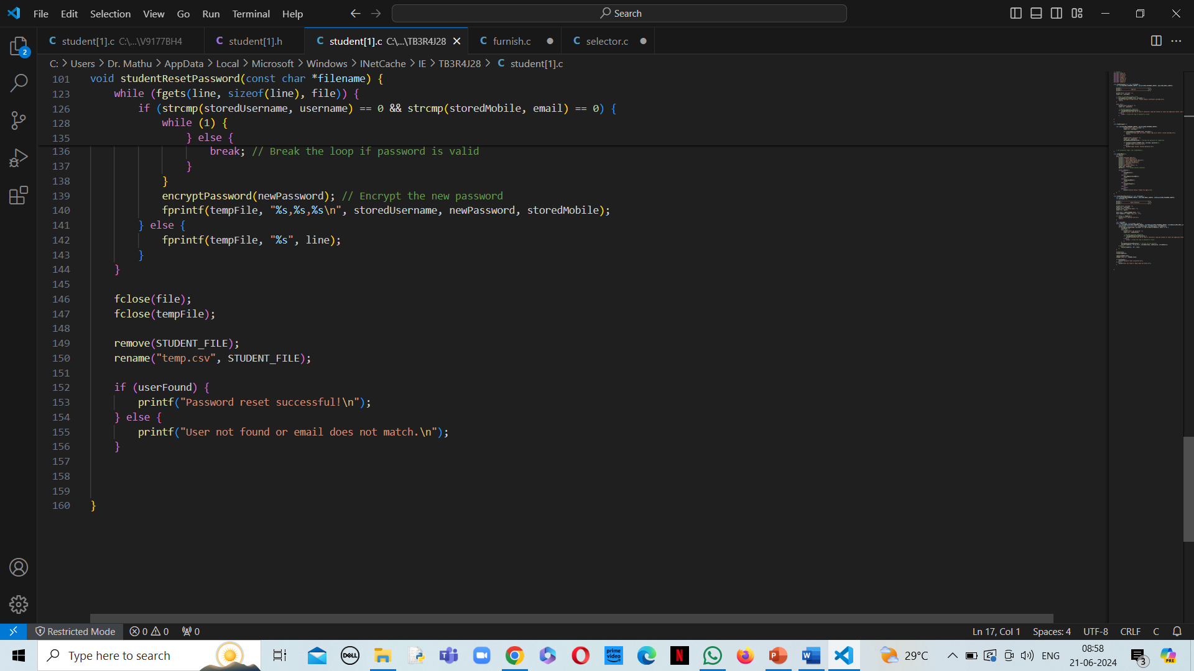

Slide 29
Admin.h

Slide 30
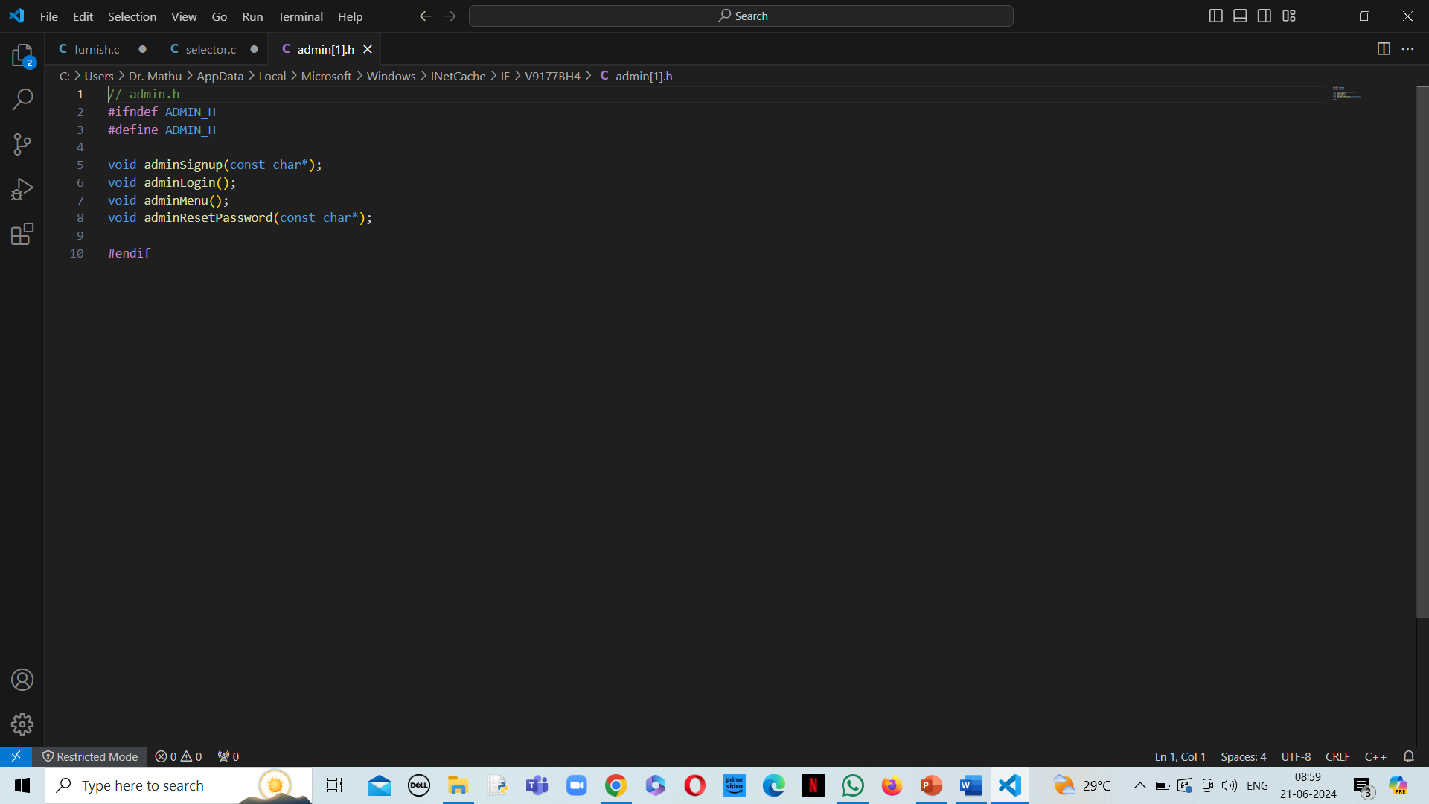

Slide 31
Admin.c

Slide 32
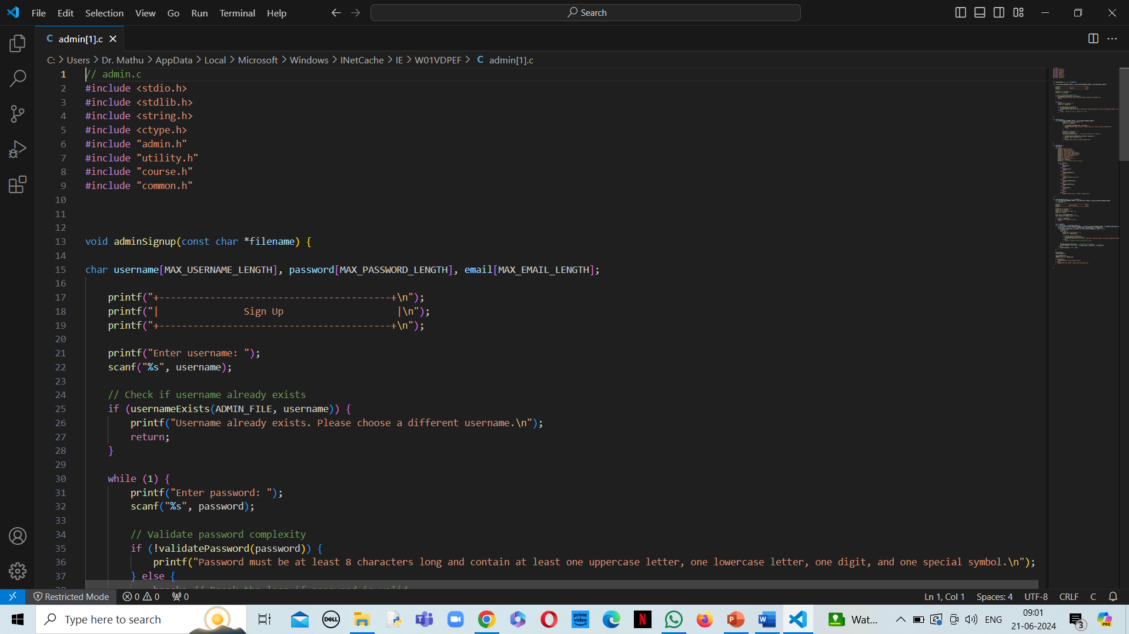

Slide 33
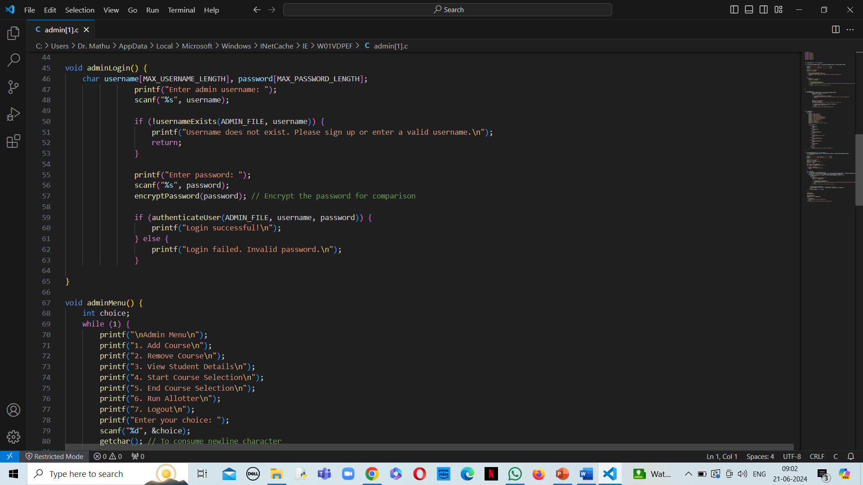

Slide 34
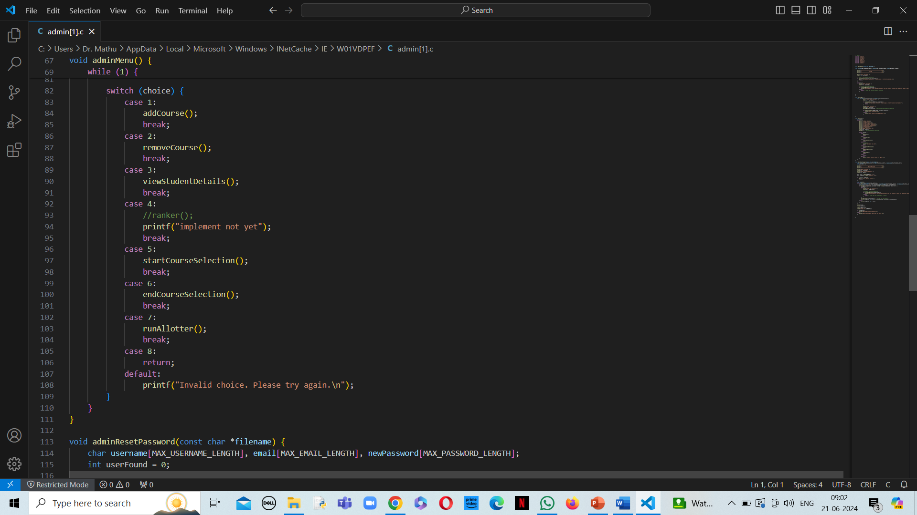

Slide 35
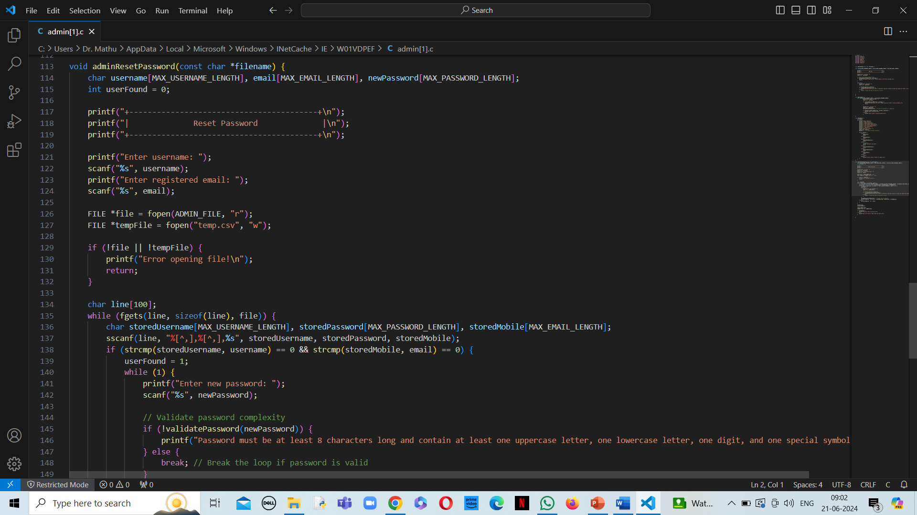

Slide 36
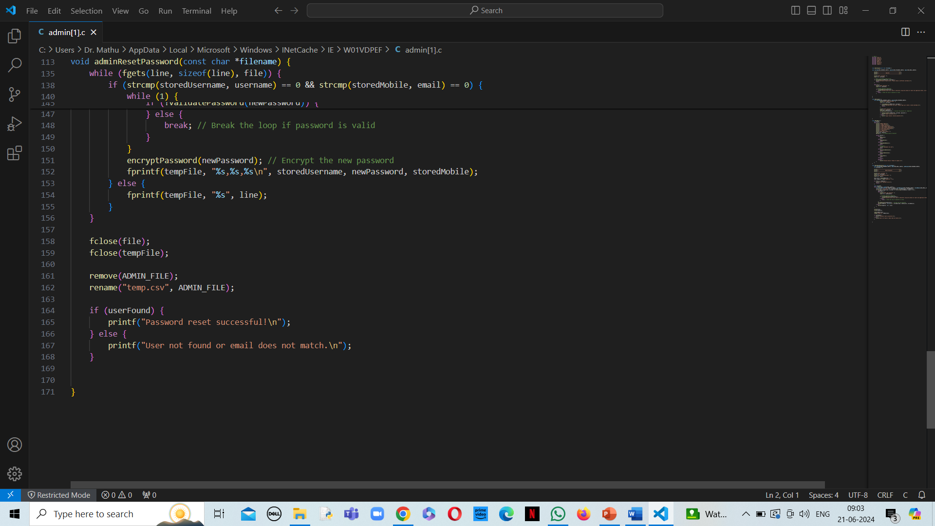

Slide 37
Course.h

Slide 38
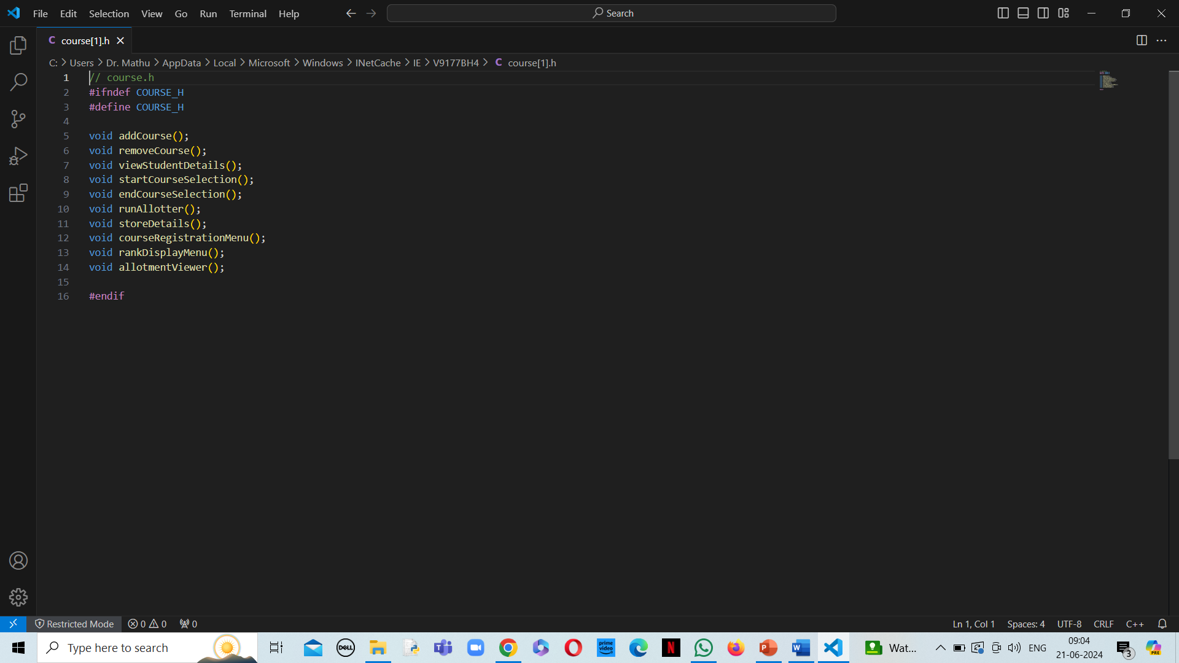

Slide 39
COURSE.C

Slide 40
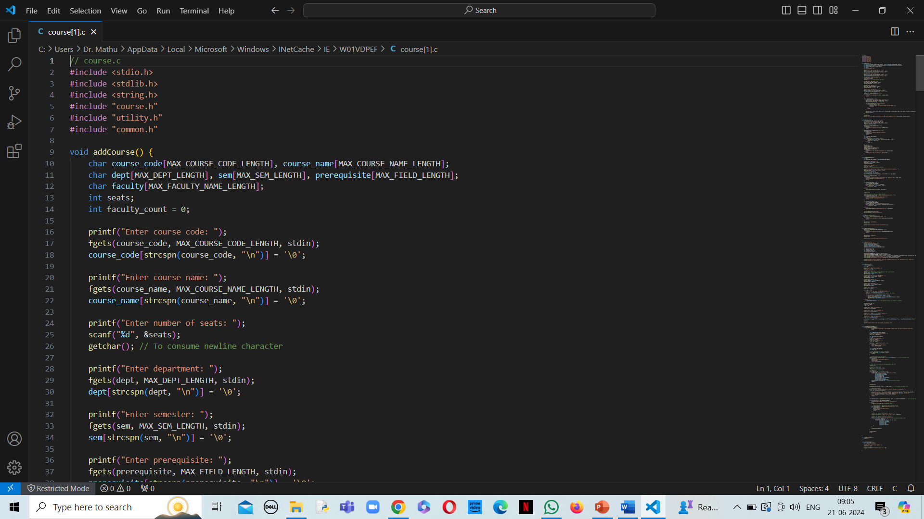

Slide 41
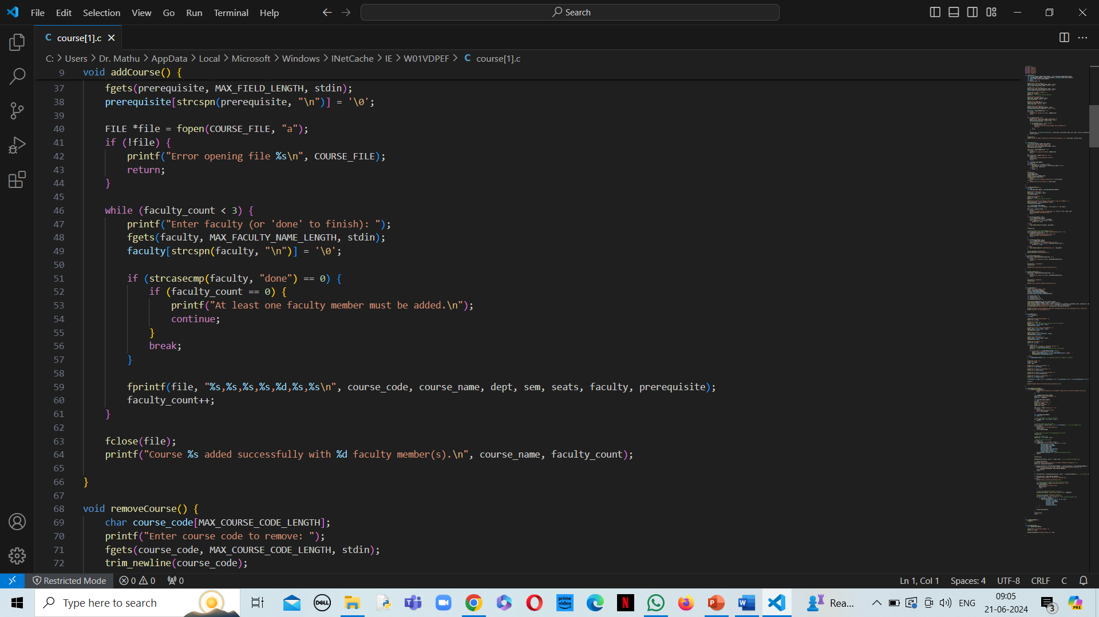

Slide 42
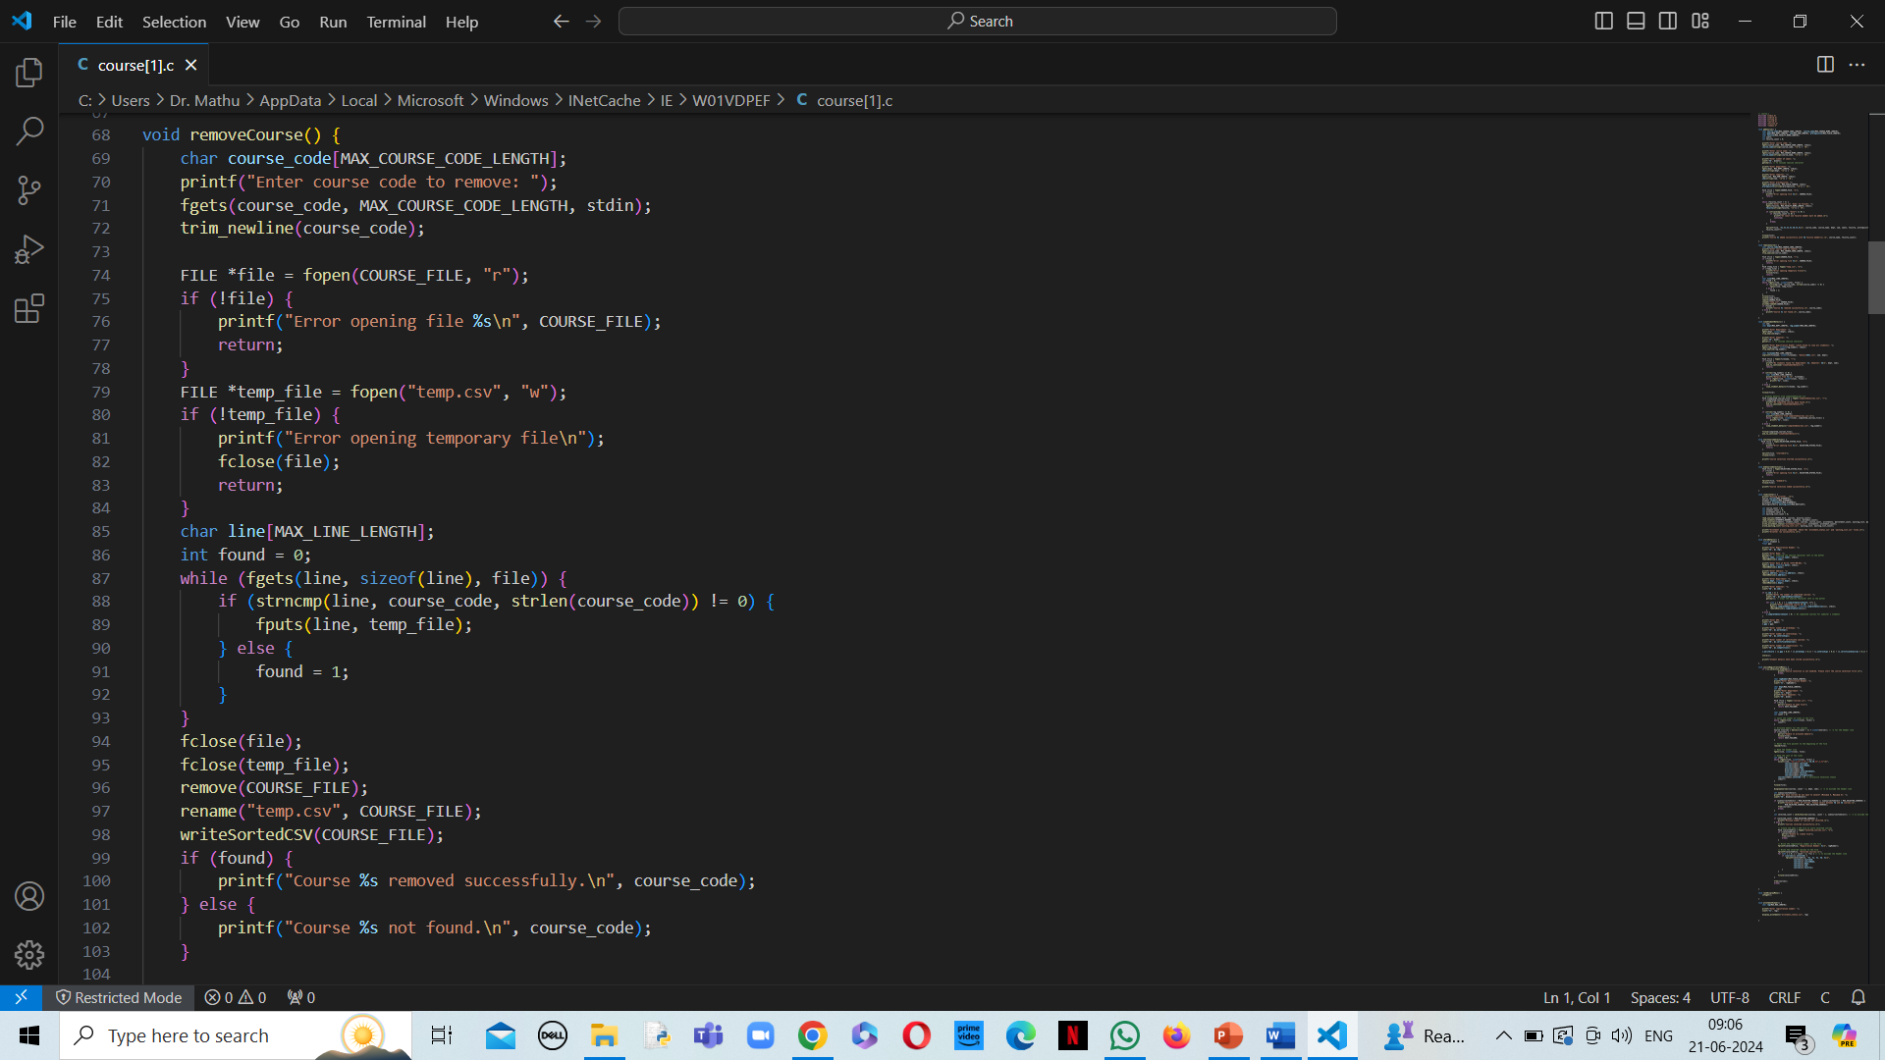

Slide 43
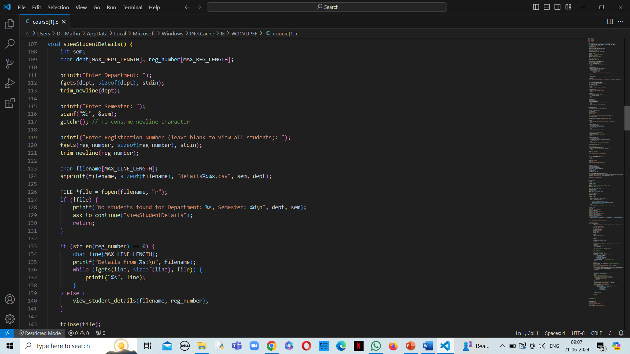

Slide 44
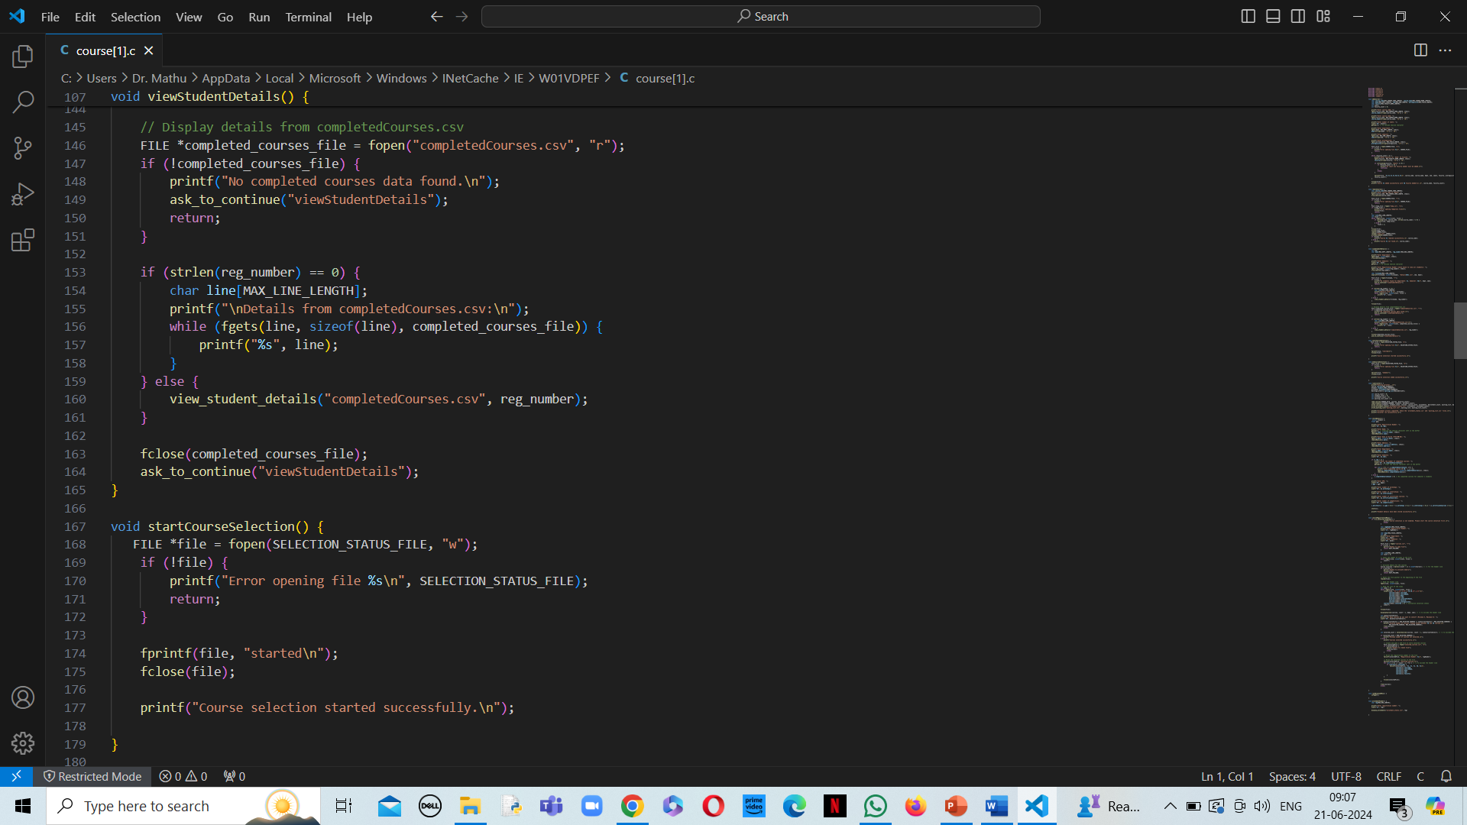

Slide 45
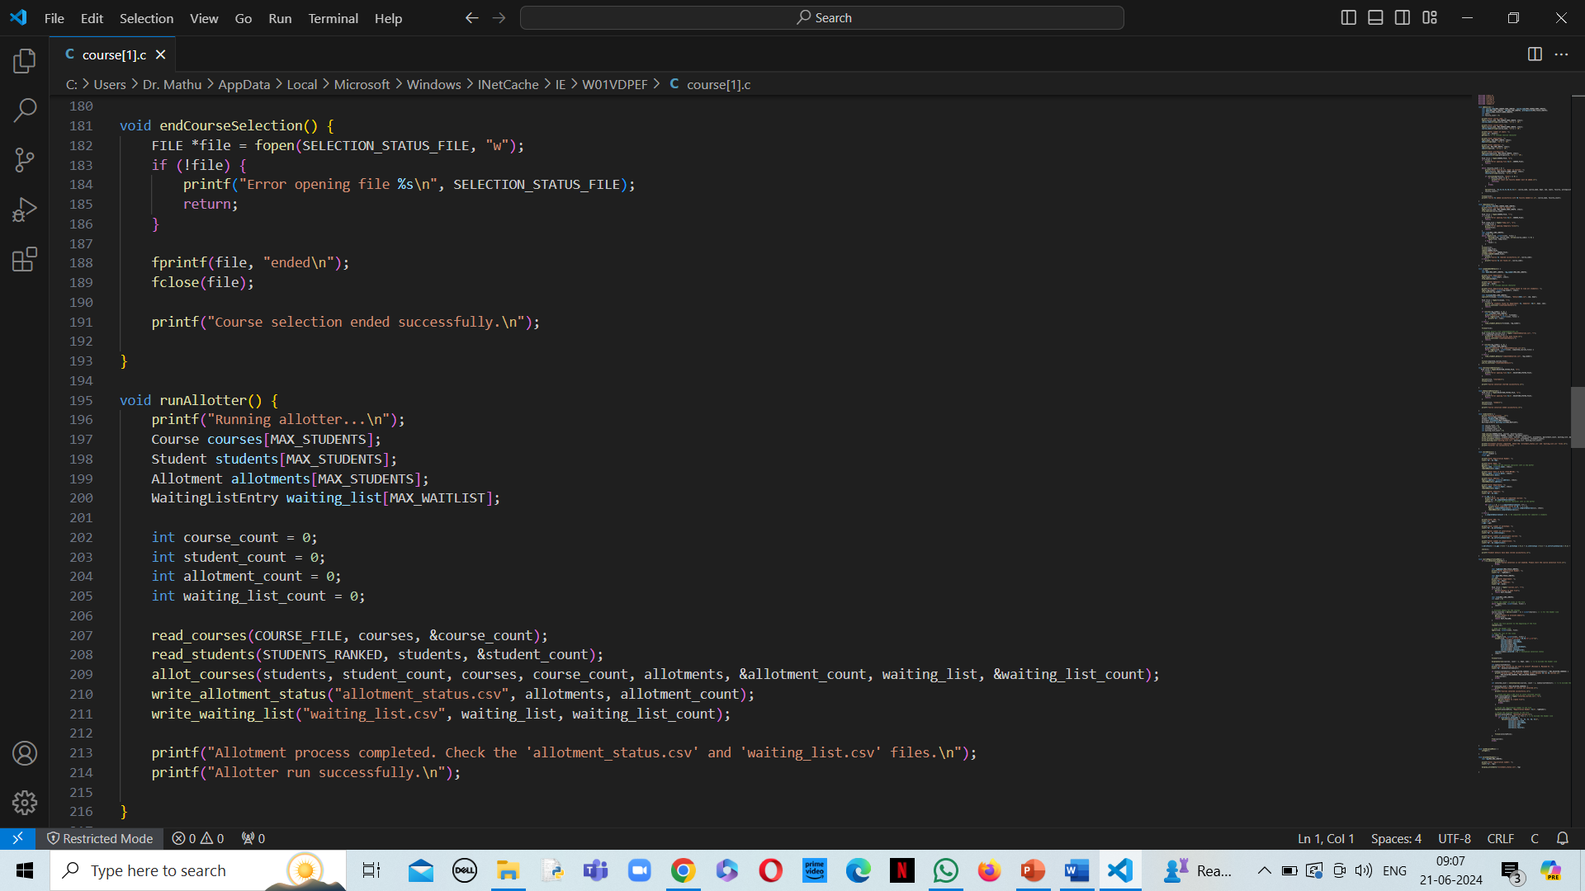

Slide 46
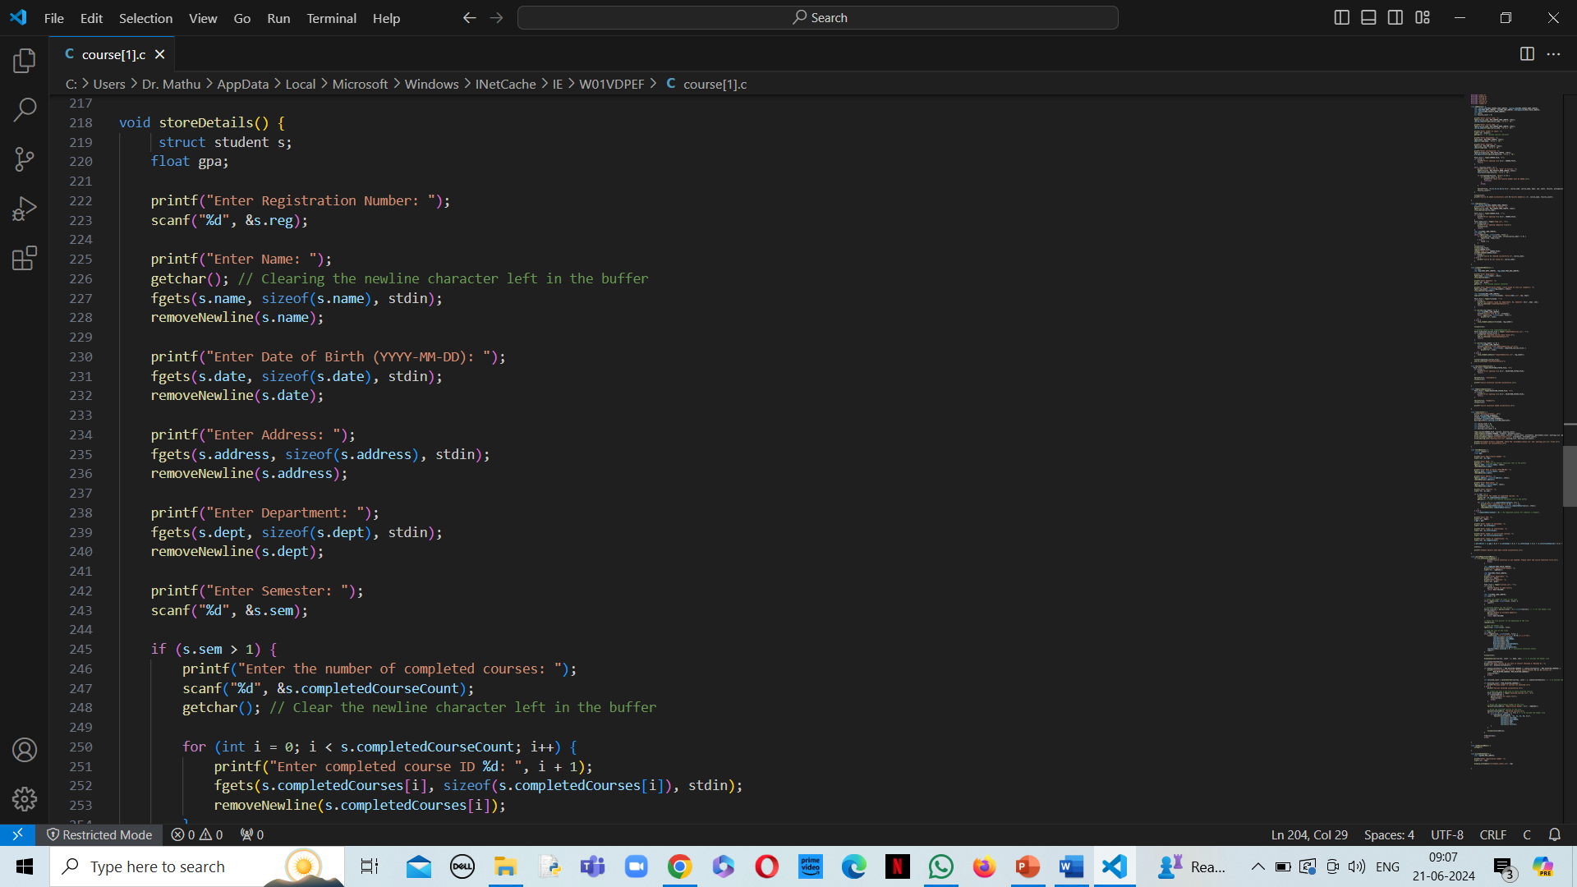

Slide 47
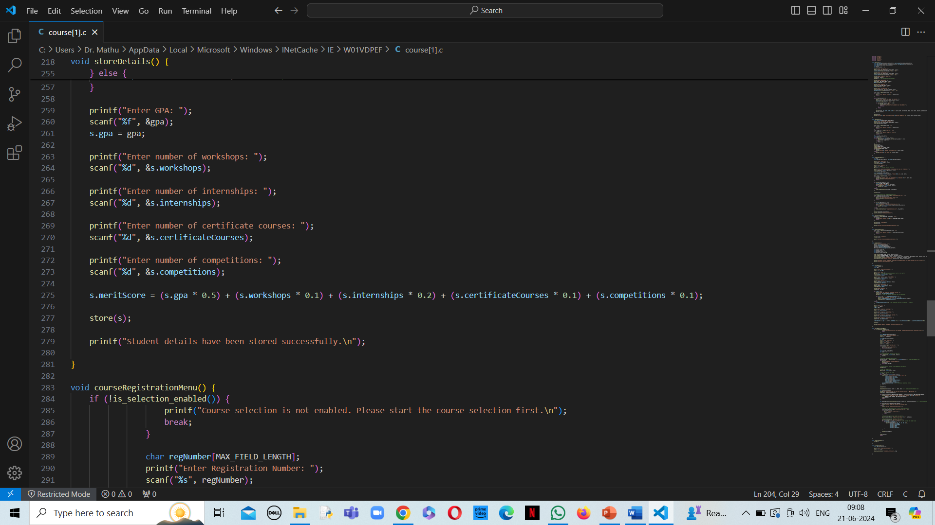

Slide 48
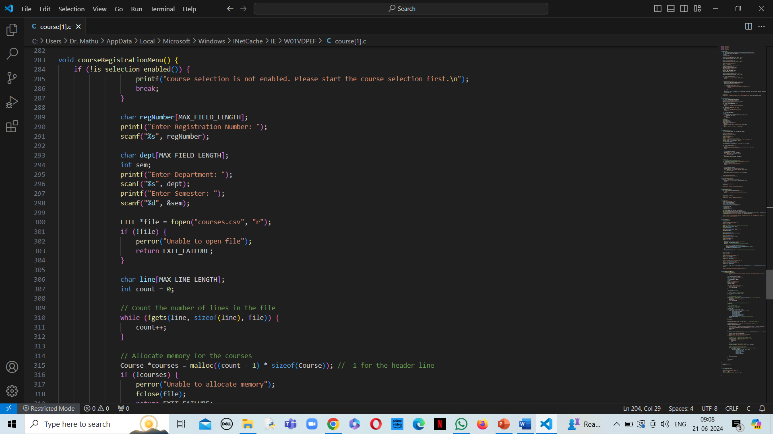

Slide 49
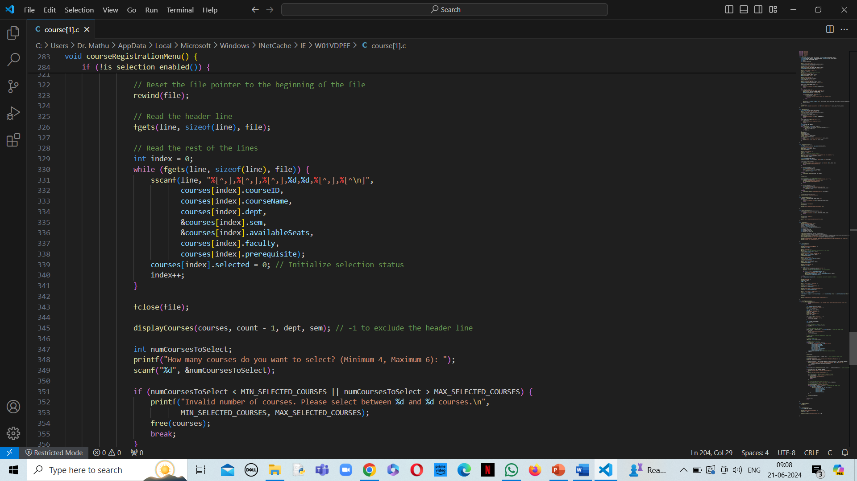

Slide 50
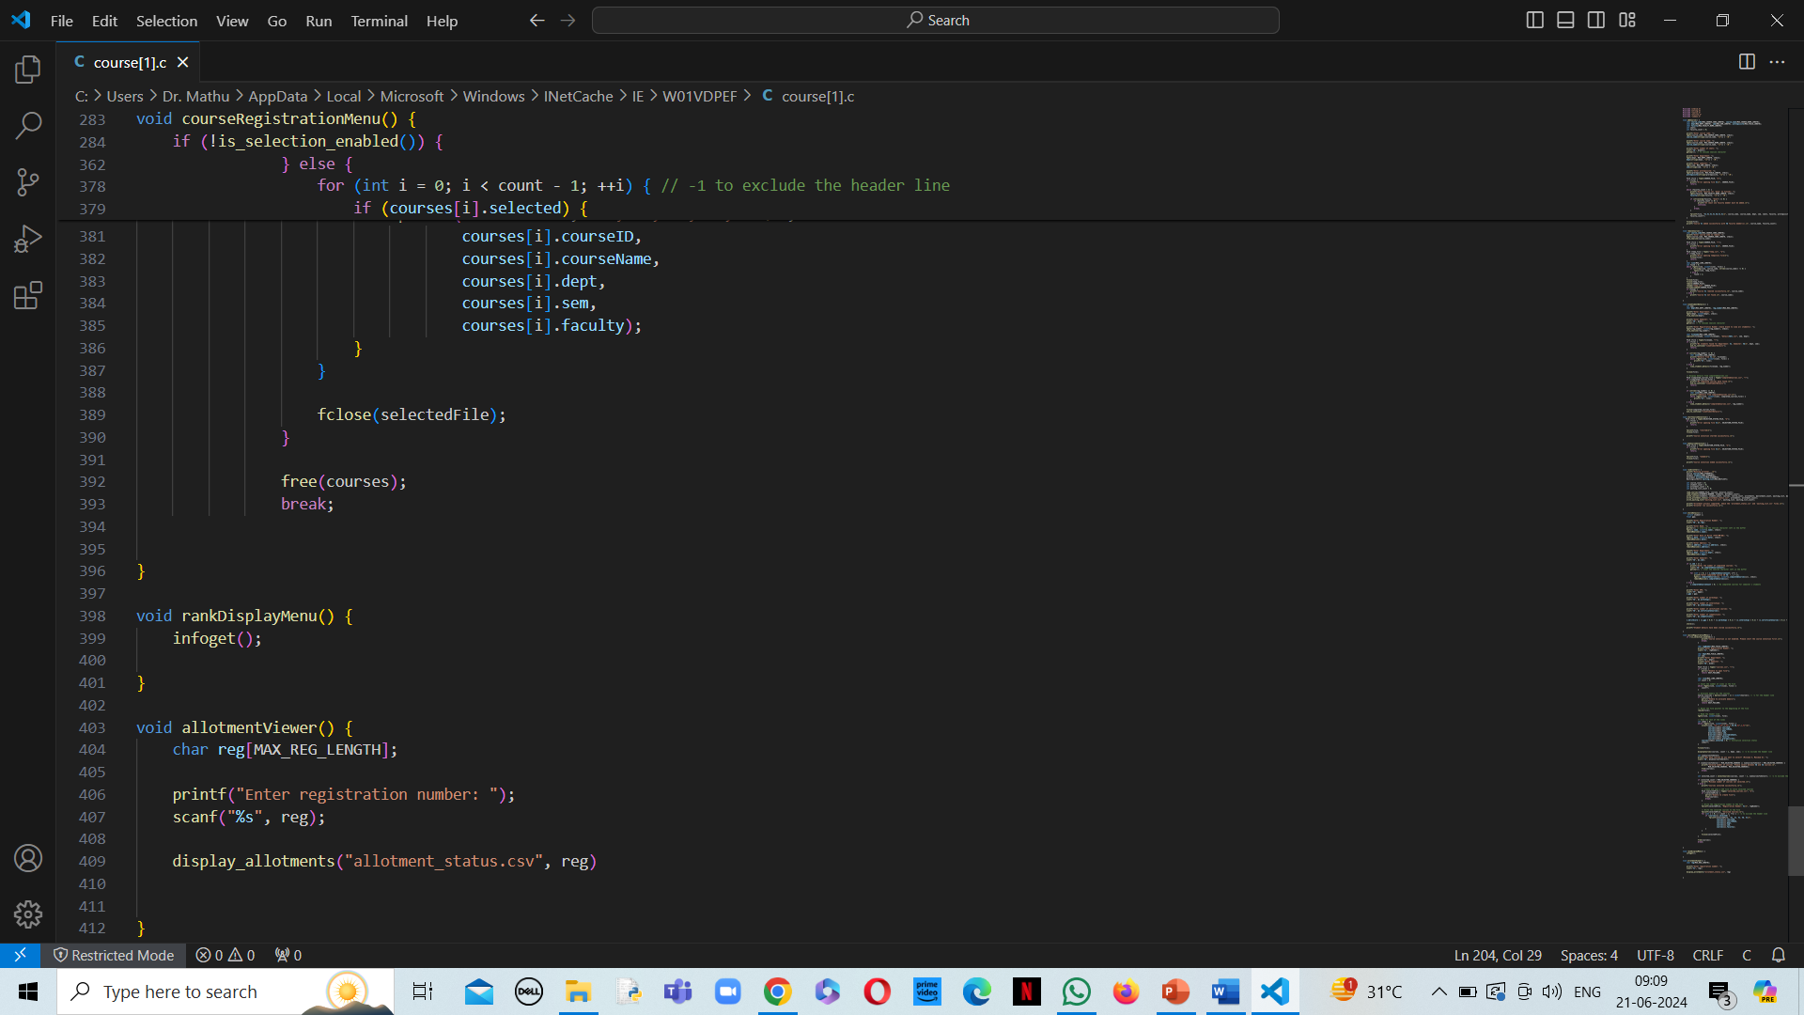

Slide 51
COMMON.C

Slide 52
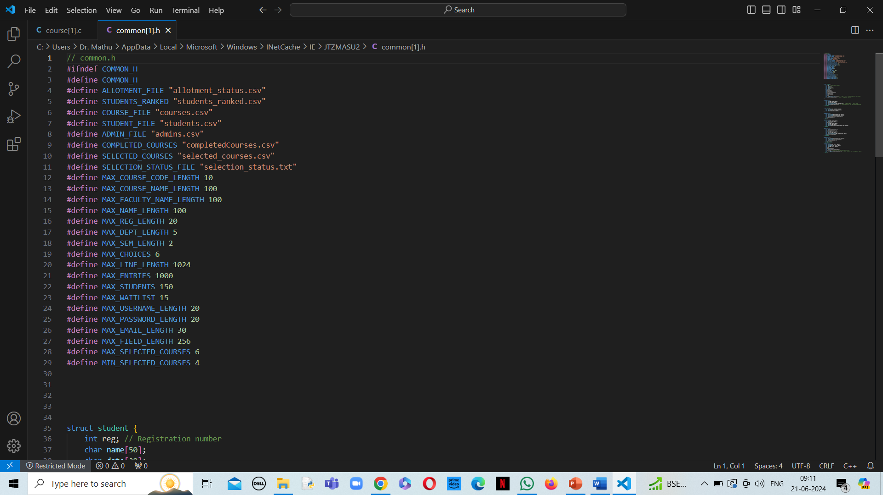

Slide 53
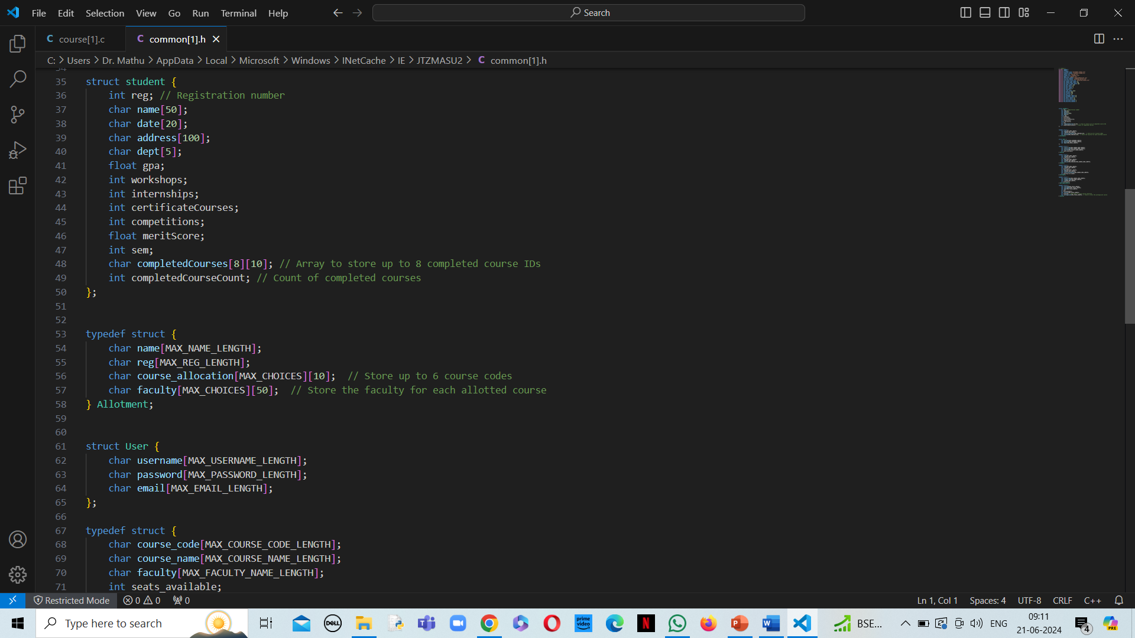

Slide 54
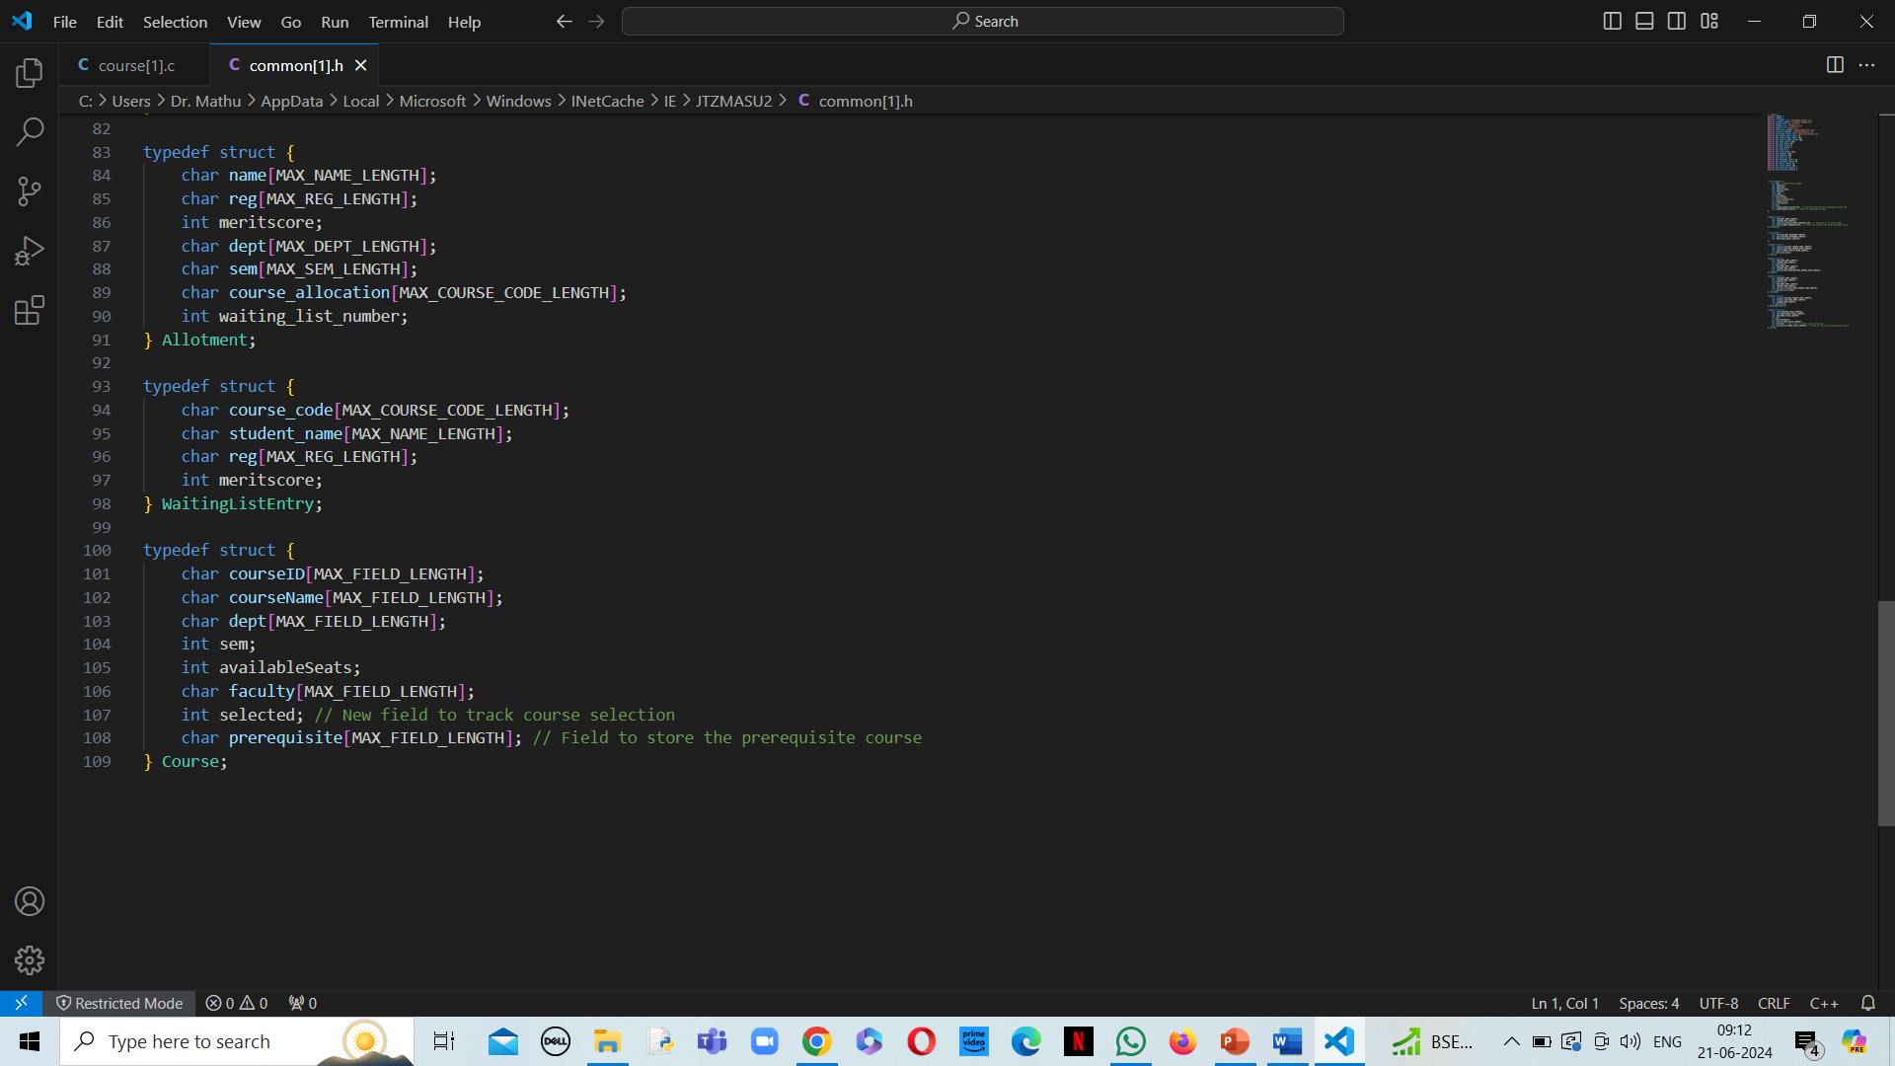

Slide 55
Utility.h

Slide 56
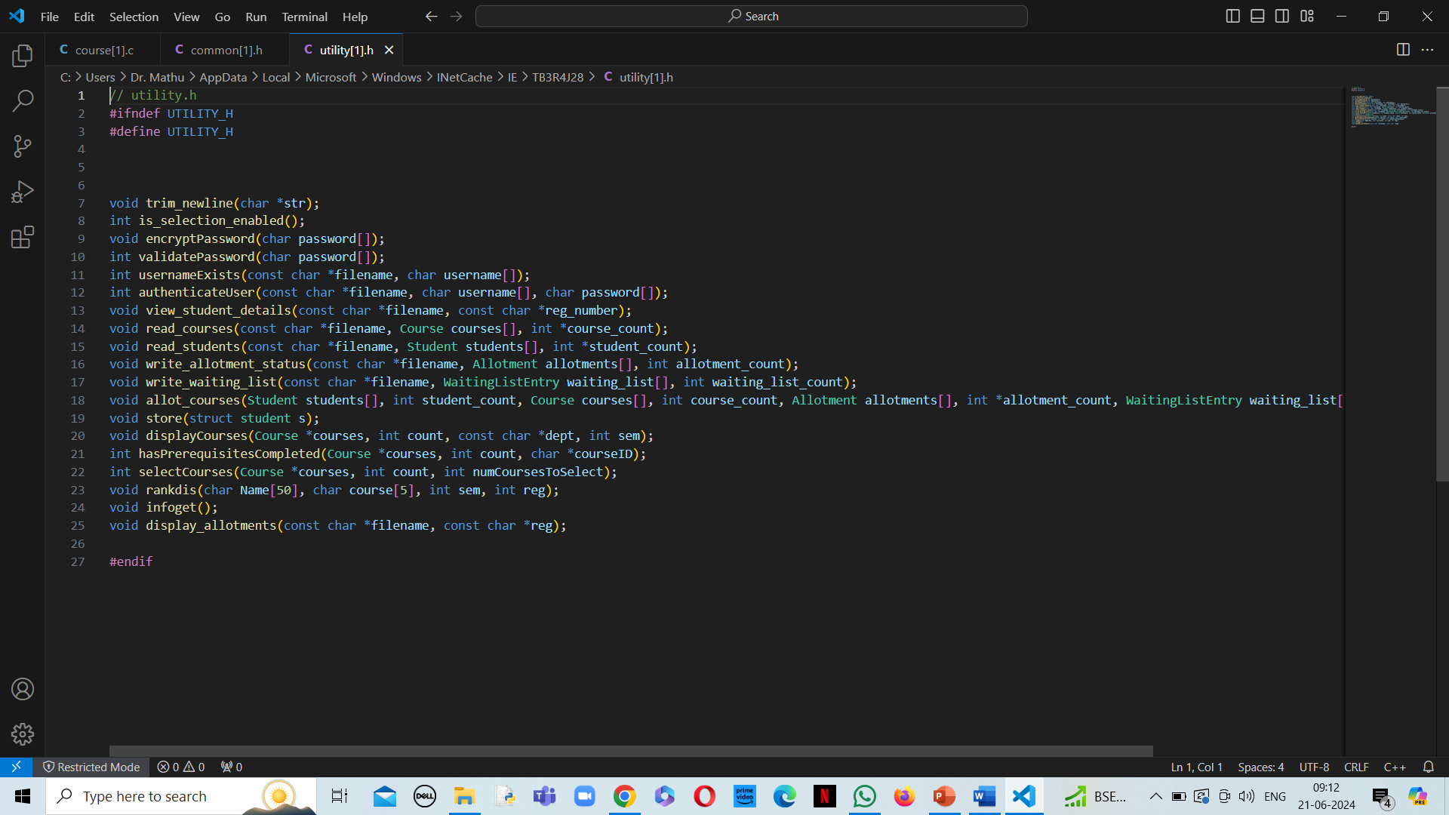

Slide 57
UTILITY.C

Slide 58
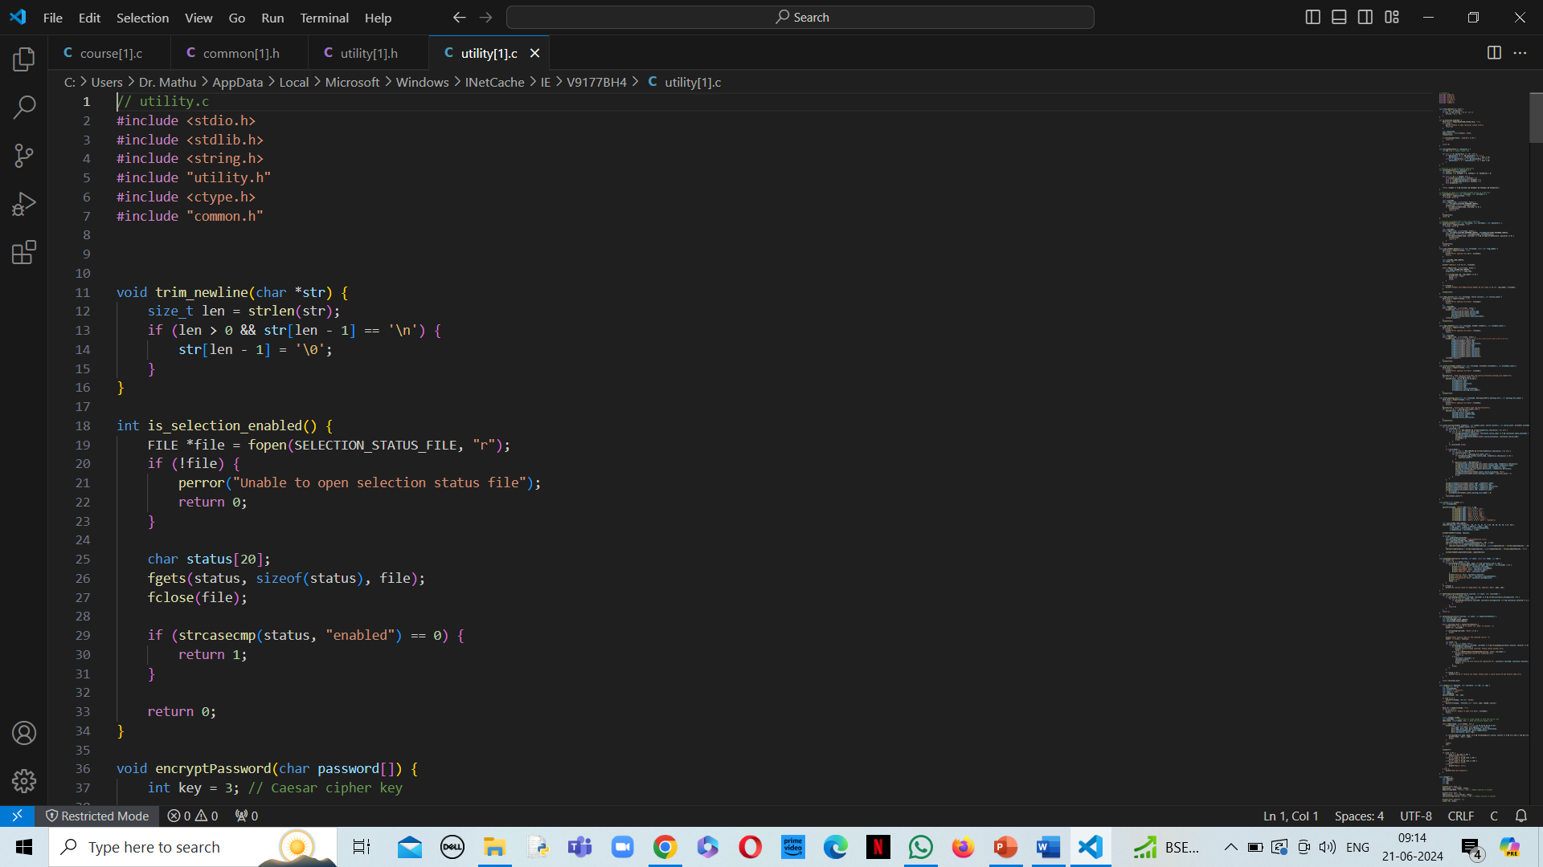

Slide 59
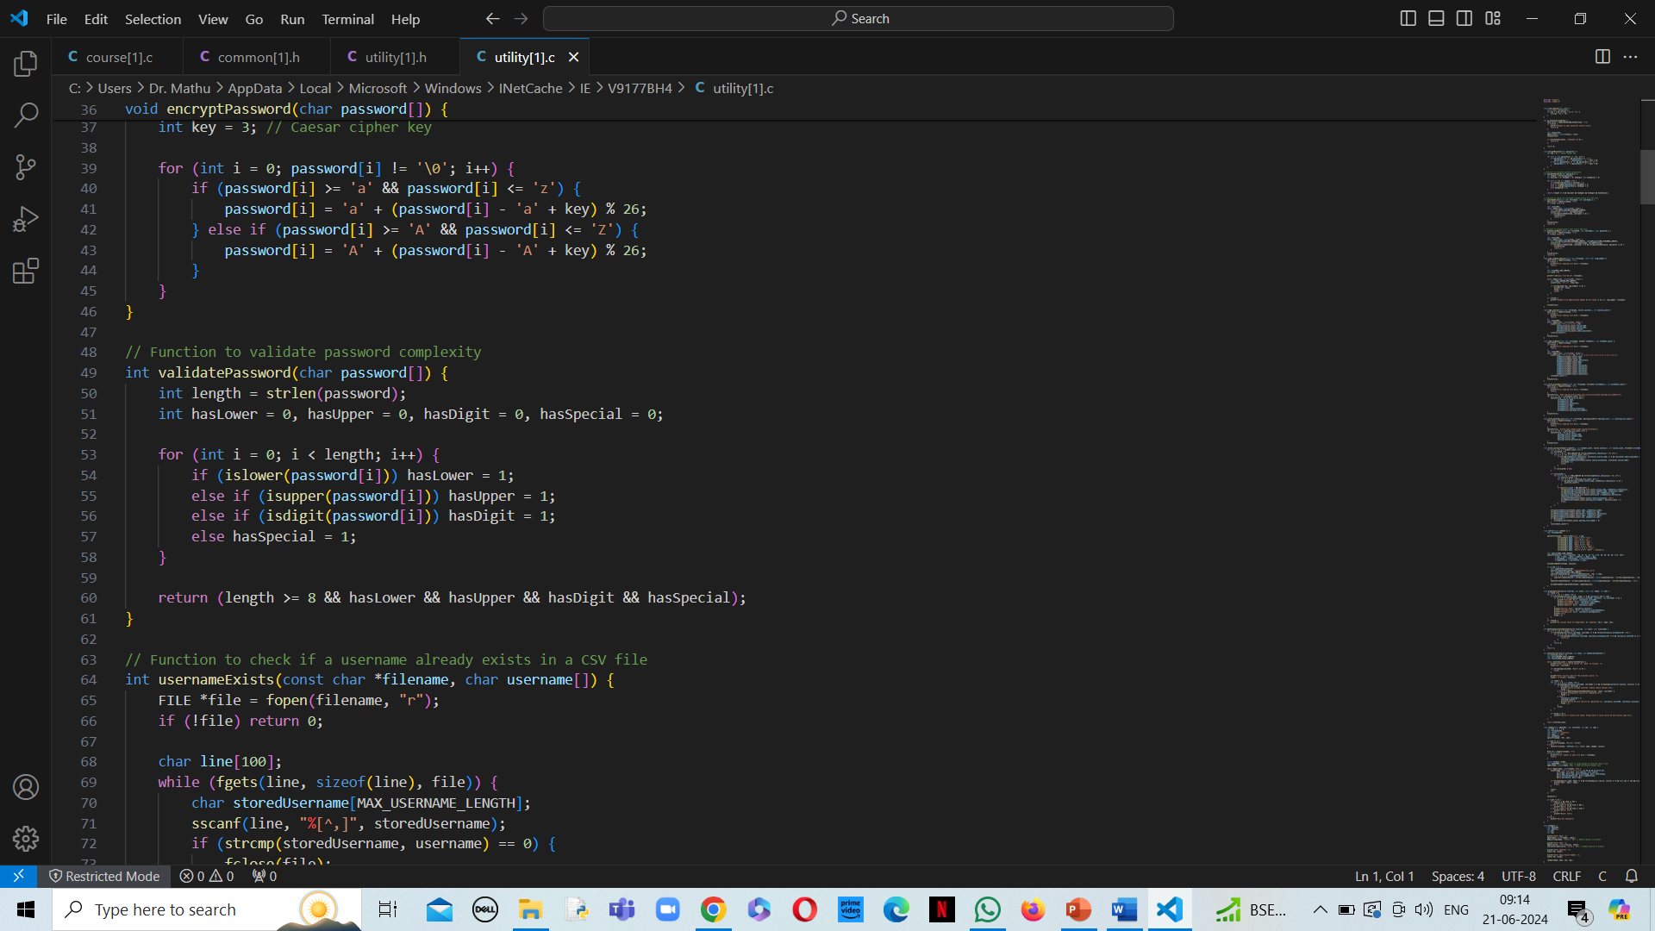

Slide 60
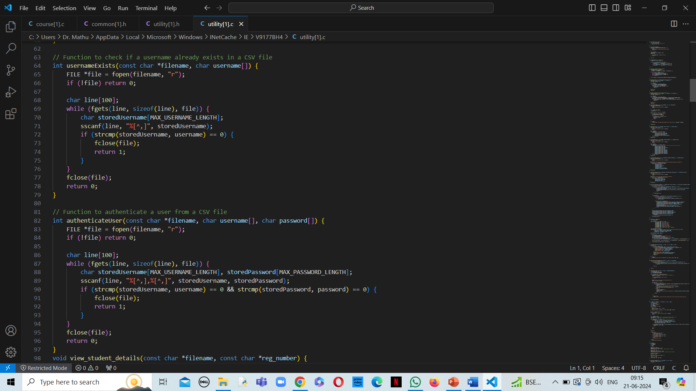

Slide 61
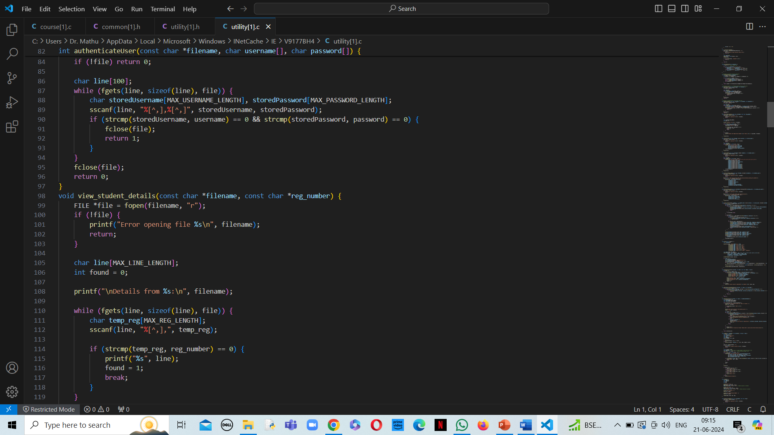

Slide 62
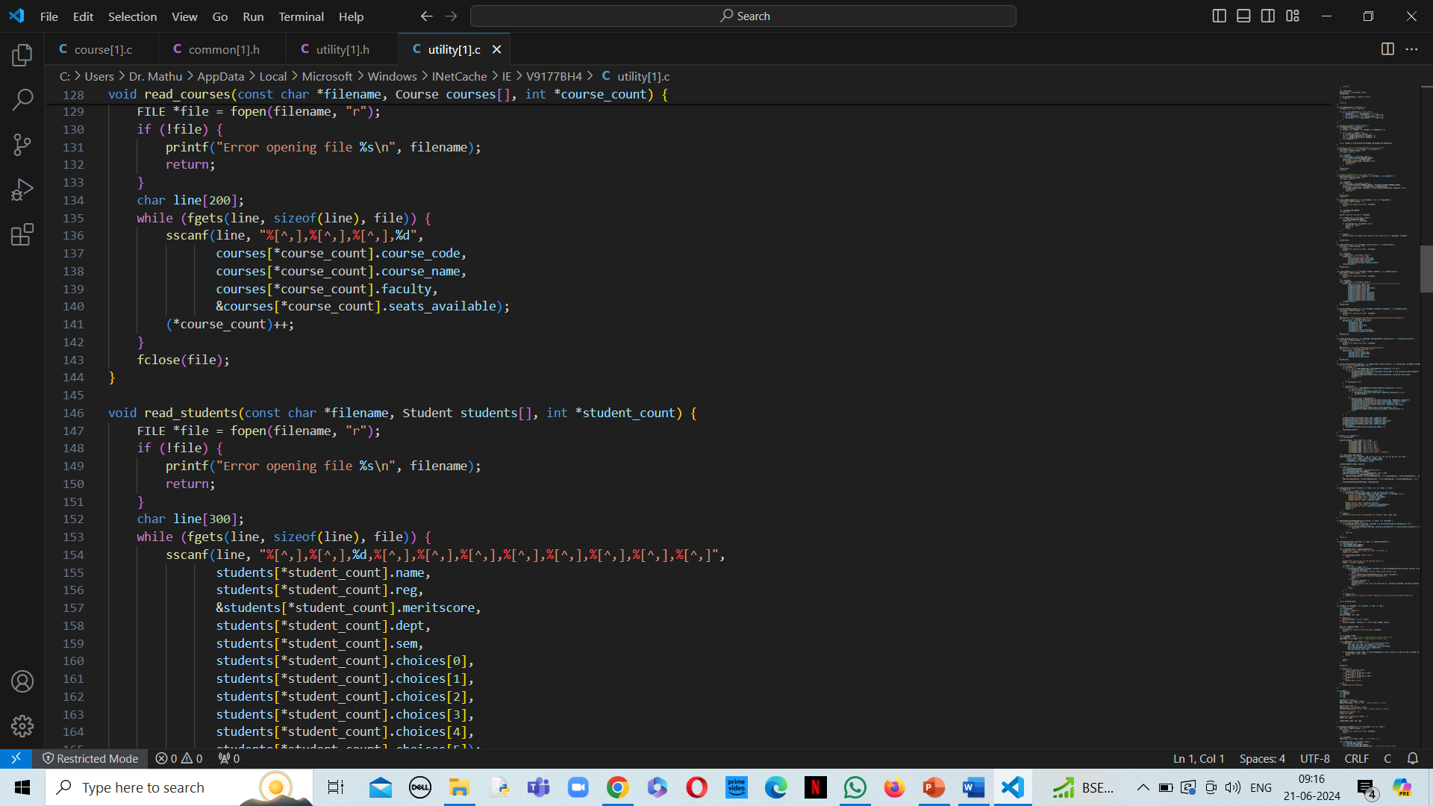

Slide 63
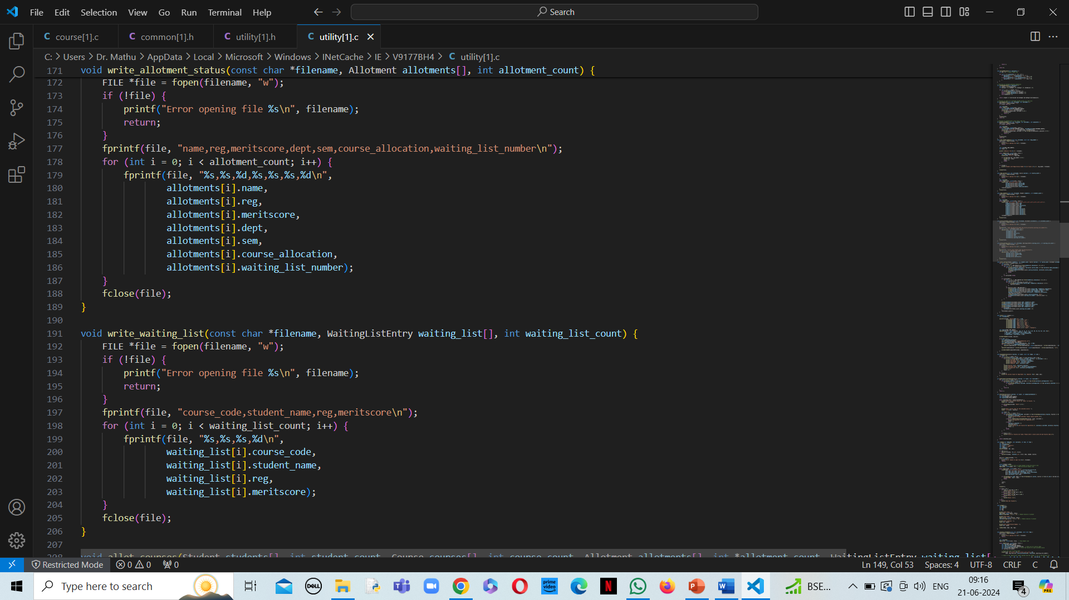

Slide 64
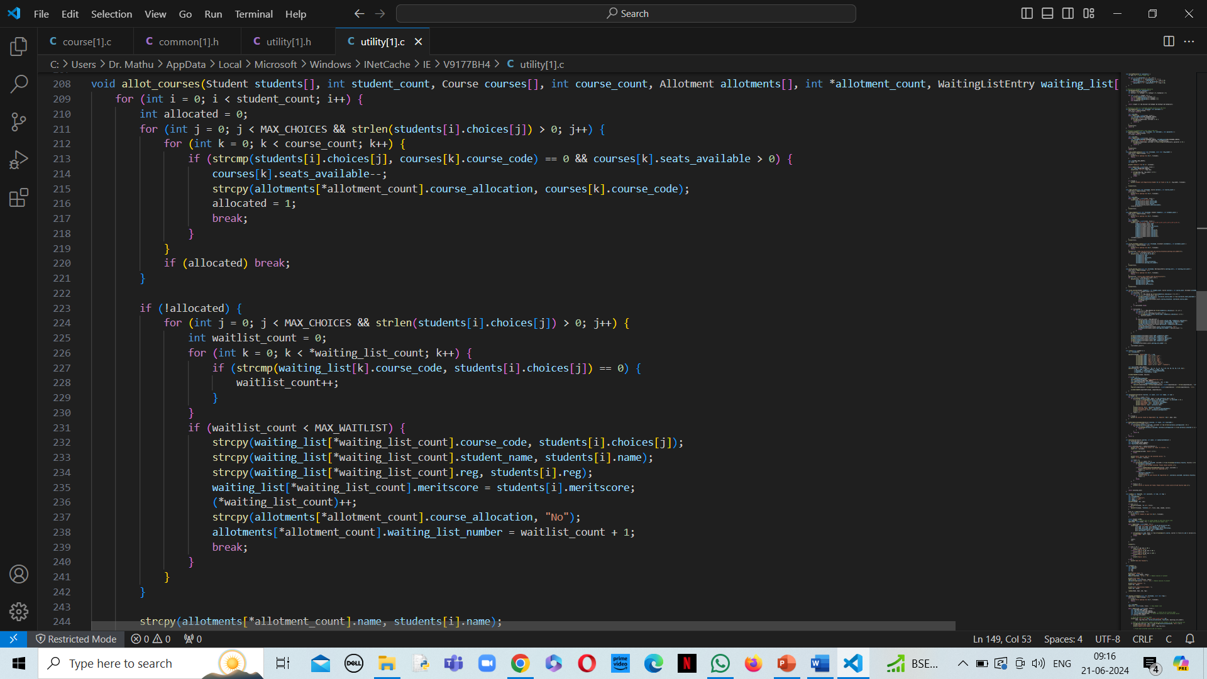

Slide 65
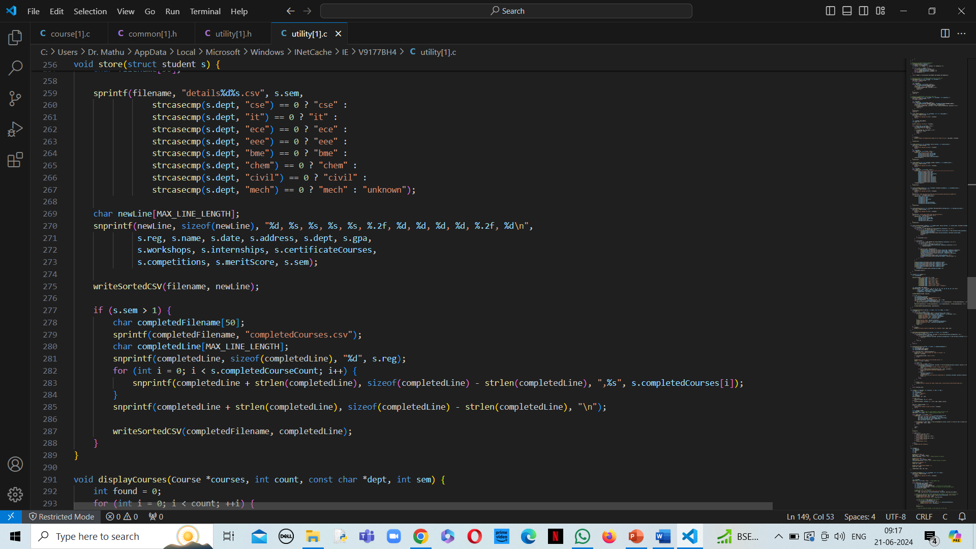

Slide 66


Slide 67


Slide 68


Slide 69


Slide 70


Slide 71
LIMITATIONS
SECURITY: Lack of security to protect sensitive information of the users.
COMMUNICATION: Interaction between the user and admin is not possible in case of emergency.
STORAGE: Storing the information of students in files takes up a lot of storage in the system and slows down the process.

Slide 72
THANK YOU

