Slide 1
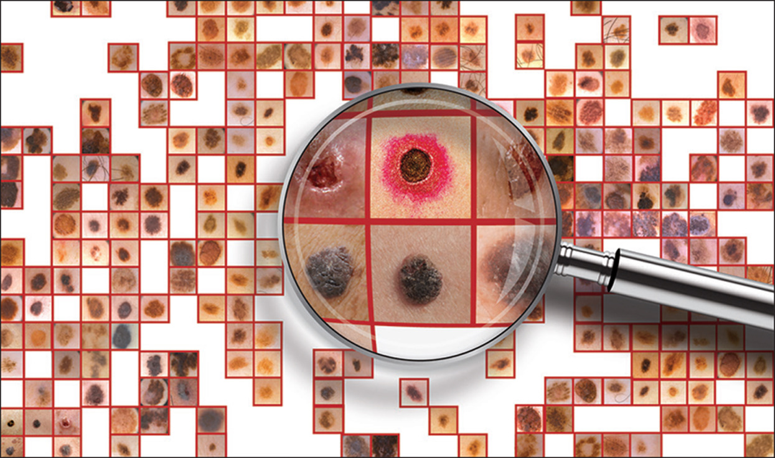
SKIN CANCER DETECTION USING TRANSFER LEARNING Approach

Slide 2
Problem Statement
In this project we will build Transfer learning based Deep Convolutional Neural Network for detecting three major types of Skin Cancers i.e.,
Basal Cell Carcinoma
Melanoma
Nevus
For building the CNN model we have used International Skin Imaging Collaboration (ISIC) 2019 Challenge dataset available at https://challenge.isic-archive.com/data/
The distribution of images in training data for each class are as follows:
Basal Cell Carcinoma (3273)
Melanoma (4472)
Nevus (4550)

Slide 3
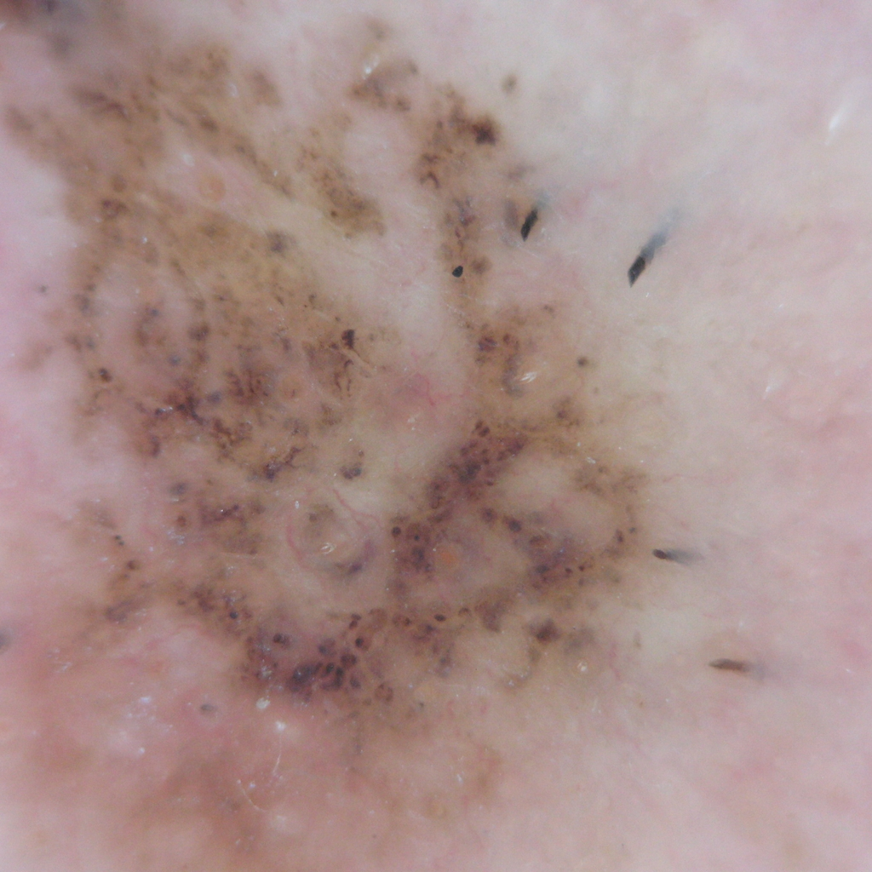
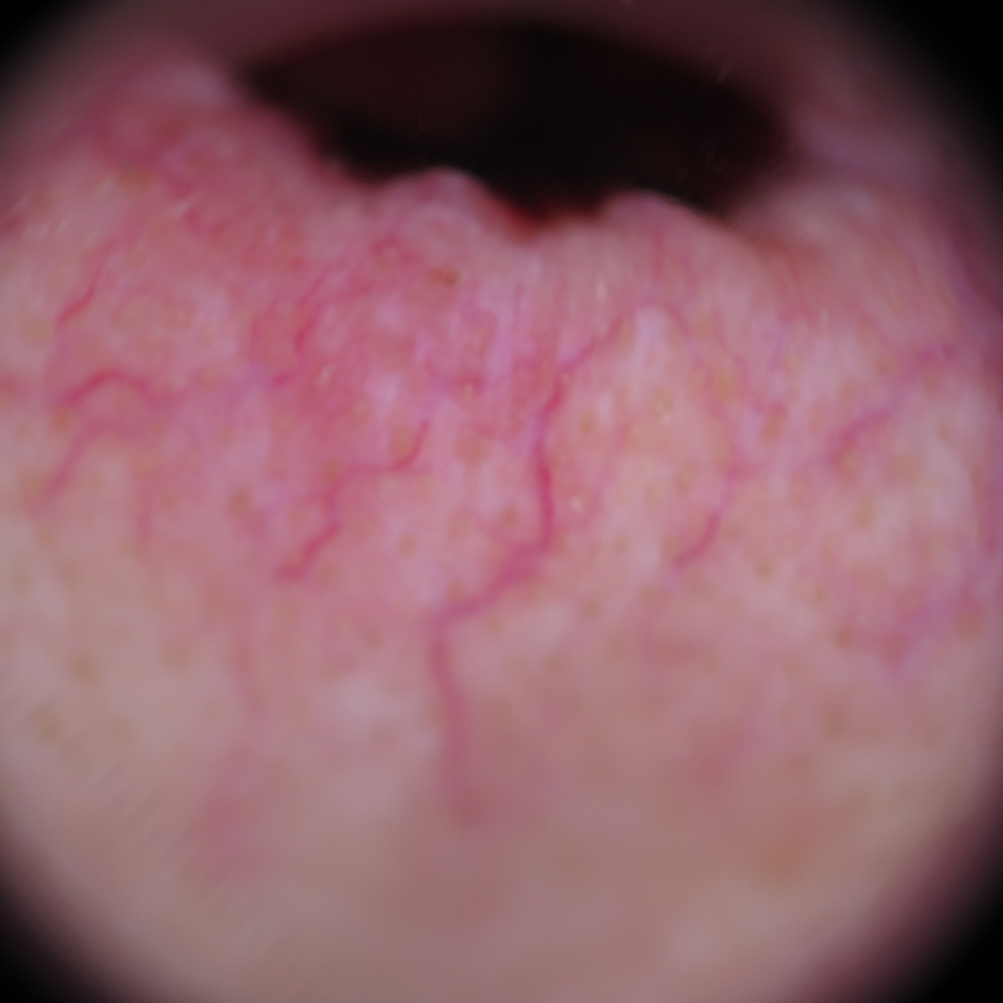
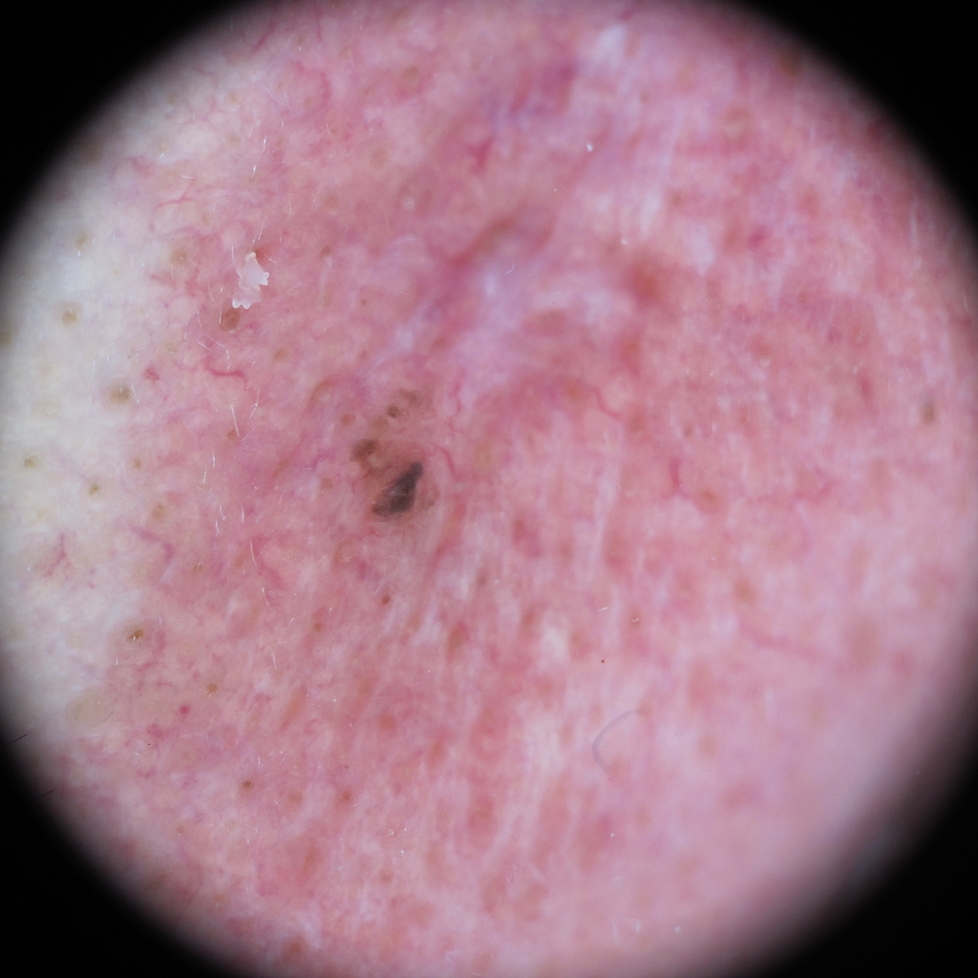
1. Basal Cell Carcinoma
Basal cells are found at the bottom of the epidermis — the outermost layer of skin.
Basal cells produce new skin cells as old ones die.
BCC most often occurs when DNA damage from exposure to ultraviolet (UV) radiation from the sun or indoor tanning triggers changes in basal cells in the outermost layer of skin (epidermis), resulting in uncontrolled growth.
BCCs may ooze, crust, itch or bleed. The lesions commonly arise in sun-exposed areas of the body.
Basal cell carcinoma is quite common. The number of reported cases in the U.S. has steadily increased.
- An estimated 3.6 million Americans are diagnosed with BCC each year.
- More than one out of every three new cancers are skin cancers, and the vast majority are BCCs.

Slide 4
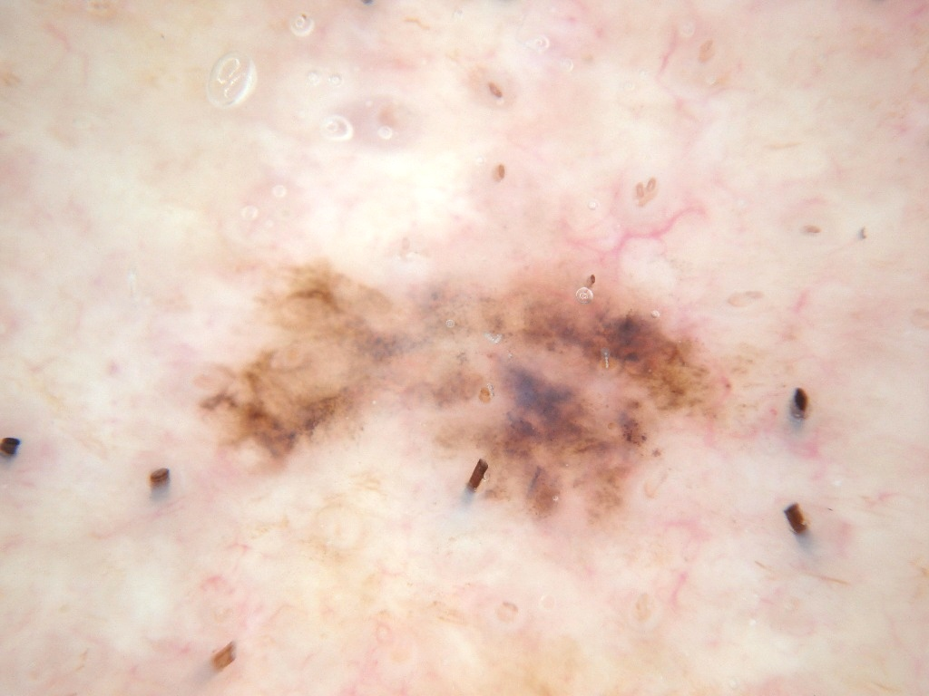
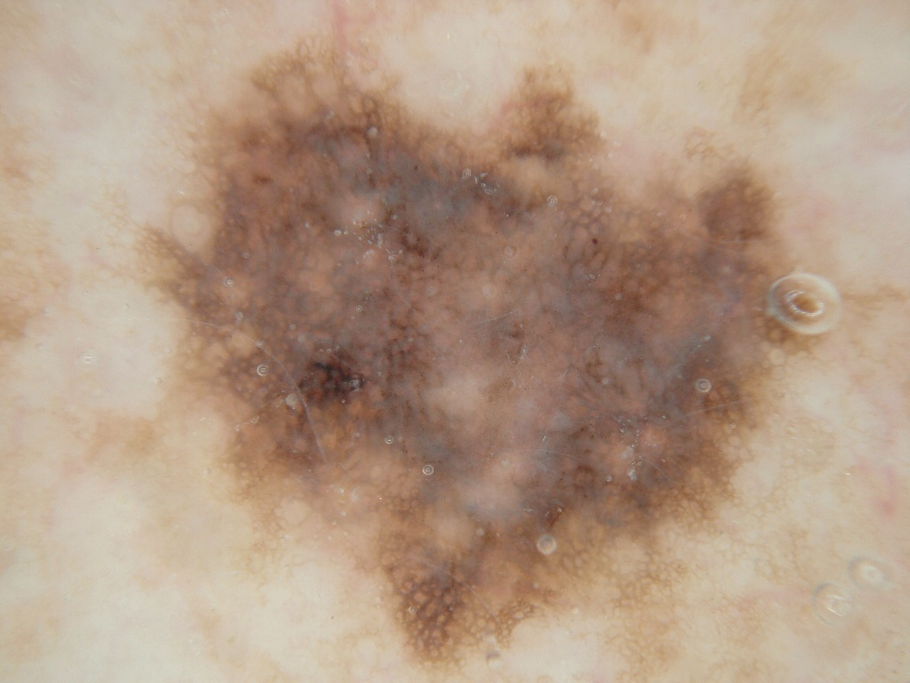
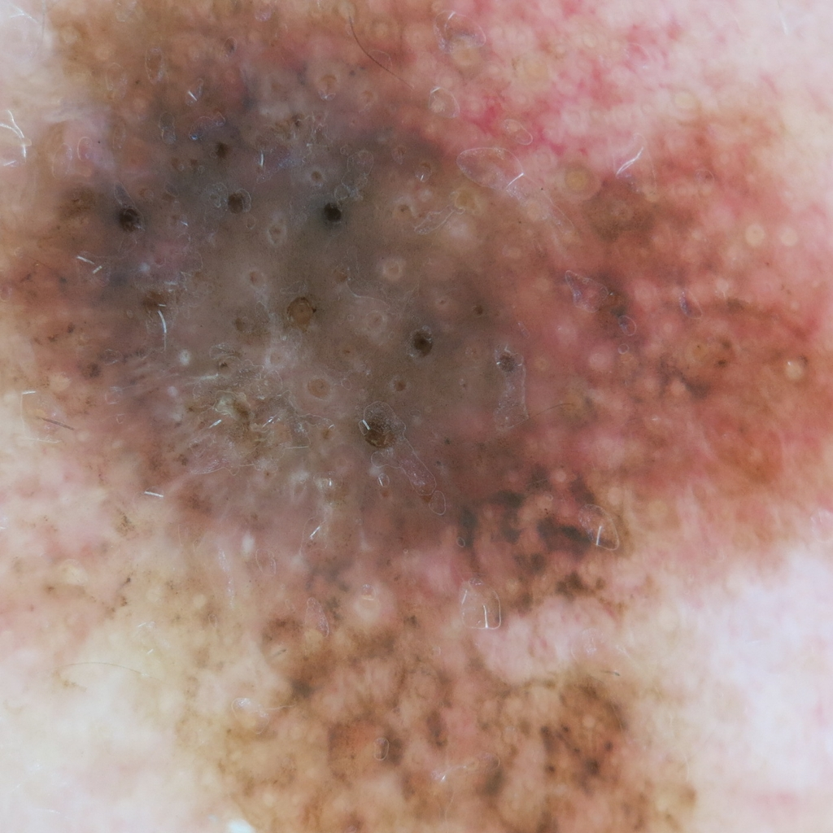
2. Melanoma
Melanoma,(black tumour) the most serious type of skin cancer, develops in the cells (melanocytes) that produce melanin — the pigment that gives your skin its color.
Melanoma occurs when the pigment-producing cells that give color to the skin become cancerous.
Symptoms might include a new, unusual growth or a change in an existing mole.
Melanomas can occur anywhere on the body.
Melanoma accounts for only about 1% of skin cancers but causes a large majority of skin cancer deaths.

Slide 5
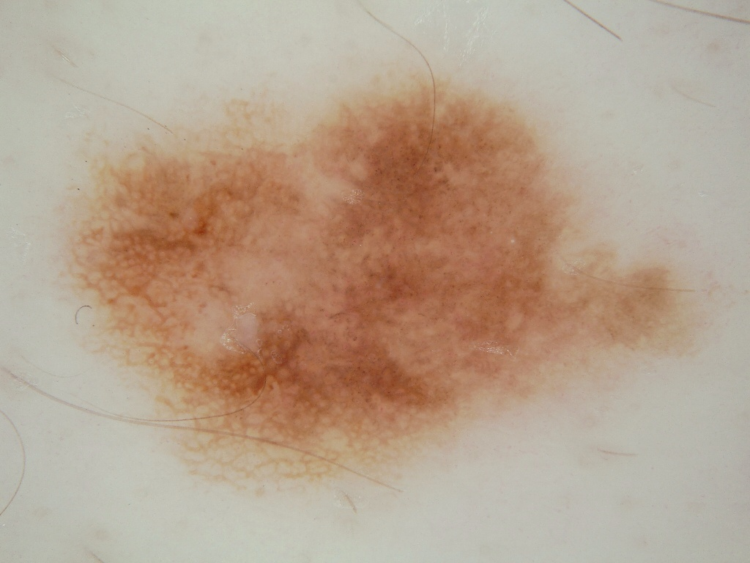
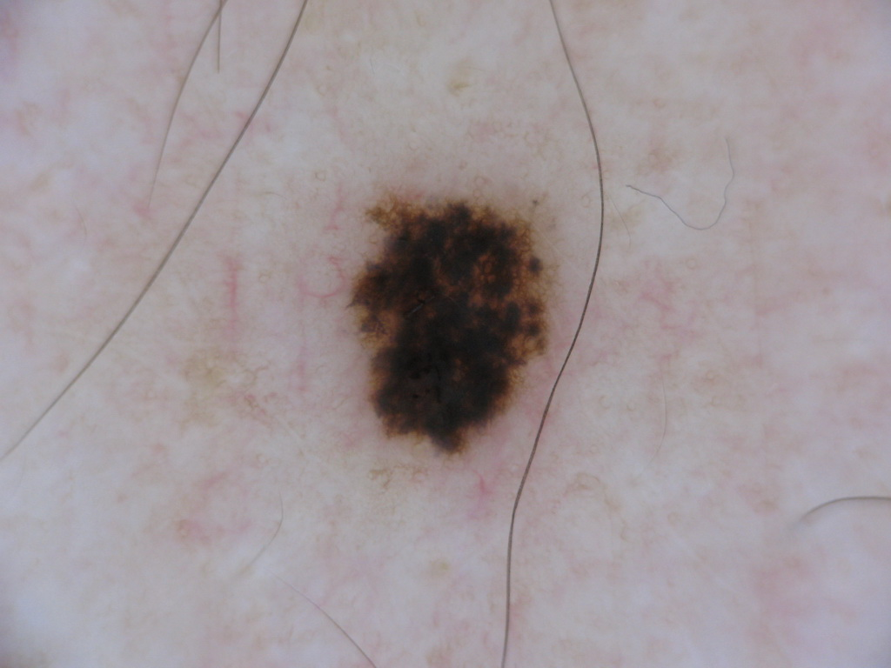
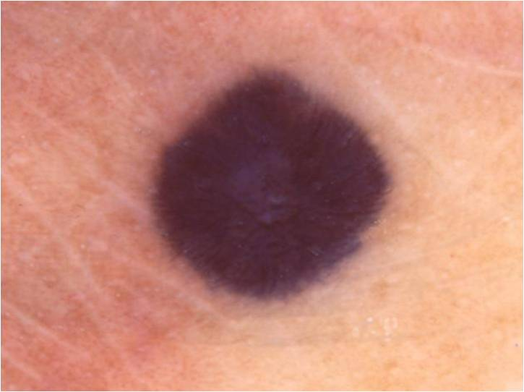
3. Nevus
Nevus is basically a mole on skin that is formed by a cluster of melanocytes (cells that make a substance called melanin, which gives color to skin and eyes).
In most cases, a nevus is benign and doesn't require treatment. Rarely, they turn into melanoma or other skin cancers. A nevus that changes shape, grows bigger or darkens should be evaluated for removal.

