Slide 1
Problem Statement: Movie recommendation system
Team : Innov8

Slide 2
Introduction :
Robust Movie recommendation based on various machine learning algorithms.
Dataset : https://grouplens.org/datasets/movielens/ (265 MB)
Algorithms Used : 1) IMDb weighted average formula
2) K-Nearest Neighbour (KNN) algorithm
3) Cosine Similarity (Content Based)
4) Matrix Factorisation (Collaborative filtering)

Slide 3
Approach:
Gather Data from “ grouplens.org “ .
Understanding Semantics of Dataset .
Create Dataframes from Datasets .
Apply IMDb Weighted Average Formula .
Apply KNN Algorithm .
Apply Cosine Similarity (Content Based) Algorithm .
Apply Matrix Factorisation (Collaborative filtering) .
Prediction .

Slide 4
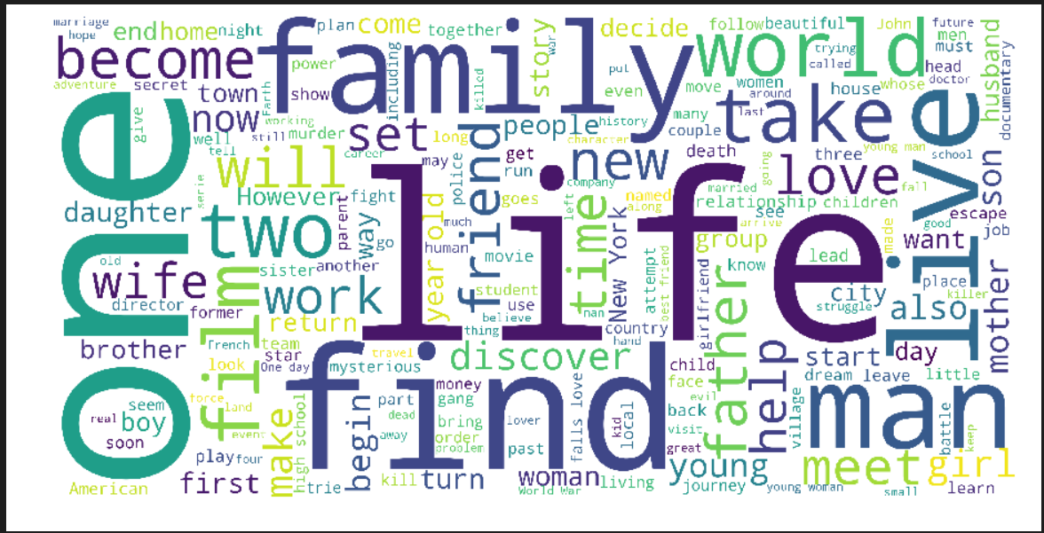
Word Cloud

Slide 5
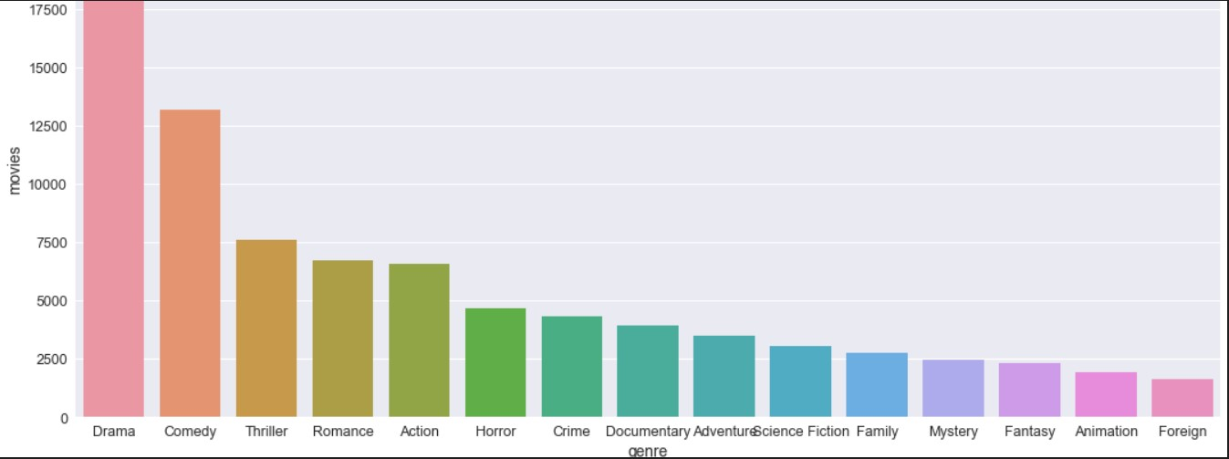
Data Visualization : Genres vs. Movies

Slide 6
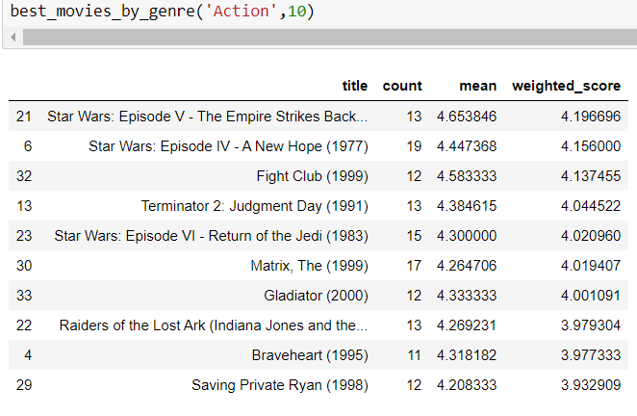
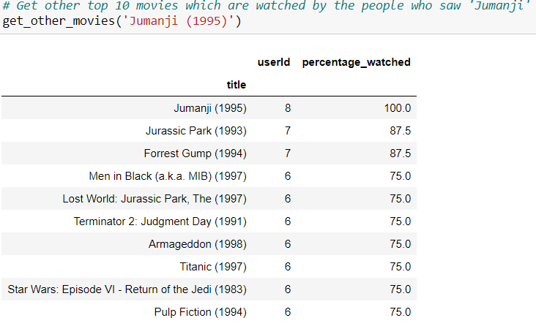
IMDb weighted average Output

Slide 7
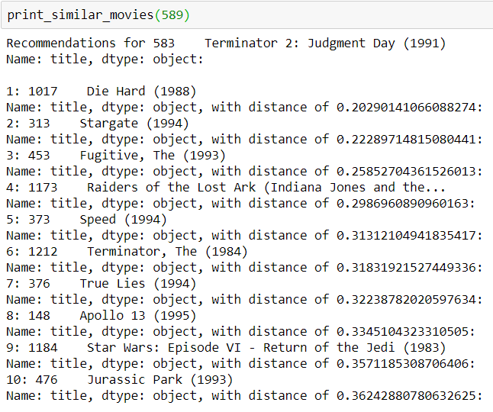
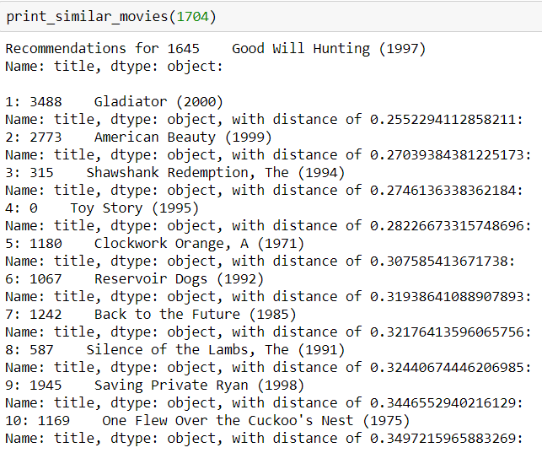
K-Nearest Neighbour (KNN) Output

Slide 8
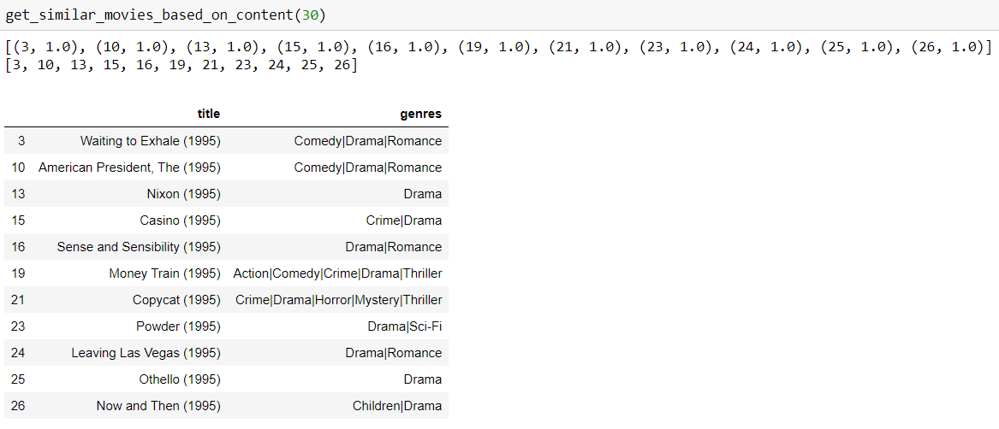
Cosine Similarity (Content Based) Output

Slide 9
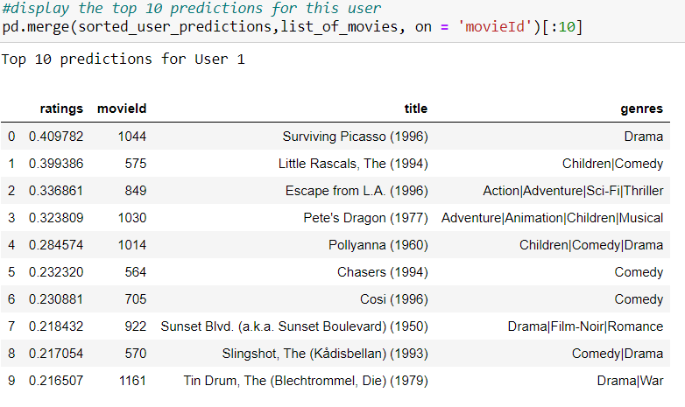
Matrix Factorisation (Collaborative filtering) Output

