Slide 1
VAKIL SETU
Multilingual legal intake and consultation
Problem Reason Objective Journey
Execution Contribution Takeaway
Faculty project presentation
01
Notes:
Good morning. We are presenting Vakil Setu, a multilingual legal intake and consultation project. Our focus is the first step a person takes when facing a legal concern: explaining the situation, reviewing a clear summary, and finding an appropriate advocate. The current project is a web application with English, Hindi and Punjabi pilot interfaces. We will explain the problem, our development approach, how the application works, and the evidence behind our results.
Presenter cue: Introduce the team verbally. Keep the opening under 30 seconds.
Sources:
C:/Users/DELL/Vakil-Setu/rebuild/README.md
C:/Users/DELL/Vakil-Setu/rebuild/docs/decisions.md

Slide 2
P / PROBLEM
The difficult first step
A person can describe a problem without knowing its legal category
People
Citizens unfamiliar with legal processes or legal English
Friction
Unstructured facts, language mismatch and uncertainty about whom to contact
Today
Personal referrals, online searches and separate consultation services
Project gap
A private, reviewed intake that carries into a consultation request
Problem hypothesis. No field survey or measured user impact is claimed.
02
Notes:
The problem we address is uncertainty at the beginning of a legal interaction. A person may know what happened but may not know the relevant legal category, which facts matter, or whom to contact. Searching online or relying on personal referrals can leave the person repeating the same story across different channels. Our working hypothesis is that a private intake in a familiar language, followed by a reviewed summary, can make this first interaction easier. We have not yet measured that benefit through a field study, so we present it as the problem we are testing.
Presenter cue: Use a hypothetical tenant whose security deposit has not been returned. Do not give a legal conclusion.
Sources:
C:/Users/DELL/Vakil-Setu/rebuild/docs/requirements.md
C:/Users/DELL/Vakil-Setu/rebuild/docs/srs-source.txt

Slide 3
R / REASON
Existing services and our focus
Access to legal help already has established approaches
Tele-Law
Connects people with lawyers through phone and video services
LawRato
Offers advocate discovery and consultation options
Vakil Setu
Focuses on multilingual intake, user review and controlled summary sharing
Why this scope
Citizens prepare their account. Advocates receive the version the user approved.
Differentiation is a project focus. Comparative superiority remains untested.
03
Notes:
The need for digital legal access is already recognised. Tele-Law connects people with lawyers through telephone and video services, while LawRato provides lawyer discovery and consultation options. We therefore cannot claim that online access to lawyers is a new idea. Our project focuses on the intake before the consultation: retaining the user's words, letting the user review a summary, and sharing a specific version with a chosen advocate. Citizens and advocates are the intended beneficiaries. Whether this approach improves completion or reduces repeated explanations still requires a comparative user study.
Presenter cue: Explain the project's chosen focus without claiming competitors lack these capabilities.
Sources:
https://www.tele-law.in/faq.html
https://lawrato.com/cmses/page/how-does-lawrato-work
C:/Users/DELL/Vakil-Setu/rebuild/packages/backend/convex/bookings.ts

Slide 4
O / OBJECTIVE
A reviewable path to consultation
The MVP centres on a private intake and an explicit request lifecycle
Included in the MVP
Completion criteria
Accounts and application roles
Preserve the user's reviewed words
Private intake and versioned summaries
Enforce ownership on the backend
Advocate approval and discovery
Share only the approved summary version
Future slots and consultation requests
Show pending and accepted states clearly
Payments, reviews, native mobile and guaranteed emergency dispatch are deferred.
04
Notes:
Our objective is to implement a reviewable path from a person's concern to a consultation request. The MVP includes user accounts, application roles, private cases, versioned summaries, advocate approval, discovery and future consultation slots. Successful completion means that the system preserves the user's words, checks ownership on the backend, shares the exact approved summary version, and clearly records the request state. A request remains pending until an advocate accepts it. Payments, public reviews, a native mobile application and guaranteed emergency connections are outside the current MVP.
Presenter cue: Separate the implemented workflow from the remaining hosted acceptance checks.
Sources:
C:/Users/DELL/Vakil-Setu/rebuild/README.md
C:/Users/DELL/Vakil-Setu/rebuild/docs/requirements.md
C:/Users/DELL/Vakil-Setu/rebuild/packages/backend/convex/bookings.ts

Slide 5
J / JOURNEY
Development approach and decisions
The rebuild preserves the legacy application in a separate directory
01 Audit
Compared the SRS with legacy code and checked advertised capabilities
02 Define
Selected three pilot languages and bounded the consultation MVP
03 Build
Implemented backend rules, private workflows and responsive pages
04 Verify
Used automated checks, browser scenarios and a hosted intake check
Key choice: expand in stages instead of treating a language registry as complete support.
05
Notes:
We began by comparing the source requirements with the inherited React and Express application. That audit exposed a gap between some advertised features and the actual code, so we kept the legacy version and built the maintained implementation separately. We narrowed the first language pilot to English, Hindi and Punjabi. We then developed the backend permissions and consultation lifecycle alongside the web interface. An alternative was to expand every feature and language immediately. We chose staged coverage so that each capability could have separate evidence. Validation combined automated tests, responsive browser checks and a limited real hosted intake check.
Presenter cue: Describe the actual sequence. Do not invent interviews, sprint dates or survey findings.
Sources:
C:/Users/DELL/Vakil-Setu/rebuild/docs/legacy-ai-audit.md
C:/Users/DELL/Vakil-Setu/rebuild/docs/decisions.md
C:/Users/DELL/Vakil-Setu/rebuild/docs/verification.md
C:/Users/DELL/Vakil-Setu/rebuild/docs/hosted-activation.md

Slide 6
E / EXECUTION
Application architecture
Identity and application permissions have separate responsibilities
Web interface
Next.js, React and TypeScript render the multilingual workflows
Identity
Clerk handles sign-in and sessions
Application backend
Convex checks roles and ownership, stores cases and reserves slots
Optional AI
A server-side gateway adapter requires configuration and explicit consent
Shared domain and language packages support consistent rules across the application.
06
Notes:
The current implementation uses Next.js and React for the web interface, with TypeScript across the workspace. Clerk handles identity and sessions. Convex owns the application data and checks roles, record ownership and permitted actions. It also handles slot reservations and lifecycle changes through backend mutations. Shared domain and language packages keep common rules separate from the interface. These choices support a typed web application with a hosted backend and managed identity. AI sits behind a server-side gateway adapter. The browser never needs the provider credentials, and a successful sign-in does not grant unrestricted access to application data.
Presenter cue: If asked why the stack changed, explain the explicit identity and backend permission boundaries.
Sources:
C:/Users/DELL/Vakil-Setu/rebuild/packages/backend/ARCHITECTURE.md
C:/Users/DELL/Vakil-Setu/rebuild/packages/backend/convex/lib/access.ts
C:/Users/DELL/Vakil-Setu/rebuild/packages/backend/convex/lib/provider.ts
C:/Users/DELL/Vakil-Setu/rebuild/package.json

Slide 7
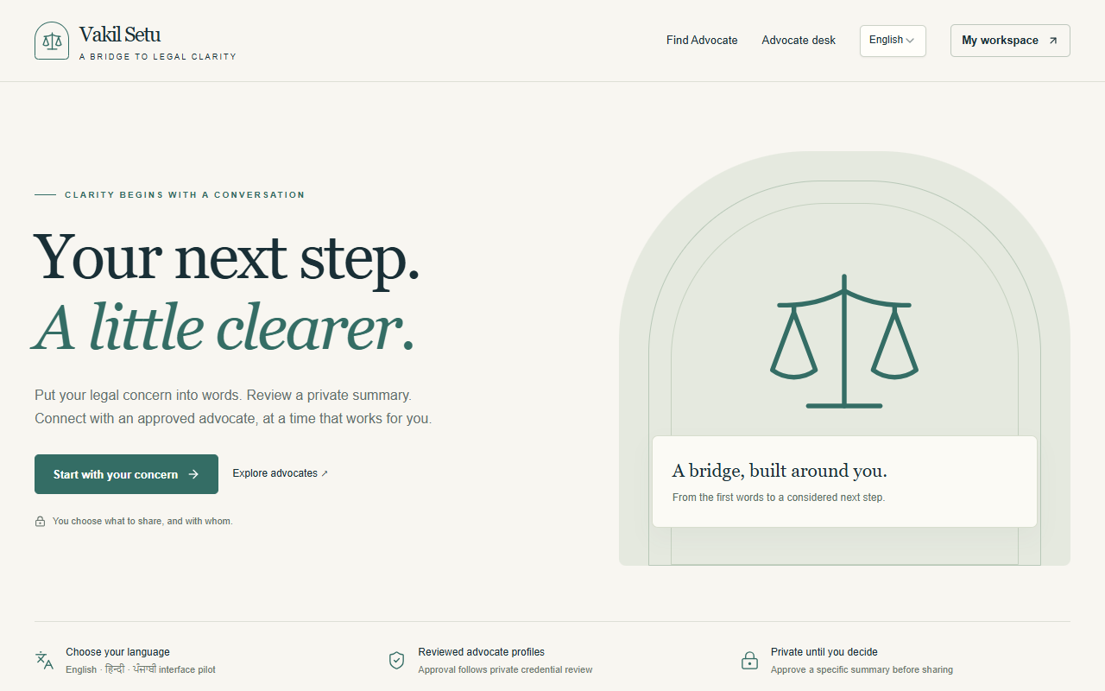
E / EXECUTION
The implemented web experience
Users begin with their own words and choose what to share
Enter
Type a concern or use optional browser speech
Review
Correct the text before saving privately
Continue
Review a summary and browse advocates
Project screenshot. The script includes a separate live-demo sequence.
07
Notes:
This is the implemented web experience. A user starts by describing a concern, either by typing or by trying browser speech where available. The text remains editable before saving. Saving an intake stores the user's words privately. It does not automatically produce AI analysis. The saved case confirms that distinction and offers a manual summary starting from the original intake, or advocate discovery. This gives us a useful workflow even when the AI provider is unavailable. A person should always know whether they are reading their own summary or a provider-generated draft.
Presenter cue: Point to the start action. For a live demo, use the synthetic example in the script appendix.
Sources:
C:/Users/DELL/Vakil-Setu/rebuild/apps/web/src/components/intake.tsx
C:/Users/DELL/Vakil-Setu/rebuild/apps/web/src/components/cases.tsx
C:/Users/DELL/Vakil-Setu/rebuild/.runtime/browser-qa/landing-en-1280.png
C:/Users/DELL/Vakil-Setu/rebuild/docs/verification.md

Slide 8
E / EXECUTION
Consultation request lifecycle
The backend checks the slot and the specific summary-sharing consent
Prepare
Review a summary and choose an approved advocate with a future slot
Consent
Approve the recipient and the exact summary version
Request
Reserve the slot and create a pending consultation request
Resolve
Record acceptance, decline, cancellation, expiry or completion
Lifecycle rules have automated test evidence. Full hosted booking acceptance remains pending.
08
Notes:
The consultation flow begins with a reviewed summary and an approved advocate who has a future slot. Before submitting, the user consents to share a specific summary version with that advocate. The backend checks ownership, approval and slot availability together, then reserves the slot and records a pending request. Repeated identical submissions use an idempotency key, which prevents duplicate request records. The advocate can accept or decline, and the system handles cancellation and expiry through recorded state changes. Automated tests exercise these rules, including competing reservations. A complete hosted user-to-advocate acceptance trial remains part of the next validation stage.
Presenter cue: Explain pending versus accepted. Avoid describing a request as a completed consultation.
Sources:
C:/Users/DELL/Vakil-Setu/rebuild/packages/backend/convex/bookings.ts
C:/Users/DELL/Vakil-Setu/rebuild/packages/domain/src/index.ts
C:/Users/DELL/Vakil-Setu/rebuild/packages/backend/tests/backend.test.ts
C:/Users/DELL/Vakil-Setu/rebuild/docs/hosted-activation.md

Slide 9
E / EXECUTION
Language capability and AI status
Each capability needs its own evidence
Interface pilot
English, Hindi and Punjabi bundles. Some operational text remains English.
Read aloud
Hindi and Punjabi engine lifecycle checked. Human pronunciation review pending.
Recognition
Optional browser path. Microphone accuracy remains unverified.
AI analysis
Adapter implemented. DGX endpoint and live inference remain unverified.
The registry covers 22 scheduled languages plus English. Registry entries are expansion targets.
09
Notes:
Language support has several independent parts. Our pilot has English, Hindi and Punjabi interface bundles, although some operational text still falls back to English. Hindi and Punjabi read-aloud use a bundled engine whose audio generation and browser lifecycle have been checked. That does not establish pronunciation quality or physical audibility. Speech recognition uses an optional browser path and still needs microphone accuracy testing. The broader registry includes 22 scheduled languages plus English, but those entries are expansion targets. The AI adapter exists, while the DGX endpoint and live inference remain unverified. We therefore claim neither complete multilingual AI nor measured legal accuracy.
Presenter cue: Emphasise the distinction between a translated interface, speech and AI comprehension.
Sources:
C:/Users/DELL/Vakil-Setu/rebuild/docs/language-matrix.md
C:/Users/DELL/Vakil-Setu/rebuild/docs/verification.md
C:/Users/DELL/Vakil-Setu/rebuild/docs/hosted-activation.md
C:/Users/DELL/Vakil-Setu/rebuild/packages/backend/convex/lib/provider.ts

Slide 10
C / CONTRIBUTION
Application workstreams and ownership
Each presenter should identify the work they can explain and demonstrate
Web workflows
Intake, case review, discovery and responsive interaction
Backend rules
Ownership, credential review and consultation lifecycle
Language access
Pilot copy, locale handling and read-aloud behaviour
Validation
Automated scenarios, browser checks and evidence records
These are application workstreams. Individual ownership requires team confirmation.
10
Notes:
The project work falls into four areas. The web workflow covers intake, case review, discovery and responsive interaction. The backend area covers ownership, credential review and the consultation lifecycle. Language access covers pilot text, locale handling and read-aloud behaviour. Validation covers the automated scenarios, browser checks and evidence records. For individual evaluation, each team member should name the component they personally handled, explain one decision, describe a challenge and show the resulting behaviour. We will attribute individual work only after confirming it within the team.
Presenter cue: Replace the final two sentences with the confirmed personal contribution paragraph in the preparation section.
Sources:
C:/Users/DELL/Vakil-Setu/rebuild/docs/completion-record.md
C:/Users/DELL/Vakil-Setu/rebuild/docs/verification.md
C:/Users/DELL/Vakil-Setu/rebuild/apps/web/src/components/
C:/Users/DELL/Vakil-Setu/rebuild/packages/backend/convex/

Slide 11
T / TAKEAWAY
Results and the evidence boundary
Recorded checks support specific behaviours, not a general production claim
78 tests
Recorded passing checks: 60 backend, 12 language and 6 case-render tests
Build and layout
Typechecks and production build passed. Responsive browser checks recorded.
Hosted intake
Synthetic Punjabi intake saved through Clerk and Convex and survived reload
Still pending
Cross-account hosted checks, full booking acceptance and live AI evaluation
Evidence dates: 14–16 October 2026. These are recorded project results, not a new test run.
11
Notes:
The recorded verification provides three useful forms of evidence. First, the latest record reports 78 passing tests: 60 backend tests, 12 language tests and six case-render tests. Typechecks and the production build also passed. Second, browser checks covered narrow and desktop layouts and specific speech lifecycle scenarios. Third, a labelled synthetic Punjabi intake crossed real Clerk authentication and Convex persistence, preserved the Gurmukhi text and remained available after reload. These checks support those specific behaviours. They do not establish production readiness, full hosted booking reliability or AI quality. The evidence dates are the fourteenth to sixteenth of October 2026.
Presenter cue: Call these recorded results. Do not claim a coverage percentage or a fresh test run.
Sources:
C:/Users/DELL/Vakil-Setu/rebuild/docs/verification.md
C:/Users/DELL/Vakil-Setu/rebuild/docs/hosted-activation.md

Slide 12
T / TAKEAWAY
Lessons and current limitations
Implementation, configuration and real-world validation are different milestones
What the work taught us
What limits the current result
Backend checks must enforce privacy
No measured user or legal accuracy study
Users need clear outcomes after saving
Incomplete human language review
Speech failures need visible recovery
Hosted multi-role acceptance still pending
Evidence must name the behaviour tested
Speech asset provenance needs release review
The Punjabi interface preference currently resets on reload. Saved case text remains preserved.
12
Notes:
The main lesson is that implementation, configuration and real-world validation are separate milestones. A hidden button cannot replace a backend ownership check. A saved intake needs an explicit success state so the user understands what happened. Speech features need recovery behaviour when a voice or browser capability fails. The remaining limitations are substantial: we have no measured user study or legal accuracy evaluation, human language review is incomplete, and hosted multi-role acceptance still needs work. The bundled speech assets also need source and build provenance review before public redistribution. These limits define the next work rather than disappearing behind a successful build.
Presenter cue: Connect these lessons to engineering judgement and professional growth.
Sources:
C:/Users/DELL/Vakil-Setu/rebuild/docs/verification.md
C:/Users/DELL/Vakil-Setu/rebuild/docs/hosted-activation.md
C:/Users/DELL/Vakil-Setu/rebuild/docs/language-matrix.md

Slide 13
T / TAKEAWAY
Next validation and development steps
Release work takes priority over adding more features
First
Complete independent-account, administrator and advocate booking trials
Then
Test microphone accuracy and run human language and usability reviews
AI gate
Obtain the gateway contract and evaluate consent, failures and legal output
Later
Expand languages and assess native mobile after the pilot meets its criteria
Pilot metrics to collect: task completion, text corrections, consent comprehension and booking conflicts.
13
Notes:
Our immediate priority is validation of the existing workflow. We need independent user and advocate accounts to exercise approval, sharing, booking and cancellation on the hosted system. We then need microphone trials and human review of language quality and usability. AI activation requires an actual gateway contract, explicit consent tests and a legally reviewed evaluation set. Only after those checks should we expand the language coverage or assess native mobile work. We would measure task completion, corrections to captured facts, understanding of sharing consent and booking conflicts. These are proposed pilot metrics, not results already achieved.
Presenter cue: Avoid promising a delivery date without an agreed schedule or dependencies.
Sources:
C:/Users/DELL/Vakil-Setu/rebuild/docs/verification.md
C:/Users/DELL/Vakil-Setu/rebuild/docs/operations.md
C:/Users/DELL/Vakil-Setu/rebuild/README.md

Slide 14
T / TAKEAWAY
Vakil Setu
A working foundation for reviewed legal intake
Outcome
A multilingual web workflow with private intake and controlled sharing
Remaining work
Hosted workflow acceptance, language review and verified AI inference
Questions
14
Notes:
To conclude, Vakil Setu provides a working foundation for multilingual legal intake, user-reviewed summaries and controlled consultation requests. The original objective is partly achieved: the core workflows exist and specific behaviours have evidence, while complete hosted acceptance and validated AI remain unfinished. The next milestone is a measured pilot that tests whether users can complete the process and understand what they share. Thank you. We are ready for questions.
Presenter cue: Pause for questions. Use the viva answers in the script as preparation.
Sources:
C:/Users/DELL/Vakil-Setu/rebuild/README.md
C:/Users/DELL/Vakil-Setu/rebuild/docs/verification.md
C:/Users/DELL/Vakil-Setu/rebuild/docs/hosted-activation.md

