Slide 1
Multiomics discriminant analysis of maize nodal root samples – lab FR697
Cluster 50

Slide 2
Data info
18 samples for both datasets(3 replicates from each region and stress level)
All samples were aligned to b73 maize reference genome
Rna-seq – filtered down to genes differentially expressed in 3 comparisons – Wwa_vs_Ssa, WWb_vs_SSb & WWc_vs_SSc
3836 genes (duplicates removed)
Metabolites – all metabolites expressed in all replicates
569 metabolites

Slide 3
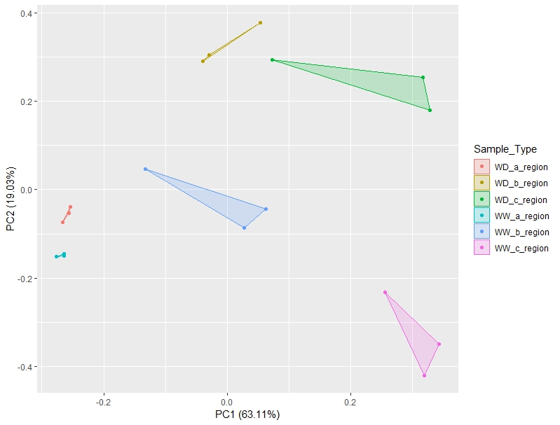
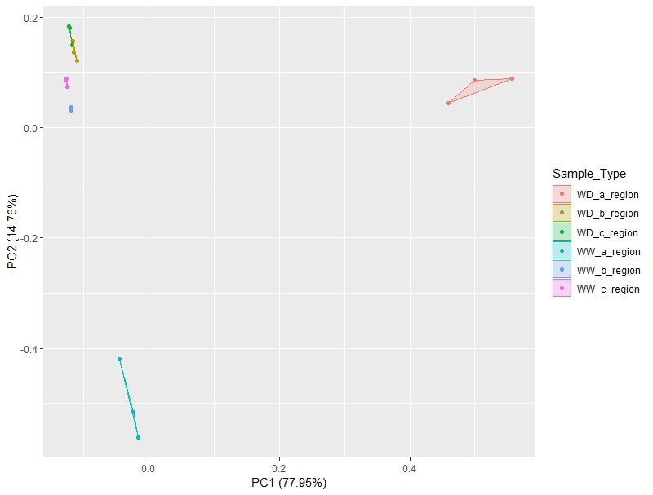
Pca plot for initial data
Command - autoplot(prcomp(mRNA_drought_info[1:3836]), data = mRNA_drought_info,colour = "Sample_Type", label = FALSE, label.size = 1,frame = TRUE)
RNA-seq – using DE genes only
All metabolite expression

Slide 4
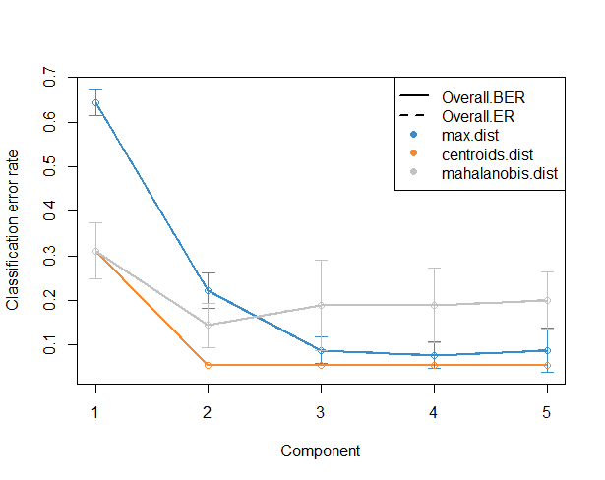
Cross validation error rate
Centroids error rate selected for lowest error rate.
Balanced error rate selected – recommended when omics datasets having unequal number of elements – Error rate is not baised towards majority class/dataset
First 2 components significant, as error rate stabilizes from 3 comp.
Command - plot(perf.diablo)

Slide 5
Results – genes and metabolites from each component
rna-comp1 (50)
Zm00001d014756 | Zm00001d033421 | Zm00001d027760
Zm00001d052749 | Zm00001d030303 | Zm00001d003213
Zm00001d051995 | Zm00001d002025 | Zm00001d010450
Zm00001d042302 | Zm00001d031943 | Zm00001d021365
Zm00001d053998 | Zm00001d012581 | Zm00001d043164
Zm00001d048299 | Zm00001d023901 | Zm00001d049190
Zm00001d030230 | Zm00001d020052 | Zm00001d052918
Zm00001d022226 | Zm00001d045649 | Zm00001d048366
Zm00001d027939 | Zm00001d041957 | Zm00001d038467
Zm00001d018624 | Zm00001d015560 | Zm00001d047081
Zm00001d033365 | Zm00001d017871 | Zm00001d039989
Zm00001d016082 | Zm00001d000168 | Zm00001d030698
Zm00001d010656 | Zm00001d038087
Zm00001d039471 | Zm00001d023801 | rna-comp2 (5)
Zm00001d011642 | Zm00001d038149 | Zm00001d035612
Zm00001d018531 | Zm00001d018415 | Zm00001d000237
Zm00001d048086 | Zm00001d025342 | Zm00001d051420
Zm00001d039498 | Zm00001d021453 | Zm00001d033339
Zm00001d002546 | Zm00001d032876 | Zm00001d002287
metabolites-comp1 (5)
N.stearoyl.sphinganine..d18.0.18.0.. | N.formylphenylalanine | X2.oxoarginine.
ceramide..d18.1.20.0..d16.1.22.0..d20.1.18.0.. | malonate | betaine
inosine | X1.2.dilinoleoyl.digalactosylglycerol..18.2.18.2.. | citrulline
tryptophan | X6.oxopiperidine.2.carboxylate | nicotinate
X1.2.dipalmitoyl.GPG..16.0.16.0. | stigmastadienone | fructose
 | myo.inositol | X1.palmitoyl.2.linolenoyl.GPA..16.0.18.3..
metabolites-comp2 (50) | campesterol | glycerophosphoinositol.
X2.3.dihydroxyisovalerate | X5.methylcytidine | pipecolate
X3.methylhistidine | saccharopine | X1.linoleoyl.2.linolenoyl.GPA..18.2.18.3..
stigmasterol | proline | leucylglutamine.
X5.6.dihydrouridine | allantoic.acid | ergothioneine
galactinol | cysteinylglycine.disulfide. | valylleucine
pseudouridine | alanylleucine | adenosine
uridine.2..3..cyclic.monophosphate | X1.2.dilinoleoyl.GPA..18.2.18.2.. | lysine
X3.hydroxy.3.methylglutarate | cytidine.2..3..cyclic.monophosphate | indole.3.carboxylate
glutarate..C5.DC. | abscisate | trimethylamine.N.oxide
X4.hydroxy.nonenal.glutathione | histidinol | glycerophosphoglycerol
X2.3.dihydroxy.3.methylvalerate | adenosine.2..3..cyclic.monophosphate | phytosphingosine
hypotaurine | phosphate | threonylphenylalanine
Component 1
RNA – 50
Metabolites – 5
Component 2
RNA – 5
Metabolites – 50

Slide 6
Component 1 element annotations
rna-comp1 (50) |  | Zm00001d033421 | Deoxyuridine 5'-triphosphate nucleotidohydrolase | Zm00001d027760 | Histone H2A
Zm00001d014756 | cell cycle is regulated by cyclins, a type of protein that binds and activates cyclin dependent kinases | Zm00001d030303 | THAUMATIN-LIKE PROTEIN 1 | Zm00001d003213
Zm00001d052749 | nucleosome/chromatin assembly factor D | Zm00001d002025 | AP2-like ethylene-responsive transcription factor AIL5 | Zm00001d010450 | GDSL esterase/lipase
Zm00001d051995 | proliferating cell nuclear antigen2 | Zm00001d031943 | kinesin-related protein4 | Zm00001d021365 | DNA primases
Zm00001d042302 | DEK domain-containing chromatin associated protein | Zm00001d012581 | Serine/threonine-protein kinase WNK (With No Lysine)-related | Zm00001d043164 | Cyclin-B1-4
Zm00001d053998 | Putative wee1-like protein kinase | Zm00001d023901 | Histone H2A | Zm00001d049190 | DNA replication licensing factor MCM2
Zm00001d048299 |  | Zm00001d020052 | GDP-mannose transporter GONST4 | Zm00001d052918 | Ubiquitin-protein ligase/ zinc ion binding protein
Zm00001d030230 | Kinesin-like protein KIN-5D | Zm00001d045649 | Ribonucleoside-diphosphate reductase small chain | Zm00001d048366 | Expressed protein; protein
Zm00001d022226 | Origin recognition complex subunit 6 | Zm00001d041957 | Fizzy-related protein | Zm00001d038467 | DNA replication licensing factor MCM3 homolog 2
Zm00001d027939 | B3 domain-containing protein | Zm00001d015560 | PLATZ transcription factor family protein | Zm00001d047081 | GATA transcription factor 2
Zm00001d018624 | kinesin-related protein11 | Zm00001d017871 | Protein S-acyltransferase 18 | Zm00001d039989
Zm00001d033365 | Putative cyclin-A3-1 | Zm00001d000168 | cell division cycle201 | Zm00001d030698 | Expressed protein; Os12g0569100 protein
Zm00001d016082 | High mobility group B protein 6 | Zm00001d038087 | dwarf & irregular leaf1
Zm00001d010656 | Cyclin1 | Zm00001d023801 | DNA polymerase alpha 2 | metabolites-comp1 (5)
Zm00001d039471 | IQ-domain 6 | Zm00001d038149 | ?? | N.stearoyl.sphinganine..d18.0.18.0.. | waxy lipid molecules
Zm00001d011642 | Phosphoethanolamine N-methyltransferase 3 | Zm00001d018415 | Proliferating cell nuclear antigen | ceramide..d18.1.20.0..d16.1.22.0..d20.1.18.0.. | waxy lipid molecules(this and previous are connected)
Zm00001d018531 | Replication protein A 32 kDa subunit A | Zm00001d025342 | Serine/threonine-protein kinase KIPK | inosine | involved in the homeostasis of endogenous nucleosides
Zm00001d048086 | Replication protein A 70 kDa DNA-binding subunit B | Zm00001d021453 | Regulator of Vps4 activity in the MVB pathway protein | tryptophan | essential amino acid
Zm00001d039498 | aurora b kinase1 | Zm00001d032876 | Expansin-A11 | X1.2.dipalmitoyl.GPG..16.0.16.0. | phospholipid

Slide 7
Component 2 element annotations
rna-comp2 (5) |  | N.formylphenylalanine | ?? | X2.oxoarginine. | a guanidino compound metabolite of arginine catabolism
Zm00001d035612 | Putative inositol polyphosphate phosphatase (Synaptogenin-like) family protein | malonate | daidzein conjugates interconversion, genistein conjugates interconversion, medicarpin conjugates interconversion | betaine | act as an osmoprotectant
Zm00001d000237 | cis-zeatin O-glucosyltransferase1 | X1.2.dilinoleoyl.digalactosylglycerol..18.2.18.2.. | ?? | citrulline | Arginine biosynthesis
Zm00001d051420 | dehydrin3 | X6.oxopiperidine.2.carboxylate | ?? | nicotinate | a carboxylic derivative of pyridine
Zm00001d033339 | Serine/threonine-protein kinase SRK2E | stigmastadienone | ?? | fructose | sugar
Zm00001d002287 | LRR receptor-like serine/threonine-protein kinase FLS2 | myo.inositol | Metabolism of lipids, Galactose metabolism, Ascorbate and aldarate metabolism, Streptomycin biosynthesis | X1.palmitoyl.2.linolenoyl.GPA..16.0.18.3.. | ??
metabolites-comp2 (50) |  | campesterol | Steroid biosynthesis, Brassinosteroid biosynthesis, | glycerophosphoinositol. | pubchem: 167572
X2.3.dihydroxyisovalerate | intermediate in Valine, leucine and isoleucine biosynthesis | X5.methylcytidine | ?? | pipecolate | Pipecolic acid is a metabolite of lysine
X3.methylhistidine | Histidine metabolism | saccharopine | Lysine biosynthesis | X1.linoleoyl.2.linolenoyl.GPA..18.2.18.3.. | ??
stigmasterol | Steroid biosynthesis | proline | Arginine and proline metabolism, Novobiocin biosynthesis, Aminoacyl-tRNA biosynthesis, ABC transporters | leucylglutamine. | Leucyl-Glutamine is a dipeptide composed of leucine and glutamine
X5.6.dihydrouridine | Dihydrouridine is found only in tRNA molecules. An inhibitor of nucleotide metabolism | allantoic.acid | Purine metabolism, Metabolic pathways | ergothioneine | Ergothioneine is a naturally occurring metabolite of histidine that has antioxidant properties
galactinol | Galactose metabolism | cysteinylglycine.disulfide. | L-Cysteinylglycine disulfide is one of the hydrolysis products of glutathione | valylleucine | Valyl-Leucine is a dipeptide composed of valine and leucine
pseudouridine | Pyrimidine metabolism | alanylleucine | Alanyl-Leucine is a dipeptide composed of alanine and leucine | adenosine | A nucleoside that is composed of adenine and d-ribose. Adenosine itself is a neurotransmitter
uridine.2..3..cyclic.monophosphate | Pyrimidine metabolism | X1.2.dilinoleoyl.GPA..18.2.18.2.. | ??? | lysine | essential amino acids
X3.hydroxy.3.methylglutarate | Nadph binding | cytidine.2..3..cyclic.monophosphate | naturally occurring metabolite of histidine that has antioxidant properties | indole.3.carboxylate | monocarboxylic acid anion
glutarate..C5.DC. | Fatty acid degradation, Lysine degradation | abscisate | Abscisic acid (ABA) is an isoprenoid plant hormone | trimethylamine.N.oxide | oxidation product of trimethylamine
X4.hydroxy.nonenal.glutathione | ?? | histidinol | penultimate step in the pathway of histidine biosynthesis. | glycerophosphoglycerol | ??
X2.3.dihydroxy.3.methylvalerate | ?? | adenosine.2..3..cyclic.monophosphate | part of the purine metabolism pathway | phytosphingosine | ??
hypotaurine | Taurine and hypotaurine metabolism | phosphate | salt of phosphoric acid | threonylphenylalanine | a dipeptide composed of threonine and phenylalanine

Slide 8
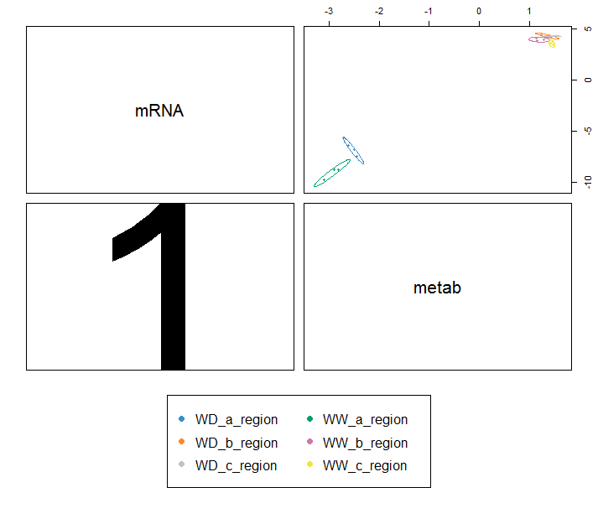
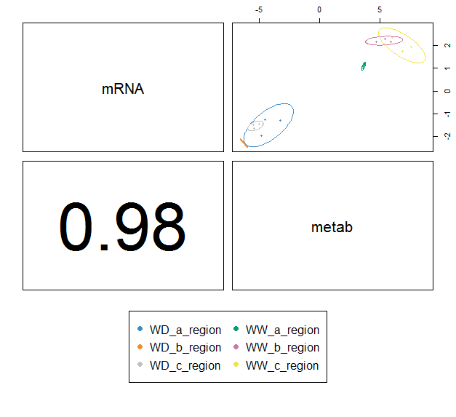
Correlation plots
Command - plotDiablo(sgccda.res, ncomp = 1,legend.ncol = 2)
Component 1
Component 2

Slide 9
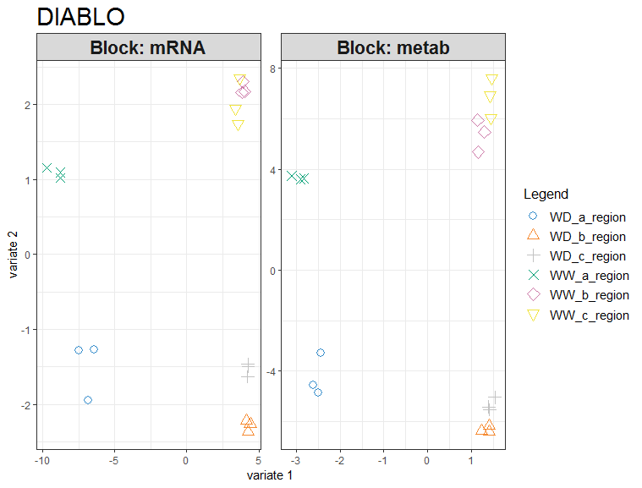
Scatter plots for sample (experimental units)representation
Command -
plotIndiv(sgccda.res, ind.names = FALSE, legend = TRUE, title = 'DIABLO')

Slide 10
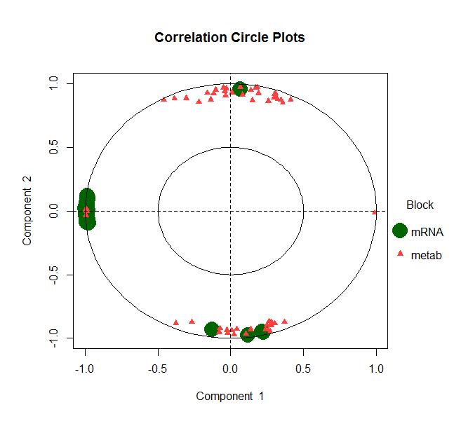
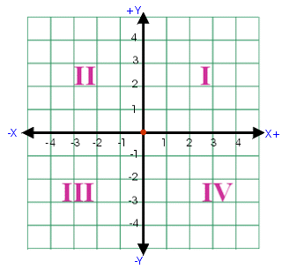
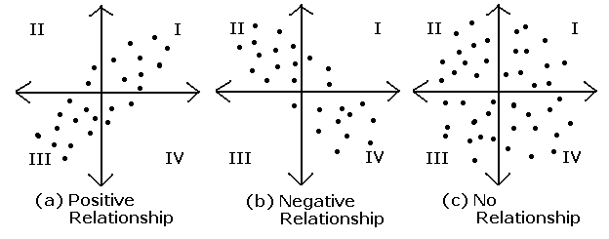
Circle plot
Command -
plotVar(sgccda.res, var.names = FALSE, style = 'graphics', legend = TRUE, pch = c(16, 17), cex = c(3,1), col = c('darkgreen', 'brown1'))

Slide 11
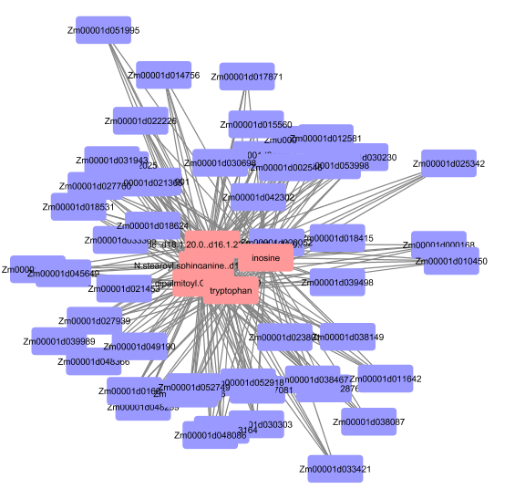
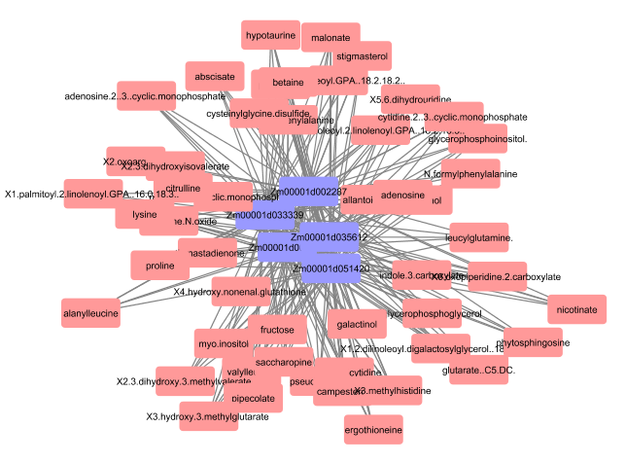
Network Map – relationships between elements
Commands -
my.network = network(sgccda.res, blocks = c(1,2),color.node = c('darkorchid', 'brown1'), cutoff = 0.7, 'lightgreen' save = 'jpeg', name.save = 'network_de_gene_maize_subtype')
library(igraph)
my.network = network(sgccda.res, blocks = c(1,2), color.node = c('darkorchid', 'brown1'), cutoff = 0.7)
Component 1
Component 2

Slide 12
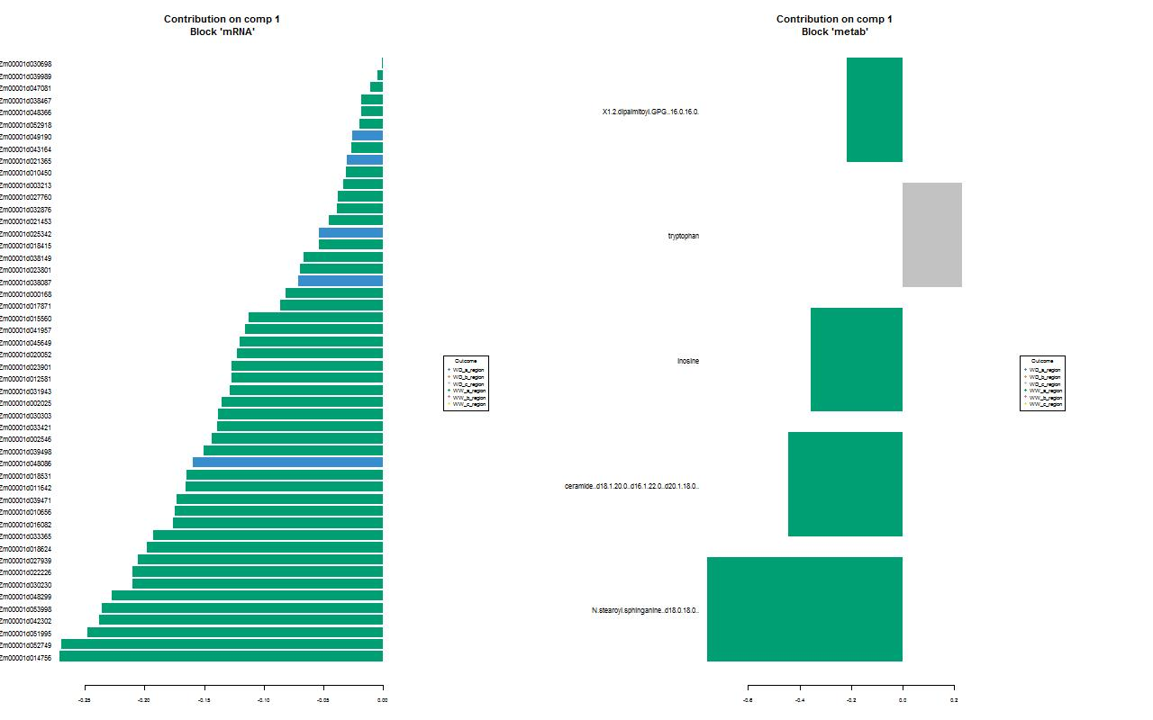
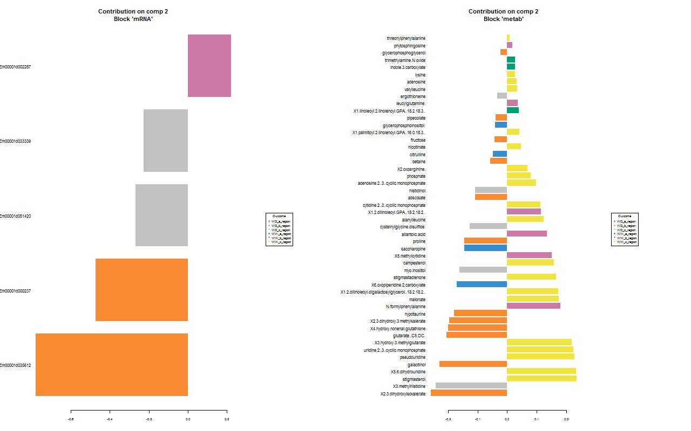
Contribution of elements to a component
Command - plotLoadings(sgccda.res, comp = 2, contrib = 'max', method = 'median',size.name = 1.00)
Component 1
Component 2
WD_A region
WD_B region
WD_C region
WW_A region
WW_B region
WW_C region
WD_A region
WD_B region
WD_C region
WW_A region
WW_B region
WW_C region
WD_A region
WD_B region
WD_C region
WW_A region
WW_B region
WW_C region
WD_A region
WD_B region
WD_C region
WW_A region
WW_B region
WW_C region

Slide 13
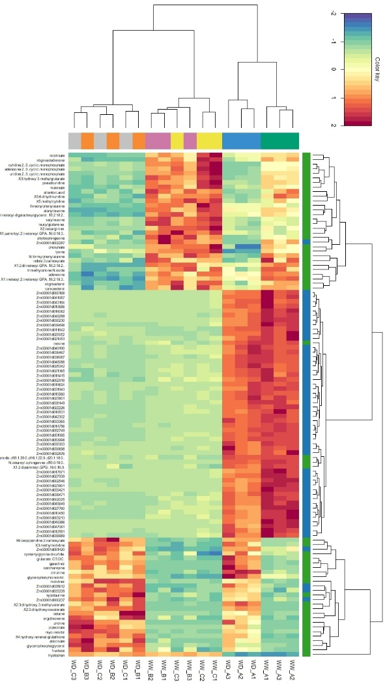
Clustered image map Represents the multi-omics molecular signature expression for each sample
WD_A region
WD_B region
WD_C region
WW_A region
WW_B region
WW_C region
Positive side – component 2
Tryptophan – component 1
component1
Command -
cimDiablo(sgccda.res,margin=c(10,4),legend = FALSE)
negative side – component 2

