Slide 1
Deepfake Detection Website
A Web-Based Tool for Detecting Fake Videos
By
Siddharth Gupta
Mallikarjune Kolii
April 2024

Slide 2
Introduction
What are Deepfakes?
- Definition: AI-generated media that manipulates content to present false or misleading information.
- Created using Generative Adversarial Networks (GANs) and autoencoders.
- Growing impact on misinformation, privacy, and trust.

Slide 3
Problem Statement
The Growing Threat of Deepfakes
- Deepfakes are used for malicious purposes (fraud, identity theft, political manipulation).
- Lack of accessible tools for detecting deepfakes.
- Increasing demand for automated detection methods.

Slide 4
Solution Overview
Deepfake Detection Website
- Web-based platform for detecting deepfake videos.
- Uses TensorFlow and OpenCV to analyze video content.
- User-friendly interface for non-technical users.

Slide 5
Code/Tool Breakdown - Backend
Backend Development Using Flask
- Flask is used for the web server and handling video uploads.
- Routes for video processing and deepfake detection.
Example:

Slide 6
@app.route('/upload', methods=['POST'])
def upload():
video = request.files['video']
video.save('static/input.mp4')
result = detect_deepfake('static/input.mp4')
return render_template('result.html', prediction=result)

Slide 7
Code/Tool Breakdown - Deepfake Detection
Deepfake Detection Model
- TensorFlow for loading a pre-trained CNN model (e.g., XceptionNet).
- Process video frames for classification.
- Key components: face detection, image preprocessing, classification.

Slide 8
Real-World Use Cases - Media
Use Case 1: Journalism
- Verifying the authenticity of video news reports.
- Preventing the spread of misinformation through manipulated videos.

Slide 9
Real-World Use Cases - Legal
Use Case 2: Digital Forensics
- Video evidence verification in criminal investigations.
- Ensuring digital media integrity in courtrooms.

Slide 10
Real-World Use Cases - Social Media
Use Case 3: Content Moderation
- Automatically flagging or removing deepfake content on social media.
- Preventing harmful deepfakes from spreading.

Slide 11
Future Enhancements - Real-Time Deepfake Detection
Real-Time Deepfake Detection
- Implement real-time detection for live video streams (e.g., video calls, livestreams).
- Adding support for voice deepfake detection.

Slide 12
Future Enhancements - Multi-Modal Detection
Multi-Modal Deepfake Detection
- Incorporating video and audio analysis for higher accuracy.
- Combining facial recognition, voice synthesis detection, and behavioral analysis.

Slide 13
Future Enhancements - Mobile and Cloud
Mobile and Cloud Deployment
- Developing mobile versions of the tool (Android/iOS).
- Hosting on the cloud for scalability and accessibility.

Slide 14
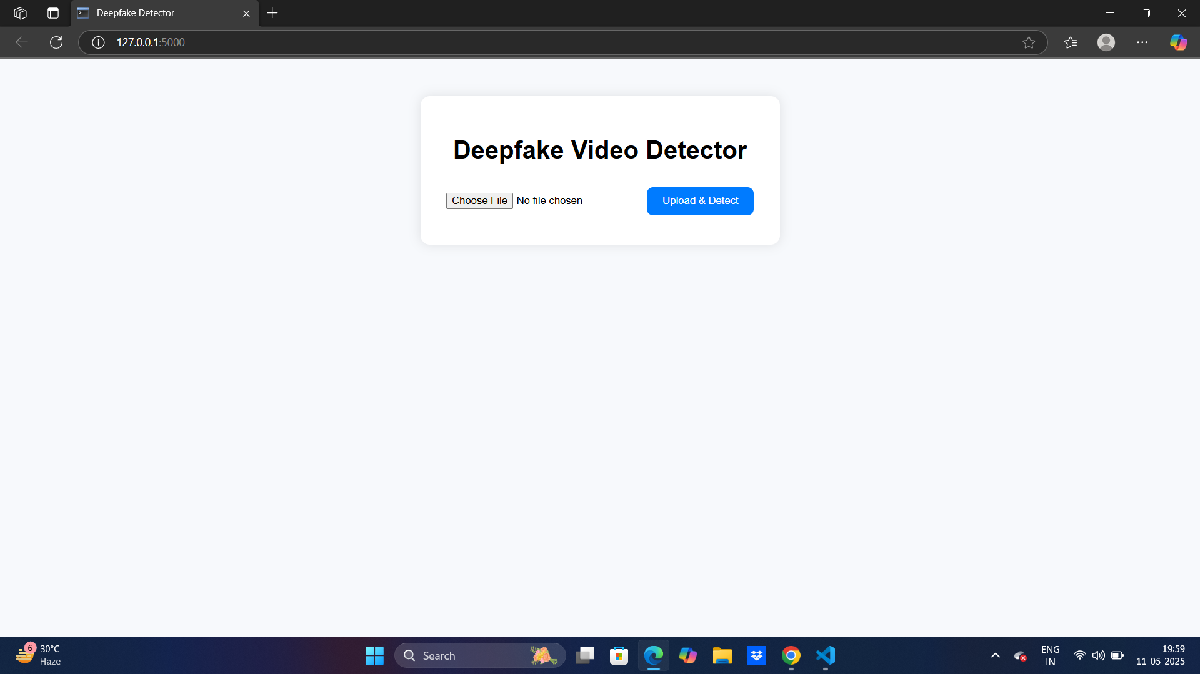
Screenshots

Slide 15


Slide 16
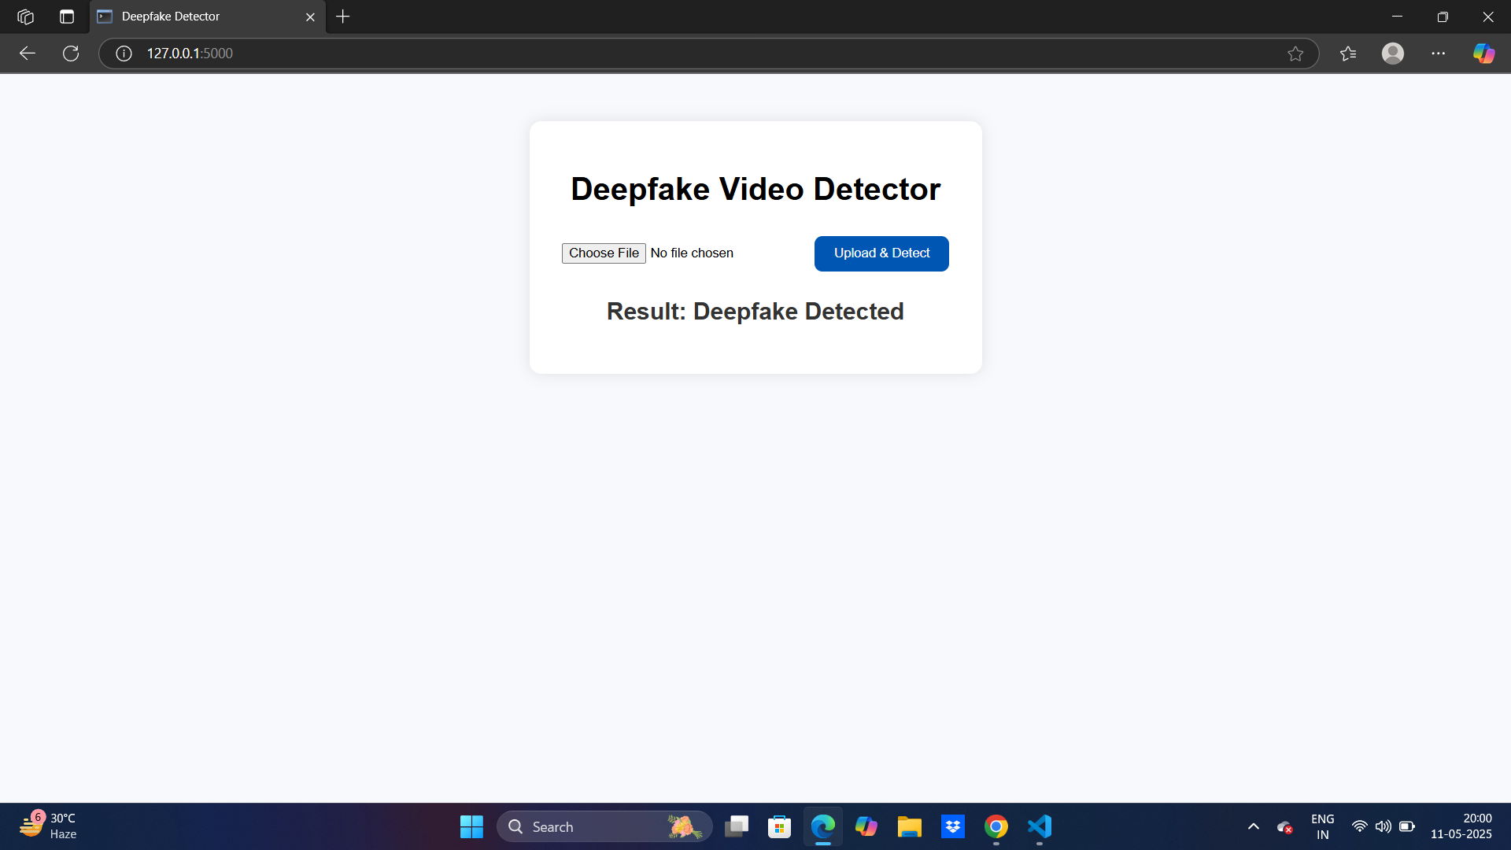

Slide 17
Conclusion
Final Thoughts
- Deepfake detection is crucial to maintaining trust in digital media.
- This tool provides an accessible solution for detecting deepfake content.
- Ongoing development will broaden its impact.

