Slide 1
Kalpa Health · Brief C — Money · Group 11
Q2 2026 · INVOICED → CAPTURED
The Revenue Bridge
From what Kalpa billed to the cash it actually captured — every rupee placed, the gap explained, and the growth question answered honestly.
For Dr. Priya Menon, COO & the finance controller
Notes:
Group 4's Brief C finding. We reconciled every Q2 2026 invoice to the cash the gateway actually captured, to the exact rupee, and checked whether the billing gap explains the organisation's weak test-volume growth.

Slide 2
Kalpa Health · Brief C — Money · Group 4
THE EXECUTIVE QUESTION · Q2 2026
Collections run below billing.
Leak, timing, or data artifact?
BILLED
CAPTURED IN-QUARTER
₹13.28 Cr
vs
₹11.93 Cr
79,246 invoices
89.8% of billing
A ₹1.36 Cr gap the board can't read — is it money lost, or money simply not in yet? The next slide places every rupee of it.
Notes:
Finance saw collections running about 10 percent below billing. Calling the whole 1.36 crore gap a leak would trigger brand-damaging collection calls on patients who have simply not yet paid. Our job was to decompose the gap into timing, float, and the genuinely recoverable amount.

Slide 3
Kalpa Health · Brief C — Money · Group 4
THE EVIDENCE · THE Q2 BRIDGE, ₹ CRORE
Every rupee of the gap, placed
BILLED
CAPTURED
₹13.28
+0.05
₹11.93
Never paid
Paid in July
Cr · start
Over / under
Cr · end
−0.30
−1.11
13.28 − 1.11 − 0.30 + 0.05 = 11.93 · residual ₹0.00
never paid · paid in July (timing) · net over-capture · hover a bar for exact rupees
Notes:
The bridge balances to zero. The gap is three moves: 1.11 crore never captured, 0.30 crore captured after the quarter closed in July, and a small 0.05 crore net over-capture from duplicate charges. Nothing is unexplained; SQL agrees independently.

Slide 4
Kalpa Health · Brief C — Money · Group 4
WHAT TO DO WITH THE GAP
Only ₹48 L is a real leak — chase, wait, fix.
CHASE
WAIT
FIX
₹48.41 L
₹62.67 L
317 + 4,588
2,854 aged invoices (>7 days) — the real recoverable leak.
3,727 Jun 24–30 invoices — normal float, still settling.
Double-captures to refund; orphan payments to reconcile.
Owner · Finance recovery
Owner · Credit control
Owner · Engineering
Notes:
Most of the gap is not a leak. Over 62 lakh is recent working float from the last week of June — do not chase it. The genuinely recoverable leak is 48 lakh across 2,854 aged invoices. Separately, 317 invoices were double-captured and 4,588 orphan payments reference no invoice. Three teams, three jobs.

Slide 5
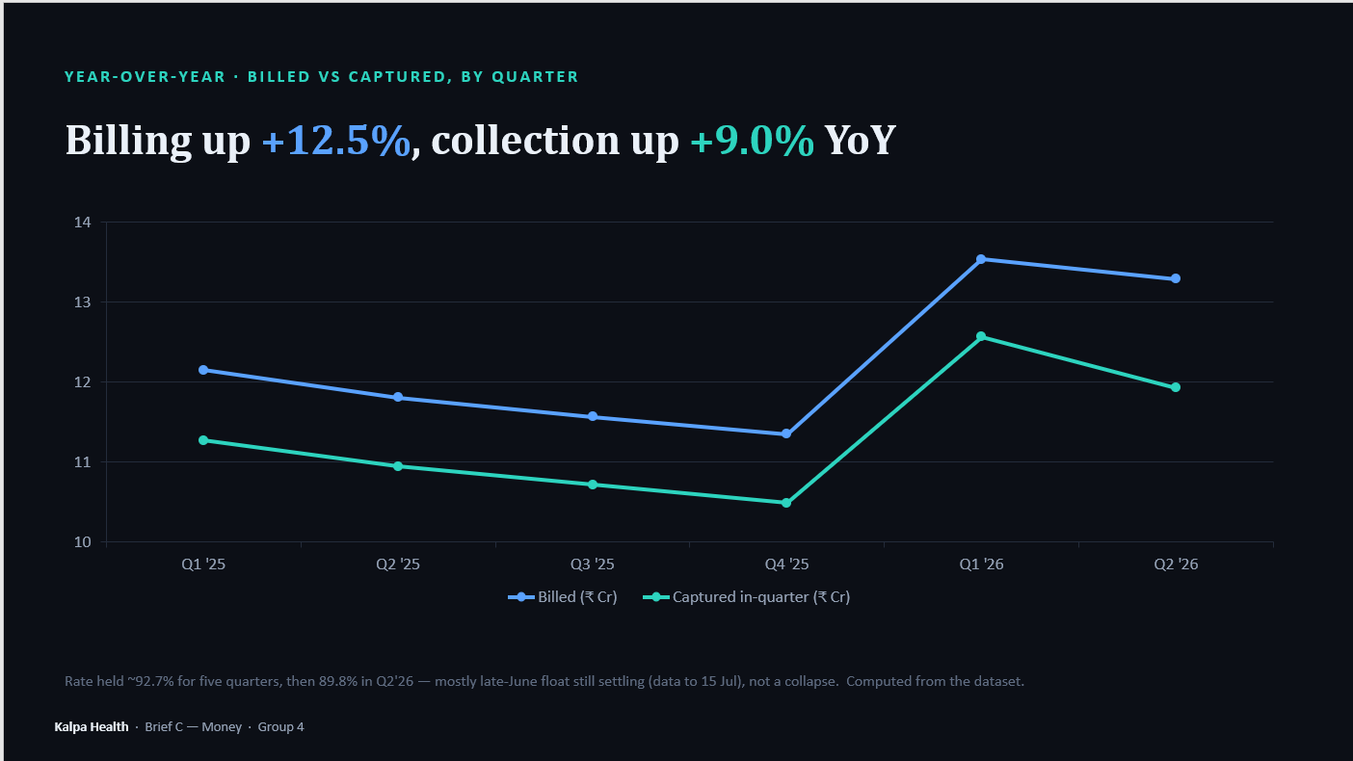

Slide 6
Kalpa Health · Brief C — Money · Group 4
THE QUESTION BEHIND THE QUESTION
Did this leak cause the growth miss? No.
Test volume (legacy + nova) · % change vs Q1-2025
+5.8% grown vs an +18% plan — only ~31% of the planned increase. Volume swings on demand — down through 2025, a +6% jump in Q1'26 — and a test is counted before it is billed, so the leak can't drive it. The miss is demand — Jaipur −12%, Chennai −5% patients — not billing.
Notes:
The board's real question is the growth miss. We reproduced it from the data: H1 test volume grew 5.8 percent against an 18 percent plan — only about 31 percent of the planned increase. Volume swings on demand: down through 2025, a 6 percent jump in Q1 2026, then back near flat. Billing happens after a test is counted, so it cannot be the cause. The miss is demand — Jaipur down 12 percent, Chennai down 5 percent patients.

Slide 7
Kalpa Health · Brief C — Money · Group 4
THE ONE SENTENCE FOR THE BOARD
The gap is explained, mostly timing & float — and the growth miss is demand, not billing.
The invoiced-to-captured bridge balances to zero, the only recoverable leak is a short, identity-checked chase list, and test-volume growth is a separate, demand-side workstream.
● Balances to ₹0.00 · every figure traces to rows in invoice_reconciliation.csv · a bank statement still confirms net settlement
Notes:
In one sentence: the Q2 billing gap is explained to the rupee and is mostly timing and float, with only 48 lakh genuinely recoverable; and it is a realization problem, separate from the demand-driven growth miss. Every figure traces to rows. Thank you.

