Slide 1
qemu + gdb + sample_code: Run sample code in QEMU OS and observe Linux Kernel behavior
Adrian Huang | Apr, 2023
* Based on kernel 6.2 (x86_64) – QEMU
* 2-socket CPUs (4 cores/socket)
* 16GB memory
* Kernel parameter: nokaslr norandmaps
* KASAN: disabled
* Userspace: ASLR is disabled
* Host OS: Ubuntu 20.04.1

Slide 2
Refer this slide first:
qemu + gdb: The efficient way to understand/debug Linux kernel code/data structure

Slide 3
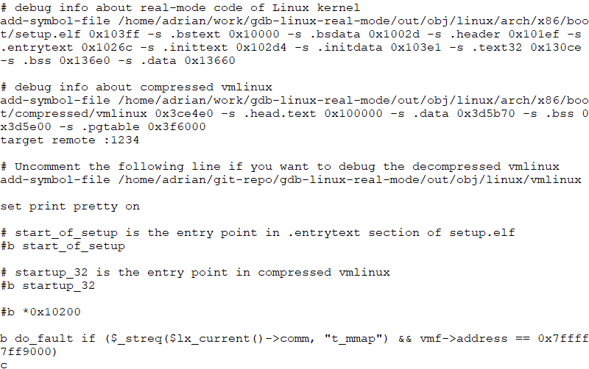
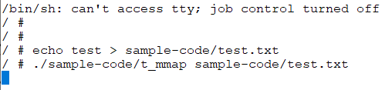
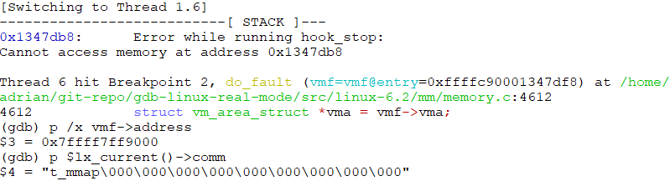
Observe page fault behavior about mmap address: Conditional breakpoint
gdb-files/gdb-linux-kernel-real-mode.txt
Console #1: QEMU: Guest OS
Console #2: gdb console
Note
0x7ffff7ff9000 is the mmap address provide by Linux Kernel
Reference: Memory Mapping Implementation (mmap) in Linux Kernel
Sample code to trigger the conditional breakpoint: t_mmap.c

