Slide 1
Slab Allocator in Linux Kernel
Adrian Huang | Aug, 2022
* Based on kernel 5.11 (x86_64) – QEMU
* 2-socket CPUs (4 cores/socket)
* 16GB memory
* Kernel parameter: nokaslr norandmaps
* KASAN: disabled
* Userspace: ASLR is disabled
* Legacy BIOS

Slide 2
Agenda
Slab & Buddy System
Slab Concept
“Chicken or the egg” problem
Will not focus the differences about slab/slub/slob: Lots of info about them in Internet.
Note: SLUB is the default allocator since 2.6.23.
[Init & Creation] kmem_cache_init(): Let’s check the initialization detail
How to initialize ‘boot_kmem_cache’ and ‘boot_kmem_cache_node’?
What are freepointers?
Data structures: kmem_cache & kmem_cache_node
[Comparison] Generic kmem_cache_create() & low-level implementation __kmem_cache_create()
[Cache allocation] slab_alloc_node – Allocate a slab cache with specific node id
Fast path & slow path
Will follow kmem_cache_init() flow
[Cache release/free] kmem_cache_free()
Fast path & slow path
kmalloc & slab

Slide 3
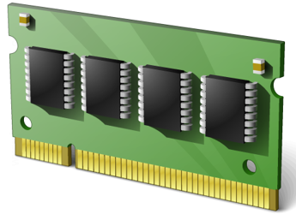
Slab & Buddy System
glibc: malloc/free
brk/mmap
User Space
Kernel Space
[glibc] malloc
Balance between brk() and mmap()
Use brk() if request size < DEFAULT_MMAP_THRESHOLD_MIN (128 KB)
The heap can be trimmed only if memory is freed at the top end.
sbrk() is implemented as a library function that uses the brk() system call.
Use mmap() if request size >= DEFAULT_MMAP_THRESHOLD_MIN (128 KB)
The allocated memory blocks can be independently released back to the system.
Deallocated space is not placed on the free list for reuse by later allocations.
Memory may be wasted because mmap allocations must be page-aligned; and the kernel must perform the expensive task of zeroing out memory allocated.
Note: glibc uses the dynamic mmap threshold
Detail: `man mallopt`
kmem_cache_alloc/kmem_cache_free kmalloc/kfree
vmalloc
Slab Allocator
Buddy System
alloc_page(s), __get_free_page(s)
Hardware
. . .

Slide 4
Slab Concept
global list_head
slab_caches
Slab Cache
(page order = 0)
slab
Page #N
slab object
slab object
slab object
…
…
slab object
slab object
slab object
slab object
slab object
slab
Page #0
slab object
4 objects per page
slab object
slab object
slab object
Memory (object) allocation
Slab Allocator
.
.
.
Slab Cache (page order = 1)
…
Page #N
slab object
slab object
…
slab object
slab object
slab
Page #1
slab object
slab object
Page #0
slab object
2 objects per page
* object = data structure
slab object
Allocating/freeing data structures is the common operations in Linux kernel
Slab is a generic data structure-caching layer

Slide 5
Slab Cache
percpu cache
Page
kmem_cache_cpu (CPU #0)
..
slab object
slab object
slab object
struct page *page
void **freelist
struct page *partial
.
.
Page
Page
kmem_cache (Slab cache)
kmem_cache_cpu (CPU #N)
..
..
slab object
slab object
slab object
slab object
slab object
slab object
__percpu *cpu_slab
struct page *page
*node[MAX_NUMNODES]
void **freelist
struct page *partial
kmem_cache_node
(Node #0)
Page
Page
struct list_head partial
..
..
slab object
slab object
slab object
slab object
slab object
slab object
.
.
kmem_cache_node
(Node #N)
struct list_head partial
Node-based cache
Node-based cache: freelist concept is implemented in page struct (not shown)

Slide 6
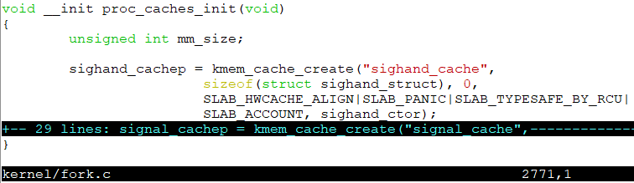
Slab Cache
[Slab Cache] struct kmem_cache *kmem_cache
percpu cache
kmem_cache_cpu (CPU #0)
Page
struct page *page
void **freelist
..
slab object
slab object
kmem_cache (Slab cache)
struct page *partial
slab object
.
.
__percpu *cpu_slab
*node[MAX_NUMNODES]
Node-based cache
Page
kmem_cache_node (Node #0)
..
1
Allocate from ‘kmem_cache’ slab cache
struct list_head partial
slab object
slab object
.
.
slab object
[Slab Cache] struct kmem_cache *sighand_cachep
2
percpu cache
[Slab Cache] struct kmem_cache *kmem_cache_node
kmem_cache_cpu (CPU #0)
percpu cache
struct page *page
kmem_cache_cpu (CPU #0)
Page
void **freelist
struct page *page
kmem_cache (Slab cache)
struct page *partial
void **freelist
..
slab object
slab object
.
.
kmem_cache (Slab cache)
struct page *partial
slab object
__percpu *cpu_slab
.
.
*node[MAX_NUMNODES]
3
__percpu *cpu_slab
Node-based cache
*node[MAX_NUMNODES]
kmem_cache_node (Node #0)
Allocate from ‘kmem_cache_node’ slab cache
Node-based cache
Page
struct list_head partial
kmem_cache_node (Node #0)
.
.
struct list_head partial
..
slab object
slab object
.
.
slab object

Slide 7

Slab Allocator Initialization: “Chicken or the egg” problem
[Slab Cache] struct kmem_cache *kmem_cache = NULL
percpu cache
kmem_cache_cpu (CPU #0)
struct page *page
void **freelist
kmem_cache = NULL (Slab cache)
struct page *partial
.
.
[Slab Allocator Init] Just an example: Not in Linux kernel code
__percpu *cpu_slab
*node[MAX_NUMNODES]
Node-based cache
kmem_cache_node (Node #0)
[Cannot work] Allocate from ‘kmem_cache’ slab cache
struct list_head partial
1
.
.
2
[Slab Cache] struct kmem_cache *kmem_cache
percpu cache
[Slab Cache] struct kmem_cache *kmem_cache_node = NULL
kmem_cache_cpu (CPU #0)
percpu cache
struct page *page
kmem_cache_cpu (CPU #0)
void **freelist
struct page *page
kmem_cache (Slab cache)
struct page *partial
void **freelist
.
.
kmem_cache = NULL (Slab cache)
struct page *partial
__percpu *cpu_slab
.
.
*node[MAX_NUMNODES]
3
__percpu *cpu_slab
Node-based cache
*node[MAX_NUMNODES]
kmem_cache_node (Node #0)
[Cannot work] Allocate from ‘kmem_cache_node’ slab cache
Node-based cache
struct list_head partial
kmem_cache_node (Node #0)
.
.
struct list_head partial
.
.

Slide 8
Slab Allocator Initialization: “Chicken or the egg” problem
[Slab Cache] struct kmem_cache *kmem_cache = NULL
percpu cache
kmem_cache_cpu (CPU #0)
struct page *page
void **freelist
kmem_cache = NULL (Slab cache)
struct page *partial
.
.
[Example] Slab allocator init for kmem_cache
__percpu *cpu_slab
*node[MAX_NUMNODES]
Node-based cache
kmem_cache_node (Node #0)
[Cannot work] Allocate from ‘kmem_cache’ slab cache
struct list_head partial
1
.
.
2
[Slab Cache] struct kmem_cache *kmem_cache
percpu cache
[Slab Cache] struct kmem_cache *kmem_cache_node = NULL
kmem_cache_cpu (CPU #0)
percpu cache
struct page *page
kmem_cache_cpu (CPU #0)
void **freelist
struct page *page
kmem_cache (Slab cache)
struct page *partial
void **freelist
.
.
kmem_cache = NULL (Slab cache)
struct page *partial
__percpu *cpu_slab
.
.
*node[MAX_NUMNODES]
3
__percpu *cpu_slab
Node-based cache
*node[MAX_NUMNODES]
kmem_cache_node (Node #0)
[Cannot work] Allocate from ‘kmem_cache_node’ slab cache
Node-based cache
struct list_head partial
kmem_cache_node (Node #0)
.
.
struct list_head partial
.
.
Who initializes global variables ‘kmem_cache’ and ‘kmem_cache_node’?

Slide 9
Slab Allocator Initialization: “Chicken or the egg” problem
[Slab Cache] struct kmem_cache *kmem_cache = NULL
percpu cache
kmem_cache_cpu (CPU #0)
struct page *page
void **freelist
kmem_cache = NULL (Slab cache)
struct page *partial
.
.
__percpu *cpu_slab
*node[MAX_NUMNODES]
Node-based cache
kmem_cache_node (Node #0)
[Cannot work] Allocate from ‘kmem_cache’ slab cache
struct list_head partial
1
.
.
[Slab Cache] struct kmem_cache *sighand_cachep
2
percpu cache
[Slab Cache] struct kmem_cache *kmem_cache_node = NULL
kmem_cache_cpu (CPU #0)
percpu cache
struct page *page
kmem_cache_cpu (CPU #0)
void **freelist
struct page *page
kmem_cache (Slab cache)
struct page *partial
void **freelist
.
.
kmem_cache = NULL (Slab cache)
struct page *partial
__percpu *cpu_slab
.
.
*node[MAX_NUMNODES]
3
__percpu *cpu_slab
Node-based cache
*node[MAX_NUMNODES]
kmem_cache_node (Node #0)
[Cannot work] Allocate from ‘kmem_cache_node’ slab cache
Node-based cache
Slab allocator: statically initialized ‘kmem_cache_boot’
Slob allocator: statically initialized ‘kmem_cache_boot’
Slub allocator: static local variables ‘boot_kmem_cache’ and ‘boot_kmem_cache_node’
struct list_head partial
kmem_cache_node (Node #0)
.
.
struct list_head partial
.
.

Slide 10
[Init & Creation] kmem_cache_init(): Let’s check the initialization detail
How to initialize ‘boot_kmem_cache’ and ‘boot_kmem_cache_node’?
What are freepointers?
Data structures: kmem_cache & kmem_cache_node
[Comparison] Generic kmem_cache_create() & low-level implementation __kmem_cache_create()
* Call paths are based on SLUB (the unqueued slab allocator)

Slide 11
kmem_cache_init()
Declare two static variables ‘boot_kmem_cache’ and ‘boot_kmem_cache_node’
Assign the addresses of two static variables to generic/global variables
kmem_cache_node = &boot_kmem_cache_node
kmem_cache = &boot_kmem_cache
start_kernel
mm_init
kmem_cache_init
Calculate page order and objects per slab
calculate_sizes
Allocate/init ‘kmem_cache_node’ structs for all CPU nodes (sockets)
create_boot_cache(kmem_cache_node, …)
__kmem_cache_create
kmem_cache_open
init_kmem_cache_nodes
create_boot_cache(kmem_cache, …)
Allocate/init a ‘kmem_cache_cpu’ struct
kmem_cache = bootstrap(&boot_kmem_cache)
alloc_kmem_cache_cpus
__alloc_percpu
kmem_cache_node = bootstrap(&boot_kmem_cache_node)
init_kmem_cache_cpus
Assign cpu id to kmem_cache_cpu->tid
setup_kmalloc_cache_index_table
create_kmalloc_caches

Slide 12
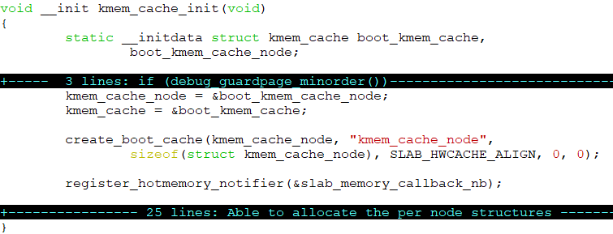
kmem_cache_node/boot_kmem_cache_node init
object size = sizeof(struct kmem_cache_node) = 64
object size with alignment (SLAB_HWCACHE_ALIGN: 64) = 64
calculate_sizes (): order = 0
slab
Page #0
slab object #63
kmem_cache
…
…
64 objects per page
…
…
…
…
slab object #0
* object = data structure
Slub allocator: A generic data structure-cache layer

Slide 13
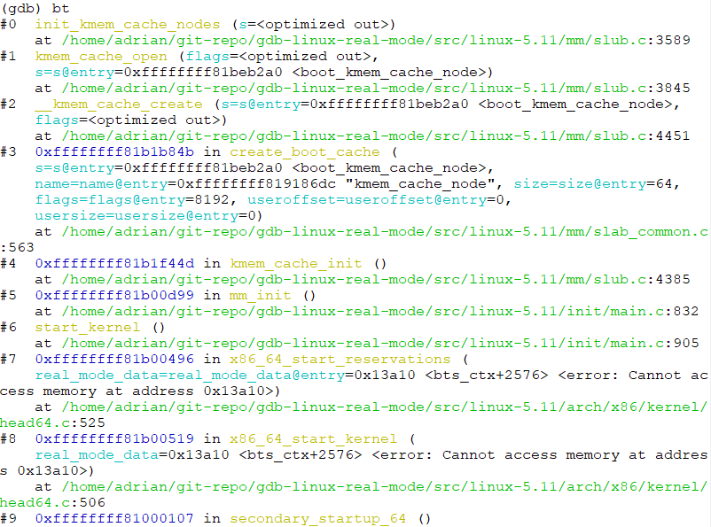
kmem_cache_node/boot_kmem_cache_node init
object size = sizeof(struct kmem_cache_node) = 64
object size with alignment (SLAB_HWCACHE_ALIGN: 64) = 64

Slide 14
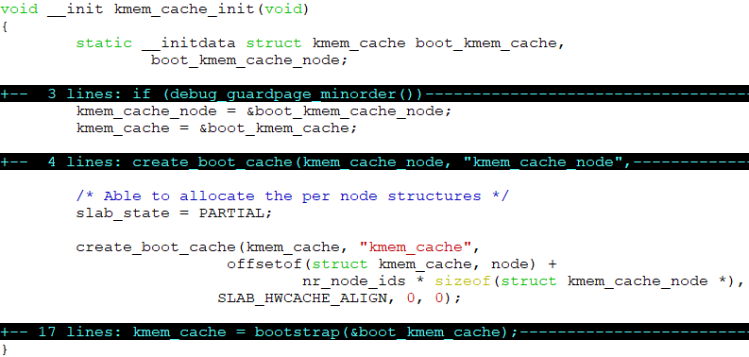
kmem_cache/boot_kmem_cache init
object size = offsetof(struct kmem_cache, node) +
nr_node_ids * sizeof(struct kmem_cache_node *)
nr_node_ids = 2 (2-socket guest OS)
object size = 200 + 2 * 8 = 216
object size with alignment (SLAB_HWCACHE_ALIGN: 64) = 256
calculate_sizes (): order = 1
slab
Page #1
slab object
slab object
slab object
slab object
Page #0
slab object
16 objects per page
kmem_cache
slab object
slab object
slab object
* object = data structure
Slab allocator: A generic data structure-cache layer

Slide 15
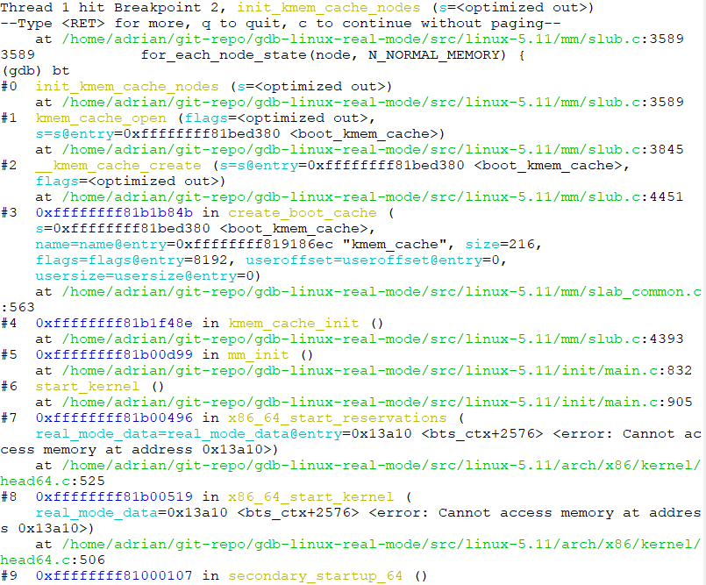
kmem_cache/boot_kmem_cache init
object size = 200 + 2 * 8 = 216

Slide 16
init_kmem_cache_nodes()
Calculate page order and objects per slab
calculate_sizes
Allocate/init ‘kmem_cache_node’ structs for all CPU nodes (sockets)
create_boot_cache(kmem_cache_node, …)
__kmem_cache_create
kmem_cache_open
init_kmem_cache_nodes
Allocate/init a ‘kmem_cache_cpu’ struct
alloc_kmem_cache_cpus
__alloc_percpu
init_kmem_cache_cpus
Assign cpu id to kmem_cache_cpu->tid
init_kmem_cache_nodes
for_each_node_state()
slab_state == DOWN
N
Generic path
Y
early_kmem_cache_node_alloc
n = kmem_cache_alloc_node()
Special (one-shot) path:
Fix ‘chicken or the egg’ problem
init_kmem_cache_node
kmem_cache->node[node] = n

Slide 17
early_kmem_cache_node_alloc for ‘kmem_cache_node’
early_kmem_cache_node_alloc
page = new_slab(kmem_cache_node, …)
allocate_slab
page = alloc_slab_page()
page->slab_cache = s
Update freepointers for the allocated pages
n = page->freelist
page->freelist = get_freepointer(kmem_cache_node, n)
kmem_cache_node->node[node] = n
init_kmem_cache_node(n)
inc_slabs_node
__add_partial(n, page, DEACTIVATE_TO_HEAD)

Slide 18
allocate_slab() – freelist/freepointer configuration
early_kmem_cache_node_alloc
page = new_slab(kmem_cache_node, …)
allocate_slab
page = alloc_slab_page()
page->slab_cache = s
static local variable
boot_kmem_cache_node
page struct (slab, slob or slub)
Page
Update freepointers for the allocated pages
struct list_head slab_list
kmem_cache (kmem_cache_node)
..
struct (Partial Page)
struct page *next
slab object
slab object
union
slab object
n = page->freelist
__percpu *cpu_slab
int pages
page->freelist = get_freepointer(kmem_cache_node, n)
min_partial = 5
int pobjects
size = 64
struct kmem_cache *slab_cache
object_size = 64
void *freelist (first free object)
kmem_cache_node->node[node] = n
offset = 32
s_mem: first object - SLAB
cpu_partial = 30
counters - SLUB
init_kmem_cache_node(n)
oo (order objects) = 64
union
struct (SLUB)
inuse: 16 = 64
max = 64
objects:15 = 64
inc_slabs_node
min = 64
frozen: 1 = 1
inuse = 64
__add_partial(n, page, DEACTIVATE_TO_HEAD)
align = 64
name = “kmem_cache_node”
list
*node[MAX_NUMNODES]
Reference functions: get_freepointer/set_freepointer

Slide 19
allocate_slab() – freelist/freepointer configuration
static local variable
boot_kmem_cache_node
page struct (slab, slob or slub)
Page
kmem_cache (kmem_cache_node)
struct list_head slab_list
struct (Percpu Partial Page)
struct page *next
..
slab object
slab object
union
slab object
__percpu *cpu_slab
int pages
min_partial = 5
int pobjects
size = 64
struct kmem_cache *slab_cache
slab object #n -1
object_size = 64
NULL
offset = 32
void *freelist (first free object)
cpu_partial = 30
s_mem: first object - SLAB
.
.
.
oo (order objects) = 64
counters - SLUB
max = 64
union
struct (SLUB)
inuse: 16 = 64
min = 64
objects:15 = 64
slab object #1
inuse = 64
frozen: 1 = 1
X + kmem_cache->size
X + kmem_cache->size * 2
align = 64
slab object #0
point to the next free slab object
name = “kmem_cache_node”
X + kmem_cache->offset
X + kmem_cache->size
X
Page address = X
list
*node[MAX_NUMNODES]
freepointer in slab object: Point to the next slab object (address: middle of object → avoid buffer overflow or underflow)
Reference functions: get_freepointer/set_freepointer

Slide 20
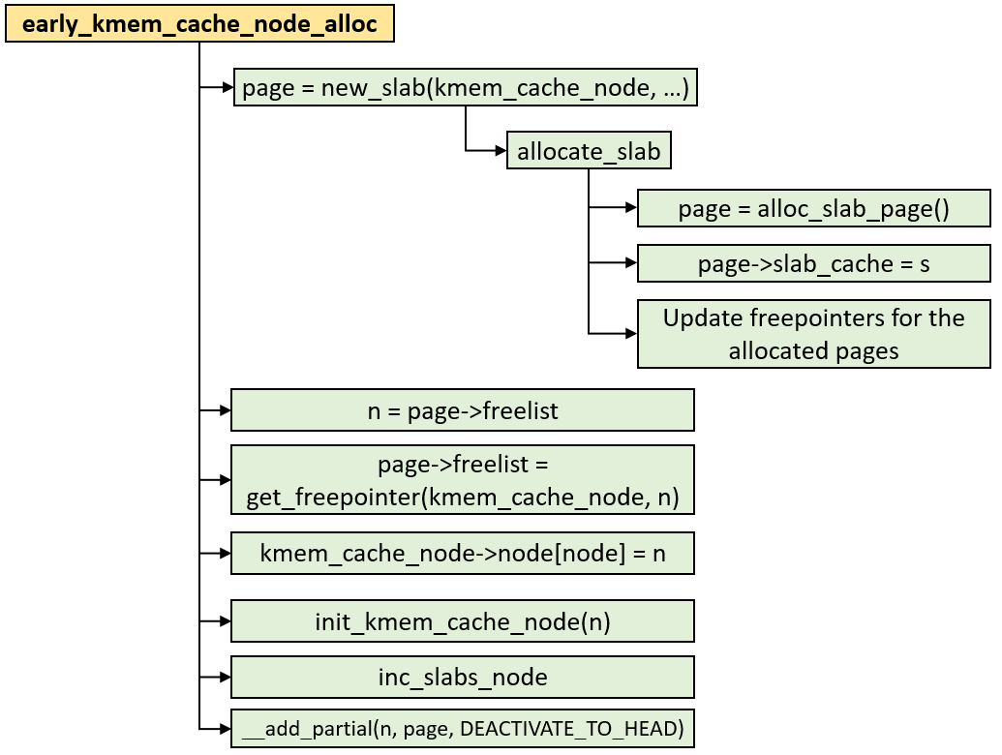
early_kmem_cache_node_alloc() – Get a slab object from freelist
static local variable
Get a slab object from page->freelist
boot_kmem_cache_node
kmem_cache (kmem_cache_node)
page struct (slab, slob or slub)
Page
kmem_cache_node
struct list_head slab_list
list_lock
__percpu *cpu_slab
struct (Percpu Partial Page)
struct page *next
..
nr_partial
slab object
slab object
union
slab object
min_partial = 5
int pages
struct list_head partial
size = 64
int pobjects
nr_slabs
object_size = 64
total_objects
offset = 32
struct kmem_cache *slab_cache
struct list_head full
cpu_partial = 30
void *freelist (first free object)
oo (order objects) = 64
s_mem: first object - SLAB
max = 64
counters - SLUB
min = 64
union
struct (SLUB)
inuse: 16 = 64 1
inuse = 64
objects:15 = 64
align = 64
frozen: 1 = 1 0
name = “kmem_cache_node”
list
*node[MAX_NUMNODES]
kmem_cache_node->node[node] = n

Slide 21
early_kmem_cache_node_alloc() – Get a slab object from freelist
static local variable
Get a slab object from page->freelist
boot_kmem_cache_node
kmem_cache (kmem_cache_node)
page struct (slab, slob or slub)
Page
kmem_cache_node
struct list_head slab_list
list_lock
__percpu *cpu_slab
struct (Percpu Partial Page)
struct page *next
..
nr_partial = 0
slab object
slab object
union
slab object
min_partial = 5
int pages
struct list_head partial
size = 64
int pobjects
nr_slabs = 0
object_size = 64
total_objects = 0
offset = 32
struct kmem_cache *slab_cache
struct list_head full
cpu_partial = 30
void *freelist (first free object)
oo (order objects) = 64
s_mem: first object - SLAB
max = 64
counters - SLUB
min = 64
union
struct (SLUB)
inuse: 16 = 1
inuse = 64
objects:15 = 64
align = 64
frozen: 1 = 0
name = “kmem_cache_node”
list
*node[MAX_NUMNODES]
kmem_cache_node->node[node] = n

Slide 22
early_kmem_cache_node_alloc() – Get a slab object from freelist
static local variable
Get a slab object from page->freelist
boot_kmem_cache_node
kmem_cache (kmem_cache_node)
page struct (slab, slob or slub)
Page
kmem_cache_node
struct list_head slab_list
list_lock
__percpu *cpu_slab
struct (Percpu Partial Page)
struct page *next
..
nr_partial = 0
slab object
slab object
union
slab object
min_partial = 5
int pages
struct list_head partial
size = 64
int pobjects
nr_slabs = 0 1
object_size = 64
total_objects = 0 64
offset = 32
struct kmem_cache *slab_cache
struct list_head full
cpu_partial = 30
void *freelist (first free object)
oo (order objects) = 64
s_mem: first object - SLAB
max = 64
counters - SLUB
min = 64
union
struct (SLUB)
inuse: 16 = 1
inuse = 64
objects:15 = 64
align = 64
frozen: 1 = 0
name = “kmem_cache_node”
list
*node[MAX_NUMNODES]
kmem_cache_node->node[node] = n

Slide 23
early_kmem_cache_node_alloc() – Get a slab object from freelist
list_head
static local variable
boot_kmem_cache_node
Get a slab object from page->freelist
kmem_cache (kmem_cache_node)
page struct (slab, slob or slub)
Page
kmem_cache_node
struct list_head slab_list
list_lock
__percpu *cpu_slab
struct (Percpu Partial Page)
struct page *next
..
nr_partial = 0 1
slab object
slab object
union
slab object
min_partial = 5
int pages
struct list_head partial
size = 64
int pobjects
nr_slabs = 1
object_size = 64
total_objects = 64
offset = 32
struct kmem_cache *slab_cache
struct list_head full
cpu_partial = 30
void *freelist (first free object)
oo (order objects) = 64
s_mem: first object - SLAB
max = 64
counters - SLUB
min = 64
union
struct (SLUB)
inuse: 16 = 1
inuse = 64
objects:15 = 64
align = 64
frozen: 1 = 0
name = “kmem_cache_node”
list
*node[MAX_NUMNODES]
kmem_cache_node->node[node] = n

Slide 24
early_kmem_cache_node_alloc(): configure node #0
list_head
static local variable
boot_kmem_cache_node
Get a slab object from page->freelist
kmem_cache (kmem_cache_node)
page struct (slab, slob or slub)
Page
kmem_cache_node
struct list_head slab_list
list_lock
__percpu *cpu_slab
struct (Percpu Partial Page)
struct page *next
..
nr_partial = 1
slab object
slab object
union
slab object
min_partial = 5
int pages
struct list_head partial
size = 64
int pobjects
nr_slabs = 1
object_size = 64
total_objects = 64
CONFIG_SLUB_DEBUG = y
offset = 32
struct kmem_cache *slab_cache
struct list_head full
cpu_partial = 30
void *freelist (first free object)
oo (order objects) = 64
s_mem: first object - SLAB
max = 64
counters - SLUB
min = 64
union
struct (SLUB)
inuse: 16 = 1
inuse = 64
objects:15 = 64
align = 64
frozen: 1 = 0
name = “kmem_cache_node”
list
*node[MAX_NUMNODES]
kmem_cache_node->node[node] = n
Allocate slab page(s) for kmem_cache_node struct allocation: Fix “the chicken or egg problem”

Slide 25
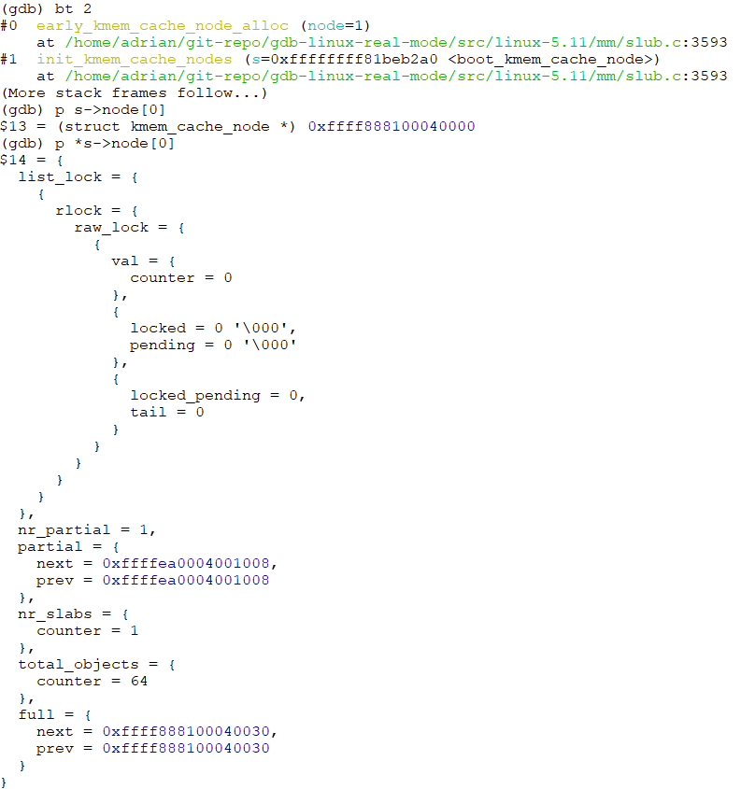
early_kmem_cache_node_alloc(): configure node #0
list_head
Get a slab object from page->freelist
kmem_cache (kmem_cache_node)
page (slab, slob or slub)
Page
kmem_cache_node
struct list_head slab_list
list_lock
__percpu *cpu_slab
struct (Partial Page)
struct page *next
..
nr_partial = 1
slab object
slab object
union
slab object
min_partial = 5
int pages
struct list_head partial
size = 64
int pobjects
nr_slabs = 1
object_size = 64
total_objects = 64
CONFIG_SLUB_DEBUG = y
offset = 32
struct kmem_cache *slab_cache
struct list_head full
cpu_partial = 30
void *freelist (first free object)
oo (order objects) = 64
s_mem: first object - SLAB
max = 64
counters - SLUB
min = 64
union
struct (SLUB)
inuse: 1
inuse = 64
objects:15 = 64
align = 64
frozen: 1 = 0
name = “kmem_cache_node”
list
*node[MAX_NUMNODES]
kmem_cache_node->node[node] = n

Slide 26
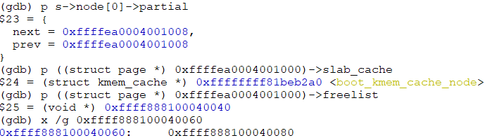
early_kmem_cache_node_alloc(): configure node #0
list_head
static local variable
Get a slab object from page->freelist
boot_kmem_cache_node
kmem_cache (global variable: kmem_cache_node)
page struct (slab, slob or slub)
Page
kmem_cache_node
struct list_head slab_list
list_lock
__percpu *cpu_slab = NULL
struct (Percpu Partial Page)
struct page *next
..
nr_partial = 1
slab object
slab object
union
slab object
min_partial = 5
int pages
struct list_head partial
size = 64
int pobjects
nr_slabs = 1
object_size = 64
total_objects = 64
CONFIG_SLUB_DEBUG = y
offset = 32
struct kmem_cache *slab_cache
struct list_head full
cpu_partial = 30
void *freelist (first free object)
oo (order objects) = 64
s_mem: first object - SLAB
max = 64
counters - SLUB
min = 64
union
struct (SLUB)
inuse: 16 = 1
inuse = 64
objects:15 = 64
align = 64
frozen: 1 = 0
name = “kmem_cache_node”
list
*node[MAX_NUMNODES]
kmem_cache_node->node[node] = n

Slide 27
early_kmem_cache_node_alloc(): Fully-configured
list_head
static local variable
Get a slab object from page->freelist
boot_kmem_cache_node
kmem_cache (global variable: kmem_cache_node)
page struct (slab, slob or slub)
Page
kmem_cache_node
struct list_head slab_list
list_lock
__percpu *cpu_slab = NULL
struct (Percpu Partial Page)
struct page *next
..
nr_partial = 1
slab object
slab object
union
slab object
min_partial = 5
int pages
struct list_head partial
size = 64
int pobjects
nr_slabs = 1
object_size = 64
total_objects = 64
CONFIG_SLUB_DEBUG = y
offset = 32
struct kmem_cache *slab_cache
struct list_head full
cpu_partial = 30
void *freelist (first free object)
.
.
oo (order objects) = 64
s_mem: first object - SLAB
max = 64
counters - SLUB
kmem_cache_node
min = 64
union
struct (SLUB)
inuse: 16 = 1
list_lock
inuse = 64
objects:15 = 64
nr_partial = 1
align = 64
frozen: 1 = 0
struct list_head partial
name = “kmem_cache_node”
nr_slabs = 1
list
total_objects = 64
*node[MAX_NUMNODES]
struct list_head full
kmem_cache_node->node[node] = n

Slide 28
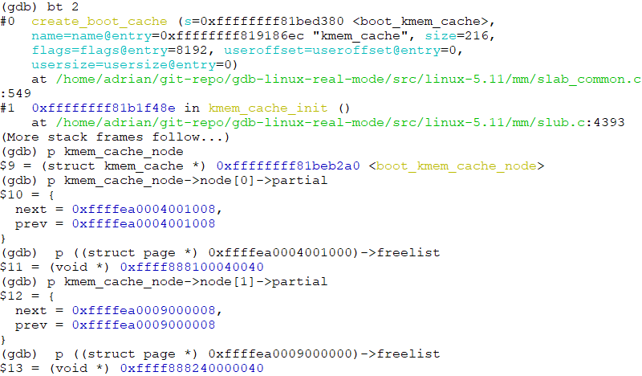
early_kmem_cache_node_alloc(): Fully-configured
list_head
static local variable
Get a slab object from page->freelist
boot_kmem_cache_node
kmem_cache (global variable: kmem_cache_node)
page struct (slab, slob or slub)
Page
kmem_cache_node
struct list_head slab_list
list_lock
__percpu *cpu_slab = NULL
struct (Percpu Partial Page)
struct page *next
..
nr_partial = 1
slab object
slab object
union
slab object
min_partial = 5
int pages
struct list_head partial
size = 64
int pobjects
nr_slabs = 1
object_size = 64
total_objects = 64
offset = 32
struct kmem_cache *slab_cache
struct list_head full
cpu_partial = 30
void *freelist (first free object)
.
.
oo (order objects) = 64
s_mem: first object - SLAB
max = 64
counters - SLUB
kmem_cache_node
min = 64
union
struct (SLUB)
inuse: 16 = 1
list_lock
inuse = 64
objects:15 = 64
nr_partial = 1
align = 64
frozen: 1 = 0
struct list_head partial
name = “kmem_cache_node”
nr_slabs = 1
list
total_objects = 64
*node[MAX_NUMNODES]
struct list_head full
kmem_cache_node->node[node] = n

Slide 29
[Comparison] Generic kmem_cache_create() & low-level implementation __kmem_cache_create()
start_kernel
mm_init
kmem_cache_init
Calculate page order and objects per slab
calculate_sizes
Allocate/init ‘kmem_cache_node’ structs for all CPU nodes (sockets)
create_boot_cache(kmem_cache_node, …)
__kmem_cache_create
kmem_cache_open
init_kmem_cache_nodes
create_boot_cache(kmem_cache, …)
Allocate/init a ‘kmem_cache_cpu’ struct
alloc_kmem_cache_cpus
__alloc_percpu
init_kmem_cache_cpus
Assign cpu id to kmem_cache_cpu->tid
__kmem_cache_alias
find_mergeable
kmem_cache_create
Allocate a ‘kmem_cache’ struct from a global variable ‘kmem_cache’
kmem_cache_create_usercopy
kmem_cache_zalloc
kmem_cache_alloc
slab_alloc
slab_alloc_node
__kmem_cache_create
create_cache
list_add(&s->list, &slab_caches)

Slide 30
[Cache allocation] slab_alloc_node – Allocate a slab cache with specific node id
Fast path & slow path
Will follow kmem_cache_init() flow

Slide 31
kmem_cache_init()
Declare two static variables ‘boot_kmem_cache’ and ‘boot_kmem_cache_node’
Assign the addresses of two static variables to generic/global variables
kmem_cache_node = &boot_kmem_cache_node
kmem_cache = &boot_kmem_cache
start_kernel
mm_init
kmem_cache_init
calculate_sizes
Allocate/init ‘kmem_cache_node’ structs for all CPU nodes (sockets)
create_boot_cache(kmem_cache_node, …)
__kmem_cache_create
kmem_cache_open
init_kmem_cache_nodes
create_boot_cache(kmem_cache, …)
Allocate/init a ‘kmem_cache_cpu’ struct
kmem_cache = bootstrap(&boot_kmem_cache)
alloc_kmem_cache_cpus
__alloc_percpu
kmem_cache_node = bootstrap(&boot_kmem_cache_node)
init_kmem_cache_cpus
Assign cpu id to kmem_cache_cpu->tid
setup_kmalloc_cache_index_table
create_kmalloc_caches

Slide 32
kmem_cache: init_kmem_cache_nodes()
for_each_node_state()
kmem_cache_cpu
slab_state == DOWN
N
void **freelist
init_kmem_cache_nodes
Generic path
tid (transaction id) = cpu id
Y
struct page *page
early_kmem_cache_node_alloc
n = kmem_cache_alloc_node()
struct page *partial
Special (one-shot) path:
Fix ‘chicken or the egg’ problem
init_kmem_cache_node
stat[NR_SLUB_STAT_ITEMS]
boot_kmem_cache
kmem_cache->node[node] = n
static variable
kmem_cache (global variable: kmem_cache)
Allocate from global variable ‘kmem_cache_node’
* init_kmem_cache_nodes -> kmem_cache_alloc_node
__percpu *cpu_slab
kmem_cache_node
min_partial = 5
list_lock
size = 256
nr_partial = 0
object_size = 216
struct list_head partial
offset = 112
nr_slabs = 0
cpu_partial = 13
total_objects = 0
CONFIG_SLUB_DEBUG = y
oo (order objects) = 0x10020
struct list_head full
max = 0x10020
.
.
min = 0x10
inuse = 216
kmem_cache_node
align = 64
list_lock
name = “kmem_cache”
nr_partial = 0
list
struct list_head partial
*node[MAX_NUMNODES]
kmem_cache_node->node[node] = n
nr_slabs = 0
total_objects = 0
struct list_head full

Slide 33
kmem_cache_alloc_node/slab_alloc_node
node_id
kmem_cache_alloc_node
kmem_cache_alloc
slab_alloc
slab_alloc_node
NUMA_NO_NODE
kmalloc_node
__kmalloc_node
node_id
slow path
get_freelist -> __cmpxchg_double_slab
c->page &&
!c->freelist
Get a slab object from page->freelist
!c->freelist or !c-> page
!c->page && c->partial
Get partial page from percpu cache
Y
__slab_alloc
___slab_alloc
c->page = slub_percpu_partial(c)
N
!c->page && !c->partial
Get partial page from node cache (kmem_cache_node)
Get a slab object from c->freelist
get_partial
this_cpu_cmpxchg_double()
new_slab_objects
fast path
new_slab
allocate_slab
alloc_slab_page
Allocate pages from Buddy system

Slide 34
Fast Path
percpu cache
percpu cache
Page
Page
kmem_cache_cpu (CPU #0)
..
kmem_cache_cpu (CPU #0)
..
slab object
slab object
slab object
slab object
slab object
slab object
slab object
slab object
struct page *page
struct page *page
void **freelist
get a slab object
void **freelist
kmem_cache (Slab cache)
struct page *partial
struct page *partial
.
.
Page
Page
.
.
Page
Page
__percpu *cpu_slab
kmem_cache_cpu (CPU #N)
..
..
kmem_cache_cpu (CPU #N)
..
..
slab object
slab object
slab object
slab object
slab object
slab object
slab object
slab object
slab object
slab object
slab object
slab object
struct page *page
struct page *page
void **freelist
void **freelist
struct page *partial
struct page *partial
Get a slab object from kmem_cache_cpu->freelist

Slide 35
slab_alloc_node(): slowpath #1 – Get an object from node’s partial page
node_id
kmem_cache_alloc_node
kmem_cache_alloc
slab_alloc
slab_alloc_node
NUMA_NO_NODE
kmalloc_node
__kmalloc_node
node_id
slow path
get_freelist -> __cmpxchg_double_slab
c->page &&
!c->freelist
Get a slab object from page->freelist
!c->freelist or !c-> page
!c->page && c->partial
Get partial page from percpu cache
Y
__slab_alloc
___slab_alloc
c->page = slub_percpu_partial(c)
N
Get partial page from node cache (kmem_cache_node)
!c->page && !c->partial
get_partial
Get a slab object from c->freelist
new_slab_objects
this_cpu_cmpxchg_double()
fast path
new_slab
allocate_slab
alloc_slab_page
Allocate pages from Buddy system

Slide 36
Slowpath #1 – Get an object from node’s partial page
static local variable
boot_kmem_cache_node
kmem_cache_cpu (CPU #N)
kmem_cache (global variable: kmem_cache_node)
1
struct page *page = NULL
Allocate a slab object from node #0
void **freelist = NULL
Move node’s partial page (slab) to percpu cache
__percpu *cpu_slab
struct page *partial = NULL
4
min_partial = 5
static local variable
size = 64
object_size = 64
2
Get a page (slab) from kmem_cache_node
boot_kmem_cache
offset = 32
cpu_partial = 30
kmem_cache
(kmem_cache)
oo (order objects) = 64
kmem_cache_node (node 0)
page struct (slab, slob or slub): node #0
max = 64
list_lock
struct list_head slab_list
*node[]
min = 64
nr_partial = 1
union
struct (Partial Page)
struct page *next
Allocate slab objects for node[0] & node[1]
inuse = 64
struct list_head partial
int pages
align = 64
nr_slabs = 1
int pobjects
list_head
name = “kmem_cache_node”
total_objects = 64
struct kmem_cache *slab_cache
list
struct list_head full
void *freelist (first free object)
Page
*node[MAX_NUMNODES]
s_mem: first object - SLAB
counters - SLUB
..
kmem_cache_node (node 1)
union
slab object
slab object
slab object
struct (SLUB)
inuse: 16 = 1
slab object
list_lock
objects:15 = 64
nr_partial = 1
frozen: 1 = 0
struct list_head partial
nr_slabs = 1
3
total_objects = 64
Get a page (slab) from ‘partial’ member
struct list_head full
*node[MAX_NUMNODES]
page struct (slab, slob or slub): node #1

Slide 37
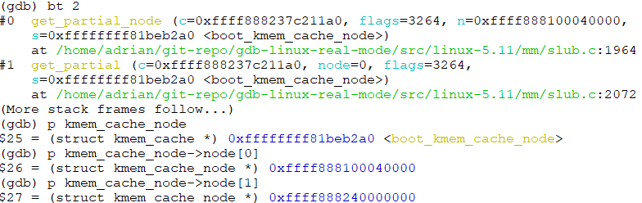
Slowpath #1 – Get an object from node’s partial page
static local variable
boot_kmem_cache_node
kmem_cache_cpu (CPU #N)
kmem_cache (global variable: kmem_cache_node)
1
struct page *page = NULL
Allocate a slab object from node #0
void **freelist = NULL
Move node’s partial page (slab) to percpu cache
__percpu *cpu_slab
struct page *partial = NULL
4
min_partial = 5
static local variable
size = 64
object_size = 64
2
Get a page (slab) from kmem_cache_node
boot_kmem_cache
offset = 32
cpu_partial = 30
kmem_cache
(kmem_cache)
oo (order objects) = 64
kmem_cache_node (node 0)
page struct (slab, slob or slub): node #0
max = 64
list_lock
struct list_head slab_list
*node[]
min = 64
nr_partial = 1
union
struct (Partial Page)
struct page *next
Allocate slab objects for node[0] & node[1]
inuse = 64
struct list_head partial
int pages
align = 64
nr_slabs = 1
int pobjects
list_head
name = “kmem_cache_node”
total_objects = 64
struct kmem_cache *slab_cache
list
struct list_head full
void *freelist (first free object)
Page
*node[MAX_NUMNODES]
s_mem: first object - SLAB
counters - SLUB
..
kmem_cache_node (node 1)
union
slab object
slab object
slab object
struct (SLUB)
inuse: 16 = 1
slab object
list_lock
objects:15 = 64
nr_partial = 1
frozen: 1 = 0
struct list_head partial
nr_slabs = 1
3
total_objects = 64
Get a page (slab) from ‘partial’ member
struct list_head full
*node[MAX_NUMNODES]
page struct (slab, slob or slub): node #1

Slide 38
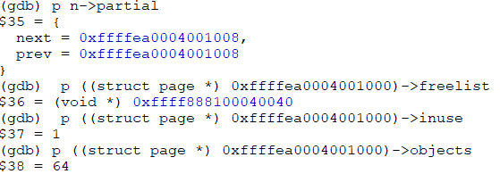
Slowpath #1 – Get an object from node’s partial page
static local variable
boot_kmem_cache_node
kmem_cache_cpu (CPU #N)
kmem_cache (global variable: kmem_cache_node)
1
struct page *page = NULL
Allocate a slab object from node #0
void **freelist = NULL
Move node’s partial page (slab) to percpu cache
__percpu *cpu_slab
struct page *partial = NULL
4
min_partial = 5
static local variable
size = 64
object_size = 64
2
Get a page (slab) from kmem_cache_node
boot_kmem_cache
offset = 32
cpu_partial = 30
kmem_cache
(kmem_cache)
oo (order objects) = 64
kmem_cache_node (node 0)
page struct (slab, slob or slub): node #0
max = 64
list_lock
struct list_head slab_list
*node[]
min = 64
nr_partial = 1
union
struct (Partial Page)
struct page *next
Allocate slab objects for node[0] & node[1]
inuse = 64
struct list_head partial
int pages
align = 64
nr_slabs = 1
int pobjects
list_head
name = “kmem_cache_node”
total_objects = 64
struct kmem_cache *slab_cache
list
struct list_head full
void *freelist (first free object)
Page
*node[MAX_NUMNODES]
s_mem: first object - SLAB
counters - SLUB
..
kmem_cache_node (node 1)
union
slab object
slab object
slab object
struct (SLUB)
inuse: 16 = 1
slab object
list_lock
objects:15 = 64
nr_partial = 1
frozen: 1 = 0
struct list_head partial
nr_slabs = 1
3
total_objects = 64
Get a page (slab) from ‘partial’ member
struct list_head full
*node[MAX_NUMNODES]
page struct (slab, slob or slub): node #1

Slide 39
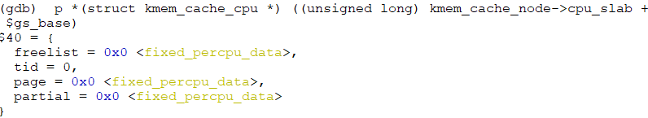
Slowpath #1 – Get an object from node’s partial page
static local variable
boot_kmem_cache_node
kmem_cache_cpu (CPU #N)
kmem_cache (global variable: kmem_cache_node)
1
struct page *page = NULL
Allocate a slab object from node #0
void **freelist = NULL
Move node’s partial page (slab) to percpu cache
__percpu *cpu_slab
struct page *partial = NULL
4
min_partial = 5
static local variable
size = 64
object_size = 64
2
Get a page (slab) from kmem_cache_node
boot_kmem_cache
offset = 32
cpu_partial = 30
kmem_cache
(kmem_cache)
oo (order objects) = 64
kmem_cache_node (node 0)
page struct (slab, slob or slub): node #0
max = 64
list_lock
struct list_head slab_list
*node[]
min = 64
nr_partial = 1
union
struct (Partial Page)
struct page *next
Allocate slab objects for node[0] & node[1]
inuse = 64
struct list_head partial
int pages
align = 64
nr_slabs = 1
int pobjects
list_head
name = “kmem_cache_node”
total_objects = 64
struct kmem_cache *slab_cache
list
struct list_head full
void *freelist (first free object)
Page
*node[MAX_NUMNODES]
s_mem: first object - SLAB
counters - SLUB
..
kmem_cache_node (node 1)
union
slab object
slab object
slab object
struct (SLUB)
inuse: 16 = 1
slab object
list_lock
objects:15 = 64
nr_partial = 1
frozen: 1 = 0
struct list_head partial
nr_slabs = 1
3
total_objects = 64
Get a page (slab) from ‘partial’ member
struct list_head full
*node[MAX_NUMNODES]
page struct (slab, slob or slub): node #1

Slide 40
Slowpath #1 – Get an object from node’s partial page
static local variable
page struct (slab, slob or slub): node #0
boot_kmem_cache_node
kmem_cache_cpu (CPU #N)
struct list_head slab_list = invalid
kmem_cache (global variable: kmem_cache_node)
union
struct (Partial Page)
struct page *next
Return this object address
struct page *page
int pages
void **freelist
int pobjects
Allocate a slab object from node #0
__percpu *cpu_slab
struct page *partial = NULL
struct kmem_cache *slab_cache
min_partial = 5
void *freelist (first free object) = NULL
Page
size = 64
s_mem: first object - SLAB
static local variable
object_size = 64
counters - SLUB
..
slab object
slab object
slab object
boot_kmem_cache
offset = 32
union
struct (SLUB)
inuse: 16 = 64
slab object
cpu_partial = 30
objects:15 = 64
kmem_cache
(kmem_cache)
oo (order objects) = 64
frozen: 1 = 1
max = 64
kmem_cache_node (node 0)
*node[]
min = 64
list_lock
Allocate slab objects for node[0] & node[1]
node[0]: allocated
inuse = 64
nr_partial = 0
align = 64
struct list_head partial
name = “kmem_cache_node”
nr_slabs = 1
list
total_objects = 64
*node[MAX_NUMNODES]
struct list_head full
kmem_cache_node (node 1)
list_lock
nr_partial = 1
page struct (slab, slob or slub): node #1
struct list_head partial
nr_slabs = 1
total_objects = 64
struct list_head full
*node[MAX_NUMNODES]

Slide 41
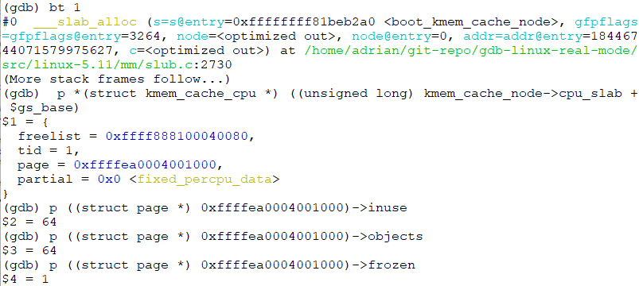
Slowpath #1 – Get an object from node’s partial page
static local variable
page struct (slab, slob or slub): node #0
boot_kmem_cache_node
kmem_cache_cpu (CPU #N)
struct list_head slab_list = invalid
kmem_cache (global variable: kmem_cache_node)
union
struct (Partial Page)
struct page *next
Return this object address
struct page *page
int pages
void **freelist
int pobjects
Allocate a slab object from node #0
__percpu *cpu_slab
struct page *partial = NULL
struct kmem_cache *slab_cache
min_partial = 5
void *freelist (first free object) = NULL
Page
size = 64
s_mem: first object - SLAB
static local variable
object_size = 64
counters - SLUB
..
slab object
slab object
slab object
boot_kmem_cache
offset = 32
union
struct (SLUB)
inuse: 16 = 64
slab object
cpu_partial = 30
objects:15 = 64
kmem_cache
(kmem_cache)
oo (order objects) = 64
frozen: 1 = 1
max = 64
kmem_cache_node (node 0)
*node[]
min = 64
list_lock
Allocate slab objects for node[0] & node[1]
node[0]: allocated
inuse = 64
nr_partial = 0
align = 64
struct list_head partial
name = “kmem_cache_node”
nr_slabs = 1
list
total_objects = 64
*node[MAX_NUMNODES]
struct list_head full
kmem_cache_node (node 1)
list_lock
nr_partial = 1
page struct (slab, slob or slub): node #1
struct list_head partial
nr_slabs = 1
total_objects = 64
struct list_head full
*node[MAX_NUMNODES]

Slide 42
Slowpath #1 – Get an object from node’s partial page
static local variable
page struct (slab, slob or slub): node #0
percpu page’s node is mismatch
boot_kmem_cache_node
struct list_head slab_list = invalid
2
kmem_cache_cpu (CPU #N)
kmem_cache (global variable: kmem_cache_node)
union
struct (Partial Page)
struct page *next
1
struct page *page
int pages
void **freelist
int pobjects
Allocate a slab object from node #1
__percpu *cpu_slab
struct page *partial = NULL
struct kmem_cache *slab_cache
min_partial = 5
void *freelist (first free object) = NULL
Page
size = 64
s_mem: first object - SLAB
static local variable
object_size = 64
counters - SLUB
..
slab object
slab object
slab object
boot_kmem_cache
offset = 32
union
struct (SLUB)
inuse: 16 = 64
slab object
cpu_partial = 30
objects:15 = 64
kmem_cache
(kmem_cache)
oo (order objects) = 64
frozen: 1 = 1
max = 64
kmem_cache_node (node 0)
*node[]
min = 64
list_lock
Allocate slab objects for node[0] & node[1]
node[0]: allocated
inuse = 64
nr_partial = 0
align = 64
struct list_head partial
name = “kmem_cache_node”
nr_slabs = 1
3
deactivate_slab(): Remove percpu slab
list
total_objects = 64
*node[MAX_NUMNODES]
struct list_head full
kmem_cache_node (node 1)
list_lock
nr_partial = 1
page struct (slab, slob or slub): node #1
struct list_head partial
nr_slabs = 1
total_objects = 64
struct list_head full
*node[MAX_NUMNODES]

Slide 43
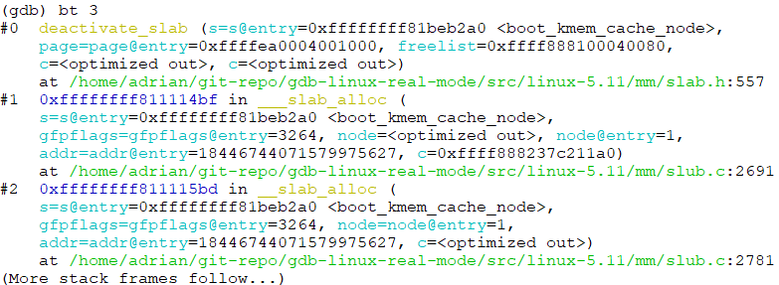
Slowpath #1 – Get an object from node’s partial page
static local variable
page struct (slab, slob or slub): node #0
percpu page’s node is mismatch
boot_kmem_cache_node
struct list_head slab_list = invalid
2
kmem_cache_cpu (CPU #N)
kmem_cache (global variable: kmem_cache_node)
union
struct (Partial Page)
struct page *next
1
struct page *page
int pages
void **freelist
int pobjects
Allocate a slab object from node #1
__percpu *cpu_slab
struct page *partial = NULL
struct kmem_cache *slab_cache
min_partial = 5
void *freelist (first free object) = NULL
Page
size = 64
s_mem: first object - SLAB
static local variable
object_size = 64
counters - SLUB
..
slab object
slab object
slab object
boot_kmem_cache
offset = 32
union
struct (SLUB)
inuse: 16 = 64
slab object
cpu_partial = 30
objects:15 = 64
kmem_cache
(kmem_cache)
oo (order objects) = 64
frozen: 1 = 1
max = 64
kmem_cache_node (node 0)
*node[]
min = 64
list_lock
Allocate slab objects for node[0] & node[1]
node[0]: allocated
inuse = 64
nr_partial = 0
align = 64
struct list_head partial
name = “kmem_cache_node”
nr_slabs = 1
3
deactivate_slab(): Remove percpu slab
list
total_objects = 64
*node[MAX_NUMNODES]
struct list_head full
kmem_cache_node (node 1)
list_lock
nr_partial = 1
page struct (slab, slob or slub): node #1
struct list_head partial
nr_slabs = 1
total_objects = 64
struct list_head full
*node[MAX_NUMNODES]

Slide 44
Slowpath #1 – Get an object from node’s partial page
static local variable
boot_kmem_cache_node
kmem_cache_cpu (CPU #N)
kmem_cache (global variable: kmem_cache_node)
1
struct page *page = NULL
Allocate a slab object from node #1
__percpu *cpu_slab
void **freelist = NULL
page struct (slab, slob or slub): node #0
min_partial = 5
struct page *partial = NULL
struct list_head slab_list
size = 64
union
struct (Partial Page)
struct page *next
static local variable
object_size = 64
int pages
boot_kmem_cache
int pobjects
offset = 32
struct kmem_cache *slab_cache
cpu_partial = 30
void *freelist (first free object)
Page
kmem_cache
(kmem_cache)
oo (order objects) = 64
s_mem: first object - SLAB
max = 64
kmem_cache_node (node 0)
counters - SLUB
..
slab object
slab object
slab object
*node[]
min = 64
list_lock
union
struct (SLUB)
inuse: 16 = 2
slab object
Allocate slab objects for node[0] & node[1]
node[0]: allocated
inuse = 64
nr_partial = 1
objects:15 = 64
align = 64
struct list_head partial
frozen: 1 = 0
freepointers: reverse!
name = “kmem_cache_node”
nr_slabs = 1
list
total_objects = 64
page struct (slab, slob or slub): node #1
*node[MAX_NUMNODES]
struct list_head full
struct list_head slab_list
union
struct (Partial Page)
struct page *next
kmem_cache_node (node 1)
int pages
list_lock
int pobjects
Page
nr_partial = 1
struct kmem_cache *slab_cache
void *freelist (first free object)
..
slab object
slab object
slab object
struct list_head partial
s_mem: first object - SLAB
slab object
nr_slabs = 1
counters - SLUB
total_objects = 64
union
struct (SLUB)
inuse: 16 = 1
struct list_head full
objects:15 = 64
*node[MAX_NUMNODES]
frozen: 1 = 0

Slide 45
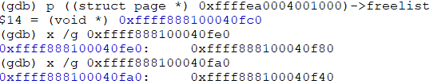
Slowpath #1 – Get an object from node’s partial page
static local variable
boot_kmem_cache_node
kmem_cache_cpu (CPU #N)
kmem_cache (global variable: kmem_cache_node)
1
struct page *page = NULL
Allocate a slab object from node #1
__percpu *cpu_slab
void **freelist = NULL
page struct (slab, slob or slub): node #0
min_partial = 5
struct page *partial = NULL
struct list_head slab_list
size = 64
union
struct (Partial Page)
struct page *next
static local variable
object_size = 64
int pages
boot_kmem_cache
int pobjects
offset = 32
struct kmem_cache *slab_cache
cpu_partial = 30
void *freelist (first free object)
Page
kmem_cache
(kmem_cache)
oo (order objects) = 64
s_mem: first object - SLAB
max = 64
kmem_cache_node (node 0)
counters - SLUB
..
slab object
slab object
slab object
*node[]
min = 64
list_lock
union
struct (SLUB)
inuse: 16 = 2
slab object
Allocate slab objects for node[0] & node[1]
node[0]: allocated
inuse = 64
nr_partial = 1
objects:15 = 64
align = 64
struct list_head partial
frozen: 1 = 0
freepointers: reverse!
name = “kmem_cache_node”
nr_slabs = 1
list
total_objects = 64
page struct (slab, slob or slub): node #1
*node[MAX_NUMNODES]
struct list_head full
struct list_head slab_list
union
struct (Partial Page)
struct page *next
kmem_cache_node (node 1)
int pages
list_lock
int pobjects
Page
nr_partial = 1
struct kmem_cache *slab_cache
void *freelist (first free object)
..
slab object
slab object
slab object
struct list_head partial
s_mem: first object - SLAB
slab object
nr_slabs = 1
counters - SLUB
total_objects = 64
union
struct (SLUB)
inuse: 16 = 1
struct list_head full
objects:15 = 64
*node[MAX_NUMNODES]
frozen: 1 = 0

Slide 46
Slowpath #1 – Get an object from node’s partial page
static local variable
boot_kmem_cache_node
kmem_cache_cpu (CPU #N)
4
Move node’s partial page (slab) to percpu cache
kmem_cache (global variable: kmem_cache_node)
struct page *page = NULL
Allocate a slab object from node #1
__percpu *cpu_slab
void **freelist = NULL
page struct (slab, slob or slub): node #0
min_partial = 5
struct page *partial = NULL
struct list_head slab_list
size = 64
union
struct (Partial Page)
struct page *next
static local variable
object_size = 64
int pages
boot_kmem_cache
int pobjects
offset = 32
struct kmem_cache *slab_cache
cpu_partial = 30
void *freelist (first free object)
Page
kmem_cache
(kmem_cache)
oo (order objects) = 64
s_mem: first object - SLAB
max = 64
kmem_cache_node (node 0)
counters - SLUB
..
slab object
slab object
slab object
*node[]
min = 64
list_lock
union
struct (SLUB)
inuse: 16 = 2
slab object
Allocate slab objects for node[0] & node[1]
node[0]: allocated
inuse = 64
nr_partial = 1
objects:15 = 64
freepointers: reverse!
align = 64
struct list_head partial
frozen: 1 = 0
name = “kmem_cache_node”
nr_slabs = 1
list
total_objects = 64
page struct (slab, slob or slub): node #1
*node[MAX_NUMNODES]
struct list_head full
struct list_head slab_list
union
struct (Partial Page)
struct page *next
kmem_cache_node (node 1)
int pages
list_lock
int pobjects
Page
nr_partial = 1
struct kmem_cache *slab_cache
void *freelist (first free object)
..
slab object
slab object
slab object
struct list_head partial
s_mem: first object - SLAB
slab object
nr_slabs = 1
counters - SLUB
total_objects = 64
union
struct (SLUB)
inuse: 16 = 1
struct list_head full
objects:15 = 64
*node[MAX_NUMNODES]
frozen: 1 = 0

Slide 47
Slowpath #1 – Get an object from node’s partial page
static local variable
page struct (slab, slob or slub): node #1
boot_kmem_cache_node
Return this object address
kmem_cache_cpu (CPU #N)
struct list_head slab_list = invalid
kmem_cache (global variable: kmem_cache_node)
union
struct (Partial Page)
struct page *next
struct page *page
int pages
Page
Allocate a slab object from node #1
__percpu *cpu_slab
void **freelist
int pobjects
struct page *partial = NULL
struct kmem_cache *slab_cache
min_partial = 5
void *freelist (first free object) = NULL
..
slab object
slab object
slab object
size = 64
s_mem: first object - SLAB
slab object
static local variable
object_size = 64
counters - SLUB
boot_kmem_cache
offset = 32
union
struct (SLUB)
inuse: 16 = 64
cpu_partial = 30
objects:15 = 64
kmem_cache
(kmem_cache)
oo (order objects) = 64
frozen: 1 = 1
max = 64
kmem_cache_node (node 0)
*node[]
min = 64
list_lock
Allocate slab objects for node[0] & node[1]
node[0]: allocated
node[1]: allocated
inuse = 64
nr_partial = 1
page struct (slab, slob or slub): node #0
align = 64
struct list_head partial
struct list_head slab_list
name = “kmem_cache_node”
nr_slabs = 1
struct (Partial Page)
struct page *next
total_objects = 64
union
list
int pages
*node[MAX_NUMNODES]
struct list_head full
int pobjects
struct kmem_cache *slab_cache
kmem_cache_node (node 1)
void *freelist (first free object)
Page
s_mem: first object - SLAB
list_lock
counters - SLUB
..
slab object
slab object
slab object
nr_partial = 1
union
struct (SLUB)
inuse: 16 = 2
slab object
struct list_head partial
objects:15 = 64
freepointers: reverse!
nr_slabs = 1
frozen: 1 = 0
total_objects = 64
struct list_head full
*node[MAX_NUMNODES]

Slide 48
kmem_cache_init()
Declare two static variables ‘boot_kmem_cache’ and ‘boot_kmem_cache_node’
Assign the addresses of two static variables to generic/global variables
kmem_cache_node = &boot_kmem_cache_node
kmem_cache = &boot_kmem_cache
start_kernel
mm_init
kmem_cache_init
calculate_sizes
Allocate/init ‘kmem_cache_node’ structs for all CPU nodes (sockets)
create_boot_cache(kmem_cache_node, …)
__kmem_cache_create
kmem_cache_open
init_kmem_cache_nodes
create_boot_cache(kmem_cache, …)
Allocate/init a ‘kmem_cache_cpu’ struct
kmem_cache = bootstrap(&boot_kmem_cache)
alloc_kmem_cache_cpus
__alloc_percpu
kmem_cache_node = bootstrap(&boot_kmem_cache_node)
init_kmem_cache_cpus
Assign cpu id to kmem_cache_cpu->tid
setup_kmalloc_cache_index_table
create_kmalloc_caches
Let’s check data structures about kmem_cache & kmem_cache_node after function call “create_boot_cache”

Slide 49
create_boot_cache(): 1/2
static local variable
page struct (slab, slob or slub): node #1
boot_kmem_cache_node
Return this object address
kmem_cache_cpu (CPU #N)
struct list_head slab_list = invalid
kmem_cache (global variable: kmem_cache_node)
union
struct (Partial Page)
struct page *next
struct page *page
int pages
Page
__percpu *cpu_slab
void **freelist
int pobjects
struct page *partial = NULL
struct kmem_cache *slab_cache
min_partial = 5
void *freelist (first free object) = NULL
..
slab object
slab object
slab object
size = 64
s_mem: first object - SLAB
slab object
object_size = 64
counters - SLUB
offset = 32
union
struct (SLUB)
inuse: 16 = 64
cpu_partial = 30
objects:15 = 64
oo (order objects) = 64
frozen: 1 = 1
max = 64
kmem_cache_node (node 0)
min = 64
list_lock
inuse = 64
nr_partial = 1
page struct (slab, slob or slub): node #0
align = 64
struct list_head partial
struct list_head slab_list
name = “kmem_cache_node”
nr_slabs = 1
struct (Partial Page)
struct page *next
total_objects = 64
union
list
int pages
*node[MAX_NUMNODES]
struct list_head full
int pobjects
struct kmem_cache *slab_cache
kmem_cache_node (node 1)
void *freelist (first free object)
Page
s_mem: first object - SLAB
list_lock
counters - SLUB
..
slab object
slab object
slab object
nr_partial = 1
union
struct (SLUB)
inuse: 16 = 2
slab object
struct list_head partial
objects:15 = 64
freepointers: reverse!
nr_slabs = 1
frozen: 1 = 0
total_objects = 64
struct list_head full
*node[MAX_NUMNODES]

Slide 50
create_boot_cache(): 2/2
static local variable
boot_kmem_cache
kmem_cache_cpu (CPU #N)
kmem_cache (global variable: kmem_cache)
struct page *page = NULL
__percpu *cpu_slab
void **freelist = NULL
min_partial = 5
struct page *partial = NULL
size = 256
object_size = 216
offset = 112
cpu_partial = 13
oo (order objects) = 0x10020
max = 0x10020
kmem_cache_node (node 0)
min = 0x10
list_lock
inuse = 216
nr_partial = 0
align = 64
struct list_head partial
name = “kmem_cache”
nr_slabs = 0
list
total_objects = 0
*node[MAX_NUMNODES]
struct list_head full
kmem_cache_node (node 1)
list_lock
nr_partial = 0
struct list_head partial
nr_slabs = 0
total_objects = 0
struct list_head full
*node[MAX_NUMNODES]

Slide 51
kmem_cache_init()
Declare two static variables ‘boot_kmem_cache’ and ‘boot_kmem_cache_node’
Assign the addresses of two static variables to generic/global variables
kmem_cache_node = &boot_kmem_cache_node
kmem_cache = &boot_kmem_cache
start_kernel
mm_init
kmem_cache_init
calculate_sizes
Allocate/init ‘kmem_cache_node’ structs for all CPU nodes (sockets)
create_boot_cache(kmem_cache_node, …)
__kmem_cache_create
kmem_cache_open
init_kmem_cache_nodes
create_boot_cache(kmem_cache, …)
Allocate/init a ‘kmem_cache_cpu’ struct
kmem_cache = bootstrap(&boot_kmem_cache)
alloc_kmem_cache_cpus
__alloc_percpu
kmem_cache_node = bootstrap(&boot_kmem_cache_node)
init_kmem_cache_cpus
Assign cpu id to kmem_cache_cpu->tid
setup_kmalloc_cache_index_table
create_kmalloc_caches

Slide 52
kmem_cache = bootstrap(&boot_kmem_cache)
bootstrap
Allocate a kmem_cache struct from global variable ‘kmem_cache’: Generic path
s = kmem_cache_zalloc(kmem_cache, …)
memcpy(s, static_cache, …)
__flush_cpu_slab
for_each_kmem_cache_node(s, node, n)
struct page *p;
list_for_each_entry(p, &n->partial, slab_list)
p->slab_cache = s
list_add(&s->list, &slab_caches)
return s

Slide 53
slab_alloc_node(): slowpath #2 – Allocate a page from Buddy system
node_id
kmem_cache_alloc_node
bootstrap
Allocate a kmem_cache struct from global variable ‘kmem_cache’
kmem_cache_alloc
slab_alloc
slab_alloc_node
s = kmem_cache_zalloc(kmem_cache, …)
NUMA_NO_NODE
kmalloc_node
__kmalloc_node
node_id
slow path
get_freelist -> __cmpxchg_double_slab
c->page &&
!c->freelist
Get a slab object from page->freelist
!c->freelist or !c-> page
!c->page && c->partial
Get partial page from percpu cache
Y
__slab_alloc
___slab_alloc
c->page = slub_percpu_partial(c)
N
Get partial page from node cache (kmem_cache_node)
!c->page && !c->partial
get_partial
Get a slab object from c->freelist
new_slab_objects
this_cpu_cmpxchg_double()
fast path
new_slab
allocate_slab
alloc_slab_page
Allocate pages from Buddy system

Slide 54
[slowpath #2] Before: bootstrap(&boot_kmem_cache) -> kmem_cache_zalloc()
static local variable
boot_kmem_cache
kmem_cache_cpu (CPU #N)
kmem_cache (global variable: kmem_cache)
struct page *page = NULL
__percpu *cpu_slab
void **freelist = NULL
min_partial = 5
struct page *partial = NULL
size = 256
object_size = 216
offset = 112
cpu_partial = 13
oo (order objects) = 0x10020
max = 0x10020
kmem_cache_node (node 0)
min = 0x10
list_lock
inuse = 216
nr_partial = 0
align = 64
struct list_head partial
name = “kmem_cache”
nr_slabs = 0
list
total_objects = 0
*node[MAX_NUMNODES]
struct list_head full
kmem_cache_node (node 1)
list_lock
nr_partial = 0
struct list_head partial
nr_slabs = 0
total_objects = 0
struct list_head full
*node[MAX_NUMNODES]

Slide 55
[slowpath #2] After: bootstrap(&boot_kmem_cache) -> kmem_cache_zalloc()
static local variable
2
Allocate from Buddy system
boot_kmem_cache
kmem_cache_cpu (CPU #N)
page struct (slab, slob or slub): order =1
kmem_cache (global variable: kmem_cache)
Return this object address
struct list_head slab_list = invalid
3
1
struct page *page
union
struct (Partial Page)
struct page *next
__percpu *cpu_slab
void **freelist
Slab Page(s)
int pages
kmem_cache_zalloc(kmem_cache, …)
struct page *partial = NULL
int pobjects
min_partial = 5
struct kmem_cache *slab_cache
size = 256
..
void *freelist (first free object) = NULL
slab object
slab object
slab object
object_size = 216
slab object
s_mem: first object - SLAB
offset = 112
counters - SLUB
cpu_partial = 13
kmem_cache_node (node 0)
union
struct (SLUB)
inuse: 16 = 32
oo (order objects) = 0x10020
list_lock
objects:15 = 32
max = 0x10020
nr_partial = 0
frozen: 1 = 1
min = 0x10
struct list_head partial
inuse = 216
nr_slabs = 0
align = 64
total_objects = 0
name = “kmem_cache”
struct list_head full
list
*node[MAX_NUMNODES]
kmem_cache_node (node 1)
oo (order objects)
list_lock
Page order
objects per slab
nr_partial = 0
struct list_head partial
16
0
15
nr_slabs = 0
total_objects = 0
struct list_head full
*node[MAX_NUMNODES]
slab_alloc_node(): slowpath #2 – Allocate a page from Buddy system

Slide 56
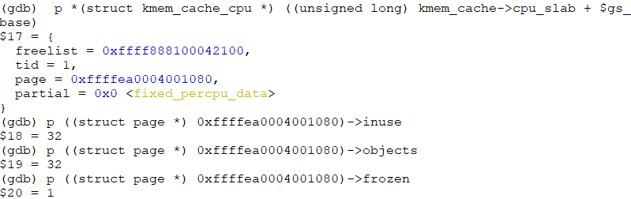
[slowpath #2] After: bootstrap(&boot_kmem_cache) -> kmem_cache_zalloc()
static local variable
2
Allocate from Buddy system
boot_kmem_cache
kmem_cache_cpu (CPU #N)
page struct (slab, slob or slub): order =1
kmem_cache (global variable: kmem_cache)
Return this object address
struct list_head slab_list = invalid
3
1
struct page *page
union
struct (Partial Page)
struct page *next
__percpu *cpu_slab
void **freelist
Slab Page(s)
int pages
kmem_cache_zalloc(kmem_cache, …)
struct page *partial = NULL
int pobjects
min_partial = 5
struct kmem_cache *slab_cache
size = 256
..
void *freelist (first free object) = NULL
slab object
slab object
slab object
object_size = 216
slab object
s_mem: first object - SLAB
offset = 112
counters - SLUB
cpu_partial = 13
union
struct (SLUB)
inuse: 16 = 32
oo (order objects) = 0x10020
objects:15 = 32
max = 0x10020
kmem_cache_node (node 0)
frozen: 1 = 1
min = 0x10
list_lock
inuse = 216
nr_partial = 0
align = 64
struct list_head partial
name = “kmem_cache”
nr_slabs = 0
list
total_objects = 0
*node[MAX_NUMNODES]
struct list_head full
oo (order objects)
kmem_cache_node (node 1)
Page order
objects per slab
list_lock
16
0
nr_partial = 0
15
struct list_head partial
nr_slabs = 0
total_objects = 0
struct list_head full
*node[MAX_NUMNODES]

Slide 57
[slowpath #2] After: bootstrap(&boot_kmem_cache) -> __flush_cpu_slab()
static local variable
boot_kmem_cache
kmem_cache_cpu (CPU #N)
X
page struct (slab, slob or slub): order =1
kmem_cache (global variable: kmem_cache)
struct list_head slab_list = invalid
struct page *page = NULL
union
struct (Partial Page)
struct page *next
void **freelist = NULL
Slab Page(s)
int pages
kmem_cache_zalloc(kmem_cache, …)
__percpu *cpu_slab
struct page *partial = NULL
int pobjects
min_partial = 5
X
struct kmem_cache *slab_cache
size = 256
..
void *freelist (first free object) = NULL
slab object
slab object
slab object
object_size = 216
slab object
s_mem: first object - SLAB
offset = 112
counters - SLUB
cpu_partial = 13
union
struct (SLUB)
inuse: 16 = 32
oo (order objects) = 0x10020
objects:15 = 32
max = 0x10020
kmem_cache_node (node 0)
frozen: 1 = 1
min = 0x10
list_lock
inuse = 216
nr_partial = 1
deactivate_slab(): Remove percpu slab
align = 64
struct list_head partial
name = “kmem_cache”
nr_slabs = 1
total_objects = 32
page struct (slab, slob or slub): order =1
Slab Page(s)
list
struct list_head slab_list
*node[MAX_NUMNODES]
struct list_head full
..
union
struct (Partial Page)
struct page *next
slab object
slab object
slab object
int pages
slab object
oo (order objects)
kmem_cache_node (node 1)
int pobjects
Page order
objects per slab
list_lock
struct kmem_cache *slab_cache
freepointers: reverse!
16
0
nr_partial = 0
void *freelist (first free object)
15
s_mem: first object - SLAB
struct list_head partial
nr_slabs = 0
counters - SLUB
total_objects = 0
union
struct (SLUB)
inuse: 16 = 1
struct list_head full
objects:15 = 32
*node[MAX_NUMNODES]
frozen: 1 = 0

Slide 58
kmem_cache = bootstrap(&boot_kmem_cache): after function returns
static local variable
global variable
boot_kmem_cache
kmem_cache
X
kmem_cache_cpu (CPU #N)
kmem_cache (global variable: kmem_cache)
struct page *page = NULL
__percpu *cpu_slab
void **freelist = NULL
min_partial = 5
struct page *partial = NULL
size = 256
object_size = 216
offset = 112
cpu_partial = 13
oo (order objects) = 0x10020
max = 0x10020
kmem_cache_node (node 0)
min = 0x10
list_lock
inuse = 216
nr_partial = 1
align = 64
struct list_head partial
name = “kmem_cache”
nr_slabs = 1
total_objects = 32
page struct (slab, slob or slub): order =1
Slab Page(s)
list
struct list_head slab_list
*node[MAX_NUMNODES]
struct list_head full
..
union
struct (Partial Page)
struct page *next
slab object
slab object
slab object
int pages
slab object
oo (order objects)
kmem_cache_node (node 1)
int pobjects
Page order
objects per slab
list_lock
struct kmem_cache *slab_cache
freepointers: reverse!
16
0
nr_partial = 0
void *freelist (first free object)
15
s_mem: first object - SLAB
struct list_head partial
nr_slabs = 0
counters - SLUB
total_objects = 0
union
struct (SLUB)
inuse: 16 = 1
struct list_head full
objects:15 = 32
*node[MAX_NUMNODES]
frozen: 1 = 0

Slide 59
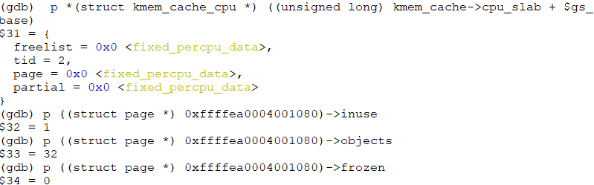
kmem_cache = bootstrap(&boot_kmem_cache): after function returns
static local variable
global variable
boot_kmem_cache
kmem_cache
X
kmem_cache_cpu (CPU #N)
kmem_cache (global variable: kmem_cache)
struct page *page = NULL
__percpu *cpu_slab
void **freelist = NULL
min_partial = 5
struct page *partial = NULL
size = 256
object_size = 216
offset = 112
cpu_partial = 13
oo (order objects) = 0x10020
max = 0x10020
kmem_cache_node (node 0)
min = 0x10
list_lock
inuse = 216
nr_partial = 1
align = 64
struct list_head partial
name = “kmem_cache”
nr_slabs = 1
total_objects = 32
page struct (slab, slob or slub): order =1
Slab Page(s)
list
struct list_head slab_list
*node[MAX_NUMNODES]
struct list_head full
..
union
struct (Partial Page)
struct page *next
slab object
slab object
slab object
int pages
slab object
oo (order objects)
kmem_cache_node (node 1)
int pobjects
Page order
objects per slab
list_lock
struct kmem_cache *slab_cache
freepointers: reverse!
16
0
nr_partial = 0
void *freelist (first free object)
15
s_mem: first object - SLAB
struct list_head partial
nr_slabs = 0
counters - SLUB
total_objects = 0
union
struct (SLUB)
inuse: 16 = 1
struct list_head full
objects:15 = 32
*node[MAX_NUMNODES]
frozen: 1 = 0

Slide 60
kmem_cache_init()
Declare two static variables ‘boot_kmem_cache’ and ‘boot_kmem_cache_node’
Assign the addresses of two static variables to generic/global variables
kmem_cache_node = &boot_kmem_cache_node
kmem_cache = &boot_kmem_cache
start_kernel
mm_init
kmem_cache_init
calculate_sizes
Allocate/init ‘kmem_cache_node’ structs for all CPU nodes (sockets)
create_boot_cache(kmem_cache_node, …)
__kmem_cache_create
kmem_cache_open
init_kmem_cache_nodes
create_boot_cache(kmem_cache, …)
Allocate/init a ‘kmem_cache_cpu’ struct
kmem_cache = bootstrap(&boot_kmem_cache)
alloc_kmem_cache_cpus
__alloc_percpu
kmem_cache_node = bootstrap(&boot_kmem_cache_node)
init_kmem_cache_cpus
Assign cpu id to kmem_cache_cpu->tid
setup_kmalloc_cache_index_table
create_kmalloc_caches

Slide 61
slab_alloc_node(): slowpath #1 – Get an object from node’s partial page
node_id
kmem_cache_node = bootstrap(&boot_kmem_cache_node)
kmem_cache_alloc_node
bootstrap
kmem_cache_alloc
slab_alloc
slab_alloc_node
Allocate a kmem_cache struct from global variable ‘kmem_cache’
NUMA_NO_NODE
s = kmem_cache_zalloc(kmem_cache, …)
kmalloc_node
__kmalloc_node
node_id
slow path
get_freelist -> __cmpxchg_double_slab
c->page &&
!c->freelist
Get a slab object from page->freelist
!c->freelist or !c-> page
!c->page && c->partial
Get partial page from percpu cache
Y
__slab_alloc
___slab_alloc
c->page = slub_percpu_partial(c)
N
Get partial page from node cache (kmem_cache_node)
!c->page && !c->partial
get_partial
Get a slab object from c->freelist
new_slab_objects
this_cpu_cmpxchg_double()
fast path
new_slab
allocate_slab
alloc_slab_page
Allocate pages from Buddy system

Slide 62
kmem_cache_node = bootstrap(&boot_kmem_cache_node) -> kmem_cache_zalloc(…)
global variable
kmem_cache
page struct (slab, slob or slub): order =1
kmem_cache_cpu (CPU #N)
Return this object address
struct list_head slab_list = invalid
kmem_cache (global variable: kmem_cache)
union
struct (Partial Page)
struct page *next
struct page *page = NULL
int pages
void **freelist = NULL
Slab Page(s)
int pobjects
kmem_cache_zalloc(kmem_cache, …)
__percpu *cpu_slab
struct page *partial = NULL
struct kmem_cache *slab_cache
min_partial = 5
..
void *freelist (first free object) = NULL
slab object
slab object
slab object
slab object
size = 256
slab object
s_mem: first object - SLAB
object_size = 216
counters - SLUB
offset = 112
union
struct (SLUB)
inuse: 16 = 32
cpu_partial = 13
objects:15 = 32
oo (order objects) = 0x10020
frozen: 1 = 1
max = 0x10020
kmem_cache_node (node 0)
min = 0x10
list_lock
get_partial_node() -> acquire_slab()
inuse = 216
nr_partial = 0
align = 64
struct list_head partial
name = “kmem_cache”
nr_slabs = 1
total_objects = 32
page struct (slab, slob or slub): order =1
Slab Page(s)
list
struct list_head slab_list
*node[MAX_NUMNODES]
struct list_head full
..
union
struct (Partial Page)
struct page *next
slab object
slab object
slab object
int pages
slab object
oo (order objects)
kmem_cache_node (node 1)
int pobjects
Page order
objects per slab
list_lock
struct kmem_cache *slab_cache
freepointers: reverse!
16
0
nr_partial = 0
void *freelist (first free object)
15
s_mem: first object - SLAB
struct list_head partial
nr_slabs = 0
counters - SLUB
total_objects = 0
union
struct (SLUB)
inuse: 16 = 1
struct list_head full
objects:15 = 32
frozen: 1 = 0
slab_alloc_node(): slowpath #1 – Get an object from node’s partial page
*node[MAX_NUMNODES]

Slide 63
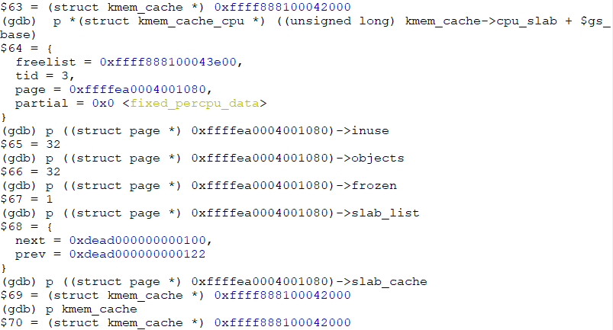
kmem_cache_node = bootstrap(&boot_kmem_cache_node) -> kmem_cache_zalloc(…)
global variable
kmem_cache
page struct (slab, slob or slub): order =1
kmem_cache_cpu (CPU #N)
Return this object address
struct list_head slab_list = invalid
kmem_cache (global variable: kmem_cache)
union
struct (Partial Page)
struct page *next
struct page *page
int pages
void **freelist
Slab Page(s)
int pobjects
__percpu *cpu_slab
struct page *partial = NULL
struct kmem_cache *slab_cache
min_partial = 5
..
void *freelist (first free object) = NULL
slab object
slab object
slab object
slab object
size = 256
slab object
s_mem: first object - SLAB
object_size = 216
counters - SLUB
offset = 112
union
struct (SLUB)
inuse: 16 = 32
cpu_partial = 13
objects:15 = 32
oo (order objects) = 0x10020
frozen: 1 = 1
max = 0x10020
kmem_cache_node (node 0)
min = 0x10
list_lock
get_partial_node() -> acquire_slab()
inuse = 216
nr_partial = 0
align = 64
struct list_head partial
name = “kmem_cache”
nr_slabs = 1
total_objects = 32
page struct (slab, slob or slub): order =1
Slab Page(s)
list
struct list_head slab_list
*node[MAX_NUMNODES]
struct list_head full
..
union
struct (Partial Page)
struct page *next
slab object
slab object
slab object
int pages
slab object
oo (order objects)
kmem_cache_node (node 1)
int pobjects
Page order
objects per slab
list_lock
struct kmem_cache *slab_cache
freepointers: reverse!
16
0
nr_partial = 0
void *freelist (first free object)
15
s_mem: first object - SLAB
struct list_head partial
nr_slabs = 0
counters - SLUB
total_objects = 0
union
struct (SLUB)
inuse: 16 = 1
struct list_head full
objects:15 = 32
*node[MAX_NUMNODES]
frozen: 1 = 0

Slide 64
kmem_cache_node = bootstrap(&boot_kmem_cache_node) -> __flush_cpu_slab()
static local variable
page struct (slab, slob or slub): node #1
boot_kmem_cache_node
kmem_cache_cpu (CPU #N)
struct list_head slab_list = invalid
kmem_cache (global variable: kmem_cache_node)
union
struct (Partial Page)
struct page *next
struct page *page
int pages
Page
__percpu *cpu_slab
void **freelist
int pobjects
struct page *partial = NULL
struct kmem_cache *slab_cache
min_partial = 5
void *freelist (first free object) = NULL
..
slab object
slab object
slab object
size = 64
s_mem: first object - SLAB
slab object
object_size = 64
counters - SLUB
offset = 32
union
struct (SLUB)
inuse: 16 = 64
cpu_partial = 30
objects:15 = 64
oo (order objects) = 64
frozen: 1 = 1
max = 64
kmem_cache_node (node 0)
min = 64
list_lock
deactivate_slab(): Remove percpu slab
inuse = 64
nr_partial = 1
page struct (slab, slob or slub): node #0
align = 64
struct list_head partial
struct list_head slab_list
name = “kmem_cache_node”
nr_slabs = 1
struct (Partial Page)
struct page *next
total_objects = 64
union
list
int pages
*node[MAX_NUMNODES]
struct list_head full
int pobjects
struct kmem_cache *slab_cache
kmem_cache_node (node 1)
void *freelist (first free object)
Page
s_mem: first object - SLAB
list_lock
counters - SLUB
..
slab object
slab object
slab object
nr_partial = 1
union
struct (SLUB)
inuse: 16 = 2
slab object
struct list_head partial
objects:15 = 64
freepointers: reverse!
nr_slabs = 1
frozen: 1 = 0
total_objects = 64
Reference from page #49
struct list_head full
*node[MAX_NUMNODES]

Slide 65
kmem_cache_node = bootstrap(&boot_kmem_cache_node) -> __flush_cpu_slab()
static local variable
boot_kmem_cache_node
kmem_cache_cpu (CPU #N)
kmem_cache (global variable: kmem_cache_node)
page struct (slab, slob or slub): node #0
struct page *page = NULL
struct list_head slab_list
__percpu *cpu_slab
void **freelist = NULL
union
struct (Partial Page)
struct page *next
min_partial = 5
struct page *partial = NULL
int pages
size = 64
int pobjects
struct kmem_cache *slab_cache
object_size = 64
void *freelist (first free object)
Page
offset = 32
s_mem: first object - SLAB
cpu_partial = 30
counters - SLUB
..
slab object
slab object
slab object
oo (order objects) = 64
union
struct (SLUB)
inuse: 16 = 2
slab object
max = 64
kmem_cache_node (node 0)
objects:15 = 64
min = 64
list_lock
freepointers: reverse!
inuse = 64
frozen: 1 = 0
nr_partial = 1
align = 64
struct list_head partial
name = “kmem_cache_node”
nr_slabs = 1
page struct (slab, slob or slub): node #1
list
total_objects = 64
struct list_head slab_list
*node[MAX_NUMNODES]
struct list_head full
struct (Partial Page)
struct page *next
union
int pages
Page
kmem_cache_node (node 1)
int pobjects
list_lock
struct kmem_cache *slab_cache
void *freelist (first free object)
..
slab object
slab object
slab object
nr_partial = 1
s_mem: first object - SLAB
slab object
struct list_head partial
counters - SLUB
freepointers: reverse!
nr_slabs = 1
union
struct (SLUB)
inuse: 16 = 2
total_objects = 64
objects:15 = 64
struct list_head full
frozen: 1 = 0
*node[MAX_NUMNODES]

Slide 66
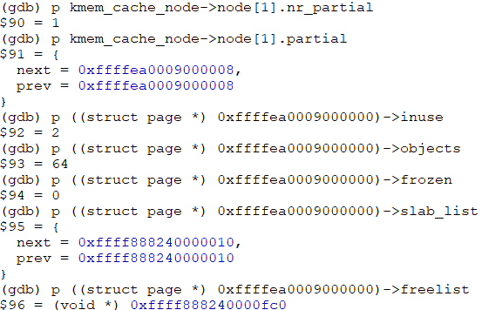
kmem_cache_node = bootstrap(&boot_kmem_cache_node) -> __flush_cpu_slab()
static local variable
boot_kmem_cache_node
kmem_cache_cpu (CPU #N)
kmem_cache (global variable: kmem_cache_node)
page struct (slab, slob or slub): node #0
struct page *page = NULL
struct list_head slab_list
__percpu *cpu_slab
void **freelist = NULL
union
struct (Partial Page)
struct page *next
min_partial = 5
struct page *partial = NULL
int pages
size = 64
int pobjects
struct kmem_cache *slab_cache
object_size = 64
void *freelist (first free object)
Page
offset = 32
s_mem: first object - SLAB
cpu_partial = 30
counters - SLUB
..
slab object
slab object
slab object
oo (order objects) = 64
union
struct (SLUB)
inuse: 16 = 2
slab object
max = 64
kmem_cache_node (node 0)
objects:15 = 64
min = 64
list_lock
freepointers: reverse!
inuse = 64
frozen: 1 = 0
nr_partial = 1
align = 64
struct list_head partial
name = “kmem_cache_node”
nr_slabs = 1
page struct (slab, slob or slub): node #1
list
total_objects = 64
struct list_head slab_list
*node[MAX_NUMNODES]
struct list_head full
struct (Partial Page)
struct page *next
union
int pages
Page
kmem_cache_node (node 1)
int pobjects
list_lock
struct kmem_cache *slab_cache
void *freelist (first free object)
..
slab object
slab object
slab object
nr_partial = 1
s_mem: first object - SLAB
slab object
struct list_head partial
counters - SLUB
freepointers: reverse!
nr_slabs = 1
union
struct (SLUB)
inuse: 16 = 2
total_objects = 64
objects:15 = 64
struct list_head full
frozen: 1 = 0
*node[MAX_NUMNODES]

Slide 67
After ‘kmem_cache_node = bootstrap(&boot_kmem_cache_node)’
static struct kmem_cache *kmem_cache_node
kmem_cache_cpu (CPU #N)
kmem_cache
page struct (slab, slob or slub): node #0
struct page *page = NULL
struct list_head slab_list
__percpu *cpu_slab
void **freelist = NULL
union
struct (Partial Page)
struct page *next
min_partial = 5
struct page *partial = NULL
int pages
size = 64
int pobjects
struct kmem_cache *slab_cache
object_size = 64
void *freelist (first free object)
Page
offset = 32
s_mem: first object - SLAB
cpu_partial = 30
counters - SLUB
..
slab object
slab object
slab object
oo (order objects) = 64
union
struct (SLUB)
inuse: 16 = 2
slab object
max = 64
kmem_cache_node (node 0)
objects:15 = 64
min = 64
list_lock
freepointers: reverse!
inuse = 64
frozen: 1 = 0
nr_partial = 1
align = 64
struct list_head partial
name = “kmem_cache_node”
nr_slabs = 1
page struct (slab, slob or slub): node #1
list
total_objects = 64
struct list_head slab_list
*node[MAX_NUMNODES]
struct list_head full
struct (Partial Page)
struct page *next
union
int pages
Page
kmem_cache_node (node 1)
int pobjects
list_lock
struct kmem_cache *slab_cache
void *freelist (first free object)
..
slab object
slab object
slab object
nr_partial = 1
s_mem: first object - SLAB
slab object
struct list_head partial
counters - SLUB
freepointers: reverse!
nr_slabs = 1
union
struct (SLUB)
inuse: 16 = 2
total_objects = 64
objects:15 = 64
struct list_head full
frozen: 1 = 0
*node[MAX_NUMNODES]

Slide 68
kmem_cache_init()
Declare two static variables ‘boot_kmem_cache’ and ‘boot_kmem_cache_node’
Assign the addresses of two static variables to generic/global variables
kmem_cache_node = &boot_kmem_cache_node
kmem_cache = &boot_kmem_cache
start_kernel
mm_init
kmem_cache_init
calculate_sizes
Allocate/init ‘kmem_cache_node’ structs for all CPU nodes (sockets)
create_boot_cache(kmem_cache_node, …)
__kmem_cache_create
kmem_cache_open
init_kmem_cache_nodes
create_boot_cache(kmem_cache, …)
Allocate/init a ‘kmem_cache_cpu’ struct
kmem_cache = bootstrap(&boot_kmem_cache)
alloc_kmem_cache_cpus
__alloc_percpu
kmem_cache_node = bootstrap(&boot_kmem_cache_node)
init_kmem_cache_cpus
Assign cpu id to kmem_cache_cpu->tid
setup_kmalloc_cache_index_table
create_kmalloc_caches
Will talk about this later

Slide 69
slab_alloc_node(): slowpath #3 – Get a partial page from percpu cache
node_id
kmem_cache_alloc_node
kmem_cache_alloc
slab_alloc
slab_alloc_node
NUMA_NO_NODE
kmalloc_node
__kmalloc_node
node_id
slow path
get_freelist -> __cmpxchg_double_slab
c->page &&
!c->freelist
Get a slab object from page->freelist
!c->freelist or !c-> page
!c->page && c->partial
Get partial page from percpu cache
Y
__slab_alloc
___slab_alloc
c->page = slub_percpu_partial(c)
N
Get partial page from node cache (kmem_cache_node)
!c->page && !c->partial
get_partial
Get a slab object from c->freelist
new_slab_objects
this_cpu_cmpxchg_double()
fast path
new_slab
allocate_slab
alloc_slab_page
Allocate pages from Buddy system
Let’s talk about another slow path

Slide 70
slowpath #3: Get a partial page from percpu cache
Slowpath #3: Get a partial page from percpu cache
1
kmem_cache_cpu (CPU #N)
Page
Page
struct page *page = NULL or valid
void **freelist = NULL or valid
..
..
page->next
slab object
slab object
slab object
slab object
slab object
kmem_cache
struct page *partial
slab object
__percpu *cpu_slab
*node[MAX_NUMNODES]
page->freelist
page->freelist
kmem_cache_node (node 0)
struct list_head partial
kmem_cache_node (node 1)
struct list_head partial
*node[MAX_NUMNODES]
Notes:
Wedson Almeida Filho

Slide 71
When to add a page to percpu partial page? – Case 1 (1/2)
kmem_cache_cpu (CPU #N)
struct page *page = NULL
void **freelist = NULL
kmem_cache
struct page *partial = NULL
__percpu *cpu_slab
*node[MAX_NUMNODES]
kmem_cache_node (node 0)
Page
Page
Page
struct list_head partial
..
..
..
1
slab object
slab object
slab object
slab object
slab object
slab object
slab object
slab object
slab object
kmem_cache_node (node 1)
struct list_head partial
Slowpath #1: Get a slab object from node’s partial (new_slab_objects->get_partial->get_partial_node->put_cpu_partial)
[Just for a scenario] Acquire 3 pages because of the number of kmem_cache->cpu_partial
*node[MAX_NUMNODES]
put_cpu_partial(): Put page(s) into a percpu partial page
Notes:
Wedson Almeida Filho

Slide 72
When to add a page to percpu partial page? – Case 1 (2/2)
Page
..
slab object
slab object
kmem_cache_cpu (CPU #N)
slab object
Page
Page
struct page *page
void **freelist
..
..
page->next
slab object
slab object
slab object
slab object
slab object
kmem_cache
struct page *partial
slab object
__percpu *cpu_slab
*node[MAX_NUMNODES]
page->freelist
page->freelist
kmem_cache_node (node 0)
Page
Page
Page
struct list_head partial
..
..
..
slab object
slab object
slab object
slab object
slab object
slab object
slab object
slab object
slab object
kmem_cache_node (node 1)
1
struct list_head partial
Slowpath #1: Get a slab object from node’s partial (new_slab_objects->get_partial->get_partial_node->put_cpu_partial)
[Just for a scenario] Acquire 3 pages because of the number of kmem_cache->cpu_partial
*node[MAX_NUMNODES]
put_cpu_partial(): Put page(s) into a percpu partial page
Notes:
Wedson Almeida Filho

Slide 73
When to add a page to percpu partial page? – Case 2: slab_free()
Page
..
slab object
slab object
kmem_cache_cpu (CPU #N)
slab object
Page
Page
struct page *page
void **freelist
..
..
page->next
slab object
slab object
slab object
slab object
slab object
kmem_cache
struct page *partial
slab object
__percpu *cpu_slab
*node[MAX_NUMNODES]
page->freelist
page->freelist
kmem_cache_node (node 0)
Page
struct list_head partial
..
slab object
slab object
slab object
kmem_cache_node (node 1)
struct list_head partial
*node[MAX_NUMNODES]
slab_free(): Move page(s) to percpu partial and node partial (if possible)
Notes:
Wedson Almeida Filho

Slide 74
When to add a page to percpu partial page? – Case 2: slab_free()
Fully-allocated objects of pages
Page
Page
Page
Page
..
..
..
..
..
slab object
slab object
slab object
slab object
slab object
slab object
slab object
slab object
slab object
kmem_cache_cpu (CPU #N)
slab object
slab object
slab object
struct page *page
Page
1
free this object
void **freelist
2
kmem_cache
struct page *partial
..
page->next
put_cpu_partial(): Move this page to percpu partial
slab object
slab object
__percpu *cpu_slab
slab object
*node[MAX_NUMNODES]
kmem_cache_node (node 0)
struct list_head partial
kmem_cache_node (node 1)
struct list_head partial
*node[MAX_NUMNODES]
slab_free(): Move page(s) to percpu partial and node partial (if possible)
* Detail will be discussed in section “[Cache release/free] kmem_cache_free()”
Notes:
Wedson Almeida Filho

Slide 75
slab_alloc_node(): slowpath #4 – Get a slab object page from page->freelist
node_id
kmem_cache_alloc_node
kmem_cache_alloc
slab_alloc
slab_alloc_node
NUMA_NO_NODE
kmalloc_node
__kmalloc_node
node_id
slow path
get_freelist -> __cmpxchg_double_slab
c->page &&
!c->freelist
Get a slab object from page->freelist
!c->freelist or !c-> page
!c->page && c->partial
Get partial page from percpu cache
Y
__slab_alloc
___slab_alloc
c->page = slub_percpu_partial(c)
N
Get partial page from node cache (kmem_cache_node)
!c->page && !c->partial
get_partial
Get a slab object from c->freelist
new_slab_objects
this_cpu_cmpxchg_double()
fast path
new_slab
allocate_slab
alloc_slab_page
Allocate pages from Buddy system

Slide 76
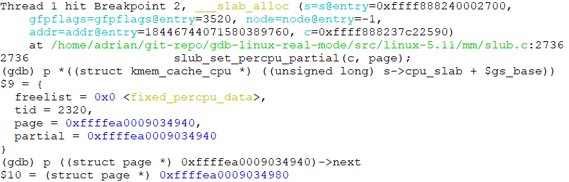
slowpath #4: Get a slab object from page->freelist
kmem_cache_cpu (CPU #N)
Page
Page
struct page *page
..
..
page->next
slab object
slab object
slab object
slab object
slab object
void **freelist = NULL
slab object
kmem_cache
struct page *partial
__percpu *cpu_slab
page->freelist
page->freelist
*node[MAX_NUMNODES]
kmem_cache_node (node 0)
struct list_head partial
kmem_cache_node (node 1)
struct list_head partial
*node[MAX_NUMNODES]
page descriptor address = virtual memory map = vmemmap_base: page #5 of Decompressed vmlinux: linux kernel initialization from page table configuration perspective
Notes:
Wedson Almeida Filho

Slide 77
slowpath #4: Get a slab object from page->freelist
page = c->page = slub_percpu_partial(c)
slub_set_percpu_partial(c, page)
1
2
kmem_cache_cpu (CPU #N)
Page
Page
struct page *page
..
..
page->next
slab object
slab object
slab object
slab object
slab object
void **freelist = NULL
slab object
kmem_cache
struct page *partial
__percpu *cpu_slab
page->freelist
page->freelist
*node[MAX_NUMNODES]
kmem_cache_node (node 0)
struct list_head partial
kmem_cache_node (node 1)
struct list_head partial
*node[MAX_NUMNODES]
Notes:
Wedson Almeida Filho

Slide 78
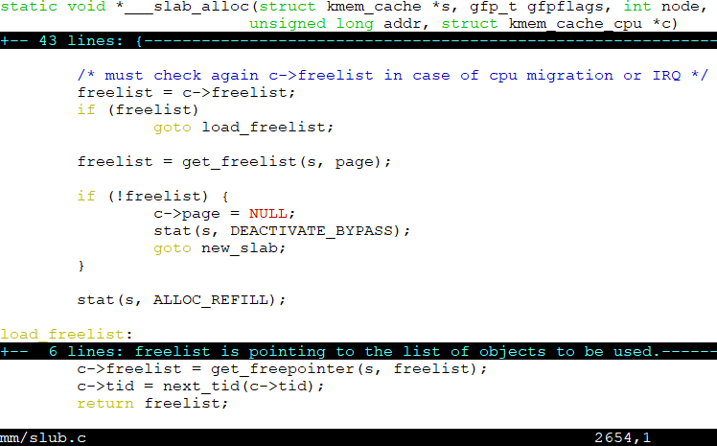
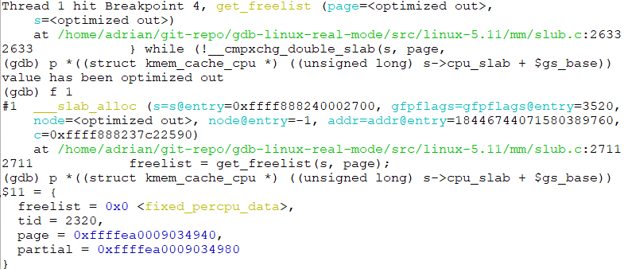
slowpath #4: Get a slab object from page->freelist
Page
kmem_cache_cpu (CPU #N)
..
slab object
slab object
slab object
struct page *page
void **freelist = NULL
page->freelist
kmem_cache
struct page *partial
Page
__percpu *cpu_slab
*node[MAX_NUMNODES]
..
page->next
slab object
slab object
slab object
page->freelist
Notes:
Wedson Almeida Filho

Slide 79
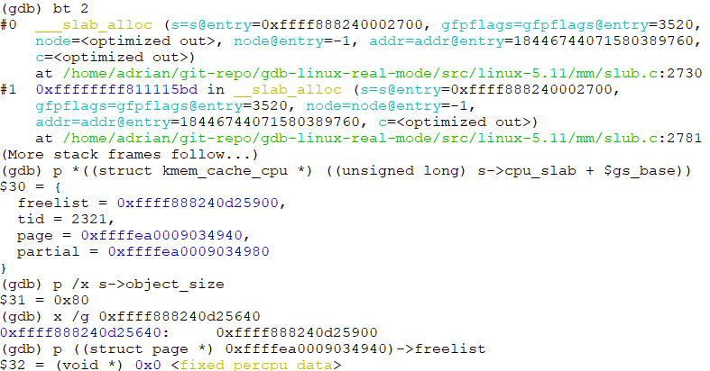
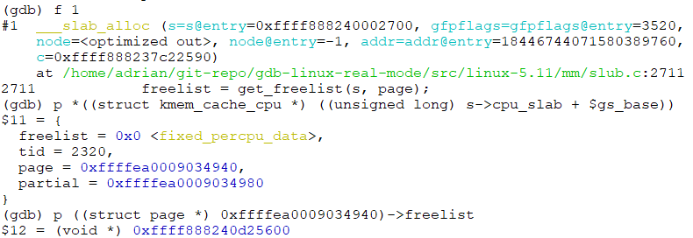
slowpath #4: Get a slab object from page->freelist
Page
page->freelist = NULL
kmem_cache_cpu (CPU #N)
..
slab object
slab object
slab object
slab object
struct page *page
void **freelist
kmem_cache
struct page *partial
Page
__percpu *cpu_slab
*node[MAX_NUMNODES]
..
slab object
slab object
slab object
2
page->freelist
1
Notes:
Wedson Almeida Filho

Slide 80
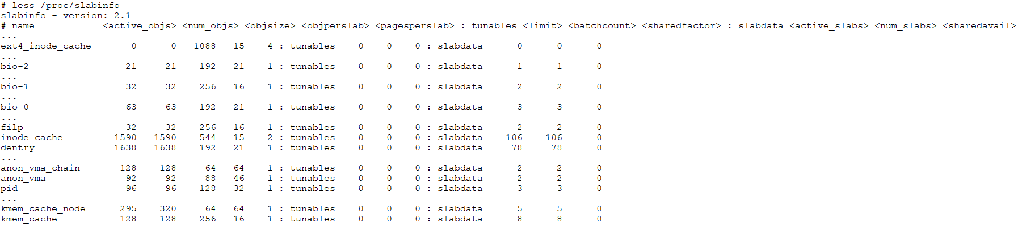
/proc/slabinfo
* active_objs = num_objs - free_objs

Slide 81
[Cache release/free] kmem_cache_free()
Fast path & slow path

Slide 82
kmem_cache_free()
kmem_cache_free
slab_free
do_slab_free
page == c->page?
N
Y
slow path: node cache
Return the slab object to c->freelist
Slowpath#1: Move page(s) to percpu partial or node partial (if possible)
this_cpu_cmpxchg_double()
put_cpu_partial
Return the slab object to page->freelist
fast path: percpu cache
__slab_free
cmpxchg_double_slab
add_partial
Slowpath#2: Move pages to node partial
remove_partial
Slowpath#3: Slab objects in page slab are all free: free to Buddy system
discard_slab
__free_slab
__free_pages

Slide 83
slowpath #1:put_cpu_partial() – Case 1: Move page(s) to percpu partial
Fully-allocated objects of pages
Page
Page
Page
Page
..
..
..
..
..
slab object
slab object
slab object
slab object
slab object
slab object
slab object
slab object
slab object
kmem_cache_cpu (CPU #N)
slab object
slab object
slab object
struct page *page
Page
1
free this object
void **freelist
2
kmem_cache
struct page *partial
..
page->next
put_cpu_partial(): Move this page to percpu partial
slab object
slab object
__percpu *cpu_slab
slab object
*node[MAX_NUMNODES]
kmem_cache_node (node 0)
struct list_head partial
slow path: node cache
kmem_cache_node (node 1)
put_cpu_partial
Slowpath#1: Move page(s) to percpu partial and node partial (if possible)
struct list_head partial
Return the slab object to page->freelist
*node[MAX_NUMNODES]
__slab_free
cmpxchg_double_slab
add_partial
Slowpath#2: Move pages to node partial
remove_partial
Slowpath#3: Slab objects in page slab are all free: free to Buddy system
discard_slab
__free_slab
__free_pages
Notes:
Wedson Almeida Filho

Slide 84
slowpath #1:put_cpu_partial() – Case 2 (1/2)
Fully-allocated objects of pages
Page
Page
Page
Page
..
..
..
..
..
slab object
slab object
slab object
slab object
slab object
slab object
slab object
slab object
slab object
kmem_cache_cpu (CPU #N)
slab object
slab object
slab object
struct page *page
1
free this object
void **freelist
kmem_cache
struct page *partial
Page
Page
Page
__percpu *cpu_slab
..
..
..
page->next
*node[MAX_NUMNODES]
slab object
slab object
slab object
slab object
slab object
slab object
slab object
slab object
slab object
kmem_cache_node (node 0)
2
if available objects > kmem_cache->cpu_partial && want_to_drain
call unfreeze_partials() to move percpu partial pages to node partial
struct list_head partial
kmem_cache_node (node 1)
struct list_head partial
*node[MAX_NUMNODES]
Notes:
Wedson Almeida Filho

Slide 85
slowpath #1:put_cpu_partial() – Case 2 (2/2)
Fully-allocated objects of pages
Page
Page
Page
Page
..
..
..
..
..
slab object
slab object
slab object
slab object
slab object
slab object
slab object
slab object
slab object
kmem_cache_cpu (CPU #N)
slab object
slab object
slab object
struct page *page
Page
1
free this object
void **freelist
3
kmem_cache
struct page *partial
..
page->next
put_cpu_partial(): Move this page to percpu partial
slab object
slab object
__percpu *cpu_slab
slab object
*node[MAX_NUMNODES]
kmem_cache_node (node 0)
Page
Page
Page
struct list_head partial
..
..
..
slab object
slab object
slab object
slab object
slab object
slab object
slab object
slab object
slab object
kmem_cache_node (node 1)
struct list_head partial
2
if available objects > kmem_cache->cpu_partial && want_to_drain
call unfreeze_partials() to move percpu partial pages to node partial
*node[MAX_NUMNODES]
Notes:
Wedson Almeida Filho

Slide 86
slowpath #2: add_partial() – Move a page to node partial
Fully-allocated objects of pages
Page
Page
Page
Page
..
..
..
..
..
slab object
slab object
slab object
slab object
slab object
slab object
slab object
slab object
slab object
kmem_cache_cpu (CPU #N)
slab object
slab object
slab object
struct page *page
1
free this object
void **freelist
kmem_cache
struct page *partial
__percpu *cpu_slab
*node[MAX_NUMNODES]
2
CONFIG_SLUB_DEBUG=y && CONFIG_SLUB_DEBUG_ON=y && !page->freelist (in percpu cache or page is full of objects)
add_partial(): Move this page to node partial
kmem_cache_node (node 0)
Page
struct list_head partial
..
slab object
slab object
slab object
kmem_cache_node (node 1)
struct list_head partial
*node[MAX_NUMNODES]
Notes:
Wedson Almeida Filho

Slide 87
slowpath #3: remove_partial() and discard_slab()
Fully-allocated objects of pages
Page
Page
Page
Page
..
..
..
..
..
slab object
slab object
slab object
slab object
slab object
slab object
slab object
slab object
slab object
kmem_cache_cpu (CPU #N)
slab object
slab object
slab object
struct page *page
void **freelist
kmem_cache
struct page *partial
All objects in page(s) are available (free) && kmem_cache_node->nr_partial >= kmem_cache->min_partial
remove_partial()
__percpu *cpu_slab
*node[MAX_NUMNODES]
2
kmem_cache_node (node 0)
Page
Page
Page
struct list_head partial
..
..
..
slab object
slab object
slab object
slab object
slab object
slab object
slab object
slab object
slab object
kmem_cache_node (node 1)
struct list_head partial
1
free this object
*node[MAX_NUMNODES]
3
free page(s): discard_slab -> free_slab -> __free_slab -> __free_pages
Buddy system
Notes:
Wedson Almeida Filho

Slide 88
kmalloc & slab
Call path
Compound page

Slide 89
kmalloc & slab
struct kmem_cache *kmalloc_caches[KMALLOC_NORMAL][]
0
NULL
kmem_cache
1
kmalloc-96
__percpu *cpu_slab
2
kmalloc-192
3
kmalloc-8
*node[MAX_NUMNODES]
4
kmalloc-16
13
…
kmalloc-8192
kmem_cache
struct kmem_cache *kmalloc_caches[KMALLOC_RECLAIM][]
__percpu *cpu_slab
*node[MAX_NUMNODES]
0
NULL
1
kmalloc-96
kmem_cache
2
kmalloc-192
3
kmalloc-8
__percpu *cpu_slab
struct kmem_cache *kmalloc_caches[NR_KMALLOC_TYPES][KMALLOC_SHIFT_HIGH + 1]
4
kmalloc-16
*node[MAX_NUMNODES]
13
…
kmalloc-8192
kmem_cache
__GFP_RECLAIMABLE
__percpu *cpu_slab
*node[MAX_NUMNODES]
struct kmem_cache *kmalloc_caches[KMALLOC_DMA][]
0
NULL
kmem_cache
1
kmalloc-96
2
kmalloc-192
__percpu *cpu_slab
3
kmalloc-8
*node[MAX_NUMNODES]
4
kmalloc-16
13
…
kmalloc-8192
__GFP_DMA
Check create_kmalloc_caches() &kmalloc_info
Notes:
Wedson Almeida Filho

Slide 90
kmalloc() & kfree()
__GFP_COMP
(Compound page)
size > KMALLOC_MAX_CACHE_SIZE (8KB)
kmalloc_large
kmalloc_order_trace
kmalloc_order
alloc_pages
kmalloc
size <= KMALLOC_MAX_CACHE_SIZE (8KB)
kmalloc_index
kmem_cache_alloc_trace
kmem_cache_alloc
Get index based on size
if size < 8 → return KMALLOC_SHIFT_LOW (3)
if size == 0 → zero allocation
Not a slab page
compound_order
__free_pages
kfree
page = virt_to_head_page(x)
A slab page (check PG_slab flag)
slab_free

Slide 91
Compound page
Compound Page
Page (head page)
Page (Tail page)
Page (Tail page)
Page (Tail page)
Page (Tail page)
. . .
flags |= PG_head
compound_head
_compound_pad_1 (compound_head)
_compound_pad_1 (compound_head)
_compound_pad_1 (compound_head)
compound_dtor
hpage_pinned_refcount
compound_order
First Tail Page only
compound_mapcount
2nd Tail Page only
deferred_list
compound_nr
Compound page – Use Cases
Mainly used in huge page
kmalloc: allocation size > 8192 bytes
Check kmalloc_order()

Slide 92
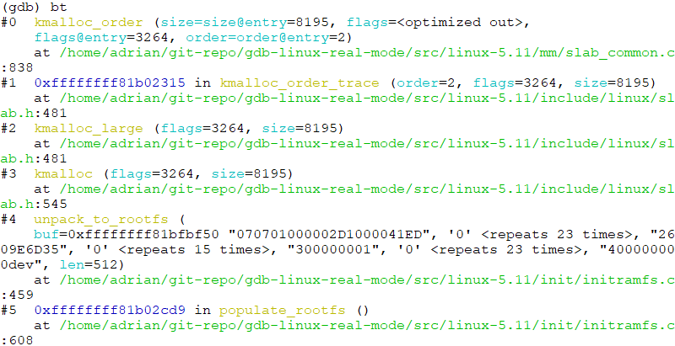
Compound page
__GFP_COMP
(Compound page)
size > KMALLOC_MAX_CACHE_SIZE (8KB)
kmalloc_large
kmalloc_order_trace
kmalloc_order
alloc_pages
kmalloc
size <= KMALLOC_MAX_CACHE_SIZE (8KB)
kmem_cache_alloc_trace
kmem_cache_alloc
Allocation size = 8195
order = 2 → 4 Pages

Slide 93
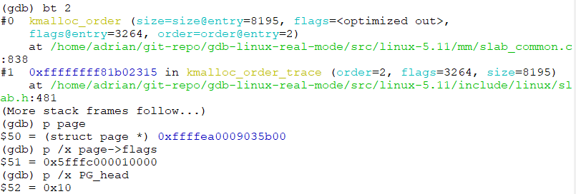
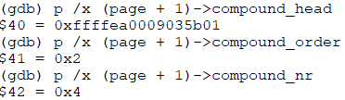
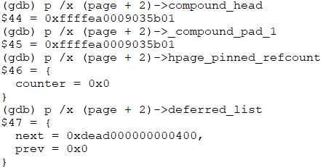
Compound page
Compound Page
Page (Head page)
Page (Tail page)
Page (Tail page)
Page (Tail page)
flags |= PG_head
compound_head
_compound_pad_1 (compound_head)
_compound_pad_1 (compound_head)
compound_dtor
hpage_pinned_refcount
compound_order = 2
First Tail Page only
compound_mapcount
2nd Tail Page only
deferred_list
compound_nr = 4
Head Page
First Tail Page
Second Tail Page

Slide 94
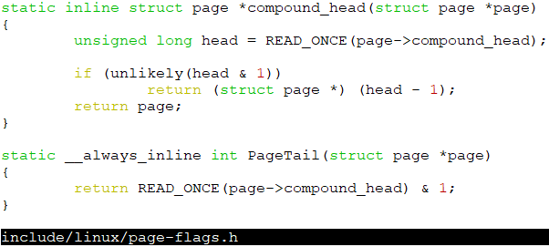
Compound page
Compound Page
Page (Head page)
Page (Tail page)
Page (Tail page)
Page (Tail page)
flags |= PG_head
compound_head
_compound_pad_1 (compound_head)
_compound_pad_1 (compound_head)
compound_dtor
hpage_pinned_refcount
compound_order = 2
First Tail Page only
compound_mapcount
2nd Tail Page only
deferred_list
compound_nr = 4
First Tail Page
Second Tail Page
bit 0: purpose

Slide 95
Q1: [SLUB] kmalloc: allocation size = 0, 1, 2, or 4 → workable?
struct kmem_cache *kmalloc_caches[KMALLOC_NORMAL][]
0
kmem_cache
1
NULL
__percpu *cpu_slab
struct kmem_cache *kmalloc_caches[NR_KMALLOC_TYPES][KMALLOC_SHIFT_HIGH + 1]
2
kmalloc-96
*node[MAX_NUMNODES]
3
kmalloc-192
4
kmalloc-8
kmalloc-16
kmem_cache
13
…
kmalloc-8192
__percpu *cpu_slab
*node[MAX_NUMNODES]
minimum kmalloc cache size = 8 bytes
__GFP_COMP
(Compound page)
size > KMALLOC_MAX_CACHE_SIZE (8KB)
kmalloc_large
kmalloc_order_trace
kmalloc_order
alloc_pages
kmalloc
size <= KMALLOC_MAX_CACHE_SIZE (8KB)
kmalloc_index
kmem_cache_alloc_trace
kmem_cache_alloc
Get index based on size
if size < 8 → return KMALLOC_SHIFT_LOW (3)
if size == 0 → zero allocation
if size < 8 → return KMALLOC_SHIFT_LOW (3)
if size == 0 → zero allocation

Slide 96
Reference
https://www.cnblogs.com/LoyenWang/p/11922887.html

Slide 97
Backup

Slide 98
Slab Cache
percpu cache
Page
kmem_cache_cpu (CPU #0)
..
slab object
slab object
slab object
struct page *page
void **freelist
global variable
struct page *partial
.
.
Page
Page
kmem_cache
kmem_cache (Slab cache)
kmem_cache_cpu (CPU #N)
..
..
slab object
slab object
slab object
slab object
slab object
slab object
__percpu *cpu_slab
struct page *page
*node[MAX_NUMNODES]
void **freelist
struct page *partial
global variable
kmem_cache_node
kmem_cache_node
(Node #0)
Page
Page
struct list_head partial
..
..
slab object
slab object
slab object
slab object
slab object
slab object
.
.
kmem_cache_node
(Node #N)
struct list_head partial
Node-based cache
Node-based cache: freelist concept is implemented in page struct (not shown)

Slide 99
Slab Allocator Initialization: “Chicken or the egg” problem
percpu cache
Page
kmem_cache_cpu (CPU #0)
..
slab object
slab object
slab object
[Slab allocator calls this automatically]
kmem_cache_alloc(kmem_cache, ..): Allocate a ‘kmem_cache’ object from global variable ‘kmem_cache’
struct page *page
void **freelist
global variable
struct page *partial
.
.
Page
Page
2
kmem_cache
kmem_cache (Slab cache)
kmem_cache_cpu (CPU #N)
..
..
1
slab object
slab object
slab object
slab object
slab object
slab object
__percpu *cpu_slab
struct page *page
[User calls this function]
k_cache = kmem_cache_create(): create/get a new cache
*node[MAX_NUMNODES]
void **freelist
struct page *partial
global variable
[Slab allocator calls this automatically]
kmem_cache_alloc_node(kmem_cache_node, …): Allocate ‘kmem_cache_node’ objects from global variable ‘kmem_cache_node’
kmem_cache_node
3
kmem_cache_node
(Node #0)
Page
Page
struct list_head partial
..
..
slab object
slab object
slab object
slab object
slab object
slab object
.
.
kmem_cache_node
(Node #N)
struct list_head partial
Who initializes global variables ‘kmem_cache’ and ‘kmem_cache_node’?
Node-based cache

Slide 100
Slab Allocator Initialization: “Chicken or the egg” problem
percpu cache
Page
kmem_cache_cpu (CPU #0)
..
slab object
slab object
slab object
[Slab allocator calls this automatically]
kmem_cache_alloc(kmem_cache, ..): Allocate a ‘kmem_cache’ object from global variable ‘kmem_cache’
struct page *page
void **freelist
global variable
struct page *partial
.
.
Page
Page
2
kmem_cache
kmem_cache (Slab cache)
kmem_cache_cpu (CPU #N)
..
..
1
slab object
slab object
slab object
slab object
slab object
slab object
__percpu *cpu_slab
struct page *page
[User calls this function]
k_cache = kmem_cache_create(): create/get a new cache
*node[MAX_NUMNODES]
void **freelist
struct page *partial
global variable
[Slab allocator calls this automatically]
kmem_cache_alloc_node(kmem_cache_node, …): Allocate ‘kmem_cache_node’ objects from global variable ‘kmem_cache_node’
kmem_cache_node
3
kmem_cache_node
(Node #0)
Page
Page
struct list_head partial
..
..
slab object
slab object
slab object
slab object
slab object
slab object
.
.
Slab allocator: statically initialized ‘kmem_cache_boot’
Slob allocator: statically initialized ‘kmem_cache_boot’
Slub allocator: static local variables ‘boot_kmem_cache’ and ‘boot_kmem_cache_node’
kmem_cache_node
(Node #N)
struct list_head partial
Node-based cache

Slide 101
Slab Allocator Initialization: “Chicken or the egg” problem
[Slab Cache] struct kmem_cache *kmem_cache = NULL
percpu cache
kmem_cache_cpu (CPU #0)
struct page *page
void **freelist
kmem_cache = NULL (Slab cache)
struct page *partial
.
.
__percpu *cpu_slab
*node[MAX_NUMNODES]
Node-based cache
kmem_cache_node (Node #0)
[Cannot work] Allocate from ‘kmem_cache’ slab cache
struct list_head partial
1
.
.
[Slab Cache] struct kmem_cache *sighand_cachep
2
percpu cache
[Slab Cache] struct kmem_cache *kmem_cache_node = NULL
kmem_cache_cpu (CPU #0)
percpu cache
struct page *page
kmem_cache_cpu (CPU #0)
void **freelist
struct page *page
kmem_cache (Slab cache)
struct page *partial
void **freelist
.
.
kmem_cache = NULL (Slab cache)
struct page *partial
__percpu *cpu_slab
.
.
*node[MAX_NUMNODES]
3
__percpu *cpu_slab
Node-based cache
*node[MAX_NUMNODES]
kmem_cache_node (Node #0)
[Cannot work] Allocate from ‘kmem_cache_node’ slab cache
Node-based cache
struct list_head partial
kmem_cache_node (Node #0)
.
.
struct list_head partial
.
.

