Slide 1

House Price Prediction
Sida Wan
06/27/2022

Slide 2

Introduction
The provided Data set including 79 explanatory variables describing almost every aspect of residential homes in Ames, Iowa.
With the SalePrice as target variable in the training set.
The goal is to predict the house prices in the test data set. The prediction will be evaluated by Root Mean Squared Logarithmic Error.
House price analysis and prediction has practical use:
Help home buyers to get an idea about the pricing
Help individual or companies to make investment decisions.

Slide 3
Understanding Dataset
Data overview
Data cleaning
Handle missing value / Outlier
Data exploration
Numerical variables / categorical variable
T test / Correlation
Feature engineering
Model training and evaluation

Slide 4
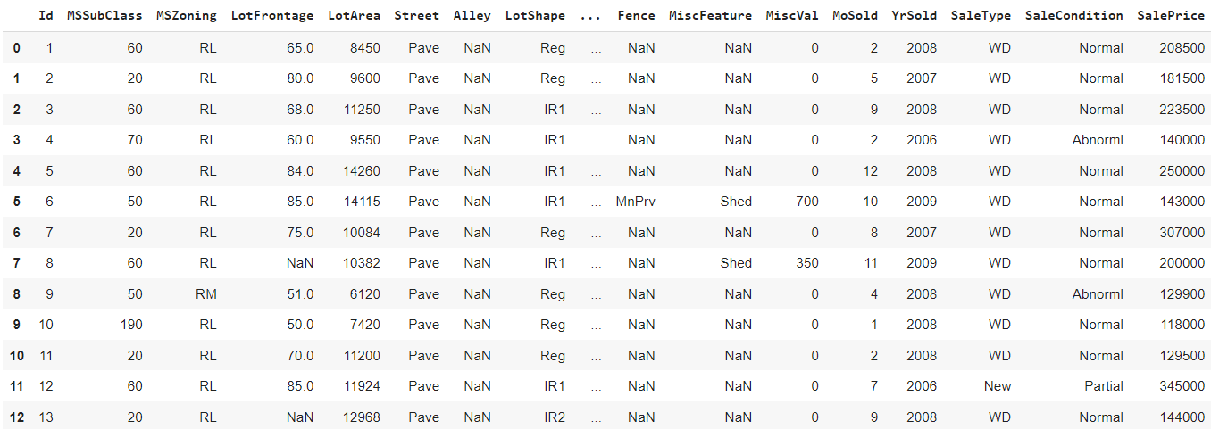
Iowa Housing Dataset
The Iowa housing dataset is from Kaggle.
It has 1459 observations, 79 columns, with 39 numerical features, and 39 categorical features.
The target variable is the SalePrice.

Slide 5
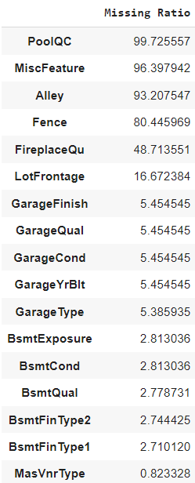
Data Cleaning
We will first drop three features have missing value ratio higher than 90.
Then:
For missing categorical values, if it’s indicated by the description that it’s None then use “None” to impute.
Otherwise chose the mode of the feature for imputation.
For missing numerical values, use 0 or mean to impute.

Slide 6
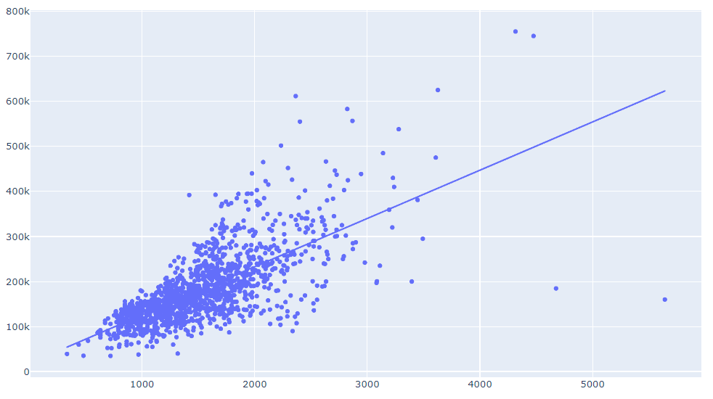
Handle the outliers
Use plots to detect outliers.
SalePrice
GrLivArea

Slide 7
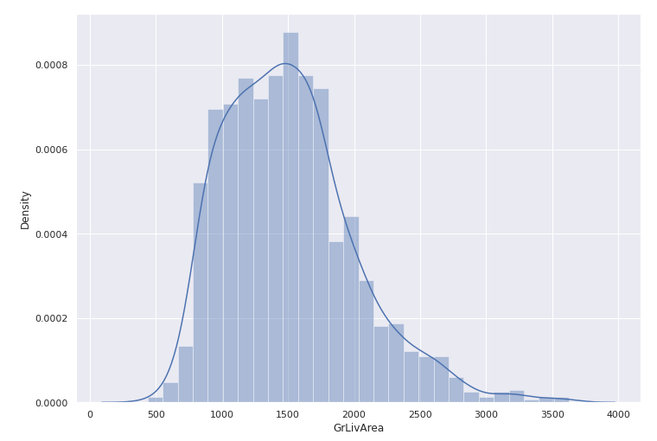
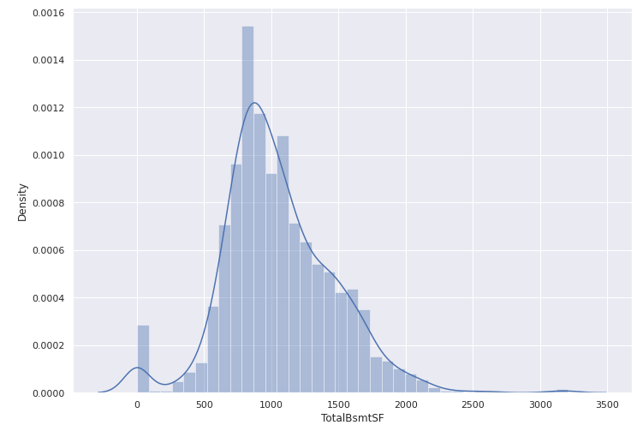
Data Exploration: Numerical

Slide 8
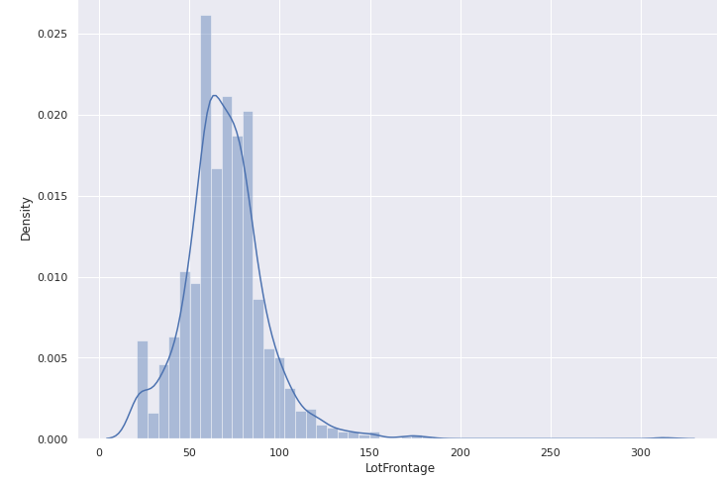
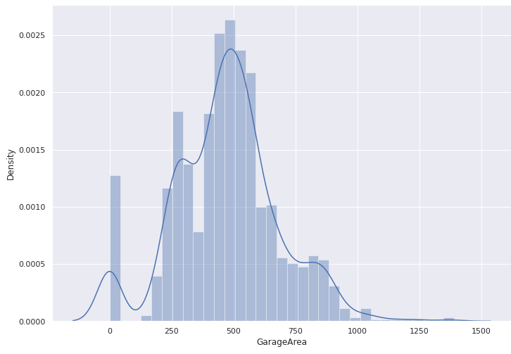
Data Exploration: Numerical

Slide 9
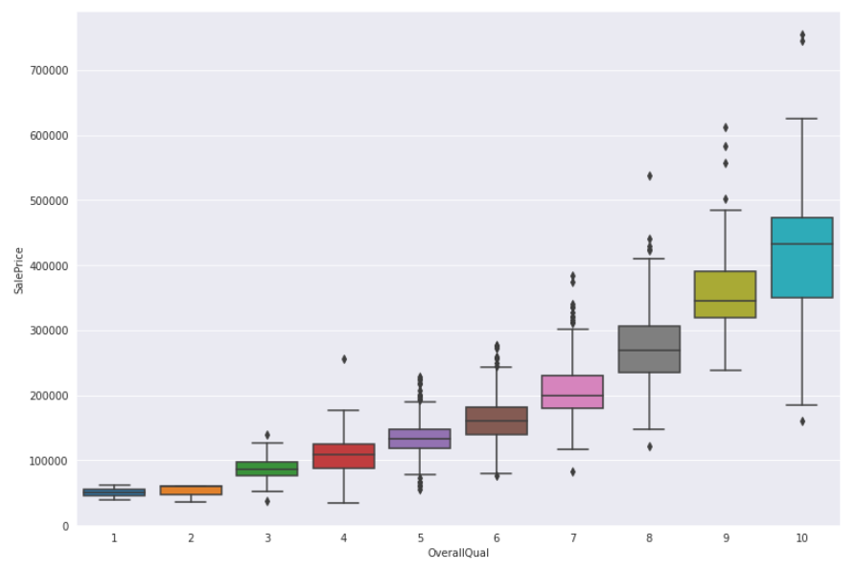
Data exploration: Categorical

Slide 10
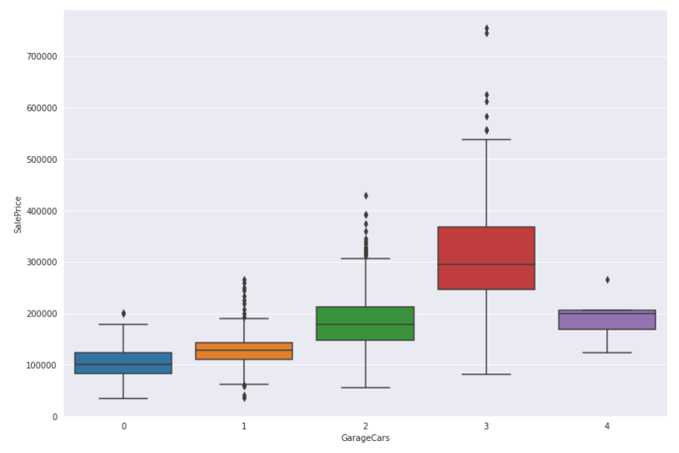
Data exploration: Categorical

Slide 11
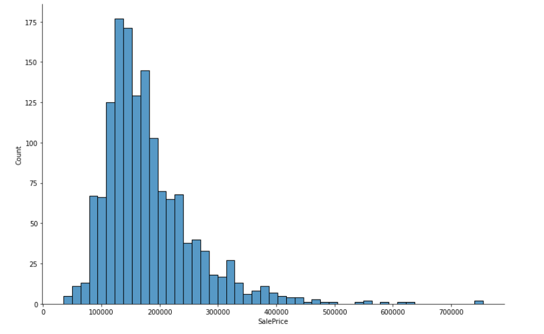
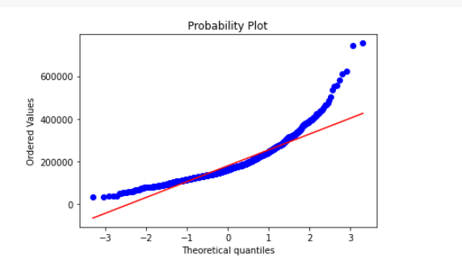
Target Variable
The target variable –→ SalePrice
It’s clearly right skewed. Need to do a Box-Cox transformation to normalize it to meet the assumption of linear models and many other models.

Slide 12
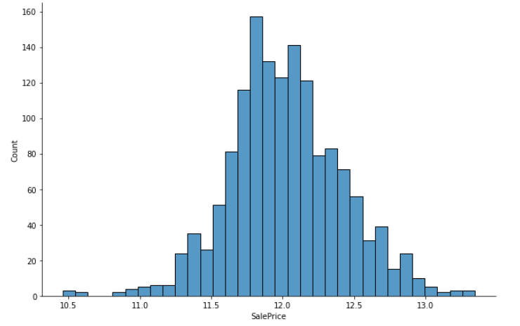
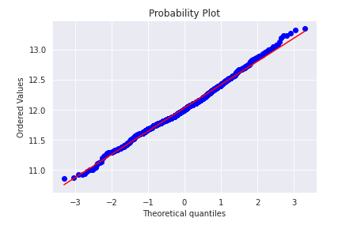
Target Variable After Transformation
The target variable is approximately normal and meets the homoscedasticity assumption.

Slide 13
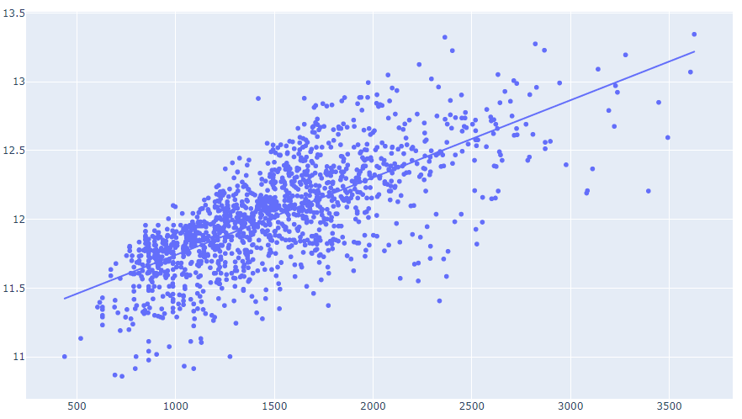
Target Variable After Transformation
SalePrice
GrLivArea

Slide 14
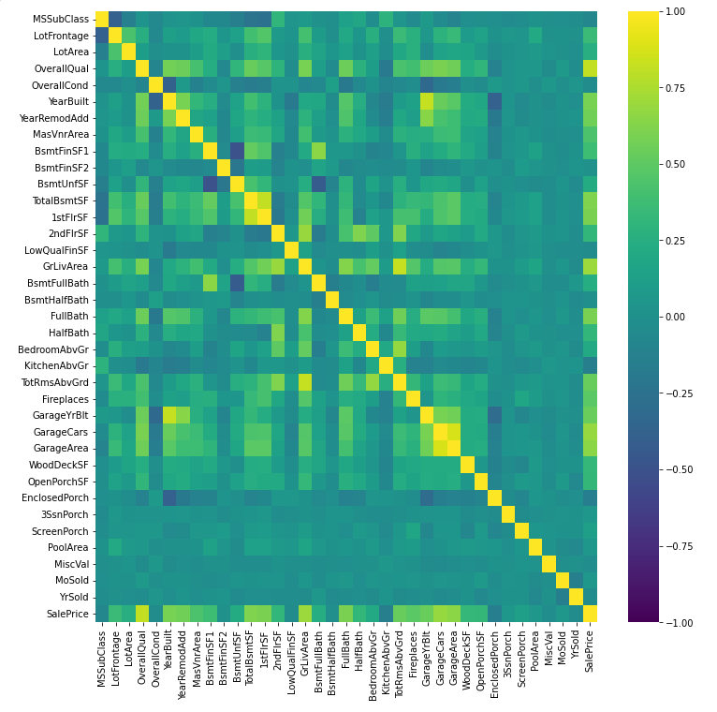
Correlation Map
Statistical testings can be done to analyze the categorical variables.

Slide 15
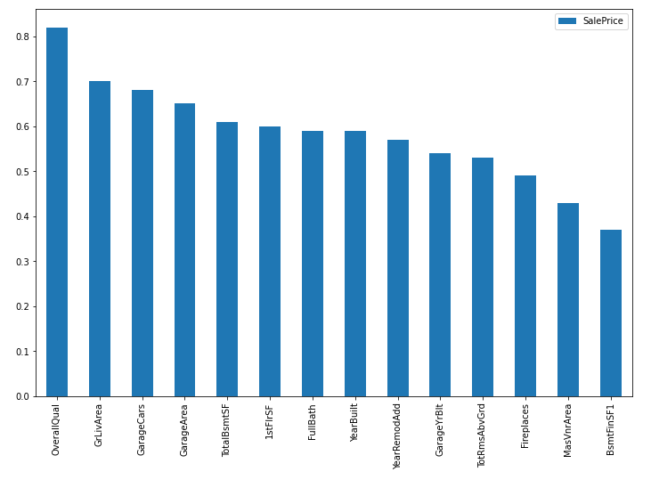
Correlation Matrix: Top correlated features with the target variable

Slide 16
Feature Engineering
Split the data into training and test set.
Get dummy variable for categorical feature.
Drop some features that might have correlation with other features for multiple linear regression model.
Standardize the features, especially for L1 and L2 regularization models.
More feature can be created. (e.g. Total Bathrooms, Average area per room, Overall Quality of the house…)

Slide 17
Models
Different models were trained.
Trained models: Linear regression / L1, L2 regression / Random forest / Boost models
Evaluate each model using Root Mean Squared Error.
Check overfitting and turn parameters.

Slide 18
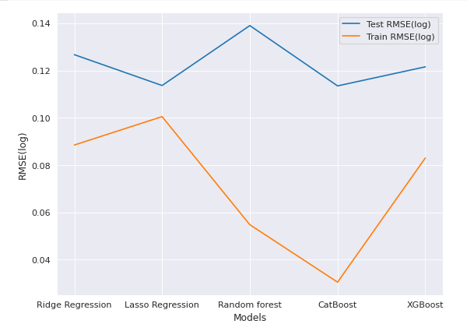
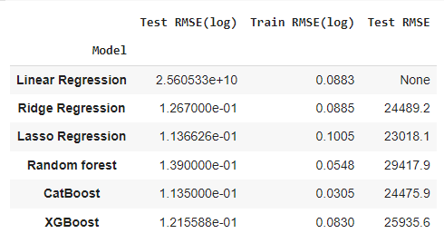
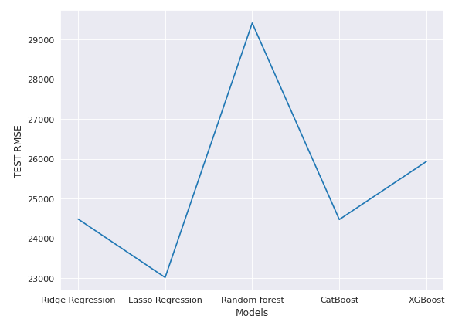
Models
Comparison of different models

Slide 19
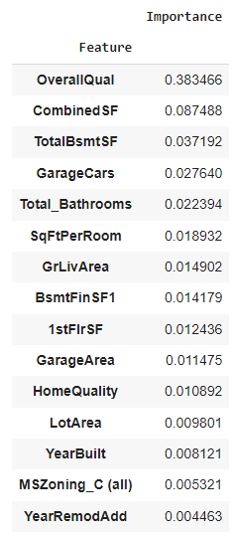
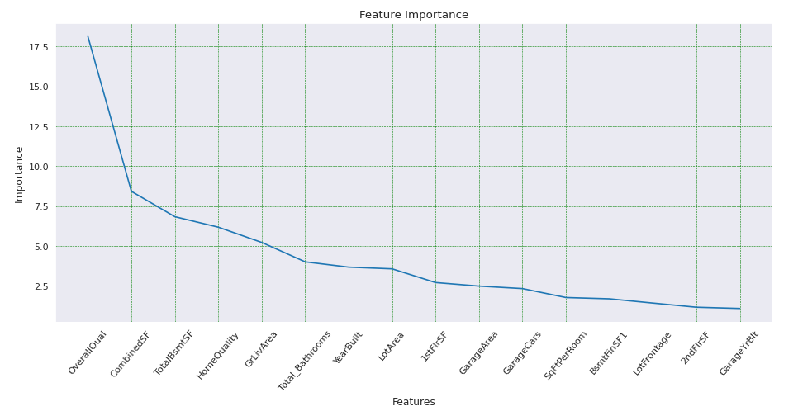
Feature Importance

Slide 20
Observations and Take-aways
Linear regression has huge test RMSE because of overfitting.
Ridge regression and Lasso regression performs significantly better than regular regression
Catboost and XGboost perform better than Random forest model.
The best Test RMSE is from Catboost, Lasso regression is also very close, if we change the RMSE back to the original unit, the error is about

Slide 21
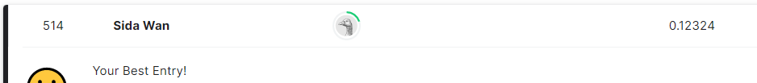
Outcome of the competition
Use ensemble method to combine Catboost, Lasso regression, XGboost results together in a 40:40:20 ratio.
Resulted in a top 514 rank.( top 11%)

Slide 22
Thank you for watching !

