Slide 1

CSCI-P556: Applied Machine Learning
Instacart – Customer Cart Prediction and Recommendation
Siddartha Rao, Siddharth Kothari, and Vishal Singh
December 2, 2018

Slide 2
Project pipeline
Motivation
Data and EDA
Prediction
Recommendation

Slide 3



Motivation
For the brand-
Gain more users
Provide delightful shopping experience to increase customer retention
For the users-
Save time and effort in shopping
Discover new and better products through recommendations

Slide 4
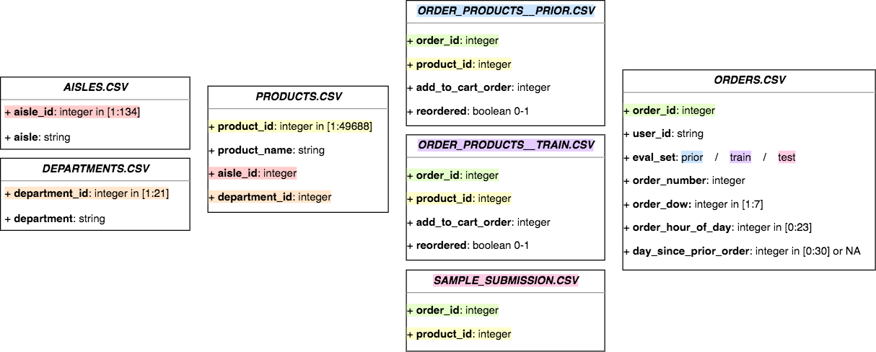
Data
The Instacart Online Grocery Shopping Dataset 2017
Relational Datasets describing customer orders
3.3 million orders for ~50k products

Slide 5
Exploratory Data Analysis

Slide 6
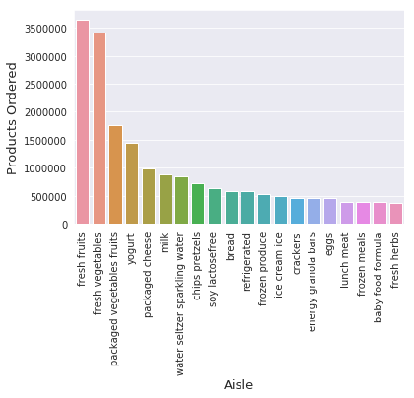
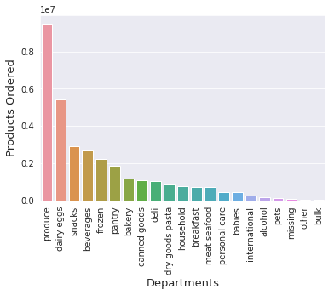
Exploratory Data Analysis
What do the users order?

Slide 7
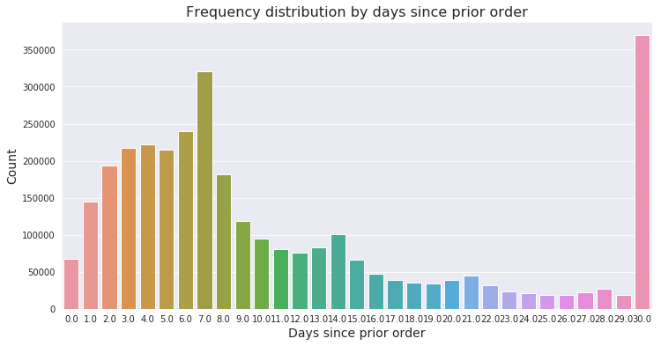
Exploratory Data Analysis
When do the users order?

Slide 8
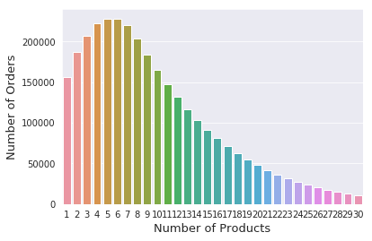
Exploratory Data Analysis
How much do the users order?

Slide 9
Prediction

Slide 10
Prediction – Feature Engineering
* Existing features
User Related
user_total_orders
User_total_items
Total_distinct_items
User_avg_days_bw_orders
user_avg_basket
User_total_buy_max
Product related features
Product_orders
Product_reorders
Product_reorder_rate
Aisle_id*
Department_id*
Order related features
Order_dow*
Order_hour_of_day*
Days_since_prior_order*
Days_since_ratio
User_X_Product related features
UP_chance_ratio
UP_chance
UP_chance_vs_bought
UP_drop_chance
UP_orders
UP_orders_ratio
UP_reorder_rate
UP_orders_since_last

Slide 11
Prediction – What will the user order?
Algorithms: XGBoost and Light GBM
Faster training speed and higher efficiency.
Lower memory usage.
Better accuracy.
Support of parallel and GPU learning.
Capable of handling large-scale data.
Model Building: We have trained model on user’s last order (eval_set = train). However, the featured created used the data from prior data set too.
Feature selection: We have used in-build method of light gbm and xgboost to find feature importance

Slide 12
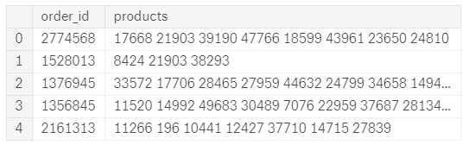
Prediction – What will the user order?
Output Format:
Results:
The highest accuracy in Kaggle was 0.4091
Model | Light GBM | XGBoost
Baseline Model CV Accuracy | 0.1599 | 0.2015
Tuned CV Accuracy | 0.4412 | 0.3965
Kaggle Accuracy | 0.3809 | 0.3786

Slide 13
Clustering

Slide 14
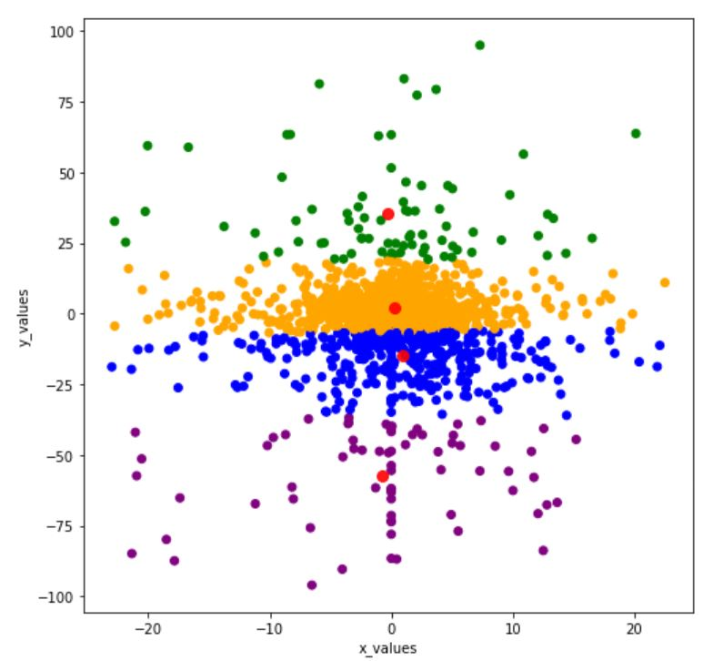
Clustering - KMeans
Segmentation of customers is performed on the frequency of products bought from an aisle
Original idea of segmenting on frequency of pairs of products did not work because of high number of product pairs(large data)
Cluster found to give the most popular products for a customer, this is used for the recommendations given
Cluster 0 | Fresh Fruits
Cluster 1 | Fresh Vegetables
Cluster 2 | Fresh Vegetables
Cluster 3 | Yogurt

Slide 15
Recommendation

Slide 16
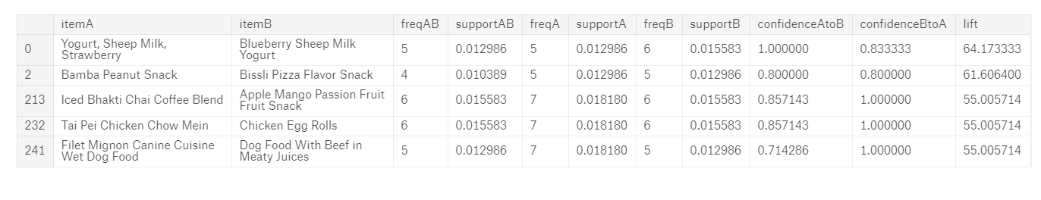
Apriori
Support : This is the percentage of orders that contains the item set
Confidence : It measures the percentage of times that item B is purchased, given that item A was purchased.
Lift : Lift indicates whether there is a relationship between A and B, or whether the two items are occurring together in the same orders simply by chance

Slide 17
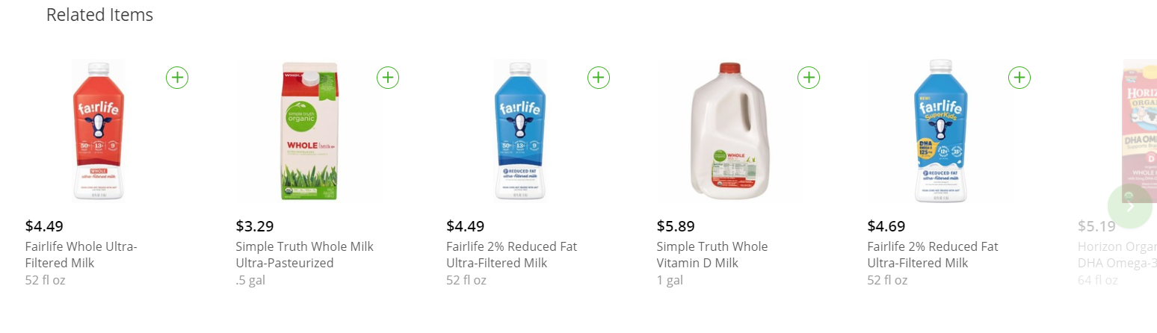
Recommendation
We are using Light GBM, Apriori and Clustering to recommend products
Step 1 - When user logs in : When user logs in, we can recommend products based on their transactional history. We are using LGBM to find products to recommend
Step 2 – When user add products to cart: After user has added product to the cart, we can suggest products which they are likely to buy with the current product. For this we are using apriori and customer segmentation. As Instacart suggest 11 products, we are also recommending 11 products – 9 from apriori and 2 from clusters

Slide 18
Recommendation
Accuracy: For every product we are recommending 11 other products. If user actually bought one or more recommended products then we will consider the recommendation as success. Accuracy for an order will be - total success/total products ordered. Final accuracy is mean of accuracy for all the orders
Results: We are a accuracy of 9.6% which means that 1 in every 10 recommendation will have a product which is actually purchased by the user
Improvement: Running apriori algorithm on entire dataset and clustering users by product pairs can improve the accuracy significantly

