Slide 1
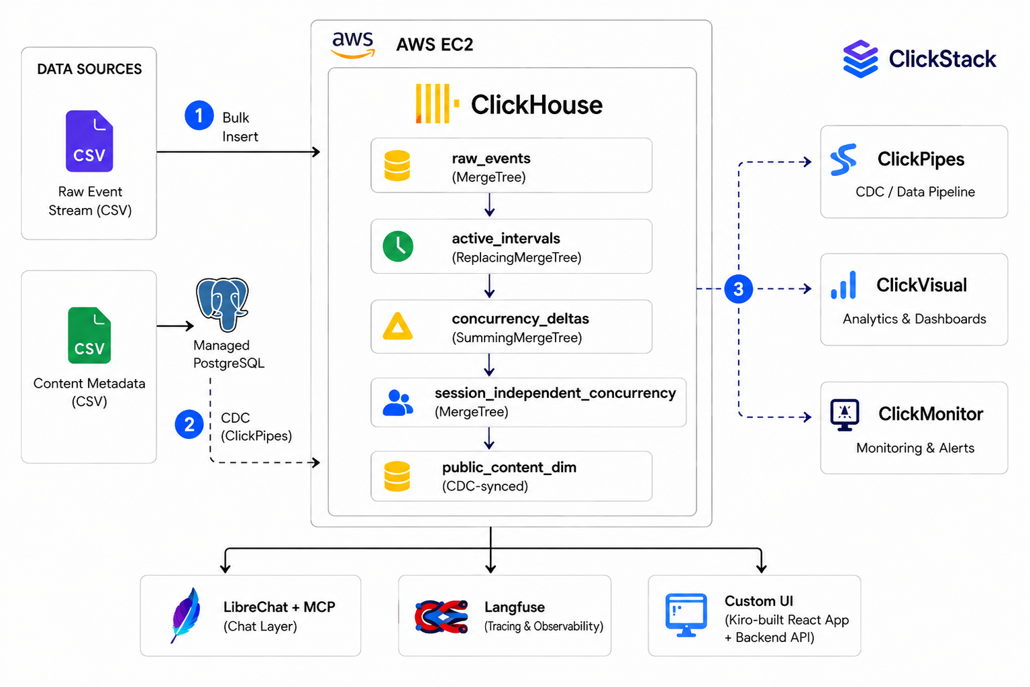
System Architecture
Two ingestion paths, one ClickHouse core, three judge-facing interfaces

Slide 2
Tech Stack
Every tool matched to a specific job in the pipeline
1
2
3
4
ClickHouse Cloud
Managed Postgres
ClickPipes (CDC)
LibreChat + MCP
Primary datastore and compute engine for every table and query
Mutable content metadata, kept separate from the event stream
Zero-ETL sync from Postgres into ClickHouse, automatically
Natural-language chat layer over live concurrency data
5
6
7
Langfuse
ClickStack
Custom UI (AWS EC2)
Traces every AI agent action for full transparency
Observability into pipeline ingestion and query performance
Live dashboard for concurrency, AI chat, and insights

Slide 3
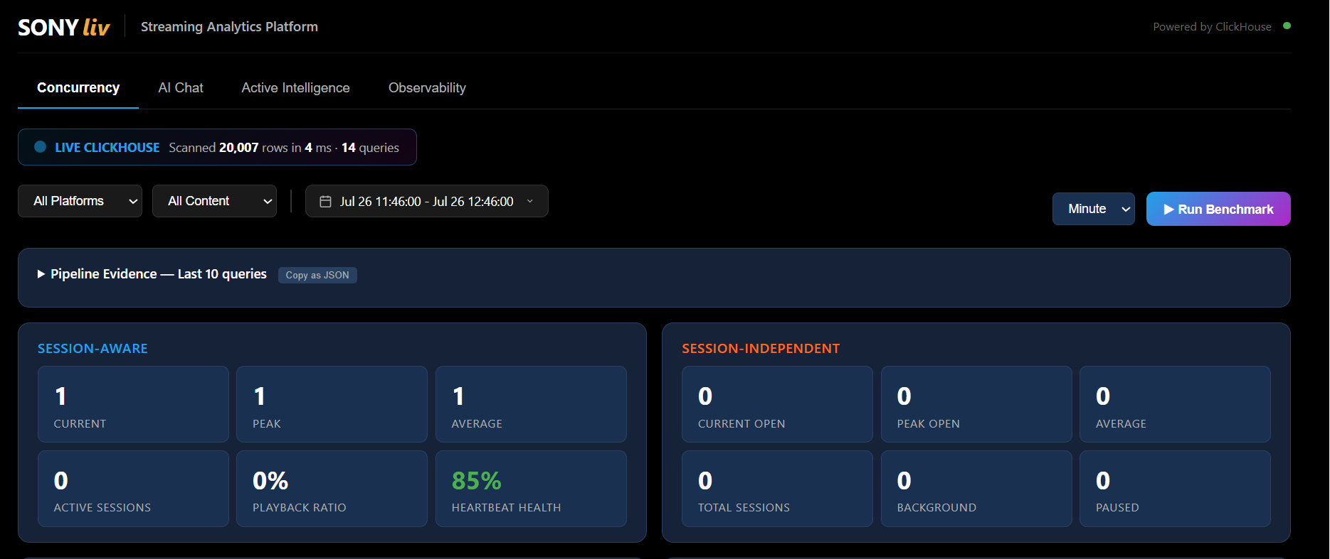
End-User Dashboard
Filterable concurrency, AI chat, and pipeline evidence — all live from ClickHouse

