Slide 1
VIEW26 · ATLYS CLICK-A-THON 2026
FeatureLens
Agentic product analytics that evolves instrumentation, semantic context, and trustworthy decisions together.
Notes:
Open with the trust gap: shipping instrumentation and shipping business meaning are usually separate workstreams.
FeatureLens makes them one governed release lifecycle.
[Sources]
- https://clickathon-2026.view26.com
- https://github.com/sidagarwal04/click-a-thon-26-submissions/blob/main/ATLYS_SUBMISSION_GUIDELINES.md
[/Sources]

Slide 2
Plausible analytics is not the same as trustworthy analytics
THE GAP
A release changes the physical data contract and what the business can safely ask. Today those changes drift apart.
A fluent answer can still use the wrong event, grain, denominator, table, or context version.
Traditional analytics
Generic AI analytics
Dashboards arrive after releases
Definitions drift across teams
Provenance is hard to audit
Text-to-SQL is too permissive
Raw rows cross the trust boundary
Confidence can hide weak evidence
2
Notes:
Frame FeatureLens as a semantic control plane, not another chatbot.
The judged problem asks for agents that instrument, analyze, and explain on ClickHouse; trust must survive every handoff.
[Sources]
- https://raw.githubusercontent.com/sidagarwal04/click-a-thon-2026/refs/heads/main/Atlys/PROBLEM_STATEMENT.md
[/Sources]

Slide 3
One release package. Three agents. No skipped gates.
01 · PHYSICAL
02 · SEMANTIC
03 · DECISION
Instrumentation Agent
Profiles arbitrary NDJSON, proposes typed ClickHouse DDL, validates it, then pauses for human approval.
Context Agent
Publishes an immutable graph only after schema, row count, event fingerprint, and blocking evolution checks pass.
Analytics Agent
Compiles ontology-linked aggregate SQL, produces a deterministic answer, and constrains optional LLM synthesis.
3
Notes:
Walk left to right and emphasize the human schema gate between the first and second milestones.
Every downstream answer carries the exact context version, schema version, SQL, evidence, confidence, and trace.
[Sources]
- https://raw.githubusercontent.com/sidagarwal04/click-a-thon-2026/refs/heads/main/Atlys/PROBLEM_STATEMENT.md
- https://bitbucket.org/view26/clickathon-2026/src/main/submission/ARCHITECTURE.md
[/Sources]

Slide 4
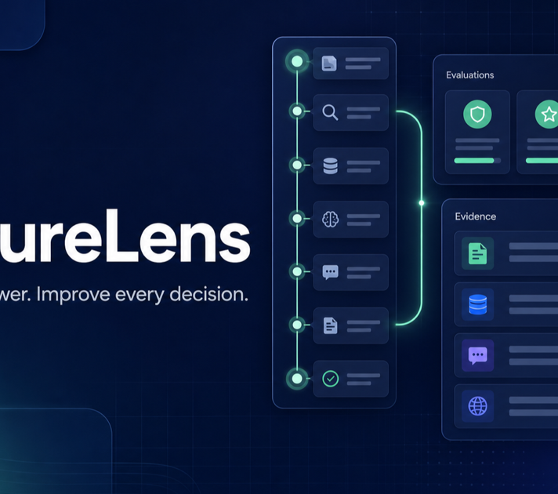
The product feels like a release workspace, not an agent demo
A PM-native control plane
Feature Releases, Decision Inbox, Ask FeatureLens, Context & Schemas, Pipeline Activity, and Trace Explorer share one governed backend. LibreChat can call the same seven MCP tools without owning business truth.
4
Notes:
Point out that the screenshot is the actual product, not a design mock.
The browser never receives ClickHouse or Langfuse credentials; all enrichment is server-side.
[Sources]
- https://clickathon-2026.view26.com
- https://bitbucket.org/view26/clickathon-2026
[/Sources]

Slide 5
The system is already producing auditable evidence
LIVE PROOF
Six releases were replayed against retained ClickHouse data. Every run passed all nine evolution checks and exported a synced Langfuse trace.
34,982
54 / 54
4 / 4
retained feature events
context gates passed
standard PM probes traced
5
Notes:
These figures come from the clean final replay: five known features plus the sealed sixth feature.
The quality suite includes semantic coverage, regression preservation, version grounding, question coverage, and distinct plan checks.
[Sources]
- https://cloud.langfuse.com/project/cmrefhio10fboad0bqqvq9xhh/traces/5089a0c4abab69dd667646e551008fda
- https://cloud.langfuse.com/project/cmrefhio10fboad0bqqvq9xhh/traces/8d660ea714fb42620a0d87f048d4513f
[/Sources]

Slide 6
Business meaning grows with the product—and stays versioned
Context v0 → v6 preserves every parent node while adding verified feature semantics.
147
396
semantic nodes
explicit edges
6
Notes:
The graph begins with 30 baseline semantic nodes and 21 edges grounded in the eight canonical source tables.
By v6 it reaches 147 nodes and 396 edges without removing a parent node.
[Sources]
- https://bitbucket.org/view26/clickathon-2026/src/main/submission/surprise/context-changelog.md
[/Sources]

Slide 7
The sealed feature generalized—and changed the product conclusion
PROMO / COUPON AT CHECKOUT
FeatureLens profiled 5,363 events, proposed a 19-column SharedMergeTree schema, inferred the success path, and kept coupon_rejected as a branch.
It then inferred a nullable cohort marker from the declared question and verified coupon_code field.
Coupon-marked cohort
Null-marker baseline
848 entrants
366 completed checkout
43.16% completion
1,252 entrants
621 completed checkout
49.60% completion
7
Notes:
The observed difference is 6.44 percentage points lower for coupon-marked applications, or 12.98% lower relative.
Do not claim causality: entering a coupon is user-selected. The action is an experiment or matched-cohort analysis.
[Sources]
- https://cloud.langfuse.com/project/cmrefhio10fboad0bqqvq9xhh/traces/8d660ea714fb42620a0d87f048d4513f
- https://bitbucket.org/view26/clickathon-2026/src/main/submission/surprise/insight.md
[/Sources]

Slide 8
Trust is designed into every layer
ClickHouse is the evidence boundary
Only allowlisted aggregate SQL executes. Raw rows never enter the LLM prompt. Physical data and governance history remain inspectable together.
The LLM is outside the trust boundary
It rewrites a complete deterministic answer into concise PM language. Invalid output falls back without losing evidence or provenance.
Langfuse closes the feedback loop
Trace Explorer shows observations, cost, tokens, evaluations, and lets PMs write typed helpfulness and issue-category scores.
8
Notes:
This is where FeatureLens differentiates from unrestricted text-to-SQL.
The feedback UI enriches the same trace used for debugging and evaluator targeting; credentials stay on the server.
[Sources]
- https://langfuse.com/docs/observability/features/url
- https://bitbucket.org/view26/clickathon-2026/src/main/README.md
[/Sources]

Slide 9
VIEW26
Trust every answer that follows.
clickathon-2026.view26.com
6 releases · 54/54 gates
ClickHouse · Langfuse · LibreChat
Notes:
Close by returning to the promise: one release package safely evolves data, meaning, and decisions.
Invite the judges to open the hosted demo, inspect the sixth-feature context diff, and follow the trace into Langfuse.
[Sources]
- https://clickathon-2026.view26.com
- https://bitbucket.org/view26/clickathon-2026
[/Sources]

