Slide 1
Data and ML Pipeline – Capstone project

Slide 2
Objective:
We have been given employees data of a big corporation in csv files. The requirement is to build an entire data and machine learning pipeline so that the data can be made available to different stakeholders for analysis. The requirement is also to build a machine learning that can predict whether an employee will leave the company soon.
How the pipeline looks
Data in csv files
MySQL database
Transfer to HDFS using Sqoop
Create hive tables on the data
Conduct exploratory analysis using Impala and Spark SQL
Build an ML model using pyspark

Slide 3
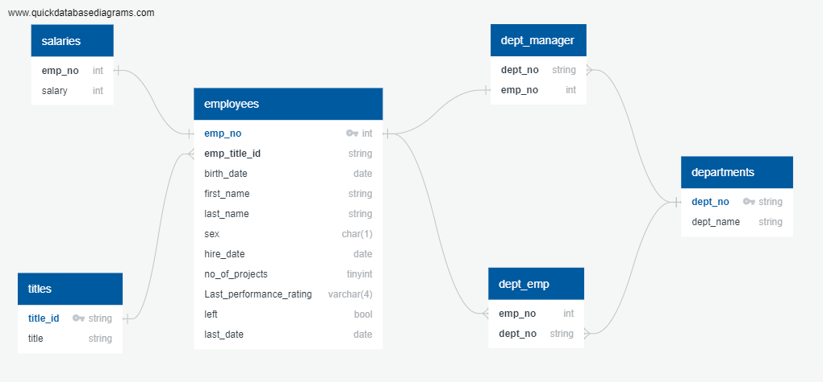
Datasets:
The client has provided datasets in csv files. There are a total of 6 tables. The ER diagram is as shown below:

Slide 4
Technology stack used
The project uses the following technologies to implement the data pipeline:
MySQL RDBMS: The provided csv data is transferred into the MySQL database to start
Sqoop: The data is transferred from the MySQL database to HDFS using Sqoop
HDFS: The data transferred from the RDBMS is stored over HDFS in Avro format
Hive: A Hive warehouse is created using the data stored in HDFS
Impala: An initial exploratory analysis of the data is conducted using Impala
Spark: Apart from Impala, Spark SQL has also been used to conduct exploratory analysis. Additionally, an ML model is created using pyspark

Slide 5
Stages of the pipeline
Stage1: Creating a MySQL database using the given csv tables
The requirement of the entire project is to build an end-to-end pipeline that can be run using a single shell file. Therefore, from the very beginning, automation has been kept in mind.
In order to achieve this stage, a single .sql script file is created that:
Creates the tables as per the given schema
Loads the data into those tables
This script file can be found in the project directory by the name mysql.sql

Slide 6
Stages of the pipeline
Stage2: Using Sqoop commands to transfer MySQL data tables to HDFS in Avro file format
Two warehouse directories are created over HDFS:
One to hold the data is Avro file format
Other to hold the schemas of that data (Sqoop transfers data and schema in separate files)
Since the schema files are stored locally by Sqoop, an additional step is required to transfer the schema files over to an HDFS directory.

Slide 7
Stages of the pipeline
Stage3: Creating Hive tables over the data stored in HDFS
A .sql script is created that automates the process of creating Hive tables over the HDFS data. This script can be found in the project directory by the name hive.sql

Slide 8
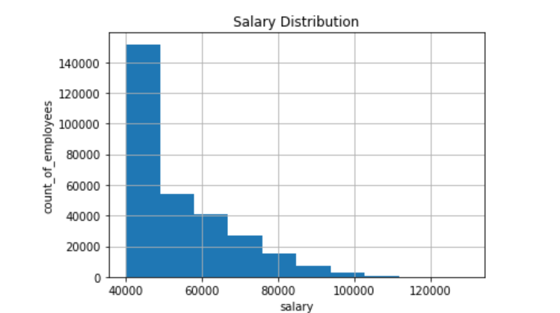
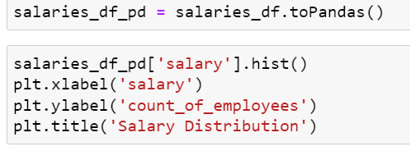
Stages of the pipeline
Stage4: Exploratory analysis is conducted on the data using Impala and Spark
Some of the analysis is show below:
Distribution of salaries of employees in the company

Slide 9
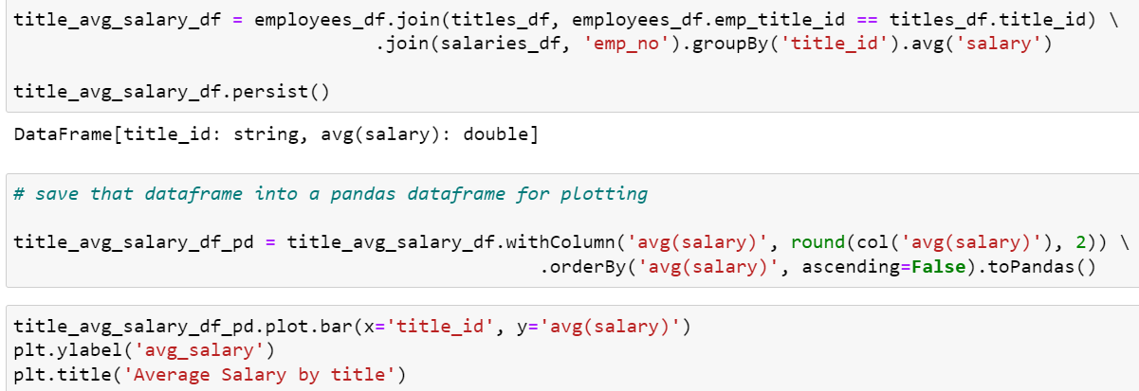
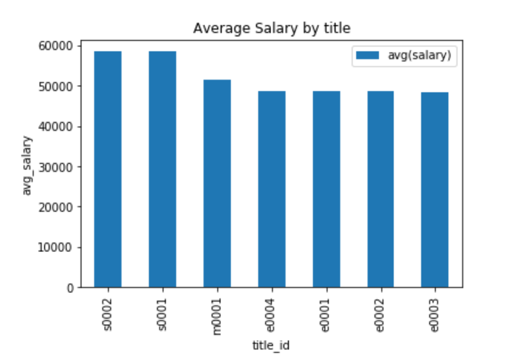
Average salaries of employees by title

Slide 10
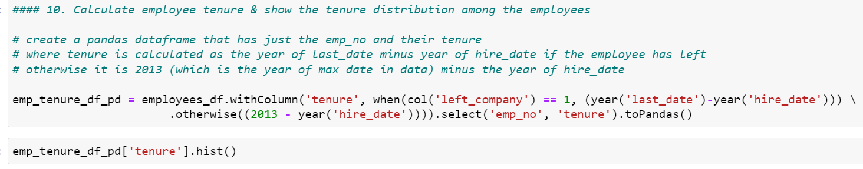
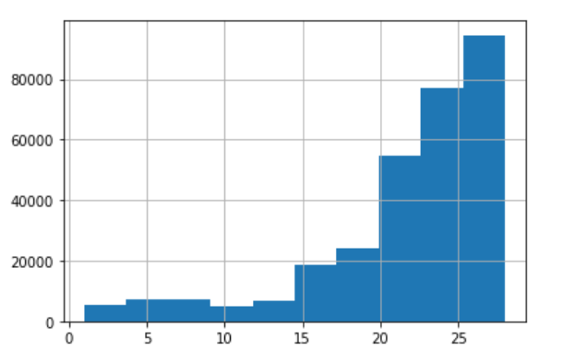
Distribution of employee tenures

Slide 11
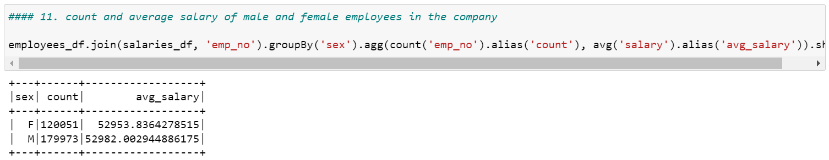
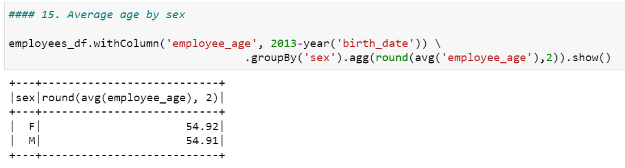
Count and average salaries of employees by gender
Average age of employees by gender

Slide 12
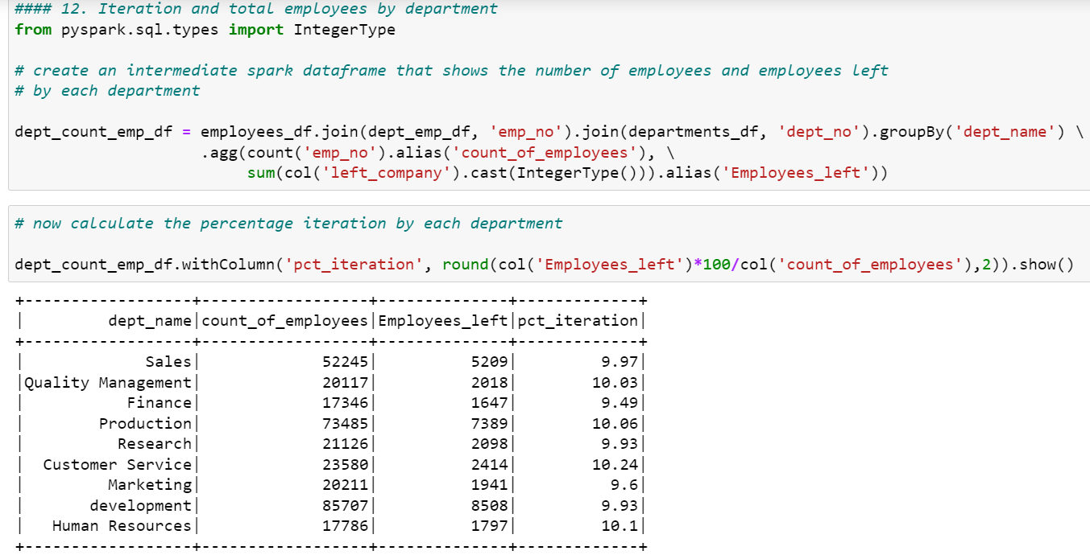
Employee iteration by department

Slide 13
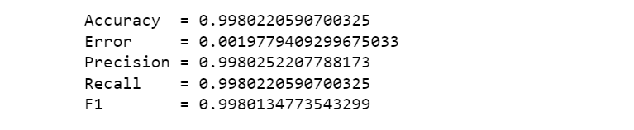
Stages of the pipeline
Stage4: Building the ML model
Dependent variable: left_company or whether an employee is expected to leave the company soon or not
Independent variables:
Categorical variables: employee title, department, sex, last performance rating
Continuous variables: no of projects, salary, employee’s age, tenure
The entire ML model is available in the project directory by the name ML_pipeline.py. The algorithm used is Random Forest Classifier. The accuracy metrics of the model are shown below:

Slide 14
Stages of the pipeline
Stage5: Bringing it all together
The whole idea of creating the pipeline is that this entire process should be automated and one should be able to run the entire using a single shell script.
The shell script can be found in the project directory by the name data-ml-pipeline.sh

