Slide 1
Building Private IaaS Cloud with openSUSE Leap 42.1 and OpenStack Liberty
Utian Ayuba
utianayuba@gmail.com

Slide 2
About Me
Come from Indonesia
Independent consultant on Linux system administration
New user of openSUSE & just join Indonesia openSUSE Community 2 months ago since Leap RC1 released

Slide 3
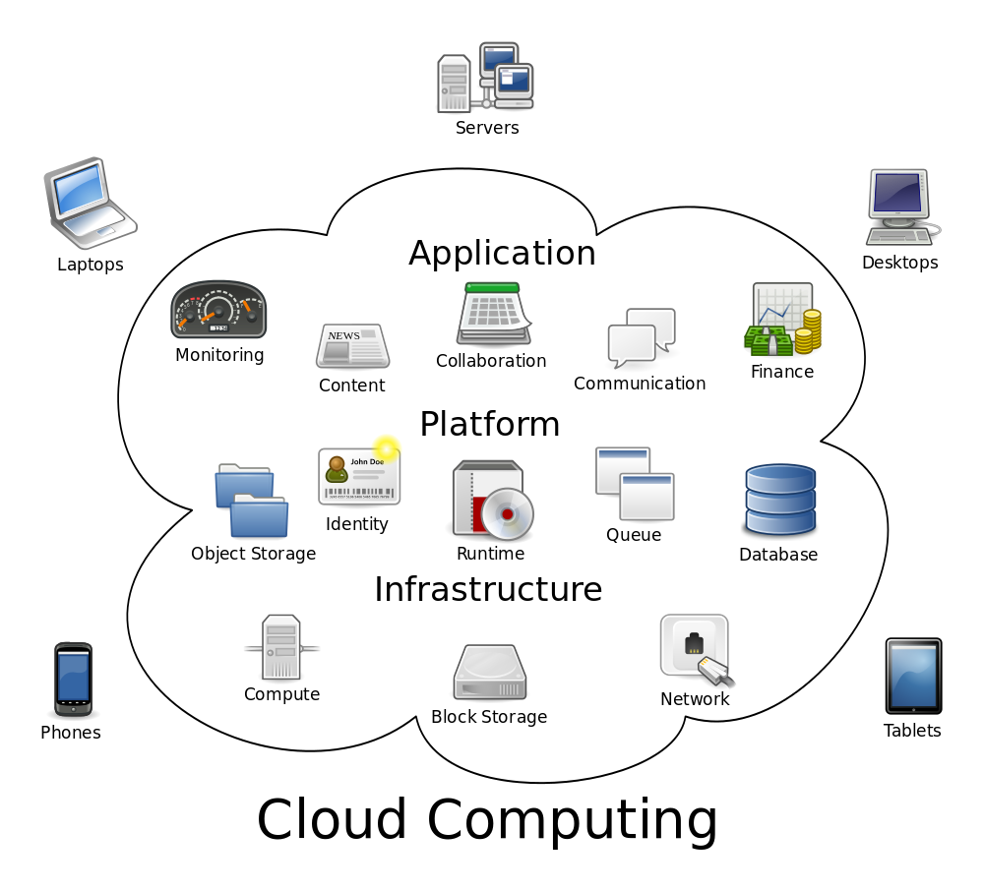
Characteristic of Cloud Computing
Resources Pooling
Broad Network Access
Measured Service
Rapid Elasticity
Self Service

Slide 4
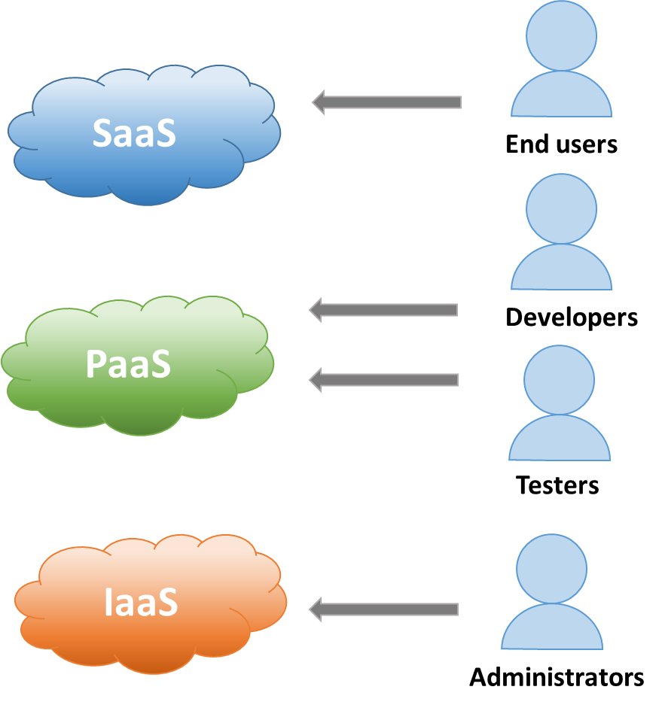
Type & User of Cloud Computing

Slide 5
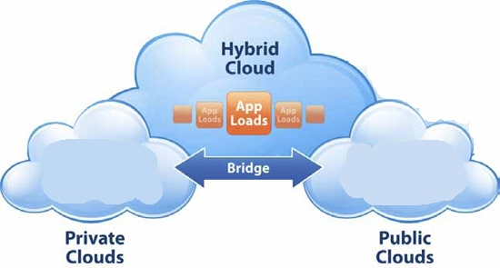
Implementation Model
Public Cloud
Private Cloud
Hybrid Cloud
Community Cloud

Slide 6
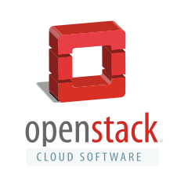
OpenStack
Open Source IaaS Private Cloud Software

Slide 7
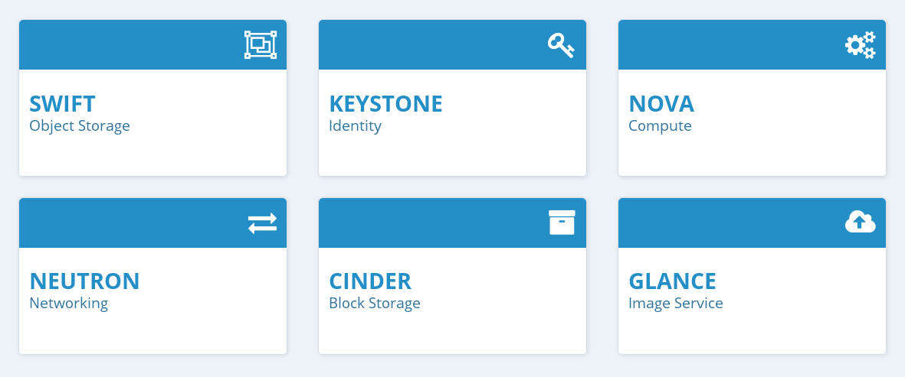
OpenStack Core Services

Slide 8
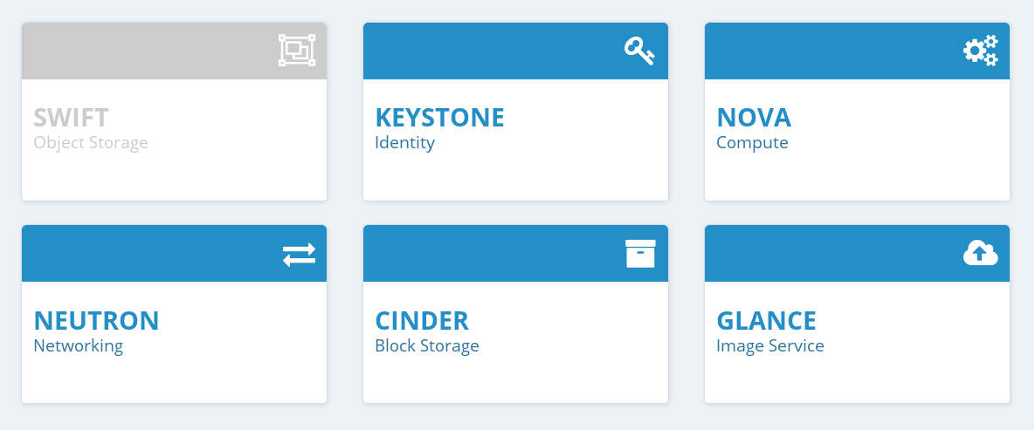
Compute Deployment

Slide 9
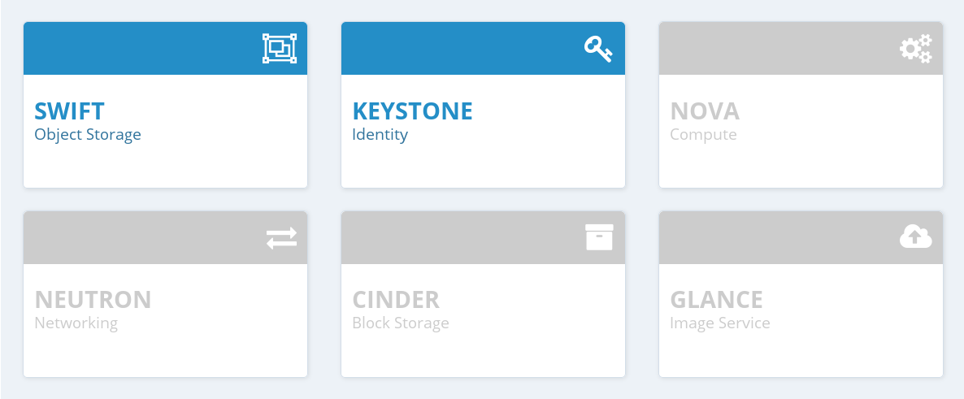
Object Storage Deployment

Slide 10
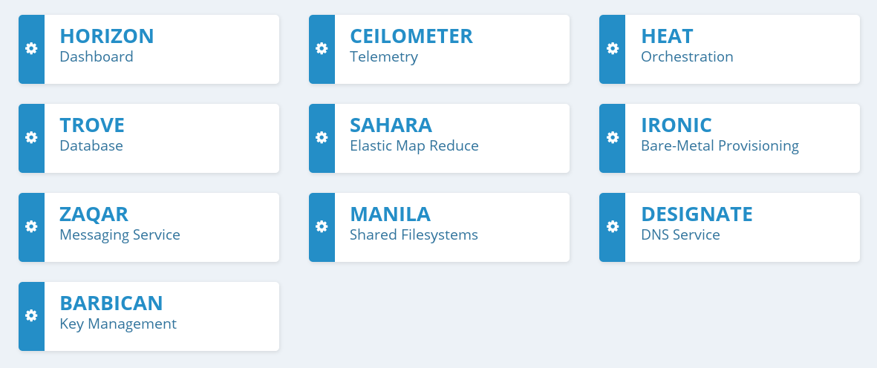
OpenStack Optional Services

Slide 11
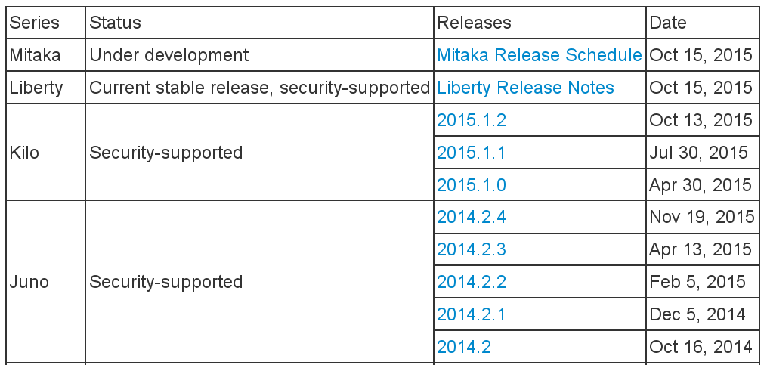
OpenStack Version

Slide 12
Demo
Install OpenStack Liberty on openSUSE Leap 42.1
Commands and Configurations: https://github.com/utianayuba/liberty_leap42.1

Slide 13
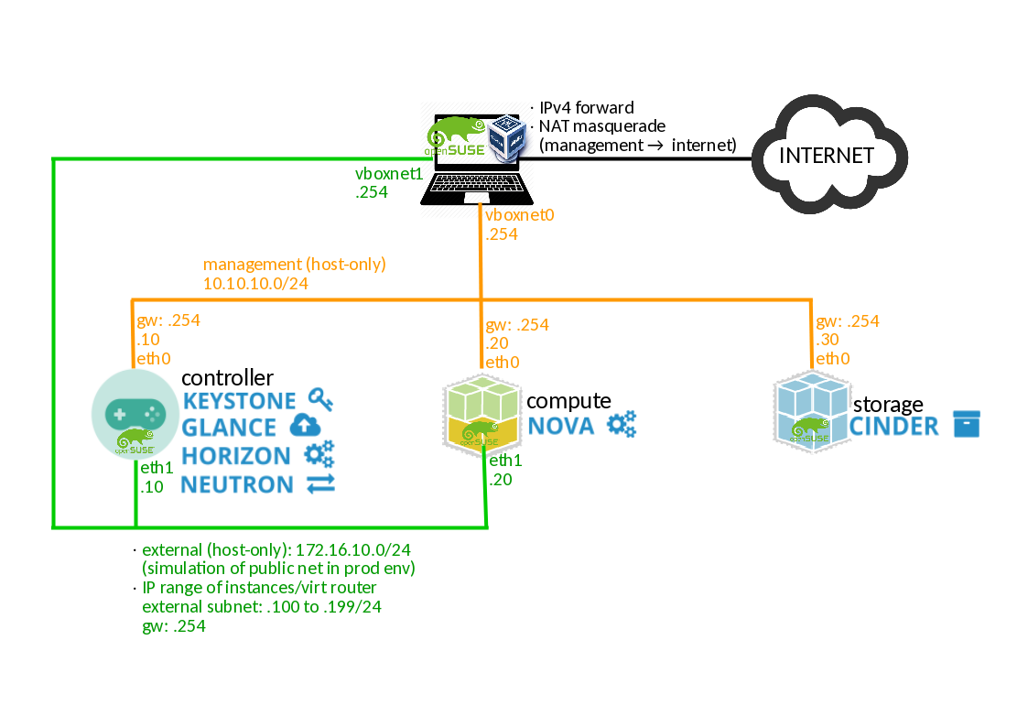
Topology

Slide 14
Discussion

