Slide 1
Introduction
To
Coding
Sidhartha Domakonda

Slide 2
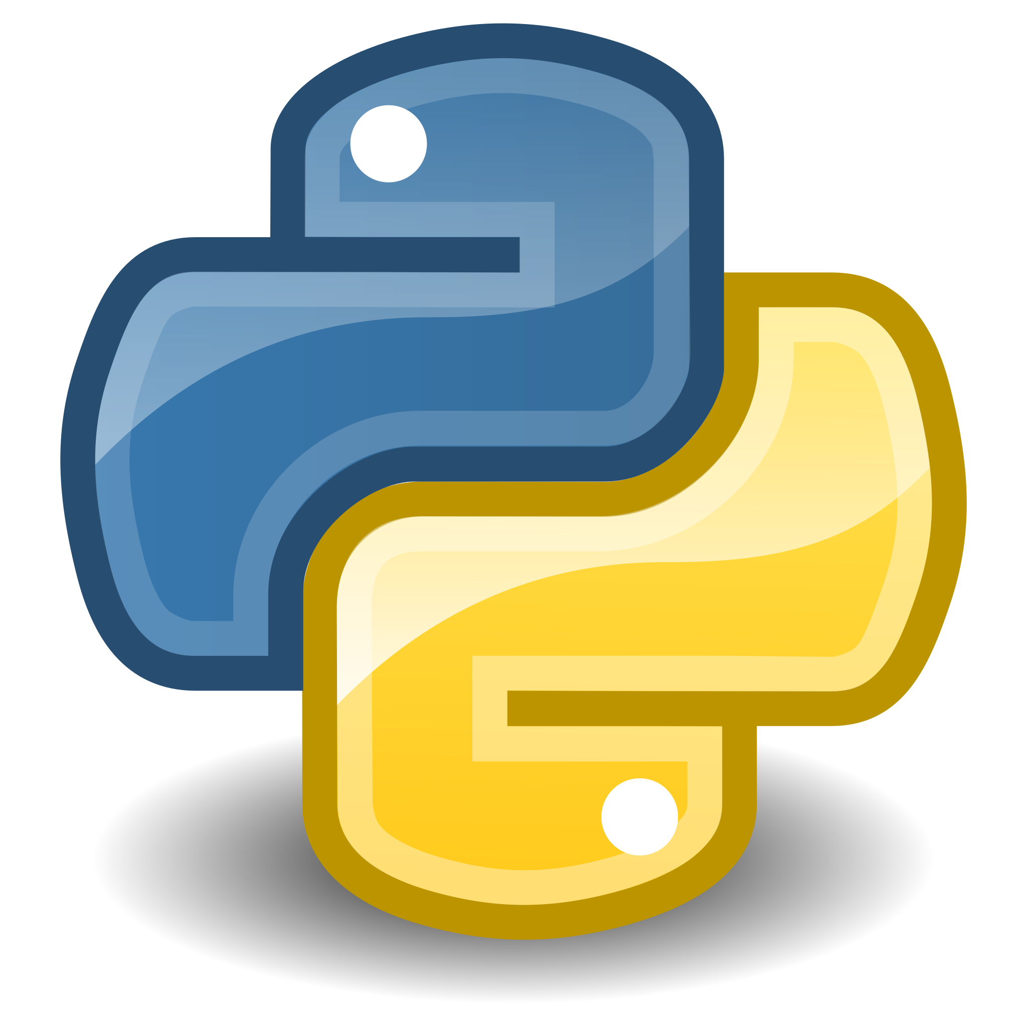
Created An Employee Lunch Booking Portal
I was inspired by a lunch booking portal from a previous job, which was developed by their team leader. I attempted to recreate a similar system using Python and Tkinter.
I developed an employee lunch booking portal that restricts lunch bookings to employees registered with the company. Employees can only make bookings between 9 am and 11:30 am, with no bookings allowed outside of this timeframe.

Slide 3



Tools Used
Visual Studio Code
DB Browser for SQLite3
Flask

Slide 4

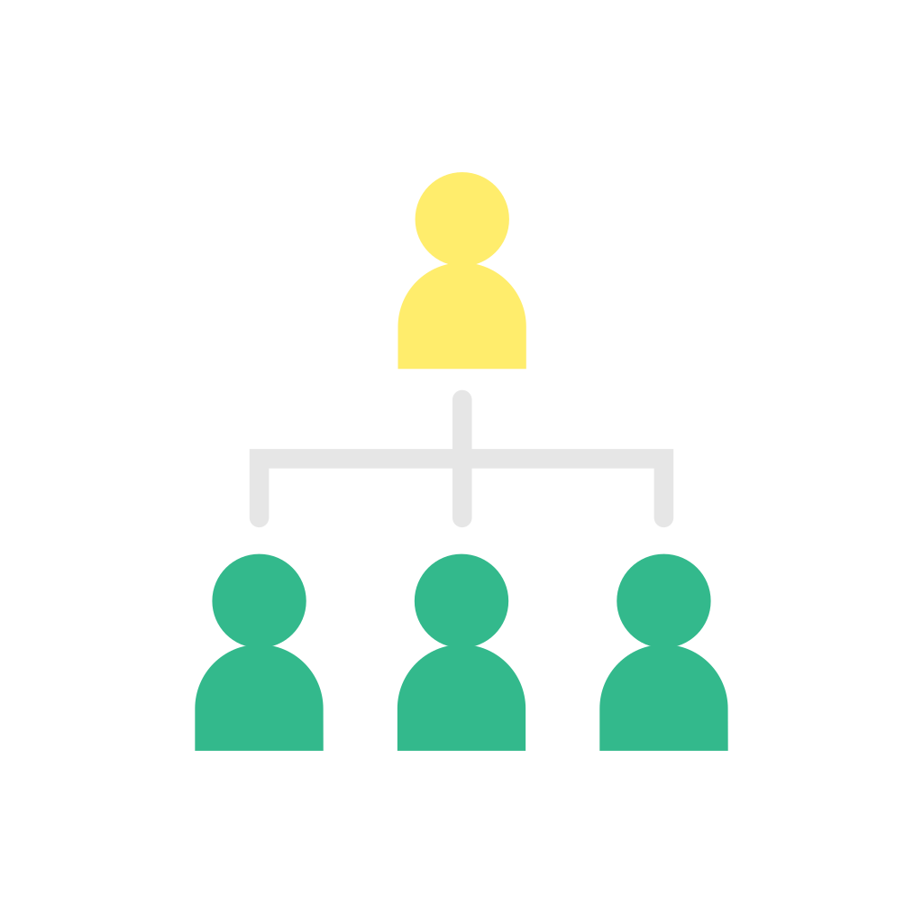
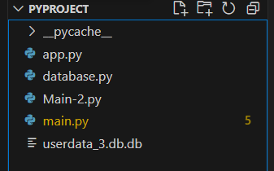
My Project Hierarchy

Slide 5
Modules/Libraries Used In Python
Tkinter
1. GUI Library: Tkinter is the standard GUI library for Python. It provides a set of tools to create graphical user interfaces.
2. Easy to Use: Tkinter is relatively easy to use and is well-suited for beginners.
3. Cross-Platform: Tkinter applications can run on Windows, macOS, and Linux without modification.
4. Widgets: Tkinter provides a variety of widgets like buttons, labels, entry boxes, and more to create interactive interfaces.
5. Integration: Tkinter can be easily integrated with other Python libraries and tools.
SQLite3
1. Embedded Database: SQLite is a lightweight, disk-based database that doesn't require a separate server process.
2. Self-Contained: A SQLite database is self-contained and requires minimal setup, making it ideal for small to medium-sized projects.
3. Transactional: SQLite is ACID-compliant and supports transactions, making it suitable for applications that require data integrity.
4. Cross-Platform: Like Python, SQLite is cross-platform and works on Windows, macOS, and Linux.
5. Python Integration: Python's standard library includes the `sqlite3` module, which provides a simple way to work with SQLite databases.

Slide 6
Things I’ve learnt
1.Tkinter Basics: The code demonstrates how to create a basic GUI application using Tkinter, including creating windows, labels, buttons, and entry widgets.
2. Event Handling: It shows how to handle events, such as button clicks, and perform actions in response to these events, like logging in or booking lunch.
3. Database Interaction: It illustrates how to interact with an SQLite database using the `sqlite3` module, including connecting to a database, executing SQL queries, and retrieving data.
4. Error Handling: Though basic, the code includes some error handling using `try` and `except` blocks, which is important for robust and reliable applications.
5. Datetime Handling: It demonstrates how to work with datetime objects in Python, including formatting and comparing times.
6. GUI Design: While simple, the code provides a starting point for designing more complex GUI applications, showcasing layout management and styling using ttk.

Slide 7
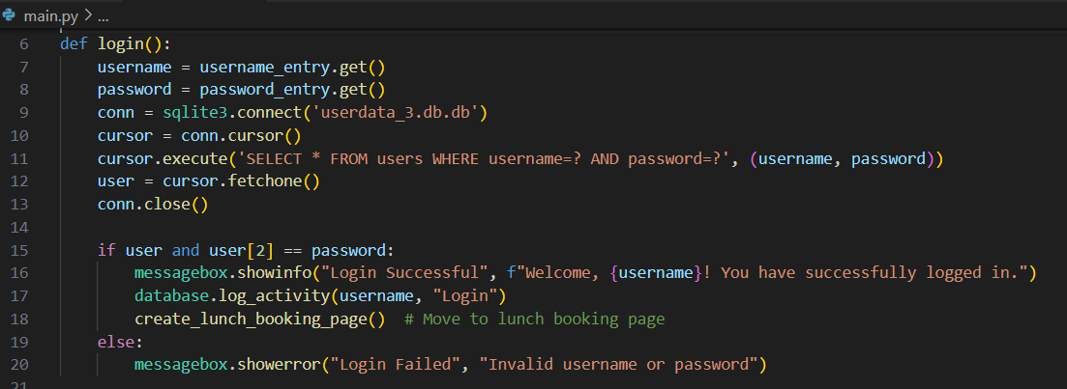
Python Code Blocks
Login Function

Slide 8
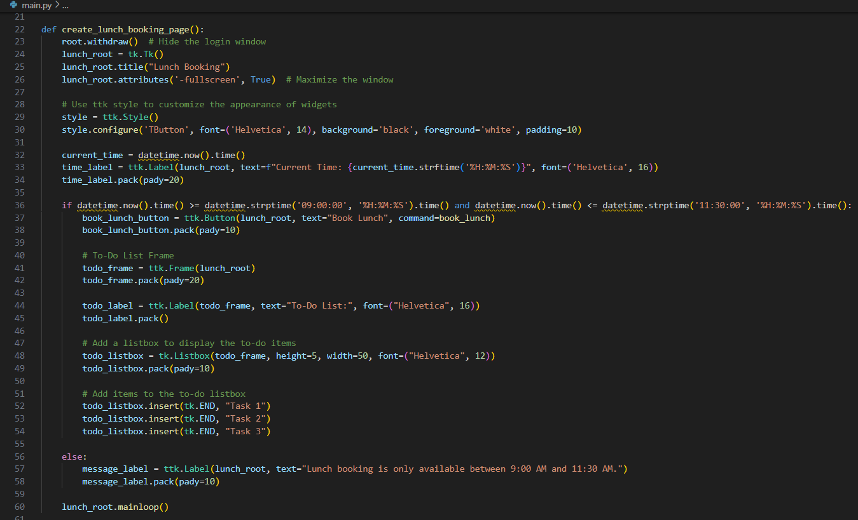
Second Window(Lunch Booking)

Slide 9
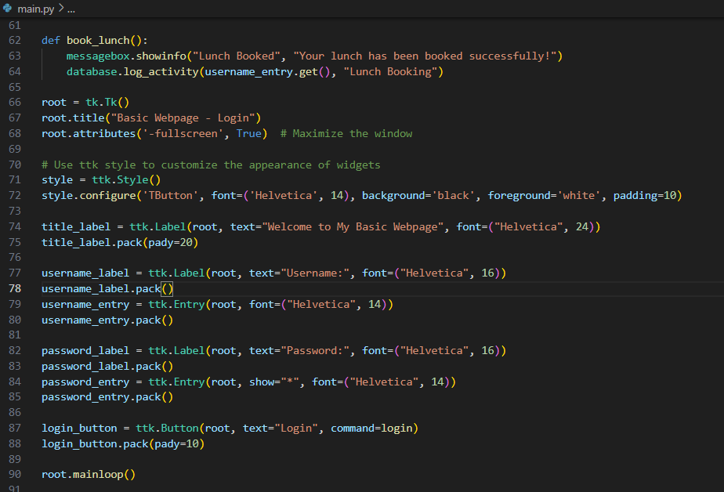

Slide 10
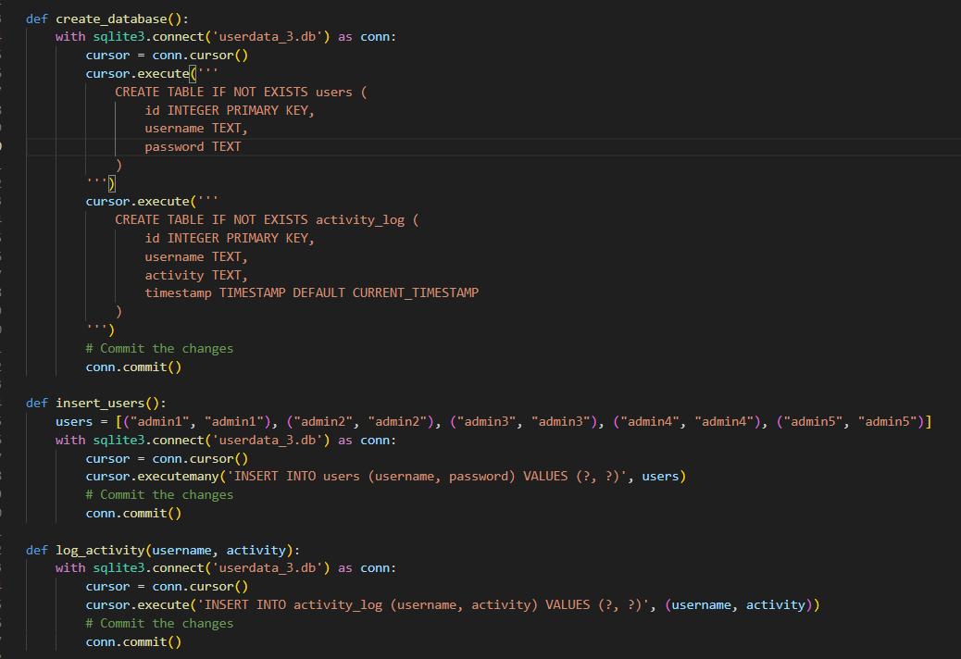
Code for Database operations

Slide 11
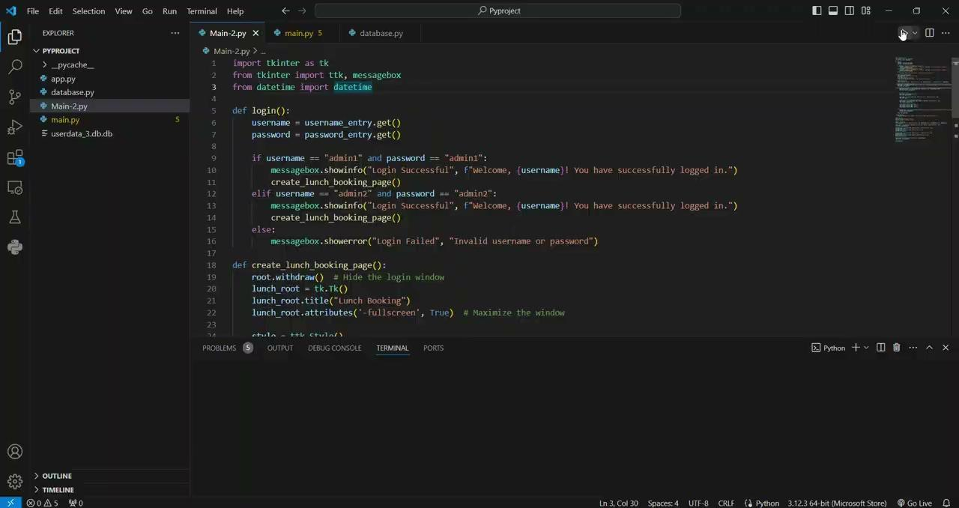
OUTPUT

Slide 12
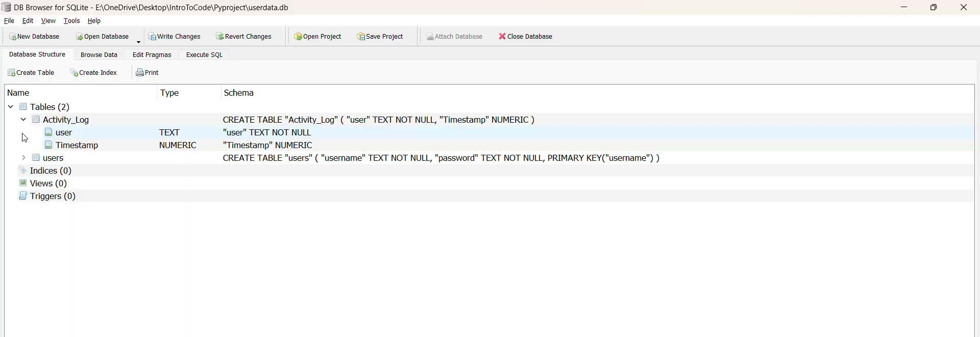
OUTPUT

