Slide 1
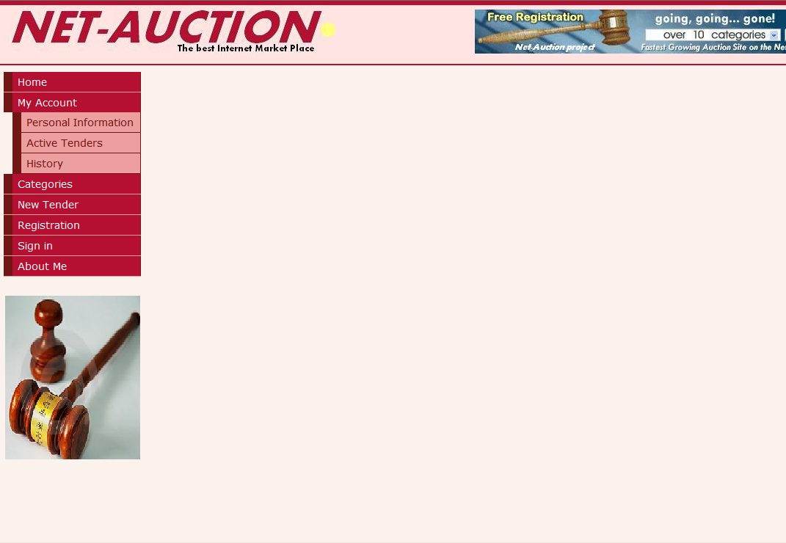


ONLINE AUCTIONING SYSTEM
By: Siddharth Agrawal (150716)
IIT KANPUR

Slide 2
Agenda
Abstract
Goals
Architecture and Patterns
Design
Demo

Slide 3
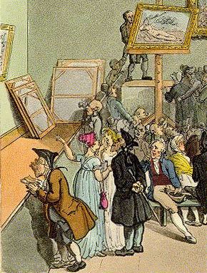
Abstract
An auction is a process of buying and selling goods or services by offering them up for bid, taking bids, and then selling the item to the highest bidder.
The word "auction" is derived from the Latin augeō which means "I increase" or "I augment".
auctions have a long history, having been recorded as early as 500 B.C.

Slide 4
Abstract
There are massive amounts of preparation that goes into a finding and researching a property for conducting auctions.
Buyers are forced to go the the auctioning sites.

Slide 5

Abstract
But now!...
You only need to turn on your computer and enter the web-site
NET-AUCTION

Slide 6
Abstract
OAS is an implementation of web auctions, like eBay, Sotheby’s, and others with it’s own design and bid politics.
This web site has an intuitive interface and unique visual objects that make it friendly for use.
Common client operations were implemented in this application. In addition, there were used some original marketing solutions.

Slide 7
Users Involved
Bidder
Auctioneer
Admin/Seller

Slide 8
OAS features
Guests
Searching for items by tags and categories
Studying available tenders and items
Studying seller’s information
Web registration
Registered users
Proposing items for tender
Participating in active tenders
Account management
Commenting and rating other users

Slide 9

Design

Slide 10
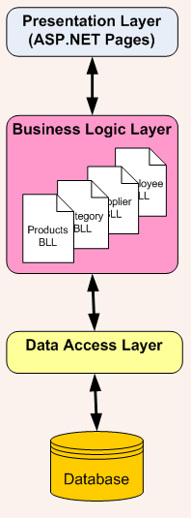
Three layer design pattern
Presentation Layer
-Web pages (GUI).
Business Logic Layer
- Project’s logic.
- Classes & algorithms
Data Access Layer
- Ordered DB access.
Related tables.

Slide 11
Three Layer design pattern
Advantages:
Modular software Technology
Disadvantage:
Complexity

Slide 12
Hardware Requirements (Minimum)
Server side:-
Processor :- 2.20 GHz
RAM :- 2GB
Hard disk :- 10 GB Free Space
Client side:-
Processor :- 2.0 GHz
RAM :- 1GB
Hard disk :- 4 GB Free Space

Slide 13
Software Requirements (Minimum)
Server side:-
Operating system :- Windows server 2003 or any compatible server OS
Framework :- .Net framework 4.0
Web Server :- IIS 6.0
Front End:- ASP. NET with C# (.NET framework 4.0)
Back End :- SQL server 2008
Client side:-
Operating system :- Windows XP or any compatible OS
Browser :- Internet Explorer 6.0 or any compatible browser

Slide 14

Funding

Slide 15
Funding
>Setting up Cost
- Hardware/Software: ~60,000 Rs
- Office Space: ~10,00,000 Rs
- Delivery vehicles: ~6,00,000 Rs
>Salary Expenditure
- per year: ~10,00,000 Rs
>Packaging Cost
- per year: ~50,000 Rs
>Delivery Cost
- Petrol Cost per year: ~50,000 Rs
>Total
- Investment Cost: ~16,60,000 Rs
- Per year Cost: ~11,00,000 Rs

Slide 16
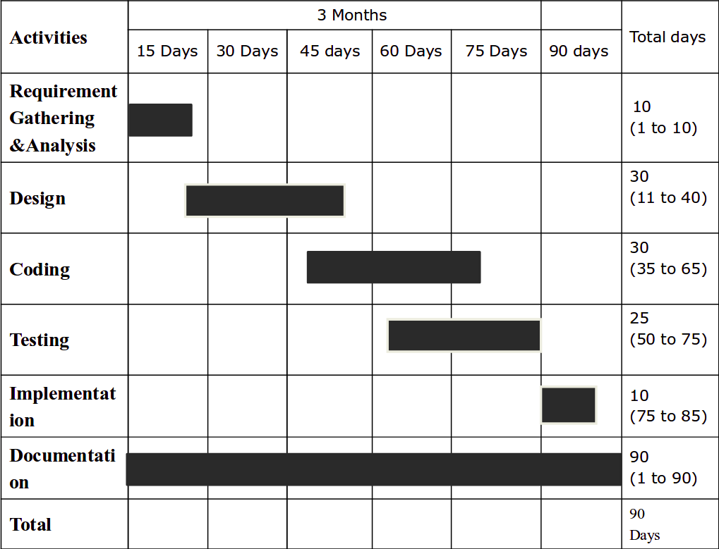
Timeline Chart

Slide 17
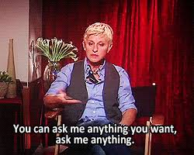
Thank You
Please ask your questions...
_x0001_

