Slide 1
Fault Tolerance

Slide 2
Topics
What is fault tolerance?
Why we need fault tolerant systems?
Existing fault tolerant techniques/models (and where they are applied)?
Challenges in developing fault tolerant systems.
Future of fault tolerance.

Slide 3
Software Services
People use software services and applications everyday.
They will continue to use them only if these services/applications are
DEPENDABLE.

Slide 4
Dependability
Specified Service : How the behavior of the service should be
Derived Service : Actual behavior of the service
If the dependability goes down, Derived service will start to deviate from the Specified Service

Slide 5
Dependability
Availability – the system is ready to be used immediately.
Reliability – the system can run continuously without failure.
Safety – if a system fails, nothing catastrophic will happen.
Maintainability – when a system fails, it can be repaired easily and quickly (and, sometimes, without its users noticing the failure).
Notes:
Dependability - Trustworthiness of a computer system so that reliance can be placed on the service it delivers
Availability: Can I use it now? Probability of being up at any given time.
Reliability: Will it be up as long as I need it? Ability to run continuously without failure. If system crashes briefly every hour, it may still have good availability (it is up most of the time) but has poor reliability because it cannot run for very long before crashing.
Safety: If it fails, ensure nothing bad happens?
Maintainability: How easy is it to fix if it breaks?

Slide 6
Dependability - Trustworthiness of a computer system so that reliance can be placed on the service it delivers
Availability: Can I use it now? Probability of being up at any given time.
Reliability: Will it be up as long as I need it? Ability to run continuously without failure. If system crashes briefly every hour, it may still have good availability (it is up most of the time) but has poor reliability because it cannot run for very long before crashing.
Safety: If it fails, ensure nothing bad happens?
Maintainability: How easy is it to fix if it breaks?

Slide 7
Reliability and Availability
Mean time to failure (MTTF) - Average time it takes for the system to fail
Mean time to recover (MTTR) - Average time it takes to recover
Mean time between failures (MTBF) - Average time between failures

Slide 8
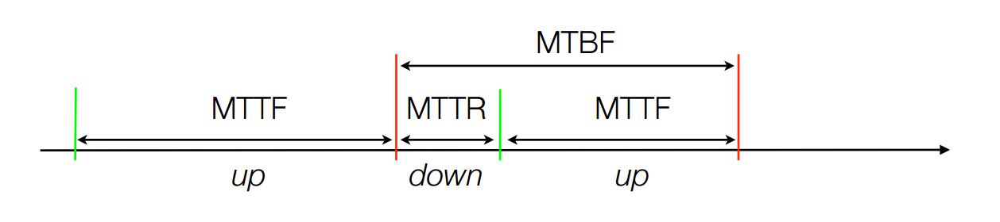
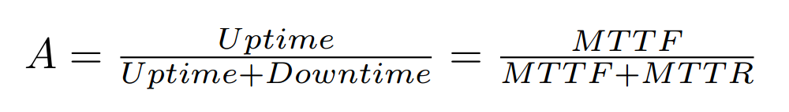
Reliability and Availability

Slide 9
Reliability and Availability
Availability | Downtime per year | Downtime per week
90.0 % (1 nine) | 36.5 days | 16.8 hours
99.0 % (2 nines) | 3.65 days | 1.68 hours
99.9 % (3 nines) | 8.76 hours | 10.1 min
99.99 % (4 nines) | 52.6 min | 1.01 min
99.999 % (5 nines) | 5.26 min | 6.05 s
99.9999 % (6 nines) | 31.5 s | 0.605 s
99.99999 % (7 nines) | 0.3 s | 6 ms

Slide 10
Faults, Errors and Failures
A fault is the cause of an error. It is associated with a defect.
An error is part of the system state that may cause a subsequent failure: a failure occurs when an error reaches the service interface and alters the service.
A system failure is an event that occurs when the derived service deviates from specified service.
A fault originally causes an error within the state of one (or more) components, but system failure will not occur as long as the error does not reach the service interface of the system.
Notes:
System failure can be a fault to high layers.

Slide 11
What is fault tolerance?
The approach of fault-tolerance expect faults to be present during system operation, but employs design techniques which insure the continued correct execution of the computing process

Slide 12
Why do we need fault tolerant systems?
Average costs per hour of downtime (Gartner 1998)
Brokerage operations in finance: $6.5 million
Credit card authorization: $2.6 million
Home catalog sales: $90.000
Airline reservation: $89.500
22-hour service outage of eBay in June 1999
Interruption of around 2.3 million auctions
9.2% stock value drop

Slide 13
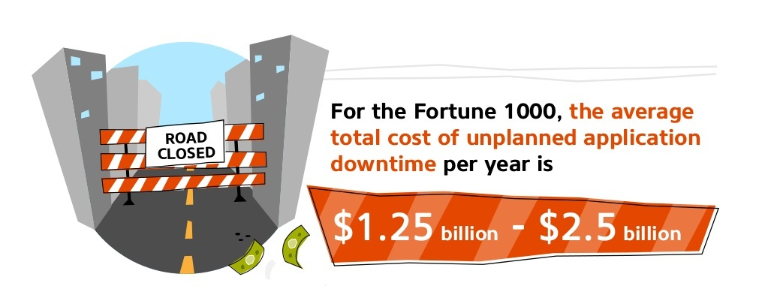
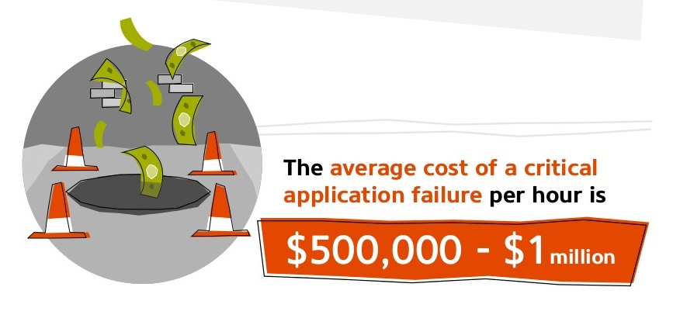
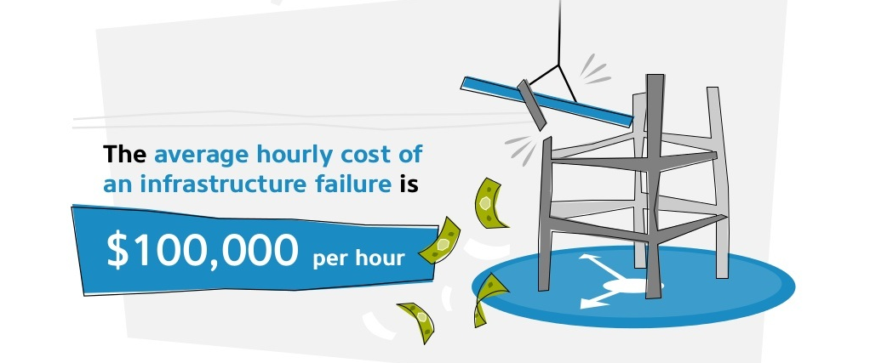
Why we need fault tolerant systems?
Stats from 2015

Slide 14
Fault Classification
By cause
Hardware Faults
Design Faults
Operation Faults
Environment Faults
By duration
Permanent Faults
Intermittent Faults
Transient Faults

Slide 15
Failure Classification
Type of failure | Description
Crash failure | A server halts, but is working correctly until it halts
Omission failure Receive omission Send omission | A server fails to respond to incoming requests A server fails to receive incoming messages A server fails to send messages
Timing failure | A server's response lies outside the specified time interval
Response failure Value failure State transition failure | The server's response is incorrect The value of the response is wrong The server deviates from the correct flow of control
Arbitrary failure (Byzantine failure) | A server may produce arbitrary responses at arbitrary times

Slide 16
Fault Tolerance Strategies
Fault tolerance in computer system is achieved through redundancy in hardware, software, information, and/or time. Such redundancy can be implemented in static, dynamic, or hybrid configurations.
Fault tolerance can be achieved by many techniques:
Fault masking is any process that prevents faults in a system from introducing errors. Example: Error correcting memories and majority voting.
Reconfiguration is the process of eliminating faulty component from a system and restoring the system to some operational state.

Slide 17
Reconfiguration Approach
Fault detection is the process of recognizing that a fault has occurred. Fault detection is often required before any recovery procedure can be initiated.
Fault location is the process of determining where a fault has occurred so that an appropriate recovery can be initiated.
Fault containment is the process of isolating a fault and preventing the effects of that fault from propagating throughout the system.
Fault recovery is the process of regaining operational status via reconfiguration even in the presence of faults.

Slide 18
The Concept of Redundancy
Redundancy is simply the addition of information, resources, or time beyond what is needed for normal system operation.
Software redundancy is the addition of extra software, beyond what is needed to perform a given function, to detect and possibly tolerate faults.
Hardware redundancy is the addition of extra hardware, usually for the purpose either detecting or tolerating faults.
Information redundancy is the addition of extra information beyond that required to implement a given function; for example, error detection codes.

Slide 19
The Concept of Redundancy
Time redundancy uses additional time to perform the functions of a system such that fault detection and often fault tolerance can be achieved. Transient faults are tolerated by this.
The use of redundancy can provide additional capabilities within a system. But, redundancy can have very important impact on a system's performance, size, weight and power consumption.

Slide 20
Software Redundancy

Slide 21
Process Resilience
Mask process failures by replication
Organize processes into groups, a message sent to a group is delivered to all members
If a member fails, another should fill in

Slide 22
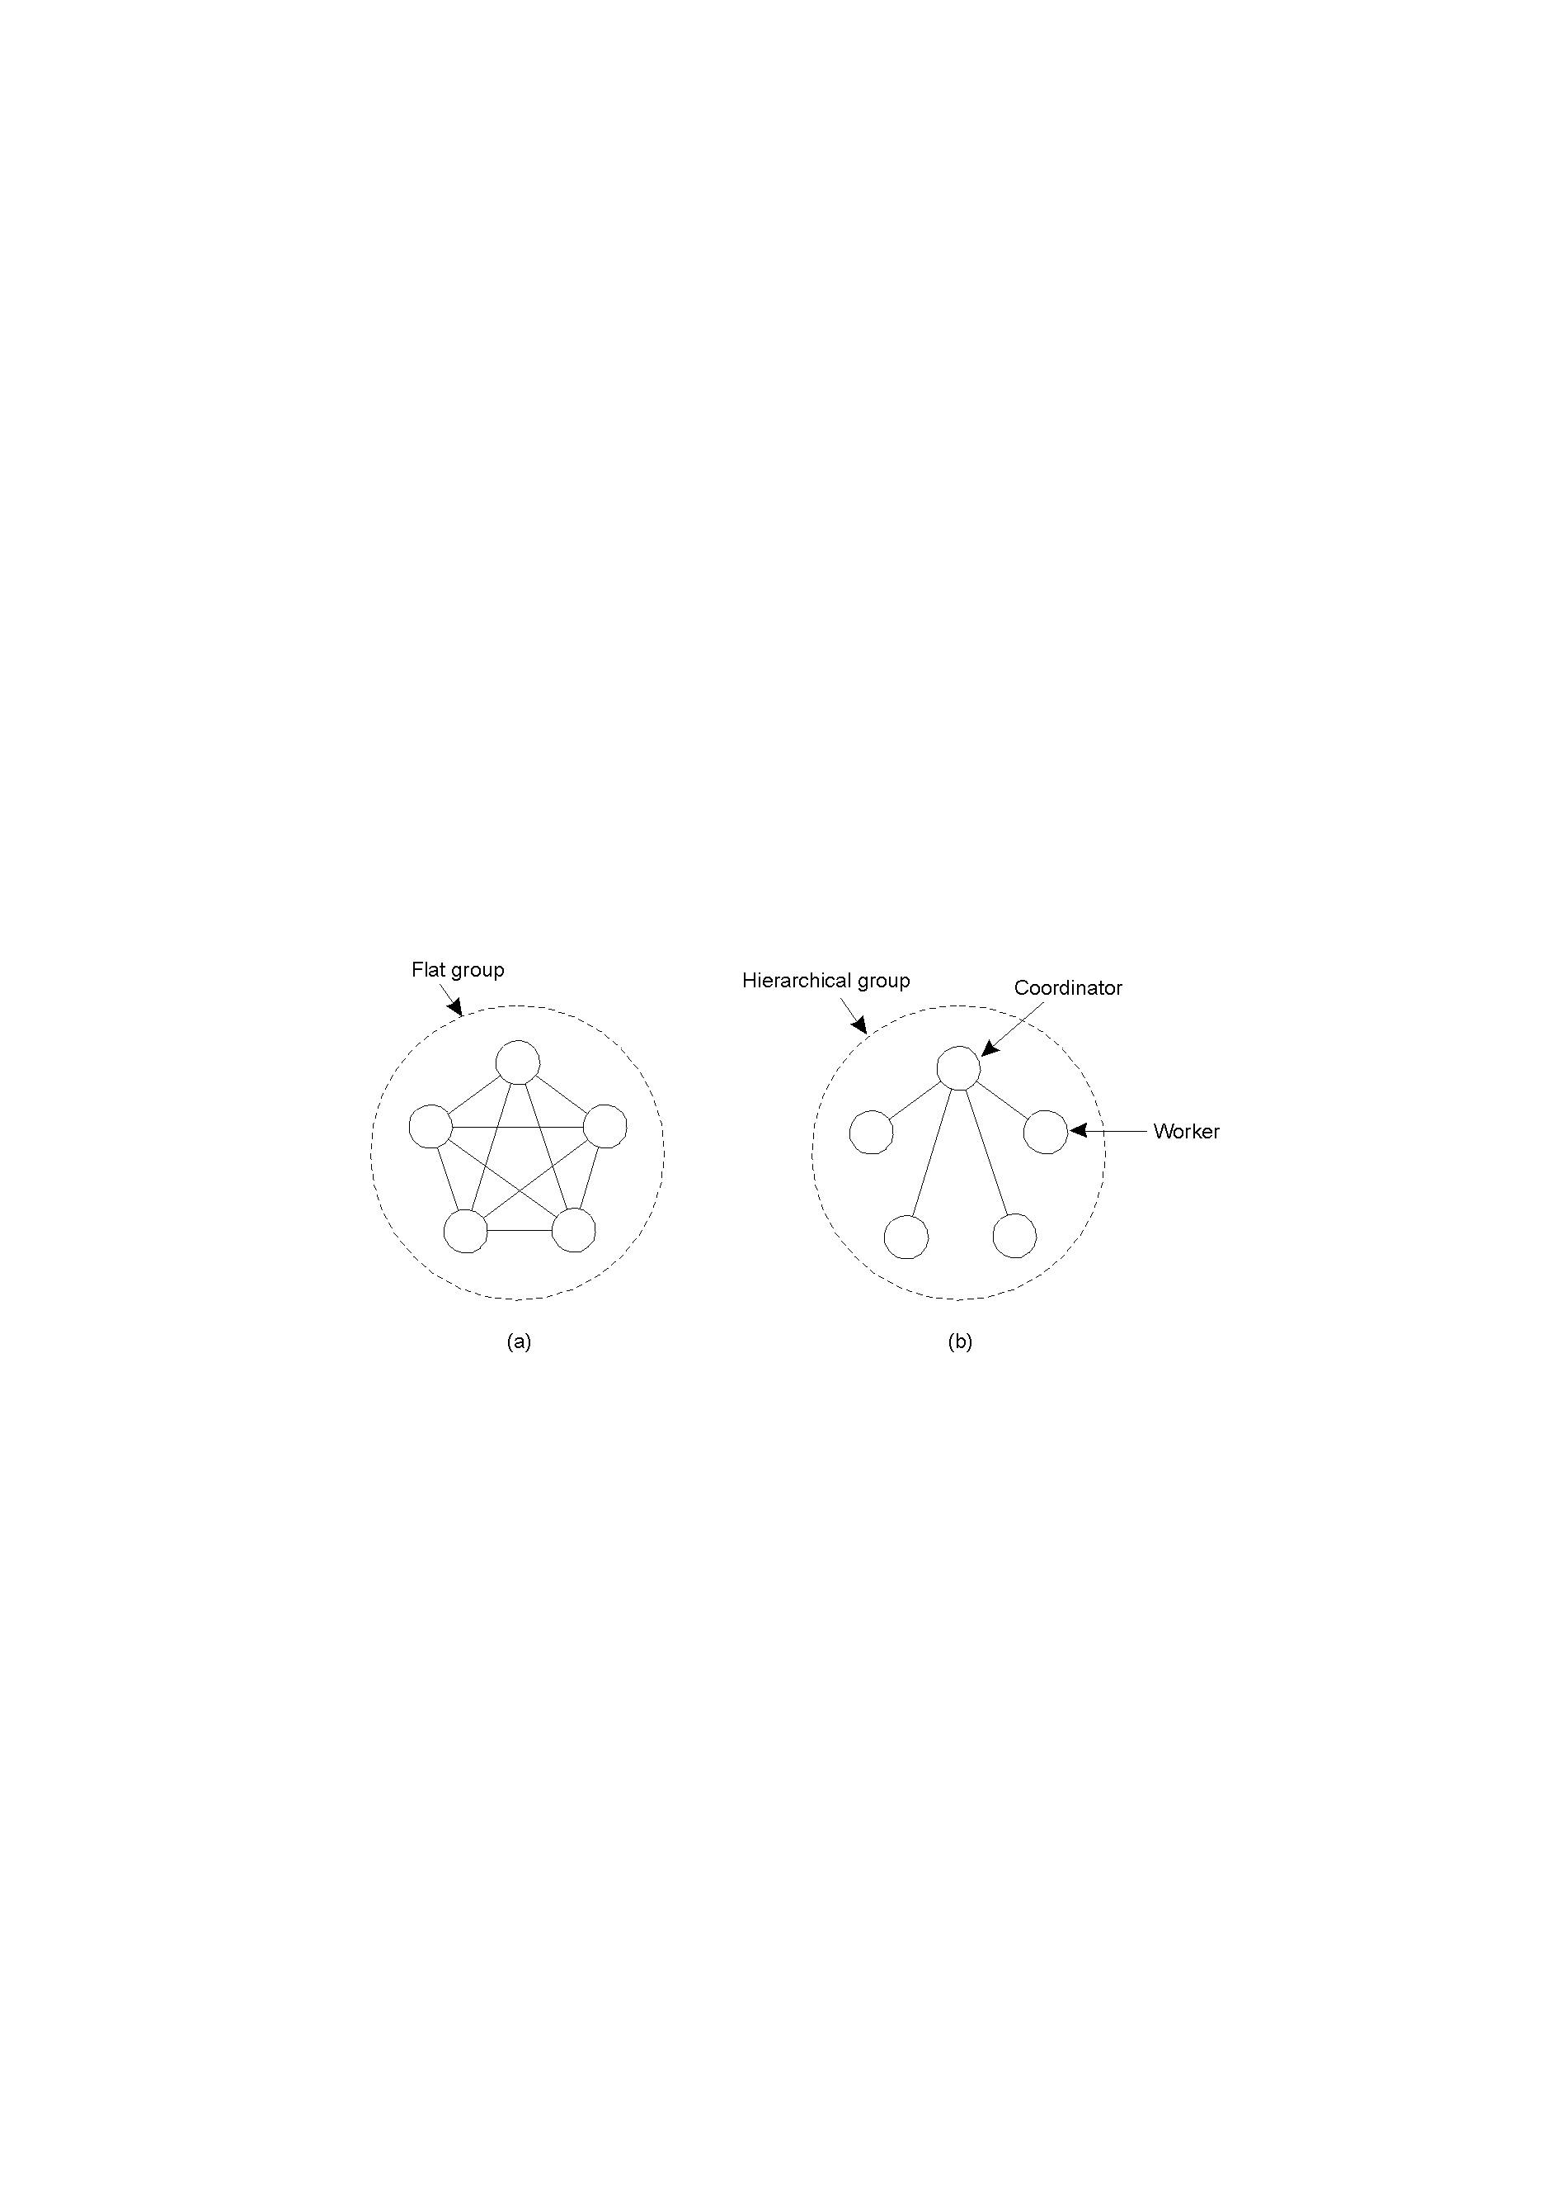
Flat Groups versus Hierarchical Groups
Communication in a flat group.
Communication in a simple hierarchical group

Slide 23
Process Replication
Replicate a process and group replicas in one group
A system is k fault-tolerant if it can survive and function even if it has k faulty processes
For crash failures (a faulty process halts, but is working correctly until it halts)
k+1 replicas
For Byzantine failures (a faulty process may produce arbitrary responses at arbitrary times)
2k+1 replicas

Slide 24
Agreement
Need agreement in DS:
Leader, commit, synchronize
Distributed Agreement algorithm: all non-faulty processes achieve consensus in a finite number of steps
Perfect processes, faulty channels: two-army
Faulty processes, perfect channels: Byzantine generals

Slide 25
Two-Army Problem
Notes:
In this example, Enemy Red Army has 5000 troops. Blue Army has two separate gatherings, Blue (1) and Blue (2), each of 3000 troops. Alone Blue will loose, together as a coordinated attack Blue can win. Communications is by unreliable channel (send a messenger who may be captured by red army so may not arrive.

Slide 26
Byzantine Generals Problem





Slide 27
Distributed COMMIT
General Goal:
We want an operation to be performed by all group members, or none at all.
There are three types of “commit protocol”: single-phase, two-phase and three-phase commit.

Slide 28
Commit Protocols
One-Phase Commit Protocol:
An elected co-ordinator tells all the other processes to perform the operation in question.
But, what if a process cannot perform the operation? There’s no way to tell the coordinator! Whoops …
The solutions:
The Two-Phase and Three-Phase Commit Protocols.

Slide 29
The Two-Phase Commit Protocol
First developed in 1978!!!
Summarized: GET READY, OK, GO AHEAD.
The coordinator sends a VOTE_REQUEST message to all group members.
The group member returns VOTE_COMMIT if it can commit locally, otherwise VOTE_ABORT.
All votes are collected by the coordinator. A GLOBAL_COMMIT is sent if all the group members voted to commit. If one group member voted to abort, a GLOBAL_ABORT is sent.
The group members then COMMIT or ABORT based on the last message received from the coordinator.

Slide 30
Big Problem with Two-Phase Commit
It can lead to both the coordinator and the group members blocking, which may lead to the dreaded deadlock.
If the coordinator crashes, the group members may not be able to reach a final decision, and they may, therefore, block until the coordinator recovers …
Two-Phase Commit is known as a blocking-commit protocol for this reason.
The solution? The Three-Phase Commit Protocol.

Slide 31
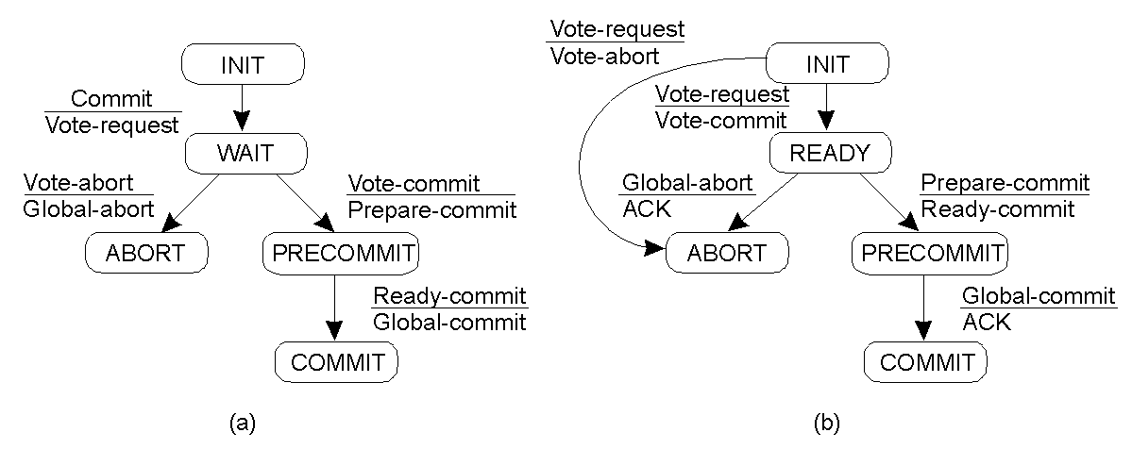
Three-Phase Commit
Finite state machine for the coordinator.
Finite state machine for a group member.
Main point: although 3PC is generally regarded as better than 2PC, it is not applied often in practice, as the conditions under which 2PC blocks rarely occur.

Slide 32
Software Redundancy – to Detect Hardware Faults
Consistency checks use a priori knowledge about the characteristics of the information to verify the correctness of that information. Example: Range checks, overflow and underflow checks.
Capability checks are performed to verify that a system possesses the capability expected. Examples: Memory test - a processor can simply write specific patterns to certain memory locations and read those locations to verify that the data was stored and retrieved properly.

Slide 33
Software Redundancy - to Detect Hardware Faults
ALU tests: Periodically, a processor can execute specific instructions on specific data and compare the results to known results stored in ROM.
Testing of communication among processors, in a multiprocessor, is achieved by periodically sending specific messages from one processor to another or writing into a specific location of a shared memory.

Slide 34
Software Redundancy - to Detect Hardware Faults.
All modern day microprocessors use instruction retry
Any transient fault that causes an exception such as parity violation is retried
Very cost effective and is now a standard technique

Slide 35
Software Redundancy - to Detect Software Faults
There are two popular approaches: N-Version Programming (NVP) and Recovery Blocks (RB).
NVP is a forward recovery scheme - it masks faults.
RB is a backward error recovery scheme.
In NVP, multiple versions of the same task is executed concurrently, whereas in RB scheme, the versions of a task are executed serially.
NVP relies on voting.
RB relies on acceptance test.

Slide 36
Single Version Fault Tolerance: Software Rejuvenation
Example: Rebooting a PC
As a process executes
it acquires memory and file-locks without properly releasing them
memory space tends to become increasingly fragmented
The process can become faulty and stop executing
To head this off, proactively halt the process, clean up its internal state, and then restart it
Rejuvenation can be time-based or prediction-based
Time-Based Rejuvenation - periodically
Rejuvenation period - balance benefits against cost

Slide 37
HARDWARE REDUNDANCY

Slide 38
Hardware Redundancy
Static techniques use the concept of fault masking. These techniques are designed to achieve fault tolerance without requiring any action on the part of the system. Relies on voting mechanisms.
(also called passive redundancy or fault-masking)
Dynamic techniques achieve fault tolerance by detecting the existence of faults and performing some action to remove the faulty hardware from the system. That is, active techniques use fault detection, fault location, and fault recovery in an attempt to achieve fault tolerance.
(also called active redundancy )

Slide 39
Hardware Redundancy (Cont’d)
Hybrid techniques combine the attractive features of both the passive and active approaches.
Fault masking is used in hybrid systems to prevent erroneous results from being generated.
Fault detection, location, and recovery are also used to improve fault tolerance by removing faulty hardware and replacing it with spares.

Slide 40
Future of Fault Tolerance
Apache Zookeeper
ZooKeeper Atomic Broadcasts
ETCD
Consul
Gossip Protocol
Doozer

