Slide 1
SHRI PROPERTIES
CASE STUDY · A COMPLETED DEAL
4081 East 64th Street
Cleveland, Ohio — bought for $75,000, sold for $115,000, sixteen months later.
$74,184
$115,000
$36,943
49.8%
CASH INVESTED
SALE PRICE
NET PROFIT
TOTAL RETURN
Presented by Shri Properties
Analysis of a completed deal. Not financial advice.

Slide 2
01 · DEAL SNAPSHOT
SHRI PROPERTIES
Cash-flowing American homes, for investors worldwide.
The thesis behind this deal, in one line: buy homes that pay rent quickly, in states that are fair to owners.
Shri Properties, a Wyoming LLC, is building a global real estate investment platform for investors worldwide. All operations, property management and servicing are handled in the US: we buy single-family homes in landlord-friendly states, pay in cash, and run each home on the ground.
HOW THE OPERATION RUNS
1
Investors worldwide
From any country; they fund and own the home
01
Cash flow first
2
Shri Properties, in the US
Buy homes that rent quickly, so income starts within months, not years.
Finds, buys and oversees; B2B Realty manages locally
02
Landlord-friendly states
3
The home
Cleveland, Ohio · single-family · rented
Simple rules for owners and low entry prices — Ohio here, at $75,000.
4
Rent back
03
All cash, no loan
Paid monthly, net of agent fees
No lender, no interest bill, no pressure to sell at the wrong time.
Presented by Shri Properties
Analysis of a completed deal. Not financial advice.
02

Slide 3
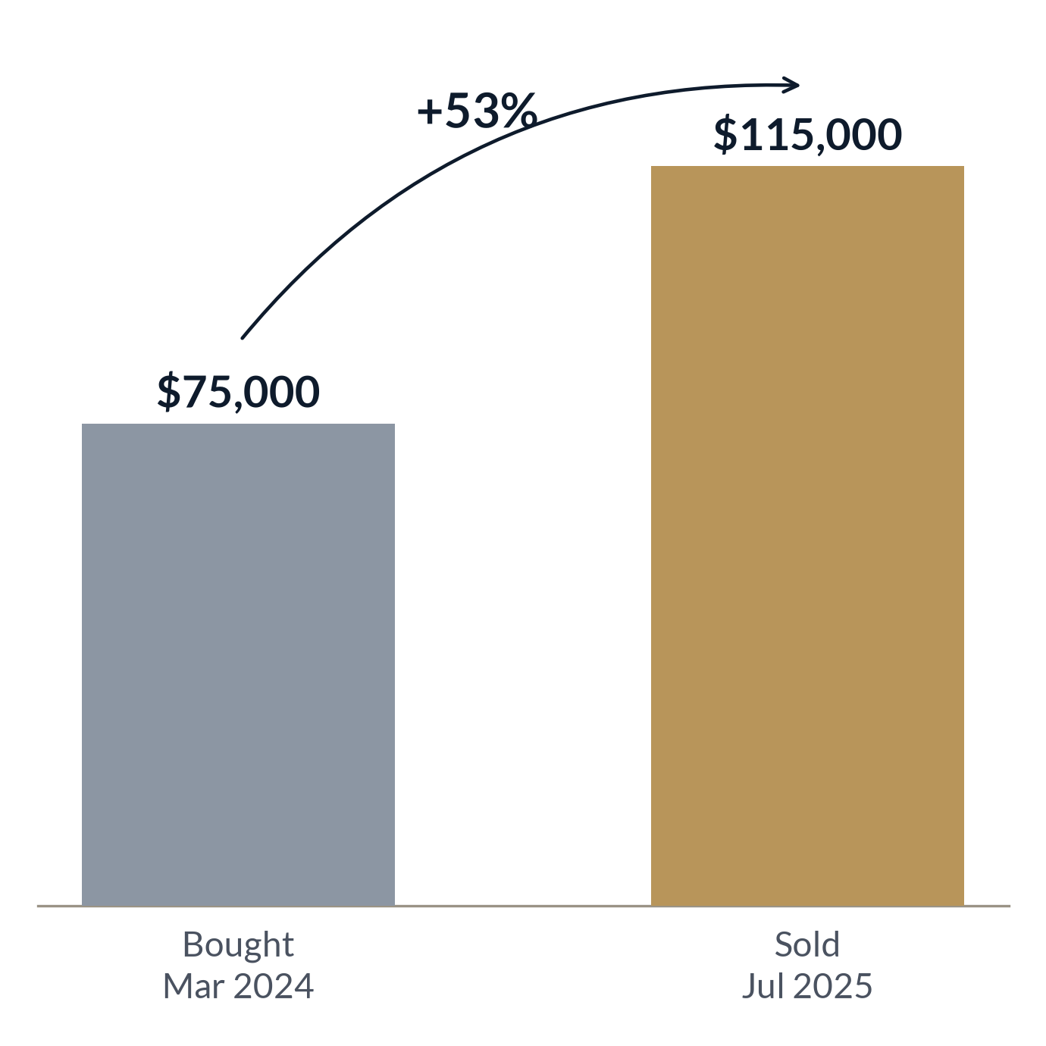
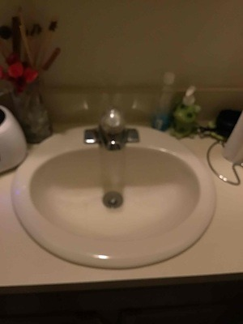
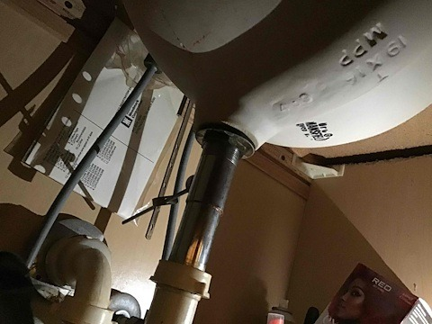
01 · DEAL SNAPSHOT
SHRI PROPERTIES
One house in Cleveland, Ohio.
A single-family home, bought in March 2024 and sold in July 2025.
ADDRESS
4081 East 64th Street, Cleveland, OH 44105
PARCEL
132-24-100
TYPE
Single-family home
OWNER
Shri Properties (title held through S2 LLC, a California LLC)
BOUGHT FROM
Invest L.A.D. LLC (Michigan)
Purchase vs sale price, Mar 2024 to Jul 2025. Grey = paid, gold = sold. Source: settlement statements.
MANAGED BY
B2B Realty
INSIDE THE HOME · BATHROOM, JUL 2024
TITLE AT PURCHASE
Chicago Title Company / Woodland Title Agency
Job photos by Sal's Heating & Cooling.
TITLE AT SALE
Infinity Title Agency
LISTING AGENT (SALE)
Coldwell Banker Schmidt Realty
SELLING AGENT (SALE)
HomeSmart Real Estate Momentum
BEFORE
AFTER
Presented by Shri Properties
Analysis of a completed deal. Not financial advice.
03

Slide 4
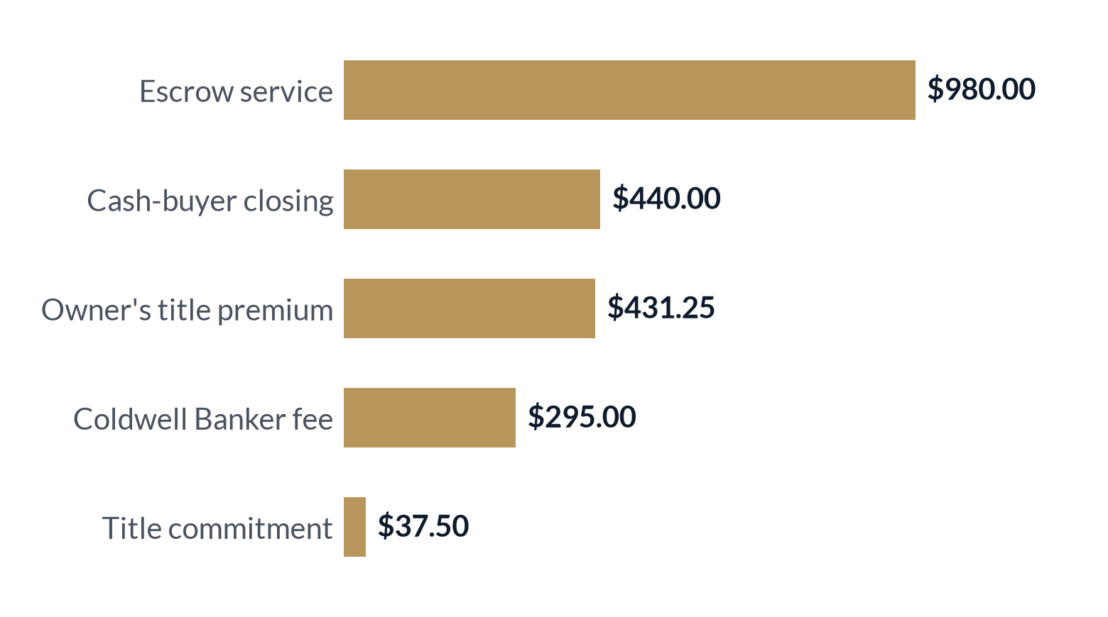
02 · THE NUMBERS
SHRI PROPERTIES
Bought for $75,000. All cash, no loan.
Closed 1 March 2024; deed recorded 13 March 2024.
Earnest money
$1,000.00
BUYER CLOSING LINES
6 Feb 2024
Balance at closing
$73,184.18
1 Mar 2024
TOTAL CASH INVESTED
$74,184.18
Why cash in was below the price: closing credits exceeded the buyer's fees by $815.82, so the total paid was $815.82 less than $75,000.
Buyer-side fee lines at purchase, in US dollars (these were more than covered by closing credits). Period: closing, 1 Mar 2024. Source: purchase settlement statement.
Presented by Shri Properties
Analysis of a completed deal. Not financial advice.
04

Slide 5
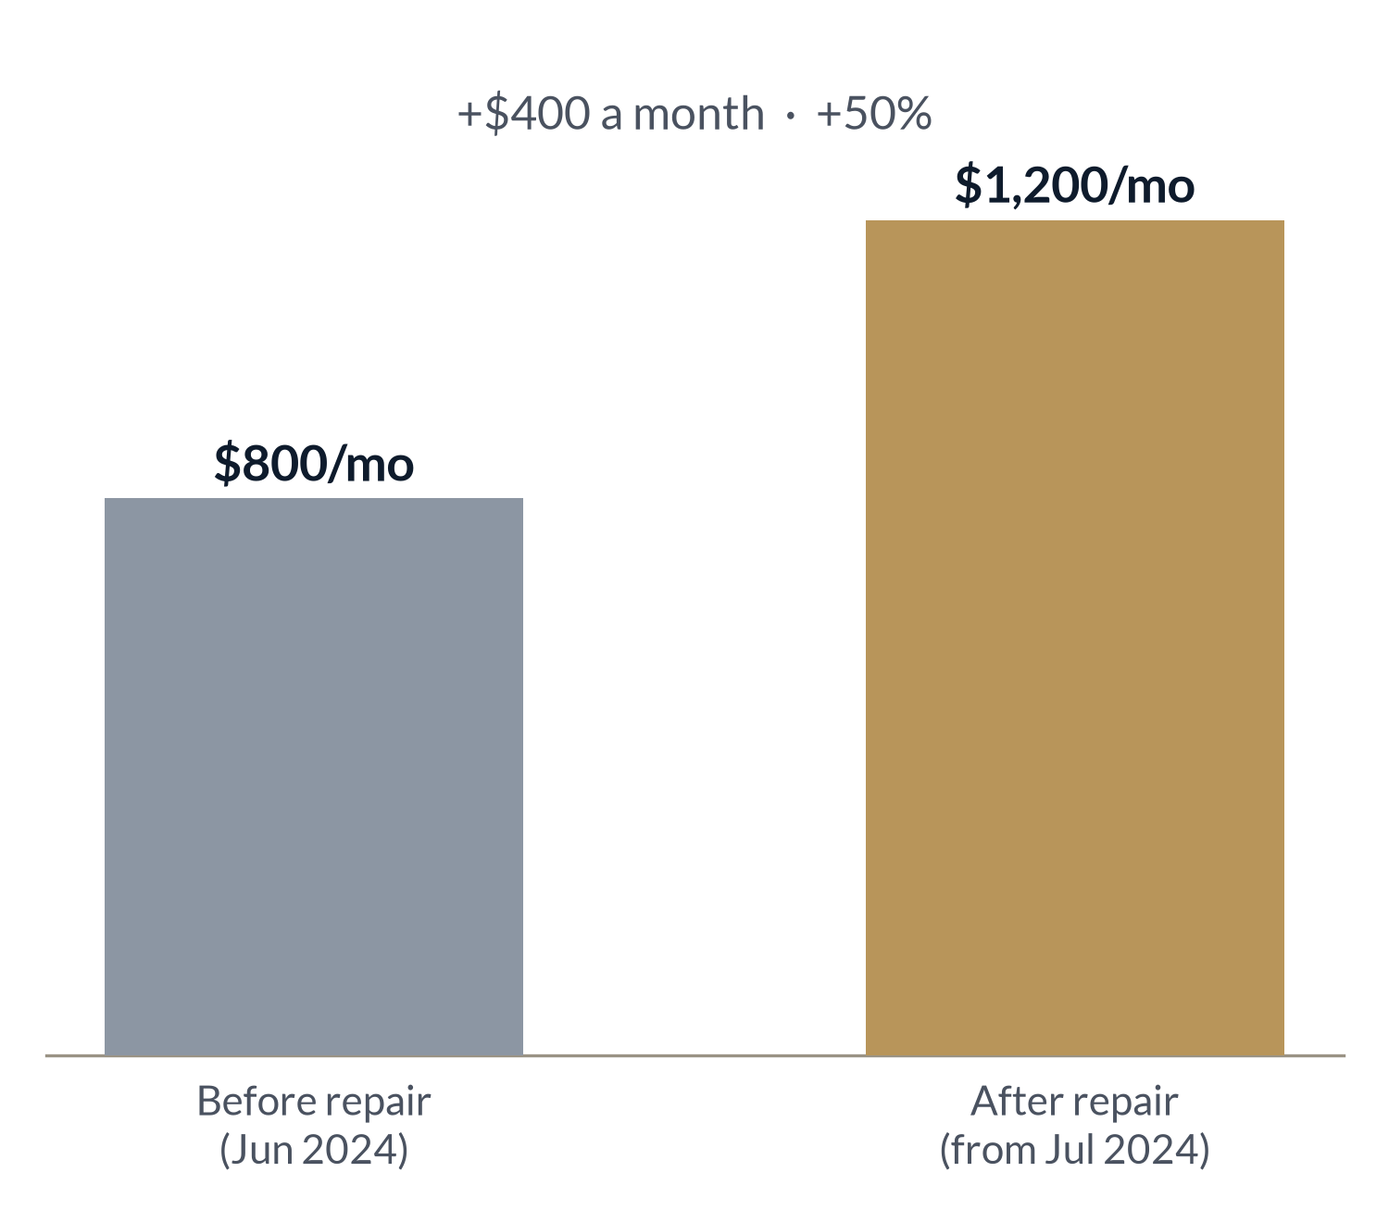
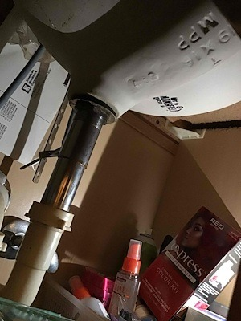
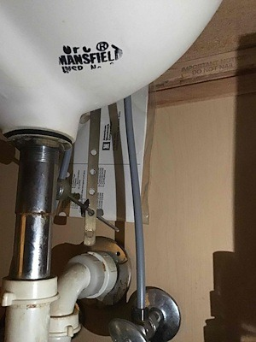
02 · THE NUMBERS
SHRI PROPERTIES
A $906 repair lifted rent by 50%.
One bathroom fix, done right before the new lease, moved rent from $800 to $1,200 a month.
BEFORE
AFTER
Contractor's job photos, July 2024: old drop-in sink, faucet and under-sink plumbing before; new sink drain and fittings after. Source: Sal's Heating & Cooling job report (Job 133748064).
The work New bathroom sink and Moen chrome faucet; countertop trimmed to fit. By Sal's Heating & Cooling, Plumbing & Sewer. Estimate dated 9 Jul 2024.
The cost $839.00 + $67.12 tax = $906.12 — the only maintenance ever paid.
PAYBACK
2.3 months
Monthly rent before vs after the repair. Period: Jun 2024 vs Jul 2024 onward. Grey = before, gold = after. Source: bank-recorded rent, net of agent fees.
$906.12 ÷ $400 extra rent a month
Presented by Shri Properties
Analysis of a completed deal. Not financial advice.
05

Slide 6
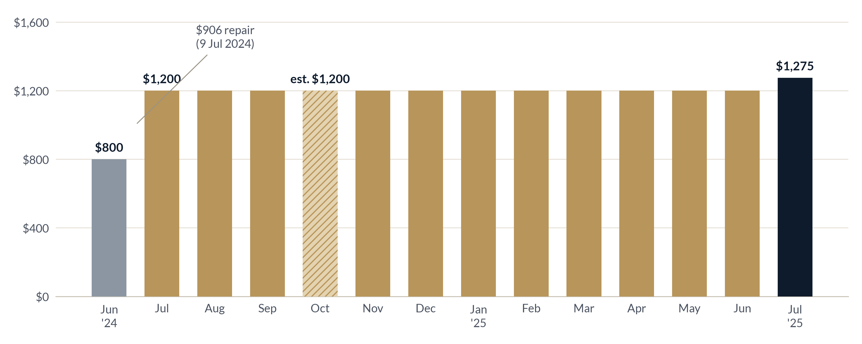
02 · THE NUMBERS
SHRI PROPERTIES
Fourteen months of rent: $16,475.
Every month from June 2024 to July 2025 was paid, after B2B Realty's fees were taken out.
$800
$1,200
$1,275
$16,475
first month, Jun 2024
a month, Jul 2024 – Jun 2025
final month, Jul 2025
total rent received
READING THE CHART
Pre-repair month ($800)
$1,200 lease, bank-recorded
Oct 2024 — estimated fill-in
Final month ($1,275)
Monthly rent received, net of agent fees. Period: Jun 2024 – Jul 2025. Source: bank records.
Presented by Shri Properties
Analysis of a completed deal. Not financial advice.
06

Slide 7
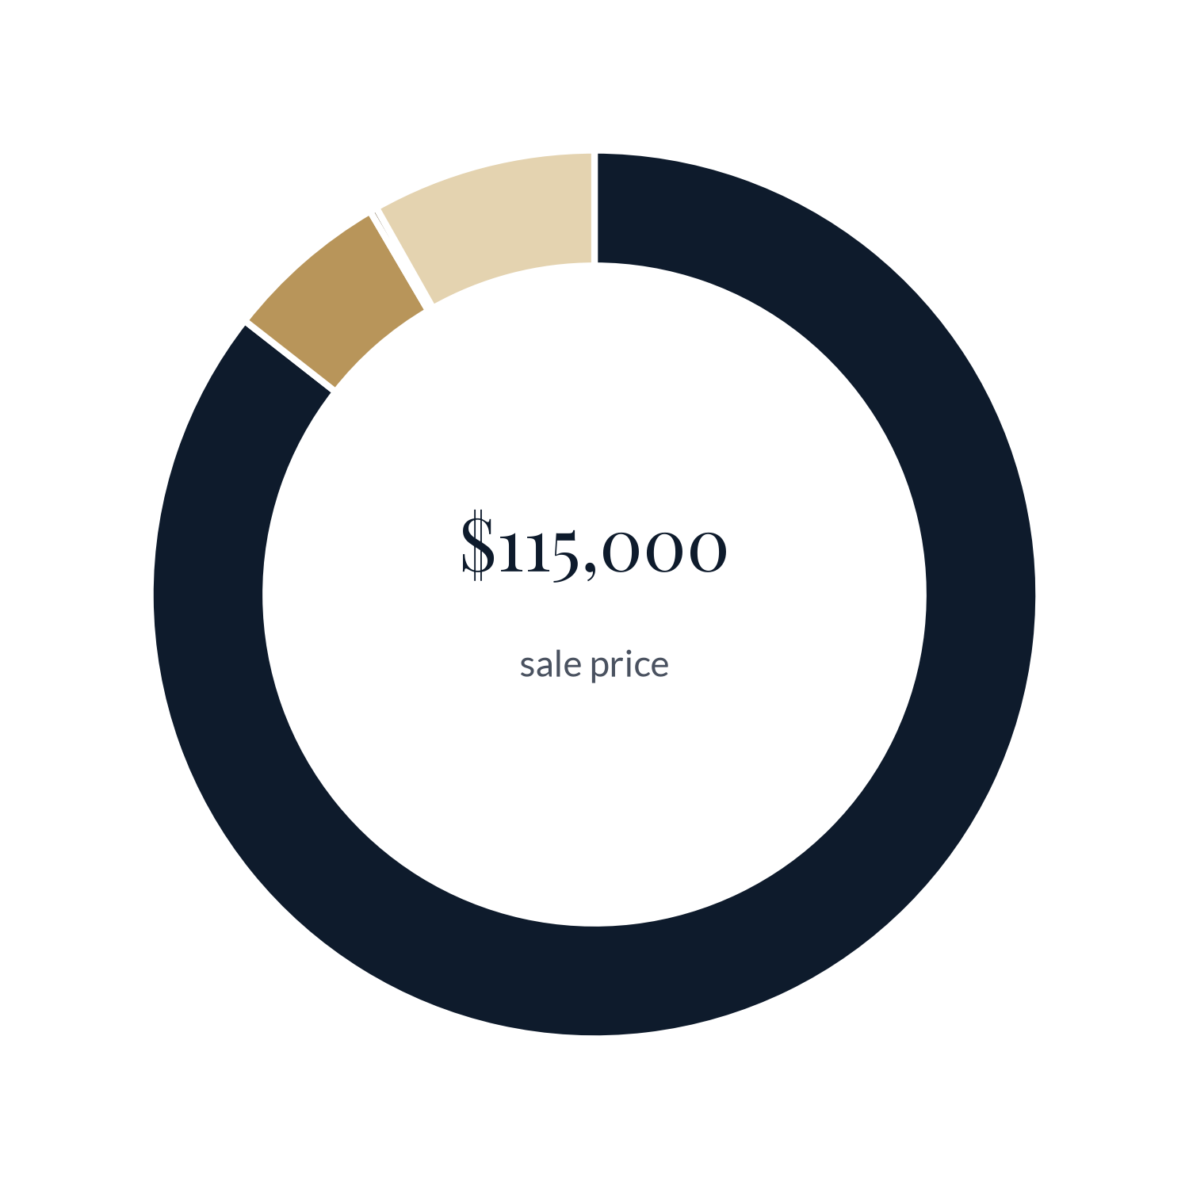
02 · THE NUMBERS
SHRI PROPERTIES
Sold for $115,000 on 11 July 2025.
After agents, title and other closing costs, $98,405.10 came back to the owner.
Sale price
$115,000.00
Net to owner
$98,405.10 · 85.6%
Commission — Coldwell Banker Schmidt
−$3,450.00
Agent commissions
Commission — HomeSmart
−$3,450.00
$6,900.00 · 6.0%
Broker fee
Broker fee
−$295.00
$295.00 · 0.3%
Title & other seller debits
−$9,399.90
Title & other seller debits
Total sale costs
−$16,594.90
$9,399.90 · 8.2%
Net wire received, 15 Jul 2025
$95,474.02
County tax refund (double payment, H1 2024)
$2,931.08
Where the $115,000 sale price went. Period: sale closing, Jul 2025. Navy = net to owner (incl. $2,931.08 county tax refund); gold shades = costs. Source: sale settlement statement and bank records.
Total sale money received
$98,405.10
Presented by Shri Properties
Analysis of a completed deal. Not financial advice.
07

Slide 8
03 · THE RETURNS
SHRI PROPERTIES
The returns.
All cash, no loan, held for 1.36 years.
NET PROFIT
49.8%
34.6%
16.1%
$36,942.78
TOTAL RETURN
A YEAR
GROSS YIELD
profit ÷ cash invested
annualised over the hold
yearly rent ÷ price
= $98,405.10 sale money received
+ $12,721.86 net rent (after tax and repair)
− $74,184.18 cash invested
13.5%
13.5%
$78,057
Price gain $75k → $115k, +53%
Gain on price $23,405.10 net
Hold 1.36 years (about 16 months)
NET YIELD
CASH-ON-CASH
BREAK-EVEN SALE
after tax, on cash invested
all cash, so equal to net yield
price needed to not lose money
Presented by Shri Properties
Analysis of a completed deal. Not financial advice.
08

Slide 9
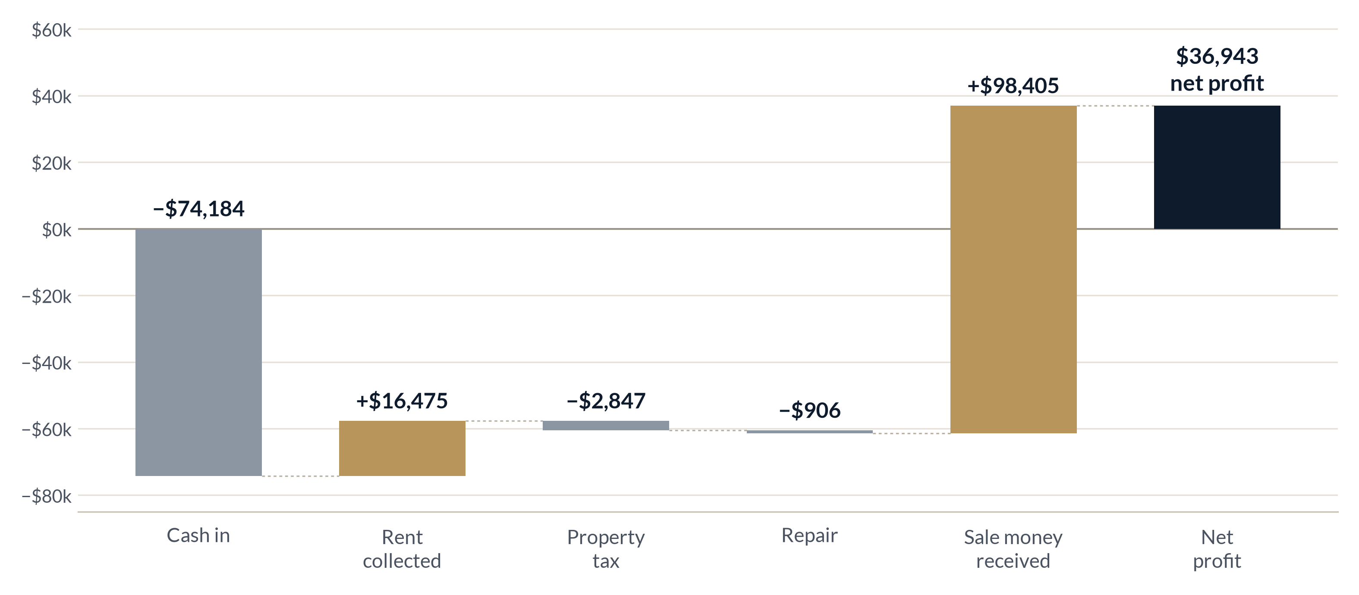
03 · THE RETURNS
SHRI PROPERTIES
Where the profit came from.
Start with the cash put in, add rent, take off tax and the repair, add the sale money.
IN ONE LINE
Every $1 put in came back as about $1.50 in 16 months.
Money out
Money in
Net profit
Cumulative cash, Feb 2024 – Jul 2025, US dollars. Source: settlement statements and bank records.
Presented by Shri Properties
Analysis of a completed deal. Not financial advice.
09

Slide 10
04 · THE TIMELINE
SHRI PROPERTIES
Sixteen months, start to finish.
From earnest money to cash in the bank: 6 February 2024 to 15 July 2025.
6 FEB 2024
1 MAR 2024
JUN 2024
9 JUL 2024
JUN 2025
11 JUL 2025
15 JUL 2025
Earnest money
Purchase closed
First rent
$906 repair
12 months at $1,200
Sale closed
Cash in bank
$1,000 down
$75,000 · deed 13 Mar
$800, net of fees
Rent moves to $1,200
Oct 2024 estimated
$115,000 · July rent $1,275
$95,474.02 net wire
TO SCALE — MONTH BY MONTH
Owned
1 Mar 2024 – 11 Jul 2025 · 1.36 years
Rented
Jun 2024 – Jul 2025 · 14 months
At $1,200 +
Jul 2024 – Jul 2025 · after repair
Source: deeds, settlement statements, bank records.
Feb 24
May 24
Aug 24
Nov 24
Feb 25
May 25
Aug 25
Presented by Shri Properties
Analysis of a completed deal. Not financial advice.
10

Slide 11
05 · WHAT'S NEXT
SHRI PROPERTIES
Lessons, turned into a playbook we repeat.
Five moves from this deal that we now run on every home.
01
02
03
04
05
Buy below value, in cash
Fix what holds the rent back
Manage on the ground
Check every bill
Sell into strength
$75,000 price; $74,184 cash in after credits.
One $906 repair lifted rent by $400 a month.
Our US team and B2B Realty ran the home; fees came out before rent was paid.
A double property-tax payment was spotted and refunded.
Sold at $115,000 in 16 months, well above the $78,057 break-even.
$75k
+50%
14 / 14
$2,931
+53%
“14 / 14” = months of rent received out of months rented (Oct 2024 estimated).
Presented by Shri Properties
Analysis of a completed deal. Not financial advice.
11

Slide 12
05 · WHAT'S NEXT
SHRI PROPERTIES
Next: one map for five landlord-friendly states.
A deal-mapping tool to find and screen homes like this one — with our returns calculator built in as a plugin.
OH
MS
AL
OK
IN
OHIO
MISSISSIPPI
ALABAMA
OKLAHOMA
HOOSIER STATE
Proven by this deal
Mapped in the tool
Mapped in the tool
Mapped in the tool
Mapped in the tool
RUN THE NUMBERS YOURSELF
THIS DEAL, IN THE CALCULATOR
sidatreya.github.io/returns-calculator
Buy $75,000 · Sell $115,000
Rent $1,200 a month · Tax $2,092.32 a year
Hold 1.36 years
Enter a price, rent, taxes and hold time; see profit, yield and yearly return in seconds. The same tool plugs into the deal map.
Presented by Shri Properties
Analysis of a completed deal. Not financial advice.
12

