Slide 1


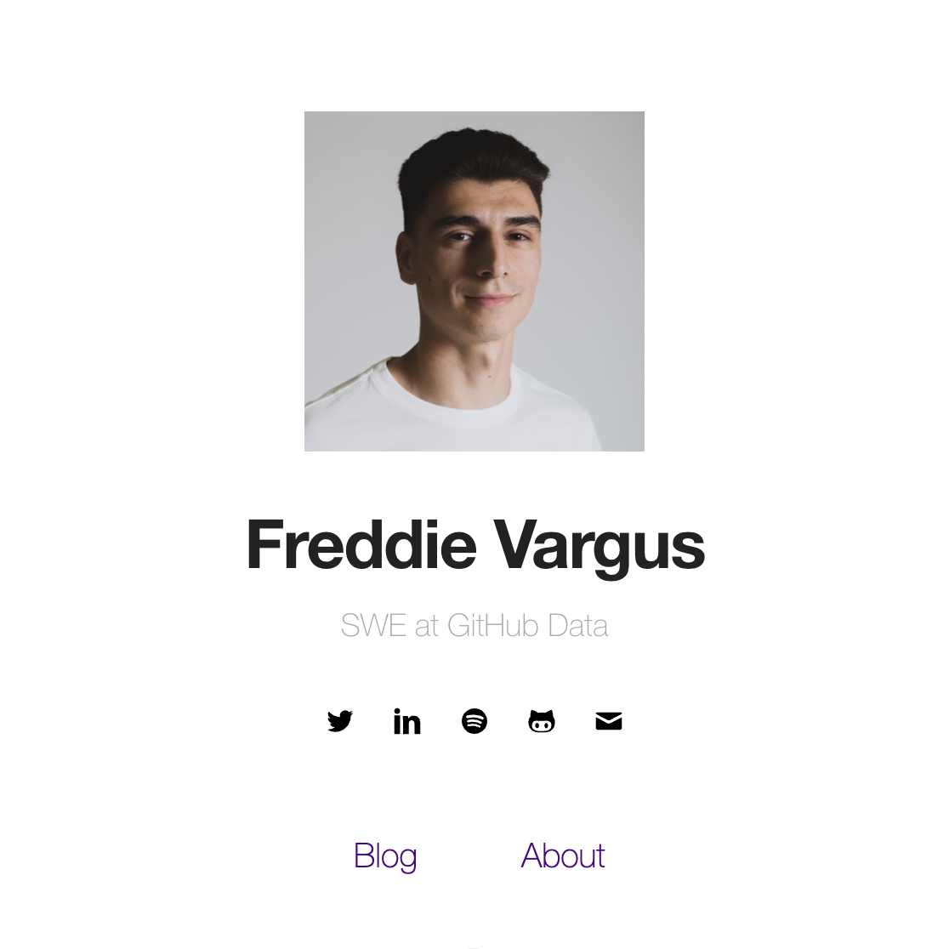
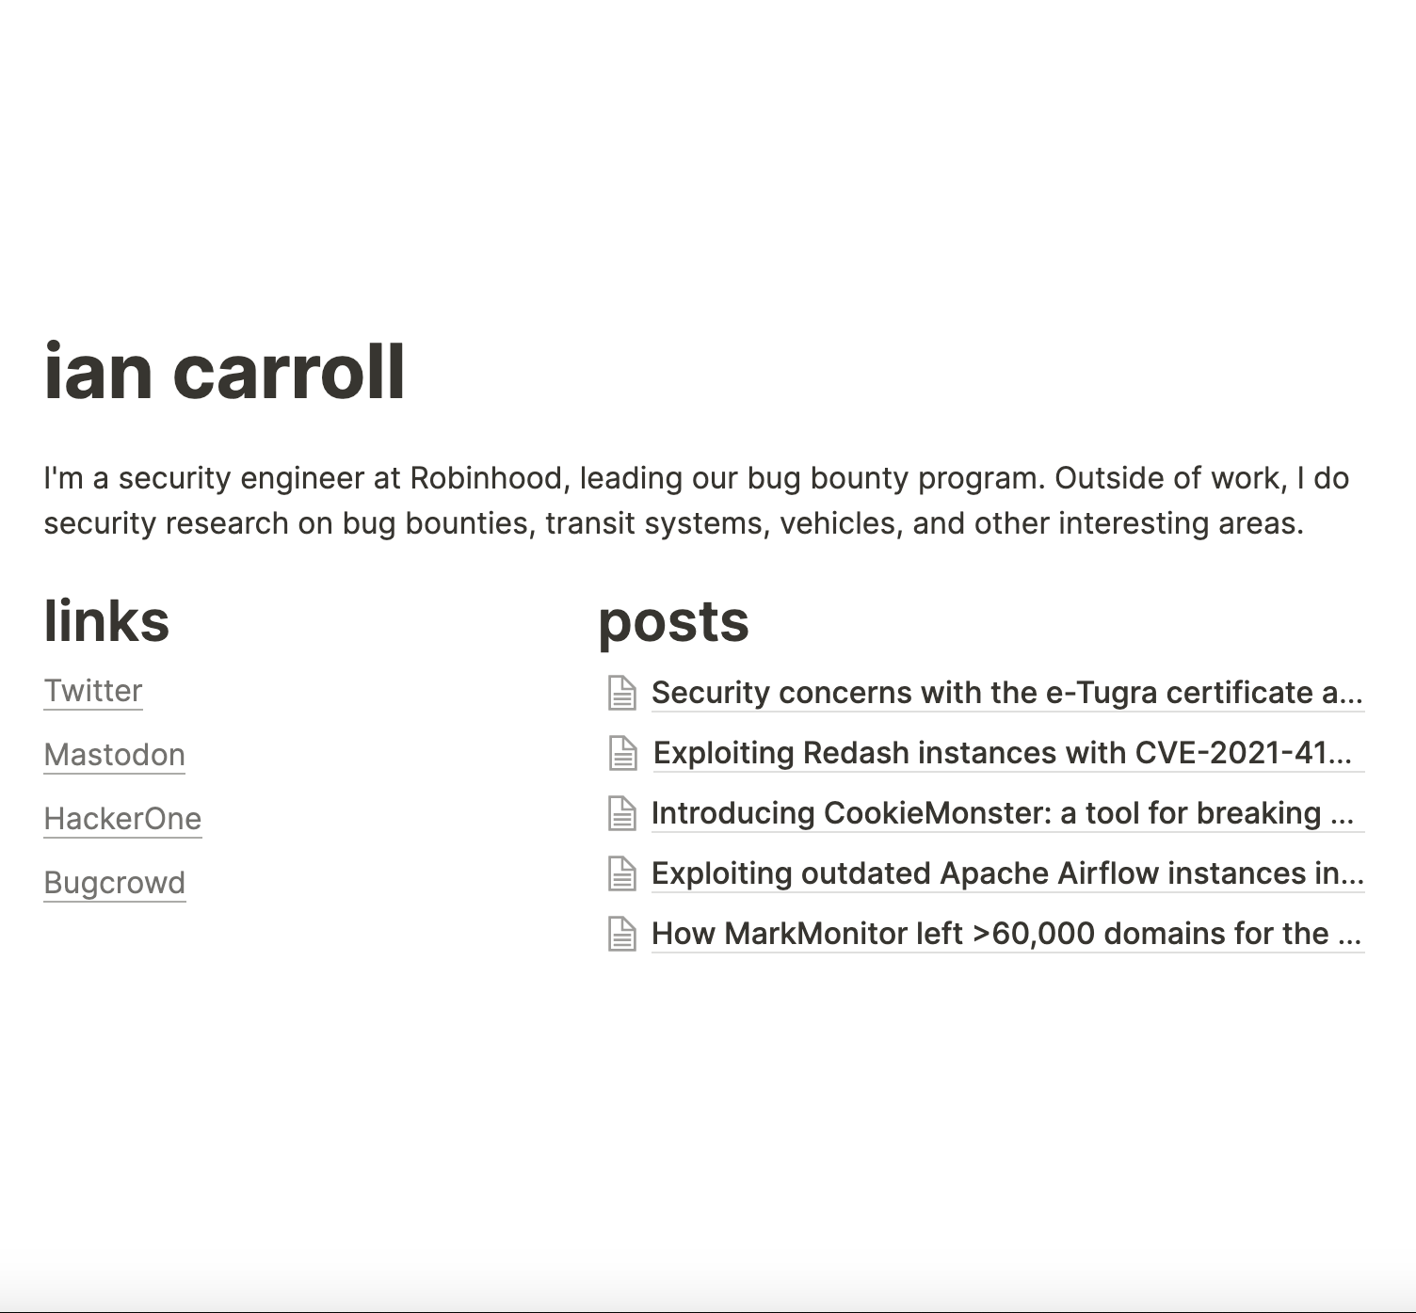
sidbh.me
sidbh.me is a personal portfolio website for myself that aims to provide a platform for myself to post career updates as well as showcasing some of my hobbies.
sidbh.me provides me a simple and elegant space on the web to advance my career. I can utilize it to post my portfolio to my needs and specifications, and it allows me to easily modify, as needed. The customizability of a personal portfolio site such as sidbh.me is not offered by traditional professional profile sites, where every profile differs only by the text on the page. With this website, I can create a minimalist design of my own taste to show off my portfolio.
Potential Employers
Recruiters or hiring managers at companies I apply to.
Hobbyists
People looking for insight on what I’m working on.
Friends or Family
People who are interested in what I’ve been up to.
Link
Link

