Slide 1



SMART INDIA HACKATHON 2026
TITLE PAGE
Problem Statement ID – SIH26160
Problem Statement Title – AI-Powered IPsec VPN Protocol Analyzer and Security Assessment Framework
Theme – Blockchain & Cybersecurity
PS Category – Software
Team ID – [TEAM ID]
Team Name – Cache me if u can
Notes:
Hi, we are team Cache me if u can. Our problem statement is SIH26160 from NTRO: an AI-powered IPsec VPN protocol analyzer and security assessment framework. Our idea is called SecurIQ.

Slide 2









SecurIQ
The problem: analysts get VPN captures they cannot decrypt, so IKE is checked by hand and the encrypted ESP part stays a black box.
Proposed Solution / Approach
SecurIQ end-to-end workflow
Start
Mark as “not observable”
Protocol identification: we read the IKE handshake (it is sent in plain text) to get the IKE version, algorithms, DH group and vendor. Each value comes with a confidence score.
Works without keys: ESP packets are encrypted, so we study their sizes. The padding pattern gives the cipher family, and message sizes show if PFS is on.
Traffic type inside the tunnel: the ML model reads packet sizes and timings in 10-second windows and names the app (web, video, VoIP, file, email, chat, ping) with its reasons.
Explainable security score: 8 RFC / NIST / CNSA checks; each finding is traced packet → parameter → rule → risk → fix, on a 5×5 threat matrix.
Fix it, then prove it: a what-if simulator re-scores a proposed config, and a digital-twin lab rebuilds and re-measures it (39.5 → 95.0).
Investigate the whole fleet: triage inbox, link graph, drift and golden-policy checks across captures; live alerts in about 3 s.
Capture traffic
PCAP file or live tap
No
Live alert
dashboard, ~3 s
Confident
enough?
Check & decode
file type, size, headers
Collect evidence
mode, auth, lifetime
Yes
Save value
with confidence + proof
Yes
Critical or
high?
Read IKE handshake
algorithms, DH, vendor
ML model
traffic type inside
Score & threats
8 checks, 5×5 matrix
Group ESP flows
pair SAs, 10 s windows
Study ESP sizes
cipher family, ICV, PFS
No
Same flow for an uploaded file and a live stream
End
Reports
HTML / PDF / JSON
Innovation and Uniqueness
How we compare with existing tools
No keys needed
Explains every finding
Wireshark
ike-scan
nDPI
SecurIQ
We only read captured packets. Nothing is decrypted and the VPN is not touched.
Packet → parameter → rule → risk → fix. Unknowns are marked “not observable”.
Works without keys
Passive (sends no packets)
Finds traffic type inside ESP
Works on noisy networks
Fix it, then prove it
Scores risk and tests fixes
Trained with jitter and loss: 90.1% vs 64.9% for a normal model.
What-if simulator + digital-twin lab: the weak VPN went 39.5 → 95.0, measured.
✓ yes – partly (Wireshark needs keys to open ESP) ✗ no
SMART INDIA HACKATHON 2026
2
Notes:
SecurIQ looks at captured VPN traffic and tells how the VPN is set up and how safe it is, without needing the keys. IKE is plain text, so we read it directly. ESP is encrypted, so we use packet sizes and timings, and an ML model finds the traffic type inside. Wireshark can read IKE but needs the SA keys to open ESP, ike-scan has to send packets to the gateway, and nDPI only labels the flow as IPsec.

Slide 3
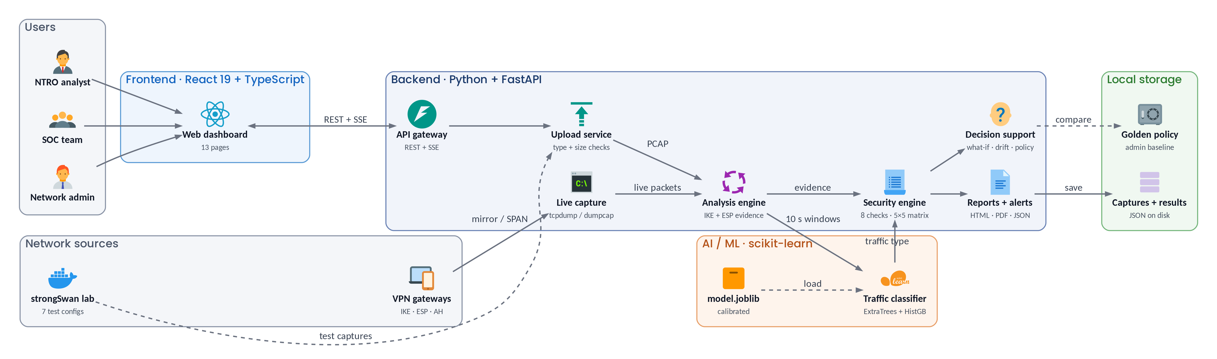
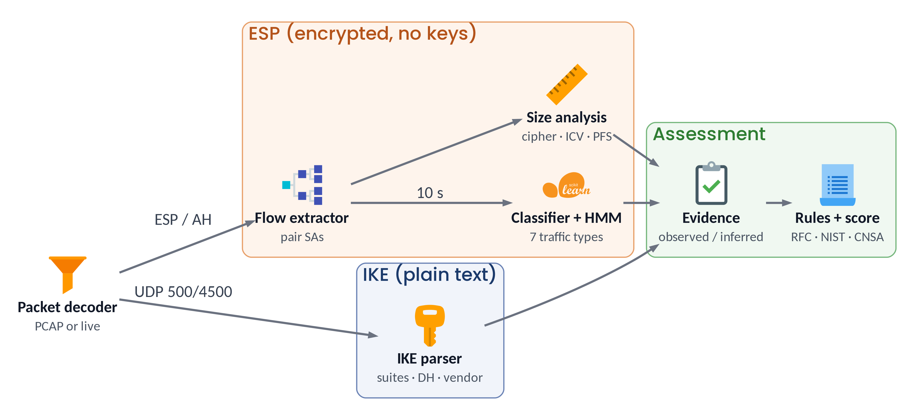










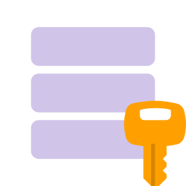


TECHNICAL APPROACH
System design of SecurIQ: runs on one laptop or an on-prem server, fully offline
1 · System architecture
16 pages
2 · Inside the analysis engine
3 · Why we designed it this way
4 · Tech stack
Passive + keyless: plugs into any mirror port without touching the VPN.
Tree ensemble, not deep learning: explainable, fast on CPU, fits our data size.
Same feature code for training and live, so live = final report.
Rules + ML, no LLM: every finding cites its RFC / NIST rule; rule updates need no retraining.
SSE for live events: one-way push that reconnects by itself.
Local JSON storage: works air-gapped and is easy to audit.
Python
FastAPI
React 19
TypeScript
Vite
scikit-learn
NumPy
Scapy
Jinja2
Docker
strongSwan
tcpdump
pytest
GitHub
SMART INDIA HACKATHON 2026
3
Notes:
Diagram 1 is our full architecture: users work in the React dashboard, the FastAPI backend takes uploads or live mirrored packets, the analysis engine builds evidence, the ML classifier returns the traffic type, and the security engine scores it and makes reports. Diagram 2 shows how IKE (plain text) and ESP (encrypted) are handled separately and merged into one evidence profile. On the right are the reasons behind our main design choices and the tools we use.

Slide 4



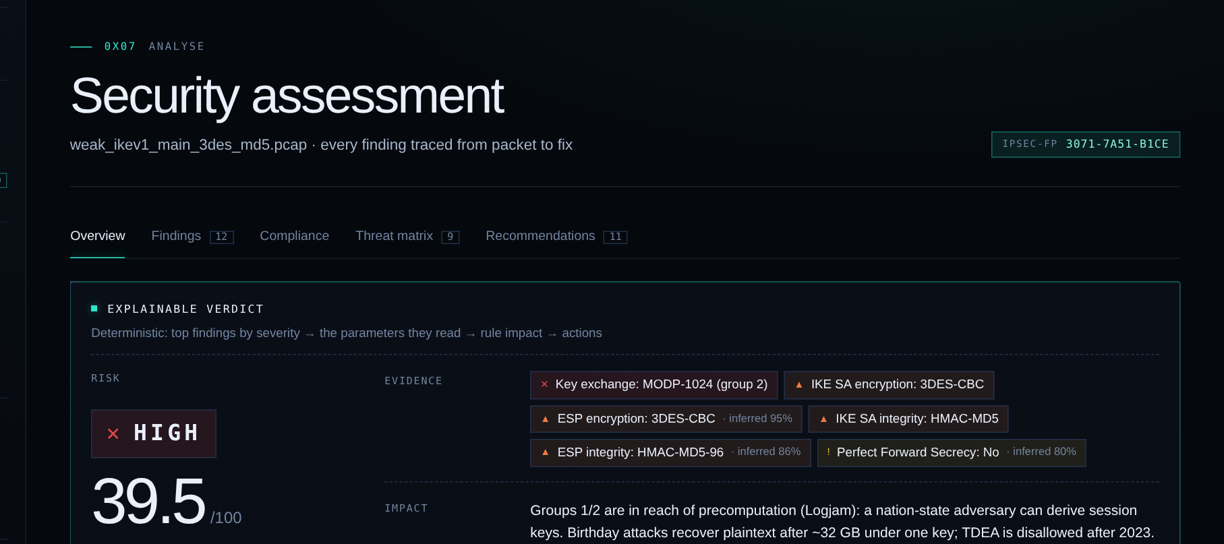
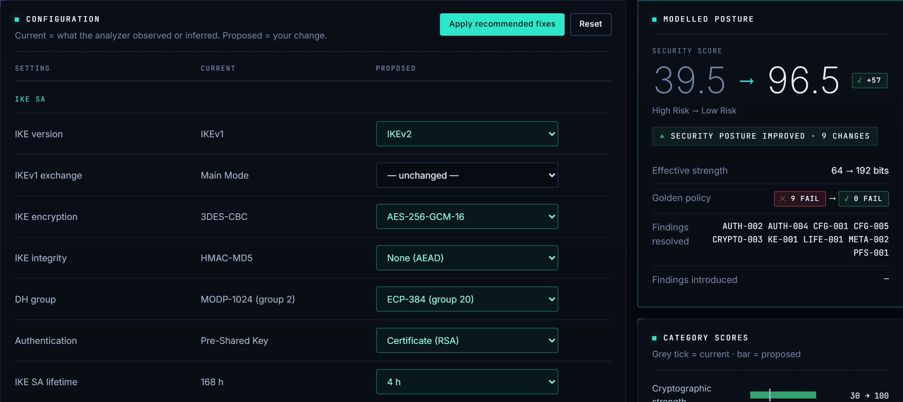
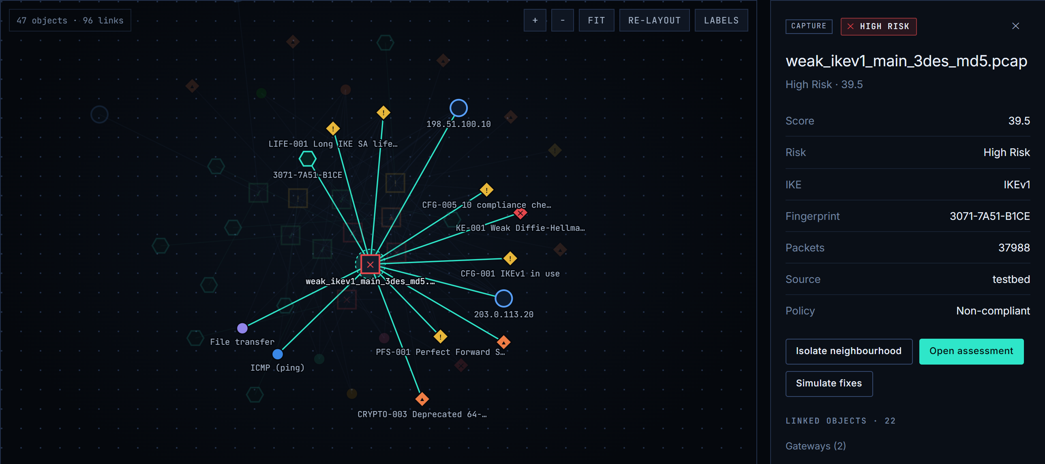
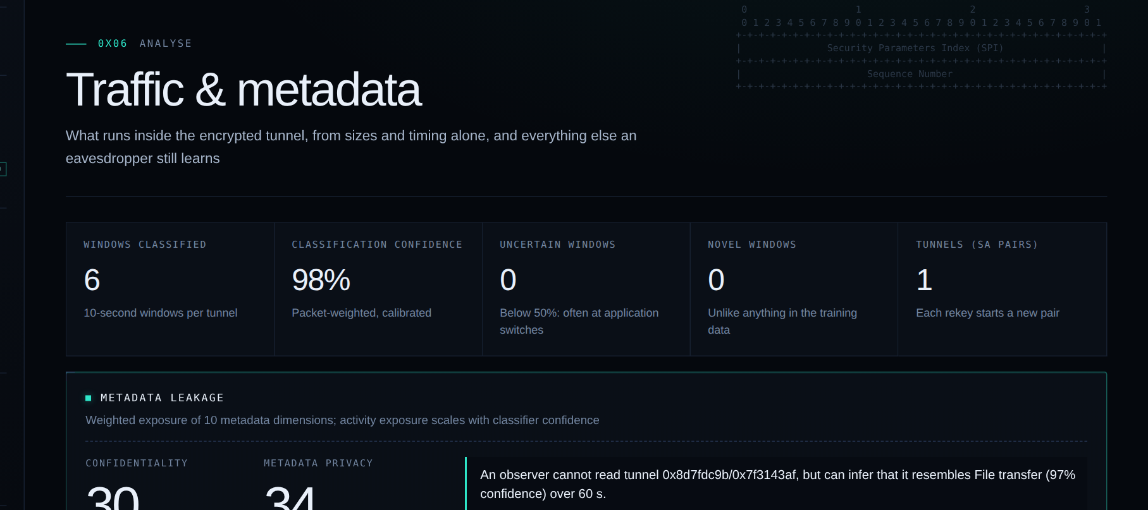



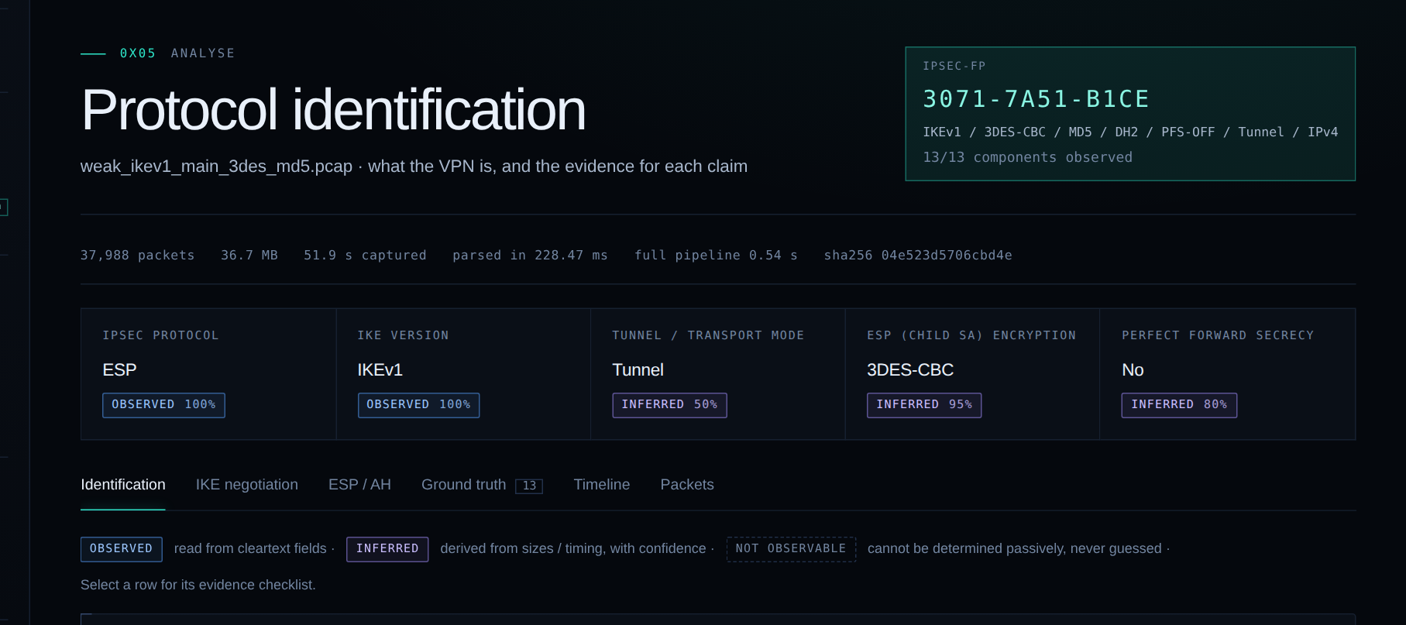
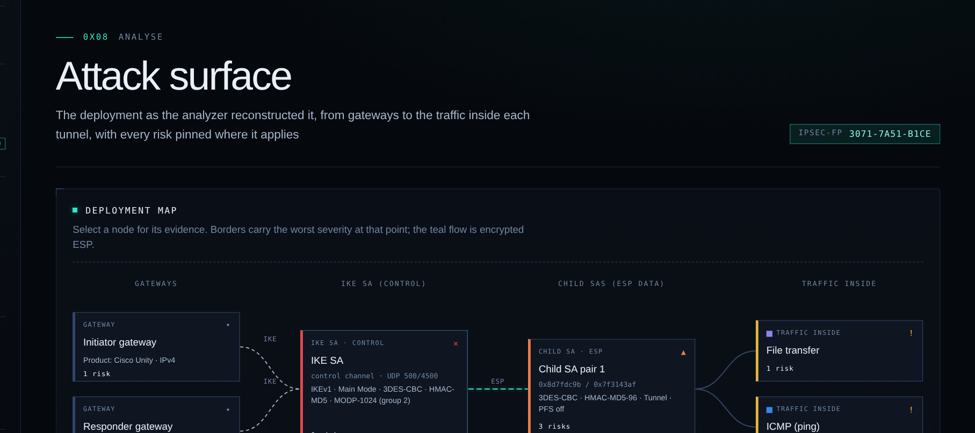
FEASIBILITY AND VIABILITY
Feasibility
Viability
Practical Implementation
Working prototype: 16-page dashboard, full pipeline, 135 backend tests + 35 browser checks passing.
Free, open-source tools: runs offline on a normal laptop.
Fast: 35K–53K packets/s on one core; a 37,988-packet capture in 0.54 s.
Accurate: 100% on protocol fields it decided; 176/176 injected misconfigurations caught.
Mirror port: plugs in with no VPN changes and no keys shared.
Public standards: rules from RFC, NIST and CNSA, so any vendor works.
One tool: offline checks and live monitoring.
No licence cost: gets faster with more CPU cores.
Lab: run our strongSwan lab and tune on real gateway traffic.
Pilot: trial on a mirror port at one site.
Rollout: Docker / VM package for the SOC, works offline.
Integration: REST API + JSON export for SIEM tools.
Our working prototype real screenshots from the SecurIQ dashboard (weak IKEv1 + 3DES test capture)
Security assessment: weak VPN scored 39.5/100 (High), every finding with its evidence.
What-if simulator: recommended fixes lift the weak VPN 39.5 → 96.5; the rebuilt capture measured 95.0.
Link graph: captures, gateways, configs and findings linked; the weak capture in focus.
Traffic & metadata: traffic inside ESP classified at 98% confidence, no keys.
01
IKEv2 hides ESP settings: ESP algorithms and PFS travel inside encrypted messages.
We infer them from packet sizes with a confidence, else say “not observable”.
01
02
Lab data is cleaner than real data: our training captures are neater than real networks.
We add jitter, loss and extra flows in training and will test on real strongSwan traffic.
02
Potential Challenges and Risks
03
Many apps in one tunnel: one SA can carry web, video and chat together.
We label 10-second windows, smooth them with an HMM, allow “uncertain”.
03
Strategies for Overcoming Challenges
04
Capture permissions: live sniffing needs admin rights or Npcap.
Uploading or replaying a PCAP needs no special rights; live mode uses tcpdump.
04
05
Sensitive traffic: government VPN captures cannot leave the building.
Everything runs locally; uploads are checked and nothing goes online.
05
SMART INDIA HACKATHON 2026
4
Notes:
We already have a working prototype: these four screenshots are from our own dashboard running on a weak IKEv1/3DES test capture. It scored 39.5/100 with every finding explained, and a 37,988-packet capture is analysed in about half a second. The main risks are on the bottom left, with our fix for each on the right.

Slide 5





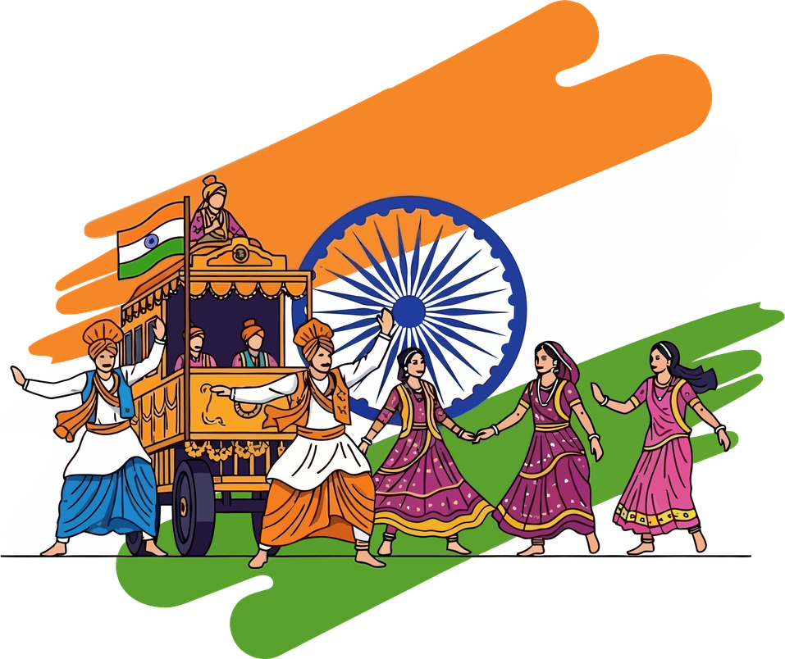



IMPACT AND BENEFITS
NTRO analysts: get the full VPN setup from one capture, with proof for each value.
Benefits of the solution
Finds weak crypto (3DES, MD5, DH group 2), ESP-NULL and leaked IKEv1 identities. Our weak test VPN scored 39.5/100; its verified fix scored 95.0.
CERT-In & SOC teams
Network admins
Security
Alerts for weak crypto, missing PFS and replays, triaged in one shared inbox.
See what is wrong in their VPN config, and test the fix in a what-if simulator first.
Potential Impact on Targeted Audience
A 37,988-packet capture is fully analysed in 0.54 s. Work that takes hours by hand in Wireshark becomes one automatic report.
Nation
Students & researchers
An Indian-made tool for checking VPNs, with no foreign dependency.
Use our labelled IPsec dataset and test lab to learn and experiment.
Economic
Critical infrastructure: check VPNs across sites without sharing any keys.
An offline, made-in-India tool for national cyber security, with no paid foreign software or cloud.
Supports: SDG 9 (resilient infrastructure) · SDG 16 (strong institutions) · Atmanirbhar Bharat · Digital India
Next: WireGuard + OpenVPN support · multi-site SOC view · SIEM export (STIX / JSON)
National
SMART INDIA HACKATHON 2026
5
Notes:
Our main users are NTRO analysts, CERT-In and SOC teams and network admins. The biggest benefits: we catch weak crypto and identity leaks early, we save hours of manual Wireshark work, and it is an offline Indian tool. It also fits SDG 9, SDG 16, Atmanirbhar Bharat and Digital India.

Slide 6
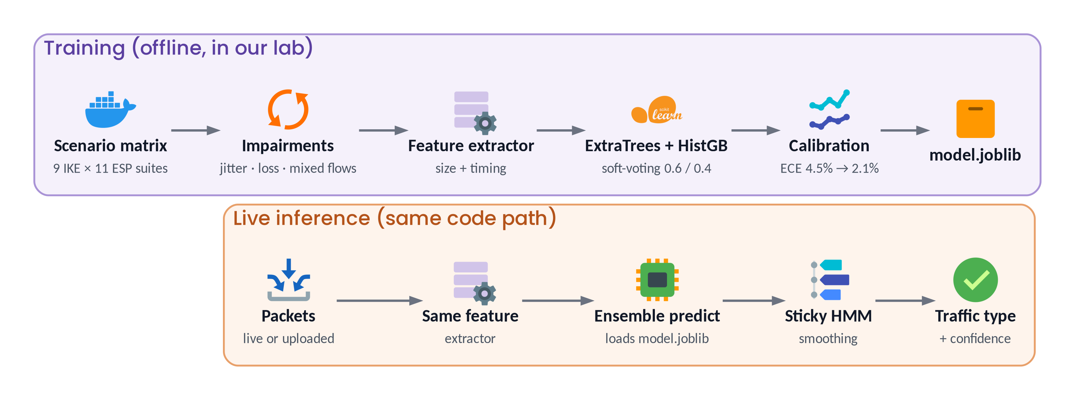
RESEARCH AND REFERENCES
Field & Applied Research: how we trained and tested the model
Traffic accuracy: normal model vs ours
Benchmark: 176/176 weaknesses caught, 0 false alarms on 22 clean captures. Next: real strongSwan gateways.
Academic & Industry Sources
links are clickable in the slideshow
IETF RFC
2014
IETF RFC
2005
IETF RFC
2017–23
NIST GUIDE
2020
RFC 7296: Internet Key Exchange v2 (IKEv2)
RFC 4303: IP Encapsulating Security Payload (ESP)
RFC 8221, 8247, 9395: algorithm rules and IKEv1 deprecation
SP 800-77 Rev. 1: Guide to IPsec VPNs
Kaufman, Hoffman, Nir, Eronen, Kivinen
S. Kent
IETF IPsecME working group
NIST Computer Security Resource Center
rfc-editor.org/rfc/rfc7296
rfc-editor.org/rfc/rfc4303
rfc-editor.org/rfc/rfc9395
csrc.nist.gov/pubs/sp/800/77/r1/final
RESEARCH PAPER
2016
RESEARCH PAPER
2006
RESEARCH PAPER
2017
TOOLS
online
Characterization of Encrypted and VPN Traffic using Time-related Features
Extremely Randomized Trees
On Calibration of Modern Neural Networks
MITRE ATT&CK, strongSwan + tools we compared
Draper-Gil et al., ICISSP (ISCX VPN dataset)
Geurts, Ernst & Wehenkel, Machine Learning 63(1)
Guo, Pleiss, Sun & Weinberger, ICML
compared: Wireshark · ike-scan · nDPI
unb.ca/cic/datasets/vpn.html
doi.org/10.1007/s10994-006-6226-1
arxiv.org/abs/1706.04599
attack.mitre.org · strongswan.org
SMART INDIA HACKATHON 2026
6
Notes:
We built our own test lab, found and fixed 11 protocol mistakes in our first version, and stress-tested the model. On noisy traffic a normal model drops to 64.9%, ours stays at 90.1%. Our main references are the IPsec RFCs, NIST SP 800-77 and three ML papers, and we compared against Wireshark, ike-scan and nDPI.

