Slide 1
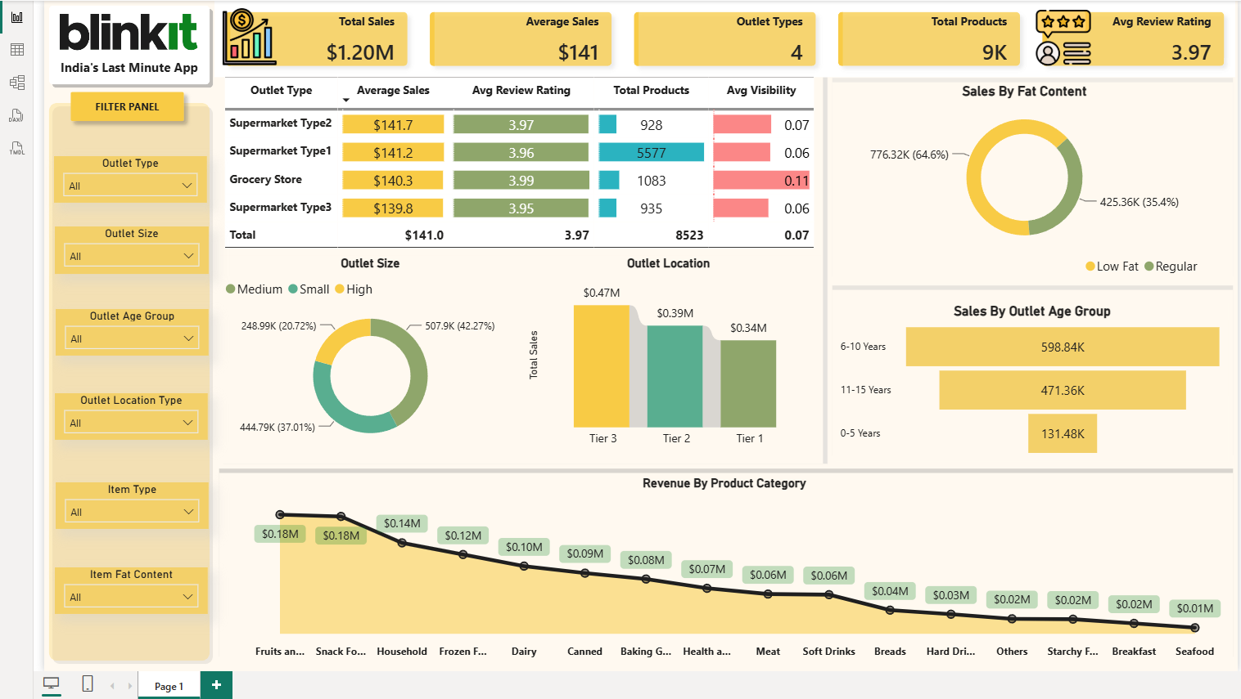
Blinkit Sales Analysis
End-to-End Data Analytics Project
Python • PostgreSQL • Power BI

Slide 2
Project Overview
Objective:
Analyze Blinkit grocery sales to identify sales trends, outlet performance and customer preferences.
Workflow:
• Data Cleaning in Python
• SQL Analysis
• Interactive Dashboard in Power BI

Slide 3
Dataset Overview
Dataset includes:
• Product details
• Outlet information
• Sales
• Ratings
• Visibility
• Fat content

Slide 4
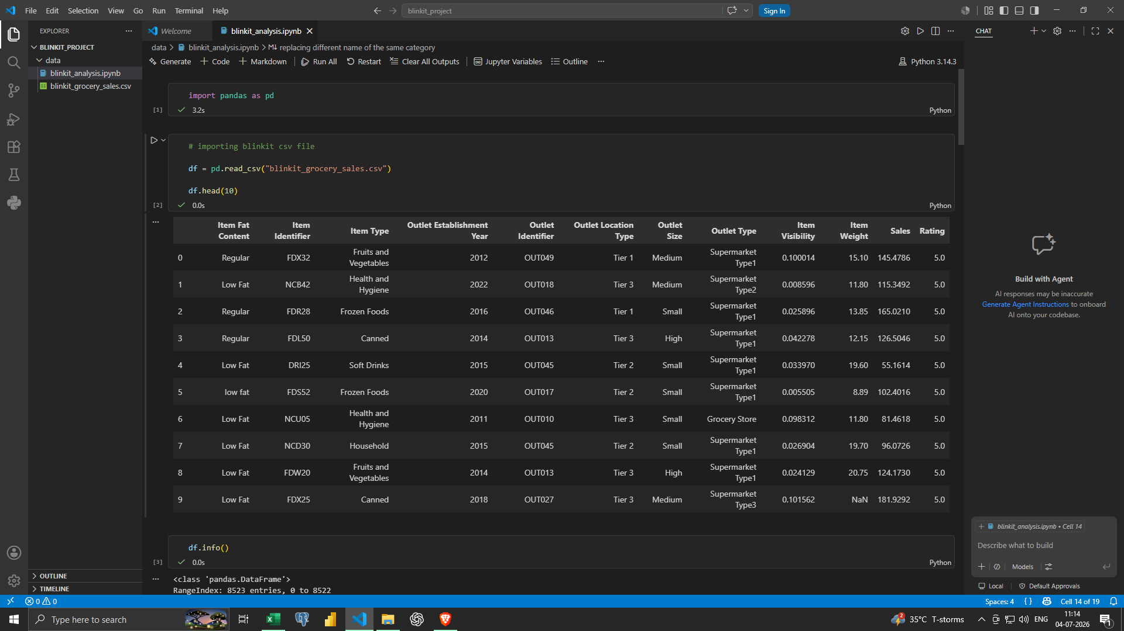
Python Data Cleaning
Cleaning steps:
• Renamed columns
• Handled missing values
• Standardized categories
• Fixed visibility values

Slide 5
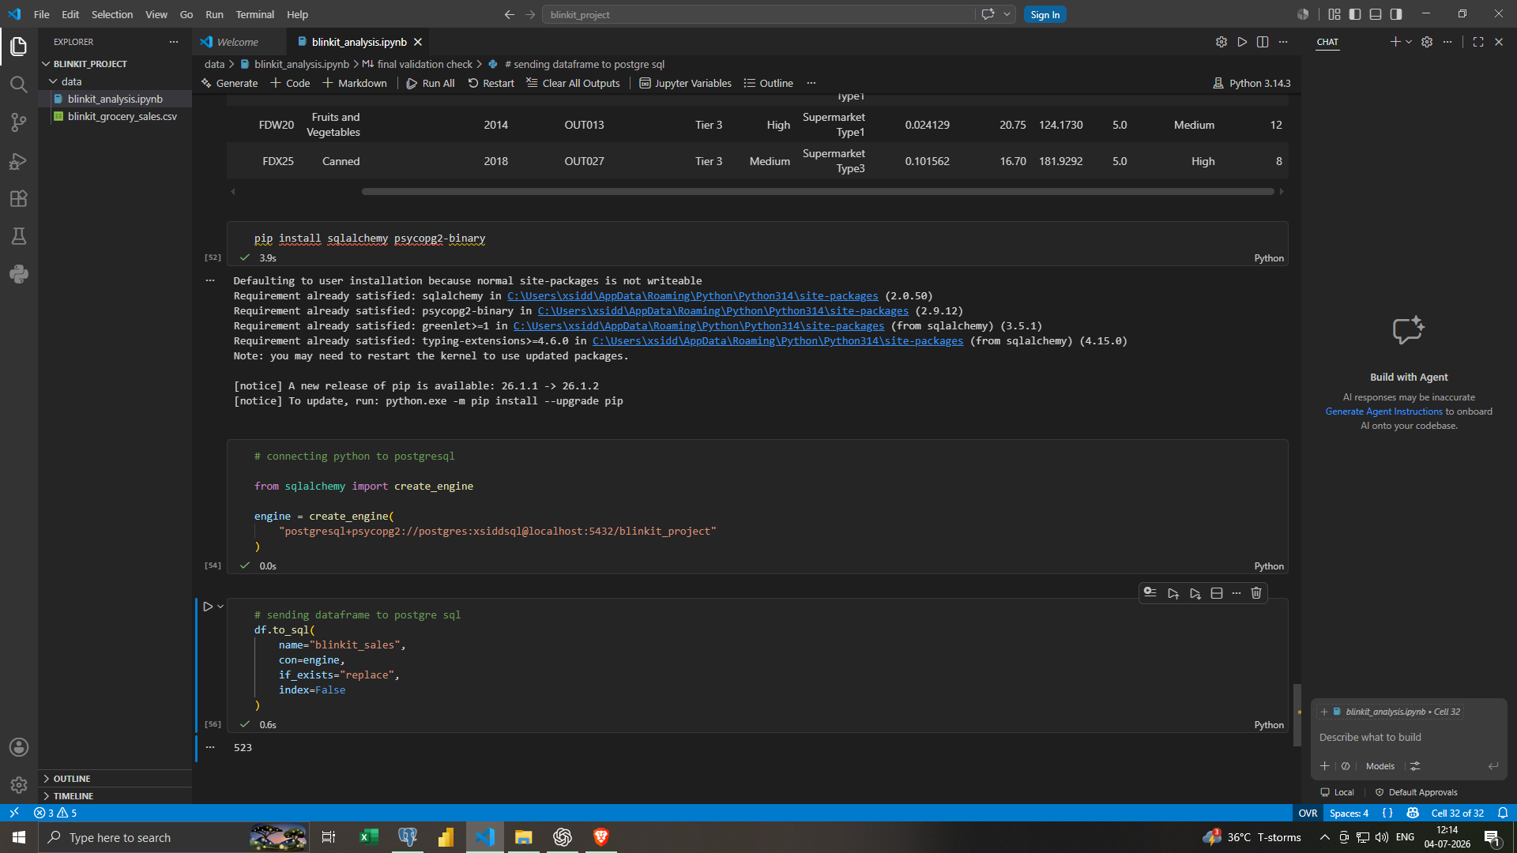
Feature Engineering
Engineered Features:
• Outlet Age
• Outlet Age Group
• Sales Category
• Visibility Group

Slide 6
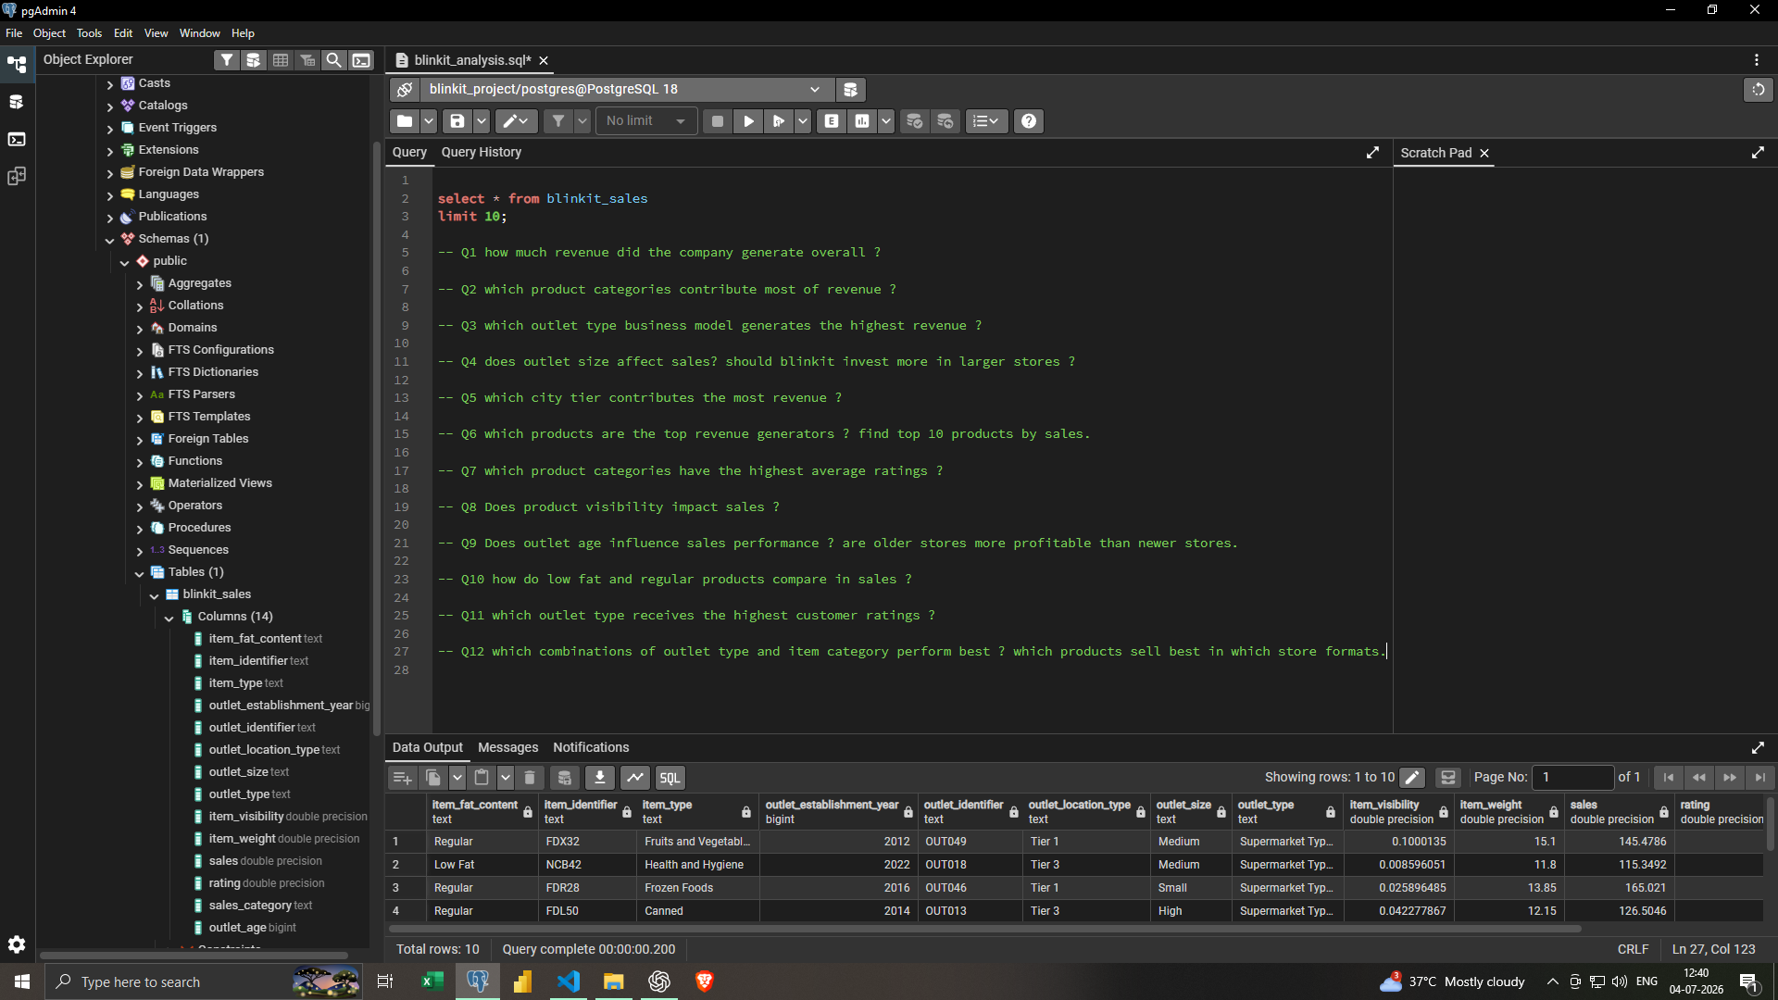
PostgreSQL Analysis
Imported cleaned data into PostgreSQL and performed business analysis using SQL.

Slide 7
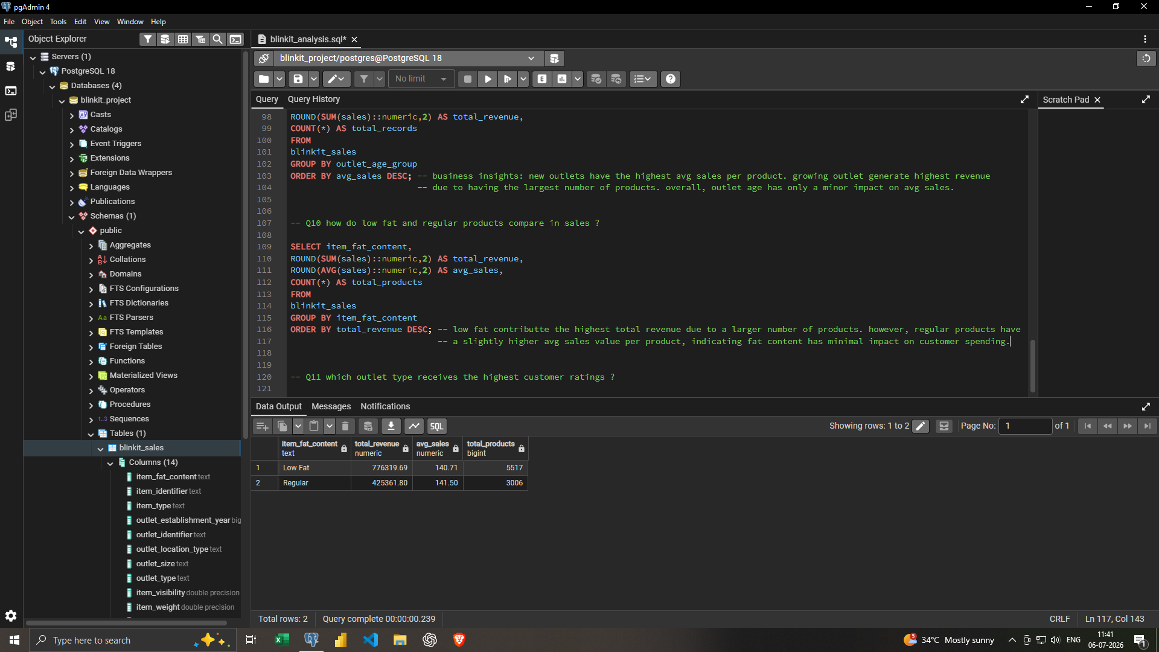
Business Questions
Key SQL Questions:
• Revenue by category
• Outlet performance
• Fat content comparison
• Rating analysis
• Visibility impact
• Outlet age performance

Slide 8
Power BI Dashboard
Interactive dashboard with KPIs, slicers and charts.

Slide 9
Key Business Insights
Insights:
• Supermarket Type 1 generated the highest sales.
• Tier 3 outlets contributed the highest revenue.
• Medium-sized outlets outperformed others.
• Low Fat products had higher sales.
• 6–10 year old outlets achieved the highest sales.

Slide 10
Tools & Workflow
Tools Used:
• Python (Pandas)
• Jupyter Notebook
• PostgreSQL
• SQL
• Power BI
• Git & GitHub

Slide 11
Project Conclusion
Outcome:
Built an end-to-end analytics solution from raw data to executive dashboard. Demonstrated ETL, SQL analysis, DAX measures and data visualization skills.

Slide 12
Thank You
Thank You
Questions?

