Slide 1

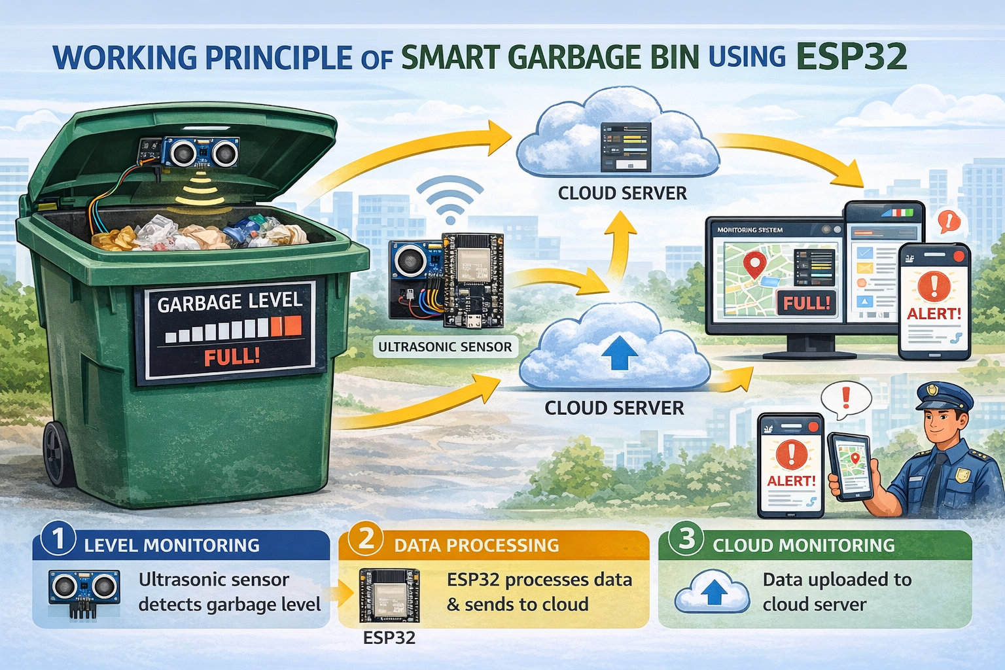

DESIGN THINKING
SMART GARBAGE BIN
TEAM NAME: TECHNOLOGY VISION KNOWLEDGE
Team Members:
1. MOHITH J (210425106124)
2. NAVIENKUMAAR C (210425106138)
3. NITISH NARAYANAN G (210425106145)
4. SHRI SHYAM A.J (210425106218)
5. SIDDHARTH S (210425106221)
6. SIVANESAN D (210425106224)
7. YUVANESH K.S (210425106269)
DEPARTMENT OF ECE
CHENNAI INSTITUTE OF TECHNOLOGY(An Autonomous Institution)

Slide 2
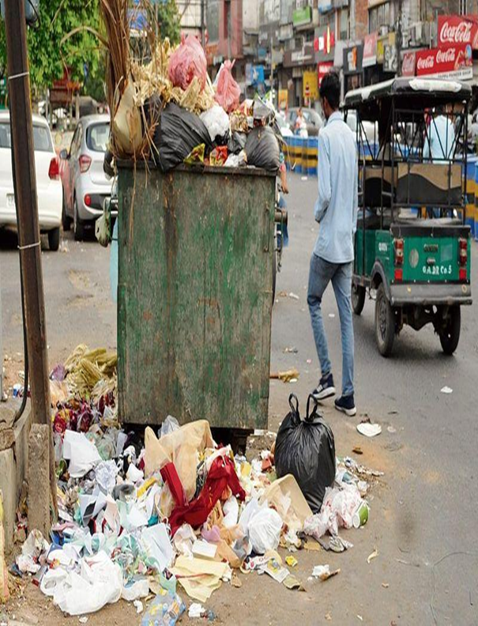
PROBLEM STATEMENT (EMPATHIZE & DEFINE):
Municipal garbage bins often overflow due to fixed collection schedules.
This causes:
- Unhygienic environment
- Bad smell and pollution
- Inefficient waste collection
- Wastage of fuel and manpower

Slide 3
SOLUTION(IDEATE):
The proposed solution is an IoT-based Smart Garbage
Monitoring System that helps municipal authorities monitor the fill
level of garbage bins in real time.
The system uses an ESP32 microcontroller and an HC‑SR04
Ultrasonic Sensor to detect the level of waste inside the bin.
This system eliminates the problem of garbage overflow
caused by fixed waste collection schedules by notifying
authorities only when the bin is nearly full.
DEPARTMENT OF ECE
CHENNAI INSTITUTE OF TECHNOLOGY(An Autonomous Institution)

Slide 4
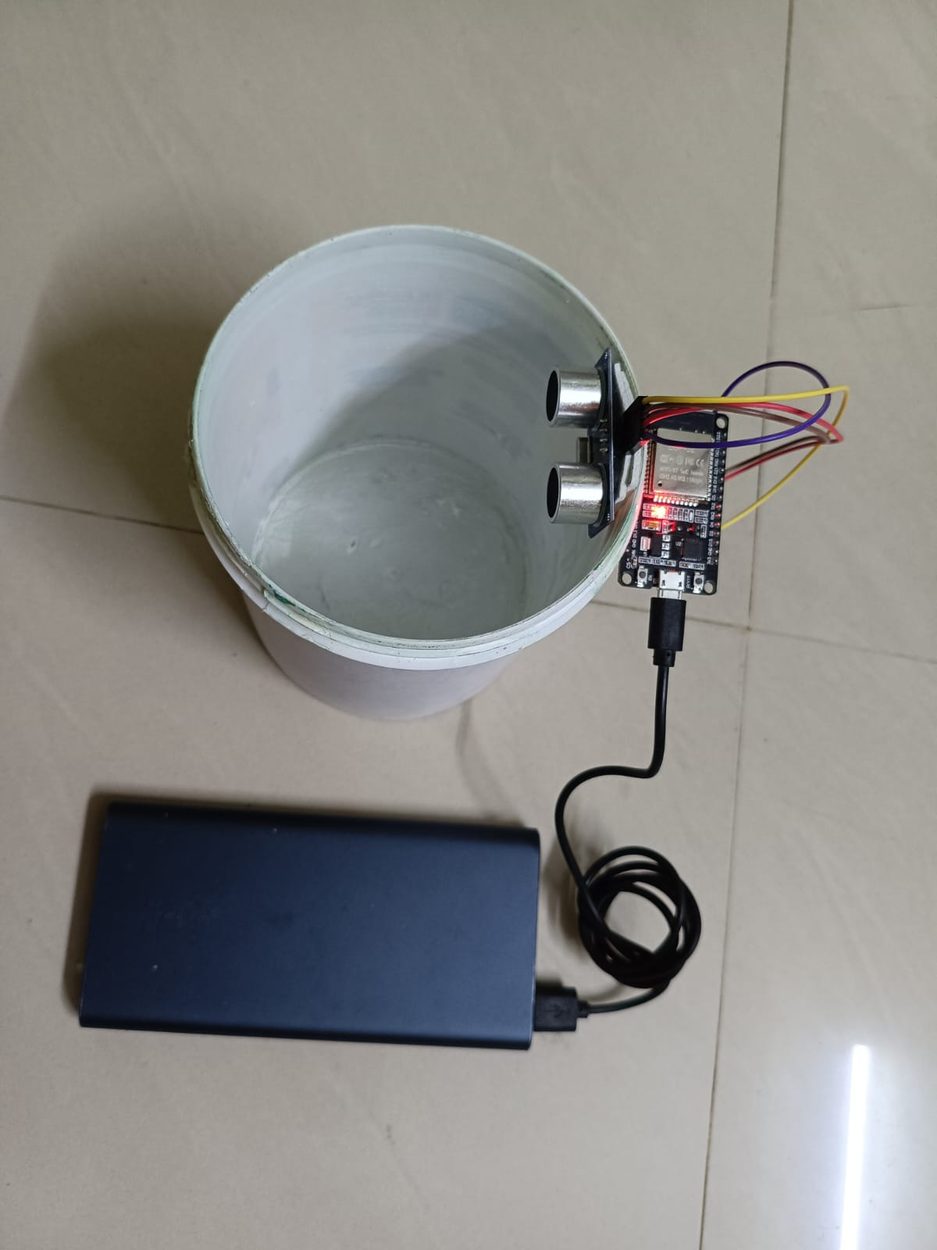
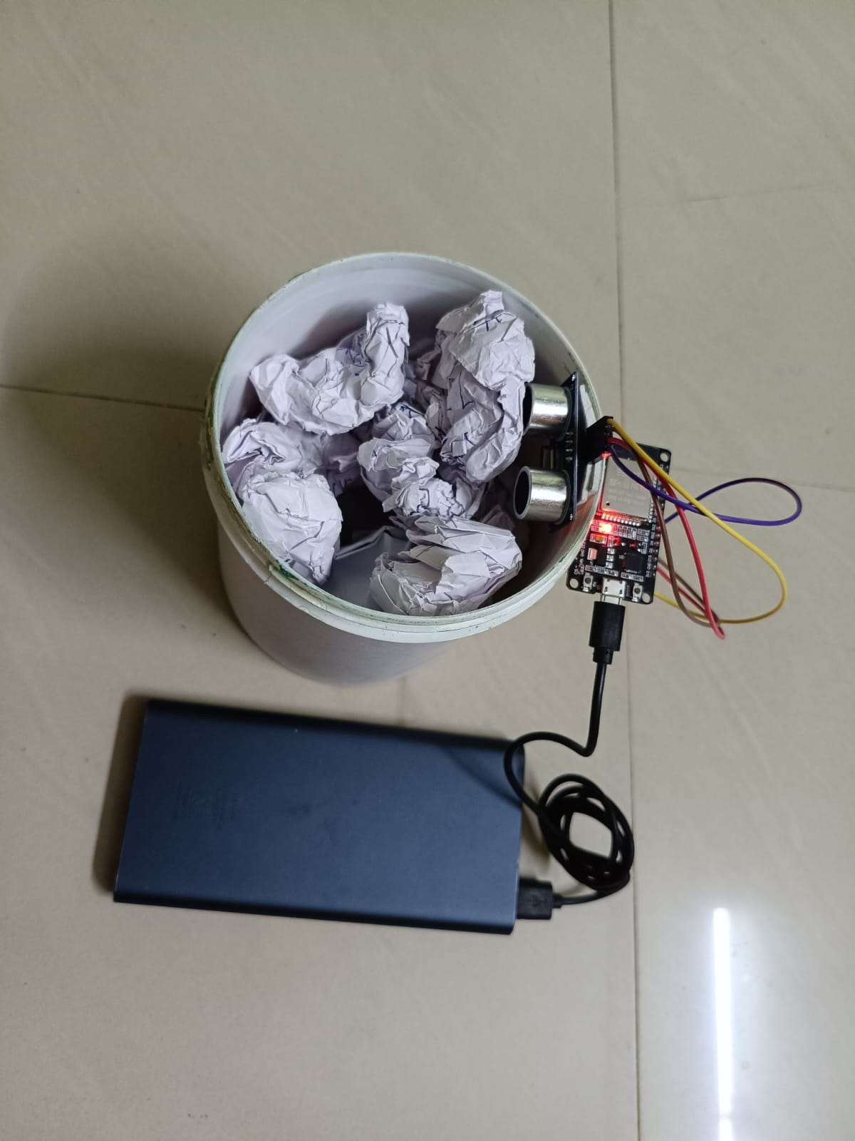
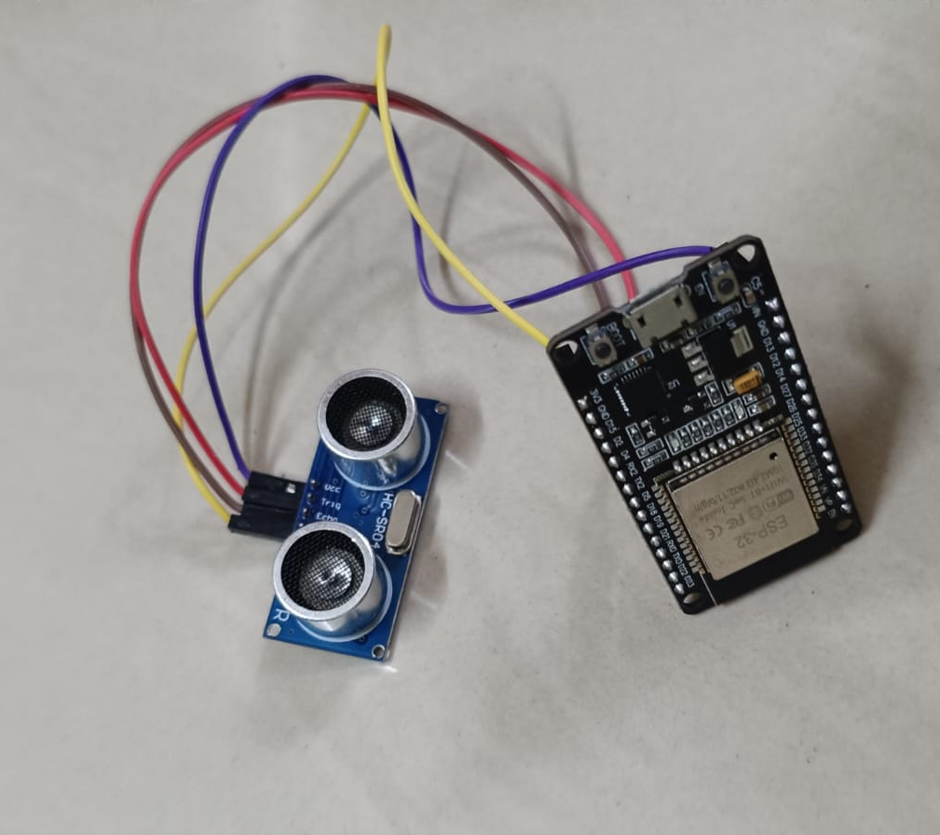
PROTOTYPE:
.

Slide 5
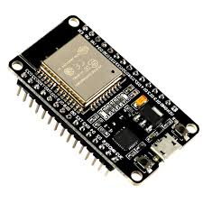
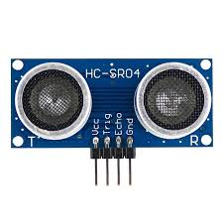
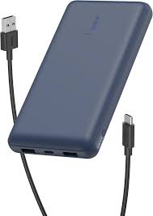
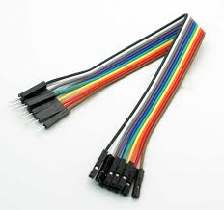
COMPONENTS USED:
ESP32 Board
Ultrasonic Sensor (HC-SR04)
Jumper Wires
Power Supply (Power Bank)
dustbin
DEPARTMENT OF ECE
CHENNAI INSTITUTE OF TECHNOLOGY(An Autonomous Institution)

Slide 6

SOFTWARE USED: ARDUINO IDE
Programming ESP32 for sensor control
Used to write and upload code to ESP32 to read data from the ultrasonic sensor (distance measurement of garbage level).
Wi-Fi configuration for smart monitoring
Arduino IDE is used to configure ESP32 Wi-Fi, enabling real-time data transmission to a web dashboard.
Web server integration
Code is written in Arduino IDE to host a local web server on ESP32, displaying bin status (Full / Empty).
Real-time debugging using Serial Monitor
Helps monitor distance values and troubleshoot issues like sensor errors or Wi-Fi connection problems.
Integration of hardware components
Arduino IDE manages interaction between ultrasonic sensor, buzzer, and ESP32 to trigger alerts when the bin is full.

Slide 7
WORKING PRINCIPLE(TESTING):
Ultrasonic sensor measures distance from sensor to garbage.
ESP32 processes the distance data.
When the bin becomes full, the buzzer alerts locally.
ESP32 sends data through WiFi to a cloud platform.
Authorities can monitor bin status remotely.

Slide 9
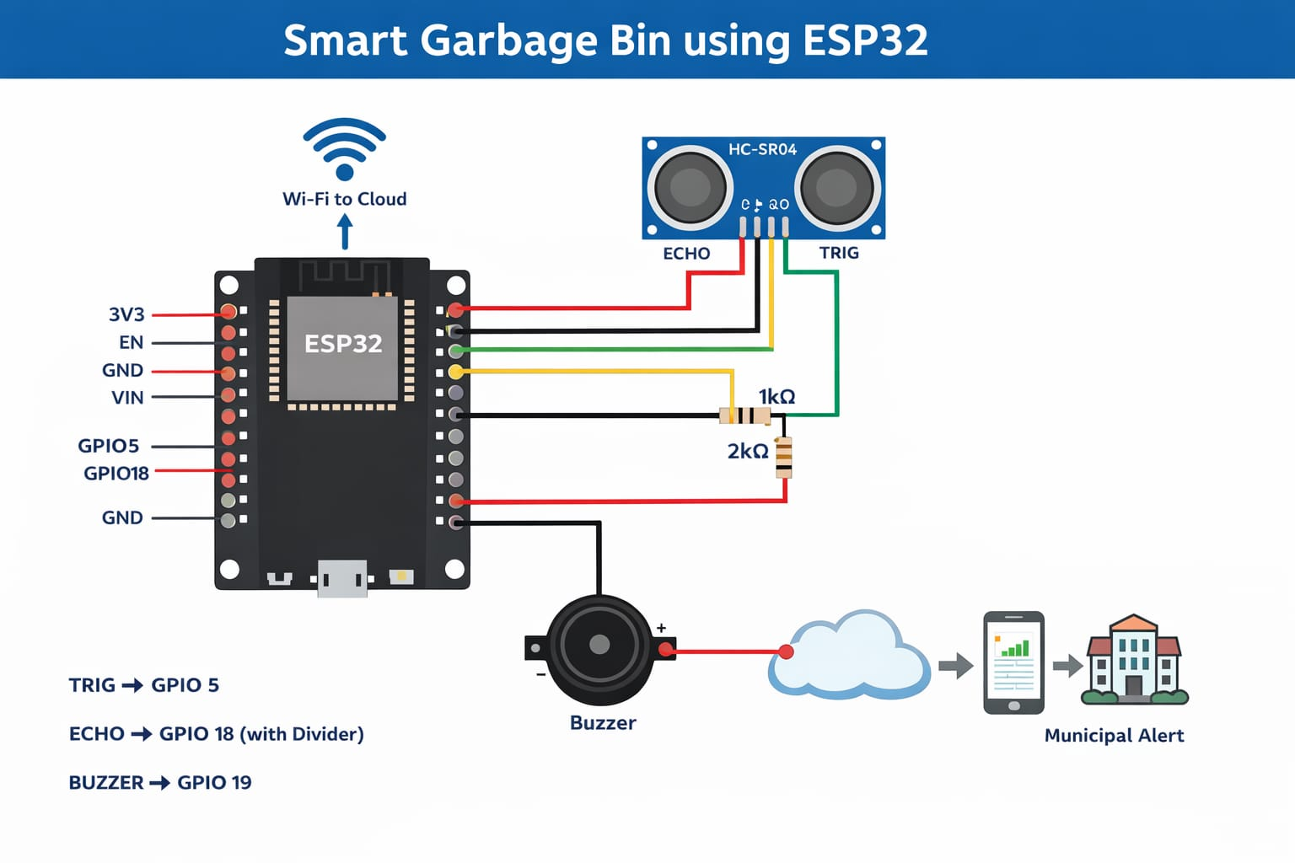
CIRCUIT DIAGRAM:

Slide 10

PROGRAM:
#include <WiFi.h>
#include <WebServer.h>
#define TRIG_PIN 18
#define ECHO_PIN 19
const char* ssid = "SIDDHU";
const char* password = "12345678";
WebServer server(80);
long duration;
float distance;
Notes:
PROGRAM

Slide 11
// Function to measure distance
float getDistance()
{
digitalWrite(TRIG_PIN, LOW);
delayMicroseconds(2);
digitalWrite(TRIG_PIN, HIGH);
delayMicroseconds(10);
digitalWrite(TRIG_PIN, LOW);
duration = pulseIn(ECHO_PIN, HIGH, 30000); // timeout added
if (duration == 0) return -1; // error case
return duration * 0.034 / 2;
}

Slide 12
// Webpage handler
void handleRoot()
{
distance = getDistance();
String status;
String color;
String icon;
bool isFull = false;
if (distance < 7)
{
status = "Bin is FULL";
color = "#ff4d4d";
icon = "⚠️";
isFull = true;
}
else
{
status = "Bin is OK";
color = "#4CAF50";
icon = "✔️";
}

Slide 13
String html = R"rawliteral(
<!DOCTYPE html>
<html>
<head>
<meta charset="UTF-8">
<meta http-equiv="refresh" content="2">
<title>Smart Garbage Bin</title>
margin: auto;
}
<style>
body {
margin: 0;
font-family: 'Segoe UI', sans-serif;
background: radial-gradient(circle at top, #0f172a, #020617);
color: white;
text-align: center;
}
.container {
width: 90%;
max-width: 500px;
margin: auto;
}
.card {
background: #111827;
padding: 20px;
margin: 20px 0;
border-radius: 15px;
box-shadow: 0 0 15px rgba(0,0,0,0.5);
}

Slide 14
.status {
font-size: 22px;
font-weight: bold;
}
</style>
</head>
<body>
<h1>Smart Garbage Bin Dashboard</h1>
<div class="container">
<!-- Adyar (REAL DATA) -->
<div class="card">
<h2>Adyar Garbage Bin</h2>
<p class="status" style="color: )rawliteral" + color + R"rawliteral(;">
)rawliteral" + icon + " " + status + R"rawliteral(
</p>
<p>Distance: )rawliteral" + String(distance) + R"rawliteral( cm</p>
</div>
<!-- T Nagar (STATIC) -->
<div class="card">
<h2>T. Nagar Garbage Bin</h2>
<p class="status" style="color:#4CAF50;">
✔️ Bin is OK
</p>
</div>

Slide 15
<!-- Triplicane (STATIC) -->
<div class="card">
<h2>Triplicane Garbage Bin</h2>
<p class="status" style="color:#4CAF50;">
✔️ Bin is OK
</p>
</div>
</div>
<script>
)rawliteral";
if (isFull)
{
html += R"rawliteral(
function beep() {
let ctx = new (window.AudioContext || window.webkitAudioContext)();
let osc = ctx.createOscillator();
osc.type = "sine";
osc.frequency.setValueAtTime(1000, ctx.currentTime);
osc.connect(ctx.destination);
osc.start();
setTimeout(() => { osc.stop(); }, 200);
}

Slide 16
beep();
setTimeout(beep, 300);
)rawliteral";
}
html += R"rawliteral(
</script>
</body>
</html>
)rawliteral";
server.send(200, "text/html", html);
}

Slide 17
void setup()
{
pinMode(TRIG_PIN, OUTPUT);
pinMode(ECHO_PIN, INPUT);
Serial.begin(115200);
WiFi.begin(ssid, password);
Serial.print("Connecting to WiFi");
while (WiFi.status() != WL_CONNECTED)
{
delay(500);
Serial.print(".");
}
Serial.println("\nWiFi Connected!");
Serial.print("IP Address: ");
Serial.println(WiFi.localIP());
// Start server
server.on("/", handleRoot);
server.begin();
Serial.println("Web server started!");
}
void loop()
{
server.handleClient(); // IMPORTANT
}

Slide 18
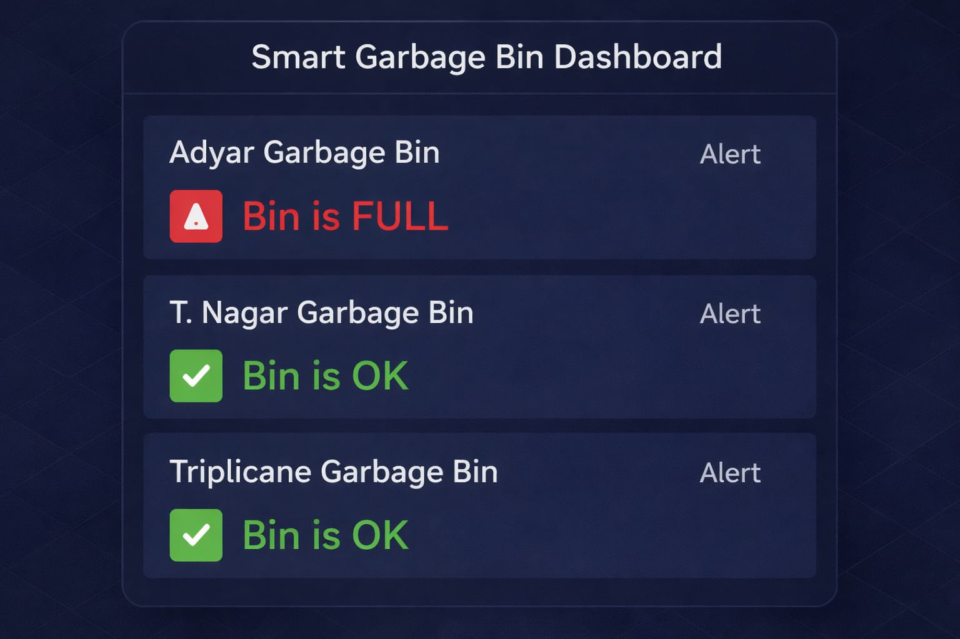
DASHBOARD:

Slide 19
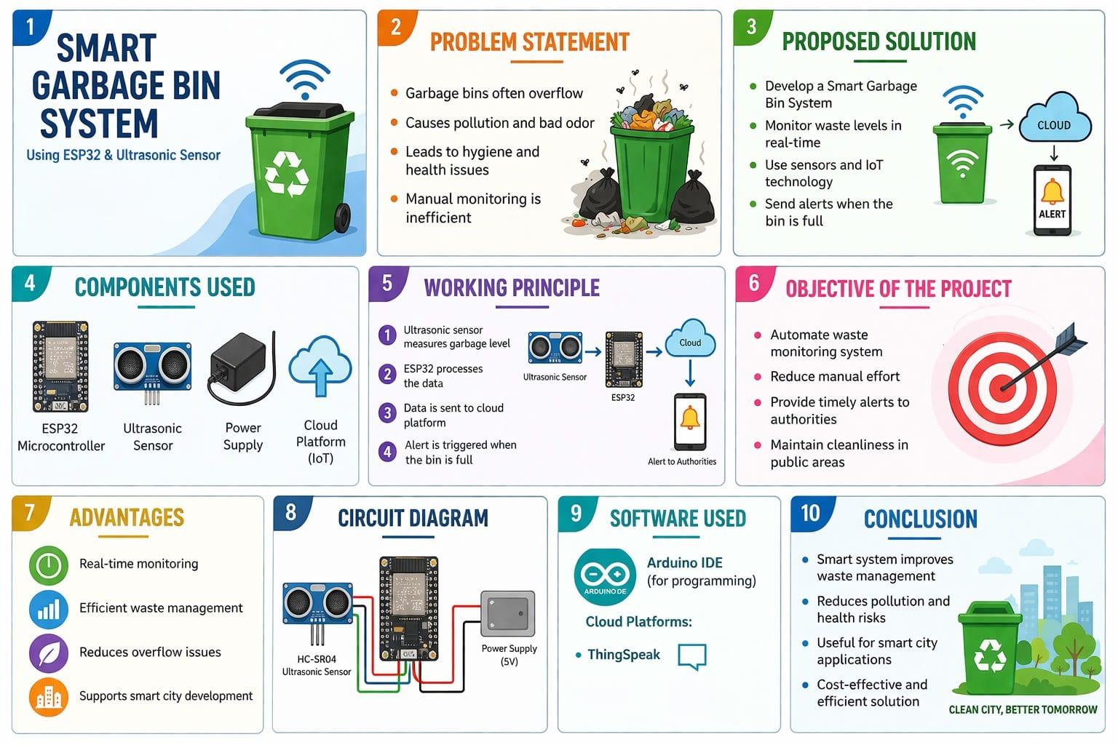
DEPARTMENT OF ECE
CHENNAI INSTITUTE OF TECHNOLOGY(An Autonomous Institution)

Slide 20
ADVANTAGES:
MONITOR GARBAGE LEVEL AUTOMATICALLY
AVOID GARBAGE OVERFLOW
IMPROVE CITY CLEANLINESS
REDUCE UNNECESSARY GARBAGE TRIPS
Touch free operation
Improves hygiene
Easy to use
BUDGET FRIENDLY project
Suitable for homes, schools, and public places.

Slide 21
