Slide 1
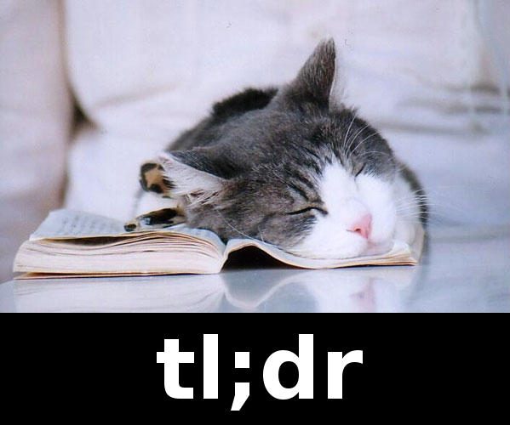


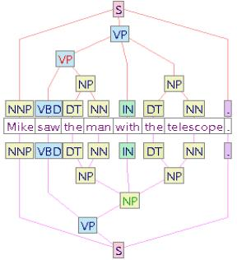
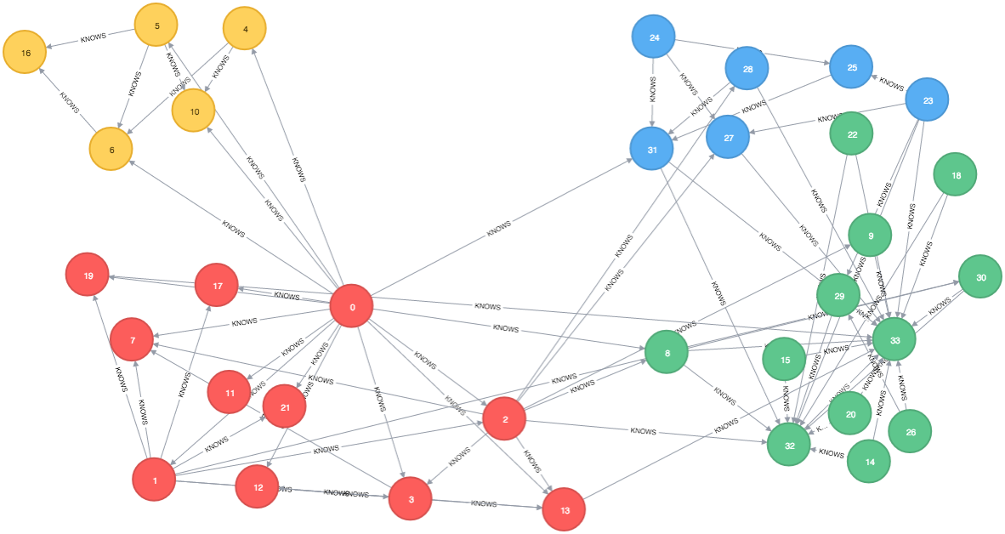
WHY?
HOW?
WHAT?
NSA
Cosine Similarity
K Means Clustering
POS Tagging
Summarizer
Google News
Twitter
Tweets for links
Sentiment
Analysis
NSA

