Slide 1
CALCULATE THE REMAINING LIFE OF HOUSEHOLD APPLIANCES
Faculty Of Science And Engineering
SCALABLE COMPUTING (WMCS16003)
Group 25
Swastik S Nayak
Siddharth B
Anil P.Mathew

Slide 2
Project Proposal
An application that predicts the remaining lifespan of household appliances based on their electrical usage and the age of the appliance.
A knowledge base should be constructed (training data) that should be utilized to train the model and predict the novel data.
Sensor data from multiple appliances should be streamed to the application to predict the relevant appliances lifespan.

Slide 3
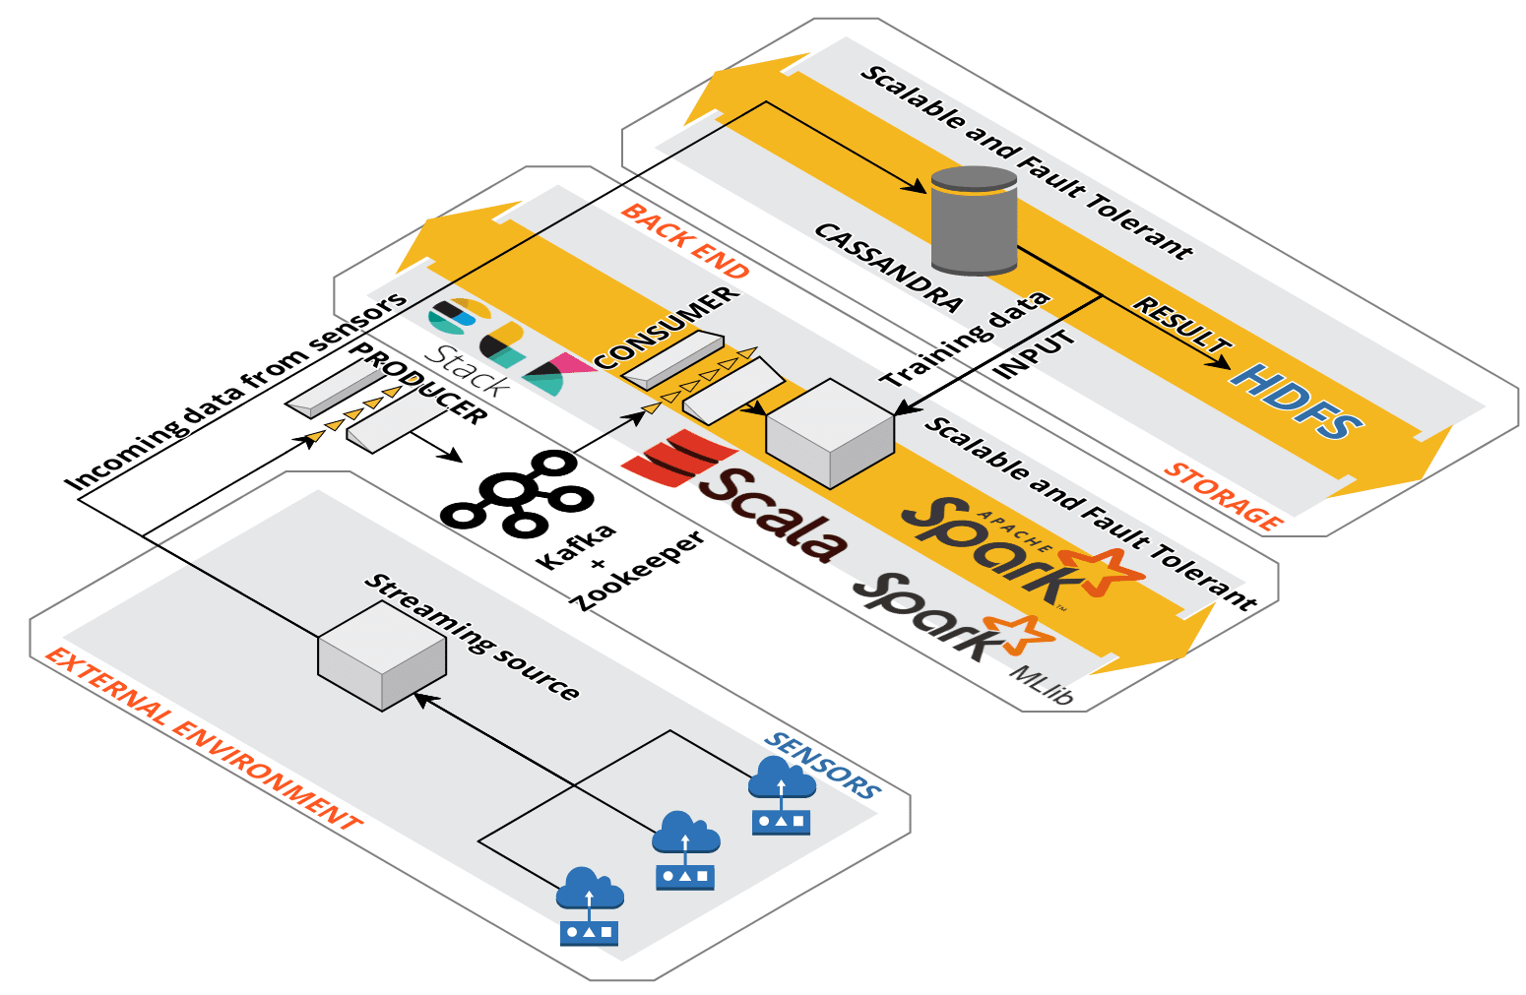

Architecture

Slide 4
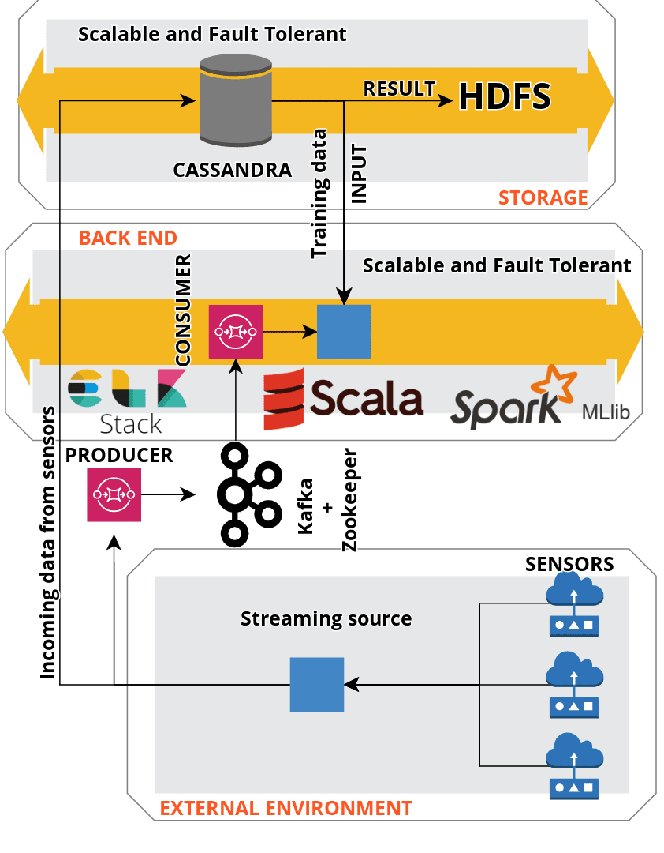

Slide 5
Requirements
FUNCTIONAL
A batch processing pipeline to train the model.
Handle the incoming streaming data from the sensors from multiple appliances.
Algorithm to predict the lifespan of the appliances.
NON-FUNCTIONAL
Scalability, the cluster should scale based on incoming data.
Fault-tolerant, the application should recover from unforeseen errors.
Performance, the application should predict the outcome in reasonable time.

Slide 6
Technologies
TECHNOLOGY | KEY FEATURES | USAGE
Scala | Scalable or Multi-paradigm (FP+OOP), concise, strongly typed, immutable-first language, non existent boiler plate codes, interoperability with java, easy to maintain, leverage the advantages of JVM. | The backend code will consist mainly of scala to enable a scalable, concise, clean and maintainable code. The language will allow for a faster turnaround time to reduce the coding efforts. Will contain the business logic or the Engine which drives the web application.
HDFS | Fault tolerance, high availability, high reliability, replication, scalability and, distributed storage. | Storage used to support the distributed computation in the application.
Spark | Speed, Supports multiple languages, In-memory computation, Advanced analytics, SparkSql and SparkML. | Spark will be used to execute the application in distributed fashion. It will utilize HDFS and Yarn to distribute the work across the cluster.
Kafka | High Throughput, lower latency, fault tolerant and durability. | Deals with streaming of data across the system. Provides a direct stream to the backend, generic kafka stream reader.
Cassandra | Handles massive amount of unstructured data, high availability and fault tolerant, elastic scalability, high performance. | Secondary database to create a fault tolerant environment. Structure: Key1, Key2, Value
Docker | Compatibility and maintainability, simplicity and faster configuration, rapid development, deployment and testing. | Used to simulate the environment and create docker images for continuous deployment, testing and releases.

Slide 7
TECHNOLOGY | KEY FEATURES | USAGE
ELK (optional) | Elastic search to support RESTful search and analytics. Logstash to support server-side data processing pipeline that ingests, transforms and loads data. Kibana lets you visualize your Elasticsearch data and navigate the Elastic Stack. | Used for tracking the status of input files and other metrics.
SBT | Build tool. | To handle continuous integration, profiling, and dependencies across the project.

Slide 8
Thank You

