Slide 1
project :calculator by Siddhesh Khairnar from digicrome academy

Slide 2
This is a basic calculator
this calculator is made using python and visual studio
for GUI i have used tKinter library from python
it has basic operations
such as addition , subtraction , multiplication , division
has 2 display window one for input and other for output
also added clear function and has fixed window size

Slide 3
some challenges i have experienced
as initially i coded each button separately
like
button_7 = tk.Button(self.buttons_frame, text="7", bg=L_B, fg=WHITE, font=DIGITS_FONT_STYLE,borderwidth=0, highlightthickness=0, command=lambda: self.add_to_expression(7))
button_7.grid(row=1, column=0, sticky="nsew")
but because of that code became lengthy
so converting it into loop was a little challenging

Slide 4
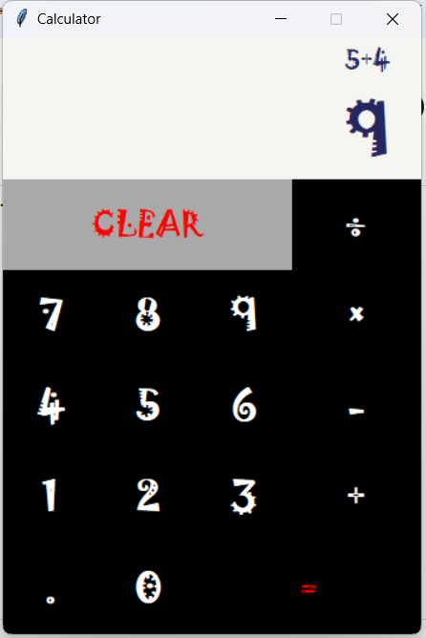
screenshot of my calculator

Slide 5
thank you for your attention hope my project meets your expectation

