Slide 1

AURIGEN.AI
Jewelery Design Generation
Shlok Bhardwaj
Sidharth Patel
E22CSEU0041
E22CSEU0044
Sarthak Chauhan
Vrinda Parmar
E22CSEU0056
E22CSEU0043

Slide 2

INTRODUCTION
In traditional jewelry design, customers often struggle to visualize their customized pieces before they are made.
They usually have to place orders based on rough sketches or verbal communication, and must purchase the final piece even if it doesn’t meet their expectations.
Our project aims to solve this by generating digital jewelry designs based on user prompts, offering a personalized, risk-free way to explore designs before committing.

Slide 3
PROBLEM STATEMENT
In the traditional jewelry design process, customers often struggle to clearly visualize their personalized pieces before they are made.
This lack of transparency and flexibility can lead to dissatisfaction, as the final product may not fully align with their original expectations.
Additionally, there are currently no dedicated digital tools that allow users to easily explore and customize jewelry designs based on their specific preferences.

Slide 4
MOTIVATION
Our project is driven by the need to give users the freedom to design and visualize customized jewelry easily. We aim to make the personalization process faster, more affordable, and accessible, eliminating the reliance on physical sketches and costly revisions. We identified a clear gap in the market — there are no dedicated AI models focused on jewelry design generation. Existing tools are basic and lack the depth needed for true customization. Through our project, we strive to bridge this gap and simplify the journey from imagination to design.

Slide 5

PROPOSED SOLUTION
We designed a hybrid model that combines Diffusion Models and StyleGAN to generate personalized jewelry designs.
Users can enter simple text prompts to describe the style, type, or features they want in their jewelry.
The model then creates realistic and detailed designs focused mainly on gold-based earrings, rings, necklaces, and bracelets.
This system allows users to digitally explore different custom designs quickly without the need to physically craft them.
Our approach makes jewelry personalization easier, more flexible, and cost-effective for customers.

Slide 6
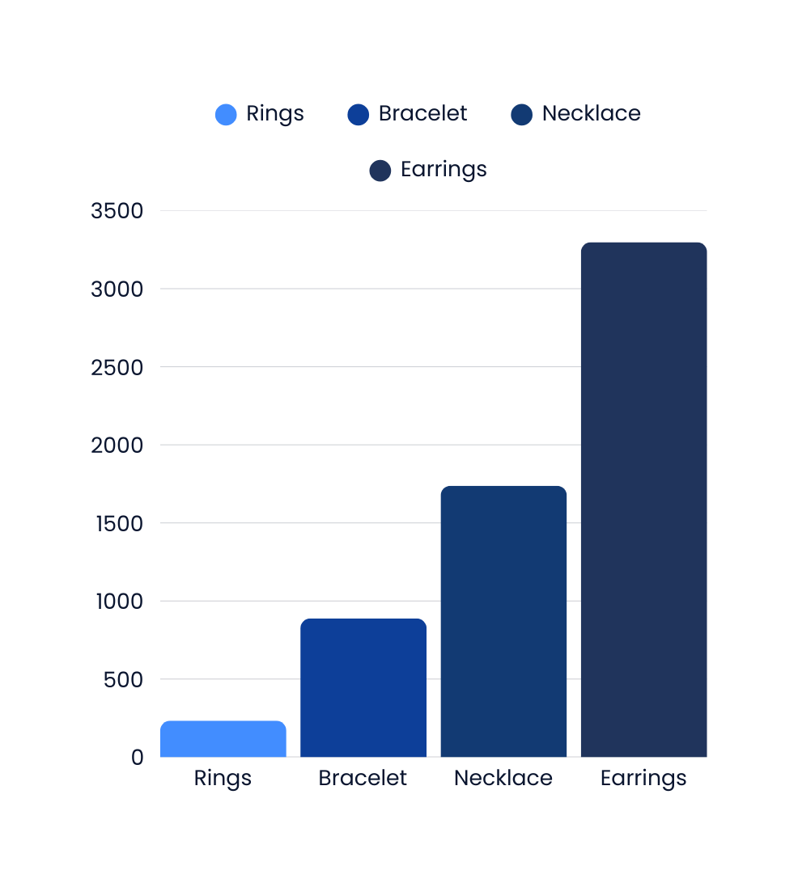
DATASET
We created a custom jewelry image dataset by combining data from sources like Roboflow, Kaggle, images.cv, GitHub, and Hugging Face.
The dataset contains 6000+ images across four jewelry classes:
Necklace
Earrings
Rings
Bracelets

Slide 7
METHODOLOGY
Models Used
Stable Diffusion XL (SDXL): A pre-trained text-to-image model capable of generating high-resolution jewelry designs (1024x1024).
ControlNet: Provides structural guidance, allowing more control over the design by using edge detection or reference images.
Why These Models?
SDXL: Ideal for creating detailed, high-quality jewelry designs based on textual descriptions.
ControlNet: Enhances design precision by conditioning SDXL with structural inputs like edge maps, improving design accuracy.

Slide 8
METHODOLOGY
Process Overview
Design Input: Users provide a design prompt, and optionally, upload reference images or sketches.
Image Generation: The models generate images based on the input prompts and reference images.
Refinement: Users can refine designs by adjusting parameters or providing modification prompts to improve specific features, such as color or texture.
Interactive Design Studio
The user-friendly interface allows real-time interaction with generated designs, offering control over aspects like number of designs, inference steps, and styling preferences.
Refinement options ensure designs can be continuously improved for better accuracy and user satisfaction.

Slide 9

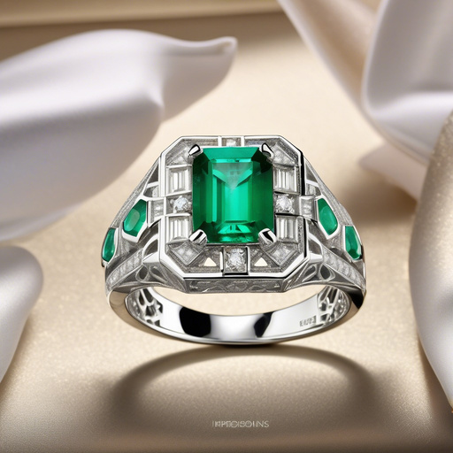
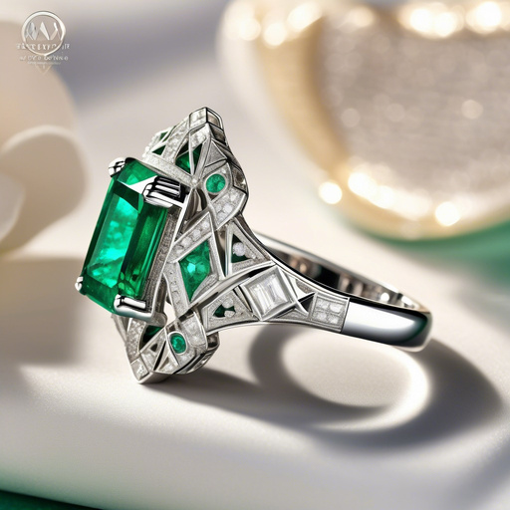
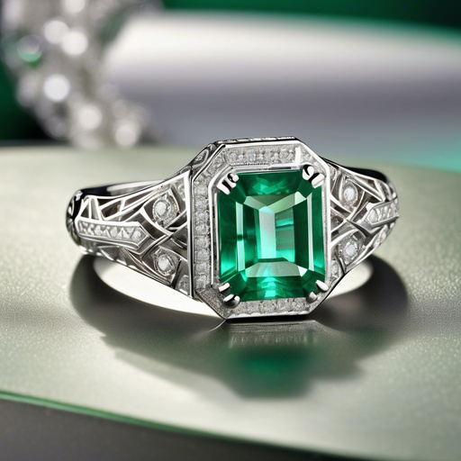
RESULTS
Prompt: A luxurious emerald and diamond ring in 18k white gold, intricate art deco design with geometric patterns, highly detailed filigree work, sparkling gemstones with perfect clarity, professional jewelry photography, studio lighting with soft shadows, 8K ultra HD, hyper-realistic, intricate craftsmanship, elegant and timeless design, displayed on a velvet jewelry stand, reflections and light play on metal surfaces.
Generated Designs:

Slide 10
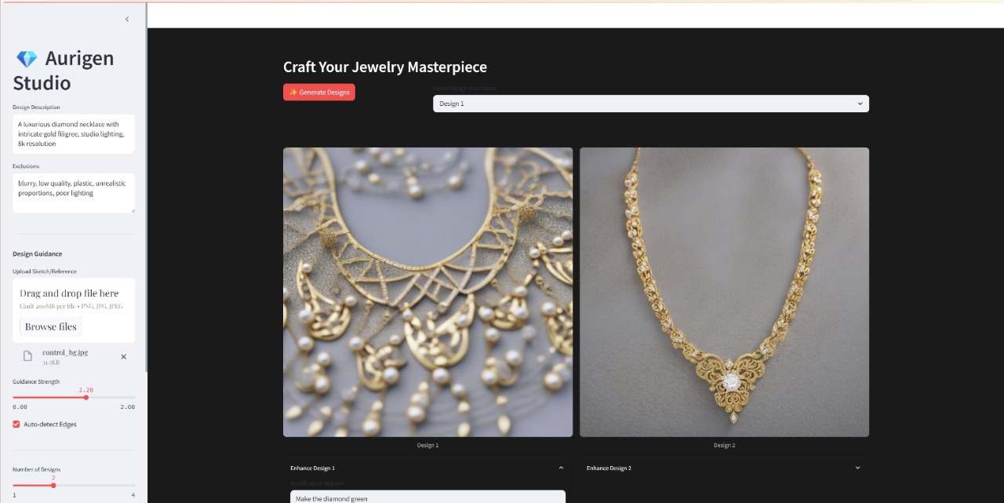
USER INTERFACE

Slide 11
CONCLUSION
Aurigen makes use of state-of-the-art diffusion models (Stable Diffusion XL) along with a userfriendly interface created on Streamlit to enable users to generate realistic and personalized jewelry. The challenges we overcame such as dataset limitations, refinement errors, and computational efficiency, mean that the system offers a robust, and accessible solution for jewelry designing and visualization.
Overall, the product has strong potential for adapting to creative industries such as fashion, interior design, along with the capability to meet different domain-specific needs by further adjusting the architecture using different models, prompts, and control mechanisms

Slide 12
THANK YOU

