Slide 1

Enhancing Content Strategy: Insights for Expanding Netflix's Library in Canada and the USA
Submitted by: Siddhant Somvanshi

Slide 2
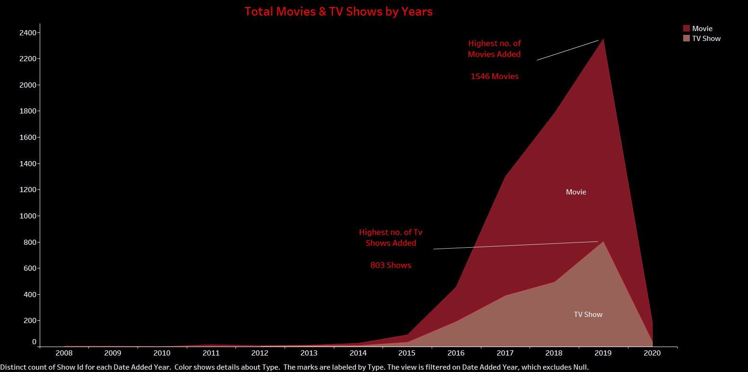

Slide 3
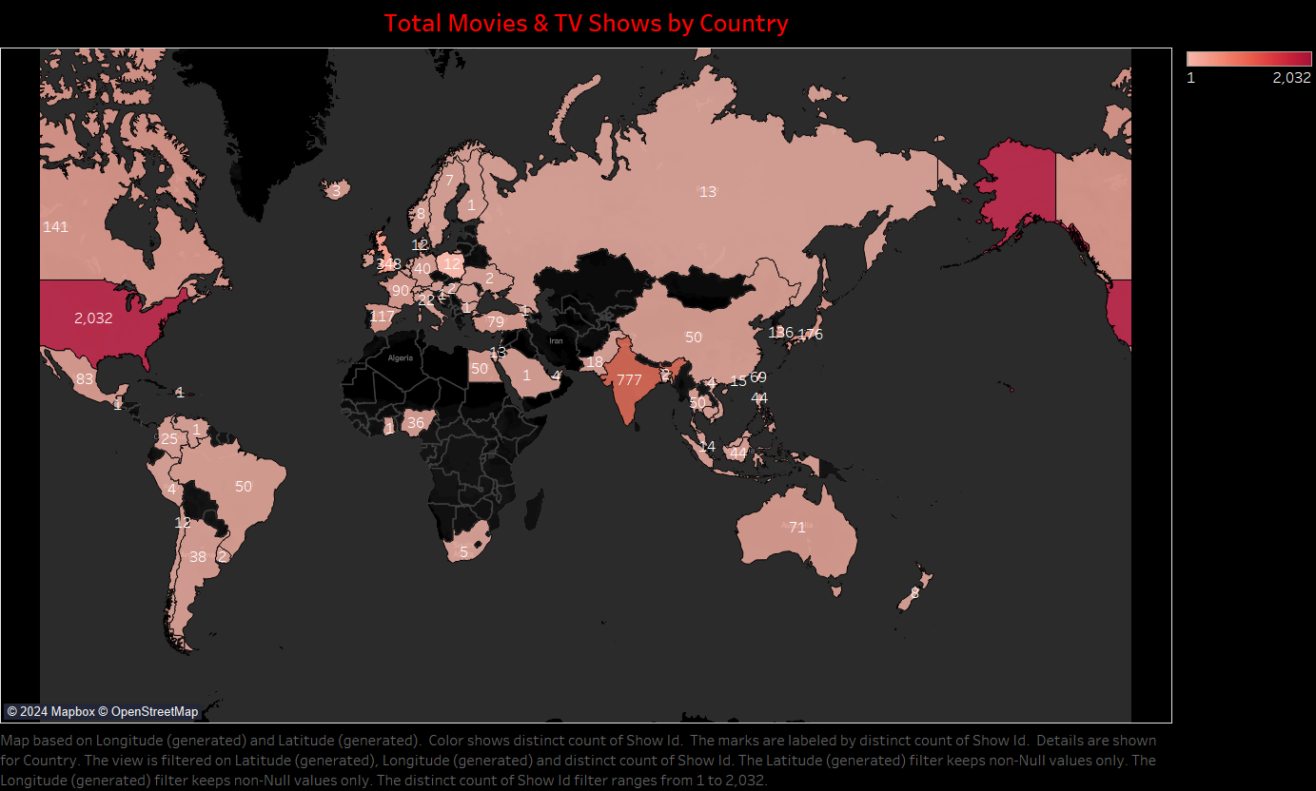

Slide 4
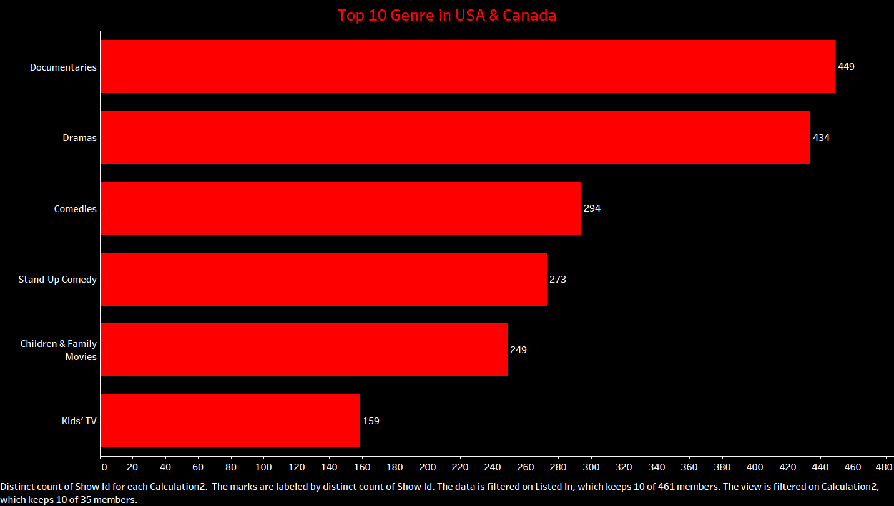

Slide 5
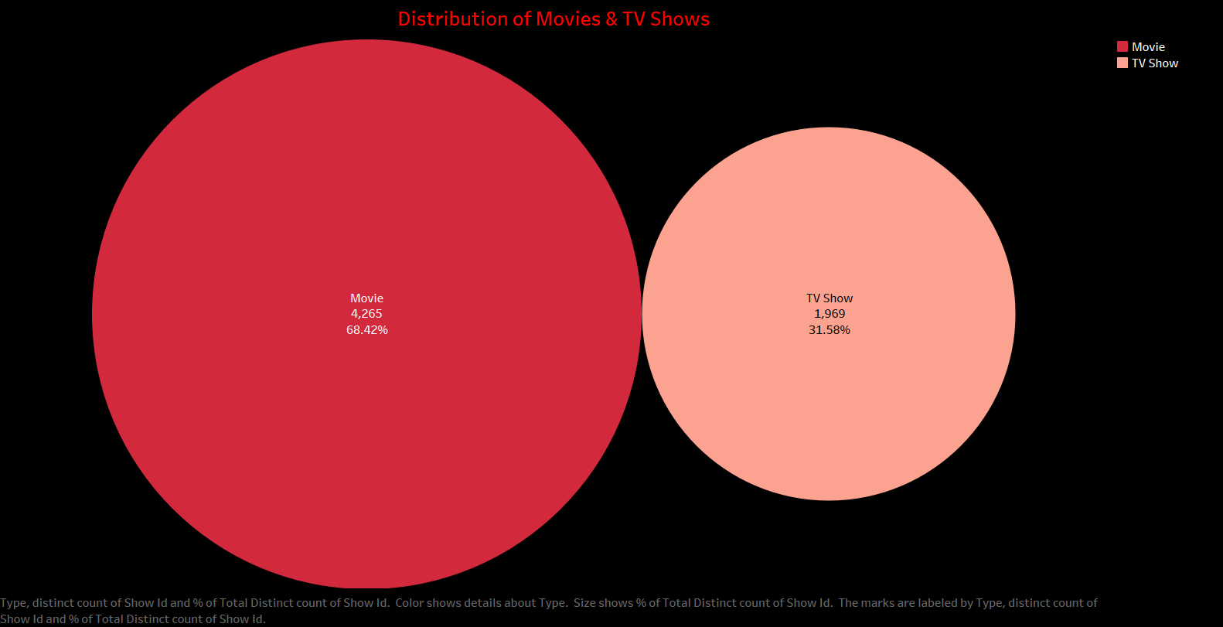

Slide 6
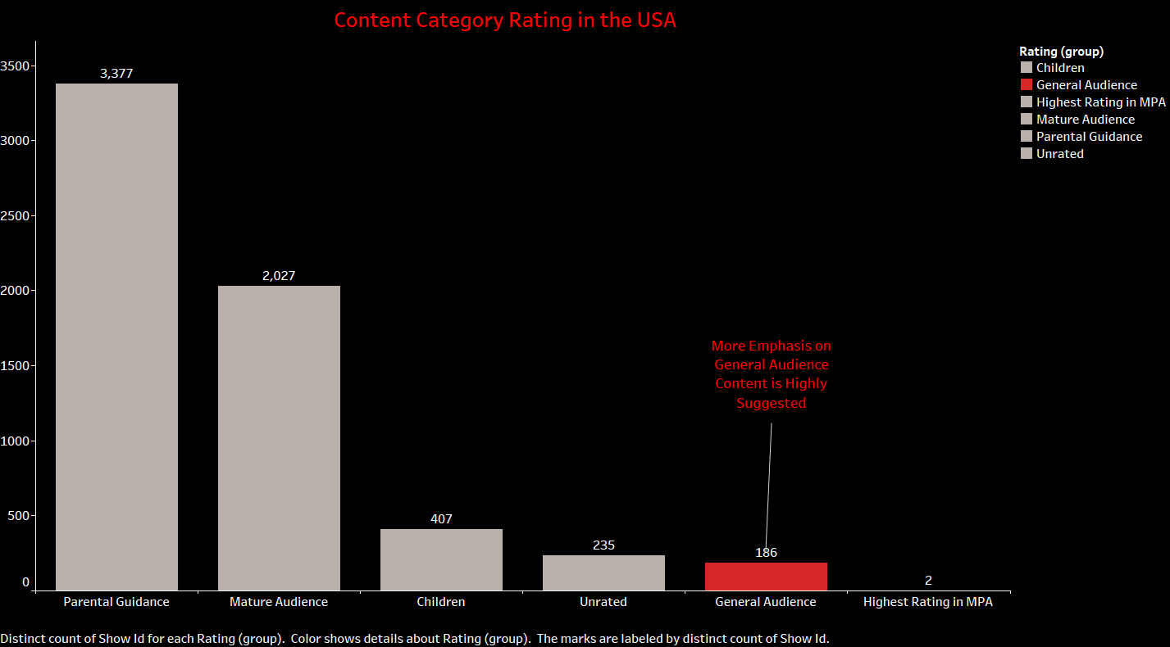

Slide 7
