Slide 1
PREDICTING MOBILES PHONES
PRICES

Slide 2

Why predicting prices is valuable?
Lots and lots of people are getting smartphones.
Will help the companies to put competitive price tags.
Helps to provide a sophisticated price metrics.

Slide 3
Data acquisition and cleaning
Mobile Phones Classification data from Kaggle.
It has a total 20 features, and 2000 instances of them.
Out of twenty, one of them is target variable.
Dropped irrelevant features, and scaled the data

Slide 4
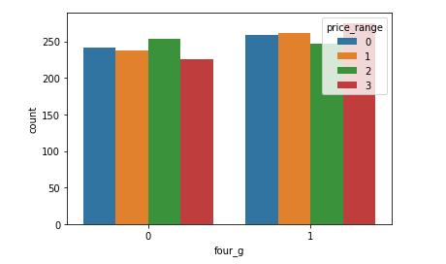
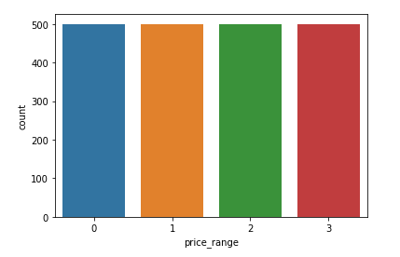
Using count plots to visualise

Slide 5
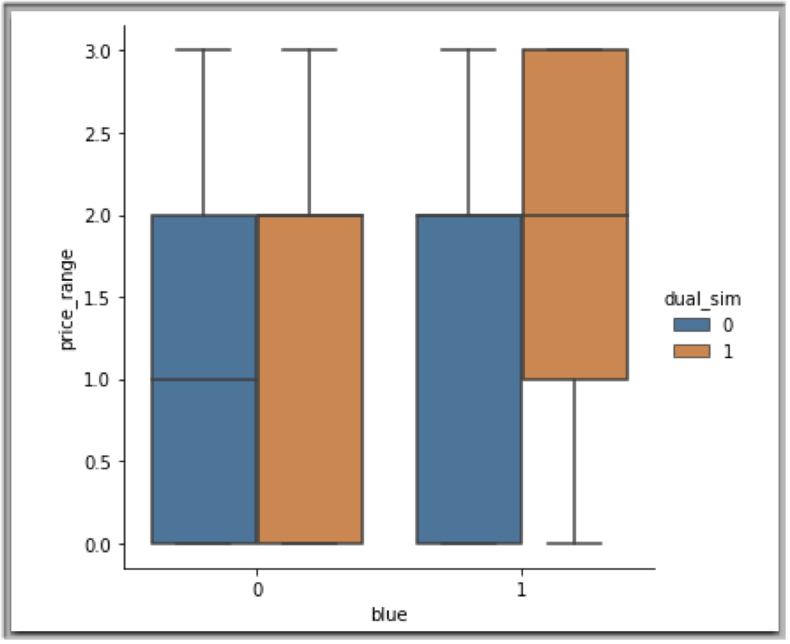
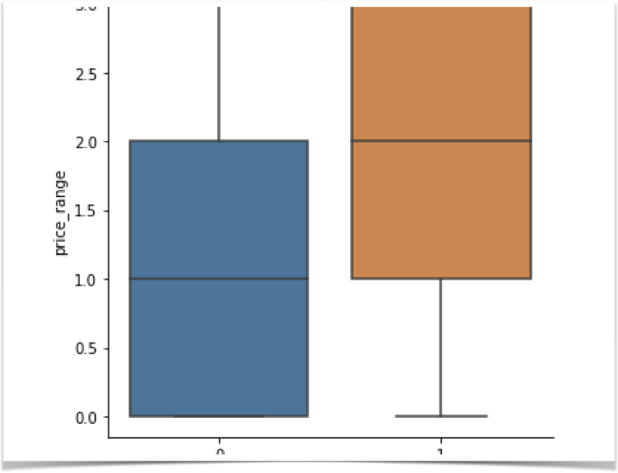
Using Box plots to visualise

Slide 6
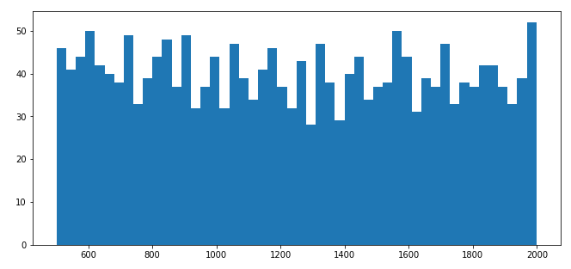
Using Histograms to visualise
This Histogram shows the variance of battery_power. It shows the distribution of battery_power as well.

Slide 7
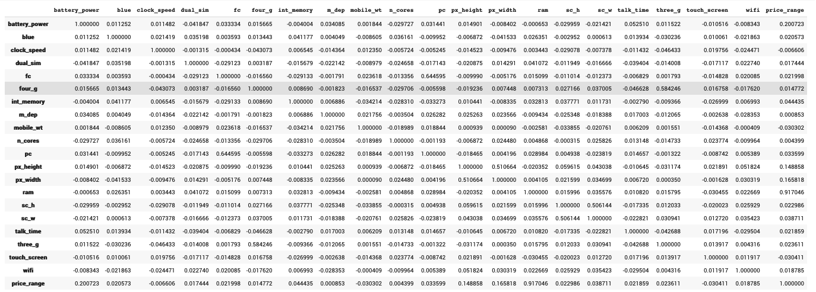
Correlation of features

Slide 8
Few points to note down
Above visualisation show that few features are more important than others.
Not all features are equally weighted.
We’ll only be considering the relevant features.

Slide 9
The models I’ve used
Decision Tree Classifier
Support Vector Classifier
Random Forest Classifier
MLP Classifier

Slide 10
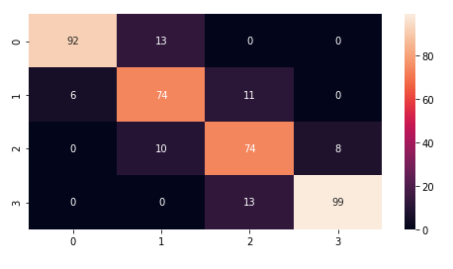
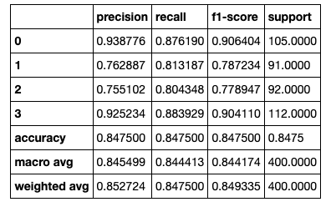
Decision Tree (Confusion Matrix and Classification Report)
Confusion Matrix
Classification Report

Slide 11
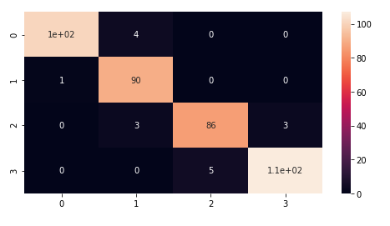
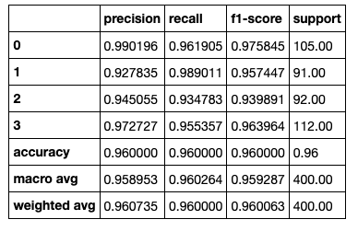
Support Vector (Confusion Matrix and Classification Report)
Confusion Matrix
Classification Report

Slide 12
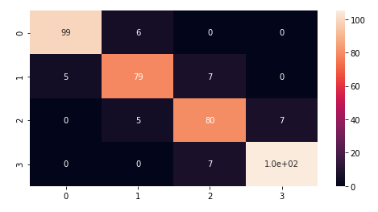
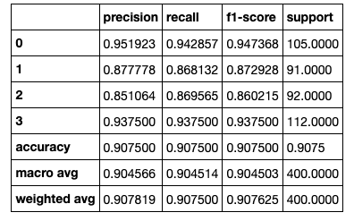
Random Forest (Confusion Matrix and Classification Report)
Confusion Matrix
Classification Report

Slide 13
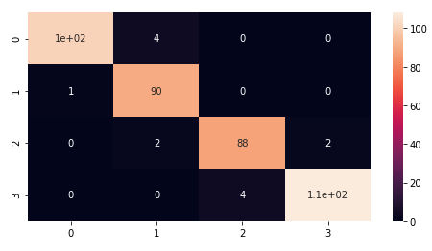
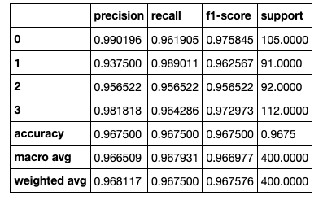
MLP Classifier (Confusion Matrix and Classification Report)
Confusion Matrix
Classification Report

Slide 14
Conclusion & Future Implementations
Built a model to predict the price range of Mobile Phones.
Accuracy and predictions has room for improvement.
Can be implemented by Companies.

