Slide 1


Slide 2

What is aws?
Amazon Web Services
Collection of Web Services
Best Cloud Platform
Pay As you go Pricing
2006 – AWS Officially Launched

Slide 3
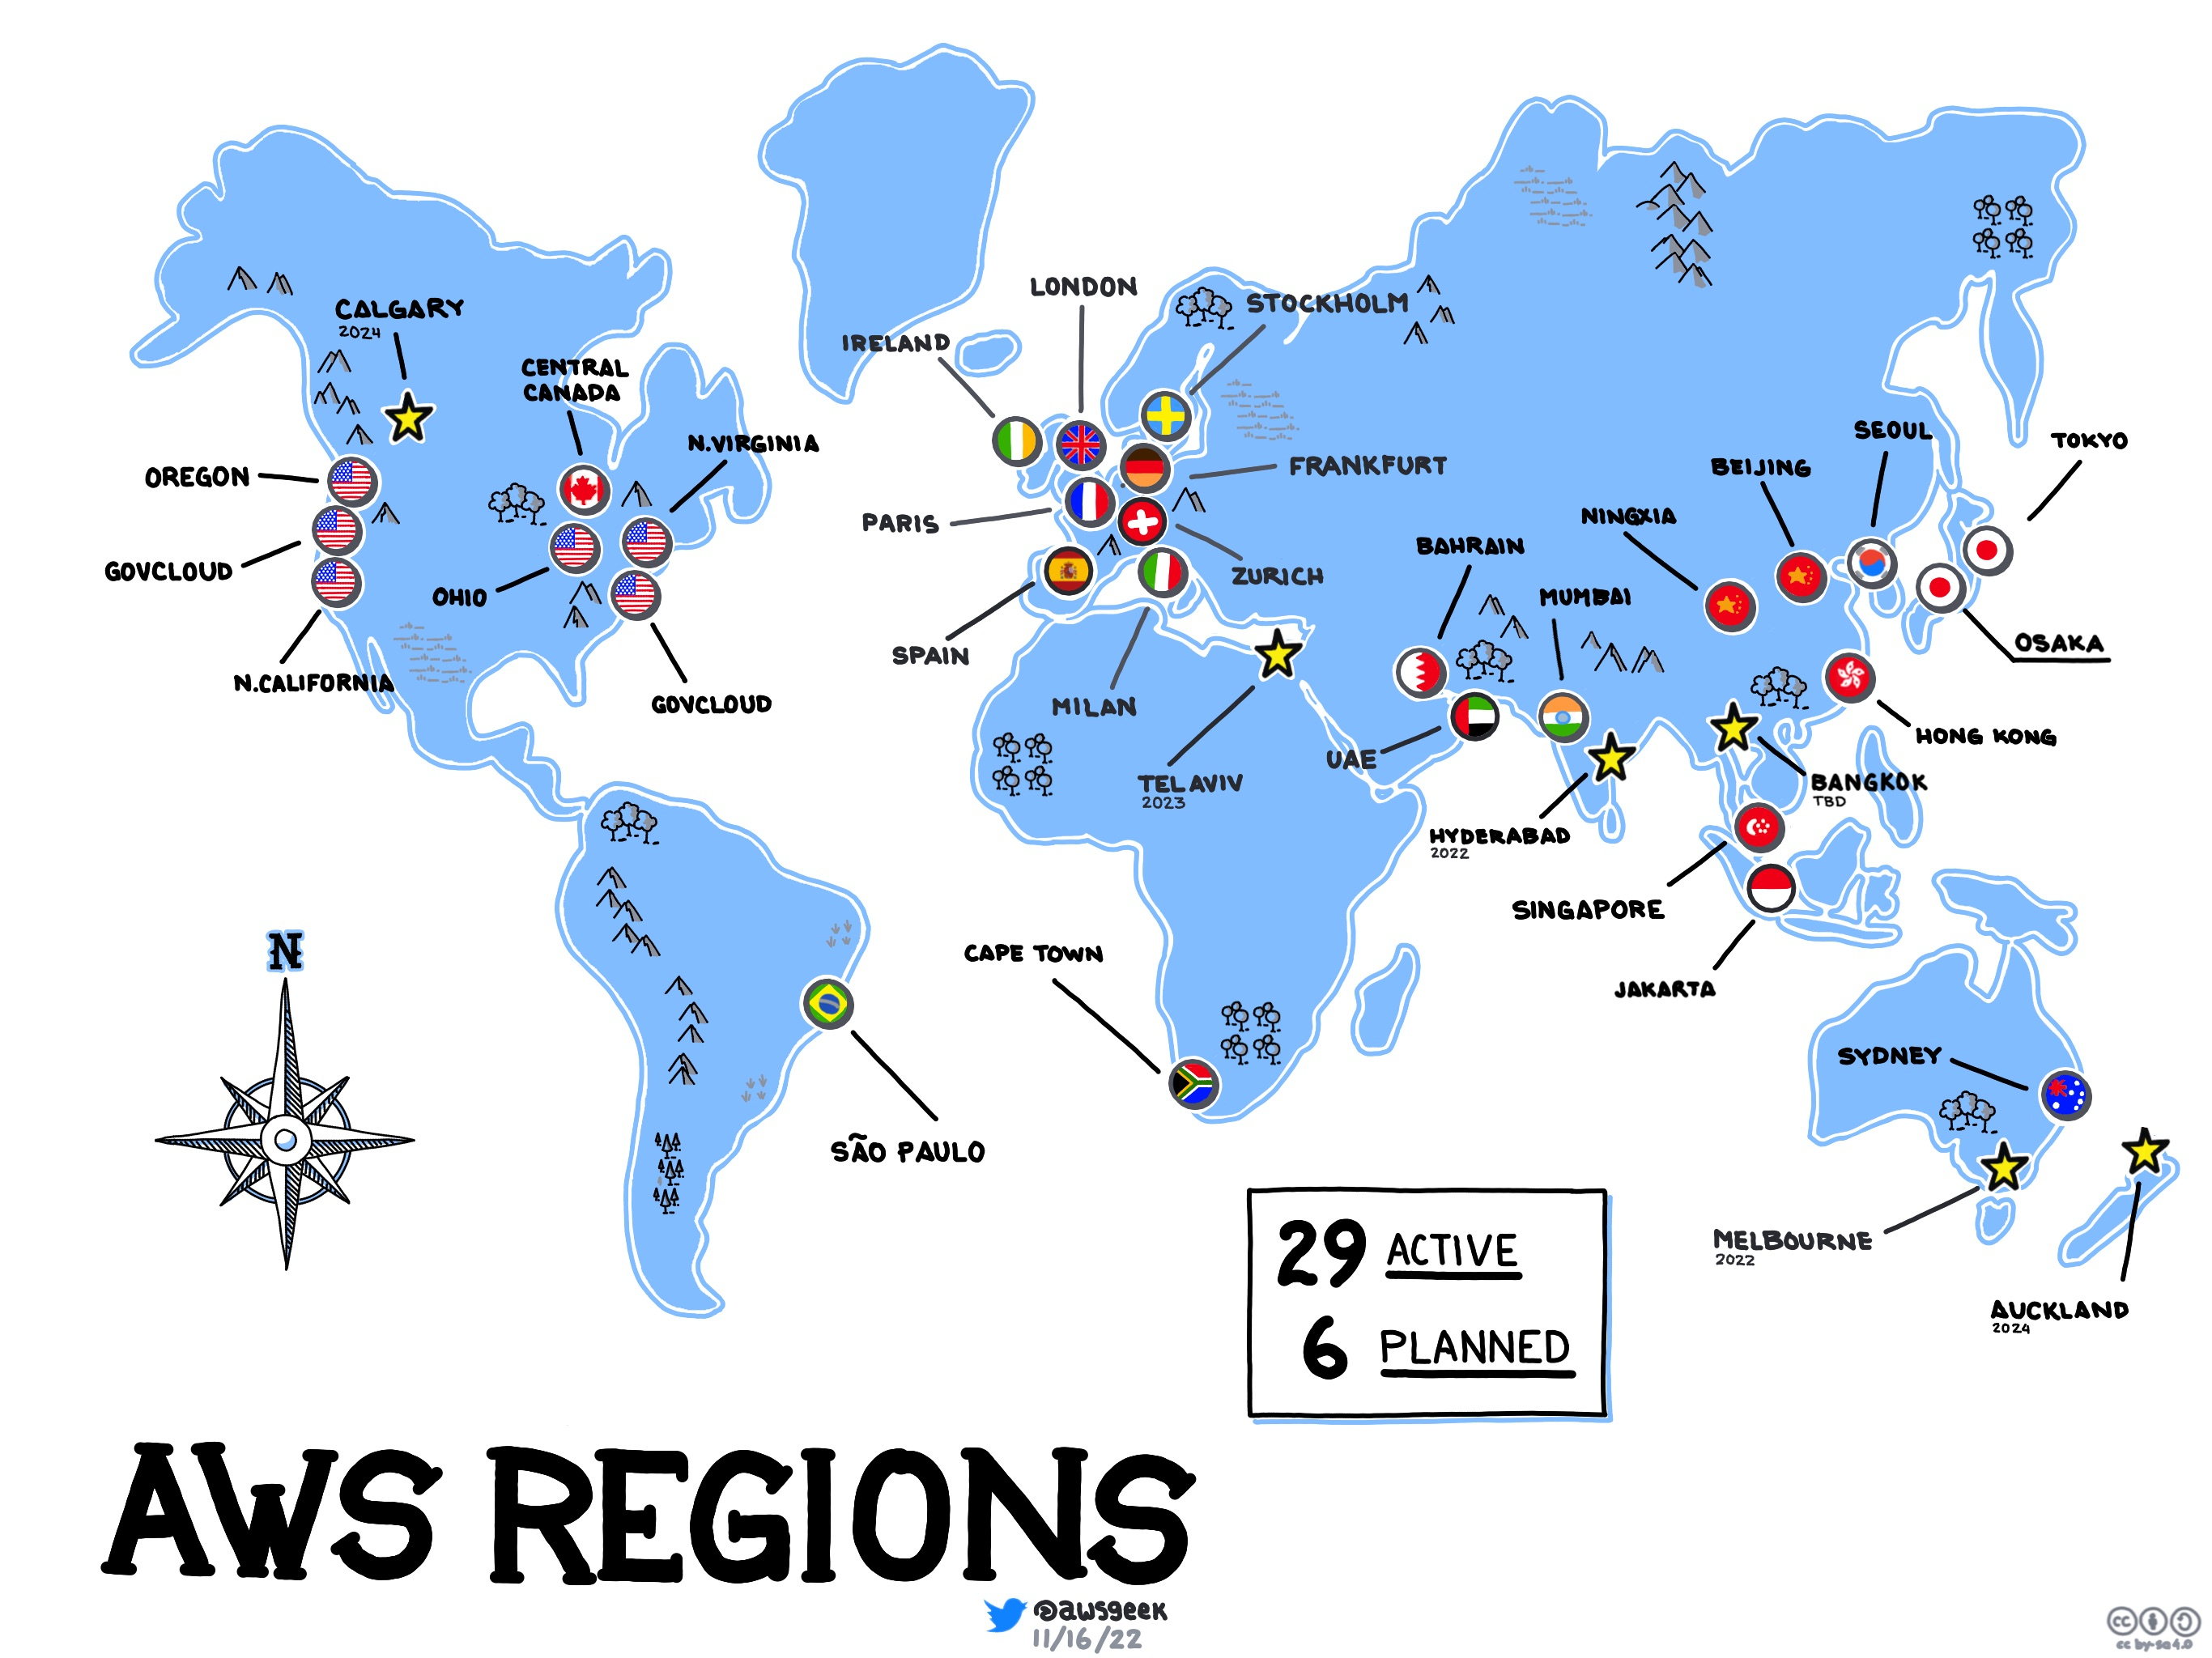
76 Availability zones & 24 Geographical Regions

Slide 4
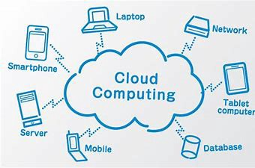
CLOUD COMPUTING
On Demand Delivery of IT Resources like Storage, Security, Databases, etc…
With Pay as you go Pricing
Through Internet

Slide 5
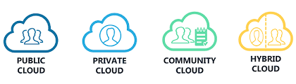
CLOUD DEPLOYMENT MODELS
PUBLIC CLOUD :
Accessed by everyone
PRIVATE CLOUD:
Available only for some users
HYBRID CLOUD:
Mix of both Public And Private

Slide 6
Cloud deployment services
IAAS: Infrastructure As a Service
ex: Infrastructure
PAAS: Platform As a Service
ex: Software Developers
SAAS: Software As a Service
ex: End Users
IAAS
PAAS
SAAS

Slide 7
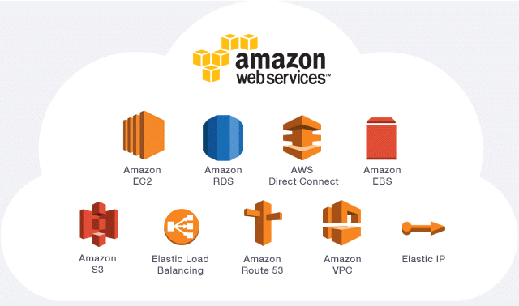
WEB SERVICES
1000+ services are available in AWS Console
Each Service Has Different Features

Slide 8
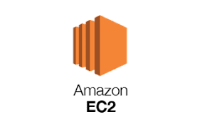
EC2 [Elastic cloud compute]
Provides Resizable Computing Capacity in Amazon Data Canters
EC2 Provides Instances [7 Steps]
On Demand Servers like Windows, Linux, Ubuntu, etc…
EC2 Service Supports REDHAT, Centos.
Sub Services are EC2 Container Service, EC2 Lambda, EBS

Slide 9

VPC [virtual private cloud]
Creates virtual network to the Services
Provides Security to the Services
It contains Subnets, Internet Gateway, Routes
The Sub Services in VPC are Cloudfont, Route53

Slide 10

IAM [IDENTITY access and management]
It Provides Security to the AWS User Account
It Manages the Access of Services
It Provides MFA
The Sub Parts in IAM are User, Groups,
Roles And Policies

Slide 11
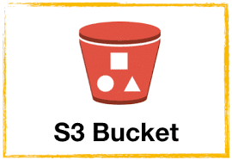
STORAGE
Stores the Data
Contains Buckets (Files)
Provides Standard Storage
Object Oriented Service (S3)
Sub Services Are Simple Storage Service,
S3 Glacier, EFS, etc…

Slide 12

database
Collection of data
Two Types: Relational DB & Non Relational DB
By using Dynamo DB we create EXCEL
Mostly used for Banking, Finance, Online Shopping, Social media sites, Manufacturing etc…

Slide 13


Load balancer
It Balances the Load
Target Groups are Available
Provides Flexibility to the Services
AUTOSCALLING
Automatically Balances the Traffic
Provides Flexibility to the Organizations

Slide 14
AWS COST MANAGEMENT
The Billing console works closely with the AWS Cost Management console.
Pay As you Pricing
AWS Billing User Guide
Cost and Usage Reports User Guide
AWS Cost Management User Guide

Slide 15
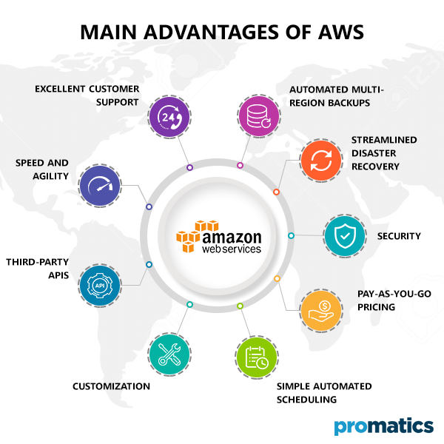
ADVANTAGES
Stop Spending money running and maintaining data Centers
Cost optimization
Increase Speed and Agility
Go Global In minutes
Scalability and Flexibility
Provides more Security
Data loss Prevention

Slide 16
DISADVANTAGES
It has some common Cloud Computing issues like downtime, backup protection etc…
AWS sets default limits on resources (from region to region)
Technical Support fee

Slide 17
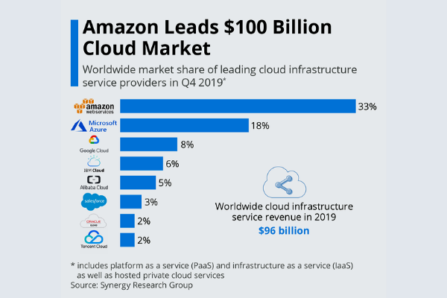
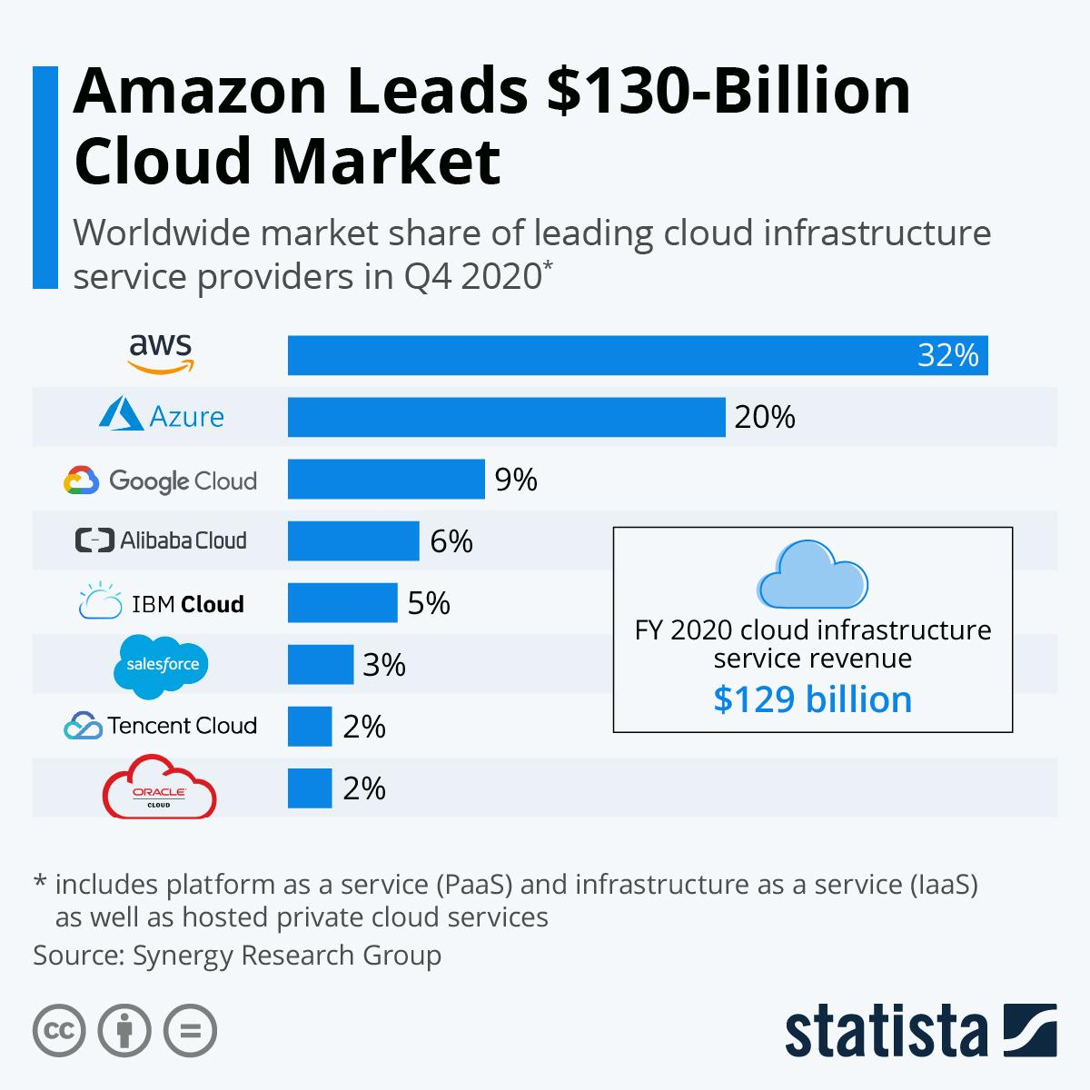
WHY AWS ?

Slide 18
CONCLUSION
APPLICATIONS:
Storage ,Backup and Big data
Enterprise IT for IT Business
Mobile, Web, Social Applications
Websites
Gaming etc…
Learn about virtualization
Understand the Key Services in AWS
Applications and uses of AWS in Daily Life

Slide 19
Presented by
20A91A0403
20A91A0414
20A91A0449
20A91A0401

Slide 20


