Slide 1
Machine Learning
Applications of Machine Learning in Sequential Data Prediction Tasks
Siddharth Agrawal
Arya Shah
Shrey Sheth
Shaan Sheth

Slide 2
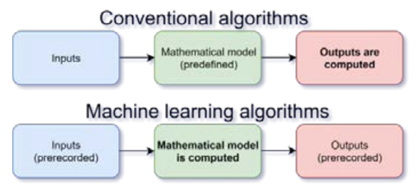
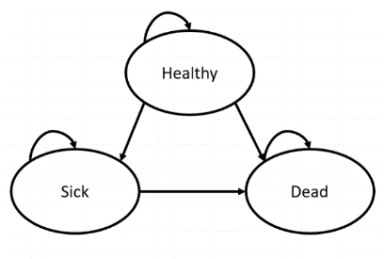
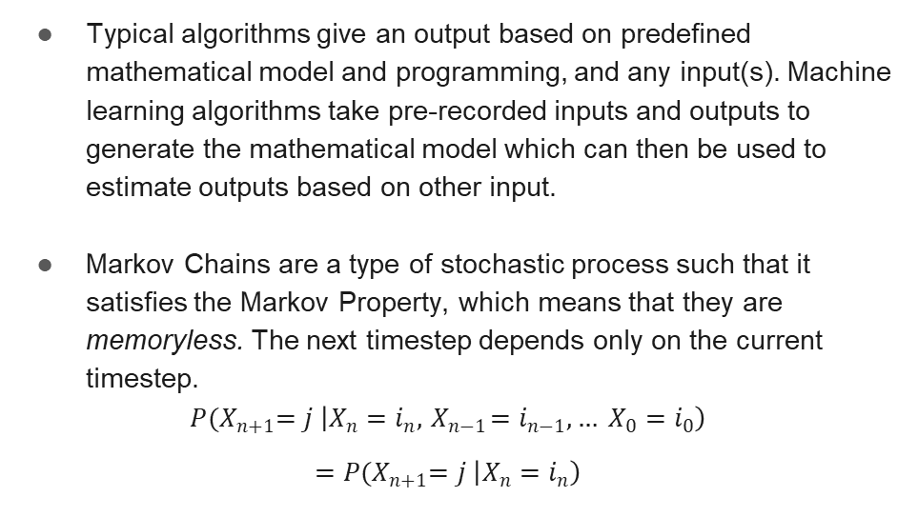
Background
Typical algorithms give an output based on predefined mathematical model and programming, and any input(s). Machine learning algorithms take pre-recorded inputs and outputs to generate the mathematical model which can then be used to estimate outputs based on other input.
Markov Chains are a type of stochastic process such that it satisfies the Markov Property, which means that they are memoryless. The next timestep depends only on the current timestep.
$$P{(X}_{n+1}=j \left|X_{n}=i_{n},{ X}_{n−1}=i_{n−1},… X_{0}=i_{0}\right)$$
$$=P{(X}_{n+1}=j \left|X_{n}=i_{n}\right)$$

Slide 3
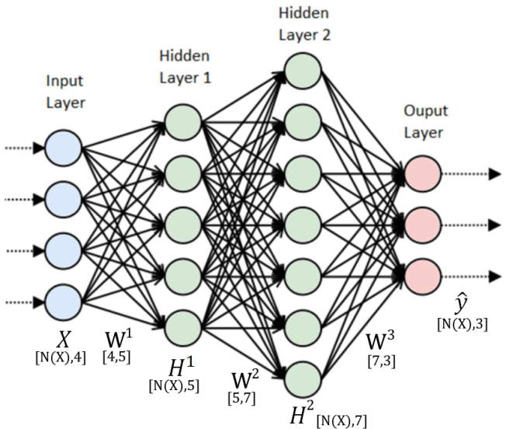

Background
Artificial neural networks are a type of machine learning algorithm. These neural networks use repeated dot product multiplications, along with nonlinear activation functions applied on these matrices, in order to get better predictions.
$$\begin{matrix} σ\left(X∙W^{1}\right)=H^{1} \\ \left. \begin{matrix}{ σ(H}^{1}∙W^{2})=H^{2} \\ ⋮ \\ {σ(H}^{N−1}∙W^{N})=H^{N}\end{matrix}\right\}N−1 times\end{matrix}$$
$${ σ(H}^{N}∙W^{N+1})=\hat{y}$$

Slide 4
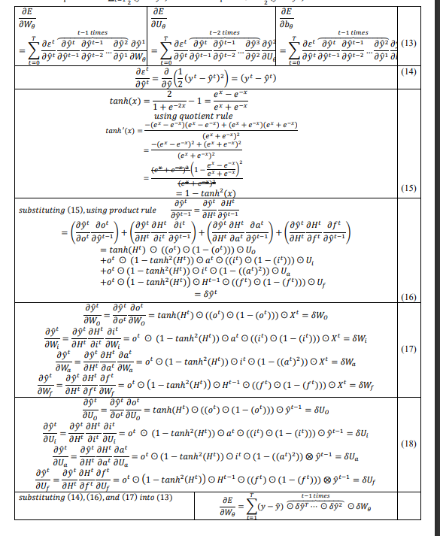
Motivation
While plenty of literature and pretrained models as well as architectures are available in abundance. The in-depth mathematical and computational understanding of models used in sequential data prediction is lacking. This paper will be demystifying these models by delving deep into the mathematics and computations behind the ML models used for such applications.
Furthermore, much of the literature on stock price prediction only focuses on predictions derived via mean squared error. This however, is insufficient if one actually wants to profit from stock price prediction models. Therefore, we innovate on the conventional mean squared error function, by proposing a new error function that optimises the amount of money earned over a trading period.
Write up of the mathematics behind LSTM written by us

Slide 5
Problem Statement
Stock price prediction and Parts of Speech tagging using Hidden Markov models and various Artificial Neural Networks (ANN, RNN, LSTM).
Develop an innovative strategy for automatic trading decisions using Machine Learning.

Slide 6
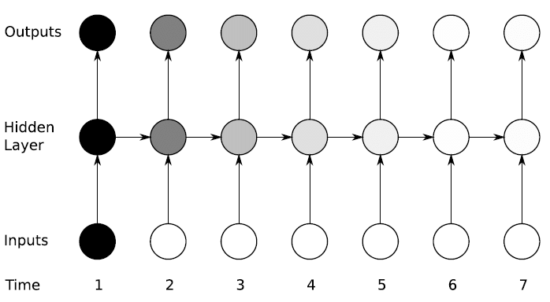

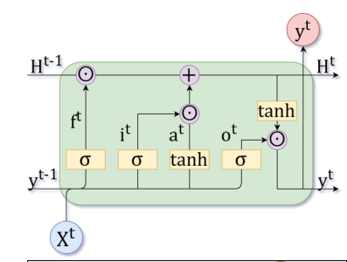
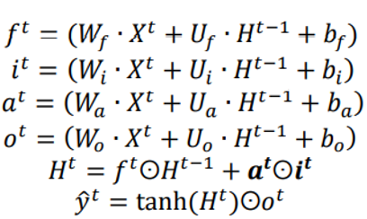
Literature Survey
Vanilla feedforward Neural Networks are not sequential and are not as good at extrapolating the future based on past data.
RNN are the most basic form of sequence based neural network but it suffers from vanishing gradients.
To address vanishing gradients problem, many models now use LSTM networks. Such networks have longer memory than RNN networks through the use of forget and input gates.

Slide 7
Literature Survey
“Stochastic Processes” book by Sheldon M. Ross was used to understand the maths behind Markov Chains.
“Parts of Speech tagging” article by Susan Lee.
YouTube video “Neural Networks Demystified” by Welch Labs.
“Backpropogating an LSTM: A numerical example” article by Aidian Gomez.

Slide 8
Markov Chains and Hidden Markov Model
Memorylessness
Chapman Kolmogorov Equations
Stationary Distribution
Algorithm for stationary distribution using power rule
Stock Price Prediction NIFTY50
Parts of Speech tagging

Slide 9
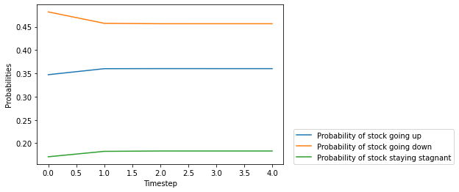
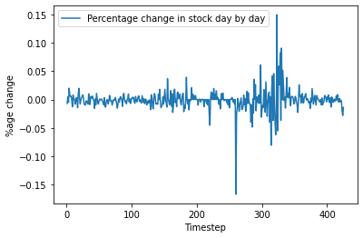
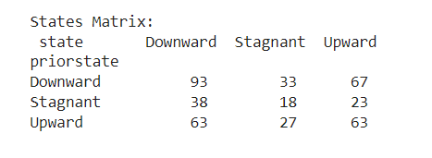
Stock Price Prediction using Markov Chains
Steady state vector:
[0.45646225 0.18338842 0.36014934]

Slide 10
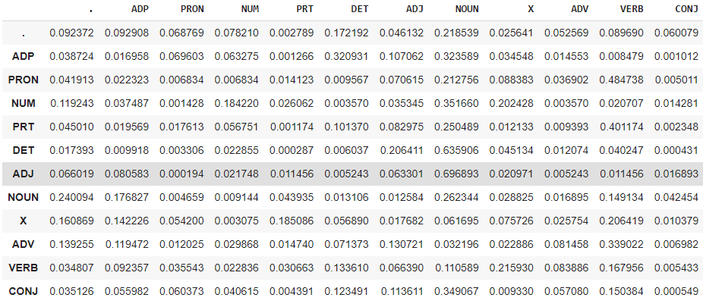
PoS Tagging using HMM
Model which was trained on treebank and universal_tagset datasets.
Time to train (in seconds): 51.79842686653137
Viterbi Algorithm Accuracy: 91.41414141414141%
Parts of Speech Tagging transition probability matrix

Slide 11
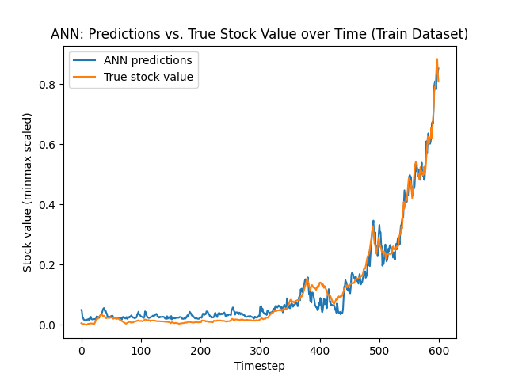
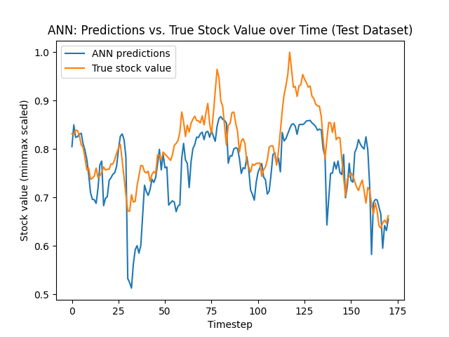
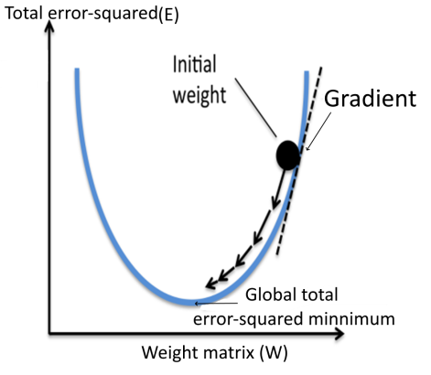
ANN
Repeated dot product multiplications and matrix additions, along with nonlinear activation functions applied on these matrices, in order to get better predictions.
Calculator errors. Differentiation is done to move in the direction opposite of gradient. Derivative of errors wrt weights. (same direction as the local minimum).
Final MSE: 0.00397

Slide 12
ANN
Final MSE: 0.00397

Slide 13
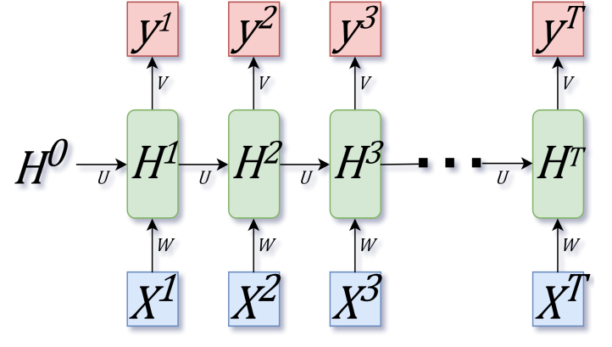
RNN
Sequential Neural Network
Uses both previous timestep’s hidden states and current timestep’s inputs to make output predictions
Vanishing gradient problem

Slide 14
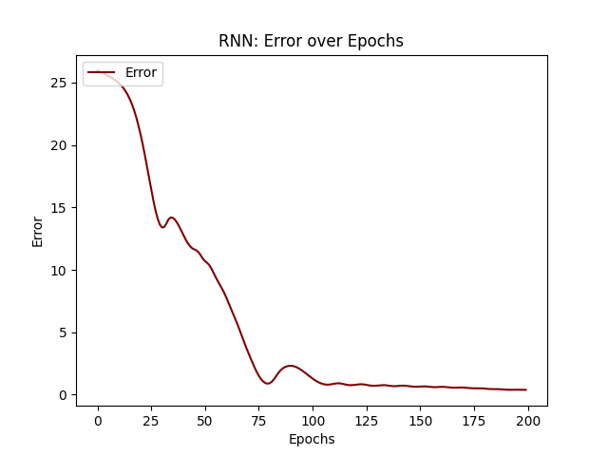
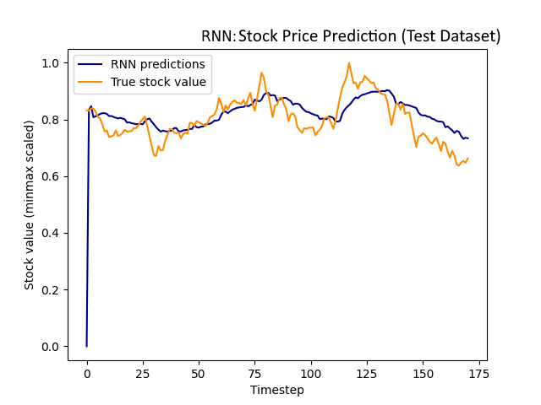
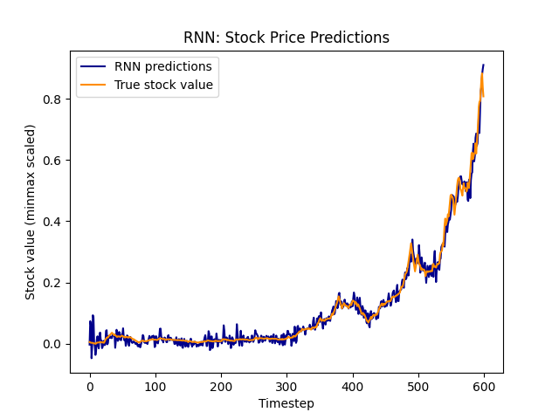
RNN
Final MSE: 0.00397

Slide 15
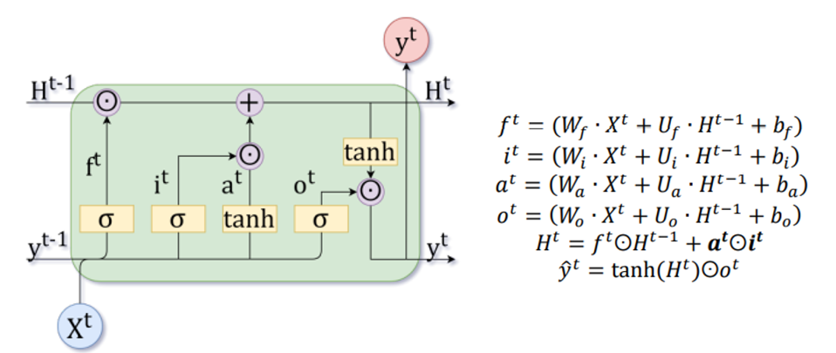
LSTM
Remedies vanishing gradients by using forget and input gates which have learned weights.
Forget gate learns how much of the old information to forget.
Input gate learns how much new information to add to the memory.
Output gate uses the filtered information from the above operations to calculate outputs.

Slide 16
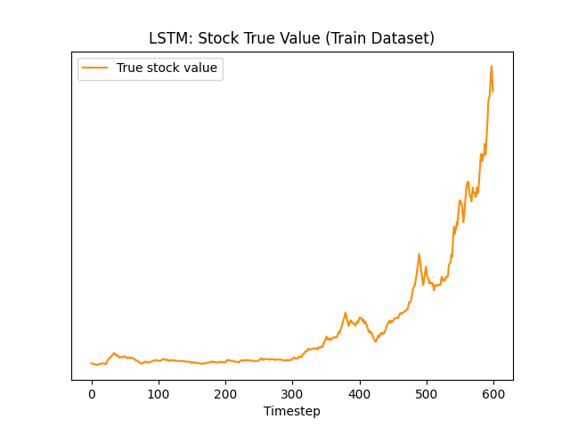
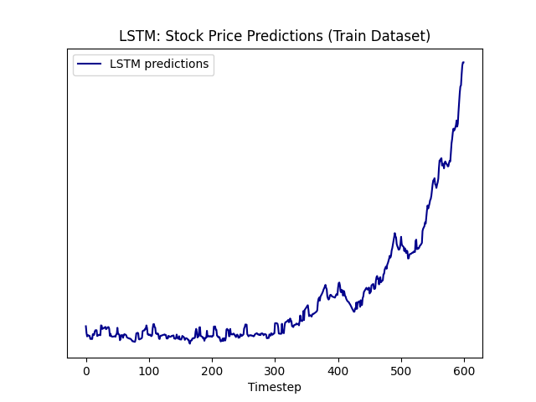
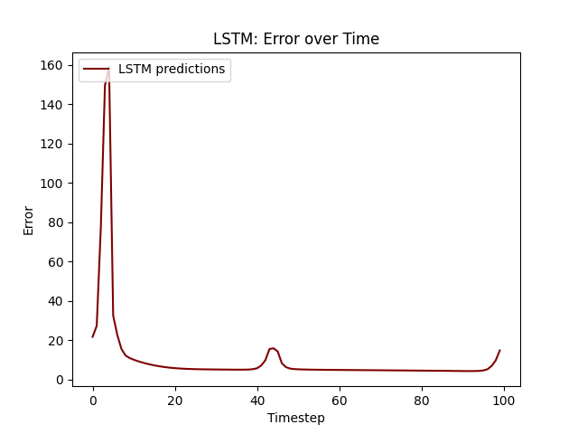
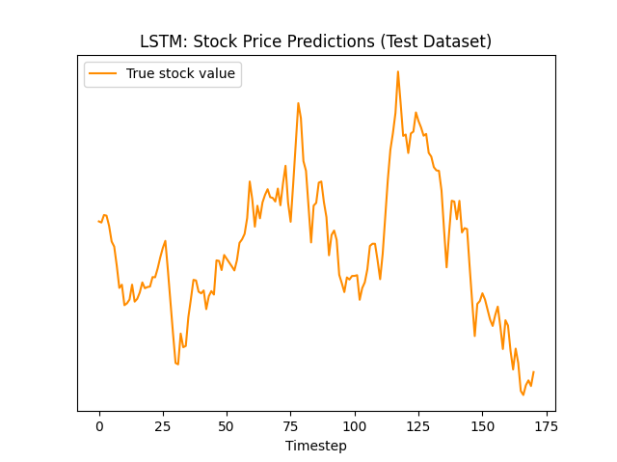
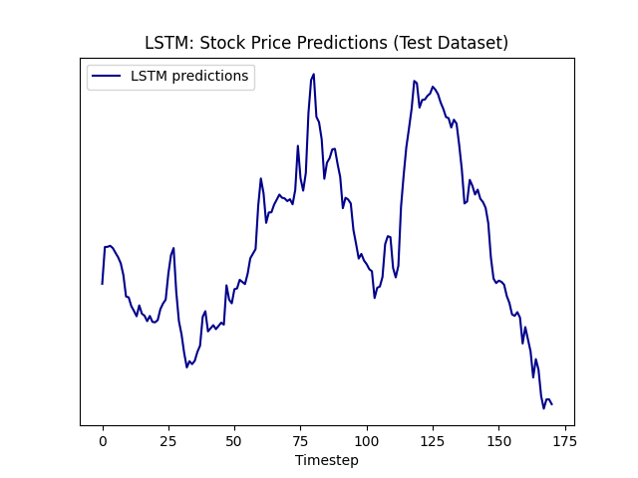
LSTM
Final MSE: 0.0003694

Slide 17
Innovation
Custom loss function.
The loss is defined as the negative of profit/ROI at the end of the training period. This is then minimized.
Thus the network learns to maximise profits given stock information in a given trading time period.
Epoch 200/200
Train loss: -1.4383. Train ROI: 143.83%
Test loss: -0.1103. Test ROI: 11.03%

Slide 18
Conclusion
LSTMs are the best for stock price prediction and yielded the lowest (best) MSE.
when compared to safer investments like fixed deposit, government bonds, and mutual funds, which usually have 6% to 12% mean ROI per year was not more effective in generating returns on investment at ~11%.
Having multiple LSTM models for each of NSE India’s 500+ stocks would increase the ROI as the model could exploit chances of earning money more often.

Slide 19
Contributions
Shrey Sheth:
Hidden Markov Model (HMM):
Introduction to Markov Chains
Background history of Markov Chains
Applications of Matkov Chains
Markov Chains and Machine Learning
Mathematical definition and transition matrices of HMM
Stock market prediction of Nifty-50 code using HMM
Aarya Shah:
Hidden Markov Model:
Part of Speech (POS) tagging using HMM
Code
Report
visualisations
Tables

Slide 20
Contributions
Shaan Sheth:
Hidden Markov Model:
Part of Speech (POS) tagging using HMM
Code
Report
Visualisations
Tables
Note: Shaan Sheth first had an accident during Diwali and later had Chikungunya.
Siddharth Agrawal:
Matrix Operations
Hidden Markov Model:
Chapman Kolmogrov Equations
Algorithm for eigenvector/steady-state vector
Code for visualisations for stock market prediction
Artificial Neural Network
Forward propagation mathematical model
Back propagation mathematical model
Application to Adani Green stock market and visualisations
Recurrent Neural Network
Forward propagation mathematical model
Back propagation mathematical model
Application to Adani Green stock market and visualisations
Vanishing Gradient problem
Long Short-Term Memory Neural Network
Forward propagation mathematical model
Back propagation mathematical model
Application to Adani Green stock market and visualisations
Report writing: Introduction, conclusion, limitations, etc. for the neural networks

Slide 21
Works Cited:
“A Primer on how to optimize the Learning Rate of Deep Neural Networks”, by Timo Böhm, Towards Data Science, https://towardsdatascience.com/learning-rate-a6e7b84f1658 Accessed on: 19 August, 2021.
“Activation Functions in Neural Networks”, by Sagar Sharma, Towards Data Science, Sep 6, 2017. https://towardsdatascience.com/activation-functions-neural-networks-1cbd9f8d91d6 Accessed on: 4 September, 2021.
“Backpropogating an LSTM: A Numerical Example”, by Aidan Gomez, Medium, Apr 19, 2016. https://medium.com/@aidangomez/let-s-do-this-f9b699de31d9 Accessed on:19 September, 2021.
“Definition of Outer Product”, Chegg Study, 2018. https://www.chegg.com/homework-help/definitions/outer-product-33 Accessed on: 7August, 2021.
“Estimating an Optimal Learning Rate for a Deep Neural Network”, by Pavel Surmenok, Towards Data Science, Nov 13, 2017 https://towardsdatascience.com/estimating-optimal-learning-rate-for-a-deep-neural-network-ce32f2556ce0 Accessed on: 17 August, 2021.
“How to Multiply Matrices,” Advanced Math is Fun, 2017, https://www.mathsisfun.com/algebra/matrix-multiplying.html Accessed on: 4 August, 2021.
Indian Mutual Funds Handbook: A Guide for Industry Professionals and Intelligent Investors, by Sundar Sankaran, Vision Books Pvt. Ltd., 2003, Accessed on 17 September, 2021.
“Learning Rate Tuning and Optimizing”, by Chaitanya Kulkarni, Medium, Feb 19, 2018, https://medium.com/@ck2886/learning-rate-tuning-and-optimizing-d03e042d0500 Accessed on: 23 August, 2021.
“Machine Learning week 1: Cost Function, Gradient Descent and Univariate Linear Regression”, by Lachlan Miller, Medium, Jan 10, 2018 https://medium.com/@lachlanmiller_52885/machine-learning-week-1-cost-function-gradient-descent-and-univariate-linear-regression-8f5fe69815fd Accessed on: 11 July, 2021.
The Matrix Cookbook by Kaare Brandt Petersen, Michael Syskind Pedersen, January 5, 2005https://www.ics.uci.edu/~welling/teaching/KernelsICS273B/MatrixCookBook.pdf Accessed on 9 October, 2021
“Neural Networks Demystified [Part 2: Forward Propagation]”, by Welch Labs, Youtube, Nov 7, 2014. https://www.youtube.com/watch?v=UJwK6jAStmg Accessed on: 30 July, 2021.
“Neural Networks Demystified [Part 3: Gradient Descent]” by Welch Labs, Youtube, Nov 21, 2014. https://www.youtube.com/watch?v=5u0jaA3qAGk Accessed on: 30 July, 2021.
“Only Numpy: Deriving Forward feed and Back Propagation in Long Short Term Memory (LSTM) part 1”, by Jae Duk Seo, Towards Data Science, Jan 12, 2018. https://towardsdatascience.com/only-numpy-deriving-forward-feed-and-back-propagation-in-long-short-term-memory-lstm-part-1-4ee82c14a652 Accessed on: 15 July, 2021.
“The Artificial Neural Networks handbook: Part 1”, produced by Jayesh Bapu Ahire, Data Science Central, August 24, 2018 . https://www.datasciencecentral.com/profiles/blogs/the-artificial-neural-networks-handbook-part-1 Accessed on: 5 September, 2021.
“Understanding LSTM Networks”, by Felix Gers, et.al., Colah’s Blog, August 27, 2015. http://colah.github.io/posts/2015-08-Understanding-LSTMs/ Accessed on: 5 September, 2018. 21 July, 2021.
“What is the sigmoid function, and what is its use in machine learning's neural networks? How about the sigmoid derivative function?” by Vinay Kumar R Quora, Aug 24, 2017. https://www.quora.com/What-is-the-sigmoid-function-and-what-is-its-use-in-machine-learnings-neural-networks-How-about-the-sigmoid-derivative-function Accessed on: 7 September, 2021.
View all posts by christinakouridi. (2019, June 20). Implementing a LSTM from scratch with Numpy. Christina’s Blog; Christina’s blog. https://christinakouridi.blog/2019/06/20/vanilla-lstm-numpy/
‌ Aditya Singh. (2021, May 22). Implementing A Recurrent Neural Network (RNN) From Scratch. Analytics India Magazine. https://analyticsindiamag.com/implementing-a-recurrent-neural-network-rnn-from-scratch/
Hochreiter, S., & Schmidhuber, J. (1997). Flat Minima. Neural Computation, 9(1), 1–42. https://doi.org/10.1162/neco.1997.9.1.1
Ross, Sheldon M. Stochastic Processes. (2011). John Wiley & Sons, 1995. https://books.google.co.in/books/about/Stochastic_Processes.html?id=qiLdCQAAQBAJ&redir_esc=y
“Neural Networks Demystified [Part 2: Forward Propagation]”, by Welch Labs, Youtube, Nov 7, 2014. https://www.youtube.com/watch?v=UJwK6jAStmg Accessed on: 30 July, 2021.
Aidan Gomez. (2016, April 18). Backpropogating an LSTM: A Numerical Example - Aidan Gomez - Medium. Medium; Medium. https://medium.com/@aidangomez/let-s-do-this-f9b699de31d9
Machine learning algorithms: Application of artificial intelligence in providing systems the ability to automatically generate, learn, and improve from experience by themselves, without explicit programming.
Bounthavong, M. (2018, March 15). Mark Bounthavong. Mark Bounthavong. https://mbounthavong.com/blog/2018/3/15/generating-survival-curves-from-study-data-an-application-for-markov-models-part-2-of-2
cheillanju. (2021). ann-from-scratch/ann-from-scratch.ipynb at master · cheillanju/ann-from-scratch. GitHub. https://github.com/cheillanju/ann-from-scratch/blob/master/ann-from-scratch.ipynb
Zedric Cheung. (2020, June 20). Customize loss function to make LSTM model more applicable in stock price prediction. Medium; Towards Data Science. https://towardsdatascience.com/customize-loss-function-to-make-lstm-model-more-applicable-in-stock-price-prediction-b1c50e50b16c
Yugesh Verma. (2021, October 16). A Guide to Hidden Markov Model and its Applications in NLP. Analytics India Magazine. https://analyticsindiamag.com/a-guide-to-hidden-markov-model-and-its-applications-in-nlp/
Pykes, K. (2020, November 25). Part Of Speech Tagging for Beginners - Towards Data Science. Medium; Towards Data Science. https://towardsdatascience.com/part-of-speech-tagging-for-beginners-3a0754b2ebba
Indian Mutual Funds Handbook: A Guide for Industry Professionals and Intelligent Investors, by Sundar Sankaran, Vision Books Pvt. Ltd., 2003, Accessed on 17 September, 2018.
Brandt, K., Michael, P., & Pedersen, S. (n.d.). The Matrix Cookbook. https://www.math.uwaterloo.ca/~hwolkowi/matrixcookbook.pdf
Böhm, Timo “A Primer on how to optimize the Learning Rate of Deep Neural Networks”, Towards Data Science, https://towardsdatascience.com/learning-rate-a6e7b84f1658 Accessed on: 19 August, 2018.
Ryan, M. (2020, June 6). A Very Simple Method of Weather Forecast Using Markov Model Lookup Table. Medium; Towards Data Science. https://towardsdatascience.com/a-very-simple-method-of-weather-forecast-using-markov-model-lookup-table-f9238e110938
Brilliant Math & Science Wiki. (2021). Brilliant.org. https://brilliant.org/wiki/markov-chains/
Chegg.com. (2021). Chegg.com. https://www.chegg.com/homework-help/definitions/outer-product-33
Hochreiter, S., & Schmidhuber, J. (1997). Flat Minima. Neural Computation, 9(1), 1–42. https://doi.org/10.1162/neco.1997.9.1.1
Ross, Sheldon M. Stochastic Processes. (2011). John Wiley & Sons, 1995. https://books.google.co.in/books/about/Stochastic_Processes.html?id=qiLdCQAAQBAJ&redir_esc=y
“Neural Networks Demystified [Part 2: Forward Propagation]”, by Welch Labs, Youtube, Nov 7, 2014. https://www.youtube.com/watch?v=UJwK6jAStmg Accessed on: 30 July, 2021.
Aidan Gomez. (2016, April 18). Backpropogating an LSTM: A Numerical Example - Aidan Gomez - Medium. Medium; Medium. https://medium.com/@aidangomez/let-s-do-this-f9b699de31d9
Ruineihart, D., & Williams, R. (n.d.). LEARNING INTERNAL REPRESENTATIONS BERROR PROPAGATION two. https://apps.dtic.mil/dtic/tr/fulltext/u2/a164453.pdf
Hochreiter, S., & Schmidhuber, J. (1997). Flat Minima. Neural Computation, 9(1), 1–42. https://doi.org/10.1162/neco.1997.9.1.1
Bounthavong, M. (2018, March 15). Mark Bounthavong. Mark Bounthavong. https://mbounthavong.com/blog/2018/3/15/generating-survival-curves-from-study-data-an-application-for-markov-models-part-2-of-2

