Slide 1

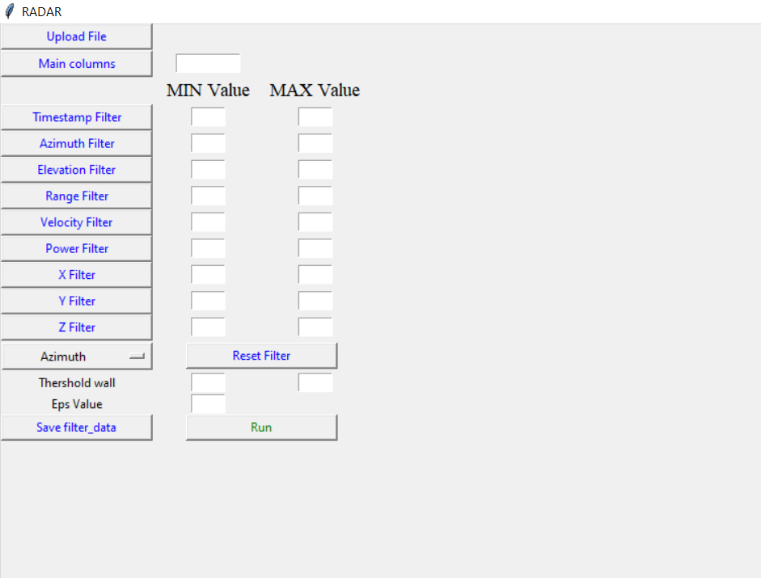
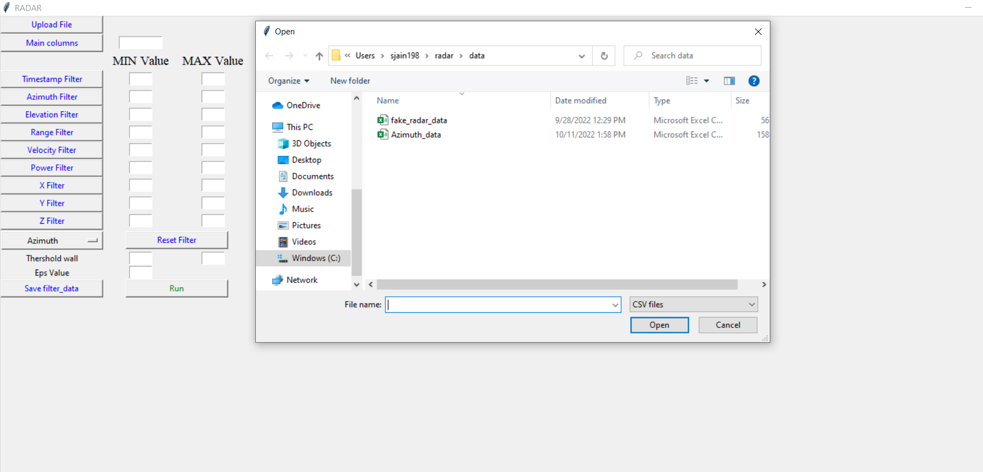
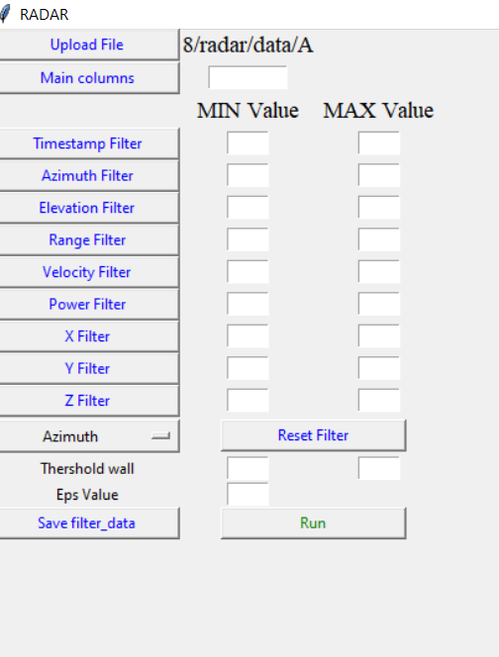
Install all the requirements using $ pip install -r requirements.txt
Run the radargui.py
Script into the terminal
File path will pop up here after successfully upload
Upload
data file

Slide 2
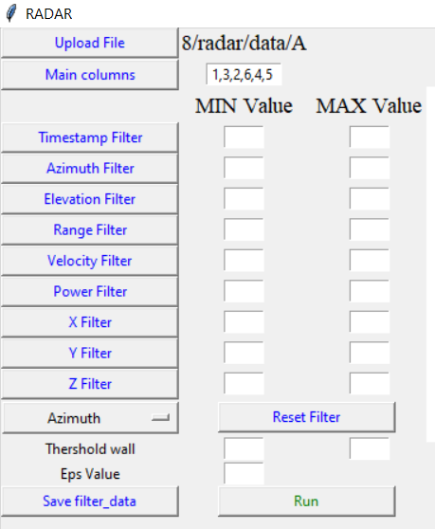
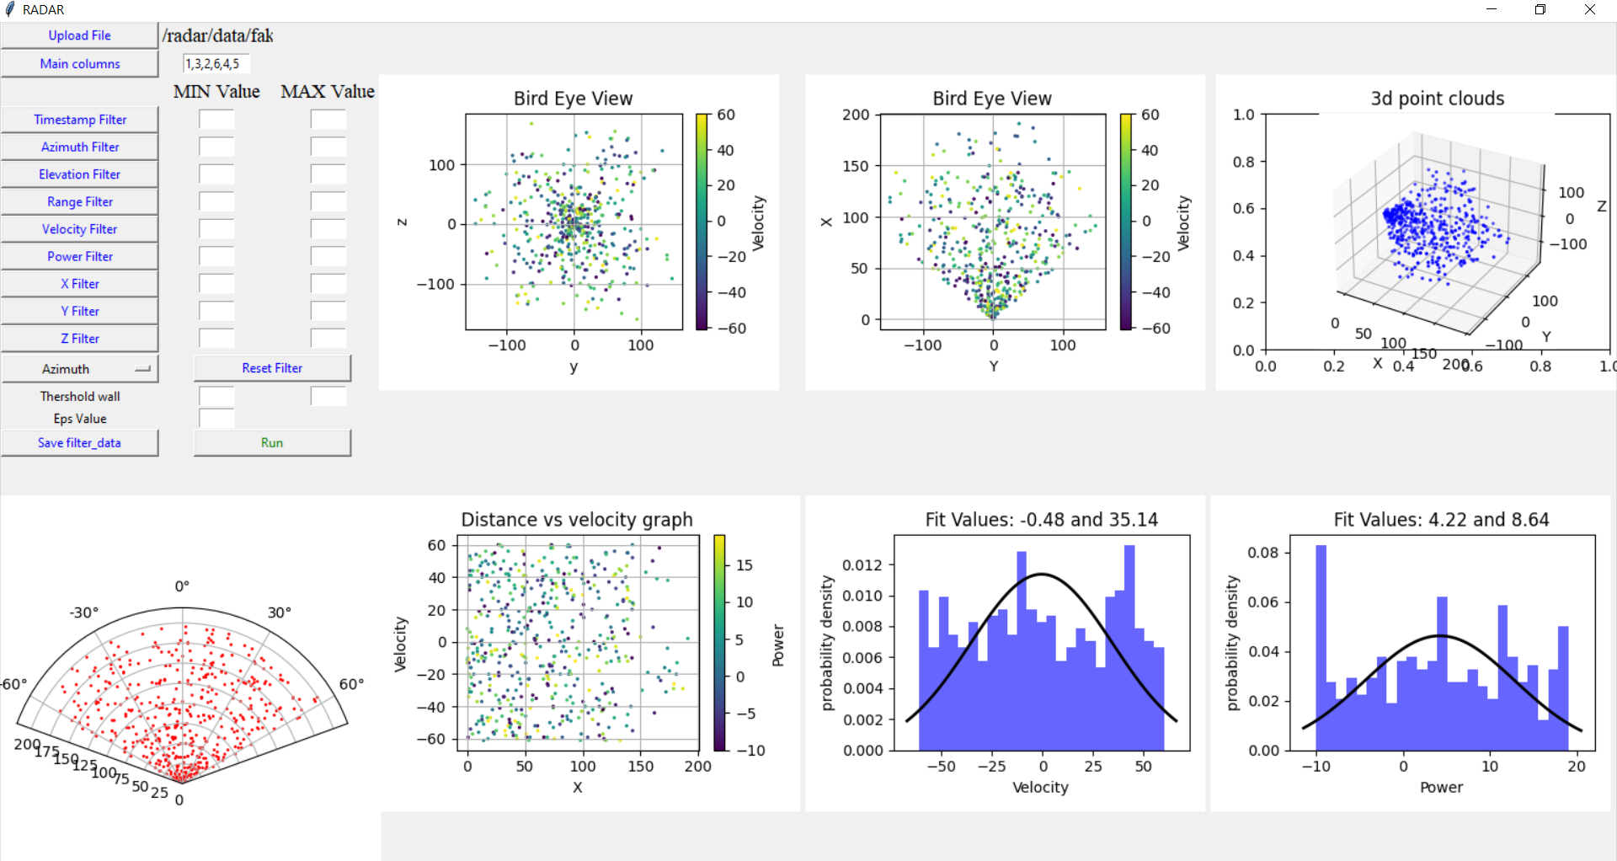
To get main columns here inputs are the number separated by ',' contain original data frame column in order to [timestamp, Azimuth, Elevation, range, range-rate, power] example: original data frame column name -> [timestamp, Elevation, Azimuth, range-rate, power, range, x, y, z] input would be 1,3,2,6,4,5
This help to rearrange the column and remove the extra column
We needed this arrangement because the data columns differ from company to company.
After Click the Main columns Button

Slide 3
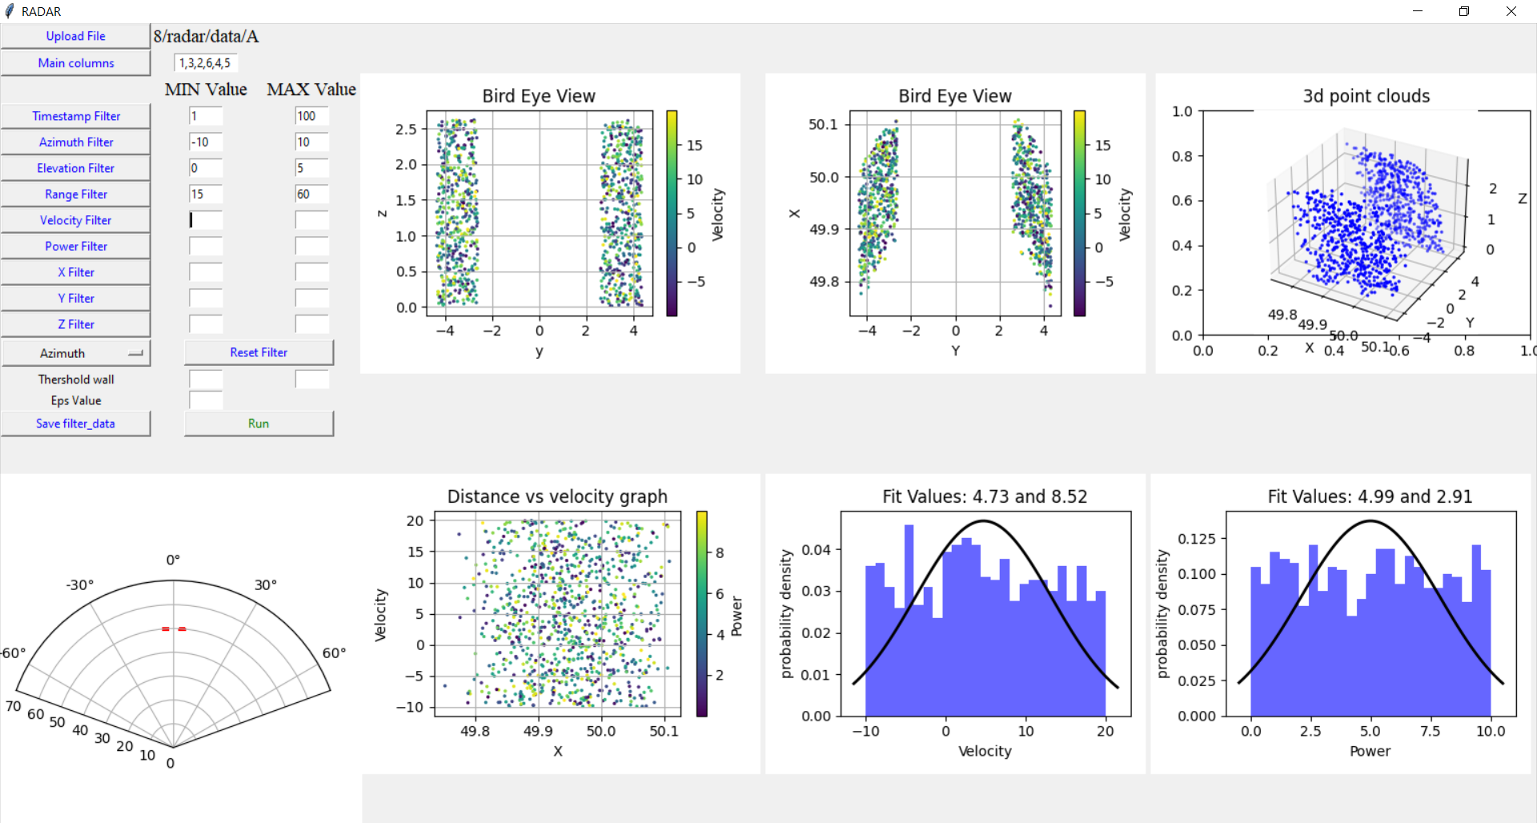
Use the filter buttons to achieve the desired target threshold
The reset filter button here help to remove all the applied filter and make the data back to original

Slide 4
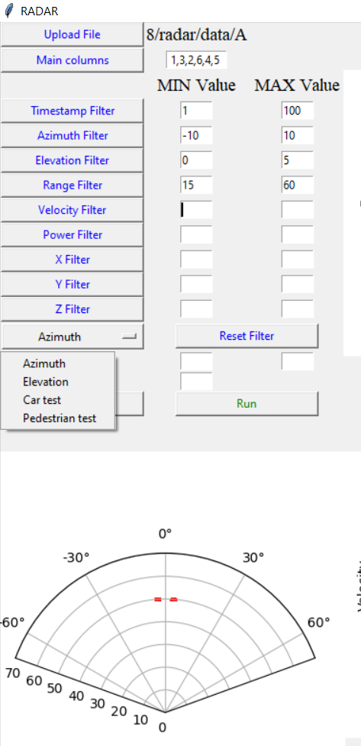
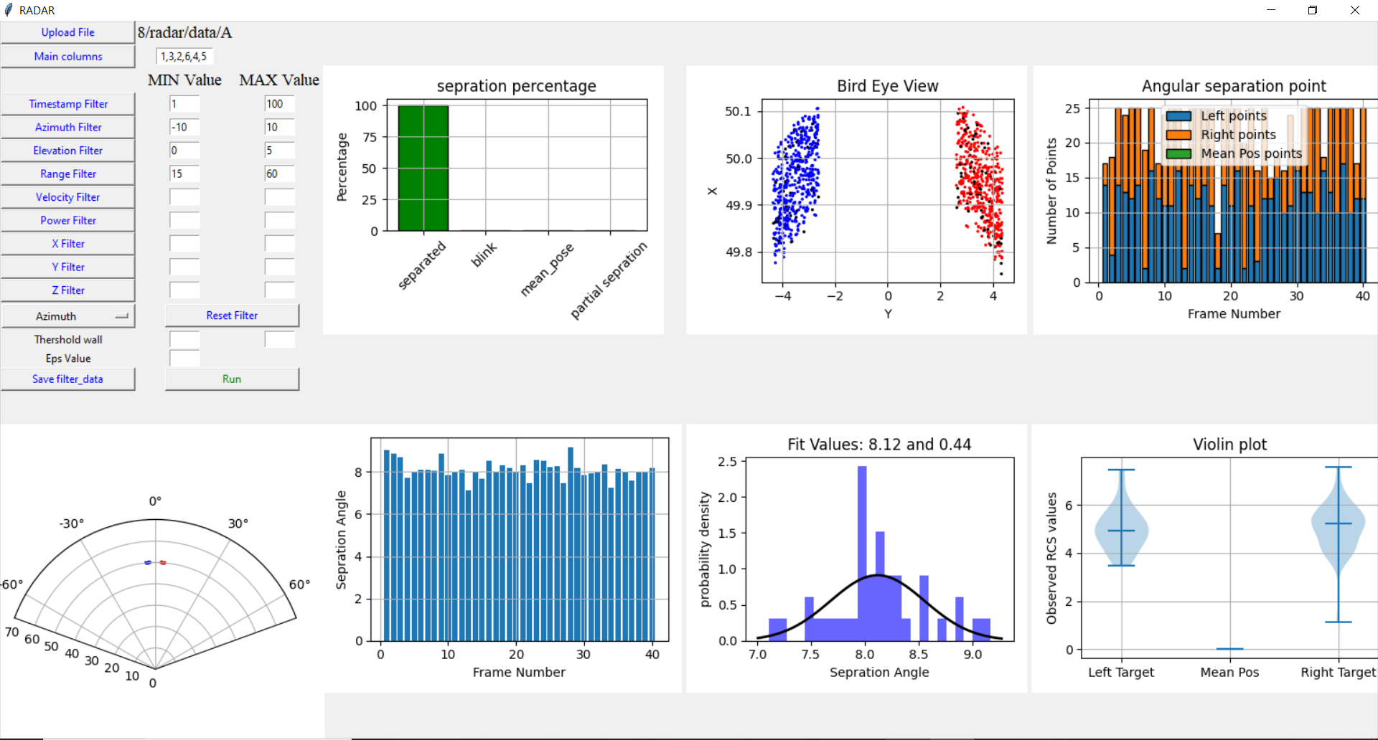
Select the test
Click the Run
The default algorithm is set to tune the eps* value that create only one cluster per target. we can also enter the eps value and play with it .
Default Threshold wall** value is set to ± 0.05 from center of graph, we can also adjust the threshold wall value
After Click the Run Button
*eps: specifies how close points should be to each other to be considered a part of a cluster.
**Threshold wall is the wall that separate the two targets and helps to determine the mean pose if value lie inside the threshold value

Slide 5
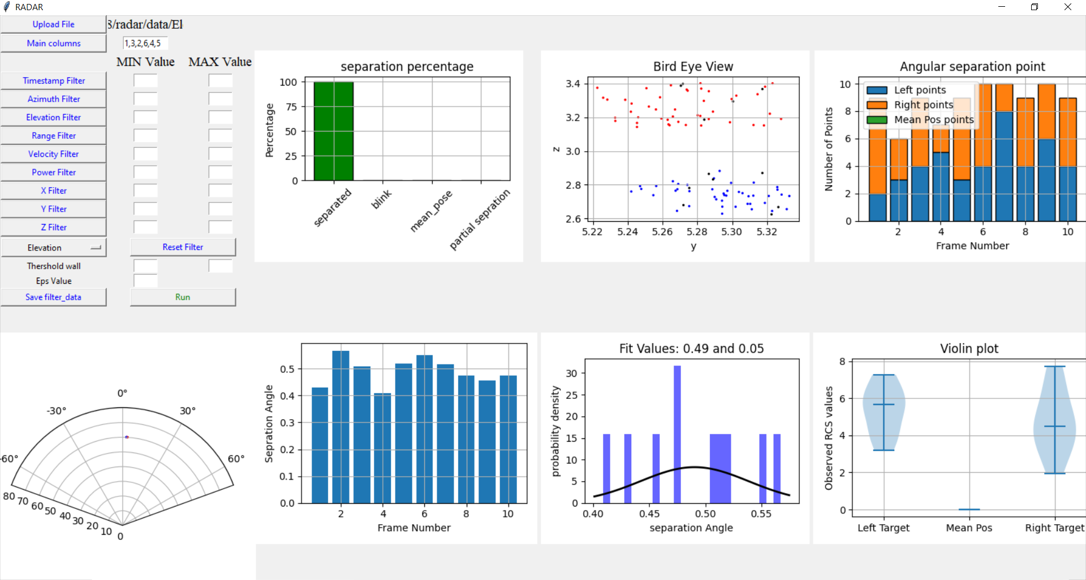
Sample Azimuth Separation Test case
Sample Elevation Separation Test case

