Slide 1
SR University — Sports & Clubs Website
Course Project Presentation
Subject: AI Assisted Code
Submitted by:
S. Kavya (2403A51037)
B.Tech – Computer Science & Engineering
Subject: AI Assisted Code

Slide 2
Project Objectives
• To design and develop a responsive website for SR University that showcases all sports and student clubs.
• To provide students with details of events, club activities, and registration forms.
• To enhance communication and engagement between students and the university’s sports & cultural bodies.
• To create a secure and user-friendly login for students to access their profiles.
Subject: AI Assisted Code

Slide 3
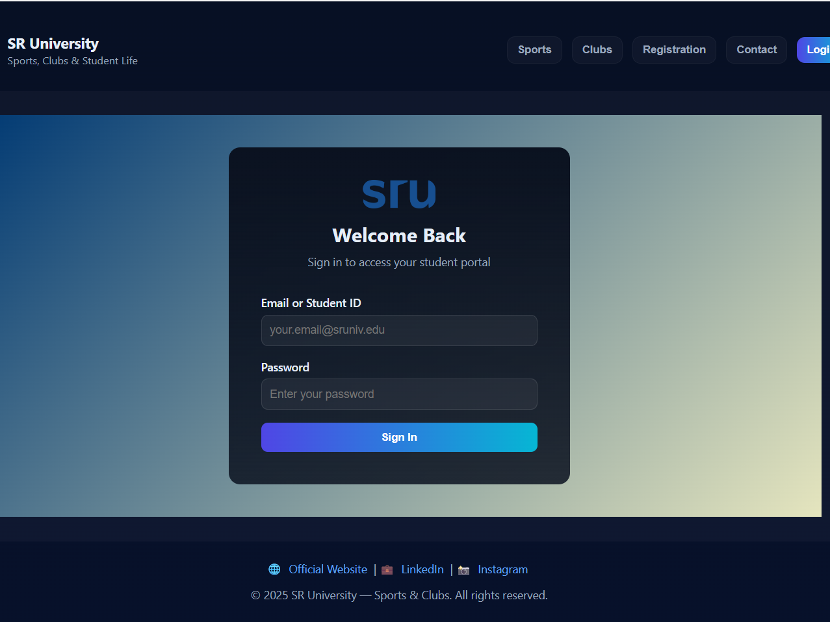

Slide 4
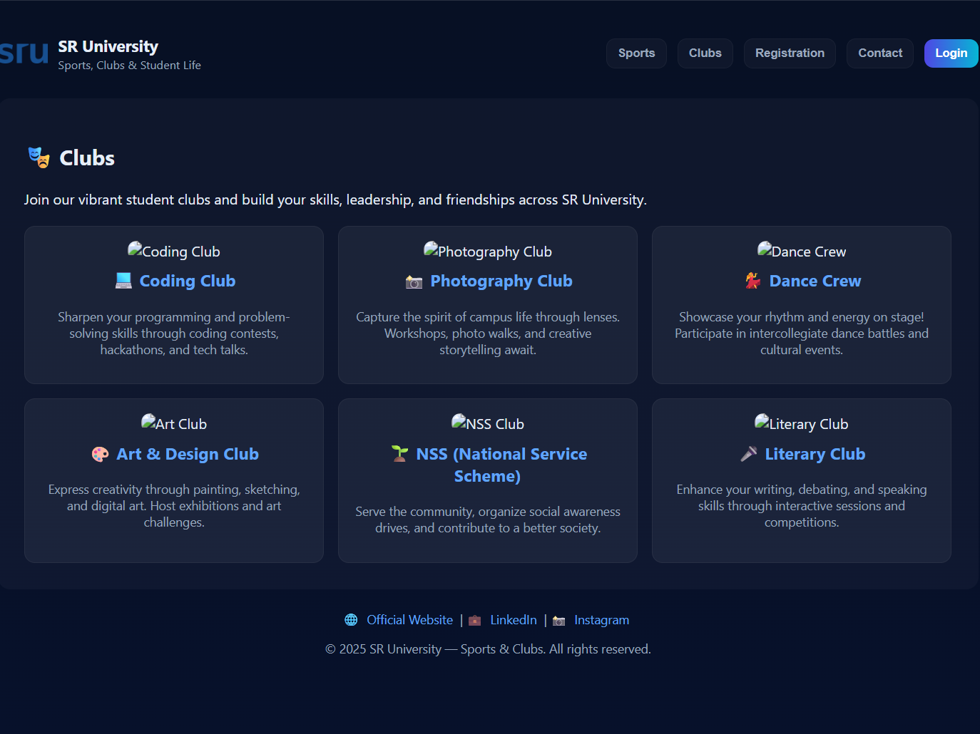

Slide 5
Stakeholders
• Students – Participate and join university sports & clubs.
• Sports Coordinators – Manage events and player records.
• Faculty Advisors – Supervise club operations and student involvement.
• University Administration – Oversee all student engagement activities.
Subject: AI Assisted Code

Slide 6
Programming Languages, Tools & Software
Frontend Languages:
• HTML5, CSS3, JavaScript
Development Tools:
• Visual Studio Code
• GitHub (for project hosting)
• Web Browser (Google Chrome)
Design Tools:
• Canva / Figma for layout preview
Subject: AI Assisted Code

Slide 7
Front-End View
The website includes:
• SR University logo and modern dark-theme UI.
• Sports section highlighting cricket, football, and athletics.
• Clubs section (Coding, Photography, Dance, Art, NSS, Literary).
• Registration form, Contact form, and Student Login page.
This web design provides a professional, interactive platform for students to explore SR University’s extracurricular activities.
Subject: AI Assisted Code

Slide 8


