Slide 1
Next Word Prediction Using RNN and Word Embedding
Pranay javvaji, siddanth Gaikwad

Slide 2
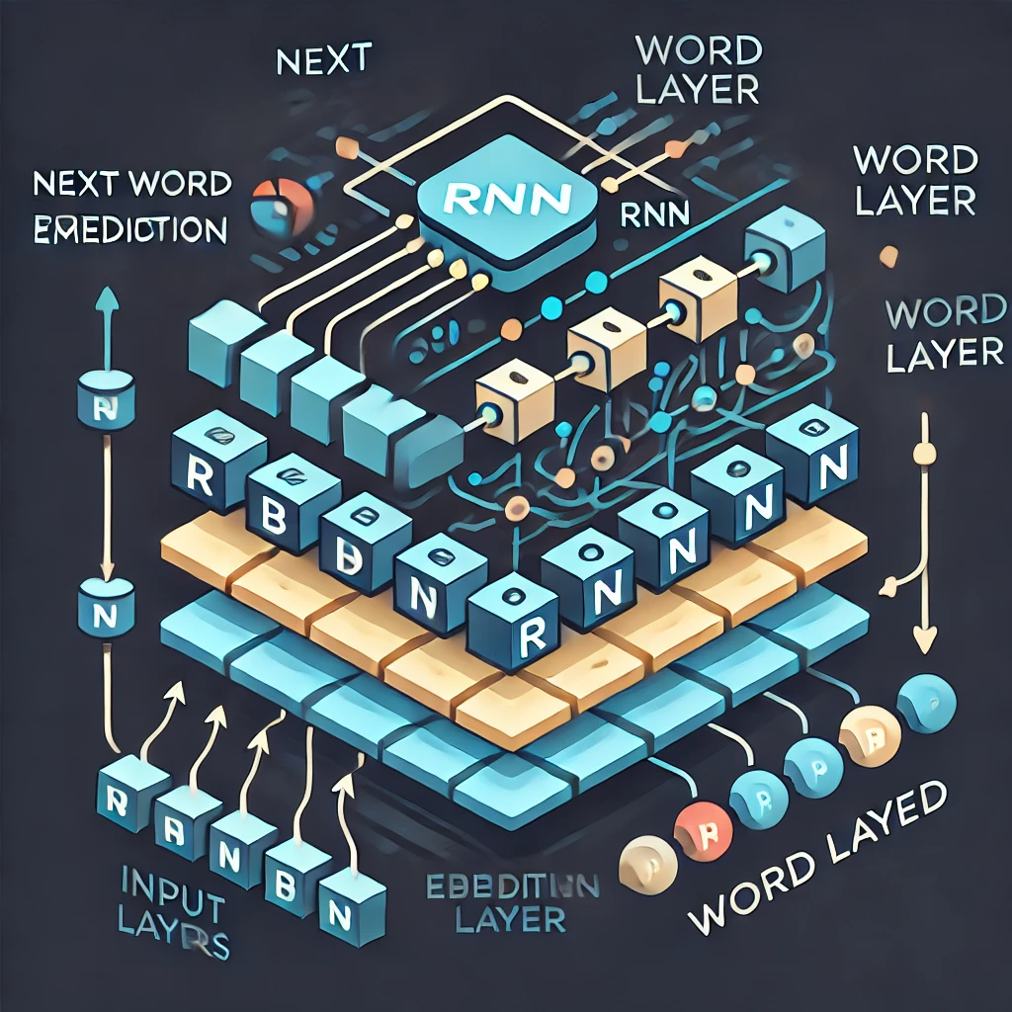
agenda
Introduction
Problem statement
Literature review
methodology
Model architecture
Algorithm workflow
Results and evaluation
Applications and future work
conclusion

Slide 3
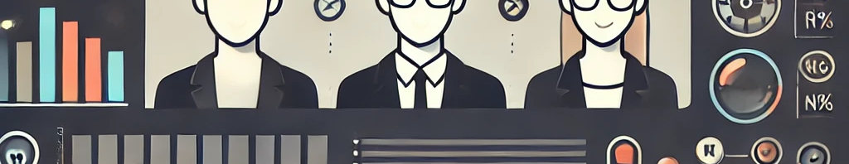
About us
Research Focus :
Natural Language Processing (NLP)
Machine Learning, specifically Recurrent Neural Networks (RNN) and Word Embedding
Developing advanced predictive models for language processing task.
Motivation:
The team is passionate about advancing language technologies and creating systems that enhance human-computer interaction.
Interested in improving the accuracy and efficiency of predictive text, which has applications in communication, creative writing, and various NLP tools.

Slide 4
introduction
What is Next Word Prediction (NWP)?
NWP is the task of predicting the next word in a sequence based on the context provided by previous words.It’s an essential function in Natural Language Processing (NLP) used in applications like text completion, chatbots, and language translation.
Importance in NLP:
Enhances user experience by improving typing efficiency and accuracy.
Vital for various applications, from predictive text in messaging apps to content generation and machine translation.
Why Use RNN and LSTM Models?
Recurrent Neural Networks (RNNs): Suitable for sequence data, as they retain context from previous inputs, allowing them to handle word sequences.
Long Short-Term Memory (LSTM): A type of RNN that addresses the limitations of standard RNNs, such as difficulty in learning long-term dependencies.
Both RNN and LSTM help models understand the context of language, making them well-suited for accurate NWP.

Slide 5
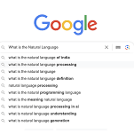
Literature Review
N-gram Models:
Use previous words for simple word prediction but struggle with long-term dependencies.
RNN Limitations:
Traditional RNNs face challenges like the vanishing gradient problem, making it difficult to retain context over long sequences.
Advancements with LSTM and BiLSTM:
LSTM: Overcomes RNN limitations by using memory gates, allowing it to handle longer dependencies.
BiLSTM: Processes data in both directions (forward and backward), capturing both past and future context for improved accuracy.
Research in Different Languages and Applications:
Studies on NWP across various languages and applications, including chatbots, language translation, and smart keyboards, show the broad relevance and impact of these models in NLP.

Slide 6
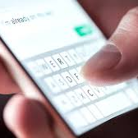
Methodology:
Preprocessing:
Cleaning: Remove irrelevant characters (URLs, HTML tags, special characters), convert text to lowercase, and eliminate non-alphanumeric characters.
Tokenization: Split text into individual words or tokens.
Stop Word Removal: Remove common words (e.g., "the", "and") that do not contribute significant meaning.
Word Embeddings
Word embeddings convert words into dense vectors in a continuous space, capturing semantic meaning. Techniques like Word2Vec, GloVe, and BERT create vector representations where similar words are closer in the vector space, enhancing machine understanding of text.

Slide 7
Model Architecture: Bi-directional LSTM (BiLSTM)
BiLSTM: Extends traditional LSTM by processing data in both forward and backward directions, capturing both past and future context for improved sequence comprehension.
Why BiLSTM?
Better Context Understanding: BiLSTM captures richer context by processing sequences in both directions, improving performance in tasks like sentiment analysis and text prediction.
Steps:
Embedding Layer: Converts words to dense vectors (word embeddings).
LSTM Layer: Learns sequential dependencies in the data.
Dense Output Layer: Produces final predictions (e.g., sentiment or classification).

Slide 8
Algorithm Workflow
Data Loading & Preprocessing: Load YouTube comments, clean and preprocess text (remove special characters, stop words).
Tokenization & Sequence Generation: Tokenize text and convert it into sequences for model input.
Model Training : Train BiLSTM model on tokenized sequences to learn patterns and context.
Text Generation: Generate text through sequences to learn patterns and context.
Tools Used
TensorFlow, Datasets, NumPy, Sklearn
Enhance
Ensure a tailored and user-focused experience

Slide 9
Results and Evaluation
Model Evaluation:
Loss and accuracy curves are used to assess model performance during training. The BiLSTM model shows improved accuracy and lower loss compared to traditional LSTM.
Charts for Loss and Accuracy curves
Show the model's performance over training epochs, with the Bi LSTM model showing faster convergence and higher accuracy.
Model Name | Accuracy
N-Gram | 92%
LSTM | 58.6%
Proposed BiLSTM Model | 93%

Slide 10
conclusion
BiLSTM's Effectiveness: The BiLSTM model effectively captures both past and future context, improving accuracy in tasks like next-word prediction (NWP) compared to traditional LSTM models.
Contextual Adaptability: By processing sequences in both directions, BiLSTM adapts to varied contexts, enhancing its ability to understand complex language patterns.
Potential Applications: BiLSTM has significant potential in NLP tasks, including Next Word Prediction, sentiment analysis, and text generation, powered by word embeddings.
Study contribution: This study advances NLP by demonstrating the power of Bi lstm in now, showcasing its ability to deliver more effiecient and contextually aware predictions.

Slide 11
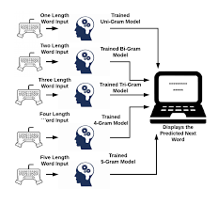
Thank you
Enjula uchoi| Pranay javvaji| siddant gaikwad

